Slide 1
TPB’s Coordinated Human Service Transportation Plan
Strategies and Priority Projects
Wendy Klancher TPB Transportation Planner Lynn Winchell-Mendy TPB Transportation Planner Access for All Advisory Committee June 7, 2018

Slide 2
Purpose of Presentation
Describe:
  The Coordinated Plan and specifics for two elements
    Strategies
    Priority projects
Agenda Item #: Using TPB PowerPoint Templates
January 9, 20XX

Slide 3
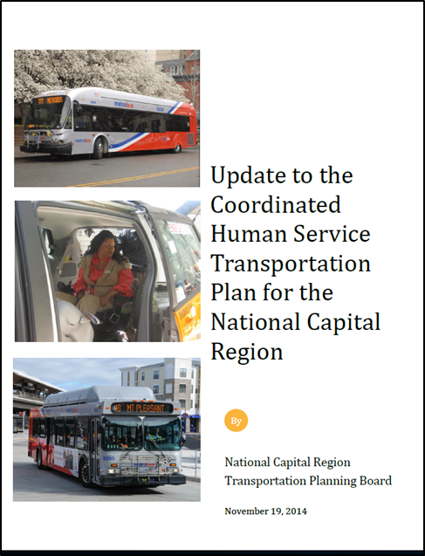
What is the Coordinated Plan?
The Federal Transit Administration (FTA) requires a Coordinated Plan to guide implementation of the Enhanced Mobility grant program
Must be updated every 4 years (in 2018)
The Coordinated Plan:
  Identifies unmet transportation needs of individuals with disabilities & older adults
  Inventories existing services
  Provides strategies for meeting those needs
  Prioritizes projects for Enhanced Mobility funding
  Outlines framework for competitive selection process
Agenda Item #: Using TPB PowerPoint Templates
January 9, 20XX

Slide 4
Unmet Transportation Needs Building Block for Coordinated Plan
Unmet Transportation Needs
Existing Transportation Services
Strategies for Improved Service and Coordination
Enhanced Mobility projects must address a strategy or a priority project
Priority Projects

Slide 5
Themes of Unmet Transportation Needs Previously Identified by the AFA
Awareness
Accessibility
Availability
Affordability

Slide 6
Strategies
  Expand availability and coordination of transportation options
  Increase awareness of existing transportation services
  Improve accessibility of transportation options
  Make transportation options more affordable and sustainable

Slide 7
Priority Projects
Previous Coordinated Plan had 12
8 are proposed for plan update because of overlapping concepts in the original 12
Applications that respond to Priority Projects AND strategies can score higher; however:
  Applicants can propose other eligible projects (per FTA)
  Competitive selection process is dependent on applications received

Slide 8
Priority Projects
Mobility Management at the Systems and Individual Level
Coordinated Planning Efforts
Travel Training
D. Door-through-Door or Escorted Transportation Service

Slide 9
Priority Projects
E. Increase Access to Transit Stations (and First Mile/Last Mile Connections)
Increase Wheelchair-Accessible Options in Taxi and Ride-Hailing Services
Volunteer Driver Programs
H. Tailored Transportation Service for Clients of Human Service Agencies (e.g. Vehicle Acquisition)

Slide 10
Break Out Groups
Questions:
Are the (strategies or priority projects) capturing the most significant transportation needs?
If not, what is missing?

Slide 11
Wendy Klancher, AICP Transportation Planner (202) 962-3321 wklancher@mwcog.org Lynn Winchell-Mendy Transportation Planner III (202) 962-3253 lmendy@mwcog.org | mwcog.org/tpb
Metropolitan Washington Council of Governments 777 North Capitol Street NE, Suite 300 Washington, DC 20002

