Slide 1

TBP Technical Committee
December 5, 2014
ITEM #8
FY 2012 - 2014
Commuter Connections TERM Analysis Results
Notes:
Good afternoon, Transportation Demand Management or TDM has been in existence since the first incidence of ridesharing success was the “Jitney Craze” in 1914 and then during WWII when gas rationing was put in place. TDM got its present day “Mojo” in the early 1970’s with the energy crisis hit and shocked commuters with high gasoline prices.
In the late 1980’s and early 1990’s focus and attention was placed on ridesharing programs based on air quality and congestion management requirements at the federal, state and local levels. Some urban areas adopted employee commute trip programs and others had voluntary efforts based on air quality conformity goals and requirements. Today’s emphasis on TDM is being placed in sustainability and health initiatives along with the understanding that there are very few funds to build our way our of traffic congestion while trying to improve air quality.

Slide 2
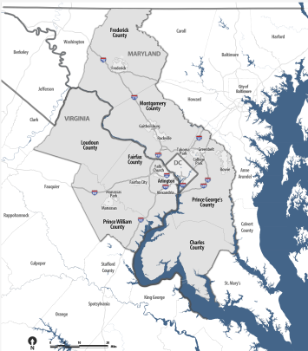
By 2040, It is Predicted that There Will be 4 million more trips each day in the region -- a 24% increase over today
Regional Growth Projections
Today:
5.3 million residents
2.7 million workers
The TPB is the designated Metropolitan Planning Organization (MPO) for the region
Notes:
In the Washington DC metropolitan region, TDM has been a strong staple of the metropolitan planning process. In 1974, the Metropolitan Washington Council of Governments started what was then known as the Commuter Club to match up residents in carpools and vanpools as a result of the energy crisis.
Fast forward 40 years later and the region which encompasses the District of Columbia, suburban Maryland and northern Virginia looks much different with just over 5 million residents and over two and a half million workers. By 2040, the forecasted growth shows a 24% increase over today’s numbers.

Slide 3
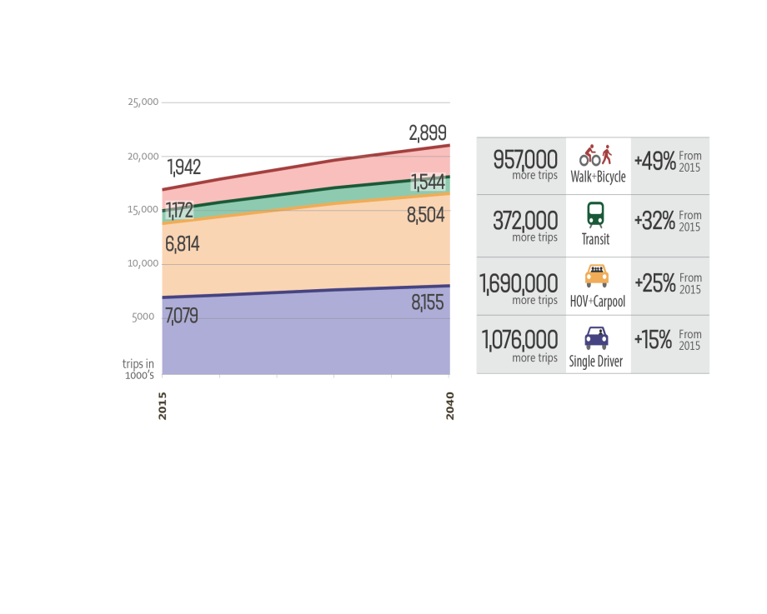
Daily Travel – Trips By Mode
Notes:
An analysis of the latest proposed update of the region's Constrained Long-Range Transportation Plan (CLRP) details how well the future transportation system laid out in the plan is expected to meet the needs of area travelers in 2040.
A majority of those new trips -- about 2.8 million -- are forecast to be made either by single drivers or by carpools, adding demand on roadways that are already heavily traveled and congested. About 372,000 new trips are expected to be made on the region's rail and bus transit systems, in some cases further straining crowded rail lines and stations, especially in the regional core.
Close to a million of the new trips forecast by 2040 are anticipated to be on foot or by bicycle, almost as many as will be made by single drivers. That represents growth of nearly 50% over the next 26 years, more than for any other travel mode in the region.

Slide 4
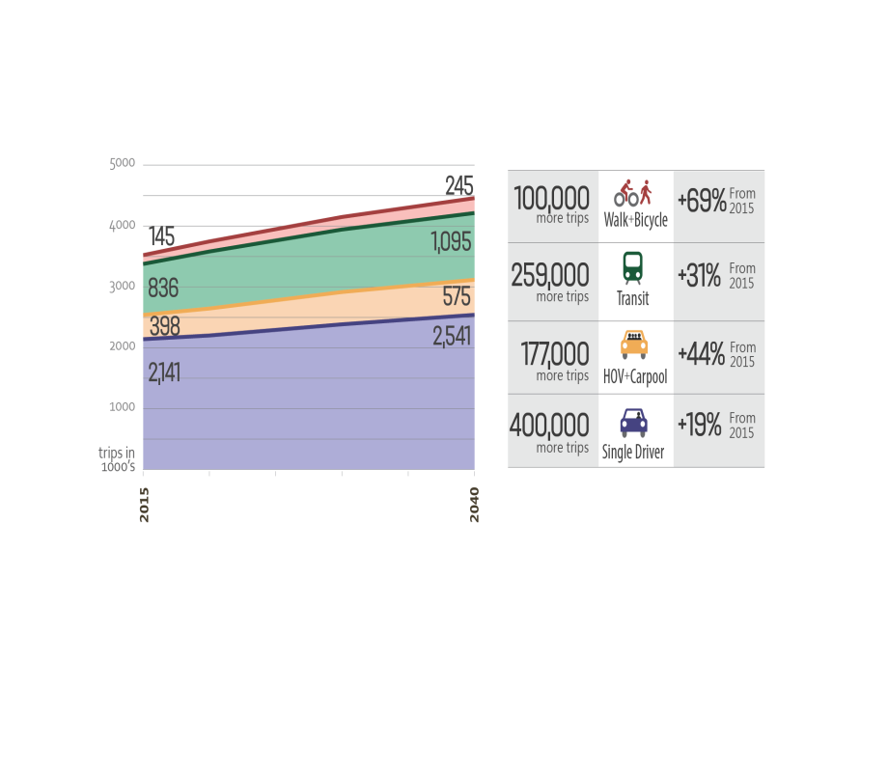
Daily Travel – Commute Trips By Mode
Notes:
Daily commute trips will also see increases in travel by auto’s, carpools, transit and a steep increase in bicycling and walking trips.

Slide 5





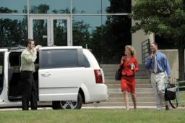
Regional Collaboration
Agree to how TDM programs can assist the region to meet congestion reduction and air quality goals.
Team
State Departments of Transportation
Businesses/Federal Agencies
Local governments
Transportation Management Associations Transit operators
Vanpool providers
Carshare/Bikeshare Services
Develop/Implement programs that will contribute to regional transportation and emission impacts.
Notes:
The original design and development of the program was part of a larger regional discussion on air quality goals based on EPA’s designation of the region as non-attainment for ozone. The program has evolved since that time given that the region is currently designated as marginal for ozone and there has been additional emphasis on congestion management and addressing sustainability through transportation.
Bringing stakeholders to the table for the discussion was paramount to its success given that much of the program delivery would be happening at the local level. Local jurisdictions with ridesharing offices in place along with transit agencies, vanpool providers and other rideshare service organizations worked together to develop the measures in a manner that would benefit local programs but also enrich the region’s ability to capture and communicate impacts resulting from each of the measures.

Slide 6

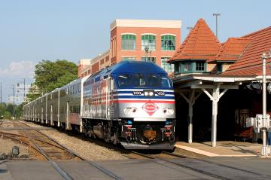

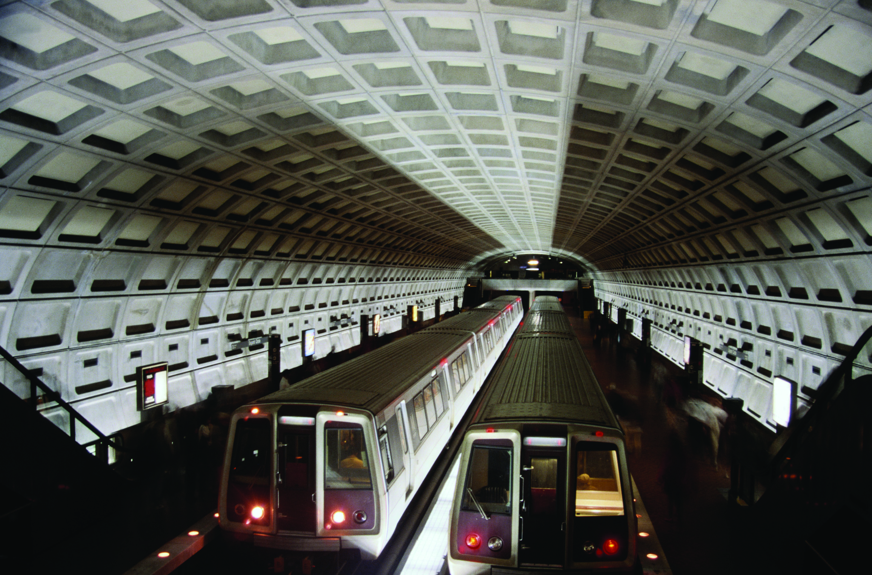
TERM Evaluation Cycle
Evaluation Methodology “Blueprint”
Data Collection
Reports
Share Results
Incorporate into Regional Planning Process
Notes:
The framework methodology, or blueprint of how we collect the data is reviewed and updated every three years. Data collection then commences and studies include Placement Rate studies to determine how commuters are using the information they receive from Commuter Connections and whether or not they are making travel behavior changes. A large regional State of the Commute survey is conducted every three years as a way to measure attitudes and awareness of commuting options, modes of travel being used, the influence that Commuter Connections marketing initiatives has on travel behavior as well as telecommuting trends.
Reports are prepared and issued on many of the data collection initiatives and then shared with network members. All of the data collected culminates into a final TERM Analysis report which is then used as part of the region’s air quality conformity and congestion management process.

Slide 7

Objective of Evaluation
Apply methodology outlined in Evaluation Framework to:
Estimate effectiveness of
Commuter Connections
TERMs
  Telework
  Guaranteed Ride Home
  Employer Outreach
  Mass Marketing
Document results of Commuter Operations Center
Adjust impacts for overlap among programs

Slide 8



Performance Continuum
Awareness – modes/programs
Attitudes – willing to try modes
  Participation – services used
  Satisfaction – with programs
    Utilization – mode / travel changes
    Influences – motivations for change
      Impacts of change (travel / AQ / energy)
Awareness Participation Utilization Impacts
and and and
Attitudes Satisfaction Influence

Slide 9

Impact Calculation Approach
Impact calculation approach uses series of
“multiplier” factors, applied to user population
Target / User Population
e.g. GRH registrants
COG tracking
X
Placement rate =
X
“Vehicle trip reduction” factor =
X
travel distance =
X
Emission factors =
“Placements”
Users with mode change
Factors derived from users surveys
Vehicle trips reduced by
mode changes
VMT reduced by
mode changes
COG factors
Emissions
reduced

Slide 10
Impacts for All TERMs + COC (Jul 2011 – Jun 2014)
Comparison of collective goals against collective impacts, including Commuter Operations Center
Goal Impact Net
  Trips reduced 109,594 131,830 22,236 +20%
  VMT reduced 2,162,400 2,473,326 310,926 +14%
  NOx reduced 1.098 T 1.061 T (0.037) T - 3%
  VOC reduced 0.654 T 0.533 T (0.121) T -19%
Met vehicle trip and VMT goals
Shortfall in emission goals due to reduced emission factors
for 2015 (cleaner cars) and shift to MOVES emission model

Slide 11


TERM Analysis Observations
The four TERMs met the collective
goals for both vehicle trips (+10%)
and VMT reduced (+6%)
CC programs overall (TERMs + COC)
exceeded the VT reduction goal (+20%) and VMT goal (+14%)
TERMs did not meet emissions goals, but this was due to a change in the emission model (MOVES) and reductions in the 2014 emission factors, compared to the factors used when the goals were established in 2005

Slide 12
Commuter Connections
Vehicle Trip Reduction – 1999 to 2014
Daily Vehicle Trips Reduced
Notes:
The next few slides show impacts for both transportation and emissions and begin back to the first evaluation cycle which was completed in 1999. We are currently working on finalizing impacts for 2014.

Slide 13
Commuter Connections
VMT Reduction – 1999 to 2014
Daily VMT Reduced
Notes:
Read from slide

Slide 14
Commuter Connections
NOx Reduced (daily tons) – 1999 to 2014
Daily tons NOx Reduced
Notes:
Read from slide
Mention cleaner vehicle fleets.

Slide 15
Commuter Connections VOC Reduced (daily tons) – 1999 through 2014
Daily tons VOC Reduced
Notes:
Read from slide
Mention cleaner vehicle fleet

Slide 16
PM 2.5 Reduced (annual tons) – 2008 to 2014
Commuter Connections TERMs + Commuter Operations Center
Annual tons PM 2.5 Reduced

Slide 17
Precursor NOx Reduced (annual tons) – 2008 to 2014
Commuter Connections TERMs + Commuter Operations Center
Annual tons PM 2.5 Precursor NOx Reduced

Slide 18
CO2 Reduced (annual tons) – 2008 to 2014
Commuter Connections TERMs + Commuter Operations Center
Annual tons CO2 – Greenhouse Gases Reduced

Slide 19
Next Steps
Report Endorsement
Report Publication and Release
Program Cost Effectiveness Calculation
Integrate results into regional air quality conformity determination and Congestion Management Process

Slide 20

Questions?
Nicholas Ramfos
Director, Alternative Commute Programs
Metropolitan Washington Council of Governments
202.962.3313
nramfos@mwcog.org

