Slide 1
2025 Regional Transit Safety Targets – Final update
Performance-Based Planning and Programming
Pierre Gaunaurd TPB Transportation Planner TPB Regional Public Transportation Subcommittee December 5, 2025
Agenda Item 2
Notes:
Draft Note, 9.22:
Left to do for Monday 9.26:
calculate rates for charts on slides 7 and 8
Add note about counting assaults on transit workers now per BIL (is only for next year or this year too?)

Slide 2
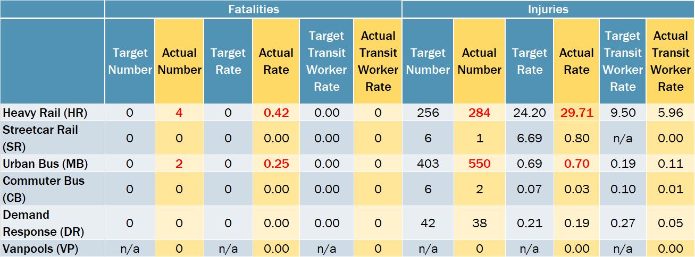
2024 Regional Transit Safety Performance (1)
2024 targets for the region adopted by the TPB in December 2024
Actual data is that reported by transit agencies to the FTA’s National Transit Database for FY24
Red text = target exceeded
Rate = Per 100,000 Vehicle Revenue Miles, except HR (per 10M VRM)
Reliability data (MDBF) is not included

Slide 3
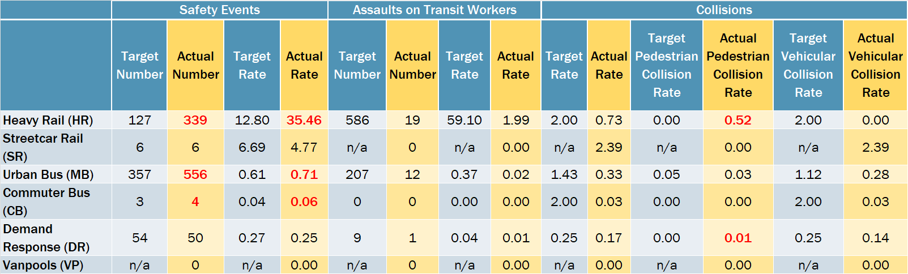
2024 Regional Transit Safety Performance (2)
2024 targets for the region adopted by the TPB in December 2024
Actual data is that reported by transit agencies to the FTA’s National Transit Database for FY24
Red text = target exceeded
Rate = Per 100,000 Vehicle Revenue Miles, except HR (per 10M VRM)
Reliability data (MDBF) is not included

Slide 4
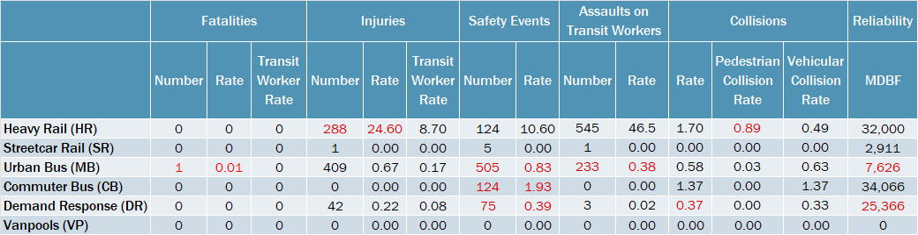
2025 Regional Transit Safety Targets - Draft
Regional targets are a calculated compilation of the targets adopted by each applicable provider of public transportation in the region
Red font represents an increase in the target figure from the 2024 target figure (i.e., less stringent)
Rate = Per 100,000 Vehicle Revenue Miles, except HR (per 10M VRM)
MDBF = Mean Distance Between Failures

Slide 5
Next Steps
December 5: Present final regional targets to the Technical Committee
December 17: Request board approval of final regional targets
TPB staff will subsequently transmit the adopted targets to the State DOTs in accordance with established written agreements for performance planning reporting

Slide 6
Potential 2026 and 2027 PBPP Work Activities
Staff are considering a deeper review of regional transit safety performance trends over the years starting later in FY26 and FY27
  Would potentially include requests for information on:
    context/further detail on types of injuries, collisions, location data, etc.
    actions taken to address safety and security incidents and repeated issues
  Driven by the Multimodal Planning team with likely involvement by the Long-range Planning team.
  Board interest in more background about regional safety targets, the context behind incident counts and events, and what is being done to make transit safer

Slide 7
Pierre Gaunaurd TPB Transportation Planner (202) 962-3761 pgaunaurd@mwcog.org | mwcog.org
777 North Capitol Street NE, Suite 300 Washington, DC 20002

