Slide 1
UPDATE ON REGIONAL INFORMATION GATHERING REGARDING TRANSIT OPERATIONS AND COVID-19
Andrew Meese
Systems Performance Planning Director
Regional Public Transportation Subcommittee
July 28, 2020
Agenda Item #4

Slide 2
Background
Greater Washington Partnership (GWP)
  The GWP is a nonprofit civic alliance of employers and entrepreneurs that represent businesses from Baltimore to Richmond
  Focuses on economic growth, transportation, and human capital
Active interest in economic recovery from COVID-19 led to GWP’s interest in coordination between employers and transit providers
  Contacted COG (and others)
Agenda Item #4: COG COVID Transit Information Gathering
July 28, 2020

Slide 3
Idea
GWP envisioned coordinating employers’ reopening plans with information on transit capacity loads and projected over-crowding at stations and routes (bus, rail, commuter rail) near a given employer’s worksite location
  GWP points to dashboards or portals being used in other cities (e.g. Boston, Chicago) and by VRE
Discussions have evolved to creation of a regional information sharing effort, through:
  GWP survey of employers
  Public sector information gathering from transportation agencies
    GWP, COG, and WMATA have been coordinating on the who and how of this information gathering
Agenda Item #4: COG COVID Transit Information Gathering
July 28, 2020

Slide 4
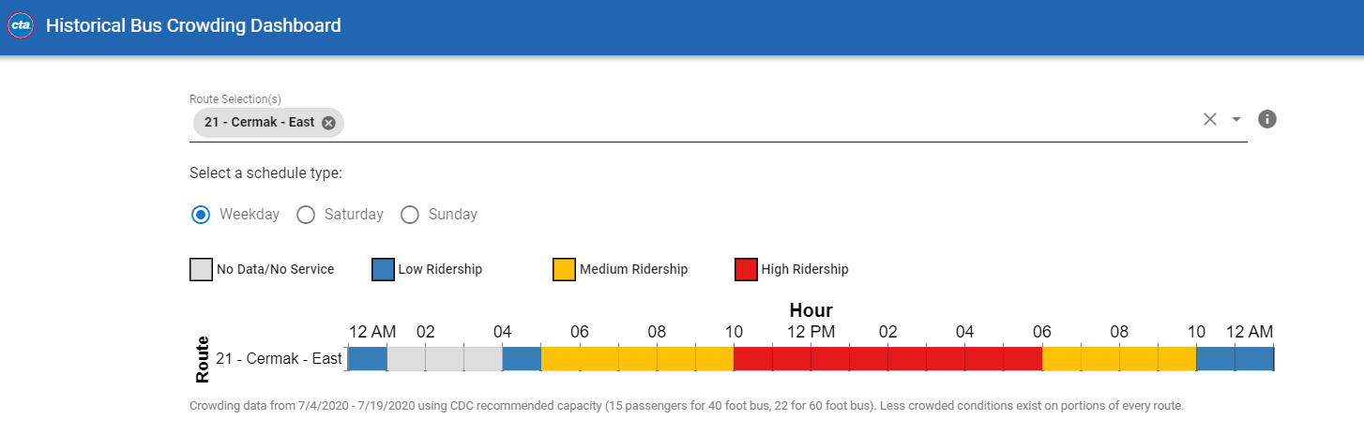
Example: Chicago
Agenda Item #4: COG COVID Transit Information Gathering
July 28, 2020

Slide 5
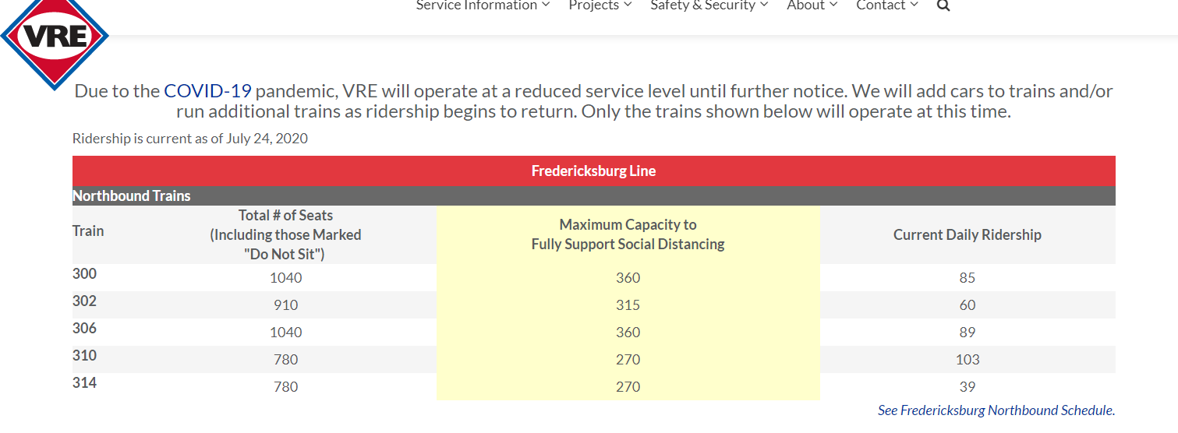
Example: VRE
Agenda Item #4: COG COVID Transit Information Gathering
July 28, 2020

Slide 6
Status of Information Sharing Plans
GWP (advised by Ernst & Young) is creating a survey of employers in the region on reentry plans and timing
WMATA has (tentatively) agreed to provide information directly to GWP (and other partners) in a useable format
COG agreed to gather recovery period operations information from transit providers in the region (other than WMATA) through a periodic questionnaire
Agenda Item #4: COG COVID Transit Information Gathering
July 28, 2020

Slide 7
GWP Survey of Employers (Preliminary)
Location, industry type, number of employees (at a given location)
Pre-COVID modes of transportation to workplace (qualitative ranking) and % of employees who used transit to get to workplace
How concerned are respondents about their employees riding transit to worksite, regarding:
  Ability to social distance; arriving at workplace on time; hours of service provided; sanitary conditions of vehicles/systems
Percentage of employees who are currently coming, or will be coming to the worksite at future timepoints, now through summer 2021
Additional work flexibility employers are offering during COVID (e.g., flexible work hours)
Suggestions/what more information is needed?
Agenda Item #4: COG COVID Transit Information Gathering
July 28, 2020

Slide 8
COG Questionnaire to Transit Operators
To be distributed through the MATOC Transit Task Force membership
  Except WMATA, handled separately through GWP
  Separate questionnaires for bus, commuter rail
Anticipated to be monthly (could move to every other month if necessary)
Questions on:
  Ridership; current and upcoming service levels; overall issues
  COVID-specific actions (e.g. rear door boarding, fare collection policy, face covering requirements, driver protection)
First questionnaire distribution/collection late July/early August
Agenda Item #4: COG COVID Transit Information Gathering
July 28, 2020

Slide 9
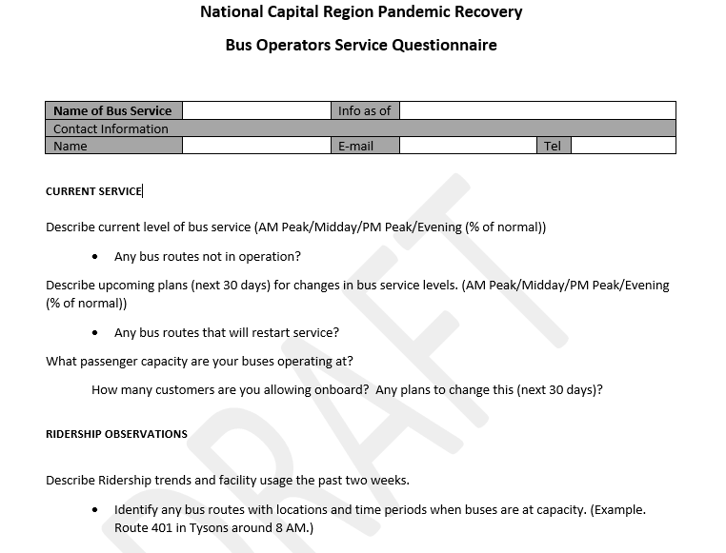
COG Questionnaire (Example)
Agenda Item #4: COG COVID Transit Information Gathering
July 28, 2020

Slide 10
Next Steps
GWP: finalize and distribute first version of employer survey
WMATA: determine what data will be shared and how
COG: finalize and distribute first version of transit providers questionnaire
Review results of the above efforts and determine synergies
Review future frequency of information gathering as recovery evolves
Agenda Item #4: COG COVID Transit Information Gathering
July 28, 2020

Slide 11
Questions?
Agenda Item #4: COG COVID Transit Information Gathering
July 28, 2020

Slide 12
Andrew Meese TPB Systems Performance Planning Director (202) 962-3789 ameese@mwcog.org | mwcog.org/TPB
Metropolitan Washington Council of Governments 777 North Capitol Street NE, Suite 300 Washington, DC 20002

