Slide 1
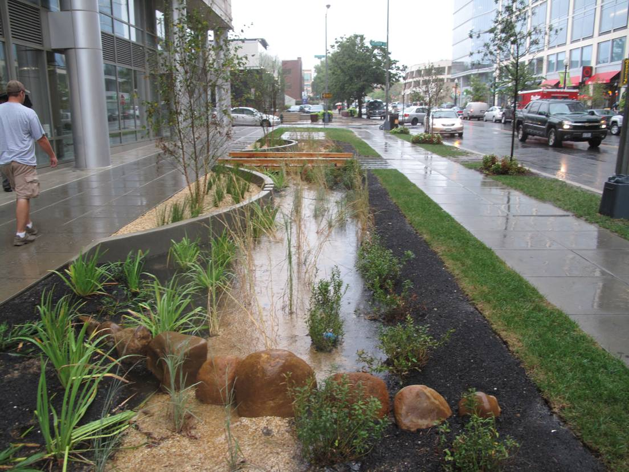

Green Streets Workshop
Best Practices Around the Region and the Country
AGENDA
WORKSHOP ON GREEN STREETS
Presentations and Discussion on Overcoming Implementation Challenges and Maximizing Benefits of Green Streets in the Washington, DC Metro Region and Beyond
Monday, July 28, 2014
11:30 am - 12:30 pm - Networking Lunch
12:30 – 4:30 pm Workshop
Metropolitan Washington Council of Governments
777 North Capitol Street NE, Washington, DC
Ron F. Kirby Training Center – 1st Floor
Networking Lunch
11:30 am – 12:30 pm
Welcome
12:30 – 12:35 pm Steve Walz, Director, Department of Environmental Programs, Metropolitan Washington Council of Governments
Background on the Workshop
12:35 – 12:40 pm Michael Farrell, National Capital Region Transportation Planning Board Staff
Keynote: A Green Street Perspective from another Region - Philadelphia’s Green Street Program used Partnerships to Overcome Implementation Challenges
12:40 – 1:00 pm Jessica Noon, City of Philadelphia Water Department
1:00 – 1:10 pm Questions and Comments
Portland’s Green Streets Challenges and Successes
1:10 – 1:40 pm Emily Hauth, Portland, OR Sustainable Stormwater Management
1:40 – 1:55 pm Questions and Comments
1:55 – 2:10 pm Brief Break
Green Streets in an Urban Context
2:10 – 2:30 pm Meredith Upchurch, District of Columbia Department of Transportation
2:30 – 2:45 pm Joseph Burckle, District of Columbia Urban Forestry Administration
2:45 – 2:55 pm Questions and Comments
Green Streets in a Suburban Context
2:55 – 3:10 pm Russell Carroll, Prince George’s County Department of Public Works & Transportation
3:10 – 3:25 pm Christin Jolicoeur, Arlington County Department of Environmental Services
3:25 – 3:35 pm Questions and Comments
Green Streets in a Highway Context
3:35 – 3:50 pm Pawan Sarang, Commonwealth of Virginia Department of Transportation
3:50 – 4:00 pm Questions and Comments
Wrap-up Discussion
4:00 – 4:20 pm Michael Farrell, Transportation Planner, MWCOG

Slide 2
Green Streets Workshop
Policies and Practices Around the Region and the Country
Biographical Information about the Speakers
Jessica Noon is the manager of Strategic Policy and Coordination for the Office of Watersheds for the Philadelphia Water Department, working closely with public and private partners to implement the innovative Green City, Clean Waters green infrastructure program. Prior to joining the Philadelphia Water Department, Jessica served as the Environmental Policy Advisor to the Bronx Borough President, focused on issues of green space, waterfront development and environmental justice. Jessica has a variety of experience in urban planning including work in New York, Boston, New Jersey and Florida. Jessica holds a Masters in City and Regional Planning from Rutgers University, and is an AICP-certified planner and Leadership in Energy and Environmental Design [LEED] Accredited Professional.
Emily Hauth is a member of the Sustainable Stormwater Division of Portland’s Bureau of Environmental Services. Since 1999, Emily has worked to promote green infrastructure implementation throughout the city; providing education and outreach, project management, and technical assistance to industry professionals and visiting delegations. Hauth is also program coordinator for the recently formed Green Street Steward Program, a partnership between the city and volunteer citizens in the care and maintenance of public green street facilities. Staying true to her native Portland roots, Emily received a B.S.in Environmental Science and Resources and minor in biology from Portland State University (2001).
Meredith Upchurch is the Low Impact Development Team lead at DDOT in Washington, D.C. where she implements projects and coordinates stormwater policy for the right-of-way. She is leading projects for RiverSmart Washington, Green Alleys, LID Design Standards and produced DDOT’s 2010 LID Action Plan. While at Casey Trees, she developed the guidelines for “Tree Space Design: Growing the Tree Out of the Box”. Upchurch’s first career was in aerospace engineering, but she changed focus to work on solving urban environmental problems. She has degrees in Engineering, Landscape Architecture, and Natural Resources from Duke and Virginia Tech.
Joseph Burckle is an Urban Forester with the District Department of Transportation Urban Forestry Administration where he has managed the ARRA, Clean Water Act, and Transportation Alternative Grants for Green Infrastructure Enhancements. A graduate of the Yale School of Forestry and a Peace Corps Volunteer; Burkle has over 20 years’ experience working as a forest land manager, consulting forester and arborist, and urban forester.
Russell Carroll is a project manager with the Prince George’s County Department of Public Works and Transportation and is responsible for the planning and design of green complete street retrofit projects. He has served for ten years as a district engineer with Prince George’s County, reviewing and permitting environmental site design and stormwater management plans for new development. Prior to Prince George’s County, Mr. Carroll was responsible for the design of urban streetscapes for 15 years as an engineering supervisor with Arlington County. Mr. Carroll is a registered professional engineer in Maryland, Virginia and North Carolina. He has an MBA from George Washington University and BS in civil engineering from Michigan State University.
Christin Jolicoeur is a watershed planner with Arlington County’s Department of Environmental Services where she manages stream and watershed protection projects, including Arlington’s Green Streets and residential BMP incentive programs. She has an undergraduate degree in geology and an M.S. in Marine Sciences from UNC-Chapel Hill, and 15 years of experience in watershed assessment, low impact development, ecological restoration, sustainable landscaping and environmental outreach.
Pawan Sarang is a Registered Professional Engineer in the State of Maryland and Commonwealth of Virginia. Sarang completed Post Graduate studies in Highway Engineering and has served with the Virginia Department of Transportation in the Northern Virginia District as District Drainage Engineer since July 2005. (The Northern Virginia District includes Arlington, Fairfax, Prince William and Loudoun Counties and various cities.) Previously, Sarang worked in Land Development, Site Design and Highway Hydraulics/Drainage/SWM field for 16 years, with extensive work in Counties of Prince George’s, Maryland and Anne Arundel, Maryland.

