Slide 1

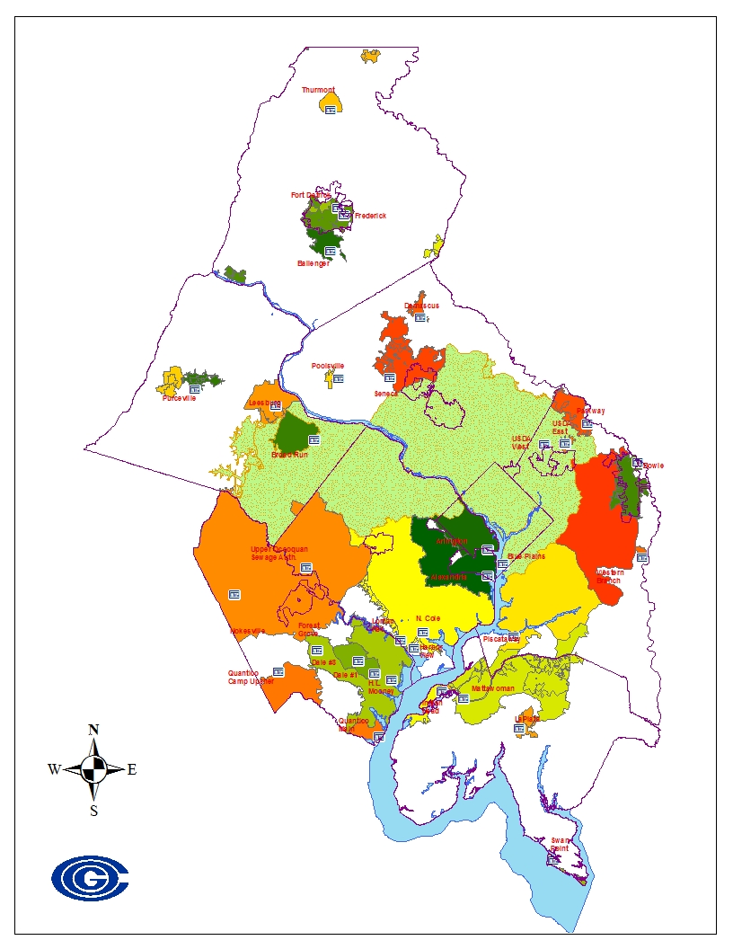
Regional Wastewater Flow Forecast Model (RWFFM)
WRTC Presentation (04/28/2015)

Slide 2
Agenda
Background
Review of Input Data
Review of Methodology
Preliminary Results
Model Demonstration
Future Direction of Model
Q/A, Informal Discussion

Slide 3
Background
RWFFM is based on Blue Plains Flow Forecast Model (BPFFM, 1993, O’Brien & Gere, LTI)
  Both models are population-based
  BPFFM uses separate GIS and Spreadsheet applications (somewhat flexible)
  RWFFM is based primarily on Microsoft Access
  With the acquisition of new service areas the model is being expanded to generate flow forecasts for other treatment plants
Notes:
The metropolitan Washington council of government has developed the regional wastewater flow forecast model to perform wastewater flow projection for the major wastewater treatment plants in the Washington DC region.
The project is based on demographic data released by COG’s cooperative forecasting program that was established in 1975
The model aides regional planning effort and can be used as a tool for decision making

Slide 4
Background
RWFFM model Requires 6 input files to execute the model queries. These input files are;
  Inflow and Infiltration rates
  Flow factors
  Base flow
  Nonsewered
  Population Round
  TAZ ratio
The RWFFM base flow is currently based on 2009 actual flow data (based on the Blue Plains Service Area assessment)
RWFFM is essentially self-enclosed. Model runs from start to finish in Microsoft Access
Results of the RWFFM Model are generated as MS Access reports that can be exported into excel or word documents

Slide 5
Input Data
Population Demographics
  COG’s Cooperative Forecast is based on Jurisdiction demographic projections
  Five year projections (2005-2040)
  Currently using Round 8.3 which was adapted by COG’s board on October 2014
  Corresponding Sewer GIS Data Layers
  Corresponding TAZ GIS data layer

Slide 6
Input Data
GIS Data Layers
  TAZs
  Sewersheds layer obtained from Chesapeake Bay Program
  Intersected layer (provides area-ratio used to allocate population for sewersheds)

Slide 7
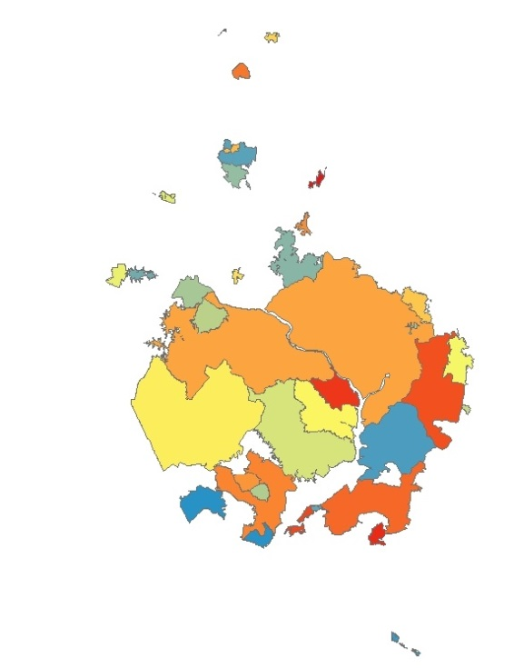
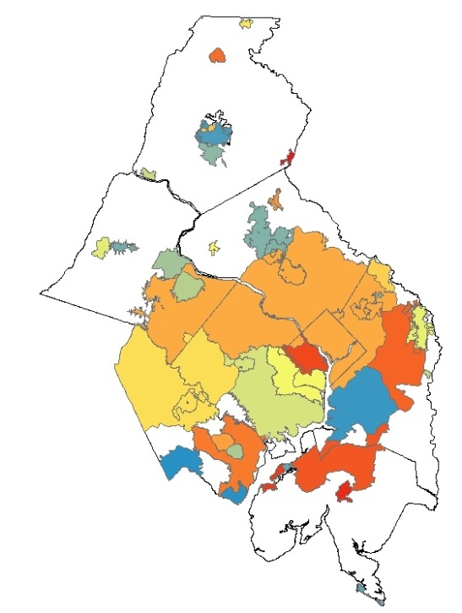
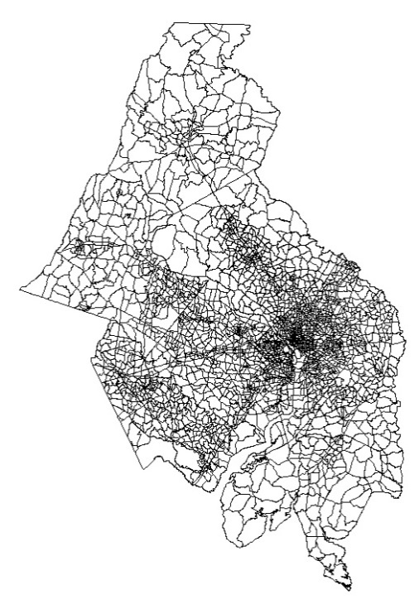
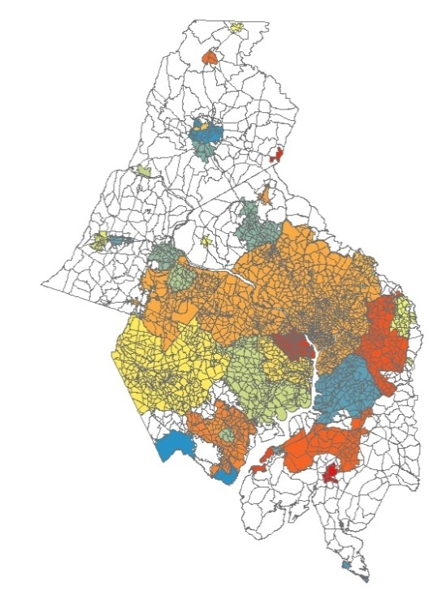
GIS Layers Processing
Sewersheds
Sewersheds + Jurisdictions
Transportation (TAZ)
Sewersheds + TAZ

Slide 8
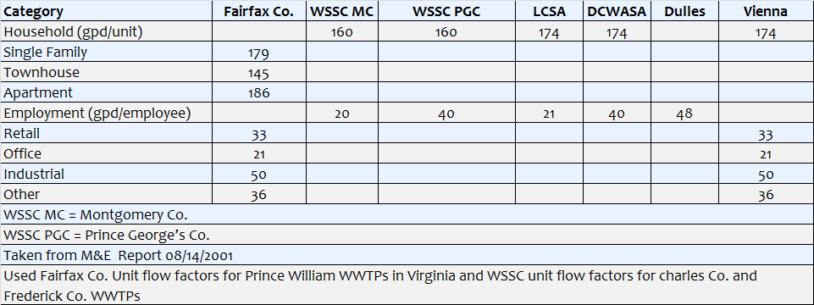
Flow Factors

Slide 10
Flow Projection Equations
    Projected Flow = Base Year Flow + Incremental Flow
    Base Year Flow = Percent Allocation x Jurisdiction Base Year Flow
    Incremental Flow = Incremental Sanitary Flow + Incremental I/I
    Incremental Sanitary Flow = (Flow Factors x Incremental Demographics)
    Incremental Demographics = Demographics (Forecast) + Nonsewered Service Conversion
    Incremental I/I = 0 (if Incremental Sanitary Flow < 0 = Percent x Incremental Sanitary Flow (if Incremental Sanitary Flow > 0)

Slide 11
Flow Projection Calculations
Incremental Population x Flow Factors
⬇ ISF
ISF x I/I Percent
⬇ Incremental I/I
Incremental I/I + ISF
⬇ Incremental Flow
Incremental Flow + 2009 Base Flow
⬇
Total Flow

Slide 12
Methodology
General Framework of the Model
  Cooperative forecast data are linked to TAZ GIS layer
  Sewersheds GIS layer used to intersect TAZ layer
  New zone areas are divided by initial “master areas” of TAZs to derive area-ratios
  Populations are multiplied by area-ratio to allocate population per sub-zone

Slide 13
Methodology
General Framework of the Model (cont..)
  New demographics table (from GIS) is summarized by shed-input zone and grouped by sewershed and jurisdiction (“rolled up” demographics)
  Fairfax demographics are a special case (broken out into specific household types) -->these are eventually “rolled up” back to the household level

Slide 14
Methodology
General Framework of the Model (cont.)
  Flow factors are applied to population, and combined with base flow (2009) and incremental I/I
  The original Base flow was based on M&E regression analysis
Black & Veatch updated Base Year Flows (BYF) & flow factors for Blue Plains in 2010
  2009 BYFs are actual annual average flows
  I/I rate of 44% of incremental sanitary flow remained the same
Used Fairfax #’s for VA plants & WSSC #’s for MD plants

Slide 15
Preliminary Model Results
Currently adjusting values and GIS data layers
General QA/QC
Results from current and old runs are tabulated in excel spreadsheet for comparison

Slide 16
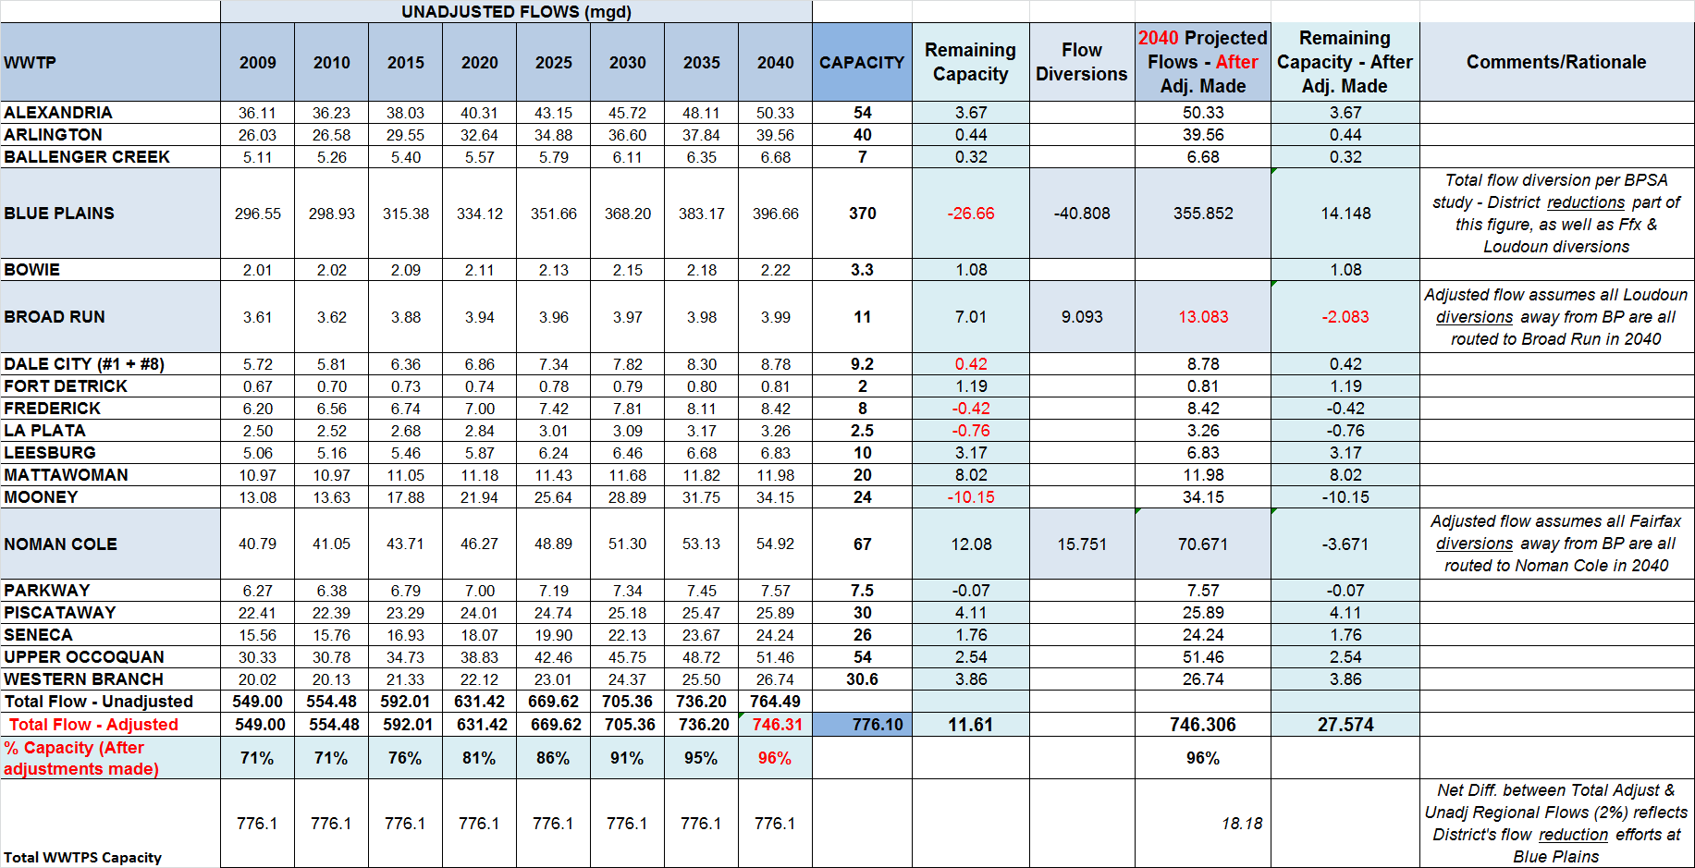
COG Major WWTPs & ‘Unadjusted’ Flow Projections

Slide 17
Demographic Projections for COG Region Served by WWTPs
From COG’s Cooperative Demographic Forecast Round 8.3
COG population constitute about 87% of the Potomac watershed population
and about 30% of Chesapeake bay population
COG Total 5.3 Million

Slide 18
COG Regional WWTPs Unadjusted Flow Projections

Slide 19
COG Regional WWTPs Adjusted Flow Projections
776 MGD Total Regional Wastewater Flow Capacity

Slide 20
Successes/Challenges
Successes
  Integration of model into a single application
  Flexibility of model (future uses)
  Easy to use MS Access model

Slide 21
Successes/Challenges
Challenges
  Sewersheds layer needs revision/update
  Any changes however slight may be to sewersheds layer can change the output
  QA/QC the subsewershed with the new sewersheds GIS layer to match the input file
  Coordination of efforts/methodologies with various jurisdictions and service providers

Slide 22
Contact info:
Mukhtar Ibrahim
Department of Environmental Programs
mibrahim@mwcog.org
202-962-3364

