Slide 1
Drought Monitoring in Maryland
A Presentation Given 2018-03-19 at the MWCOG Drought Monitoring Workshop on March 19 at Loudoun Water by John H. Smith, P.E of the Water Supply Program of the Maryland Department of the Environment

Slide 2
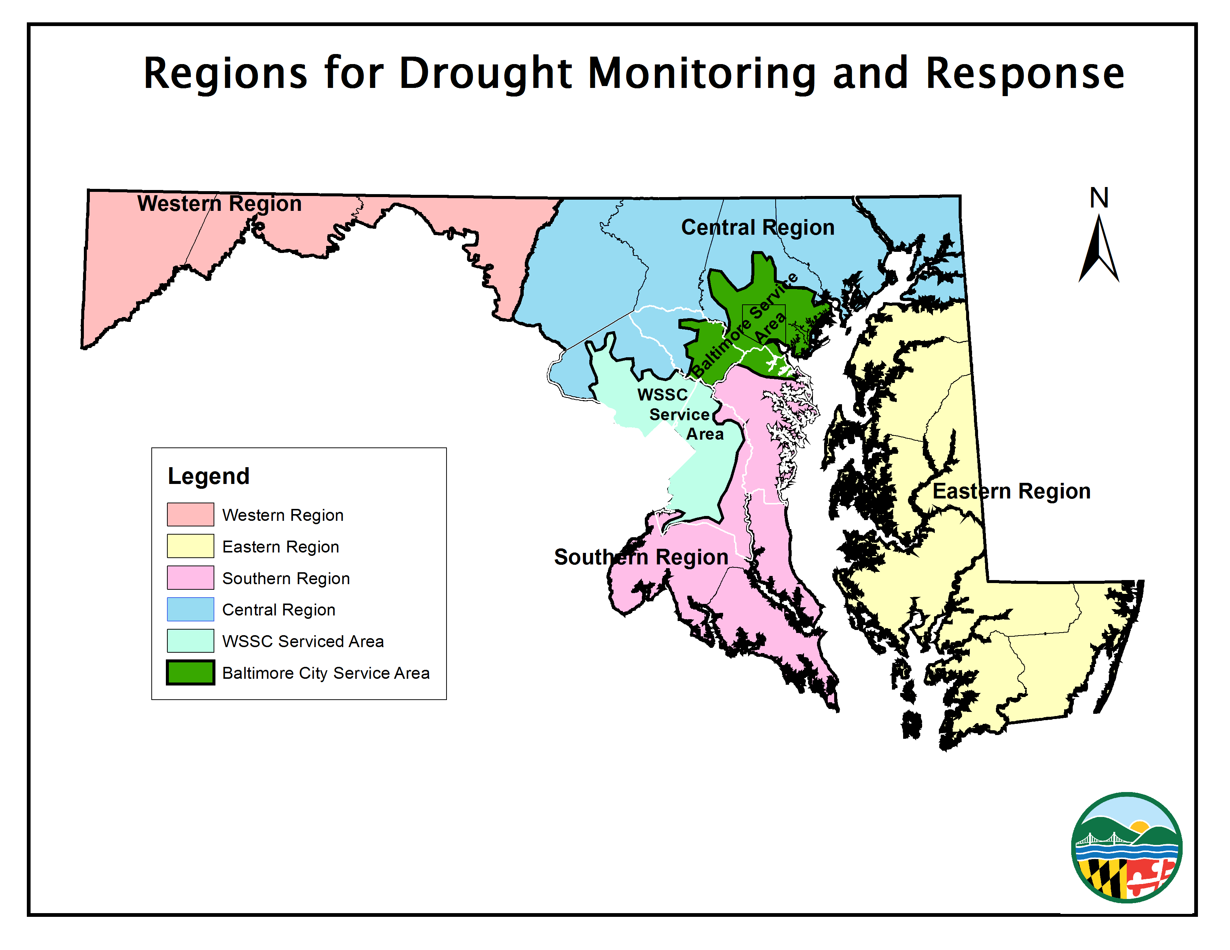
Maryland Drought Regions

Slide 3
The Rainfall Indicator

Slide 4
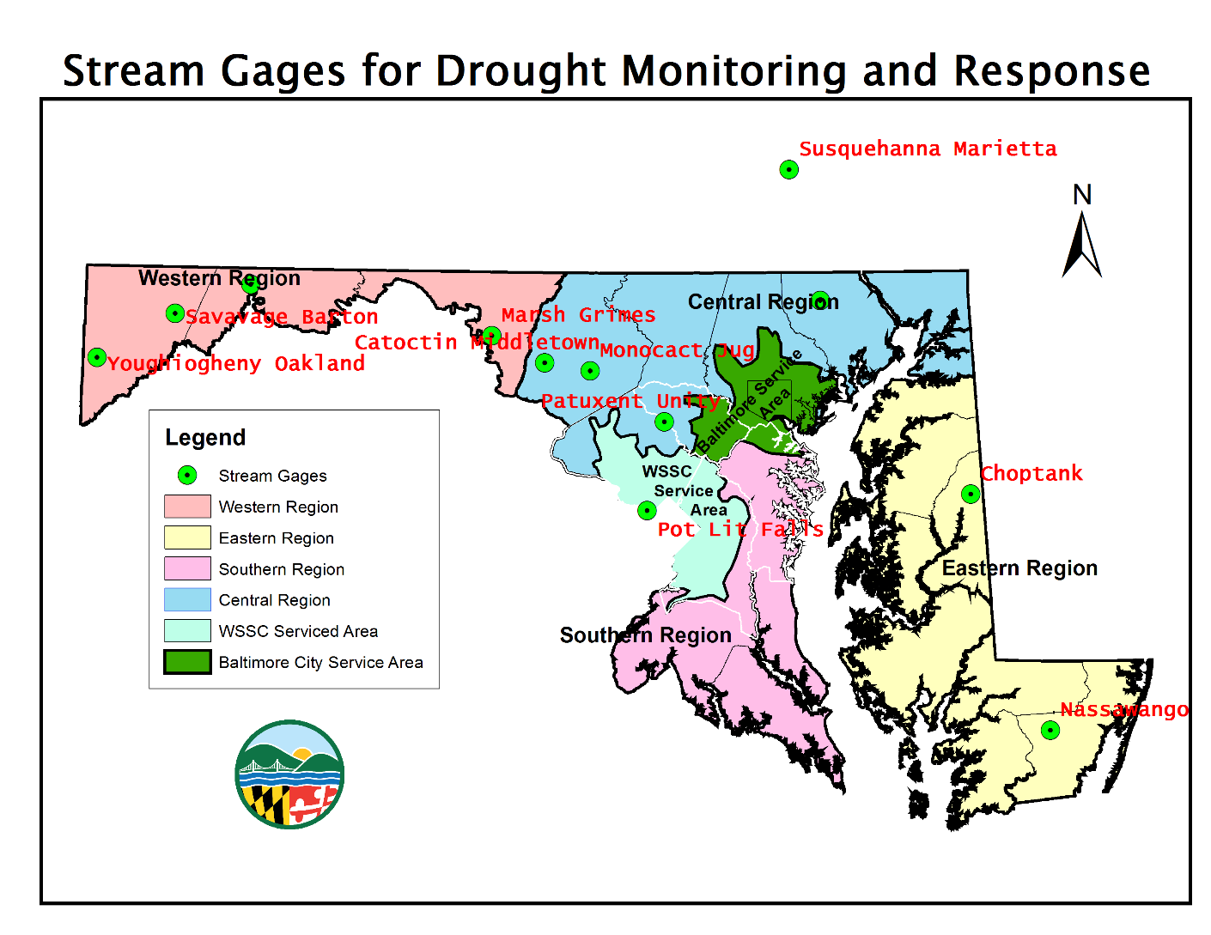
Stream Gages for Drought Monitoring and Response

Slide 5
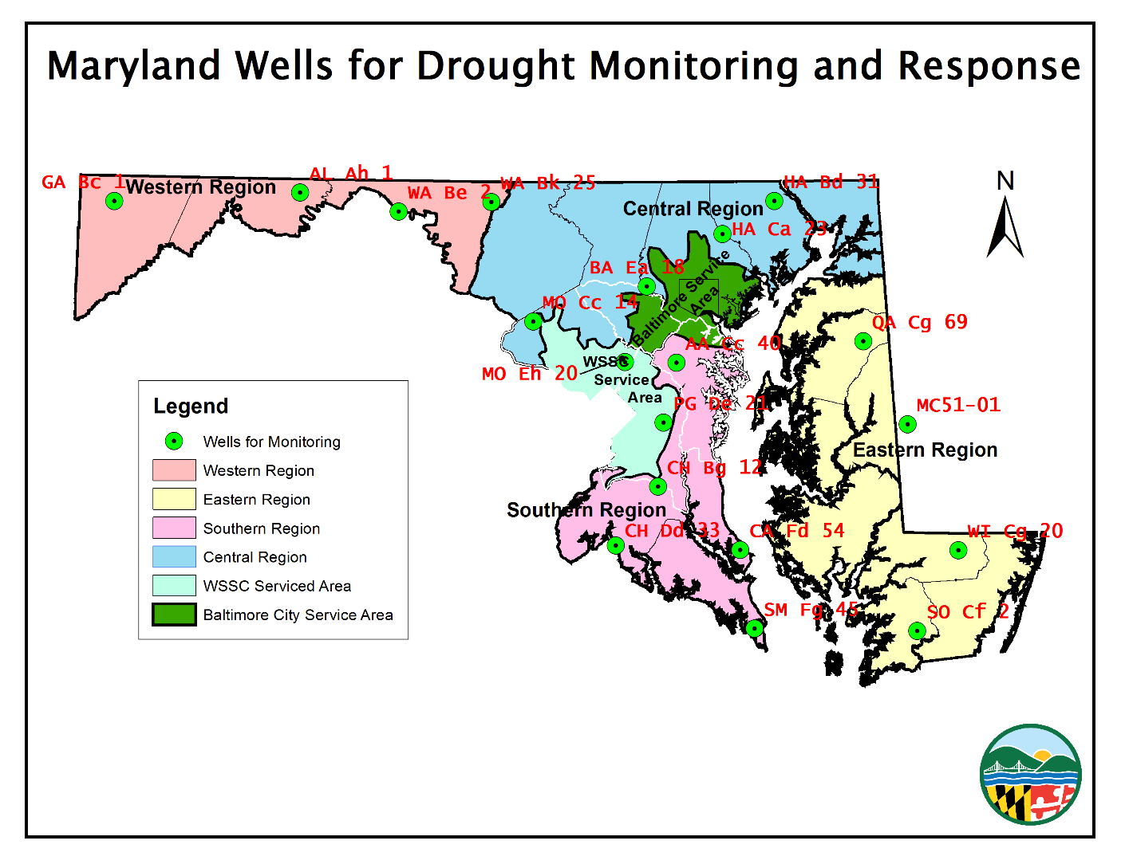
Maryland Wells Used for Drought Monitoring

Slide 6
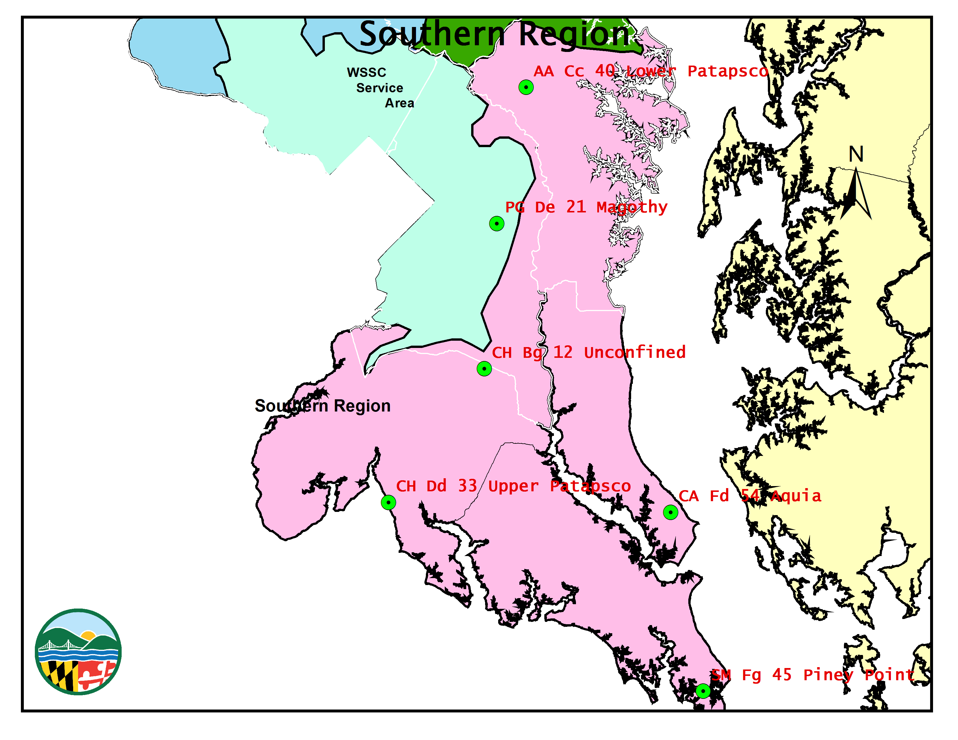
The Southern Region

Slide 7
Reservoirs

Slide 8
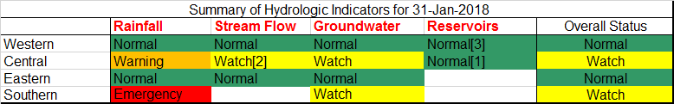
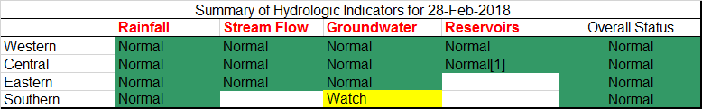
From Indicators to Status

Slide 9
Responding to Drought
The Governor's Water Conservation Advisory Committee recommended the following actions for each drought stage.
Stage 1: Normal Conditions (Green)
Stage 2: Watch (Yellow)
5% - 10% Reduction Goal
Stage 3: Warning (Orange)
10% - 15% Reduction Goal
Stage 4: Emergency (Red)
15% - 20% Reduction Goal

Slide 10
Winter Drought Issues

Slide 11
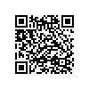
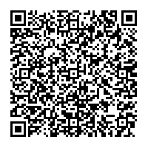
For Additional Information
For additional information, please visit our website: http://mde.maryland.gov/programs/Water/droughtinformation/Pages/index.aspx
or contact me at: John.Smith1@Maryland.gov
(410) 537-4109
John Smith
Maryland Dept of the Environment
Water Supply Program
1800 WASHINTON BLVD STE 450
BALTIMORE MD 21230-1708

