Slide 1
Getting to 30%
Ensuring a Smooth Transition to a More Efficient Future
Eric Lacey
Responsible Energy Codes Alliance

Slide 2
Introductions
RECA is a broad coalition of energy efficiency professionals, regional organizations, product and equipment manufacturers, trade associations, and environmental organizations that promote the adoption and implementation of the most recent version of the IECC nationwide.
EECC is a diverse set of state and local governments, energy efficiency advocates, energy consumers, environmental groups and industry experts who joined forces in mid-2007, creating the Energy Efficient Codes Coalition to mount a comprehensive, integrated effort to achieve an initial 30% boost in the energy efficiency of the 2009 International Energy Conservation Code (IECC) over its 2006 counterpart.

Slide 3
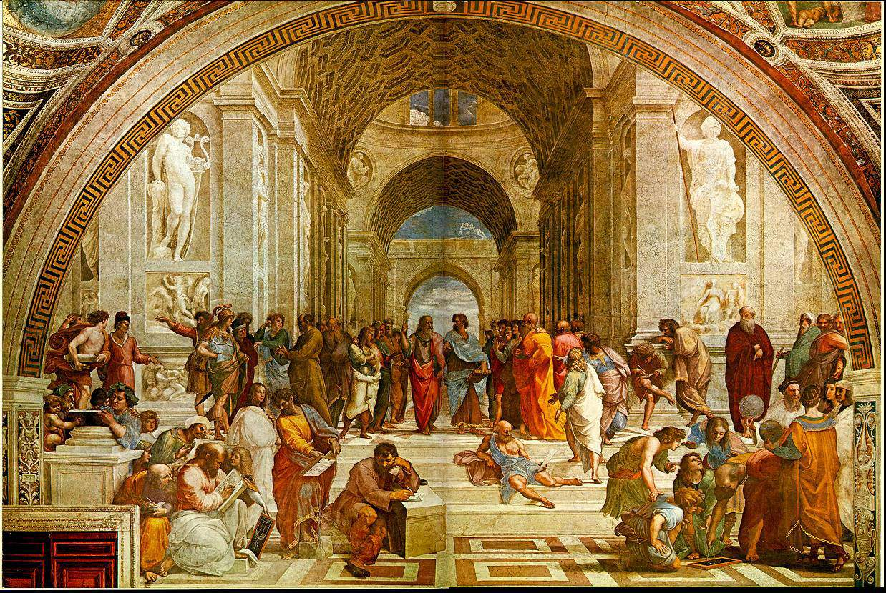
Model Code Development

Slide 4

Model Code Development

Slide 5

Model Code Development
Code Change
Proposals Submitted
Code Development
Committee Hearing
Public Comments
Final Action Hearing
New Model
Code Published

Slide 6
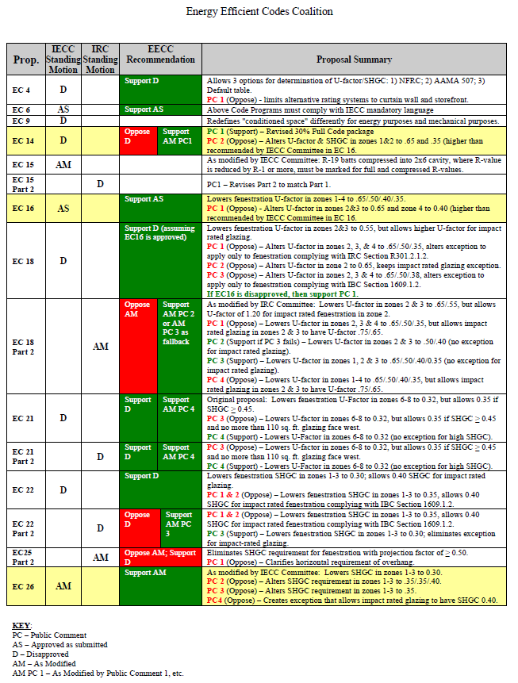
Summary and Sample Ballot
Summary Description
Committee Recommendation
Summary of Public Comments
Final Action Recommendation

Slide 7
Final Action Hearing
Three Categories of Proposals
Residential
Commercial
RE 4

Slide 8
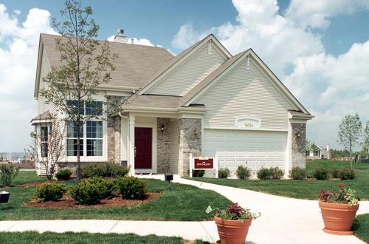
1. Residential
Potential for 30% and more

Slide 9
Residential
3 Package Proposals
DOE (EC 13)
EECC (EC 25)
NAHB (EC 16)

Slide 10
Residential
Original EC 13
Better windows, skylights, insulation
Hot water system upgrades
High efficiency lighting upgrade
Tighter air leakage and ducts
Potential legal challenge over preemption

Slide 11
Residential
EC 13 + Public Comment 11 (EECC)
Removes mechanical equipment provisions to protect against legal challenge and to ensure smooth implementation into states

Slide 12
Residential
EC 25 – Core of the EECC 30% Solution
Parallels EC 13 in form and substance, but contains additional enhancements:
  Stronger insulation and window & door requirements
  Improved air sealing inspection requirements
  Focus on consistency and simplicity
Additional strengthening proposals can be added on for additional efficiency

Slide 13
Residential
Complete EECC 30% Solution 2012
EC 25 Public Comment 3 (EECC revisions)
Individual EECC Proposals that make up the core
EECC Proposals that go beyond 30%
Proposals refined by EECC Public Comments

Slide 14
Residential
EC 16 – NAHB
All or nothing approach makes upgrades difficult
Code is frozen at < 30%
Retraining of code officials
Unclear impact on ARRA 90% Compliance

Slide 15
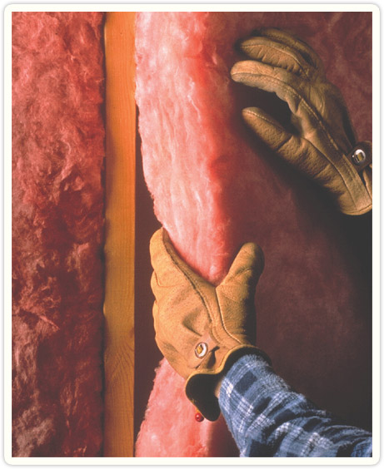
Residential
Key Insulation Proposals
Ceiling insulation in climate zones 2-5, 7-8
Wall insulation in climate zones 3-4, 6-8
Basement wall insulation in climate zones 5-8
Calculation Methods
EC 45, EC 46
EC 47, EC 48
EC 50
EC 57

Slide 16
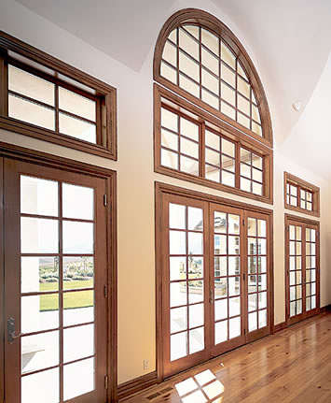
Residential
Key Window, Door, and Skylight Proposals
Lower U-factors in all climate zones
Lower SHGC in climate zones 1-4
Improved sunrooms
Improved fenestration trade-off maximums
EC 34, EC 39,
EC 41, EC 42
EC 68
EC 96

Slide 17
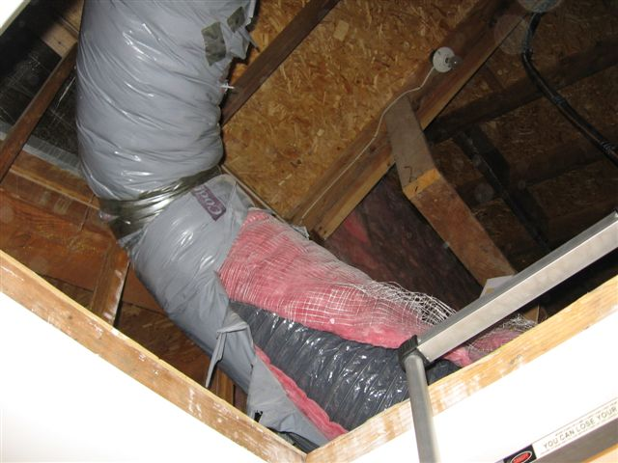
Residential
Duct and Air Leakage Proposals
EECC improved air leakage testing & inspection
DOE air leakage and testing (prefer EECC)
EECC Improved duct tightness
DOE duct tightness (prefer EECC)
EC 81
EC 79
EC 103
EC 107

Slide 18
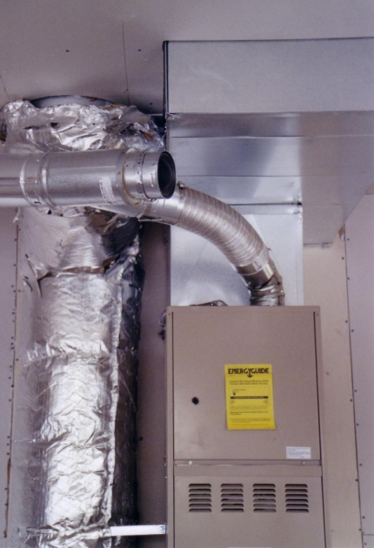
Residential
System Efficiency
Ducts in conditioned space or efficient equipment
Programmable thermostat & zones
Hot water heating
HVAC sizing
EC 126 (P.C. 1)
EC 100, EC 101
EC 114, EC 112
EC 121, EC 108

Slide 19

Residential
Negative Proposals
Return of HVAC Trade-off removed in 2009
Elimination of fenestration U-factor and SHGC maximums
Unnecessary Trade-downs such as residential projection factor trade-offs, product specific requirements

Slide 20

2. Commercial
Potential for 30% and more

Slide 21
Commercial
EECC Summary & Sample Ballot will have recommendations for commercial proposals as well.
EECC Supporters also have commercial proposals and public comments. These go through an identical vetting process by the EECC Technical Committee
Priority on efficiency, consistency, and seamless compliance/enforcement.

Slide 22


3. RE 4
Consistency Among Codes

Slide 23
RE 4
IRC/IECC Overlap
DOE: 2009 IRC is Weaker than 2009 IECC
Recovery Act Implications

Slide 24
RE 4
Solution: Borrow from MD, GA, NJ, and others
IRC Chapter 11 (energy) is replaced with reference to IECC requirements.
Result: IECC, IRC, and IBC contain identical energy efficiency requirements
RE 4 is preferred, RE 2 is a backstop

Slide 25
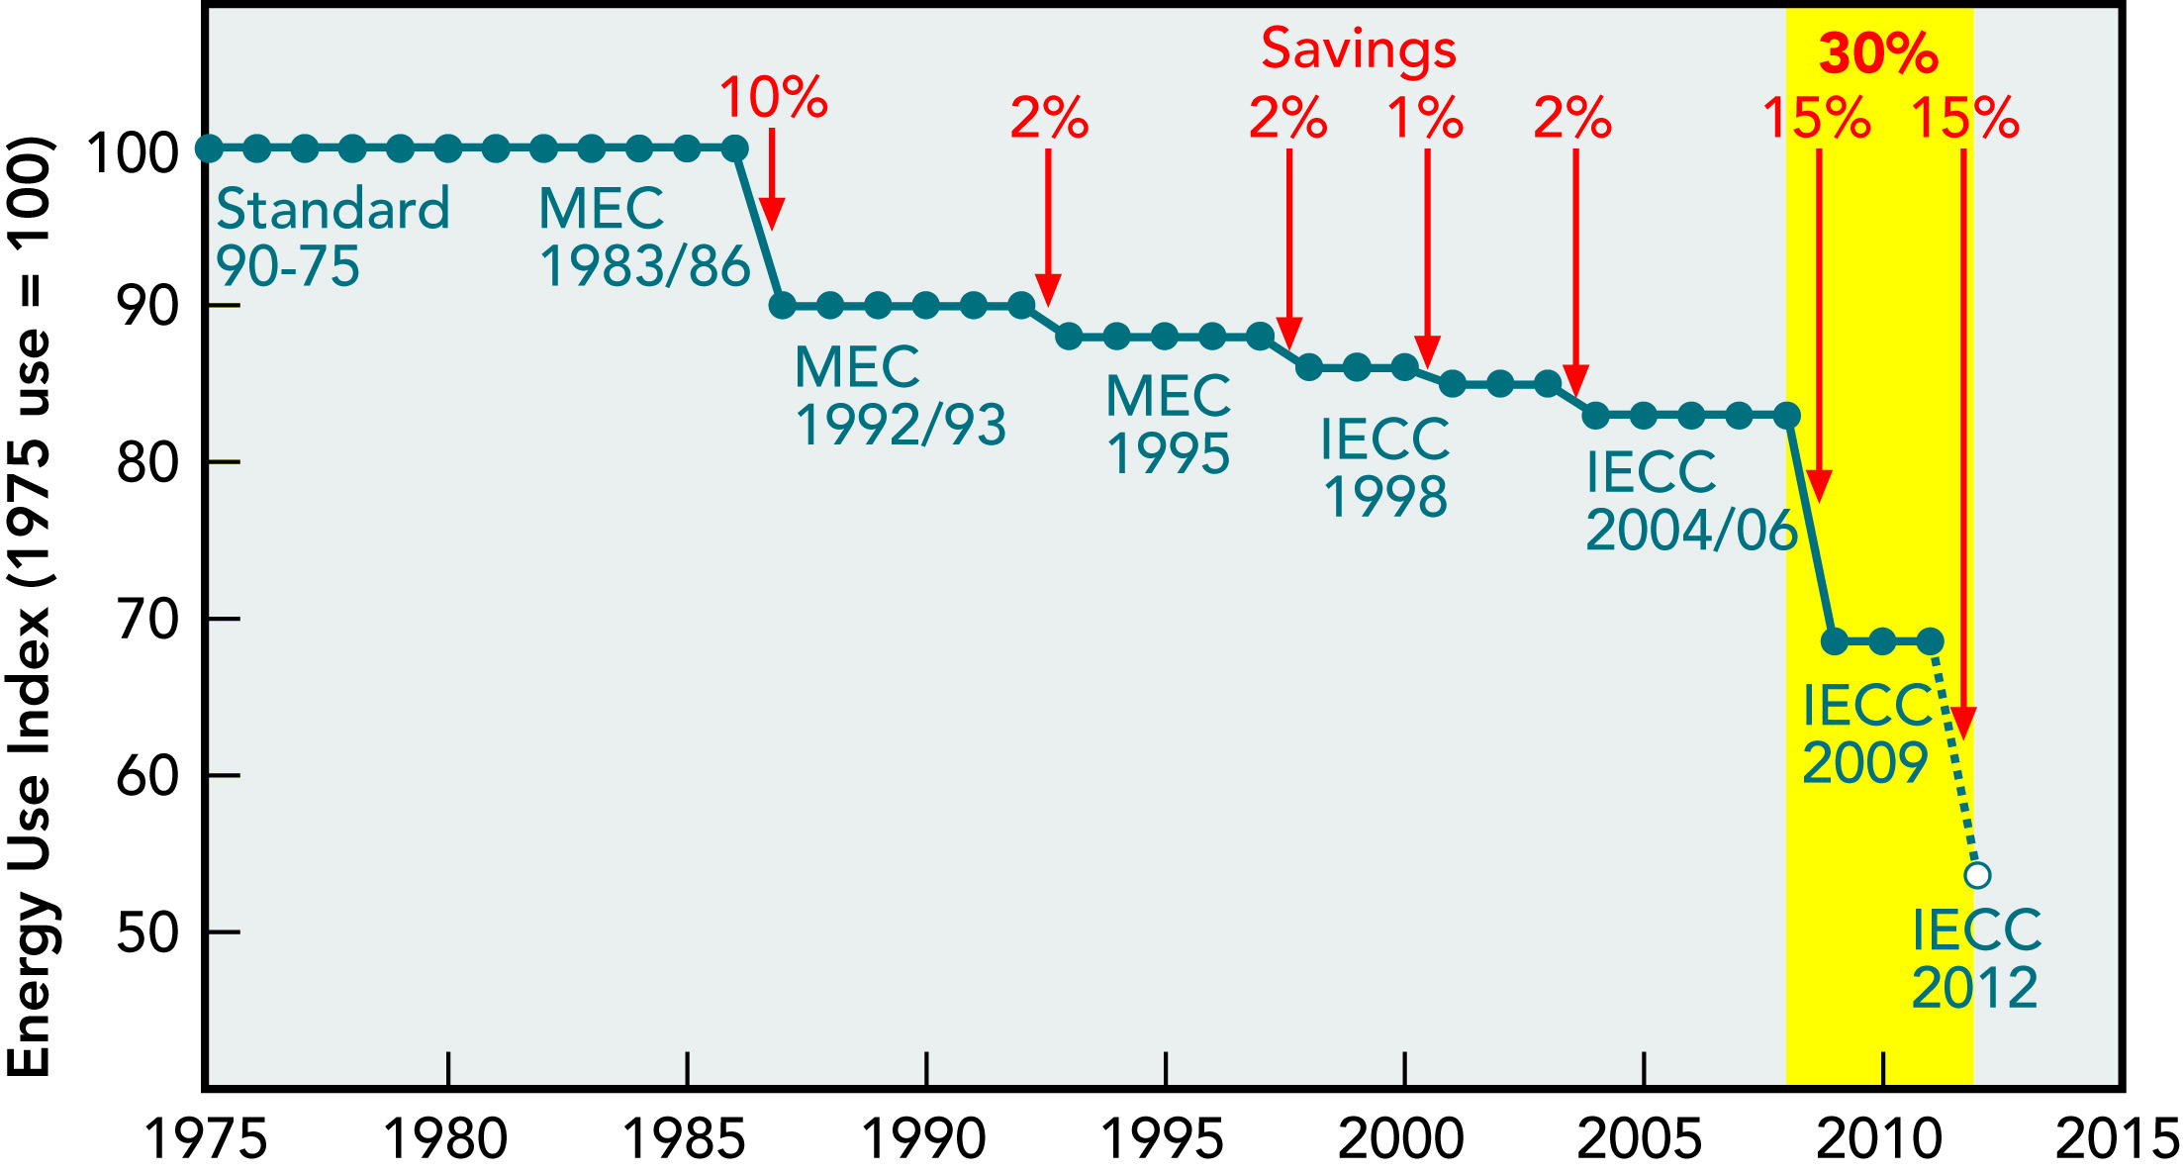
Conclusion
30% (and more) is within reach.

Slide 26
Contacts
Eric Lacey, Responsible Energy Codes Alliance
202-339-6366
eric@reca-codes.com www.reca-codes.com
Bill Fay, Energy Efficient Codes Coalition
202-857-0666
bfay@ase.org www.thirtypercentsolution.org

