Slide 1
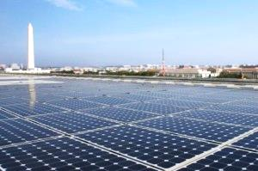
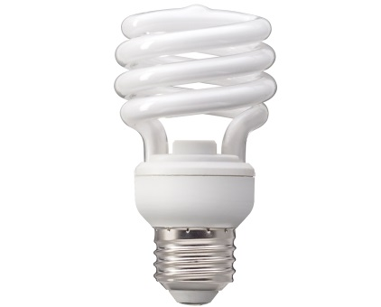
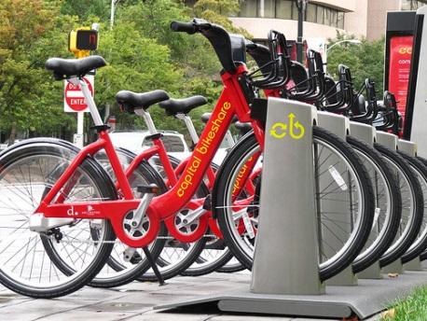
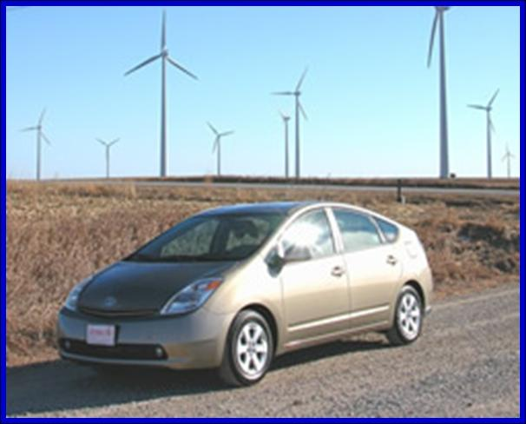

Gold Book
State and Local Clean Air Measures
Presentation to: MWAQC
February 26, 2014

Slide 2
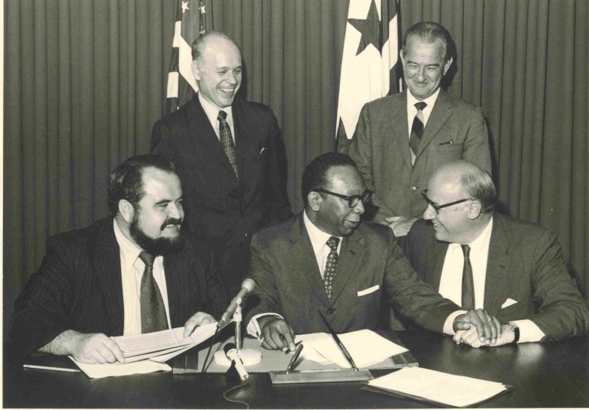
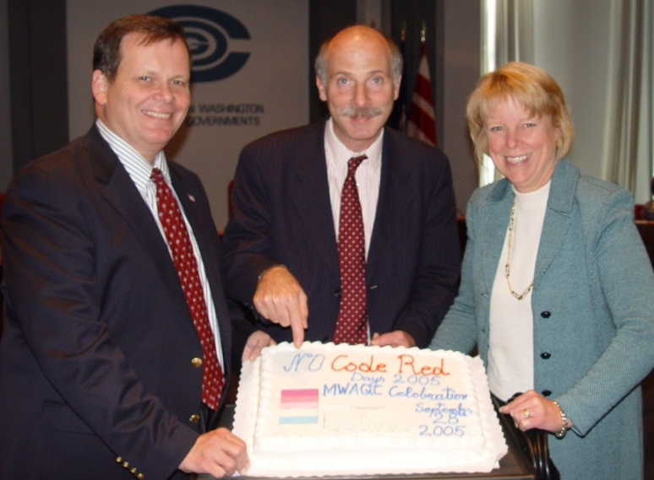




Long History of Delivering Clean Air
“They truly can be proud of the efforts they have made and the achievements that have resulted.”
Remarks on signing the Clean Air Act, President Lyndon Johnson, December 1963
Air Pollution Control Act 1968
No Code Red Days 2005

Slide 3

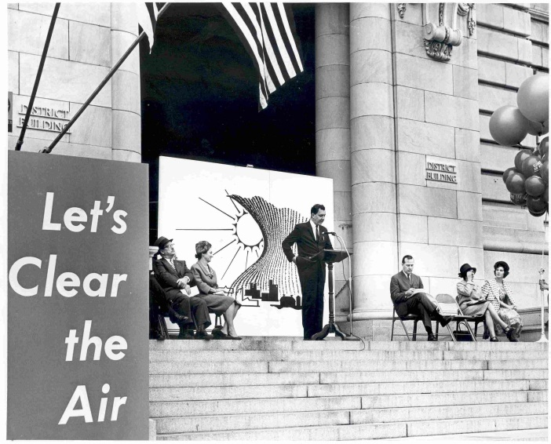
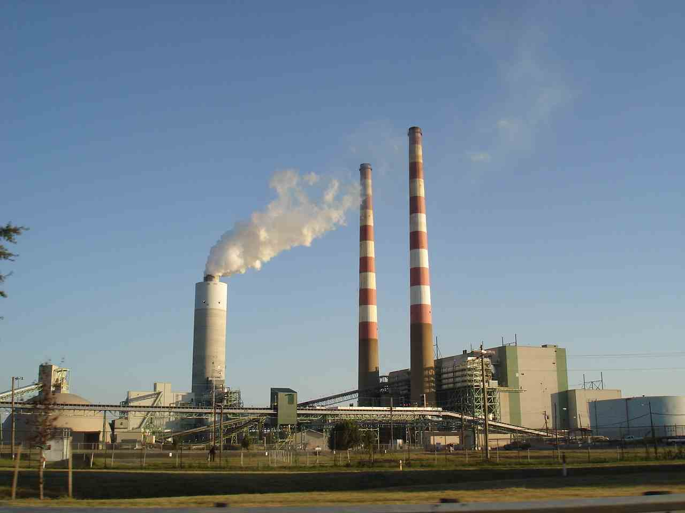
Regulatory Mandates & Local Voluntary Initiatives
State Implementation Plans:
Federal and State Control Measures
Permanent and Federally Enforceable
COG Clean Air Rally - 1963
Local Measures: Voluntary
& Important
Wet Scrubber Installed at the Morgantown Coal Plant - 2009

Slide 4
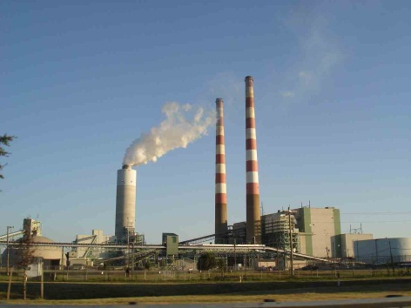
State and Federal Measures
Federal and State Measures Provide Significant Air Quality Benefits to the Region
Power Plant Emission Limits
Vehicle Emission Standards
Fuel Sulfur Standards
Fuel Efficiency Standards – Light Duty, Heavy Duty Trucks
Non-road Locomotive Standards
Product Formulations

Slide 5
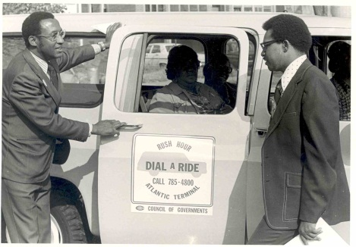

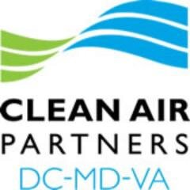
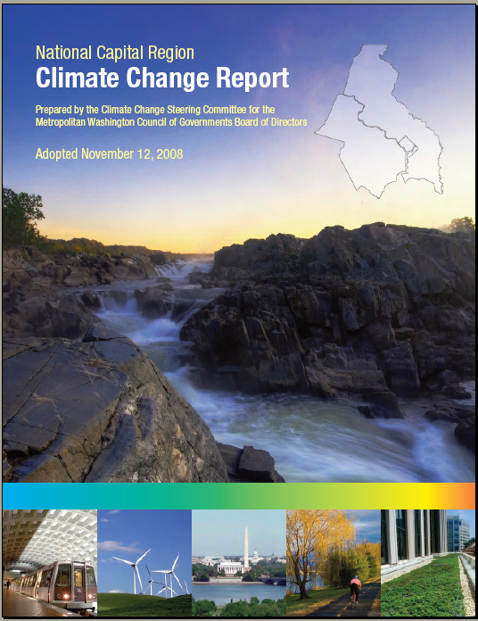
Delivering Clean Air – A Legacy of Local Leadership
1970 COG begins issuing daily air quality readings
1974 COG’s Commuter Club Formed
1985 Commuter Club Becomes RideFinders Network
1990 COG Adopts Million Tree Planting Resolution
1991 MWAQC Founded
1996 RideFinders Becomes Commuter Connections
1996 Ozone Action Days Program Begins
1997 ENDZONE Partners Founded
1997 Guaranteed Ride Home Launched
2000 ENDZONE Partners becomes Clean Air Partners
2000 20% Telework Goal Established with Board of Trade
2001 Bike To Work Day Program Launched
2008 Car Free Day Program Launched
2008 COG Climate Report Adopted

Slide 6



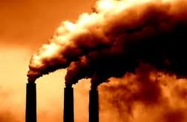

Comparison to Voluntary Bundle
Voluntary Bundle Measures
  Wind Energy Purchases
  Clean Energy Rewards Programs
  LED Traffic Signal Retrofits
  Renewable Portfolio Standards
  Building Efficiency/Green Buildings
  High Electricity Demand Day (HEDD) Initiative

Slide 7


The Gold Book
Compendium of state and local actions that improve air quality
  (but are not easily quantifiable or are not being credited in the SIP)
  First Version: 2004, Revised 2009 & 2014
For each measure:
  Description
  Progress/status
  Benefits
  Opportunity for Expansion
Notes:
Should we be sure to add any other information about each of the measures?
(Progress/status section explains if it is an existing measure, if it is available for expansion & how)

Slide 8


2009 vs. 2014
2009 Gold Book
Existing Programs
Existing but Available for Expansion
Potential Future Initiatives
2014 Gold Book
Climate, Energy & Sustainability Plans
Renewable Energy & Green Power
Energy Efficiency Programs
Stakeholder Initiatives & Partnerships
Land Use & Transportation Coordination
Transportation Options
Transportation Demand Reduction
Vehicle Emission Reduction
Other Initiatives
Notes:
Changed the structure of the gold book for 2014
Felt that sector categories were more useful
Almost all programs fall into “existing but available for expansion”
The revised version still notes when a program is available for expansion
Categories are much more applicable to COG’s National Region Climate Change Report & CEEPC’s action plan
Do people like this change?

Slide 9






Climate, Energy & Sustainability Plans
State plans:
  DC, Maryland &
  Virginia
  Regional plans:
  MWCOG GHG Reduction Targets
  Jurisdictions’ Climate Action Plans
  Energy Security & Assurance Plans
Notes:
State plans:
Maryland
Virginia
Regional plans:
MWCOG GHG Reduction Targets
Jurisdictions’ Climate Action Plans
Energy Security & Assurance Plans

Slide 10

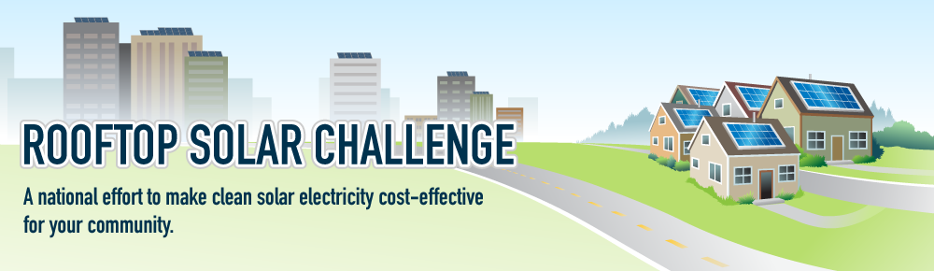
Renewable Energy & Green Power
Renewable Portfolio Standards
Government Renewable Energy Purchasing
  Green Power Partners & Communities
  DC Renewable Energy Goals, MCDGS Solar RFP
  Private Sector Renewable Purchasing
    Cooperative Solar Procurement, Community
    MD Game Changers Program
    Rooftop Solar Challenge
Notes:
RPS:
Maryland: mandatory RPS ( ), with solar carve-out (
Virginia: Voluntary RPS
Government Renewable Energy Purchasing
DC Wind Power
DC Solar Goals
Private Sector Renewable Purchasing
Cooperative solar purchasing
CEPs: Arlington,
Solarize:
Federal Partnerships
RSC: MWCOG has received two grants from DOE’s Sunshot initiative to help ramp up solar in the region
Goal = reduce soft costs (make up 40% of install costs)
Soft costs are rising/stable, versus rapidly dropping hardware & technology costs
By reducing barriers in zoning, permitting, planning, inspection, etc.
Green Power Partners
Green Power Communities

Slide 11


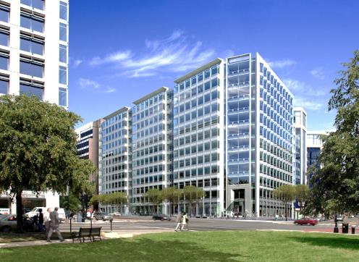

Energy Efficiency
Energy Efficiency Financing
PACE, on-bill-repayment, Green banks
Energy Performance Contracting
High Performance Buildings
Government & Private Building Requirements
Building Codes, Green Leasing
DC Sustainable Energy Utility
Notes:
Government Building Policies
DC
Alexandria
Mont Co
Commercial, Residential, Educational Facilities
IECC Building Codes
Benchmarking
DC gov building benchmarking
DC requirement for commercial buildings over ___
Pepco required to supply data to buildings with more than 5 meters

Slide 12


Local Air Quality Initiatives
Clean Air Partners Program
Localities’ Air Quality Programs
  Low VOC Paints, Pesticides
  Episodic Measures: Striping, Lawn Mowing, Refueling
  Air Quality Awareness
Cooperative Green Purchasing
Public-Private Partnerships
Airports
Colleges & Universities
Notes:
Public-Private Partnerships
Airports
Colleges & Universities
Transit Agencies
Electric & Water Utilities
Clean Air Partners Program
DC Sustainable Energy Utility
MD Game Changers Program
Federal Partnerships

Slide 13
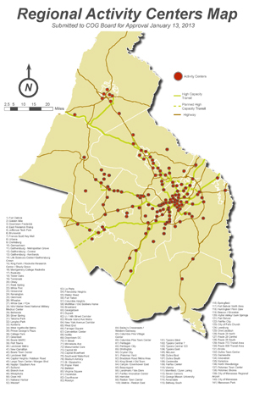
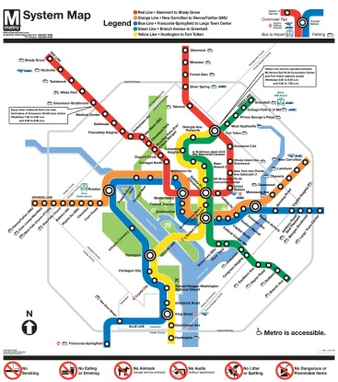
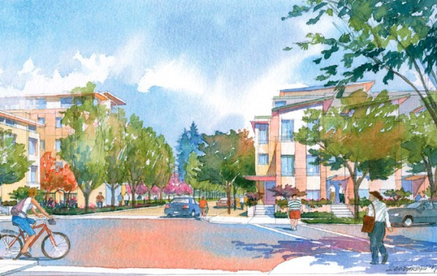
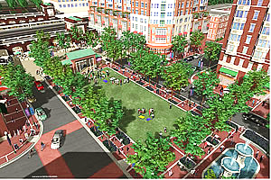
Land Use & Transportation Coordination
Smart Growth Development
Regional Activity Centers
Strategic Investment Plan
Transit-Oriented Development
Regional Transportation Priorities Plan
Transportation-Land Use Connections Program
Bonus Densities
Notes:
Smart Growth Development
Regional Activity Centers
Strategic Investment Plan
Transit-Oriented Development
Regional Transportation Priorities Plan
Transportation-Land Use Connections Program
Bonus Densities

Slide 14
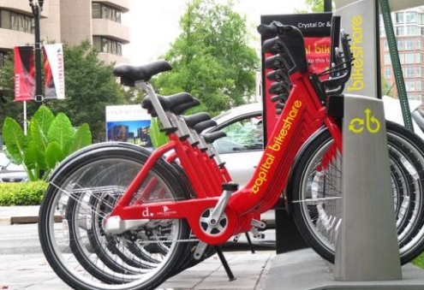

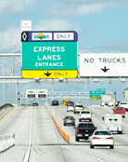
Transportation Options
Public Transit
Bus Rapid Transit & Bus Priority Enhancements
Commuter Rail
Bicycle & Pedestrian Programs
Capital Bike Share
Safety & Infrastructure Improvements
Vehicle Share Programs
Car2Go, Enterprise, ZipCar
Value Pricing (HOT Lanes)
I495 Express lanes, I95 Express Lanes, ICC
Notes:
Public Transit
Bus Rapid Transit & Bus Priority Enhancements
Commuter Rail
Bicycle & Pedestrian Programs
Capital Bike Share
Safety & Infrastructure Improvements
Vehicle Share Programs
Car2Go, Enterprise
Value Pricing (HOT Lanes)
I495 Express lanes, I95 Express Lanes, ICC

Slide 15

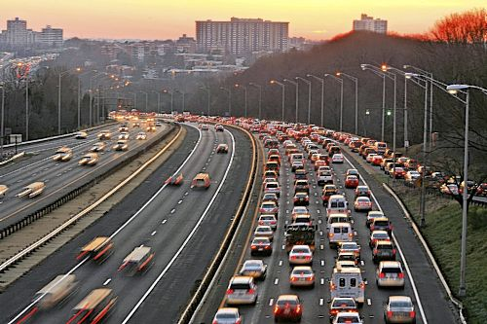
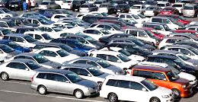


Transportation Demand Reduction
Commuter Connections
Incident Management and Communication MATOC
Telecommuting
Safe Routes to Schools
Notes:
Commuter Connections
Incident Management and Communication (MATOC)
Telecommuting
Parking Management
Safe Routes to Schools

Slide 16

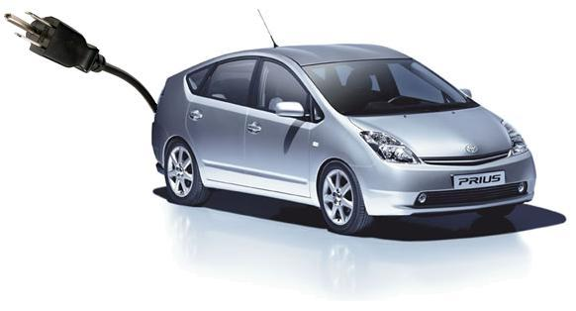
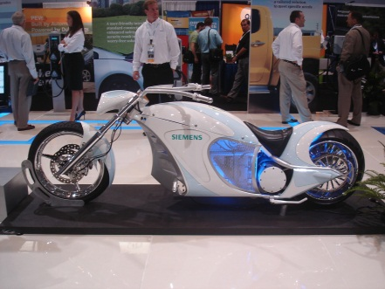
Vehicle Emission Reduction
Low Emission Vehicles & Fleets
Plug-In Hybrids
Electric Vehicles
Compressed Natural Gas Vehicles
Enhanced Idling Enforcement
Virginia Remote Sensing Program
Diesel Retrofits
Notes:
Low Emission Vehicles
Plug-In Hybrids
Electric Vehicles
Compressed Natural Gas Vehicles
Virginia Remote Sensing Program
Voluntary Diesel Retrofit Program

Slide 17

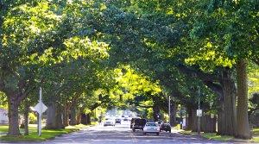
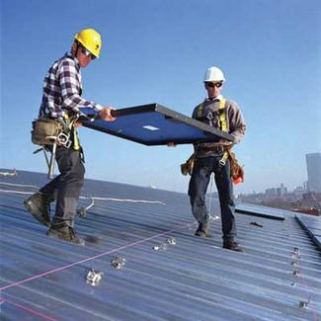
Community Initiatives
Workforce Development & Training
Urban Heat Island Mitigation
Tree Canopy Management
Notes:
Green Purchasing
Green Leasing
Urban Heat Island Mitigation
Regional Tree Canopy Plan

Slide 18

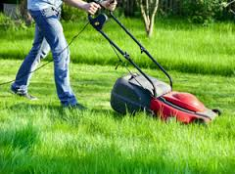
VOC Measures
Behavioral Measures
VOC measures
Low-VOC Paint & Pesticides
Gas Can Replacement Program
Refueling After Dusk
Striping & Pesticide Application Deferred
Episodic Measures
Lawn Mowing Deferred
High Electricity Demand Day Initiative
Notes:
VOC measures
Low-VOC Paint
Gas Can Replacement Program
Pesticides
Refueling After Dusk
Striping & Pesticide Application Deferred
Episodic Measures
Lawn Mowing Deferred
High Electricity Demand Day Initiative

Slide 19
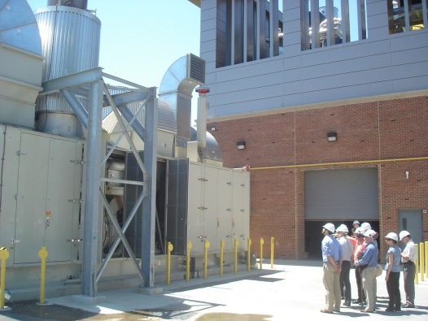
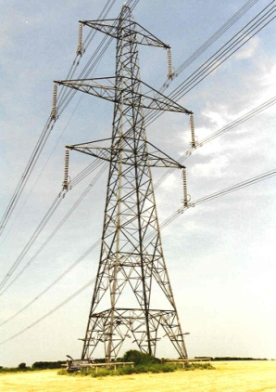

Additional Ideas
Microgrids
Combined Heat & Power
Waste-to-gas & Cogeneration
Improve access to energy efficiency & renewable energy financing
Net Zero Emission Pledges

Slide 20
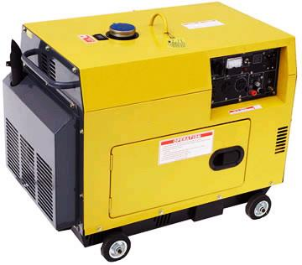
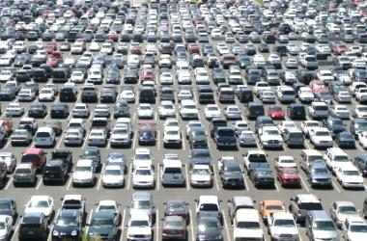
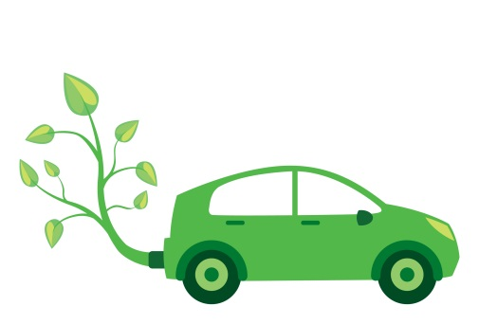
Additional Ideas
Regulate Distributed Generators
Pay-as-you-drive insurance
Eco Driving Programs
Parking management / impact fees
Traffic Signal Optimization
Hoteling

Slide 21
What’s Next?
What are the New Challenges and Opportunities for MWAQC, State, and Local Leadership?
  New Lower NAAQS? 75 => 60-70? By 2015-2020
  Use of Generators on High Electric Demand Days
  Use of Controls on Power Plants
  Low-Level NOx + Transported Pollution
  Addressing Mobile, Area, and Non-road Emissions
Areas of Possible Focus
  Fleet Turnover, Fleet Electrification, CNG
  More Telework, Smart Growth, Green Infrastructure
  Clean Distributed Generation/Intelligent Grid

Slide 22

Schedule:
MWAQC TAC:
Approve Framework & List of Measures - January 7
Review and Comment - February/March 11
MWAQC
Briefing, Review, Comment - February 26
Adopt – May 28

Slide 23
For more information
Contact:
Isabel Ricker
iricker@mwcog.org
202-962-3245
Jeff King
jking@mwcog.org
202-962-3238

