Slide 1
Chesapeake bay program updates
2017 Midpoint Assessment & Phase III WIPs
Tanya Spano, Chief, Regional Water Quality Management Heidi Bonnaffon, Environmental Planner Water Resources Technical Committee September 14, 2018

Slide 2
Bay TMDL Implementation Schedule
Key Actions & Implications for COG Members/COG Region
Final Phase III WIP Planning Targets – July 9, 2018
  Completed – Set the stage for States/District to begin working with locals to develop the Phase III WIPs (updates @ WRTC meeting)
Draft Phase III WIPs (w/ climate - narrative & # option) – April 12, 2019
  States/District need to determine what else needs to be done to meet Bay TMDL goals ‘by 2025’
  May need to evaluate ‘trading in time’ options between sectors scheduled to meet goals vs. those where implementation is lagging
  Policy issues – how done, legal/permit issues & whether truly ‘time limited’
Final Draft Conowingo WIP – June 2019 [may be delayed]
  Still uncertainty re: if/how those load allocations may impact COG region – and Phase III WIPs
  CBPC letter to PSC addressed need for specific local voice/input
WRTC
September 14, 2018
Notes:
15 million pound shortfall for Nitrogen
The implementation of BMPs specifically in the agricultural and urban sectors will need to accelerate to close this gap.
As of 2017, based on the CBP partnership modeling tool estimates, practices are in place to achieve
40 percent of the nitrogen reductions,
87 percent of the phosphorus reductions and
67 percent of the sediment reductions (compared to 2009 levels) that are necessary to attain applicable water quality standards in the Bay
Source: draft Ches Bay Management Strategy document
https://www.chesapeakebay.net/channel_files/26226/2018_3c_water_quality__2018-clean_08-31-18.pdf

Slide 3
Bay TMDL Implementation Schedule
Key Actions & Implications for COG Members/COG Region (continued)
Final Phase III WIPs – August 9, 2019
  Sets level of implementation effort for next ~6-1/2 years
  Will also need to reflect how those load reductions & implementation will need to be maintained over time/after 2025
  Conowingo Loads may have an impact
  Climate Change Loads will not yet have been reflected
Climate Change Loads/Phase III WIP Addendum (beyond narrative)– September 2021
  Questions will be focused on two key areas:
    What are best predictions of Climate Change Impacts on water quality (and the TMDL end goals)?
    How will Climate Change Impacts affect our implementation (i.e. BMPs and other nutrient reduction efforts)?
  Will all of that help or hurt either our expected progress to meet 2025 goals – or our ability to maintain our progress beyond 2025?
Timeframes - Now to 2025 & Beyond 2025 – Priorities? Feasibility?
WRTC
September 14, 2018
Notes:
15 million pound shortfall for Nitrogen
The implementation of BMPs specifically in the agricultural and urban sectors will need to accelerate to close this gap.
As of 2017, based on the CBP partnership modeling tool estimates, practices are in place to achieve
40 percent of the nitrogen reductions,
87 percent of the phosphorus reductions and
67 percent of the sediment reductions (compared to 2009 levels) that are necessary to attain applicable water quality standards in the Bay
Source: draft Ches Bay Management Strategy document
https://www.chesapeakebay.net/channel_files/26226/2018_3c_water_quality__2018-clean_08-31-18.pdf

Slide 4
Midpoint Assessment Results
The Bay Partnership set a goal of having 60% of the needed nutrient and sediment reducing practices in place by 2017, to be on target for 100% reductions by 2025.
The Midpoint evaluation found that the Bay Partnership achieved the 60% goal for phosphorus and sediments, but fell short for nitrogen.
EPA denoted Pennsylvania as having severe issues with being on target in meeting 2025 reductions for the Agricultural and Urban/suburban Sectors.
Maryland is on EPA’s “enhanced oversight,” list and both Maryland and Virginia are expected to have to increase programmatic capacity in the Urban/Suburban Stormwater sector to meet the Phase III WIP targets/Bay TMDL goal by 2025.
WRTC
September 14, 2018
Notes:
15 million pound shortfall for Nitrogen
The implementation of BMPs specifically in the agricultural and urban sectors will need to accelerate to close this gap.
As of 2017, based on the CBP partnership modeling tool estimates, practices are in place to achieve
40 percent of the nitrogen reductions,
87 percent of the phosphorus reductions and
67 percent of the sediment reductions (compared to 2009 levels) that are necessary to attain applicable water quality standards in the Bay
Source: draft Ches Bay Management Strategy document
https://www.chesapeakebay.net/channel_files/26226/2018_3c_water_quality__2018-clean_08-31-18.pdf

Slide 5
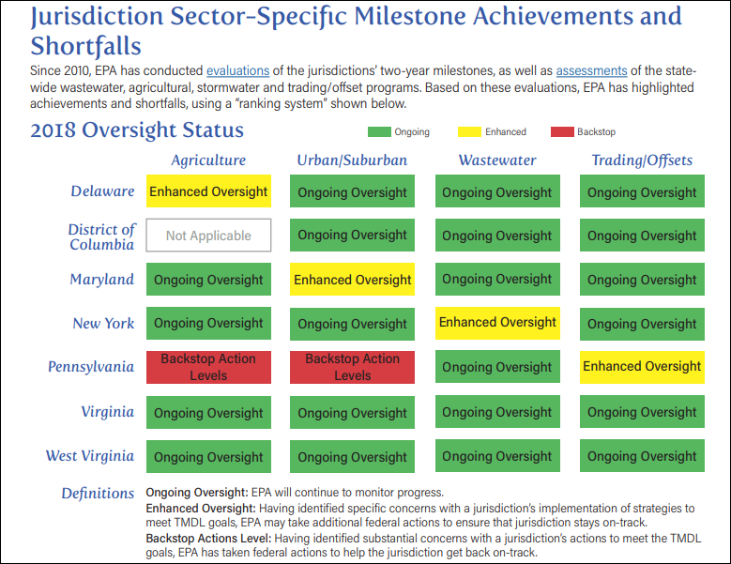
Midpoint Assessment Results
WRTC
September 14, 2018
Notes:
https://www.epa.gov/sites/production/files/2018-07/documents/factsheet-epa-midpoint-assessment-chesapeake-bay-tmdl.pdf

Slide 6
EPA Expectations for Phase III WIP Development
Specify the programmatic and numeric implementation commitments between 2018 and 2025 needed to achieve their Phase III WIP planning targets (financial and technical);
Commit to strategies for engagement of their local, regional, and federal partners in WIP implementation (schedule for involvement, clearly defined roles, BMP verification, etc.);
By 2025, account for changed conditions due to climate change, Conowingo Dam infill and growth; and
Develop and implement local planning goals below the state-major basin scales and in the form best
suited for directly engaging local, regional and federal partners in WIP implementation.
Source: EPA Phase III WIP Expectations document
WRTC
September 14, 2018
Notes:
Bullet 1: financial and technical detail
Bullet 2: schedule for involving partners/locals; clearly define roles; BMP verification protocol is up and running; CAST and other tools made available.
Bullet 3: For climate, initially qualitative climate plans. But expect to update milestones in 2022-2023 to determine climate change impacts to BMPs and develop plans to address these vulnerabilities
Bullet 4: (a) Monitoring data (USGS or local) be used to support local planning goals.
(b) The options include:
Percentage of BMP Implementation on land uses defined in the Phase 6 Watershed Model;
Quantifying implementation goals for particular BMPs;
Programmatic goals (i.e. ordinances with provisions for erosion and sediment control, urban nutrient management, post-construction performance standards) that include specific implementation, oversight and enforcement requirements;
Numeric nitrogen, phosphorus and sediment as expressed as reductions or maximum load goals
Numeric load goals for one or more pollutants (delivered load of 300 lbs. phosphorus) Numeric reduction goals for one or more pollutants (reduce loads by 4000 lbs. nitrogen)
Pace of implementation over a certain time frame;
Percent reduction of existing loads over a certain time frame; and
Percent of flow in certain tributaries/runoff captured – flow-based targets.

Slide 7
Phase III WIP Development
Phase III WIPs are expected to describe the actions jurisdictions will take to have all practices on the ground by 2025 to achieve their respective Phase III planning targets.
To assist the jurisdictions in implementing the Phase III WIPs, the CBP Partnership says it will work to:
  Develop enhanced understanding of BMP performance, siting and design under climate change conditions
  Provide technical assistance & funding to the Bay jurisdictions in Phase III WIP implementation
  Develop and implement a BMP verification program
  Continue to maintain and update Phase 6 modeling tools to reflect advances in understanding and support jurisdictions’ implementation planning and tracking
Phase III WIPs are expected to contain local planning goals
WRTC
September 14, 2018

Slide 8
Phase III WIP Development
The CBP Partnership will update the high-resolution land cover dataset every four years between 2018 and 2025, using state and local data from the CBP Partnership jurisdictions
CBP Partnership is stressing co-benefits in Phase III WIP development: For example, not only addressing water quality, but also other impairments (e.g. bacteria or toxic contaminants), environmental problems (e.g. threatened or endangered species), safety concerns (e.g. flooding, infrastructure) and 2014 Agreement Outcomes (e.g. wetlands, forest buffers).
The CBP Partnership will assure there is use of adaptive management in response to changing conditions based on monitoring, science, and changing land use and climate.
WRTC
September 14, 2018

Slide 9
Climate Change
CBP’s Scientific and Technical Advisory Committee hold a climate modeling workshop on September 24-25th
Climate change modeling will be presented at the November WRTC meeting
The Bay Program’s Climate Resiliency Work Group (CRWG) and the Management Board will be developing guidance for the Phase III WIPs narrative approaches.
The Management Board has requested the CRWG to prioritize climate change research needs: We could offer suggestions
CBPC will be requesting local involvement in the decisions about qualitative climate change milestones at their September 21st Forum
WRTC
September 14, 2018

Slide 10
Tanya Spano Chief, Regional Water Quality Management (202) 962-3776 tspano@mwcog.org Heidi Bonnaffon Environmental Planner (202) 962-3216 hbonnaffon@mwcog.org | mwcog.org
777 North Capitol Street NE, Suite 300 Washington, DC 20002

