Slide 1
Metropolitan Washington council of governments
European Parliament Liaison Office
Jeff King, Chief, Energy and Climate Department of Environmental Programs November 14, 2019

Slide 2
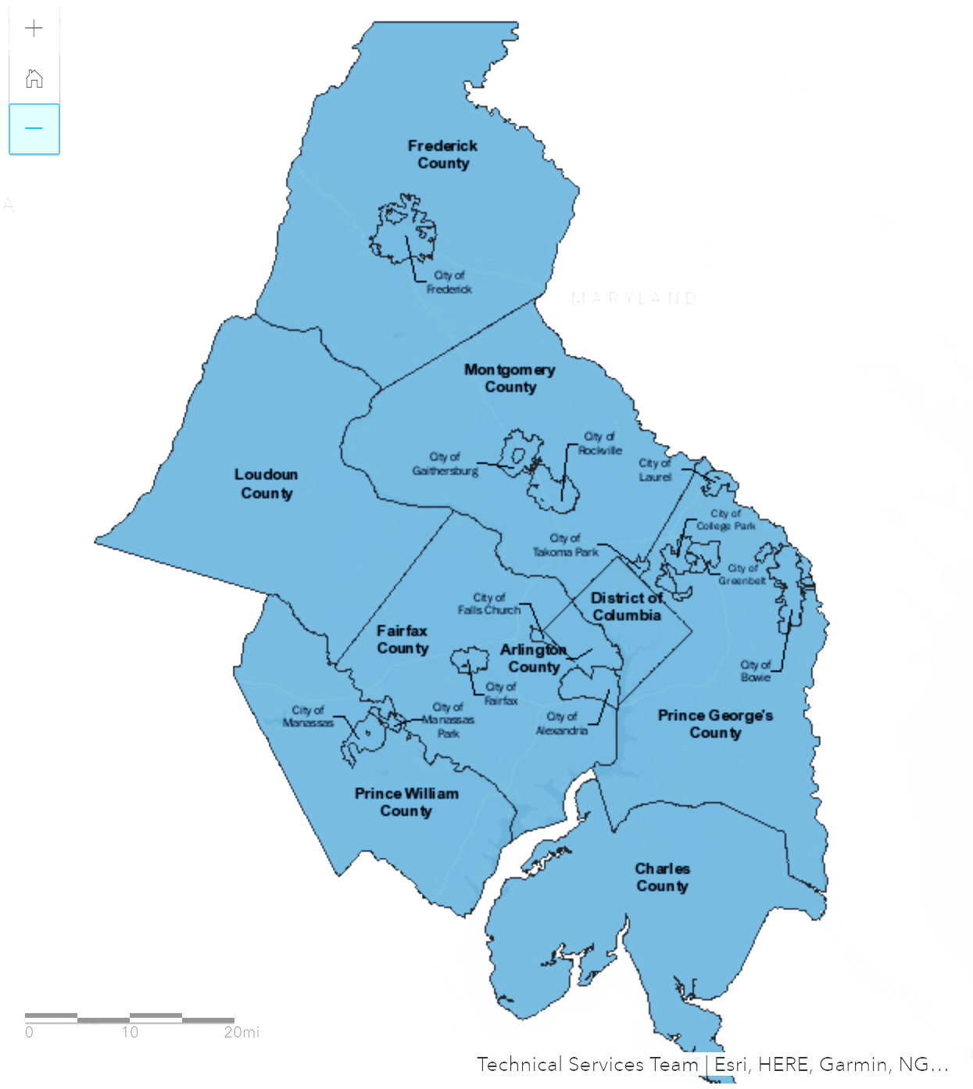
About COG
The Metropolitan Washington Council of Governments (COG) is an independent, nonprofit association of governments
Addresses regional issues
  Transportation
  Environment
  Community Planning
  Public Safety & Homeland Security
300+ elected officials from 24 local governments
Region Forward Vision
  Prosperous, Accessible, Livable, Sustainable

Slide 3
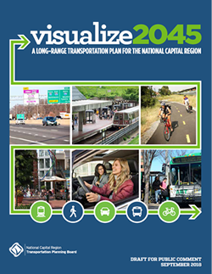
Transportation Planning
The National Capital Region Transportation Planning Board (TPB) is the federally designated Metropolitan Planning Organization (MPO) for the region
The TPB prepares plans and programs providing regional coordination in transportation planning and for federal transportation funds to flow to the region
The long-range transportation for the region – Visualize 2045
Planning areas include roads, transit, walking, biking, freight, airports, land use coordination, air quality conformity, management & operations safety, performance-based planning and fairness & accessibility

Slide 4
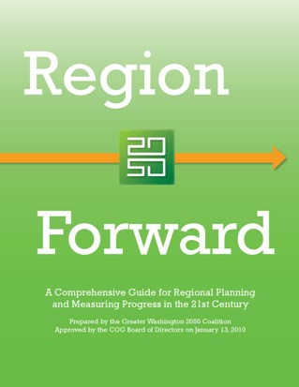
Community Planning
Region Forward – the region’s vision to shape more livable and prosperous communities
Regional cooperation on planning, the economy, and housing for all residents; population, employment, and housing forecasts; shares best practices and data on affordable housing and homelessness
COG proposes strategies to support sound land use and high-quality development in Activity Centers—the locations that can best accommodate the region’s growth
COG and its members also coordinate on public health and child welfare programs

Slide 5
Homeland Security & Public Safety
Increases the region’s ability to detect, prepare, train for, and respond to man-made and natural threats
Works with police chiefs, fire chiefs, and other first responders to address
  Homeland Security – regional priority setting, mutual aid, supporting emergency communication and coordination, and emergency training, exercises & after action assessments
  Public Safety Coordination – Planning for emergency response, information sharing and crime prevention, and addressing regional issues such as gangs, drunk driving & fire safety
  Emergency Communication – Enhance emergency communication through the Regional Incident Communication and Coordination System (RICCS), regional calls for emergency management, and support for 911 & citizen warning systems

Slide 6
Summary of Current Forecast (Round 9.1)
COG / TPB Planning Area (Thousands)
 |  |  |  | 2015 to 2045
 |  | 2015 | 2045 | Number | Percent
Employment |  | 3,160.8 | 4,273.8 | 1,113.0 | 35%
Population |  | 5,390.6 | 6,925.7 | 1,535.1 | 28%
Households |  | 2,011.7 | 2,659.9 | 648.2 | 32%
Notes:
Cooperative Forecasts will be used as land use inputs for this year’s Air Quality Conformity Analysis.
Cooperative Forecasts will be used for Travel Modeling
The Round 8.3 Cooperative Forecast will be used to analyze the 141 Activity Centers

Slide 7
Challenges from Economic Growth
Land Use & Housing
  Affordability
  Proximity to jobs
  Activity Centers
Land Use & Transportation
  Expansion and Maintenance - Funding
    Roads
    Transit
  Congestion
  Access to Jobs
Environmental Sustainability
  Water, Air, Energy, Climate
  Agriculture, Forestry
  Waste Management

Slide 8
Uncertainties
Federal Government
  Spending
  Relocation
Mobility
  Electric Vehicles
  Autonomous Vehicles
  Freight
Energy
  Grid Modernization/Microgrids
  Solar with Storage
  Fracking, Natural Gas
  Greenhouse gas emission regulation

Slide 9
Environmental Goals
Air Quality
  Ensure no unhealthy air quality days to protect the public health
Water Quality
  Ensure clean rivers & streams and a safe, resilient drinking water supply
Energy & Climate
  Conserve energy and increase use of clean energy sources to reduce greenhouse gas emissions
Waste Management
  Minimize waste generation and provide for safe, cost-effective collection, diversion or disposal

Slide 10
Region Forward: Measuring Progress
Sustainability Targets — April 2018
TARGET | By 2020, construct 5,000 certified green buildings (Target revised to show number of high-performance buildings. The data on square footage of LEED commercial construction is no longer available) | By 2020, reduce regional greenhouse gas emissions by 20% below 2005 levels | Beginning in 2014, the region’s air quality will be improving and ambient concentrations will be reduced below federal standards (0.70) | The region will identify, conserve, and enhance a network of protected open spaces, parks and green infrastructure to provide ecological benefits, wildlife habitat, recreational opportunities, and scenic beauty | By 2050, 50% of all sentinel watersheds will be in good or excellent condition | By 2025, achieve 100% of Chesapeake Bay Program’s Water Quality Implementation Goals | Beginning in 2012, the region will maintain more than 497,500 acres of its area for agricultural uses
LATEST ESTIMATE | 3,553 | 10% | 0.72 | 26% | Data not updated since 2010 | 100% | 498,946
TREND | ⬆ | ⬇ | ➔ | ➔ | Not Determined | ⬇ | ⬇
MEET / DO NOT MEET TARGET | ✓ | ✗ | ✗ (Attaining 2008 Ozone standard, long-term trend down) | ✗ | Not Determined | ✓ (Measures current attainment of TMDL wastewater nutrient limits) | ✓ (Original 450,000 acre goal adjusted to include Charles County)
SOURCE/ LATEST DATA | COG's 2020 Regional Climate and Energy Action Plan, 2016 | Draft COG Greenhouse Gas Inventories, 2005, 2012, 2015 (report and fact sheet will be published this summer) | EPA Design Value Reports - https://www.epa.gov/air-trends/air-quality-design-values, 2016 | Chesapeake Bay Program GIS data - https://www.chesapeakebay.net/what/data, 2015-2016 | Chesapeake Watershed stream health data - http://www.chesapeakeprogress.com/abundant-life/stream-health | Chesapeake Bay Total Maximum Daily Load (TMDL) Tracker, https://tmdl.chesapeakebay.net/ | USDA Census of Agricultural - https://www.agcensus.usda.gov/, 2012

Slide 11
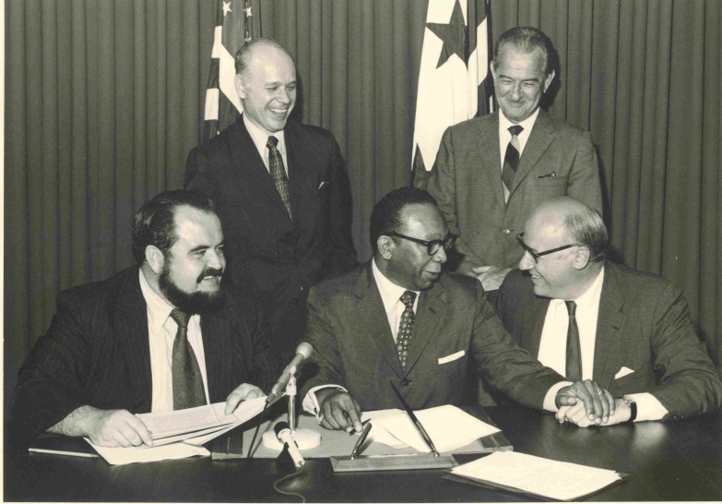
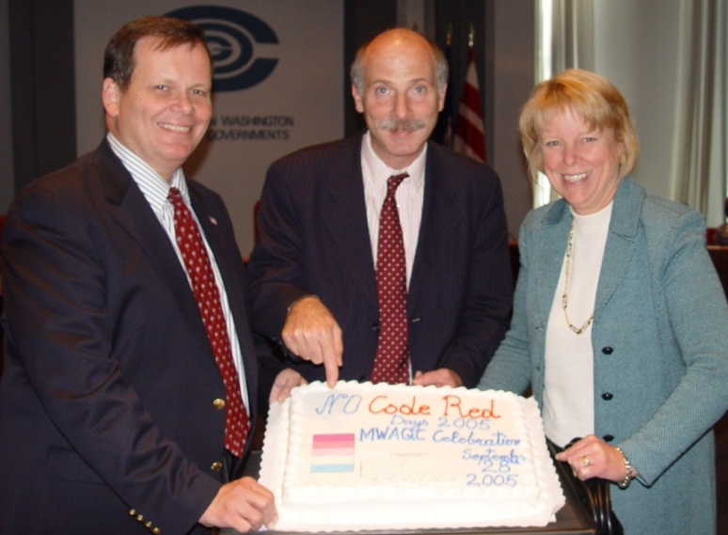



Long History of Delivering Clean Air
“They truly can be proud of the efforts they have made and the achievements that have resulted.”
Remarks on signing the Clean Air Act, President Lyndon Johnson, December 1963
Air Pollution Control Act 1968
No Code Red Days 2005

Slide 12
Air Quality Program Framework
Federal
  National Ambient Air Quality Standards (NAAQS) for criteria pollutants
    O₃, PM_{2.5}, CO, Pb, NO₂, SO₂
  Non-attainment area designations
    State Implementation Plan (SIP) and Maintenance Plan Requirements
  Sector/source regulations
    NO_{x}, VOC, SO₂, CO, CO₂ Pb, hazardous air pollutants
State
  Develop State Implementation Plans (SIPs)
  State regulatory programs
    Permit major & minor sources, vehicle inspection & maintenance (I/M)
Super-Regional
  Ozone Transport Commission (OTC)
  National Association of Clean Air Agencies (NACAA)
  Mid Atlantic Regional Air Management Association (MARAMA)
  Northeast States for Coordinated Air Use Management (NESCAUM)

Slide 13
Public Education
Clean Air Partners
  Public-private partnership
  Educating individuals, businesses, and organizations in the greater metropolitan Baltimore-Washington region about health risks associated with poor air quality and the impacts on our environment
  Actions individuals can take to reduce air pollution
  Public notices
    Daily air quality forecasts
    Unhealthy air quality notices
COG Environmental Quality Dashboard
AirNow.gov
State environmental agencies
  District Department of Energy and Environment
  Maryland Department of the Environment
  Virginia Department of Environmental Quality

Slide 14
Air Quality Monitoring
Air Monitoring
  Major Criteria Pollutants – ozone, fine particles (PM_{2.5}) - Regionwide
  Other Pollutants – carbon monoxide, lead, nitrogen dioxide, PM₁₀, SO₂, air toxics
  PM_{2.5} speciation monitors
  Hazardous Air Pollutants – Source specific (e.g., mercury)
Emission Sources
  Smokestack Continuous Emissions Monitoring (CEMS)
  Roadside Monitoring
  Tailpipe Vehicle Inspection/Maintenance (I&M)
Federal Requirements
  Number and location of monitors
  State and local Air Monitoring Stations (SLAMS)
  Clean Air Status and Trends Network (CASTNET)
  Chemical Speciation Network
  Federal Reference Method (FRM)
  Federal Equivalent Method (FEM)
  EPA Clean Air Markets Division (CAMD)

Slide 15
Air Quality Monitoring

Slide 16
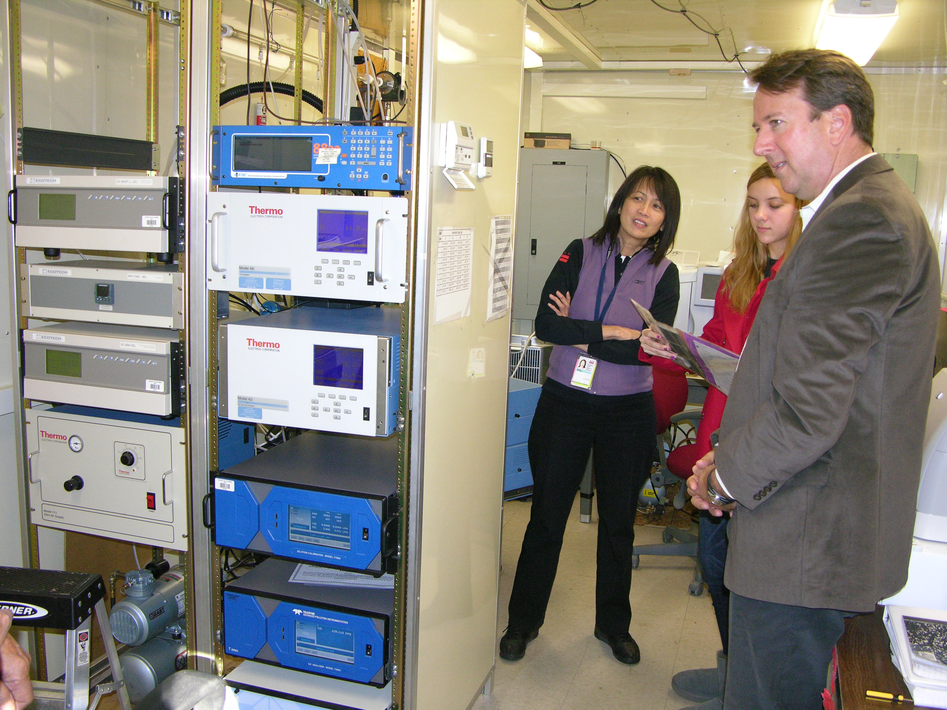
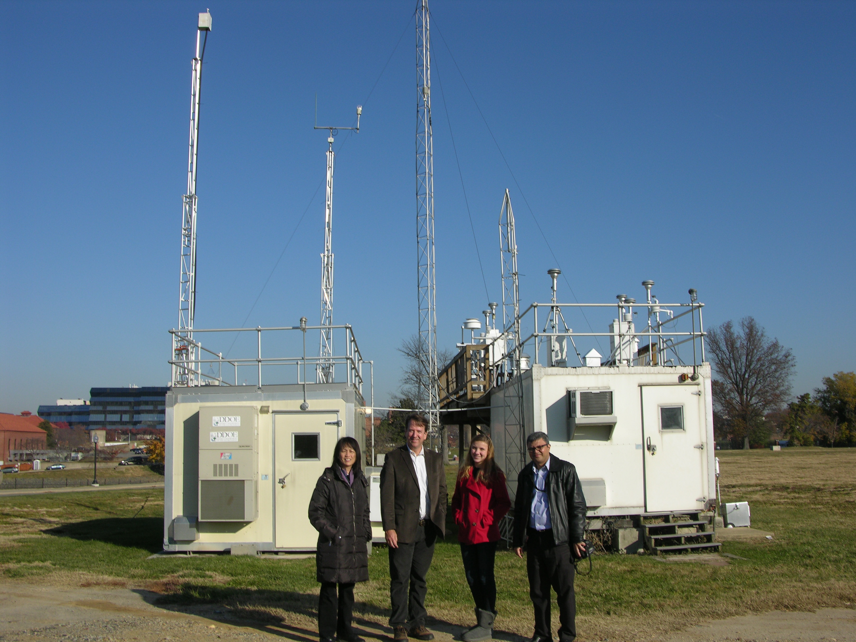
Air Quality Monitoring

Slide 17
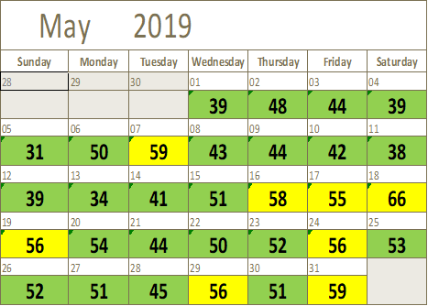
Peak 8-Hour Average Ozone Levels (ppb)
1 Code Orange Day, 26 Code Yellow Days, 68 Code Green Days
Analysis is based on draft and incomplete data as of June 4, 2019.

Slide 18
Ozone Exceedance Days

Slide 19
Air Quality Design Value
Calculation
Record hourly readings from all monitors in the region
Each monitor records a maximum 8-hour average for each day
Average the 4th highest reading for each monitor for each year for the most recent 3 year period
Design Value is the highest 3-year average 4th highest concentration from any single monitor in the region

Slide 20
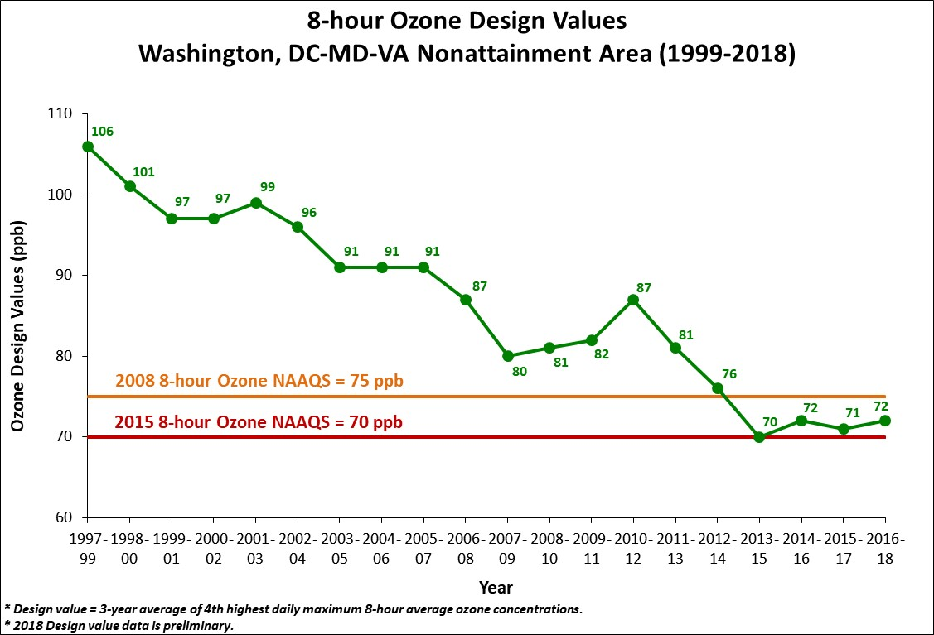
Ozone Design Value Trend

Slide 21
Why Fewer Exceedance Days Now ?
Emission Control Programs
Federal | State | Local
Acid Rain Program (1996/2000) | Vehicle Inspection & Maintenance Programs | Renewable Energy Programs Regional Wind Power Purchase Program Clean Energy Rewards Program Renewable Portfolio Standards
Tier 2 (LD Vehicle) Rule (2004) | Maryland Healthy Air Act (2009/2012) | Energy Efficiency Programs LED Traffic Signal Retrofit program Building Energy Efficiency Programs
HD Diesel vehicle Rule (2004/2007) | Virginia CSAPR Rule | VRE Idling Reduction
NOX SIP Call (2004) | Ozone Transport Commission Rules | LOW VOC Paint
CAIR/CSAPR/CSAPR Update (2009/2015/2017) |  | Gas Can Replacement

Slide 22
24-Hour Average PM2.5 Levels (µg/m³)
23 Code Yellow Days, 72 Code Green Days
Analysis is based on draft and incomplete data as of June 4, 2019.

Slide 23
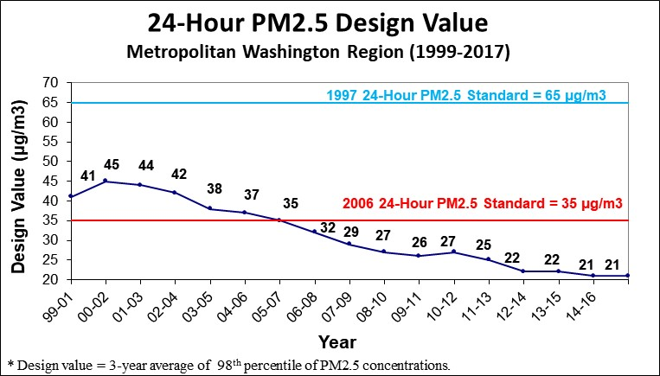
24-Hour PM2.5 Design Value Trend

Slide 24
PM2.5 Exceedance Trend
Analysis is based on draft and incomplete data as of June 4, 2019.

Slide 25
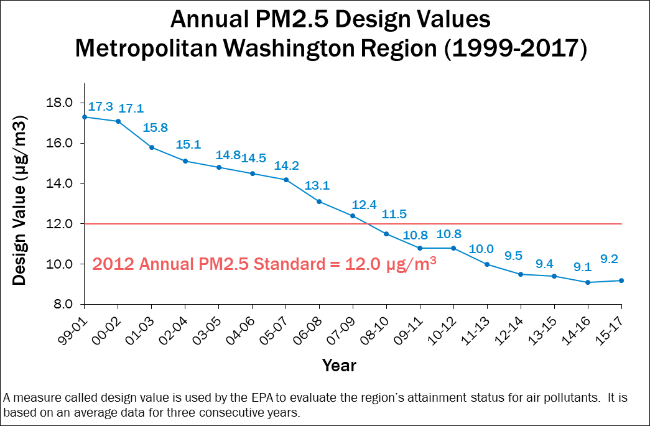
Annual PM2.5 Design Value Trend

Slide 26
Water Monitoring
WATER
Focus
  Comply with federal water quality standards
  Assess effectiveness of best management practices (BMPs)
  Determine trend in stream/river health
Drinking Water
  Test for giardia, cryptosporidium, lead
  Chlorine/Chloramine to disinfect
  Orthophosphate for corrosion
Stormwater - State MS4 Permit Requirements
  Urban streams
  Watershed
Wastewater – Total Maximum Daily Load (TMDL)
  Pretreatment
  Continuous monitoring
  Process, outfalls
  Combined sewer overflows
Pollutants and Other Areas of Interest
  Chemical, biological, flow
  Total Kjeldahl Nitrogen, Total Phosphorous, Ammonia-Nitrogen, Sediment
  Stream erosion, temperature, dissolved oxygen
  Biological oxygen demand (BOD)
  Bacteria, Benthic organisms

Slide 27
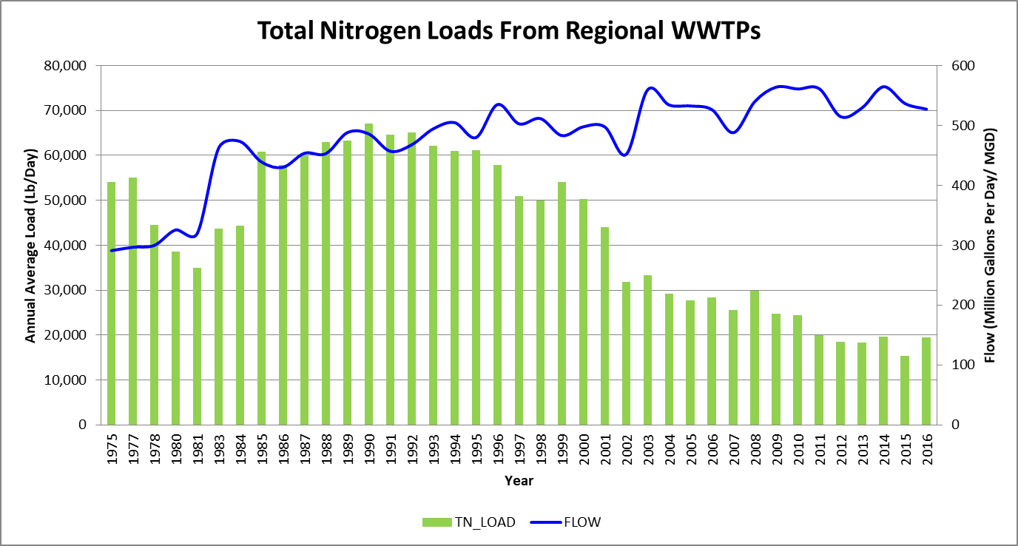
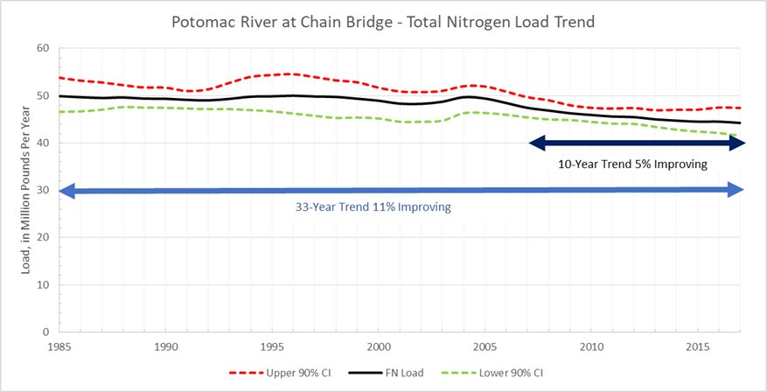
Water Quality

Slide 28
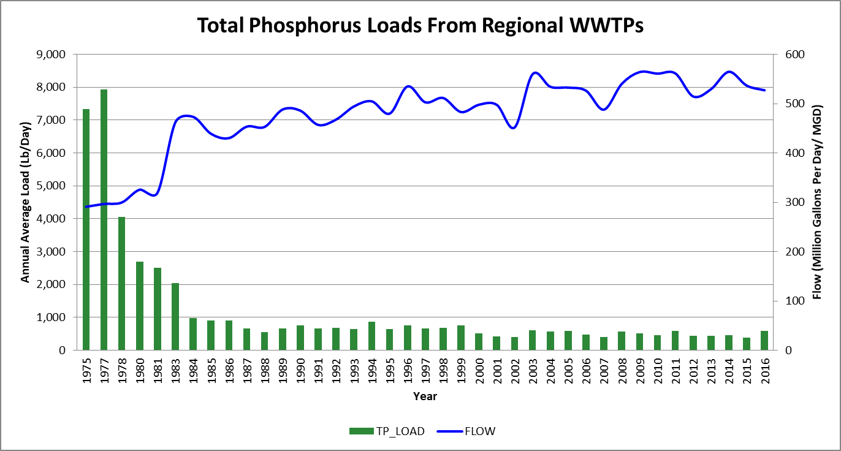
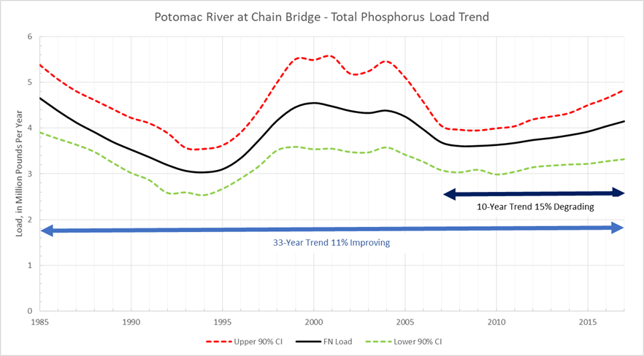
Water Quality

Slide 29
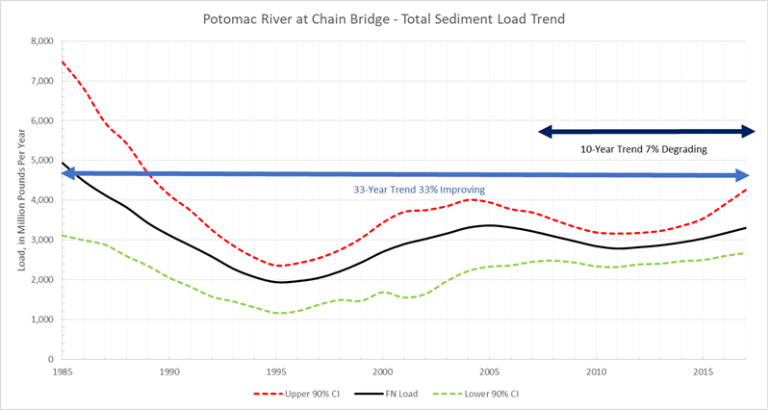
Water Quality
Potomac River Shad

Slide 30
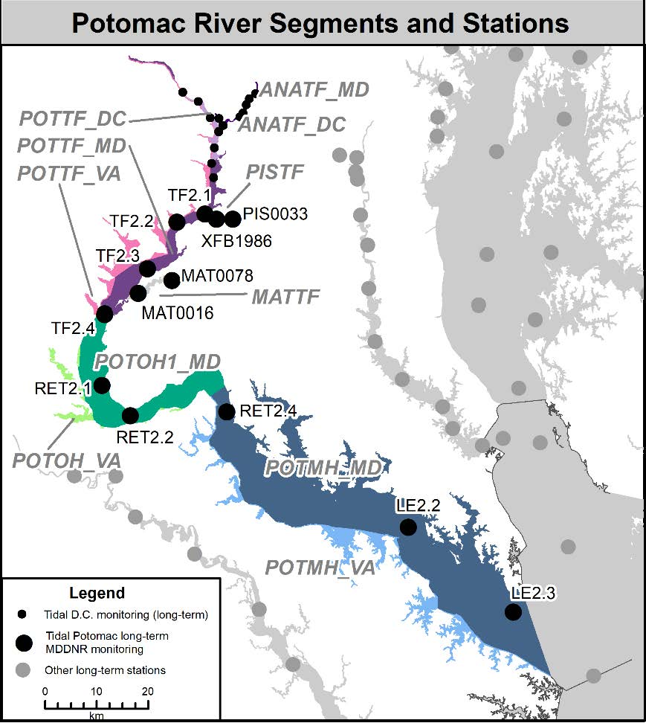
Water Quality

Slide 31
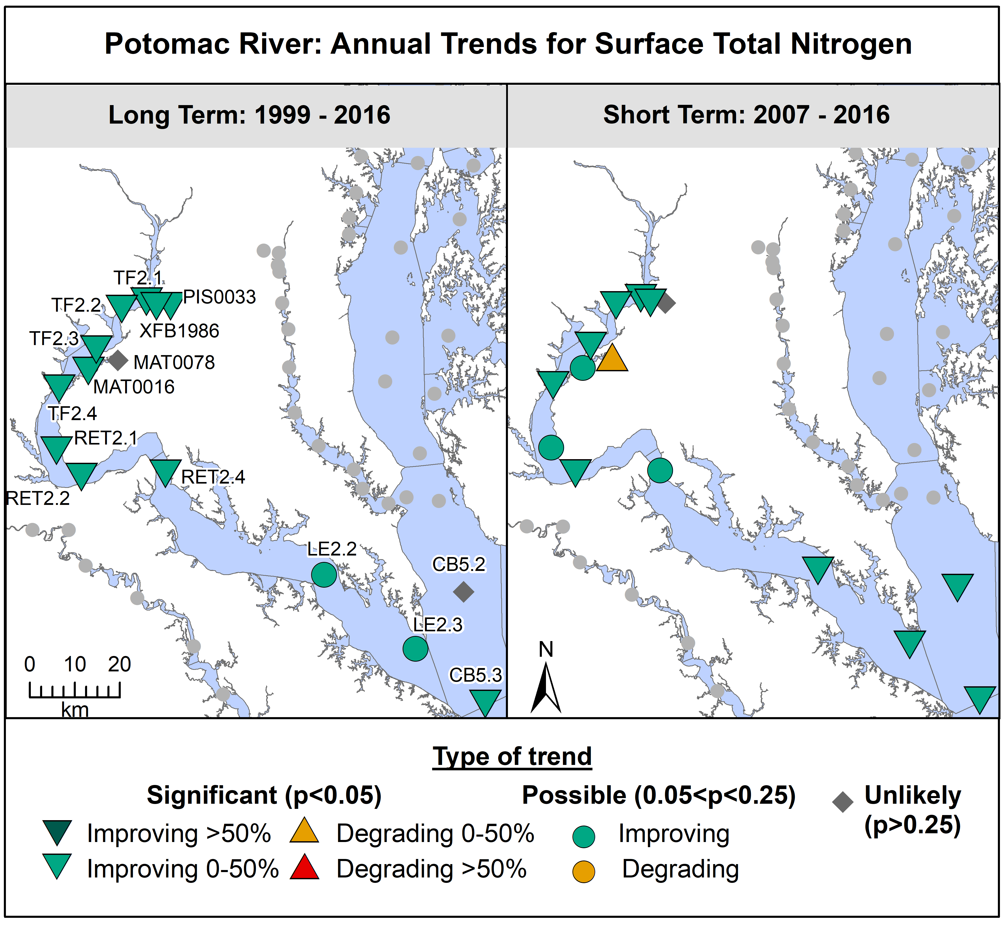
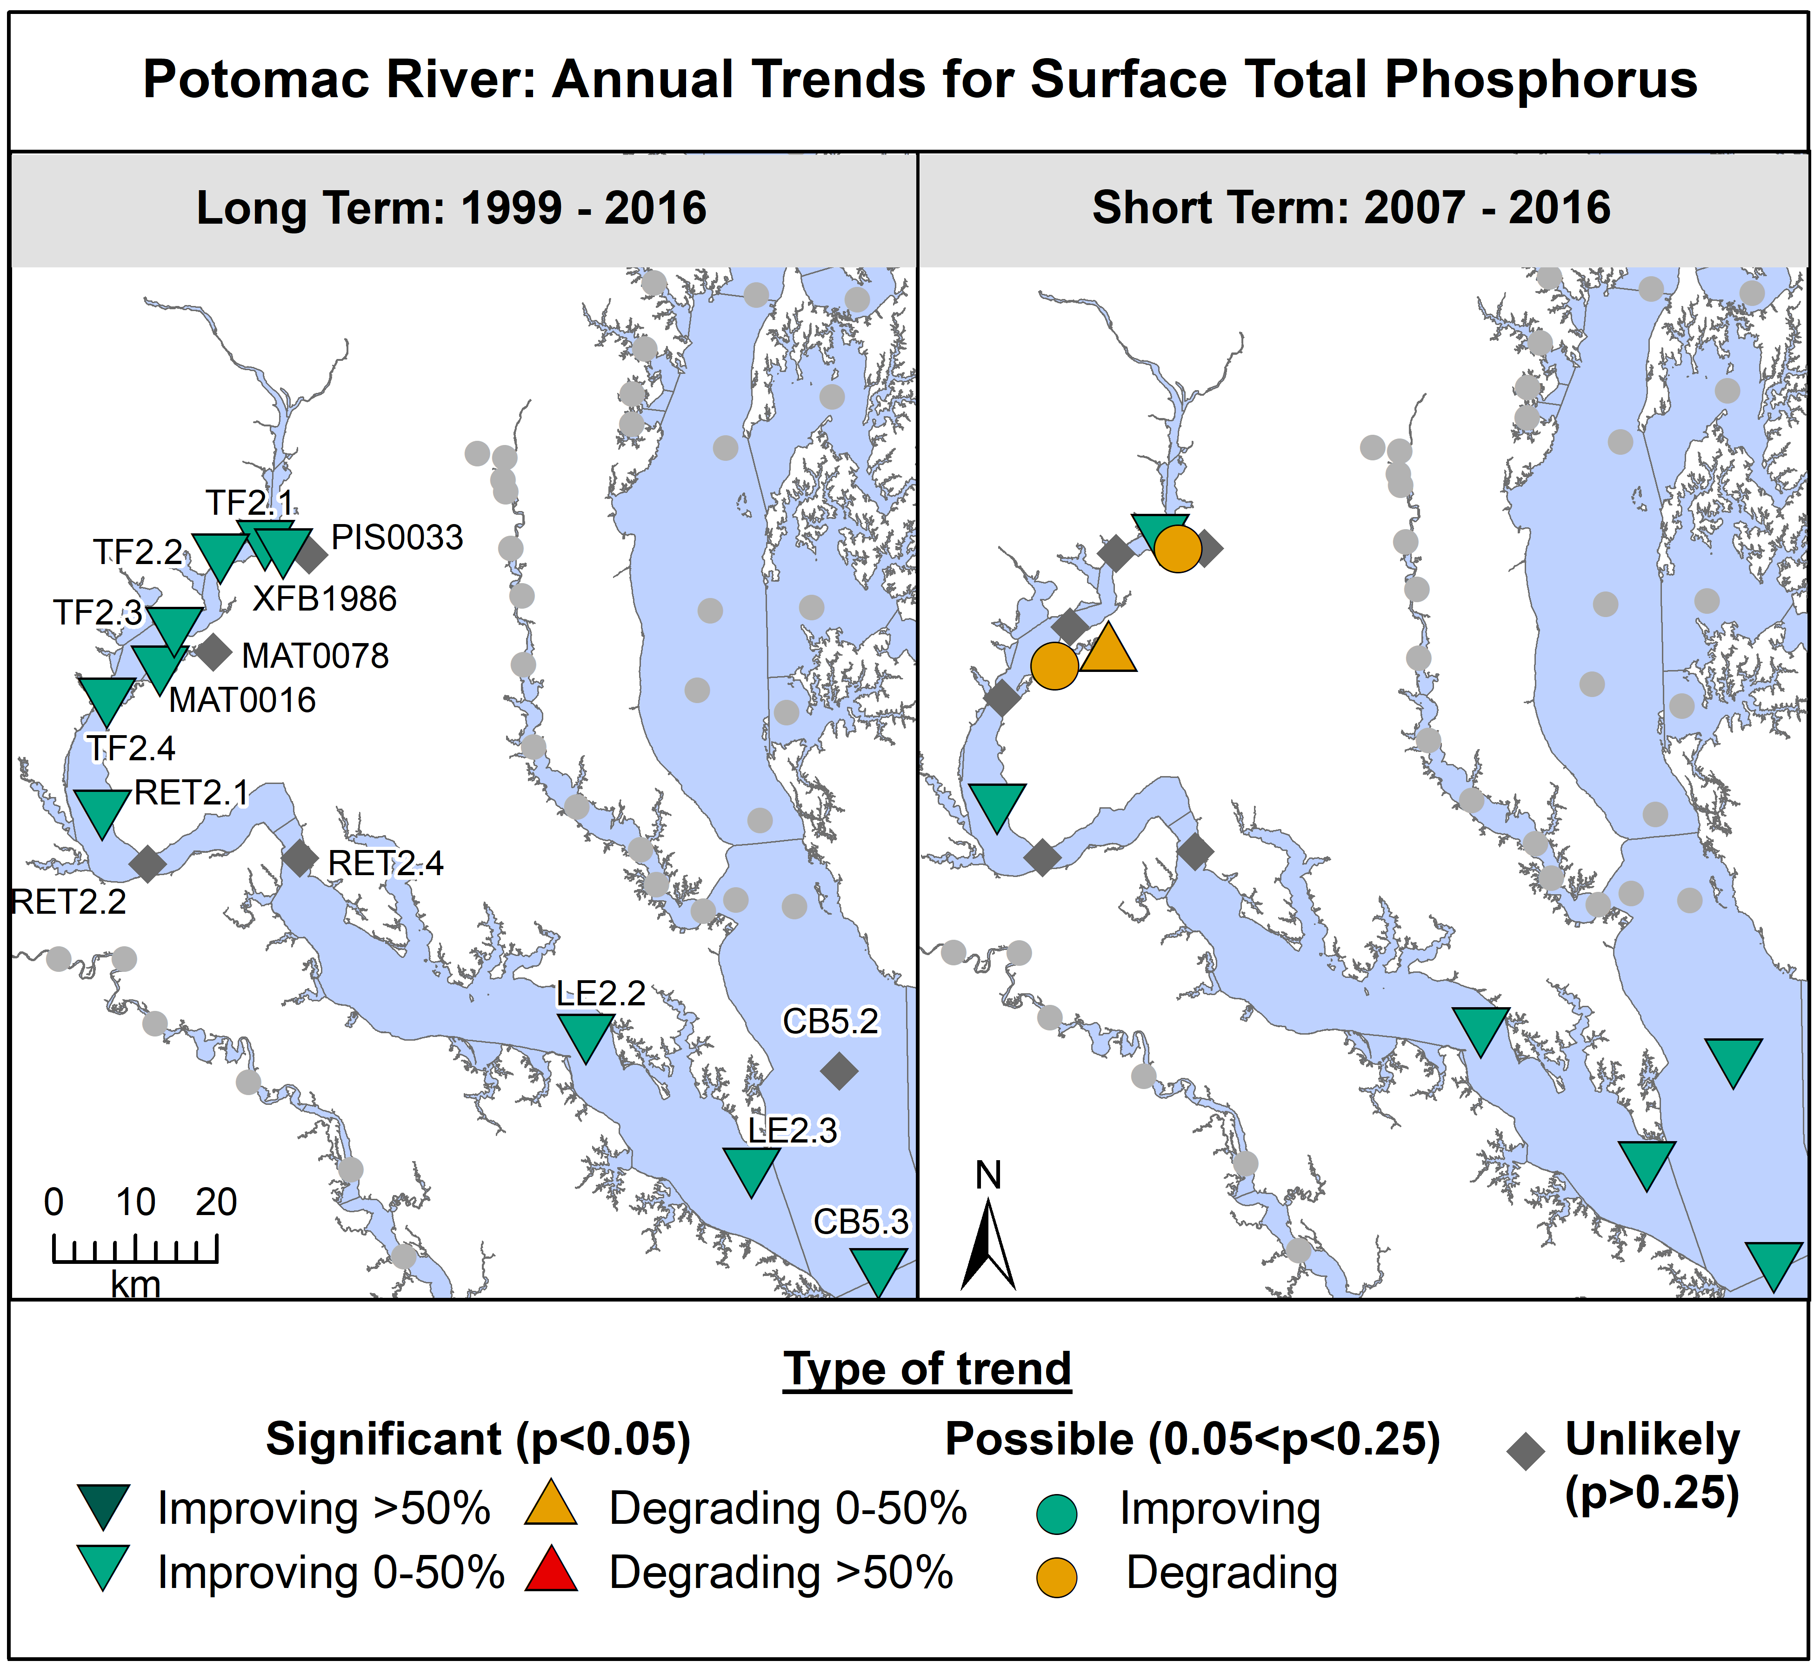
Water Quality

Slide 32
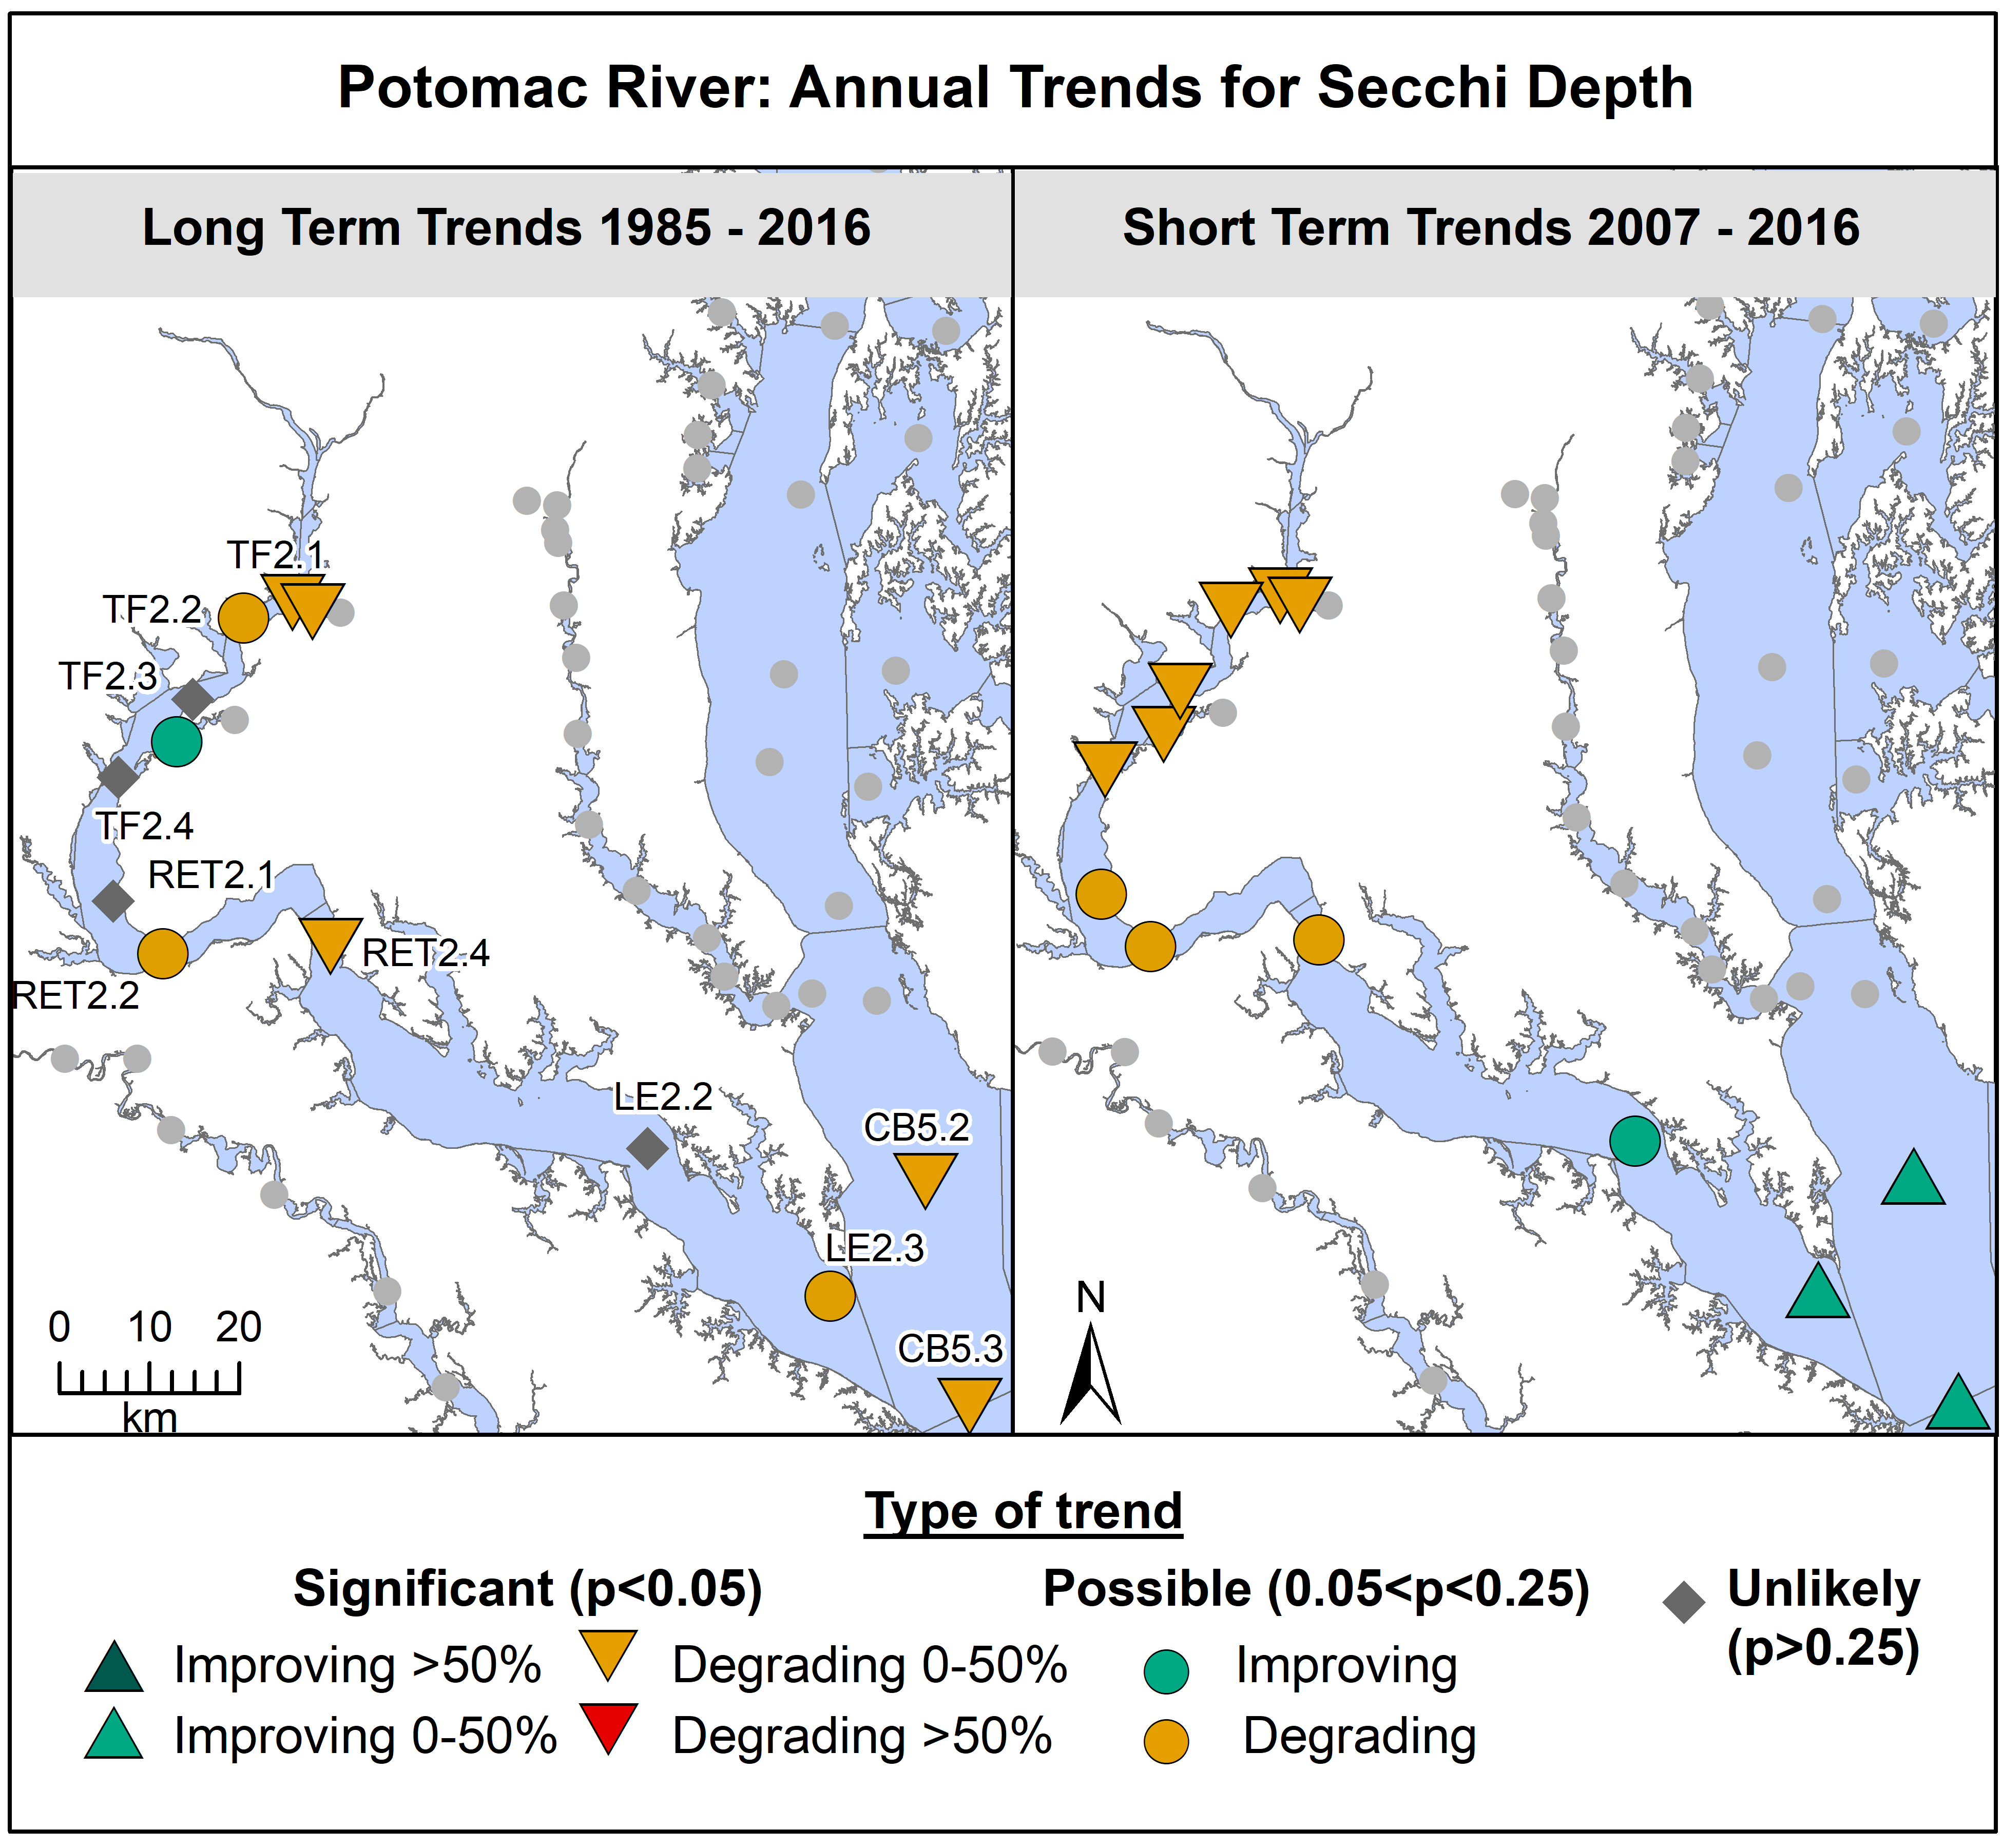
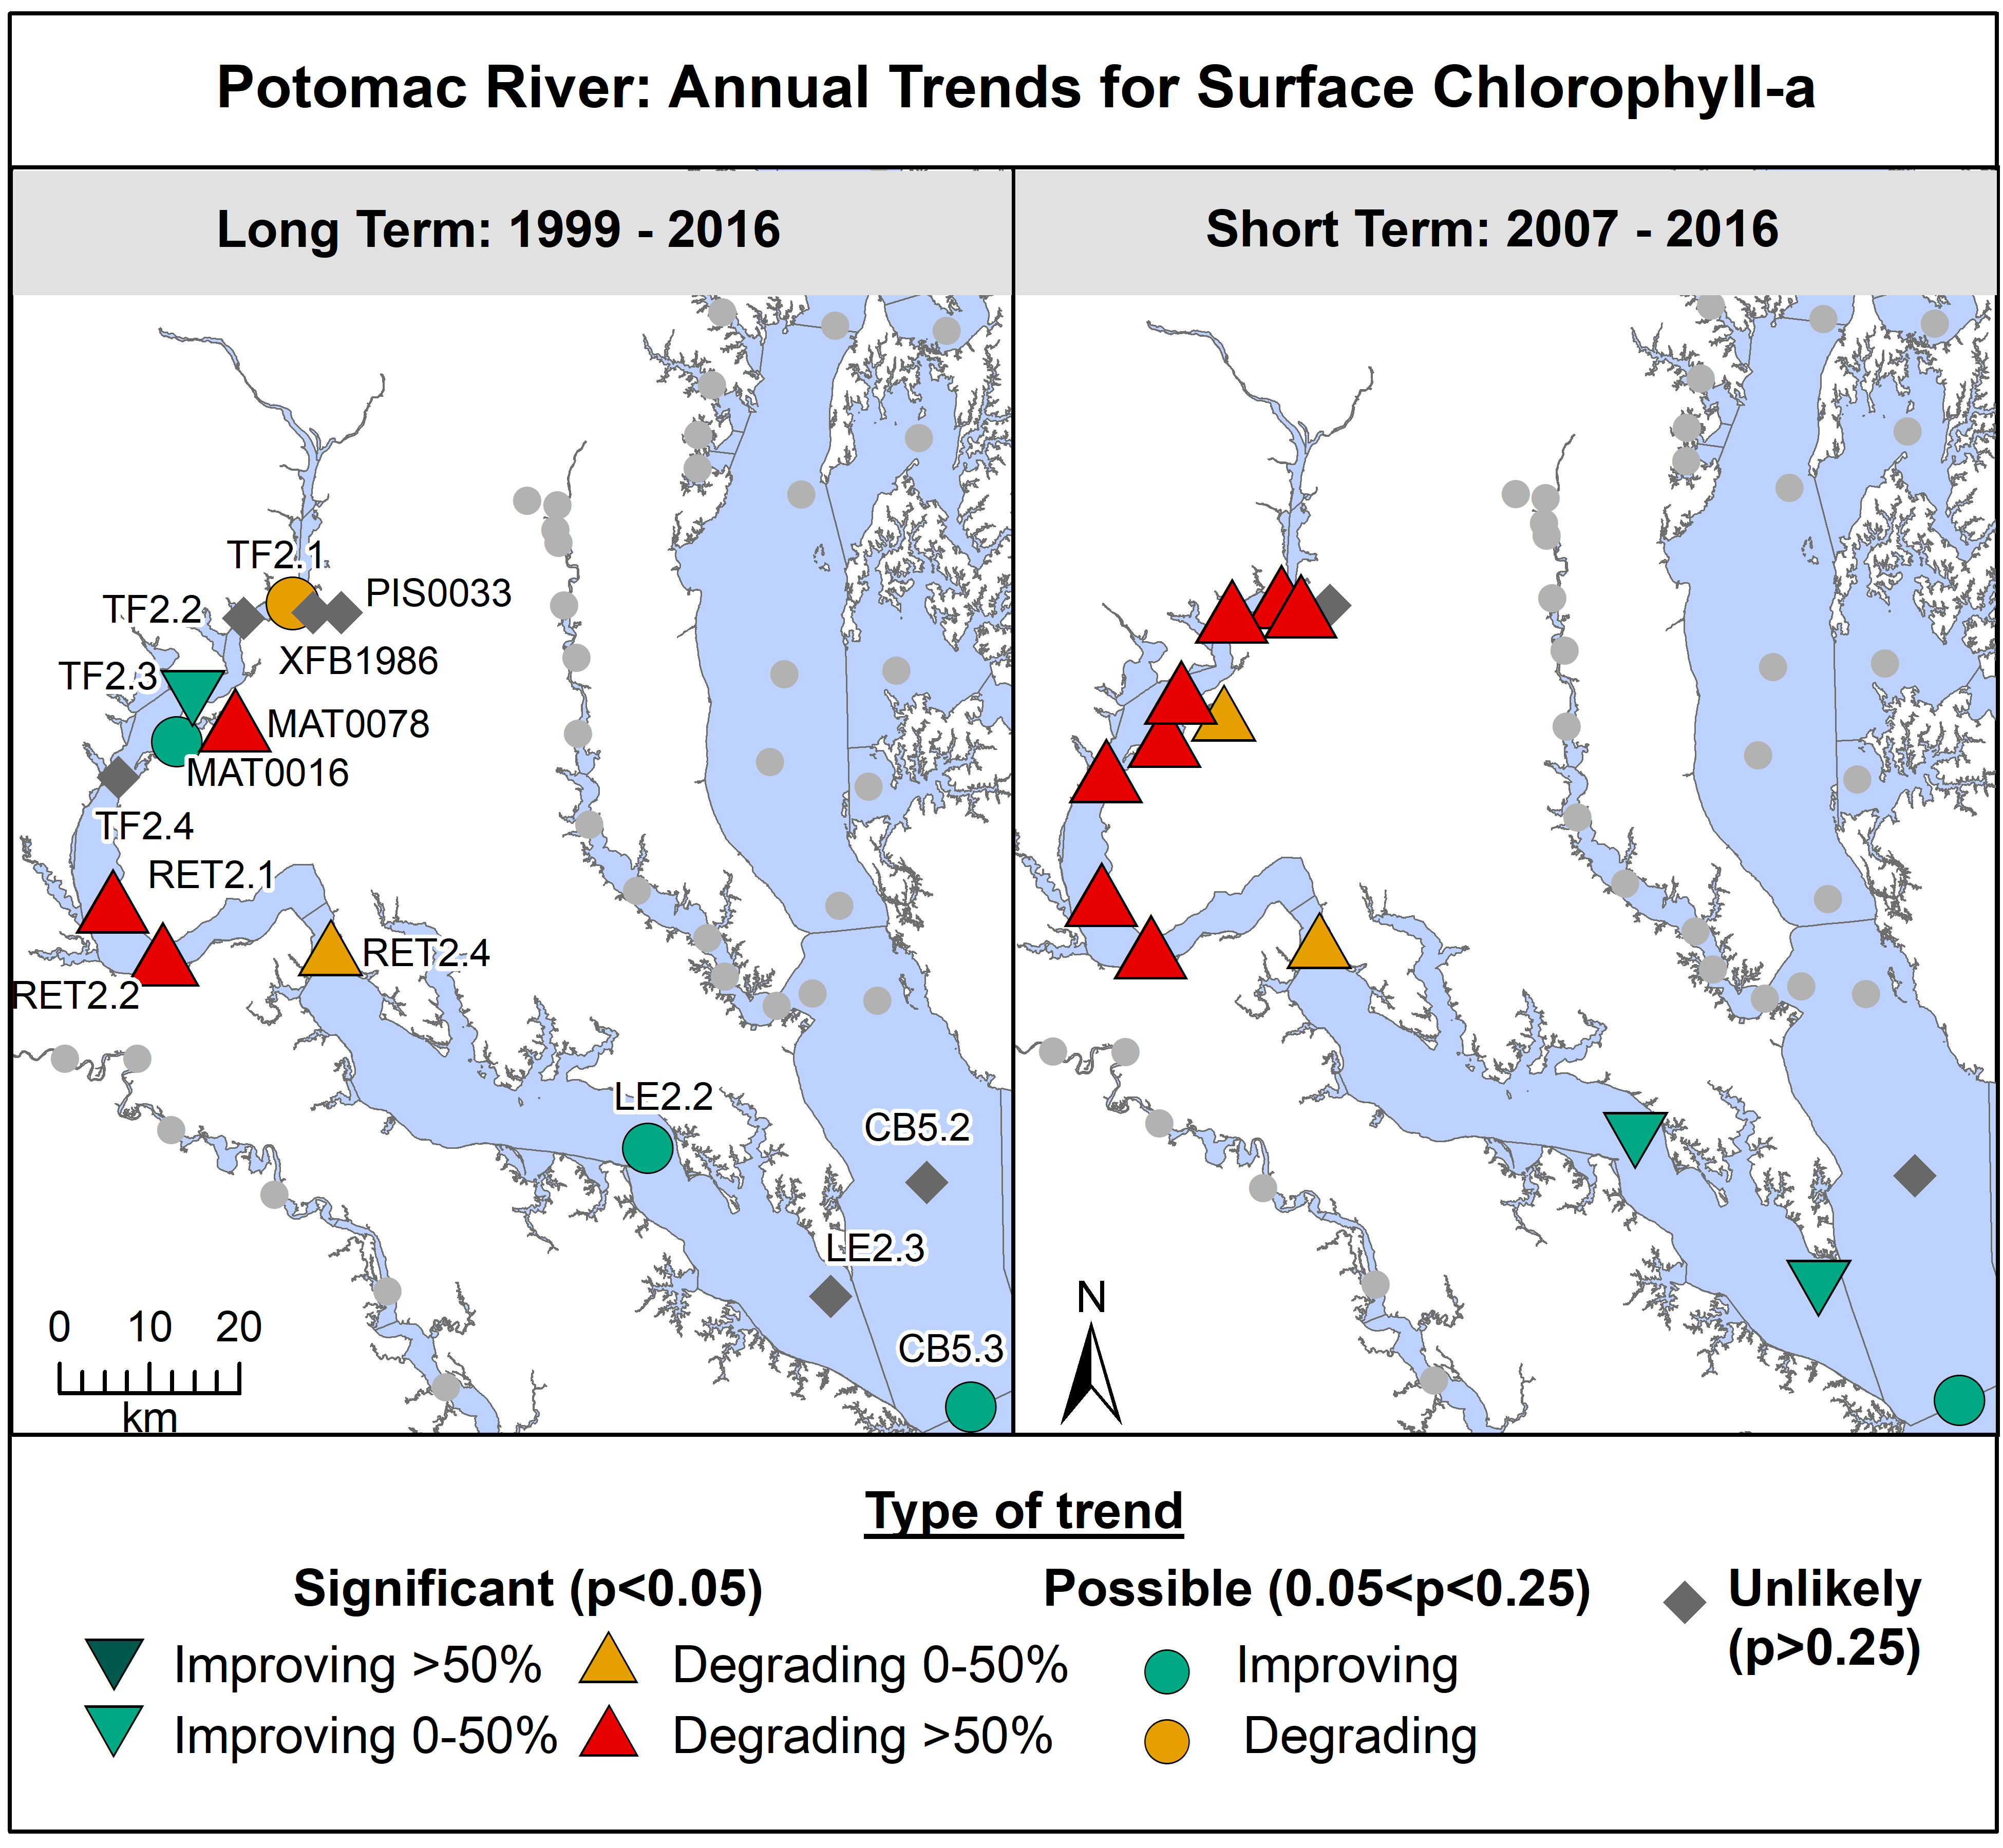
Water Quality

Slide 33
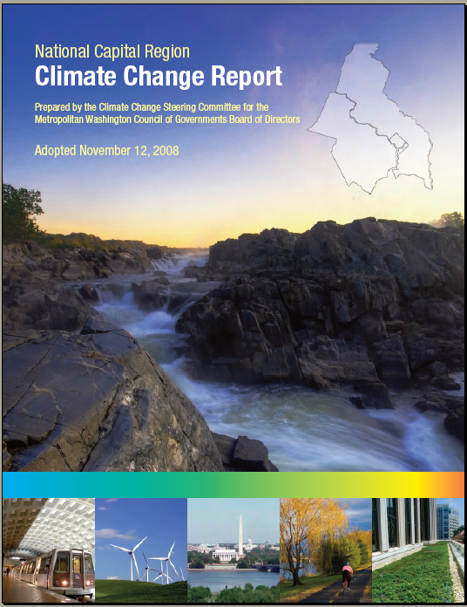
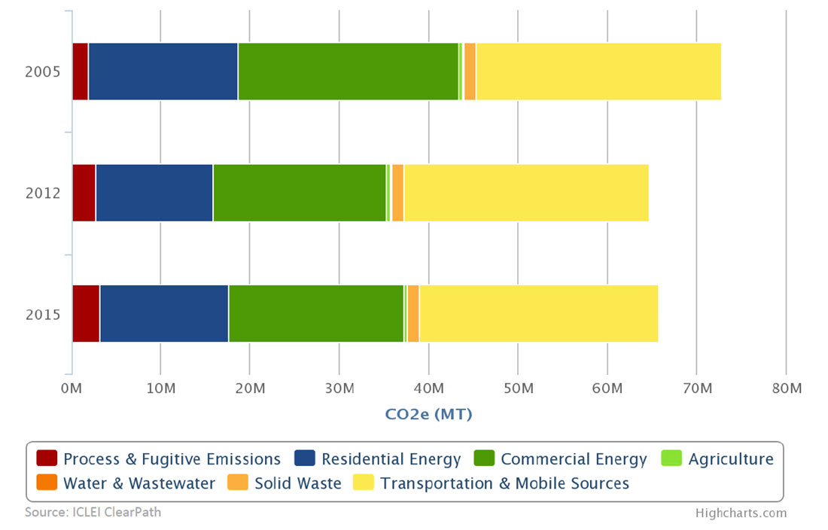
Energy and Climate Planning
Mid-2000s Recognize Problem
2008 Regional Climate Report
  Regional Goals
  Policy Committee
  Regional Environmental Fund
Climate & Energy Action Plans
Learning, Networking & Coordinating
  Climate, Energy & Environment Policy Committee
  Technical & Citizen Advisory Committees
  Partnerships
Leveraging Co-Benefits
Greenhouse Gas Emissions Inventory

Slide 34
Energy and Climate Planning
2017-2020 Climate & Energy Action Plan
  Reduce Energy Consumption
  Increase Share of Renewables
  Advance Sustainable Regional Mobility
  Increase Sustainable Urban Development
  Move Towards Zero Waste
  Build Regional Resilience
  Protect Equity and Health
  Grow the Regional Economy

Slide 35
Energy and Climate Action
Greenhouse Gas Inventory
  Drivers of Change
Utility Energy Data
Solar
  Policy & Regional Goals
  Coops & Solarize
Alternate Fuel Vehicles
  Clean Cities Coalitions Cooperative Procurement
  EV Infrastructure NESCAUM Northeast Corridor
Microgrids
Diesel efficiencies
  Switcher Locomotives
  Riverboats
  Backup Generators
Energy Codes

Slide 36
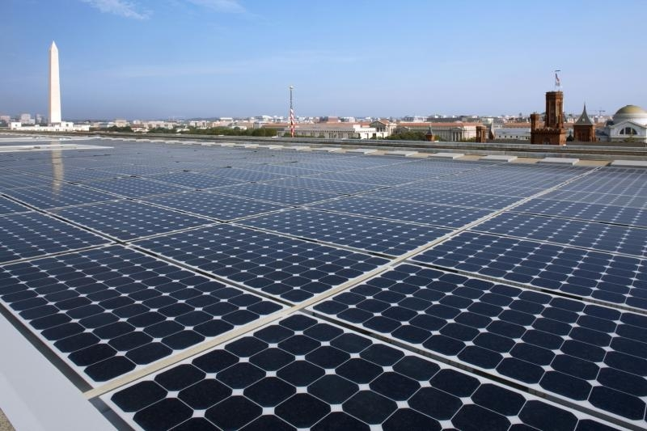
Energy and Climate
Source: EPA
Metro Washington Renewable Electricity
Source: Pepco
Source: Dominion energy
Source: COG

Slide 37
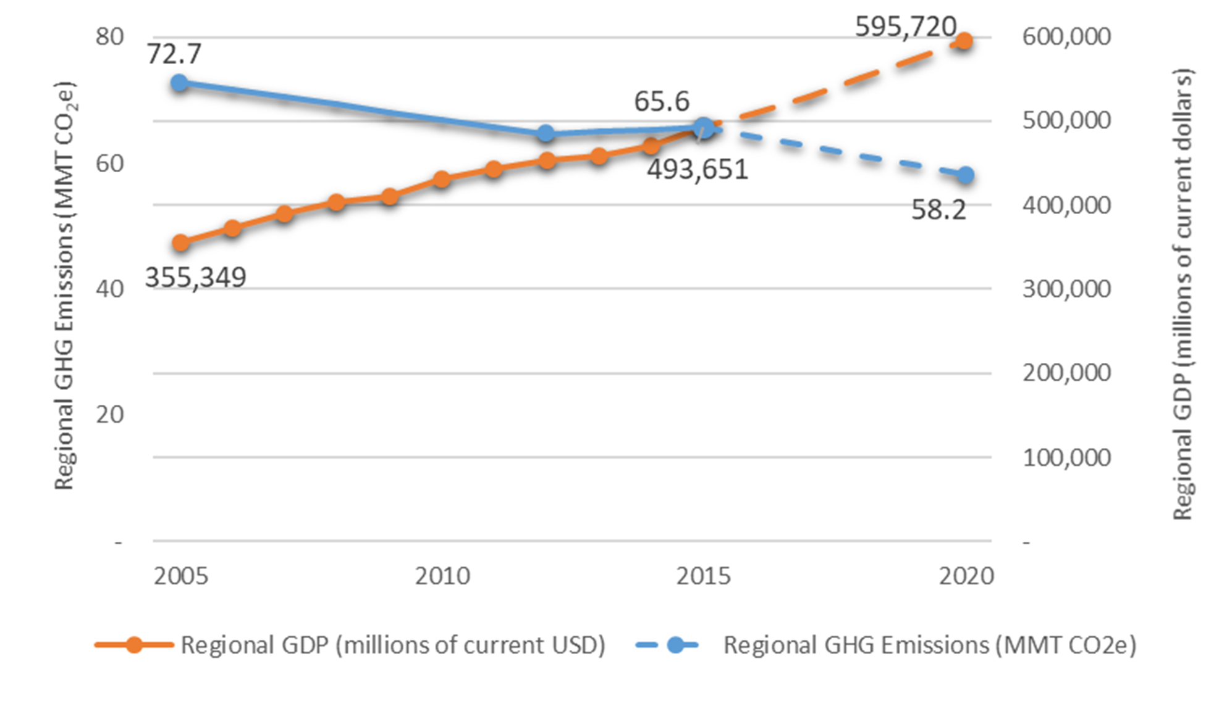
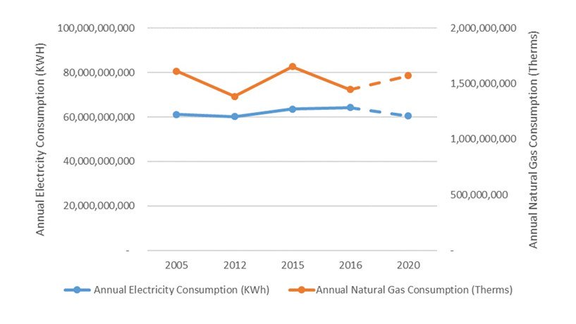
Metropolitan Washington Dashboard
Greenhouse Gas Emissions
Energy Consumption

Slide 38
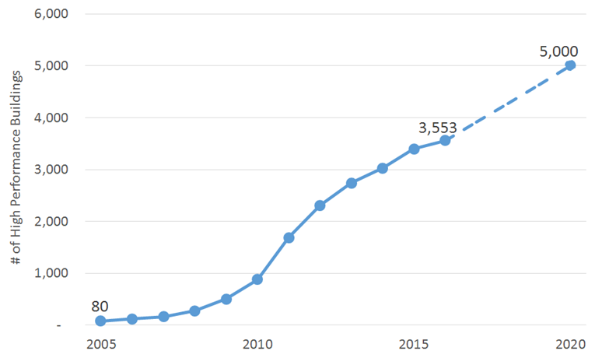
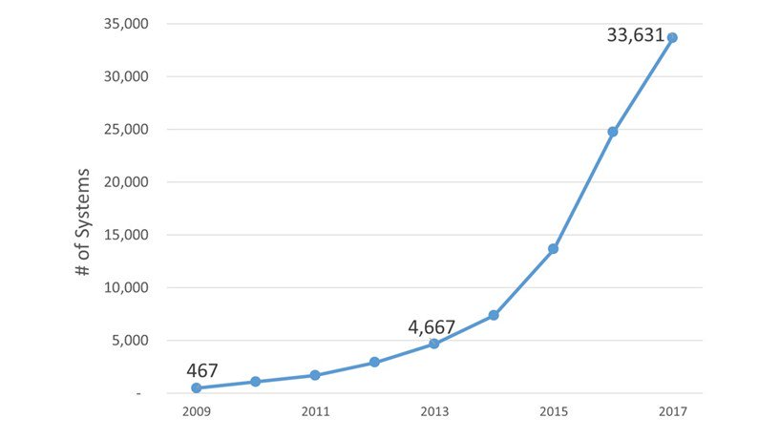
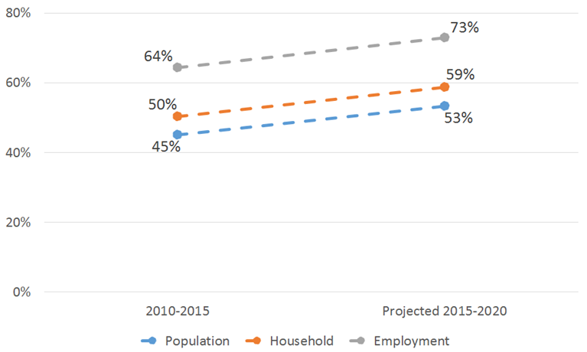
Metropolitan Washington Dashboard
High Performance Buildings
Grid Connected Renewables
Smart Land Use Planning Growth in Activity Centers

Slide 39
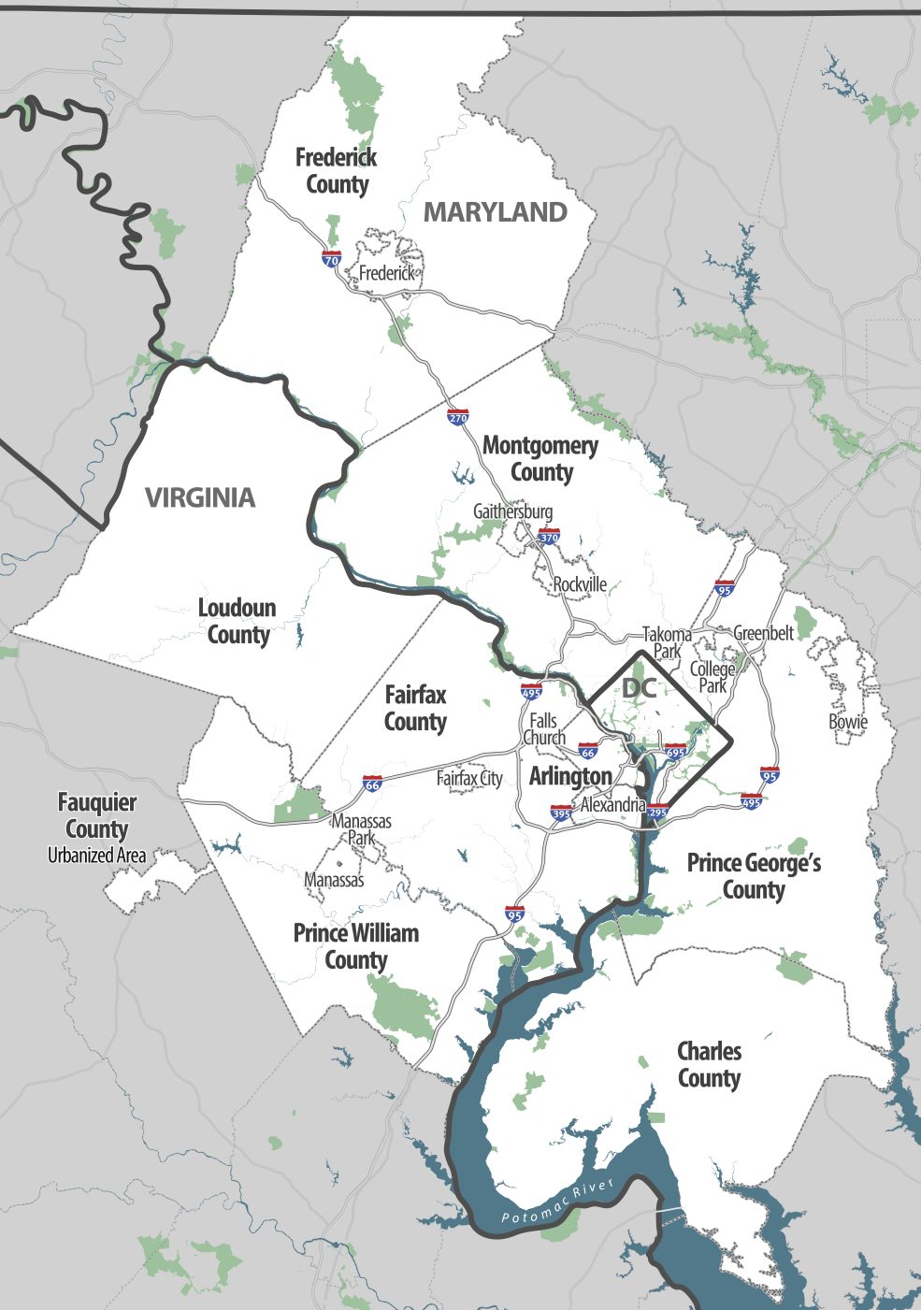
Transportation Planning - Region
Federal planning body - TPB
About - 9,100 sq. km. ;
5.5M people; 3 million jobs
Multiple stakeholders / decision makers
  State (3), County (9), City (13), Federal City (1)
  Legislatures (26), Highway agencies (26), Transit Agencies (19), Federal Entities (4)
  Varied legal authority – Transportation responsibility, Funding, Land-use and Environment
  Geographic diversity- Urban core, Suburban, Exurban/Rural

Slide 40
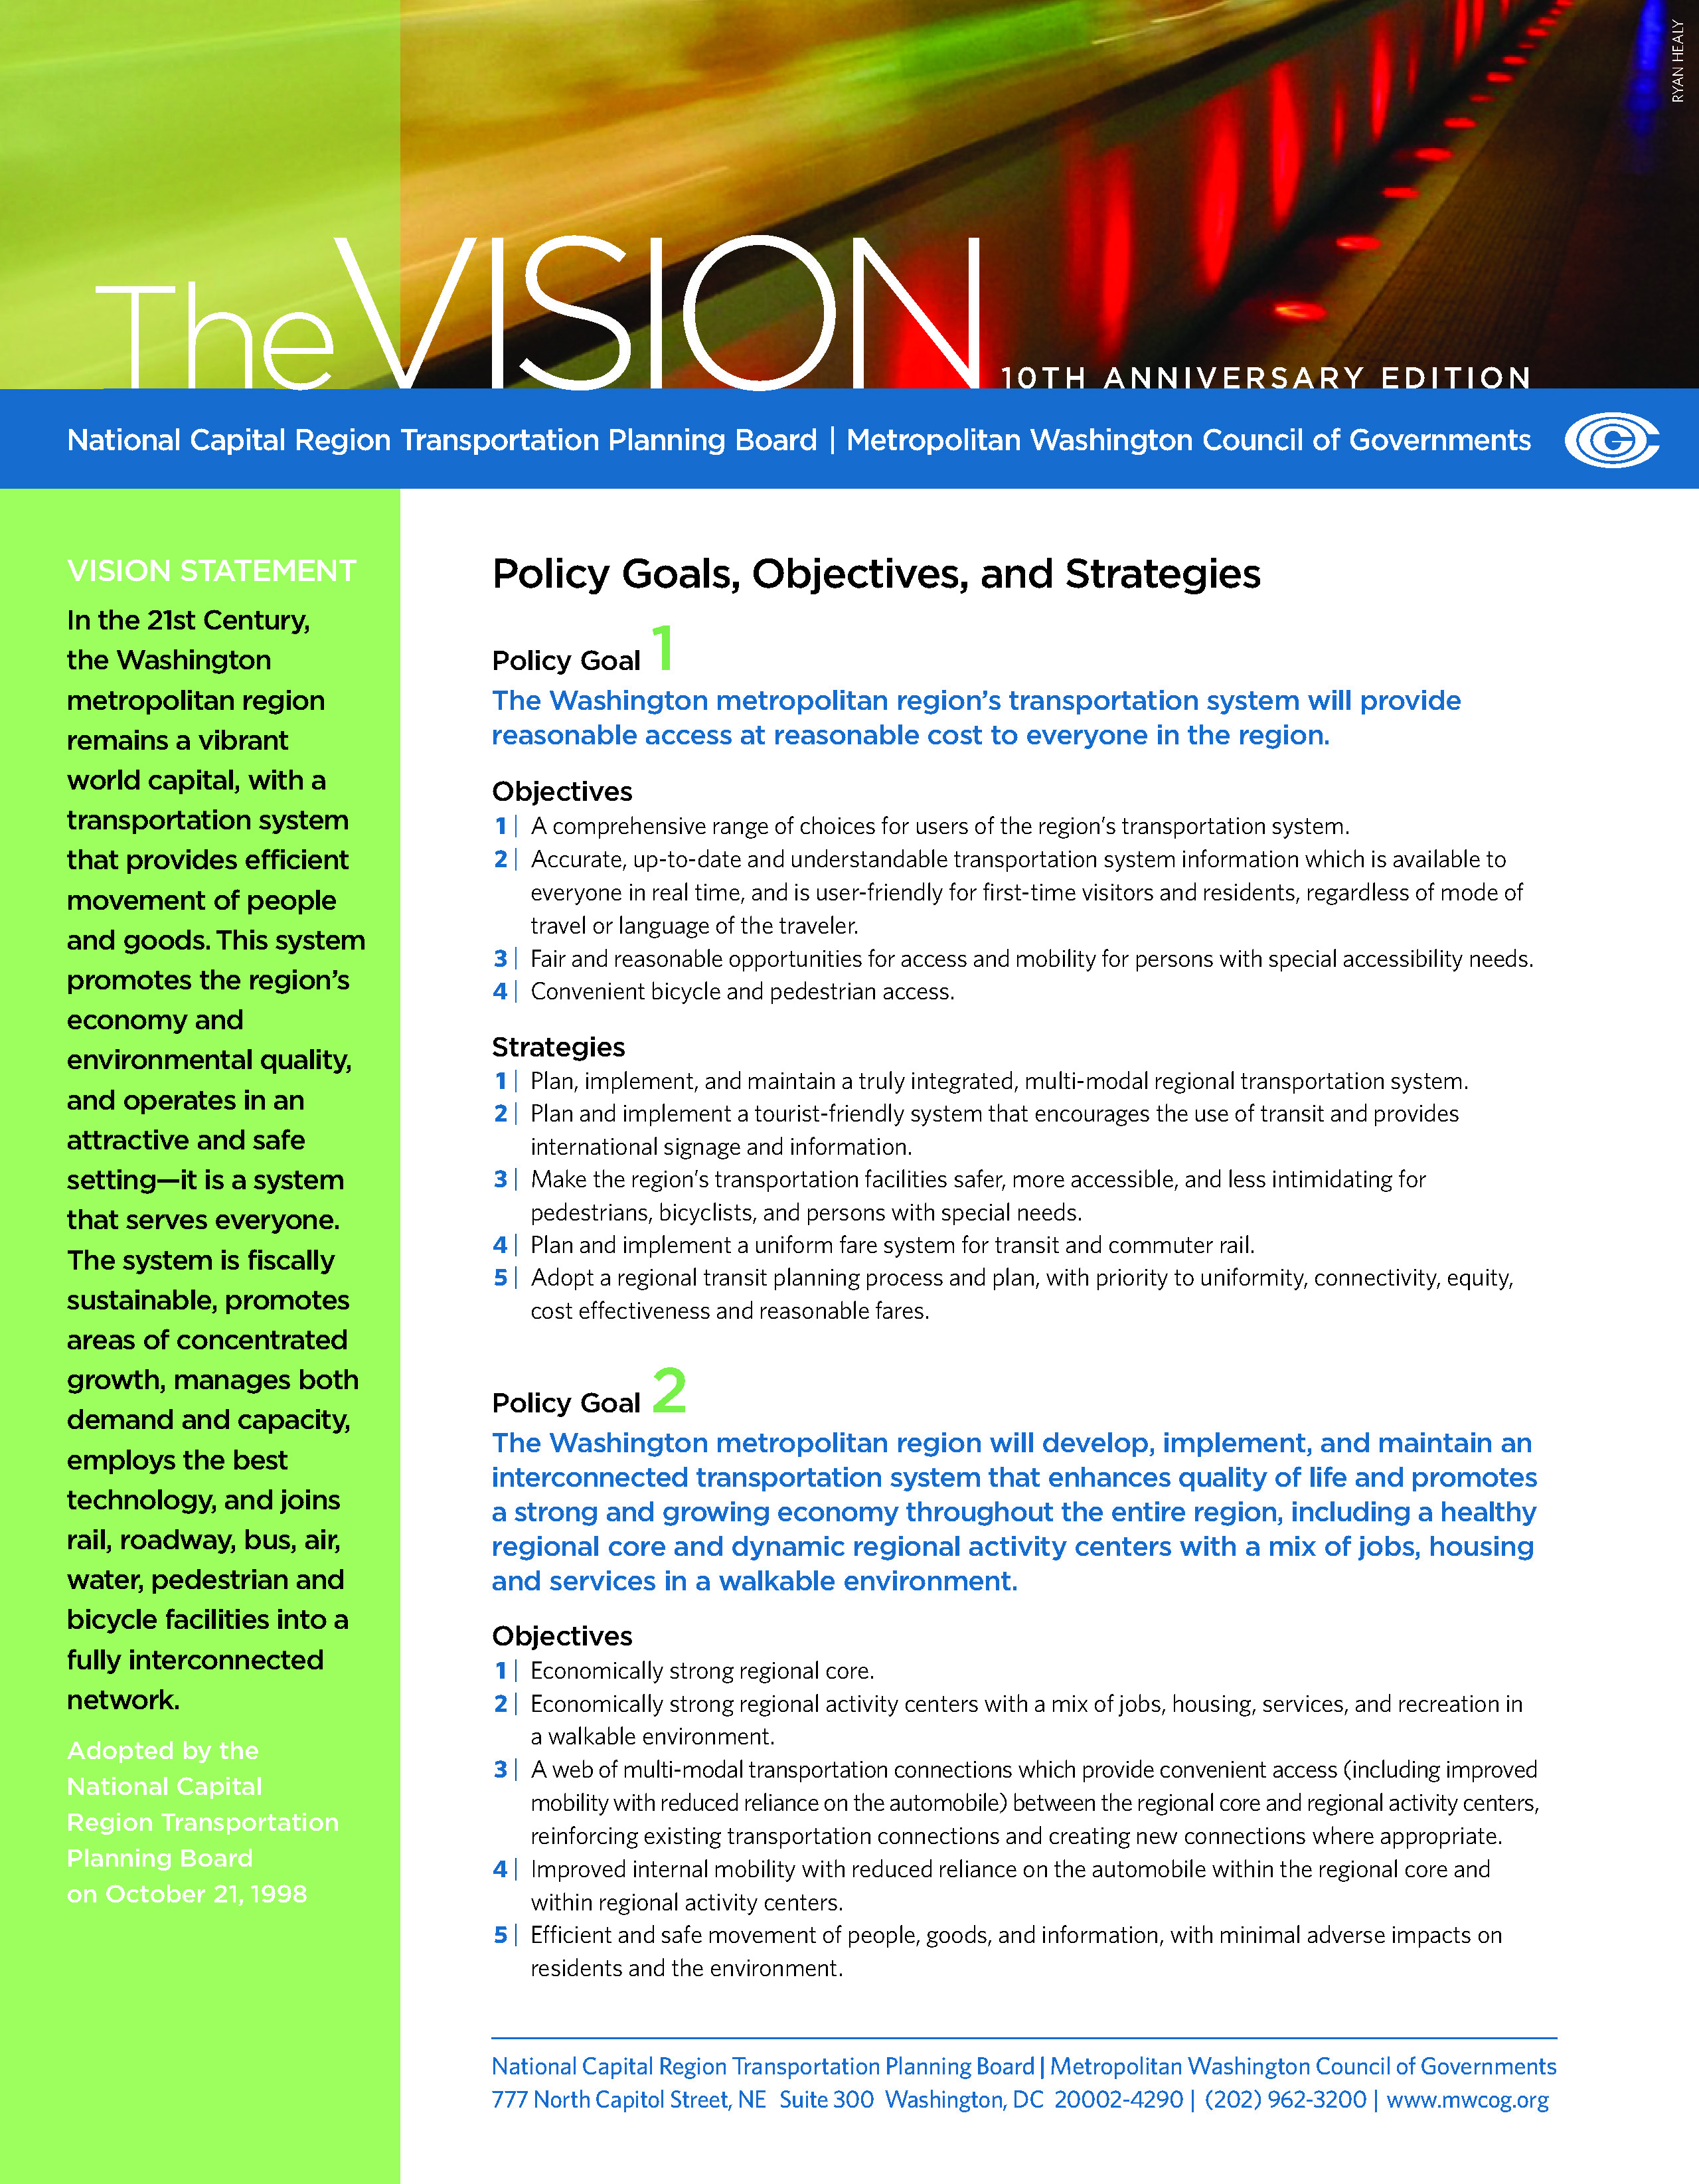
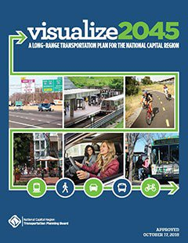
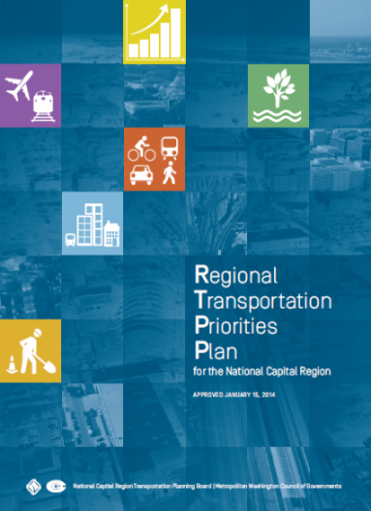
Comprehensive Collaborative Cooperative
Think Regionally, Act Locally:
Consider regional needs when developing local projects and programs for funding and implementation
  Provide a Comprehensive Range of Transportation Options
  Promote Dynamic Activity Centers
  Ensure System Maintenance, Preservation, and Safety
  Maximize Operational Effectiveness and Safety
  Protect and Enhance the Natural Environment
  Support Interregional and International Travel and Commerce

Slide 41
Transportation Planning - Requirements
All federally funded projects and other regionally significant
Funding reasonably expected for O&M and Capital
Air Quality impacts — Emissions of criteria pollutants from all projects / programs must adhere to emissions limits in the region’s air quality improvement plan.
Public Involvement – Local and regional level
Performance Targets on selected aspects
  Asset management, Safety, Congestion, Air Quality
Monitor / report on regional transportation system performance

Slide 42
Transportation Emissions Reductions
System wide – Federal / State
  Vehicle
  Vehicle Fuel
Regional – Travel
Local – Travel

Slide 43
Transportation Emission Reductions
Land Use
Travel Demand Management
  Ride matching for Carpool, Vanpool; Bus, Bike
    Work / Non Work; Via Telephone, Online, Mobile Apps
  Guaranteed Ride Home
  Teleworking
Employer Assistance / Outreach
Incentive Programs
  New Car / van pools
  Rideshare Flextime during construction and/or congestion
Other Local Programs
  Anti-idling; Traffic Signal optimization; Alternative Fuel Vehicles, Park and Ride Lots; Etc.
Estimated Daily Program Impacts (Reductions)
    Vehicle Trips 156,000/Day
    Vehicle Kilometers Travelled 7,793,274/Day
    Nitrogen Oxides 0.7 Tons/Day
    Volatile Organic Compounds 0.5 Tons/Day

Slide 44
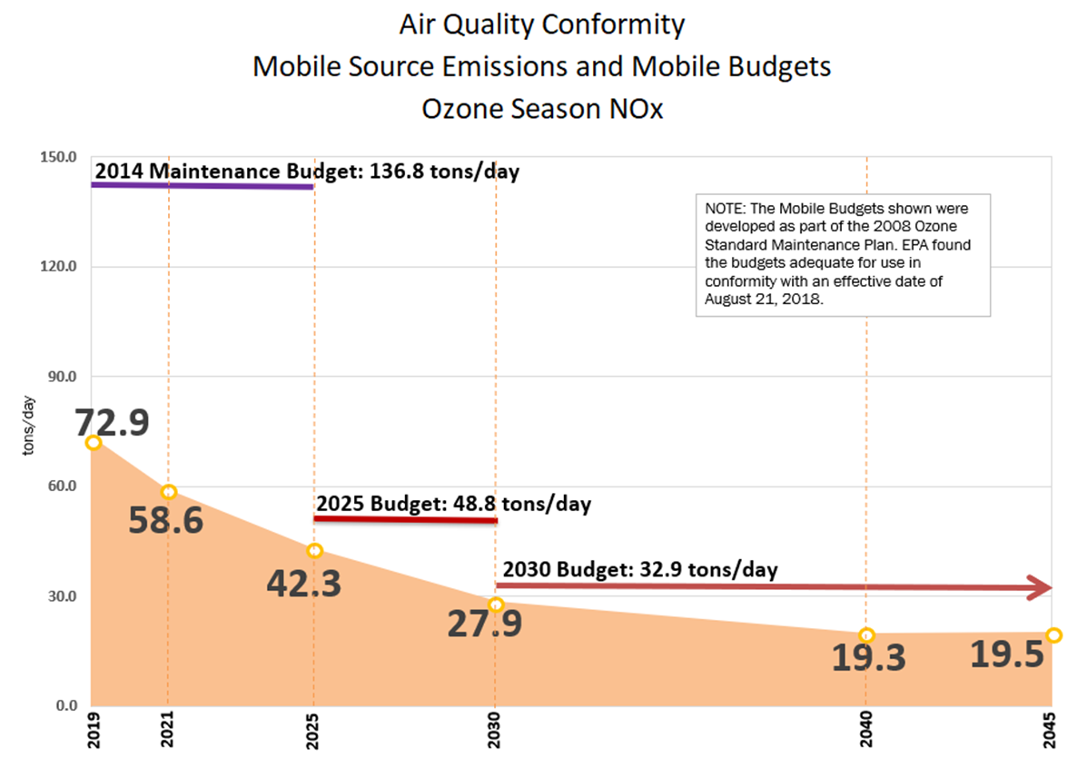
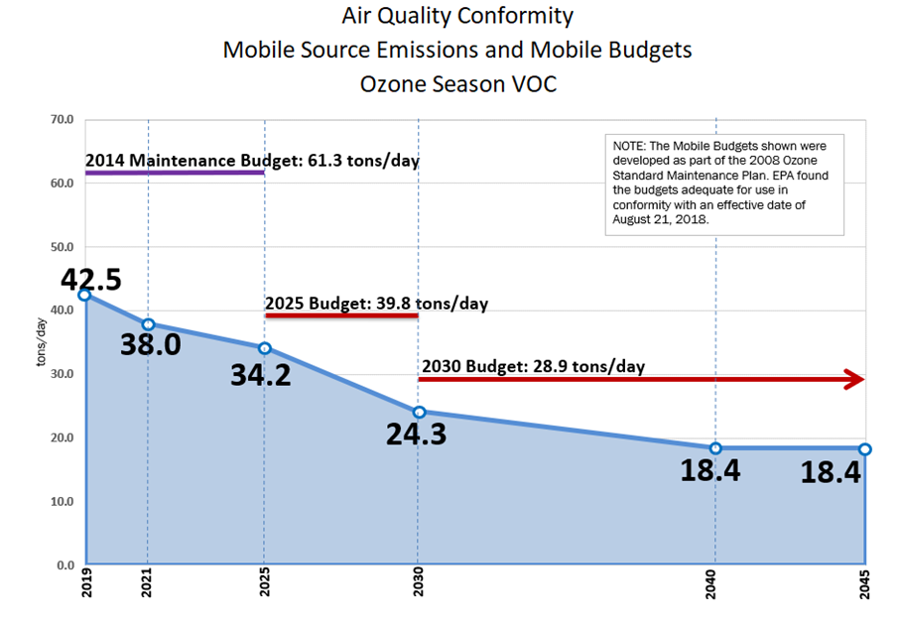
Latest Transportation Emissions Estimates (Ozone)

Slide 45
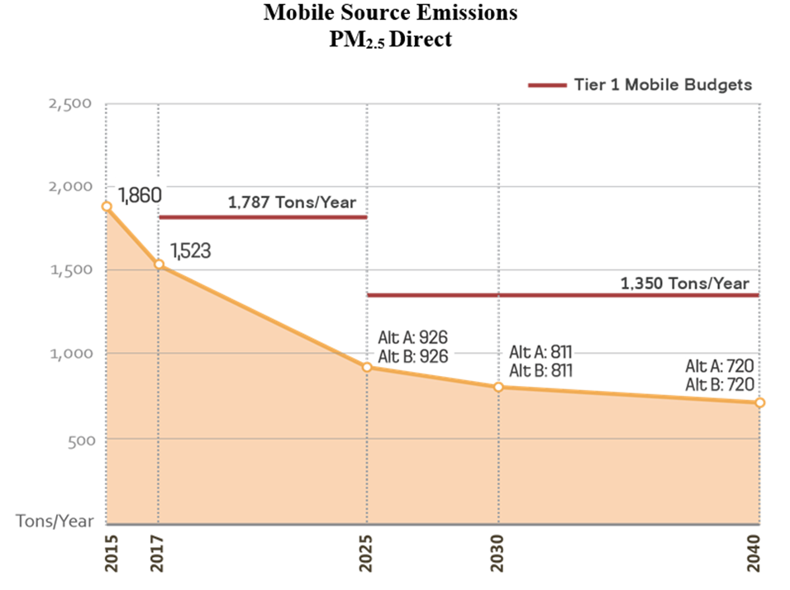
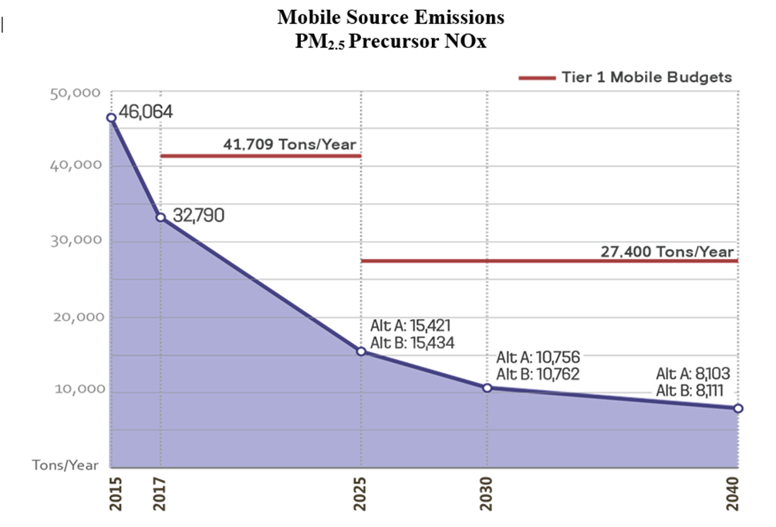
Recent Transportation Emissions Estimates (Particulate Matter)

Slide 46
Jeff King Chief, Energy and Climate 1-202-962-3200 jking@mwcog.org | mwcog.org
777 North Capitol Street NE, Suite 300 Washington, DC 20002

