Slide 1
COG’s Round 8.2 Cooperative Forecast & Regional Wastewater Flow Projections
COG staff - Presentation to WRTC
September 6, 2013

Slide 2
Overview
COG’s Wastewater Treatment Plants
  Focus on Major Plants (defined as => 2 mgd)
    20 – Including both Dale Service Corp plants
  Service Area (SA) maps – being confirmed/updated
    SAs shown for Majors, though ‘Other’ still being refined
COG’s Regional Cooperative Forecast Process
  Round 8.2 – recently adopted by COG Board
COG’s Regional Wastewater Flow Forecast Model (RWFFM)
  Basic assumptions
  Demographic trends for Majors
  Flow projections – Unadjusted & Adjusted
    Remaining regional capacity

Slide 3
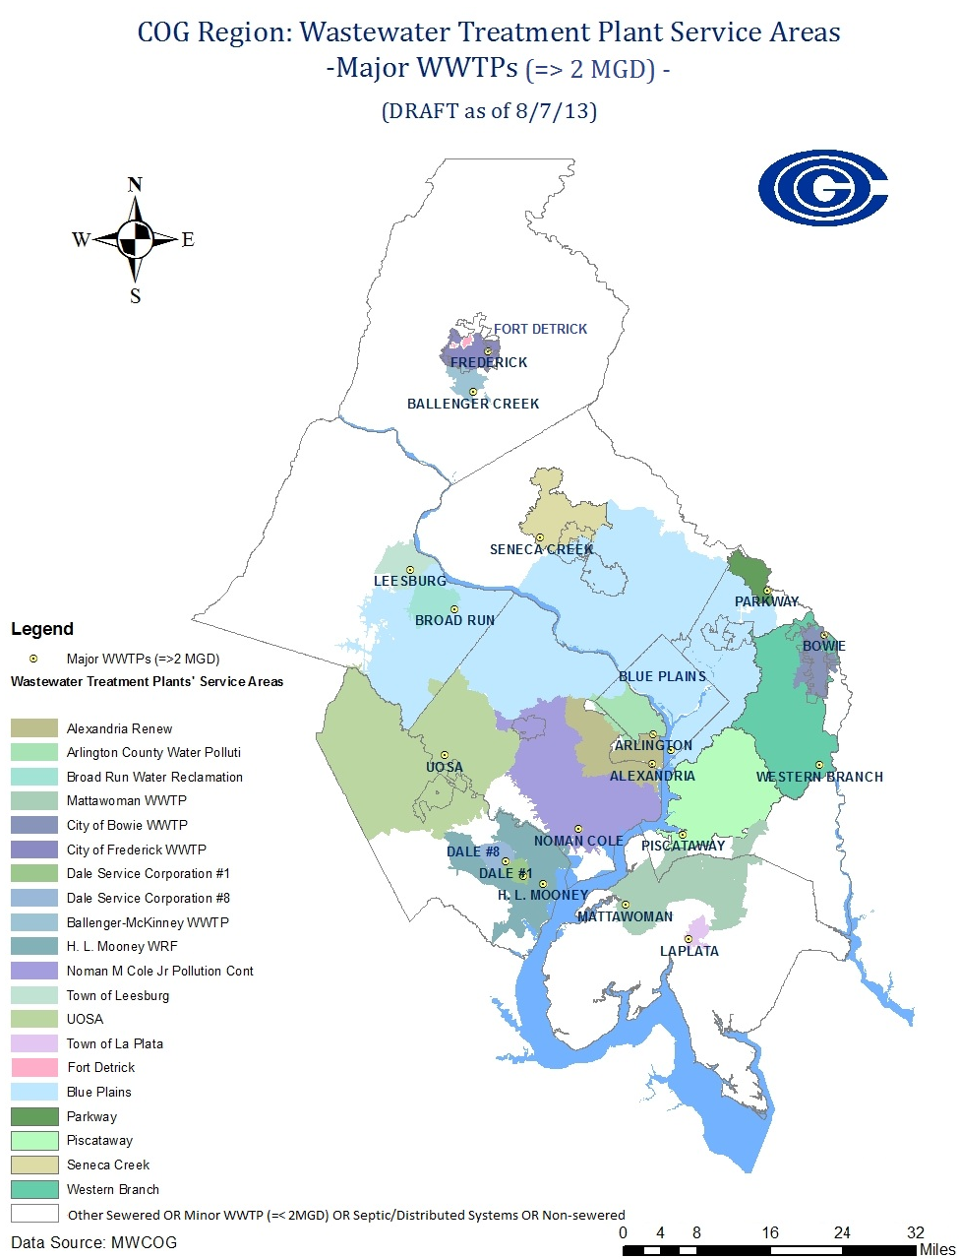

Slide 4
COG’s Regional
Cooperative Forecast Process
Round 8.2 Cooperative Forecast adopted by COG Board on July 10, 2013
Demographic projections are based on Jurisdictions’ forecasts and are within 3 percent of the econometric model projections
  Population, employment, and households
Demographic information is allocated from Transportation Analysis Zones (TAZs) to the appropriate wastewater service areas (i.e., sewersheds and sub-sewersheds)

Slide 5
COG’s RWFFM – Basic Assumptions
Regional model grown from original Blue Plains work
Wastewater projections derived employment & households and Flow Factors (not population)
Black & Veatch updated Base Year Flows (BYF) & flow factors for Blue Plains in 2010
  2009 BYFs are actual annual average flows
  I/I rate of 44% of incremental sanitary flow remained the same
Used Ffx #’s for VA plants & WSSC #’s for MD plants
Table ES-2 – 2009 Approved Flow Factors
Category | Fairfax County | WSSC | Loudoun Water | District | Dulles VA | Vienna VA
Household (gpd/unit) | 150 | 180 | 185 | 170 | NA | 170
Employment (gpd/employee) | 30 | 28 | 25 | 25 | 48 | 21-50

Slide 6
COG Total
5 million

Slide 7
COG Major WWTPs &
‘Unadjusted’ Flow Projections (Draft)
Unadjusted flows reflect only impact of demographic trends

Slide 8
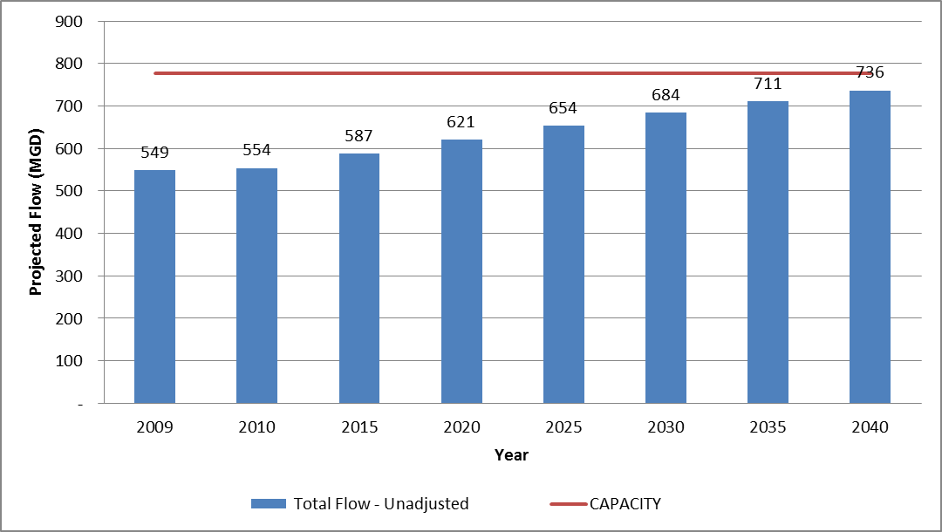
COG Major WWTPs &
‘Unadjusted’ Flow Projections (Draft)
Total Regional Capacity (for Majors) – 776 mgd
Unadjusted flows reflect only impact of demographic trends

Slide 9
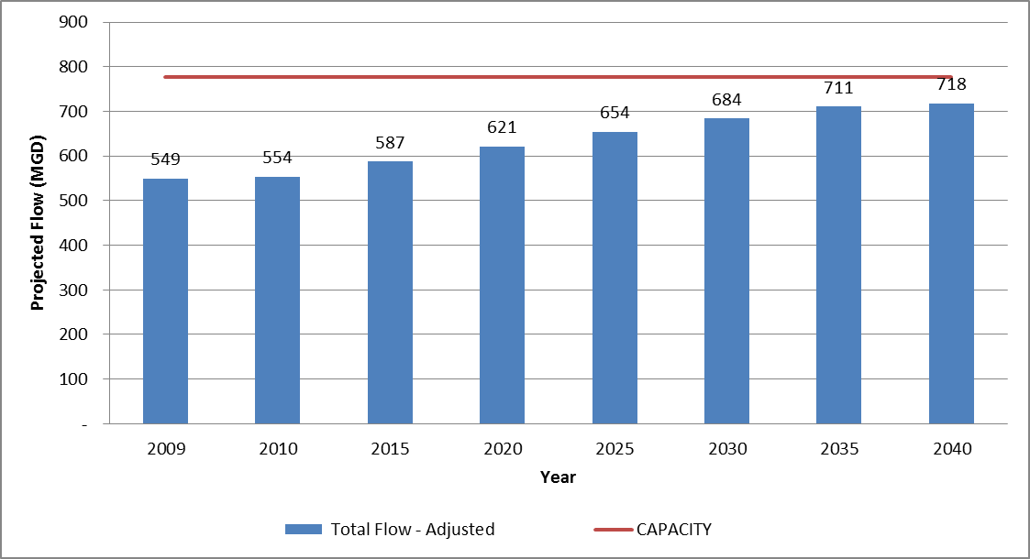
COG Major WWTPs &
‘Adjusted’ Flow Projections (Draft)
Total Regional Capacity (for Majors) – 776 mgd
718 mgd = 93% of Total Capacity
Adjusted flows reflect impact of (significant) flow reductions & flow diversions

Slide 10
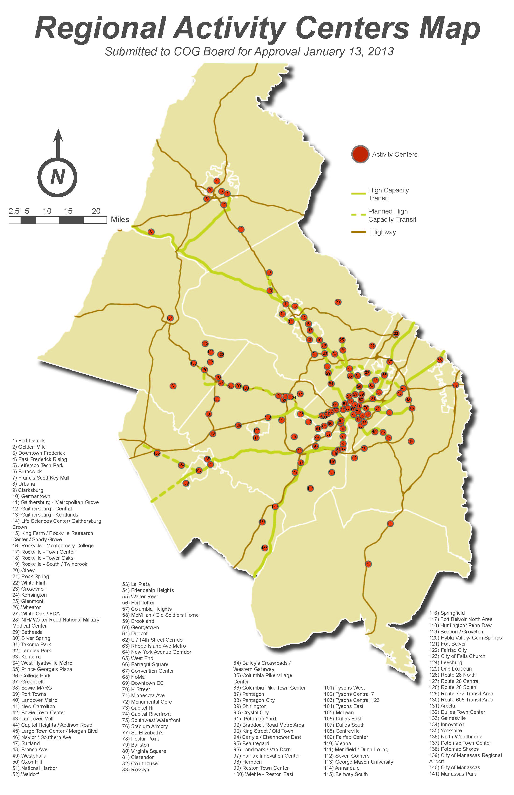
COG’s Region Forward and Economy Forward initiatives

Slide 11
Next Steps
Continue to verify with WWTP operators:
  WWTP service area maps
  Flow projections/assumptions
  Refine maps re: septic/distributed systems vs. non-sewered areas
Present overall/regional findings to CBPC (9/20/13)
Region Forward
  Report on ‘percent wastewater capacity’ findings
  Overall RAC’s on WWTP Service Areas
Flow vs. Load Capacity Analysis
  Outgrowth of work being done for Blue Plains Users

Slide 12
Wrap-up
Questions?
Ideas?
Additional presentations:
  COG’s Cooperative Forecast process
  COG’s RWFFM
  CBP’s use to characterize/project growth
Many thanks for teamed effort – Mukhtar Ibrahim, Nasser Ameen, & Lana Sindler
Contact: Tanya Spano (202) 962-3776 / tspano@mwcog.org

