Slide 1


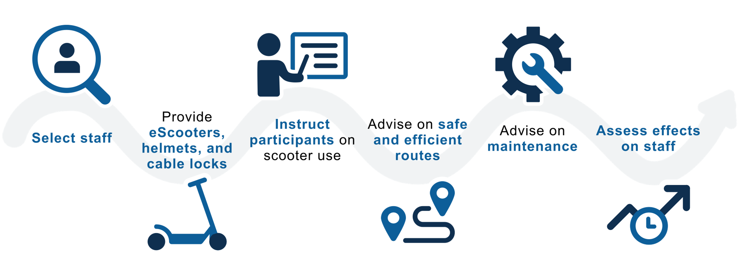
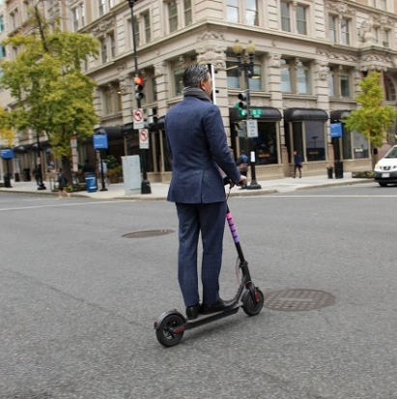
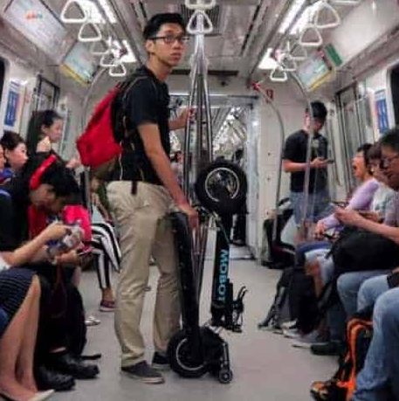

Seeking Workforce Development Partners:
Study of e-Scooters for Low-income Workers
@ 2021 MITRE. PRS 21-3606
Are your clients looking for work but challenged by limited mobility, unaffordable cars, and slow or unreliable transit?
Offer an e-Scooter option in partnership with MITRE and:
• Provide your clients with an exciting travel option
• Support research to improve employment success for low-income workers
eScooters are a flexible, easy-to-store, and low-cost travel solution for short commutes or in combination with transit.
Partner with MITRE to offer your low-income staff their own eScooter as we study the benefits and drawbacks of this new travel option.
We’ll work with you to:
Electric Scooter Report
For more information, please contact Keith Campbell at keithc@mitre.org!
Notes:
Creative Commons:
https://th.bing.com/th/id/R.a9026fd32574d9c4d3c9f2a313de5316?rik=3BCIE%2fveH7qEiQ&riu=http%3a%2f%2fla.streetsblog.org%2fwp-content%2fuploads%2fsites%2f2%2f2014%2f09%2fCyclist-First-Street.jpg&ehk=%2fd8ALUavPqjOAywCIpPCNevijelVbCYxwjV9%2bjyuZfI%3d&risl=&pid=ImgRaw&r=0
https://thecityfix.com/wp-content/uploads/2018/12/DDOT_IT.jpg
Can You Take An Electric Scooter On A Bus? – Electric Scooter Report

Slide 2
Seeking Employer Partners:
Study of e-Scooters for Low-income Employees
@ 2021 MITRE. PRS 21-3606
Are you having trouble hiring and keeping low-income staff? Employees put off by the challenges of commuting? Want to reduce late arrivals and save parking?
Offer an e-Scooter option in partnership with MITRE and:
• Provide your staff with an exciting travel option
• Support research to improve employment success for low-income workers
eScooters are a flexible, easy-to-store, and low-cost travel solution for short commutes or in combination with transit.
Partner with MITRE to offer your low-income staff their own eScooter as we study the benefits and drawbacks of this new travel option.
We’ll work with you to:
Electric Scooter Report
For more information, please contact Keith Campbell at keithc@mitre.org!
Notes:
Creative Commons:
https://th.bing.com/th/id/R.a9026fd32574d9c4d3c9f2a313de5316?rik=3BCIE%2fveH7qEiQ&riu=http%3a%2f%2fla.streetsblog.org%2fwp-content%2fuploads%2fsites%2f2%2f2014%2f09%2fCyclist-First-Street.jpg&ehk=%2fd8ALUavPqjOAywCIpPCNevijelVbCYxwjV9%2bjyuZfI%3d&risl=&pid=ImgRaw&r=0
https://thecityfix.com/wp-content/uploads/2018/12/DDOT_IT.jpg
Can You Take An Electric Scooter On A Bus? – Electric Scooter Report

