Slide 1
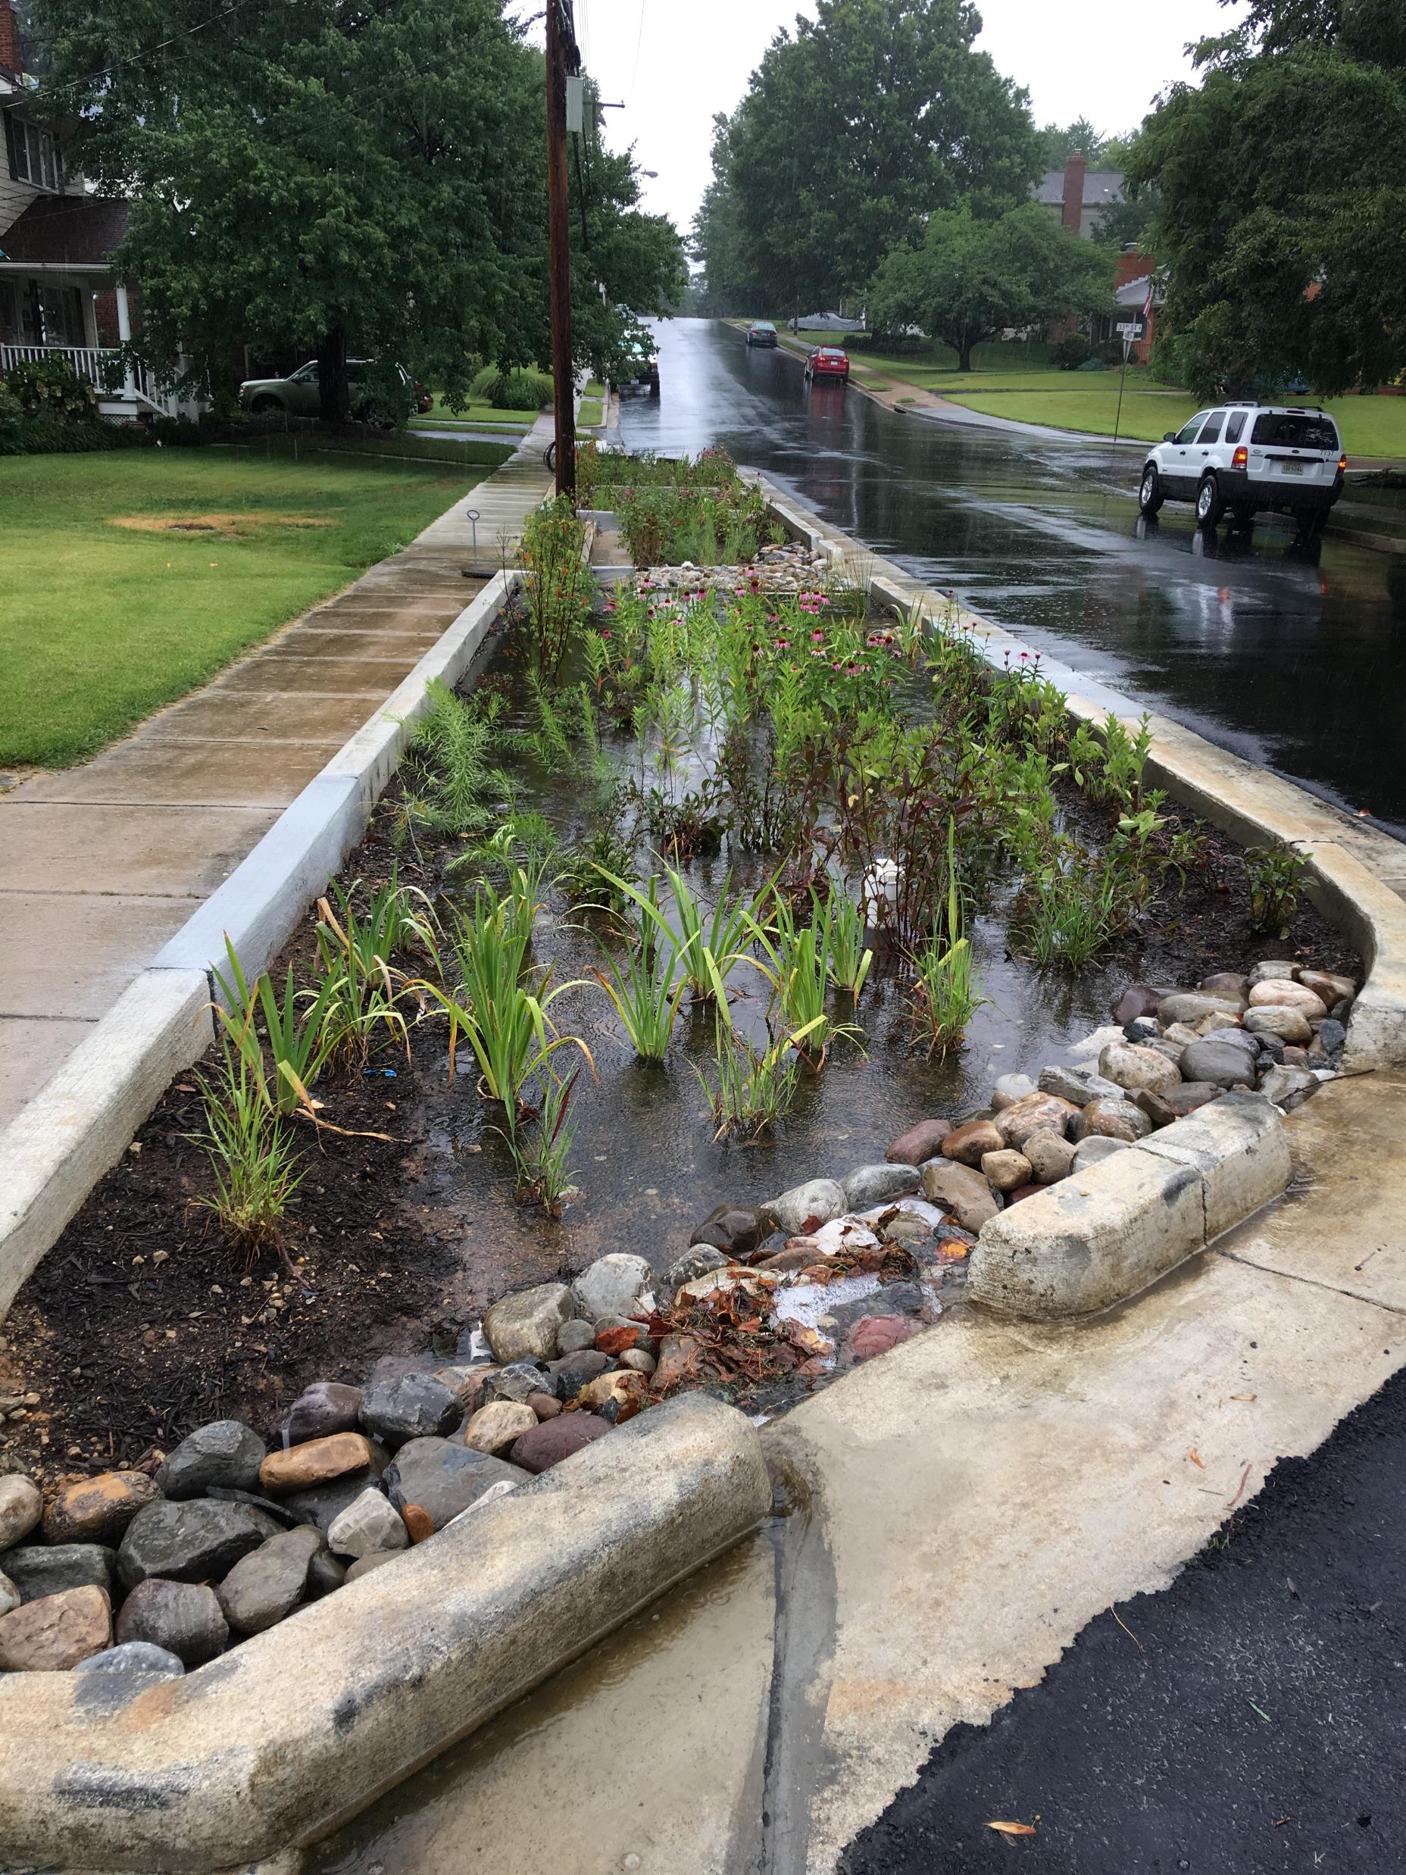
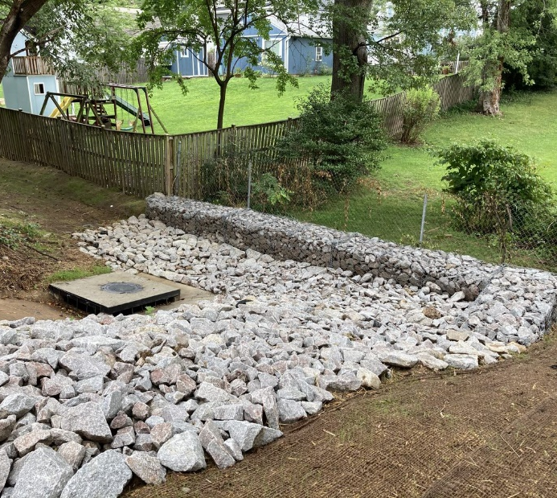
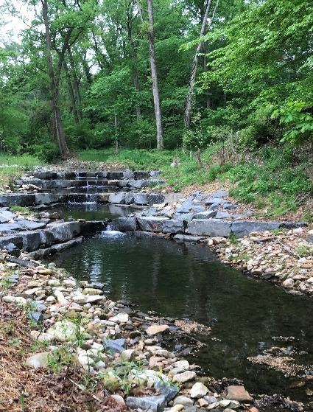
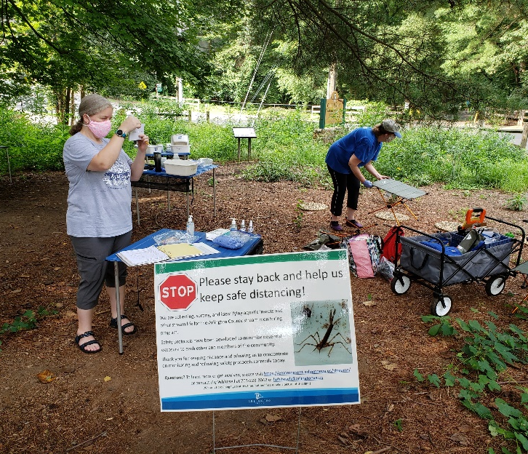
Arlington county
Phase I MS4 Permit Re-issuance update
WRTC 09.11.20

Slide 2
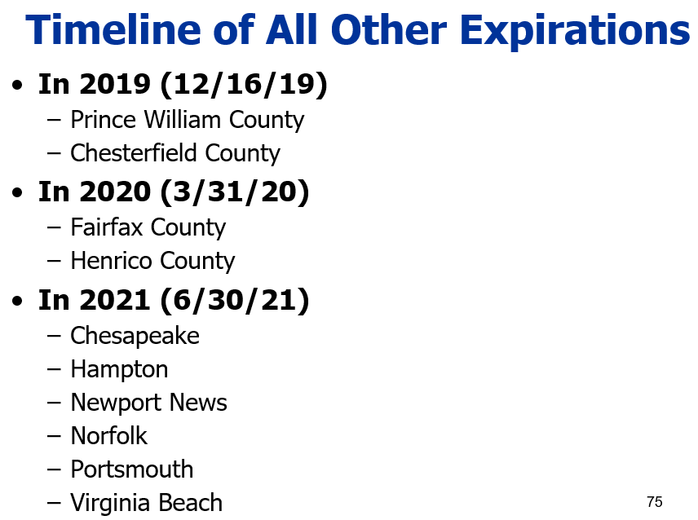
MS4 Permit Timeline
11 Phase I Large MS4 Permits in VA
  Arlington first in line – administratively continued since June 2018
  4 other Phase 1 permittees under continuance

Slide 3
Status
Draft received February 18, 2020
Submitted comments April 3, 2020
Multiple conference calls with DEQ since
No timeline at this time – ‘as soon as possible’
EPA?

Slide 4
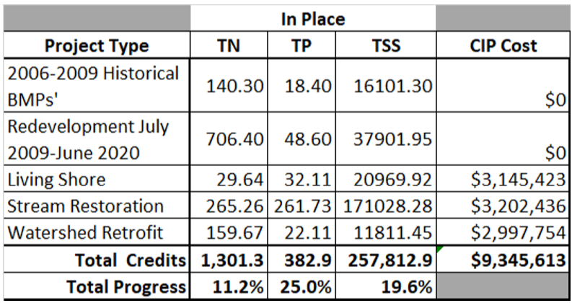
Key permit issues
‘Number of projects’ requirement for retrofitting
Numeric inspection requirements for stormwater infrastructure
Outfall vs P2 inspections
Monitoring and cost-effectiveness

Slide 5

‘Force majeure’

Slide 6
Overarching issues
Continued use of Phase 5.3.2 model for load allocations and level of effort requirements
  Consistency vs Accuracy?
Increased demands from climate change and flooding
  Back to the future?
Local streams?
  If impaired only, no requirements?
2025 vs >2030?

Slide 7
New Math?
Maryland permitting approach + Virginia permitting approach
2
=
Just Right?

Slide 8

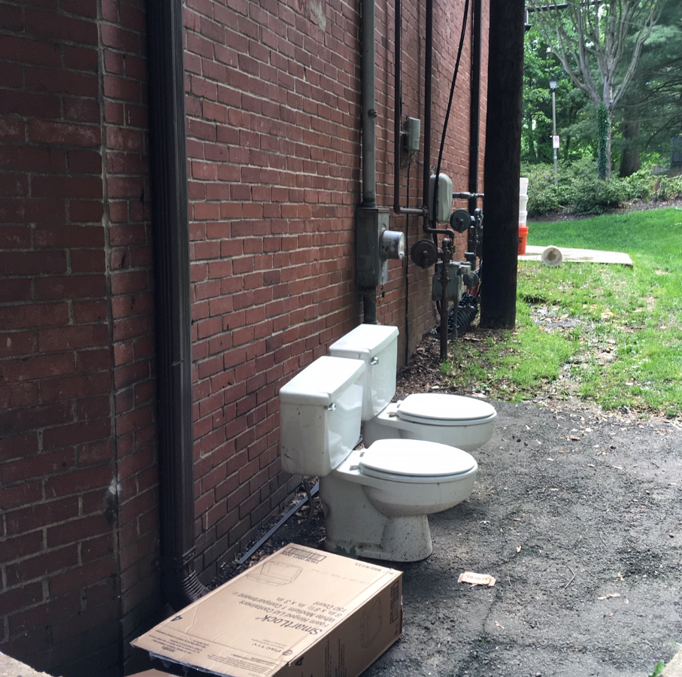
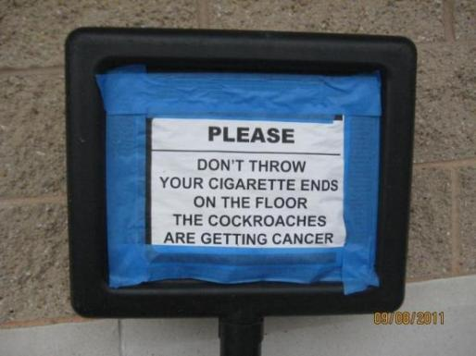
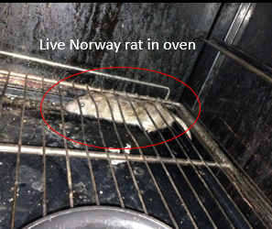
Questions…. and comic relief

