Slide 1

National Capital Region
ANNUAL REPORT
FOSTER CARE
2013
Notes:
KAMILAH: Thank you. I am Kamilah Bunn, COG’s Child Welfare Program Manager. Today I am pleased to be joined by Tracy Ambos, Assistant Director Charles County Department of Social Services. We are here to discuss and share the latest findings of the annual survey of Foster Care systems throughout the region. All 2013 local data has been collected, thanks to our regional data workgroup, and the findings have been compiled in the written report before you. Through today’s powerpoint presentation, Tracy will share our interpretation of the data findings.

Slide 2

Notes:
TRACY: The idea of Foster Care is often about revisiting the past…. By visiting the past, a family in crisis can move forward today and in the future. The role of social services is about understanding that people have the capacity to change. BUT……while they do….Foster care can be a temporary safe haven for their child.

Slide 3
Who is in Foster Care
And Why
Notes:
Who Is in Foster Care? and Why?
Children in foster care are typically school-age children; children of color.
Why are they in foster care? These children are in the system due to no fault of their own. They have experienced some form of abuse, neglect or abandonment by a caretaker. Often teachers, nurses, or someone in the school setting recognizes something might be awry with their student– they might have a bruise, or be disheveled looking, or the child may literally say they have been sexually abused or don’t have food at home. Members of the school system are mandated reporters, so they will place a call to Child Protective Services.

Slide 4
Notes:
Here, we are showing the volume of calls to Child Protective Services by month in 2011 through 2013. The top 3 lines show calls received. While the bottom 3 lines show the calls accepted.
On average, we see a spike in calls in March, May, and October each year– during the school calendar, and a dip in the summer months.
In 2013, a total of 55,449 calls were received, and 18,373 calls were investigated. The differential of about 35,000 calls were either ruled out for investigation, or received what we call in-home services, within the community. For example ….
The very good news is that more families and children are safely receiving services within the community. This is why we have seen a steady decline in the number of children in foster care, the past 6 years.

Slide 5
Notes:
Here, we are showing a steady decline in the number of children in foster care. In 2008 as compared to 2013, there was a 36% REDUCTION in the number of children in the system.
This work to reduce the number of children in the system is two-fold:
it requires a focus on prevention so that families on the fringes can receive the resources they need before they become abusive, or neglectful to their children, and
a focus on moving children who are in the system back home, when it is safe, or to relatives, or to an adoptive home.
When reunification with the child’s birth family or relatives is not an option, the challenge becomes how to transition children to a permanent home– especially since so many of our children are older.

Slide 6
Notes:
Here, we are showing children in foster care by age.
Two –thirds of the children in foster care are school-age; and more than half are teenagers

Slide 7
Placement Type (as of 12/31)
Notes:
Here, we are showing where our school-age children and teenagers are placed when they are in foster care. Fortunately, most of our children are in family settings, not group homes.
The family setting categories are:
private foster homes, which constitutes 25% -- these are privately purchased homes,
agency foster homes, which constitutes 28% -- these are home recruited by the local agency,
relative/kinship, which constitutes 10% -- these are kin relatives.
pre-adoptive homes, which constitutes 7% -- these are homes with caretakers that will adopt the child,
trial home visit, which constitutes 6% -- these are homes where the child will be permanently placed if the trial home visit goes well.
By adding up these categories the count is 76%
Agencies have been working hard to reduce the use of congregate or group care, and, now 3 out of 4 children in foster care were in home settings with families on 12/31/2013.
The right type of placement is a key ingredient to that child’s successful transition out of foster care to a permanent home, back with their birth families, relatives or an adoptive home. However, the location of that placement is also an important consideration.

Slide 8
GEOGRAPHIC PLACEMENT OF CHILDREN on 12/31/2013
 | Inside Jurisdiction |  | Outside Jurisdiction
 | With Relative | Without Relative | With Relative | Without Relative
District of Columbia | 11% | 34% | 10% | 46%
Frederick County | 17% | 46% | 1% | 36%
Montgomery County | 19% | 46% | 6% | 29%
Prince George's County | 3% | 57% | 1% | 39%
Charles County | 25% | 50% | 0% | 25%
City of Alexandria | 12% | 12% | 8% | 68%
Arlington County | 11% | 61% | 1% | 27%
Fairfax County | 3% | 59% | 2% | 36%
Loudoun County | 7% | 47% | 5% | 41%
Prince William County | 3% | 59% | 5% | 33%
Notes:
Here we are showing a chart of where our children are placed geographically. Notice that Virginia does not subsidize relative care, which has had a dramatic affect on how frequently children are able to be placed with relatives.
When children are placed outside of their home jurisdiction, they have to leave their life behind – including friends in the neighborhood, sports teams, and their place of worship. The placement of children outside their home jurisdiction can impact their educational outcomes, especially since they sometimes have to change schools or travel hours to get back and forth to their home school from their foster home – making it nearly impossible to participate in extracurricular activities after school.
What this chart also shows is how critical it is that agencies recruit more foster homes within their jurisdiction, so that children in care do not lose that neighborhood connection.

Slide 9
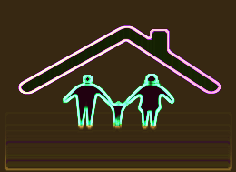
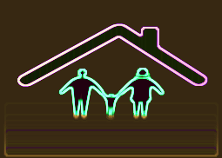







40% of all agency homes were vacant on 12/31/2013
Agency Foster Homes
Notes:
Here we are showing the number of recruited and licensed foster homes as of 12/31/2013 versus the number and percentage of those recruited and licensed homes that are vacant.
This data shows that 40% of all foster homes in the region were vacant on 12/31/2013. So 4 out of every 10 foster homes did not have children placed there– essentially these homes are sitting empty when they could be used to keep children.
Homes may be vacant for a number of reasons, but most agencies report that it is because the recruited families are unwilling to foster older teenagers, children with multiple behavior problems, large sibling groups or children with special medical needs.

Slide 10
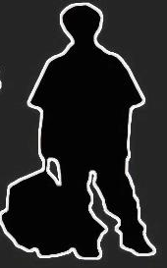
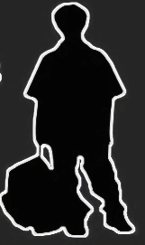
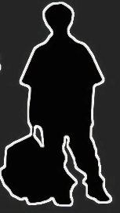
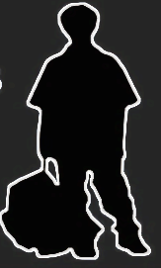
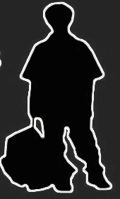
7 out of 10 waiting children are teenagers
Notes:
Here we are showing the number of children waiting to be adopted. There were 158 children waiting to be adopted, and 110 of them were teens.
70% of all children waiting to be adopted are teenagers. (We do not have data on how long these youth have been waiting, we will collect this information for next year.)
Recruiting homes for teenagers is the focus of agencies in the region. Without homes for teenagers, these children grow up in congregate care or institutions, often outside of their home jurisdiction. Youth in congregate or group homes are most at risk of aging out of the system and joining the homeless population.

Slide 11
The Relationship between APPLA and Emancipating youth
Data Unavailable
Data Unavailable
Data Unavailable
Data Unavailable
Notes:
Here we are showing the relationship between children with a goal of APPLA and those children who age-out or emancipate from the system.
The line on the top shows children with a goal of APPLA. Children with this goal, another planned permanency living arrangement, are children who have not given consent for adoption recruitment to occur. In Maryland, a child as young as 10 years old, and in the other jurisdictions children as young as 14 years old can have this goal. Unfortunately, children with this goal are often “on pace” to age-out because they are not being recruited for, and essentially prepared for independent living.
The line below the APPLA line shows children who have aged out or emancipated from the system. Although the numbers have slightly declined over the years, these youngsters are most at risk for homelessness, teen pregnancy, incarceration.

Slide 12
Takeaways
Greater support of programs that provide older youth with educational, employment, and housing assistance, and strengthen the recruitment of lifelong connections or mentors.
Continued focus on recruiting outstanding foster parents for teenagers, special needs children and large sibling groups so our children can remain in families rather than congregate care.
Advocate for kinship care financial assistance to relatives who receive their kin/children from foster care in Virginia.
Support the use of Wednesday’s Child to attract families for older teenagers before they age-out of the system.
Notes:
In closing here are some takeaways:
We hope you will provide greater support for programs that provide older youth who have or might age-out of the system with educational, employment, and housing assistance, and strengthen the recruitment of lifelong connections or mentors for these youth.
We hope you continue to focus on recruiting outstanding foster parents for teenagers, special needs children, children with multiple behavioral problems, and large sibling groups so our children can remain in families rather than congregate care. COG’s foster parent appreciation events and documentaries about foster parents have helped our agency retain excellent foster parents, and recruit more.
We hope you advocate for kinship care financial assistance to relatives who receive their kin/children from foster care in the state of Virginia.
4. We hope you continue to support Wednesday’s Child to attract families for older teenagers before they age-out of the system. Wednesday's Child has helped our agency identify connections for a young woman who aged out of the system, without a place to live.
(Time permitting: we would like to show you a 90 second video of a Wednesday’s Child segment.)

