Slide 1
Bacteria SW-WLA Implementation Plans
MDE-SSA Feedback

Slide 2
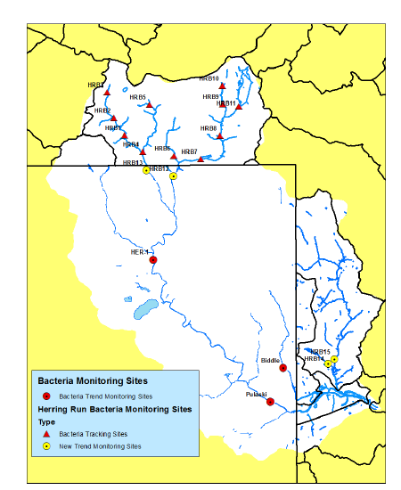
1. Develop Monitoring Program
Ultimate demonstration of progress towards bacteria TMDLs not likely via modeling and SW BMP efficiencies at this point (significant uncertainty).
Best way to demonstrate progress is long term and targeted monitoring that can show declines in concentrations over time and effectiveness of implementation strategies. If don’t see any sort of decline over X # years, go back to the drawing board (adaptive management).
Tiered approach to monitoring program:
Programmatic, i.e., accounting of how much dog waste is being collected per year
Monitoring downstream/at outfall of a particular practice to determine effectiveness, i.e., monitoring downstream of a new pet waste program area (maybe this could be done via a pooled effort)
In-stream subwatershed monitoring
Mainstem long term trend monitoring
Full hierarchy of monitoring indicates effectiveness
of implementation plan. One level may not show
progress, but others may.

Slide 3
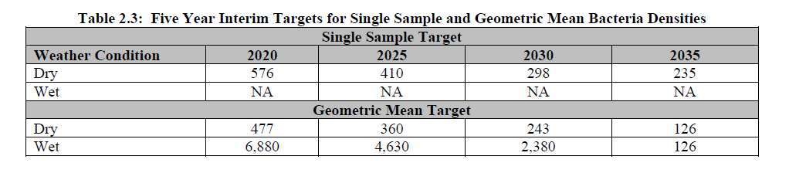
2. Focus on Target Concentrations
Set target concentrations for specified time intervals. If trend stations indicate that target concentrations aren’t being met, or there has been no decline in concentrations, ramp up implementation, or maybe it is time to implement a new suite of practices.
Key is not necessarily “meeting the TMDL” but setting targets, collecting data to assess progress towards those targets, and subsequently adjusting implementation if the data indicates targets are not being met.
Modeling and load reductions are good, but concentrations will really determine progress towards the goal, particularly in urban watersheds, where ag inputs are minimal.

Slide 4
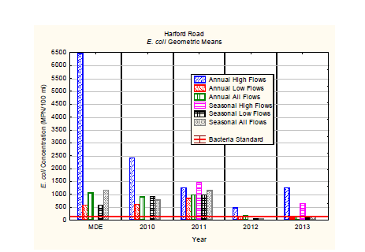
3. Use Monitoring to Demonstrate Progress in Annual Reports
Ideally, after analyzing several years of data, should be able to detect whether you’re meeting your goal, such as an obvious trend in declining concentration.
If not, then the goals, monitoring plan, and implementation efforts should be reassessed as part of the adaptive management process

Slide 5
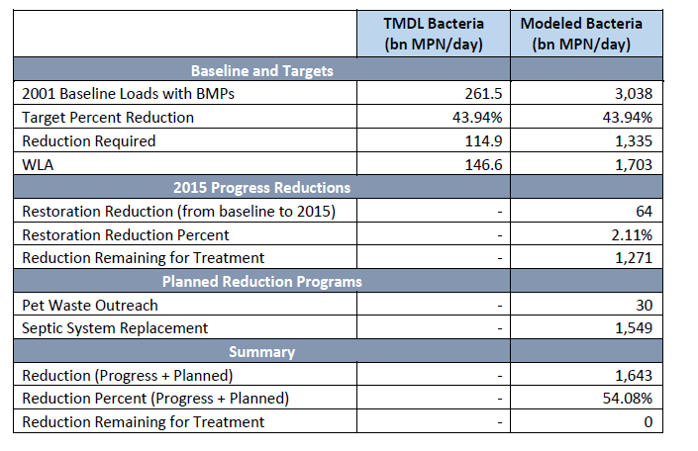
4. Focus on Source Reductions
Note: Still need better science to determine effectiveness of pet waste programs
No clear science on the effects of SW BMPs on bacteria loads. Focus on reducing bacteria at the source, namely domestic and human sources, or on determining load reductions from these practices (difficult – but maybe we can do through a pooled approach)
Load reductions alone shouldn’t be the focus, but for source reductions, they can provide insightful information. Load reduction estimates + monitoring data = broad strategy for demonstrating progress.

Slide 6
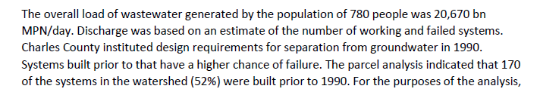
5. Look for Potential Hot Spots
Problem:
Strategy:
Synopsis: Analyses have indicated that older septic systems on Maryland’s lower western shore are likely discharging directly to groundwater. Locating and replacing these systems (older development in coastal areas) could be a cost effective means of getting significant bacteria and nitrogen reductions.
Question: Are there similar instances of potential hot spots in other regions?

Slide 7
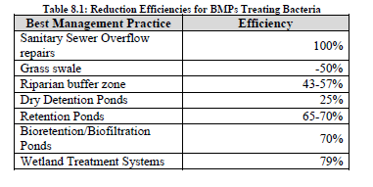
6. Don’t Estimate Load Reductions from SW BMPs
SW BMPs may reduce bacteria loads, or they may actually increase bacteria loads. Because the science is not clear, and based on best professional judgment, the best bang for the buck for reducing bacteria might be at the source.
There could be concern that without modeling reductions from SW BMPs, jurisdictions may not be able to demonstrate attainment of bacteria loads reductions by a reasonable date. SSA recognizes that bacteria load reductions for most urban watershed are significant and hard to attain. By adopting a robust adaptive management approach, jurisdictions should be able to demonstrate progress toward TMDL endpoints.

