Slide 1
Public outreach for the 2018 Long-Range Plan
Ben Hampton TPB Communications Manager TPB Citizens Advisory Committee April 13, 2017
Agenda Item #6
Notes:
Introduce – new to some, familiar to others
What I do here – lead our comms work – mainly newsletter, social media, new branding – work with AZ
Last few weeks, drafted to help with public outreach for LRP
Tonight, give you an update on where we are and what we’re planning

Slide 2
Outreach phases
PHASE I:
SURVEY
PHASE II:
WORKSHOPS
May-August 2017
Fall/Winter 2017
Agenda Item #6: Public Outreach and Communications for 2018 LRP
April 13, 2017
Notes:
Last month you heard from John about a two-phase approach; still with that
First phase; second phase
Explain thinking behind two tools, two phases
Not exactly sur what phase 2 will be just yet – want to leave that open as things evolve

Slide 3
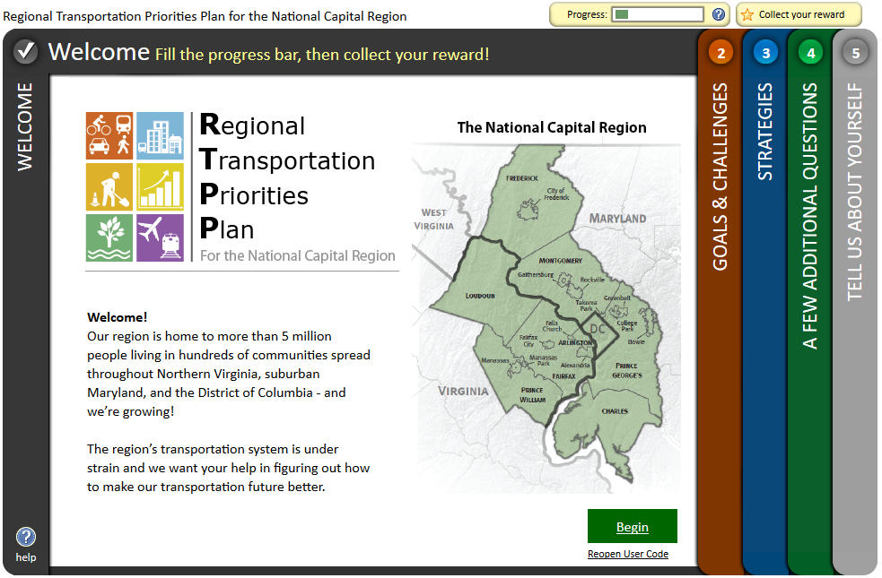
Survey: MetroQuest
Agenda Item #6: Public Outreach and Communications for 2018 LRP
April 13, 2017
Notes:
Planning to use Metroquest, an online survey tool
Used by lots of MPOs, transportation planning agencies, etc
We used it back in 2013 for the Priorities Plan
Gathered info on challenges, strategies, and other questions
Actually wound up telling us some interesting things, including Maintenance
So, we’re thinking that this will serve us well again – lots of options, ways to use it…. (TRANSITION)

Slide 4
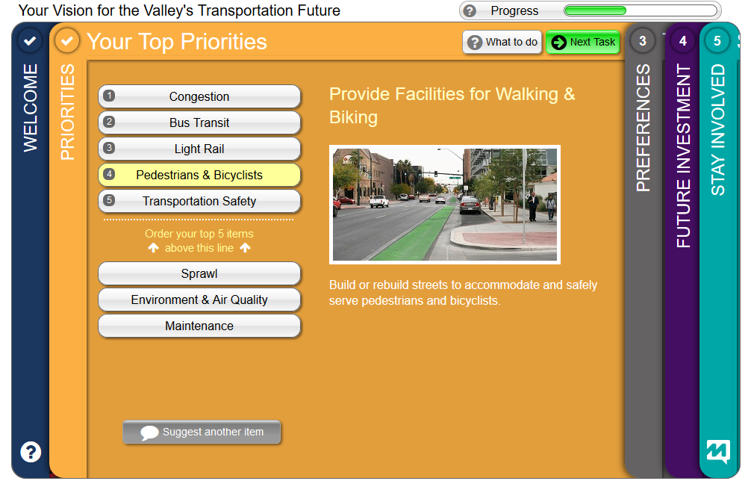
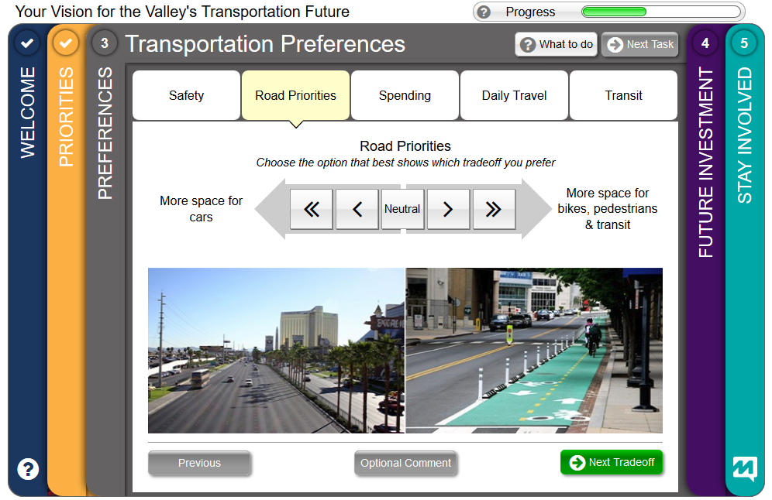
Survey: Examples
Agenda Item #6: Public Outreach and Communications for 2018 LRP
April 13, 2017
Notes:
Here are some examples
MetroQuest offers lots of ways to solicit input – ranking, rating, visual comparisons, maps

Slide 5
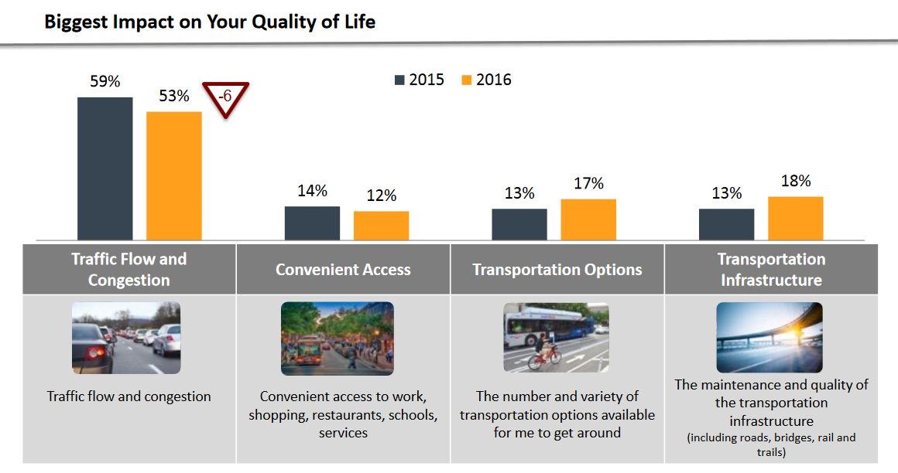
Survey: Examples
Agenda Item #6: Public Outreach and Communications for 2018 LRP
April 13, 2017

Slide 6
Survey: Sample questions
Which of the following factors has the biggest influence on your daily transportation experience?
Travel options, Affordability, Travel Time, Reliability, Safety, Convenience
How would you rate the region’s transportation system when it comes to each of these factors?
How do you think your personal experience compares to the experience of the average person in the region?
Much worse, somewhat worse, about the same, somewhat better, much better
Agenda Item #6: Public Outreach and Communications for 2018 LRP
April 13, 2017
Notes:
Sample question – just give you an idea
Broad, general – focus on attitudes – like NVTA
Will be working on refining these, making sure we’re maximizing value of MetroQuest
Expecting to have draft survey to share with you at May meeting

Slide 7
Survey: Two versions
OPEN SURVEY
??
responses
CONTROLLED SAMPLE
600
responses
Agenda Item #6: Public Outreach and Communications for 2018 LRP
April 13, 2017

Slide 8
Survey: Outreach
E-Blasts
OPEN SURVEY
??
responses
Mass Media
Social Media
Website
Postcards
Street Teams
Community Events
E-Newsletters
Agenda Item #6: Public Outreach and Communications for 2018 LRP
April 13, 2017

Slide 9

Branding: Out with the old
Agenda Item #6: Public Outreach and Communications for 2018 LRP
April 13, 2017

Slide 10
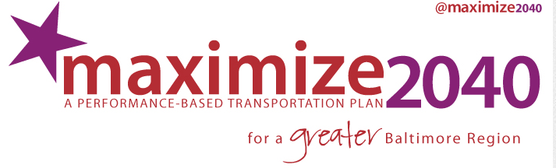



Branding: In with the new
Agenda Item #6: Public Outreach and Communications for 2018 LRP
April 13, 2017

Slide 11
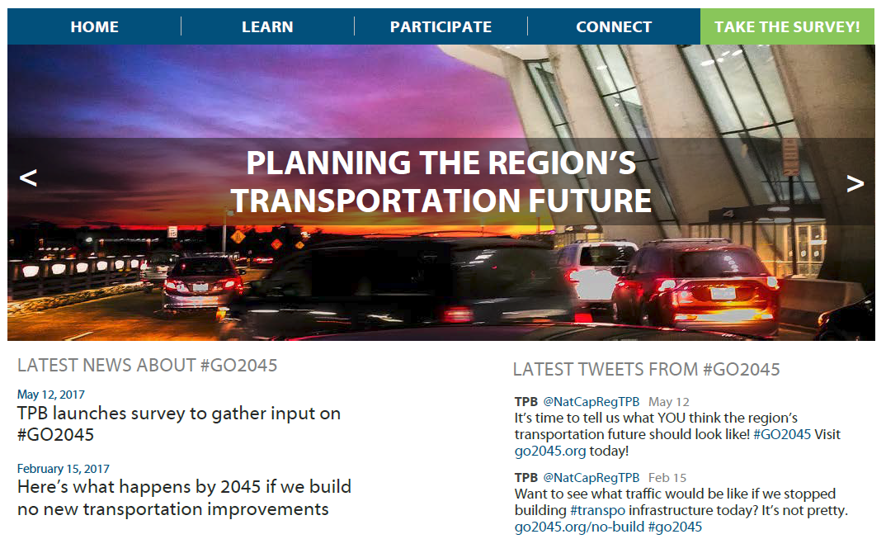
Branding: Website
Agenda Item #6: Public Outreach and Communications for 2018 LRP
April 13, 2017

Slide 12
Branding: Concepts
2045GO
Generic
Theme
OPTIONS2045
VISUALIZE
2045
Action
Agenda Item #6: Public Outreach and Communications for 2018 LRP
April 13, 2017

Slide 13
Ben Hampton TPB Communications Manager (202) 962-3275 bhampton@mwcog.org | mwcog.org/TPB
Metropolitan Washington Council of Governments 777 North Capitol Street NE, Suite 300 Washington, DC 20002

