Slide 1
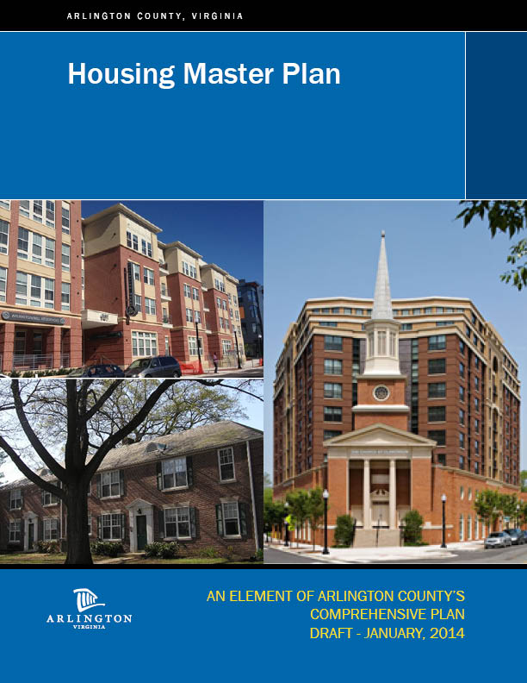
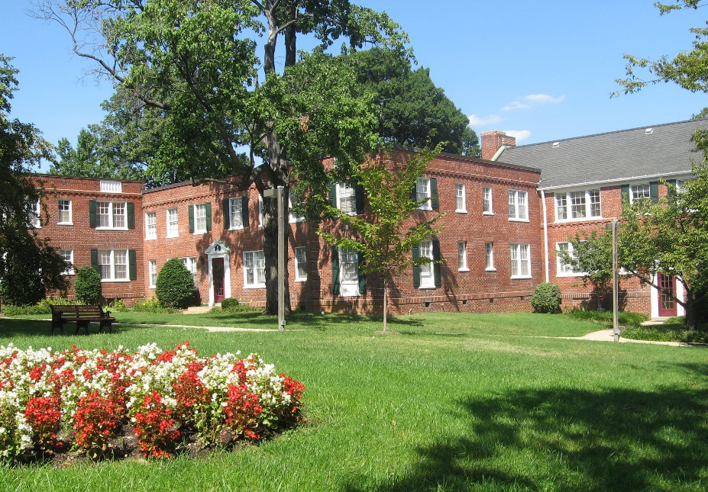
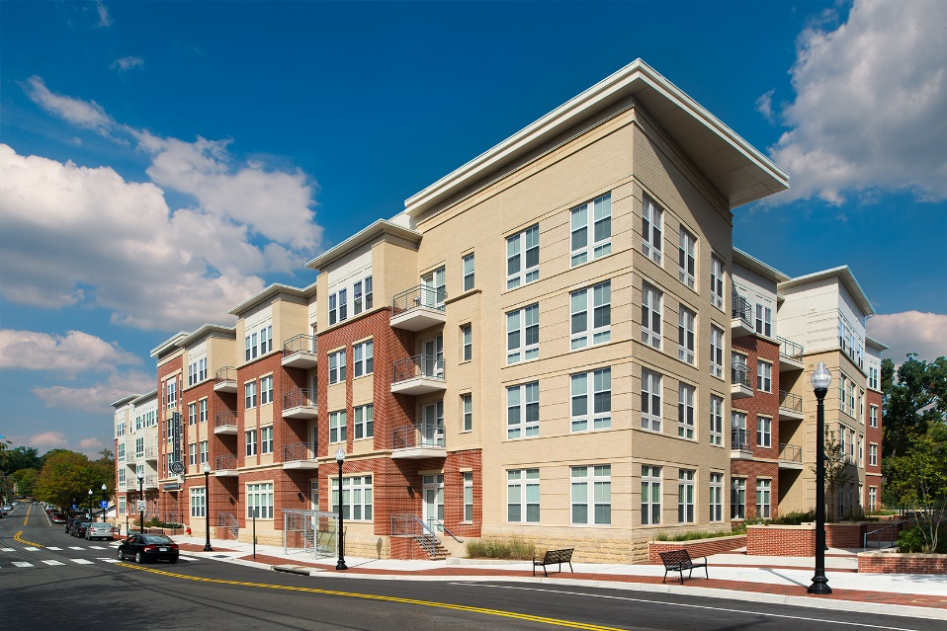
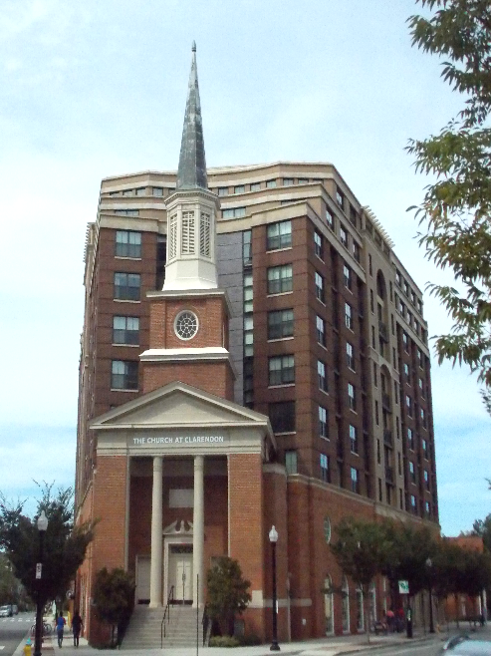
ARLINGTON COUNTY, VIRGINIA
Affordable Housing Master Plan
Adopted September 19, 2015
MWCOG Housing Directors Advisory Committee
January 21, 2016

Slide 2

Study Design
Poverty Rates by Census Tracts
3-year time frame
  Education
  Research and Analysis
  Policy Formation
  Community Consultation
Diverse stakeholder advisory working group County Manager Appointed
Policy recommendations informed by needs analysis
Separate Policy and Implementation documents
2

Slide 3
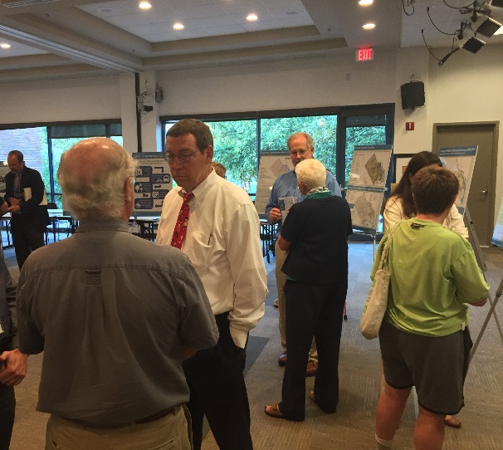
Robust Civic Engagement
What’s been done
Open Houses
Virtual open house and survey
Meetings with community groups
Presence at community events
3

Slide 4
Lessons learned
Poverty Rates by Census Tracts
Goals or targets should consider all affordable housing not only income restricted housing.
Stick to main data points/findings, repeat
Understanding the past and present are fundamental to understanding future goals
Targets should be flexible and point towards the desired direction of development.
Mechanisms need to be developed and employed to incentivize development in higher cost areas.
Areas of Concentrated Poverty should be treated with special consideration.
Engage with the community!
4

Slide 5
Results
Poverty Rates by Census Tracts
Overwhelming public testimony in support of the plan.
Board adoption 5-0
https://www.youtube.com/watch?v=LqRVh8cguRw
https://www.youtube.com/watch?v=s3DLJXOwJ4c
5

Slide 6
Thank You!
Poverty Rates by Census Tracts
housing.arlingtonva.us/affordable-housing-study
housingstudy@arlingtonva.us
rschroeder@arlingtonva.us
6

