Slide 1
Managing and updating TMC network files for VEHICLE ProBE Data
Some Observations
C. Patrick Zilliacus Transportation Engineer VEHICLE PROBE DATA USERS GROUP (VPDUG) JUNE 21, 2018
Agenda Item# 3

Slide 2
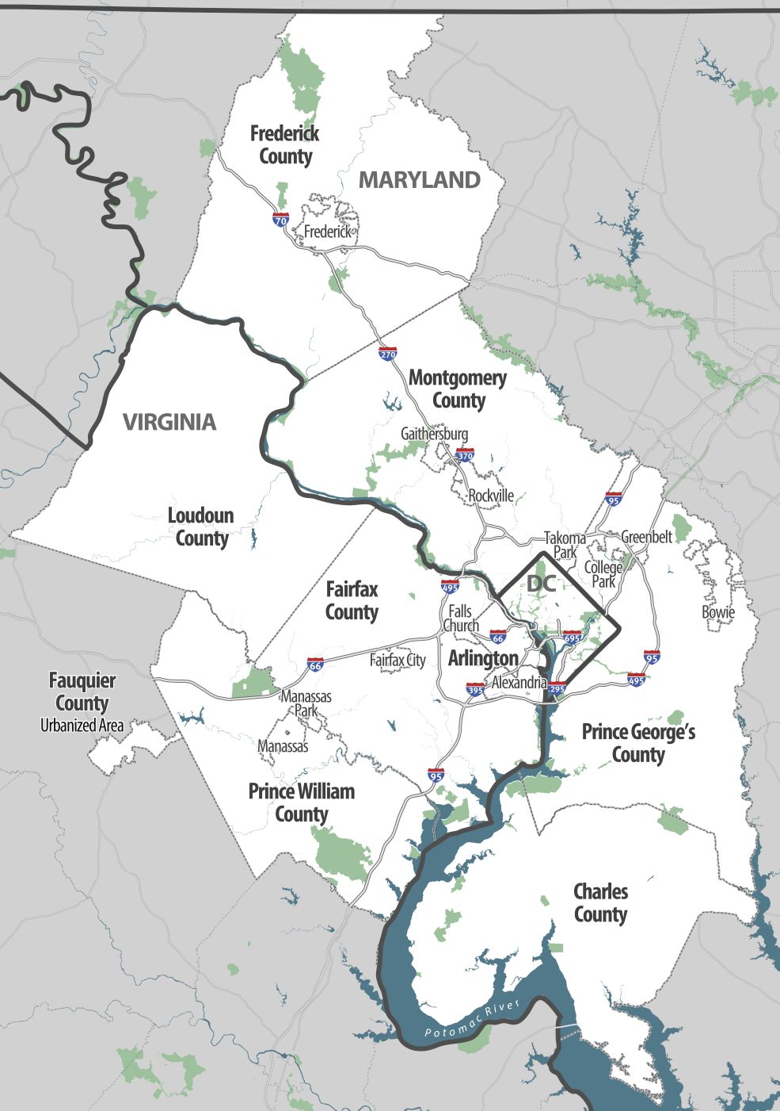
About the TPB
National Capital Region Transportation Planning Board (TPB) is the federally designated Metropolitan Planning Organization (MPO) for the region
Plays an important role as the regional forum for transportation planning
Prepares plans and programs that the federal government must approve in order for federal-aid transportation funds to flow to metropolitan Washington
Managing and Updating TMC Network Files VPDUG Item #3
June 21, 2018

Slide 3
Reliance on “old” and previously-used TMC networks may not be a good idea
An older TMC network, which once represented the entire TPB (Washington metropolitan area), including the District of Columbia; Maryland counties of Charles, Frederick, Montgomery and Prince George’s; and Virginia counties and county equivalents of Arlington, City of Alexandria, Fairfax, City of Fairfax, City of Falls Church, Loudoun and Prince William had lost about 20 network links out of about 8,900 total. We did not know what the lost links represent or why they were removed.
Staff believes there may have been additional TMC codes “recycled” for use in areas of Virginia beyond Northern Virginia, which are not included in this discussion because of uncertainty.
Managing and Updating TMC Network Files VPDUG Item #3
June 21, 2018

Slide 4
Reliance on “old” and previously-used TMC networks may not be a good idea
A current TMC network for the same cities and counties, contains over 13,000 records total.
The area of interest may change (TPB now includes an urbanized area of Fauquier County, Virginia (see map on previous slide), this added about 100 new TMC records.
Managing and Updating TMC Network Files VPDUG Item #3
June 21, 2018

Slide 5
Accounting for network changes 2016 to 2018
Managing and Updating TMC Network Files DRAFT Item #3
June 21, 2018

Slide 6
Why management of TMC Networks matters
Traffic message channel (TMC) networks can change in arbitrary ways, nearly always through deletion or addition – and apparently sometimes through relocation
The CATT Lab has no control over the TMC networks, which are developed and maintained outside of the CATT Lab and data providers such as Inrix.
Changes are not announced - they “just happen.”
However, changes from one month or quarter to another tend to be small.
Managing and Updating TMC Network Files VPDUG Item #3
June 21, 2018

Slide 7
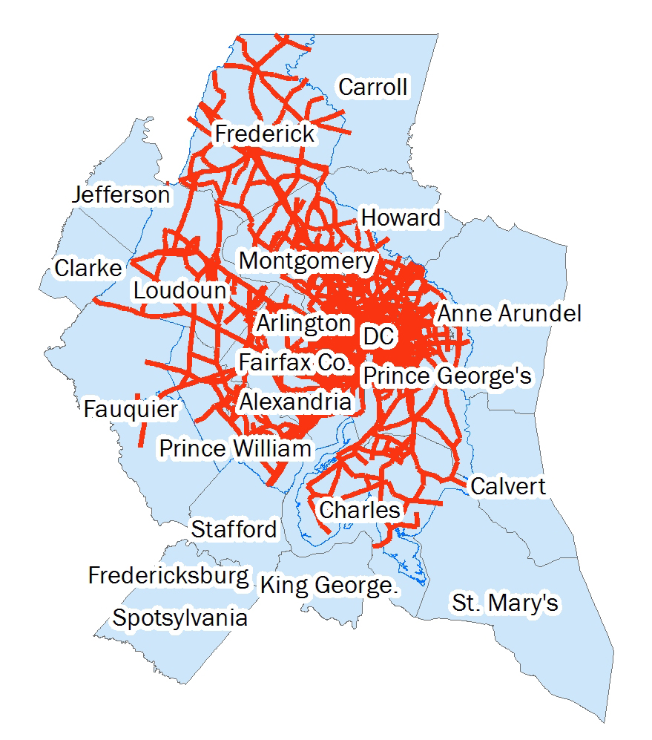
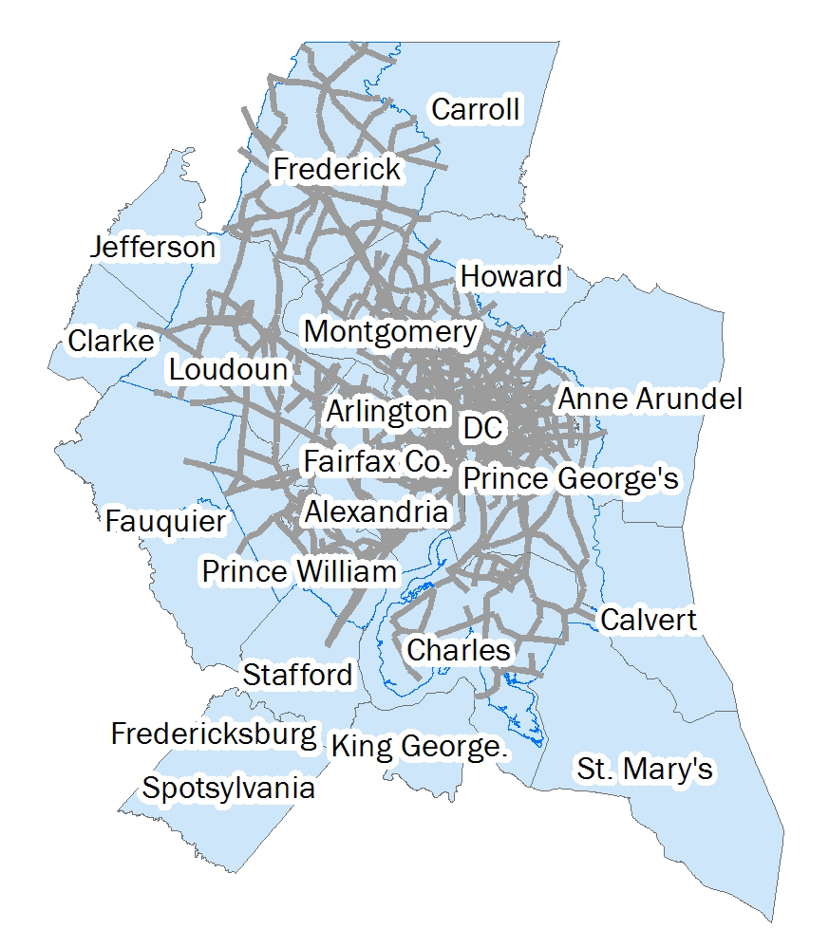
New 2018 Network
Old Network

Slide 8
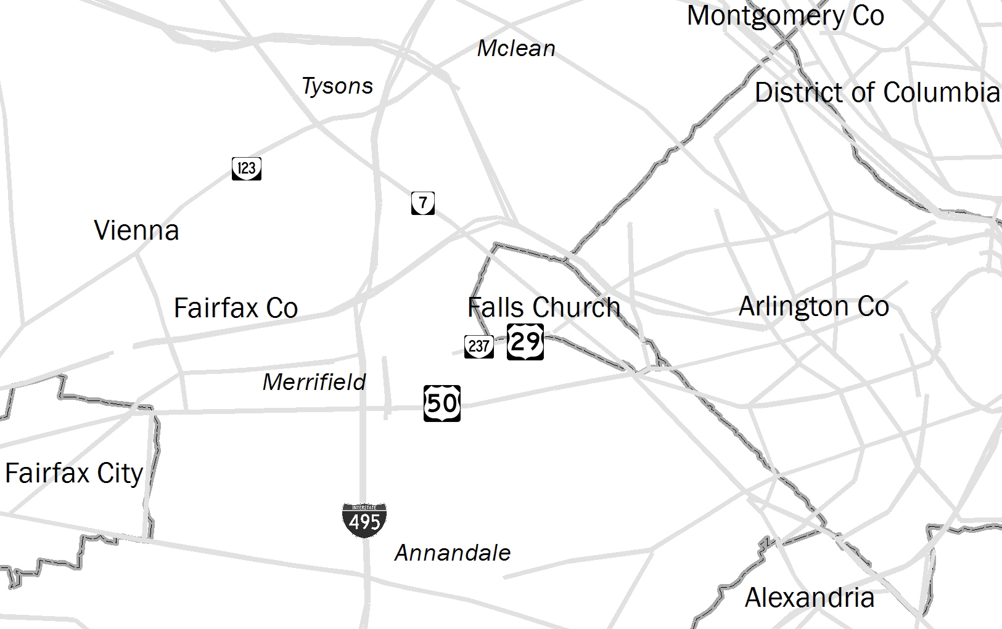
U.S. 29 Fairfax Co, Falls Ch, and Arlington
Many parts of U.S. 29 have “disappeared” from the old network of TMCs
Demonstrates why old networks might not be usable.
Managing and Updating TMC Network Files VPDUG Item #3
June 21, 2018

Slide 9
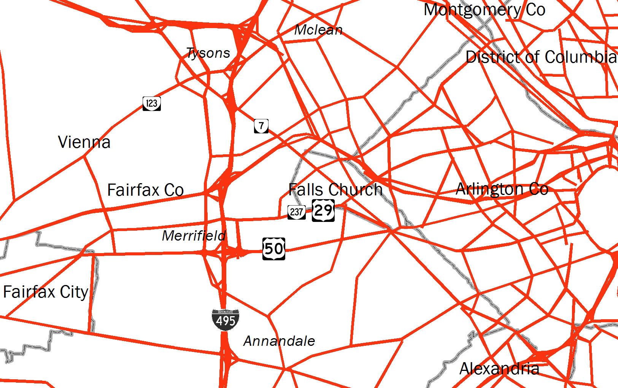
U.S. 29 Fairfax Co, Falls Ch, and Arlington
Missing sections of U.S. 29 have returned in 2018.
Managing and Updating TMC Network Files VPDUG Item #3
June 21, 2018

Slide 10
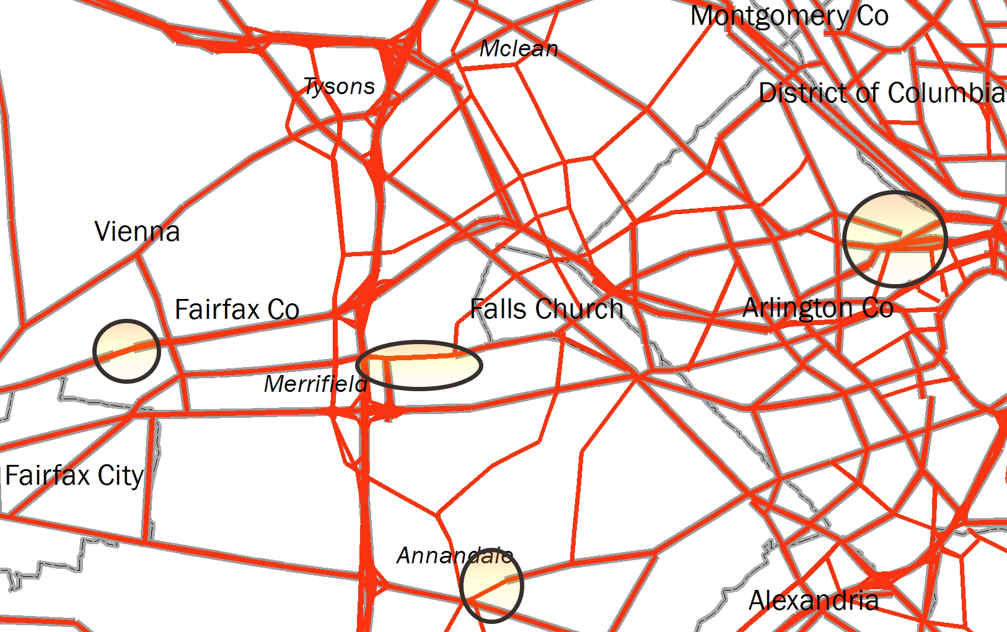
U.S. 29 Fairfax Co, Falls Ch, and Arlington
Red is new network, grey is “old” network.
Managing and Updating TMC Network Files VPDUG Item #3
June 21, 2018

Slide 11
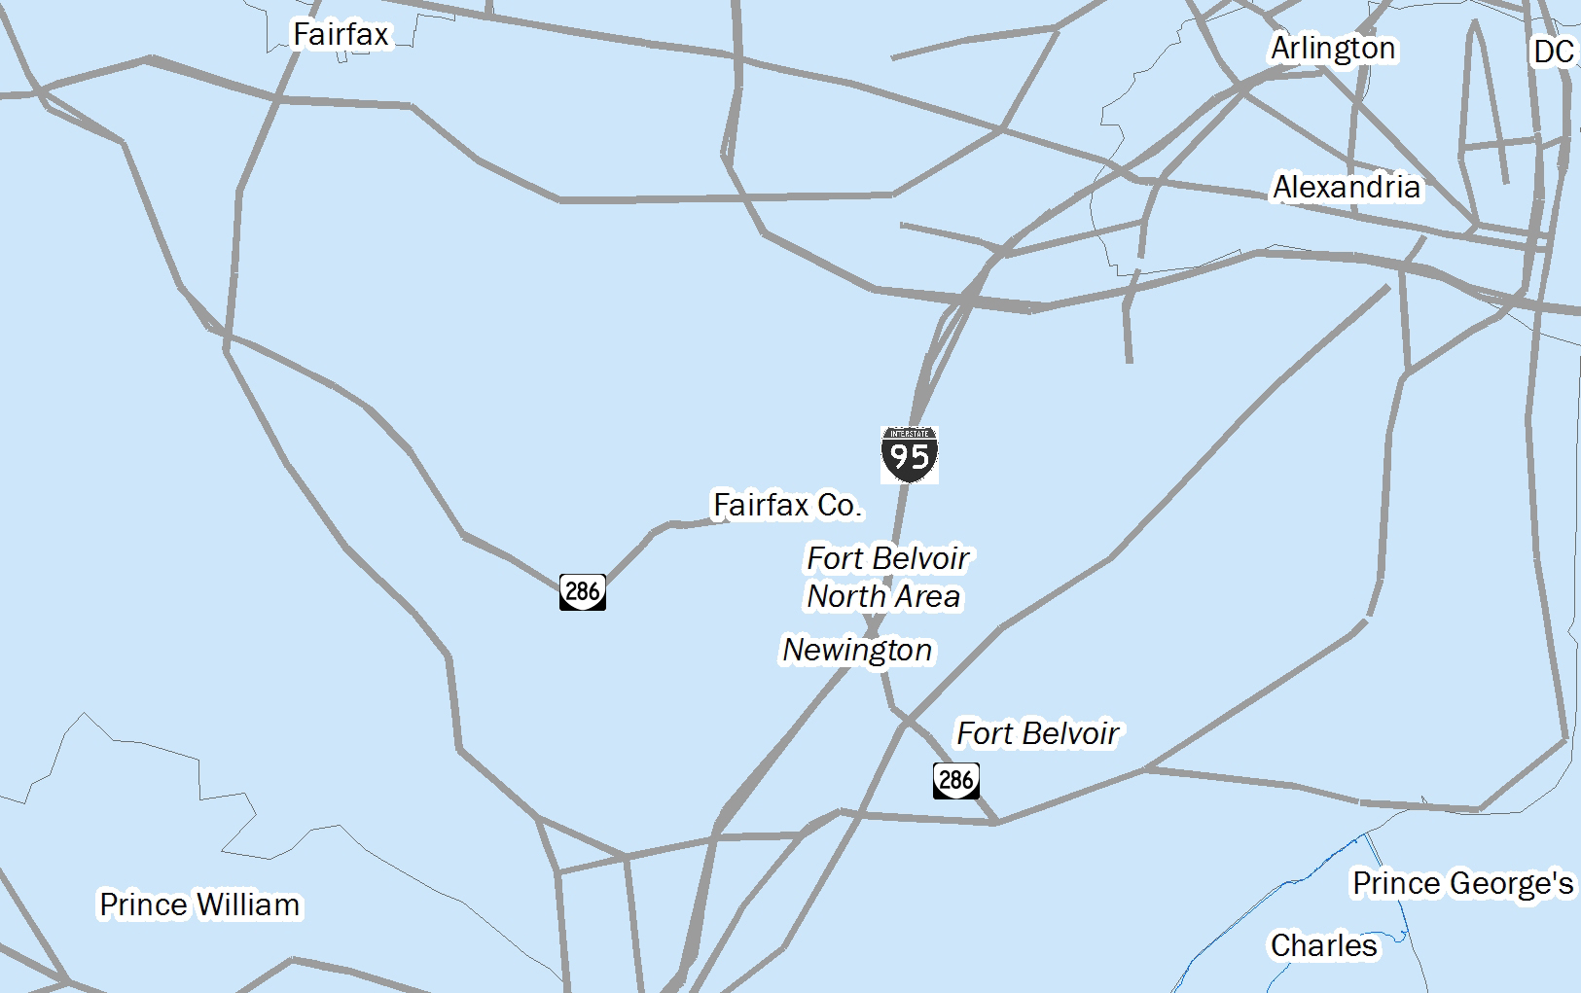
Ft Belvoir, Ft Belvoir N Area & Newington
Sections of VA-286 (Fairfax County Parkway) missing in 2016.
All of VA-289 (Franconia Springfield Parkway) also missing in 2016.
Managing and Updating TMC Network Files VPDUG Item #3
June 21, 2018

Slide 12
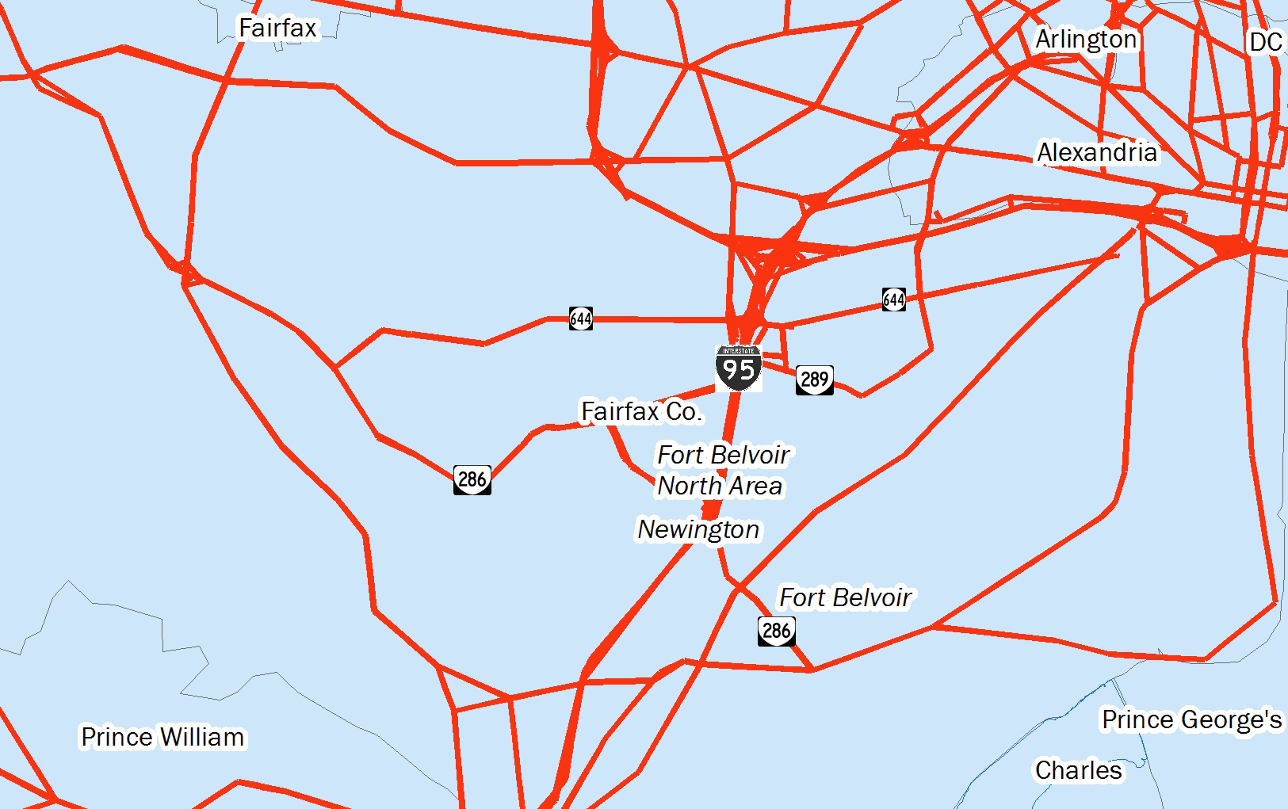
Ft Belvoir, Ft Belvoir N Area & Newington
Missing sections of VA-286 have appeared in 2018.
All of VA-289 has appeared in 2018 – as has VA-644 (Old Keene Mill Road/Franconia Road)
Managing and Updating TMC Network Files Item #3
June 21, 2018

Slide 13
What to do?
Download and archive data files on a periodic basis (disk or cloud storage is relatively cheap)
Should be done on the basis of states or counties or cities that you are interested in - not by using a list of TMCs
Monthly? Quarterly? Annually?
Monthly or quarterly should mean smaller file sizes
This provides a “frozen” TMC Network and data to go along with same if needed for a “look back”
Also allows comparisons between different networks over time if desired (COG/TPB staff find that SAS is a useful tool for such comparisons)
ArcGIS may also be helpful in some cases in checking networks
Managing and Updating TMC Network Files VPDUG Item #3
June 21, 2018

Slide 14
What to do? (cont’d.)
Do not rely on old lists of TMCs – recreate them on a regular basis
Countywide, or statewide definitions will “pick-up” changes in TMC network
Be aware that you may need to use your own tools for some of the analysis work with archived data
Managing and Updating TMC Network Files VPDUG Item #3
June 21, 2018

Slide 15
Thank you for listening
Questions?
Comments?
Managing and Updating TMC Network Files VPDUG Item #3
June 21, 2018

Slide 16
C. Patrick Zilliacus Transportation Engineer (202) 962-3292 Zill@mwcog.org | mwcog.org/TPB
Metropolitan Washington Council of Governments 777 North Capitol Street NE, Suite 300 Washington, DC 20002

