Slide 1
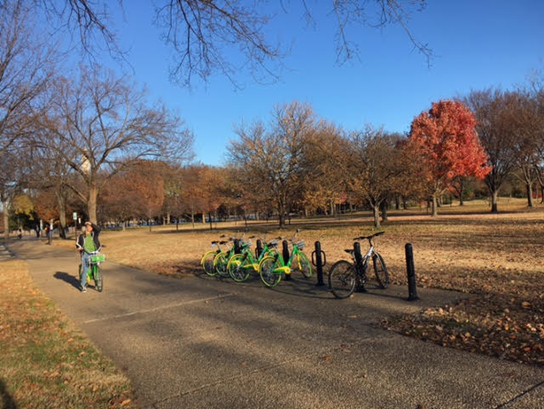
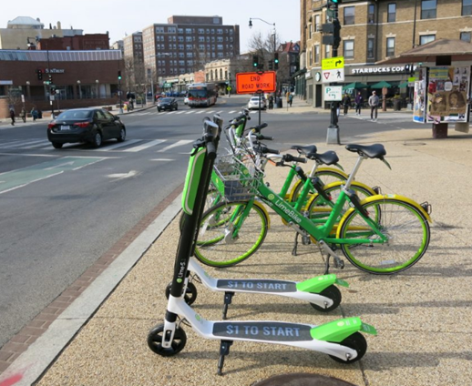
Save the Date: Dockless Vehicle Workshop
October 31, 2018
12:30 p.m. – 3:30 p.m.
Lunch at Noon
Walter A. Scheiber Board Room
Third Floor
Metropolitan Washington Council of Governments
777 North Capitol Street NE, Suite 300
Washington, DC
“
Image: National Park Service
Image: DDOT
DOT and Planning Staff will discuss:
The evolution of Dockless Vehicle (Bike and Electric Scooter) Share in the District of Columbia, Montgomery County, Arlington, and Baltimore
Results of Pilot Permit Programs
Regional Coordination and Implications for Adjoining Jurisdictions
Lessons learned and plans going forward
This is a free event, open to the public
Pre-registration is required
Register HERE

