Slide 1
TMDLs, WIPs, 2YMs*:
Content and Schedule
Take Away Messages:
Complex regulatory analysis
Much tighter permit conditions, especially for stormwater
Important & highly prescriptive Watershed Implementation Plans (WIPs)
Opportunities for review & comment in 2010 & 2011
Ted Graham
Chesapeake Bay Policy Committee
March 19, 2010
* TMDL = Total Maximum Daily Load
WIP = Watershed Implementation Plan
2YM = Two-Year Milestone

Slide 2
TMDL – The Pollution Budget
Regulation: Highly complex TMDL
  Covering 64,000 square miles
  Three TMDLs for each of the 92 “impaired” tidal segments:
    Nitrogen
    Phosphorus
    Suspended Sediment
Allocation of loads:
  “Waste Load Allocations” for permitted sources including wastewater & stormwater
  “Load Allocations” for unregulated nonpoint sources including agriculture

Slide 3
TMDL Elements
TMDL = Total Maximum Daily Load
  Pollution budget for Bay
  To meet nutrient and sediment targets by 2025
  Issued by EPA: 12/31/10
WIP = Watershed Implementation Plan
  How target loads will be achieved from now through 2017
  Phase I at basin level;
    Draft: 8/1/10; Final: 11/1/10
  Phase II at local level (anticipate county targets)
    Draft: 6/1/11; Final: 11/1/11
  Issued by States & District of Columbia
  Phase III from 2017 through 2025
2-Year Milestones
  Incremental description of progress to be made
  Issued by States & District of Columbia

Slide 4
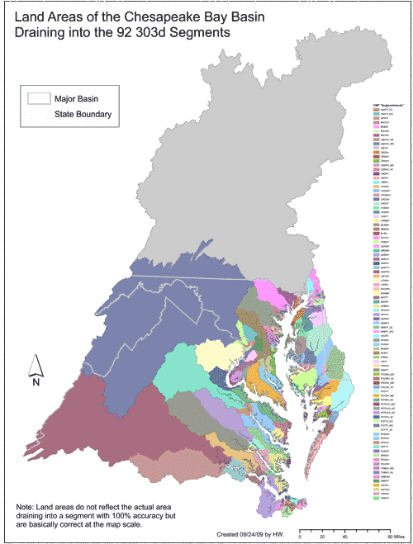
TMDL Complexity
92 distinct impaired segments
Each has a distinct tributary area
Each gets 3 TMDLs
  TN, TP & TSS
Together they comprise the Bay TMDL
Reflected in permits

Slide 5
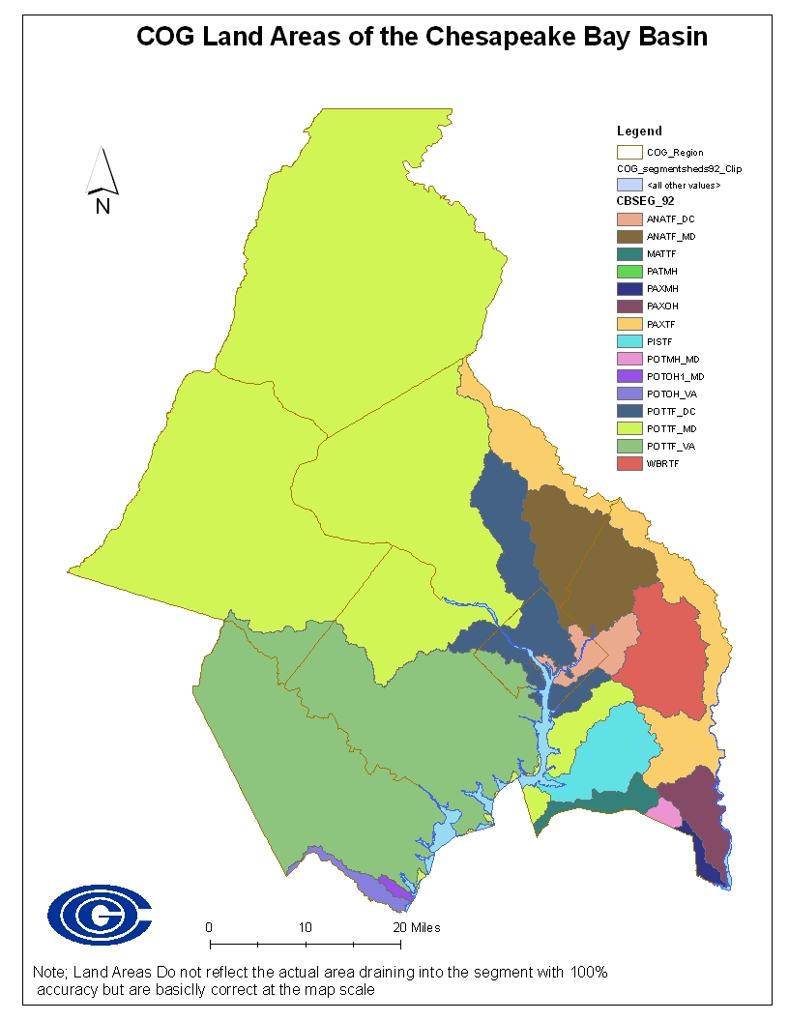
Close Up in the COG Region
County | Segments
Frederick | 1
Montgomery | 4
Pr. George’s | 10 +/-
District of Col. | 3
Loudoun | 2
Fairfax | 3
Arlington | 2
Prince William | 4

Slide 6
2010 Schedule (COG role)
March-April : WIP development by states, local pilot projects
  Informal COG staff/WRTC comment
June 1: States/District provide EPA with preliminary WIPs
  Informal COG staff/WRTC comment
June – August: EPA review, state adjustments
  July WRTC, CBPC review; potential CBPC comment letter
August 15: EPA issues draft TMDL for 60-day public comment
  September WRTC, CBPC review; potential CBPC or COG Board comment
Nov. 1: States/District issue final Phase I WIPs
Dec. 31: EPA issues final TMDL

Slide 7
2011 Schedule
June 1: States/District submit preliminary Phase II WIPs to EPA
June – October: EPA review, state adjustments
Nov 1: States submit final Phase II WIPs to EPA
January 2012: States/District announce second set of 2-year Milestones

