Slide 1
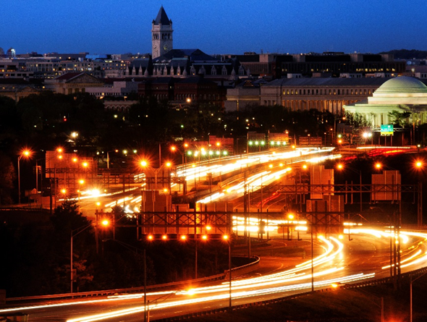
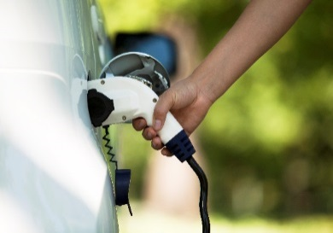
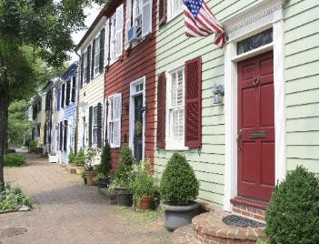

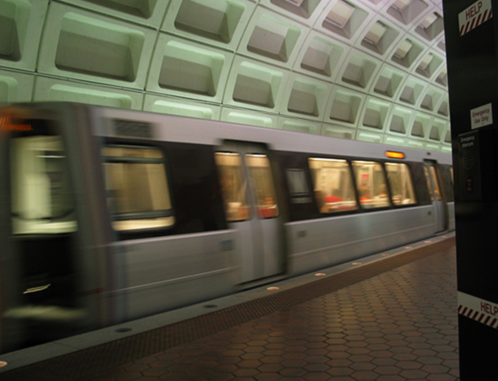
Multi-Sector Approach to Reducing Greenhouse Gas Emissions in the Metropolitan Washington Region
Process Overview
Prepared for:
Metropolitan Washington Council of Governments
Friday, May 8, 2015

Slide 2
ICF Tasked with…
Performing the necessary work to a prepare a Technical Report quantifying the benefits, costs, and co-benefits and describing possible implementation approaches and timeframes of viable, implementable, and stretch GHG reductions strategies in the Metropolitan Washington Region.

Slide 3
Definitions
Strategy
High-level actions that can be taken to reduce greenhouse gas emissions. They are drafted at a high level to provide for scenario level analysis. The scenarios may include near-term viable actions and stretch actions requiring new policy implementation across the region, states and nation.
Notes:
Policies, goals and targets will be separately considered in the next phase of this project.

Slide 4
Definitions
Implementation Action
Actions that could be put in place to support achievement of the strategy level scenarios. These differ from policies, goals and targets that do not directly result in reductions in greenhouse gas emissions.
Notes:
Policies, goals and targets will be separately considered in the next phase of this project.

Slide 5
Outcomes for Today’s Meeting
Discuss GHG reduction strategies recommended for analysis
Discuss general approach to analysis
Seek consensus on existing strategies
Discuss potential additional strategies, and seek consensus

Slide 6
Project Milestones
Timeline of strategy analysis to date
Project Kick-off
Subgroup Meetings to Discuss Strategies and Assessment
COG MSWG Meeting
Qualitative Assessment of Strategies
Technical Memo on Strategies to be Analyzed
March 25
April 8
April 13, 17
April 30
May 8
Public Comment Period April 9-20

Slide 7
Project Milestones Going Forward
ICF begins Strategy Analysis
Technical Memo on Analysis Results
Present Draft Technical Report to full MSWG
Draft Final Technical Report
COG MSWG Meeting (Exploration of Goals in Other Regions)
COG MSWG Meeting (Exploration of Goals in WASHCOG Region)
Review Analysis with Subgroups
Revised Final Technical Report
May 9
June 18
July 9
July 16, 17
July 31
September 25
October 22
November 20
ICF Conducts Strategy Analysis May 9 - July 9
Presentations to Policy Boards/Committees
(TPB, MWAQC, CEEPC, COG)
September, October, December 2015
January 2016

Slide 8
Process for Recommendations
Reviewed and refined list of GHG reduction strategies brainstormed by Sector Working Groups.
Performed qualitative analysis on strategies, identifying reduction potential, timeframe for implementation, and co-benefits, to name a few.
Accepted public comment on strategies through COG website.
Incorporated feedback, grouped/bundled and prioritized strategies for analysis.

Slide 9
GHG Reduction Strategies
Energy and Built Environment Strategies
EBE-1: Existing Buildings - Energy and water performance
EBE-2: Building-level renewables
EBE-3: Encourage development in activity centers
EBE-4: New Buildings - Energy and water performance
EBE-5: Infrastructure – Energy and water performance and increase renewable energy use
EBE-6: Reduction in power sector emissions
EBE-7: Reduction in gas pipeline leaks
EBE-8: Reduction in municipal solid waste
EBE-9: Reduction in emissions from non-road engines
EBE-10: Educate and motivate public
Transportation and Land Use Strategies
TLU-1: Increase Urban Tree Canopy and Land Stewardship
TLU-2: Sustainable Development Patterns & Urban Design (including Enhancements for Non-motorized Modes)
TLU-3: Improve Fuel Economy of Light-duty Vehicle Fleet
TLU-4: Increase Alternative Fuels in Public Sector Fleets
TLU-5: Clean Freight Technologies
TLU-6: Low Carbon Fuel Standard
TLU-7: Enhance System Operations
TLU-8: Reduce Speeding on Freeways
TLU-9: Travel Demand Management
TLU-10: Transit Enhancements
TLU-11: Transit Incentives / Fare Reductions
TLU-12: Road Pricing

Slide 10
GHG Reduction Strategies- Synergies
Coordinated analysis will take place to account for overlap across sectors
EBE-1: Existing Buildings - Energy and water performance
TLU-2: Sustainable Development Patterns & Urban Design (including Enhancements for Non-motorized Modes)
EBE-3: Encourage development in activity centers
EBE-9: Reduction in emissions from non-road engines

Slide 11
Energy & Built Environment Strategies
Bill Prindle, ICF

Slide 12
Overall Analysis Considerations
Analysis will focus on the Strategy level
  Specific implementation actions will play important roles in implementing the strategies
  Time and budget constraints limit the analysis to sketch modeling—making quantitative estimates based on existing data sources and previous analyses
Sketch modeling will differentiate COG-member actions from Federal and State actions
  Estimate incremental impacts of COG-member strategies/action as additional to Federal CAFE and appliance standards, State CPP plan impacts, etc.
Sketch modeling will draw on existing COG-region datasets
  ICF analyses for PEPCO, Dominion, and Montgomery County
  COG baseline data, including emissions, energy, and related data sources and tools

Slide 13
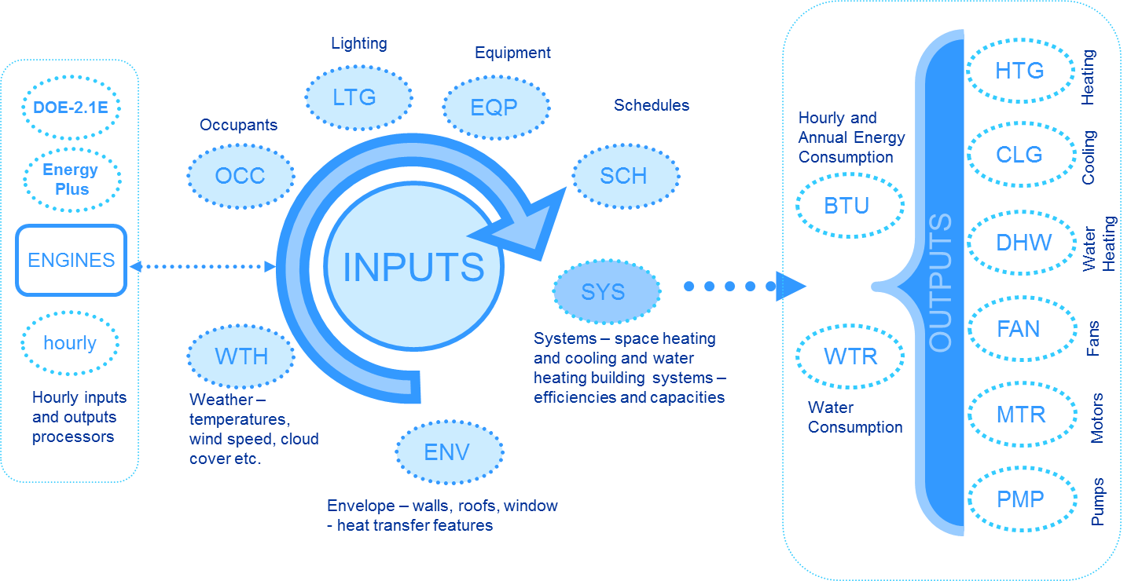

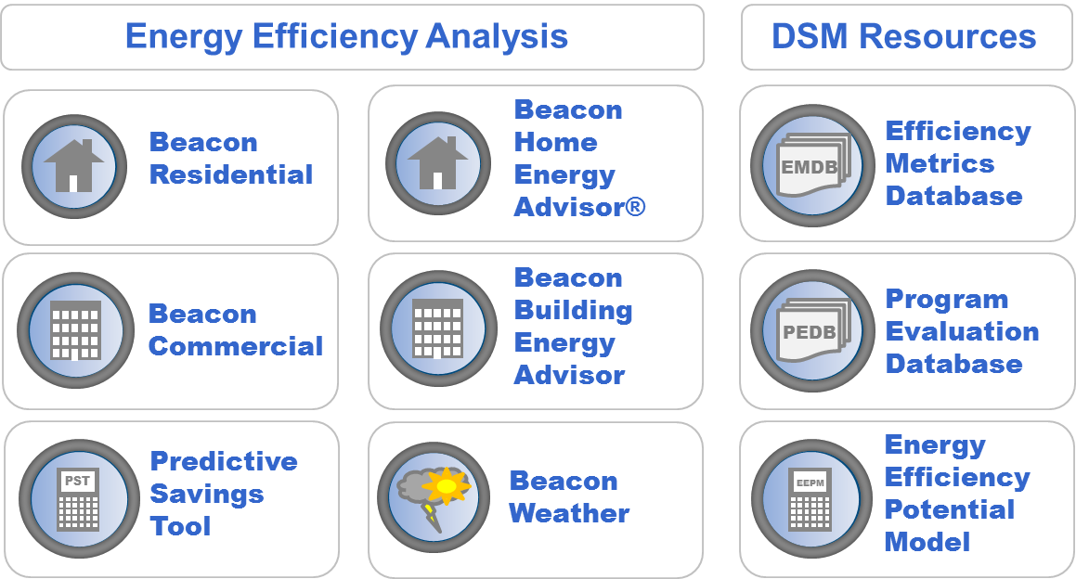
Examples of Tools/Resources Underlying EBE Sketch Analyses
ICF Beacon building simulation platform
ICF Energy Efficiency Planning Model (EEPM)
Pepco DSM potential study
MD utility electric baseline study
Montgomery County Commercial Building Energy Policy Study

Slide 14
Energy and Built Environment Scenarios
Strategy | Affected Resource Type |  | Analytic Methodology | Scenarios/Level of Aggressiveness
 | Energy Efficiency | Energy Supply
EBE-1. Existing Buildings - Energy and water performance | x |  | Apply savings estimates from existing EE potential studies (e.g. Pepco, Montgomery County), augmented by individual policy and program impact data (e.g. DC benchmarking EUI results) | 2% annual reductions, 30% cumulative reductions by 2030
EBE-2. Building-level renewables |  | x | Apply per-building RE production estimates based on regional experience to market penetration assumptions.
EBE-3. Encourage development in activity centers | x |  | Apply housing size reduction estimates and expected number of units | Increase in % of new development in Activity Centers by 2030

Slide 15
Energy and Built Environment Scenarios
Strategy | Affected Resource Type |  | Analytic Methodology | Scenarios/Level of Aggressiveness
 | Energy Efficiency | Energy Supply
EBE-4. New Buildings - Energy and water performance | x |  | Reduce energy use and emissions impacts of new residential and commercial building stock using three scenarios Calculate water usage reductions based on difference between NAECA standards and WaterSense performance levels for affected fixtures. Use existing EECC building codes calculator tool | --100% of new buildings reach ENERGY STAR levels by 2030 --50% of new buildings NZE by 2040 --100% of new buildings NZR by 2050 - 100% of new buildings use WaterSense fixtures by 2030 - 100% compliance with most stringent model codes by 2020
EBE-5. Infrastructure – Energy and water performance and increase renewable energy use | x | x | Apply scenario savings goals to current and project infrastructure usage estimates | 1% annual reduction, 35% cumulative reduction by 2050

Slide 16
Energy and Built Environment Scenarios
Strategy | Affected Resource Type |  | Analytic Methodology | Scenarios/Level of Aggressiveness
 | Energy Efficiency | Energy Supply
EBE-6. Reduction in power sector emissions | x | x | Project emission reductions on a regional mass basis, applying impact estimates of defined actions | 30% reduction in total mass emissions by 2030
EBE-7. Reduction in gas pipeline leaks |  | x | Estimate reduced methane emissions (converted to CO2e) from WGL system based on available data | 20% reduction in methane leakage by 2030

Slide 17
Energy and Built Environment Scenarios
Strategy | Affected Resource Type |  | Analytic Methodology | Scenarios/Level of Aggressiveness
 | Energy Efficiency | Energy Supply
EBE-8. Reduction in municipal solid waste | x | x | Estimate energy and emissions impacts of increased recycling/waste prevention, and increased number of waste to energy projects | Net zero waste by 2050
EBE-9. Reduction in emissions from non-road engines | x | x | See transportation analysis | 2% annual, 30% cumulative reductions in NRE GHGs by 2030
EBE-10. Educate and motivate public | x | x | Use impact estimates from previous public campaigns and educational efforts

Slide 18
Transportation & Land Use Strategies
Michael Grant, ICF
Erika Myers, ICF
Rich Kuzmyak, Renaissance Planning

Slide 19
Overall Analysis Considerations
Analysis will focus on the Strategy level
  Specific implementation actions will play important roles in implementing the strategies
  Time and budget constraints limit the analysis to sketch modeling—making quantitative estimates based on existing data sources and previous analyses
State, Regional and Local Actions, not Federal
  National policies and regulations could have the most significant impacts, but these strategies may not be feasible or desirable to be applied at a regional level
Grouping of Strategies
  For analysis, we plan to bundle several strategies
  Utilize sketch planning tools combined with emissions factors from MOVES

Slide 20
Grouping/Bundling of Strategies
Strategy for Analysis | L-1: Maximize urban tree canopy and land stewardship | L-2: Increase proportion of new housing & jobs in activity centers | L-3: Improve regional jobs/housing balance | L-4: Maximize walkable design in activity centers | L-5: Establish adequate retail balance in activity centers | L-6: Focus Government employment near premium transit | T-1: Improve fuel economy of light-duty vehicle fleet | T-2: Increase alternative fuels in public sector fleets | T-3: Clean freight technologies | T-4: Lower emissions off-road construction vehicles | T-5: Low carbon fuel standard | T-6: Roadway bottleneck relief / targeted capacity enhancements | T-7: Corridor / regional operational improvements | T-8: Promote ecodriving | T-9: Off-peak freight deliveries | T-10: Increase speed limit enforcement | T-11: Advance adoption of connected vehicle technologies | T-12: Enhance the bicycle/pedestrian environment | T-13: Enhance transit services | T-14: Transit incentives | T-15: Park-and-ride and HOV investments | T-16: Parking management | T-17: Travel demand management | T-18: Road pricing / congestion pricing | T-19: Cordon pricing | T-20: Pay As You Drive insurance | T-21: Increasing fuel taxes / Carbon tax
TLU-1: Increase Urban Tree Canopy and Land Stewardship
TLU-2: Sustainable Development Patterns & Urban Design (including Enhancements for Non-motorized Modes)
TLU-3: Improve Fuel Economy of Light-duty Vehicle Fleet
TLU-4: Increase Alternative Fuels in Public Sector Fleets
TLU-5: Clean Freight Technologies
TLU-6: Low Carbon Fuel Standard
TLU-7: Enhance System Operations
TLU-8: Reduce Speeding on Freeways
TLU-9: Travel Demand Management
TLU-10: Transit Enhancements
TLU-11: Transit Incentives / Fare Reductions
TLU-12: Road Pricing

Slide 21
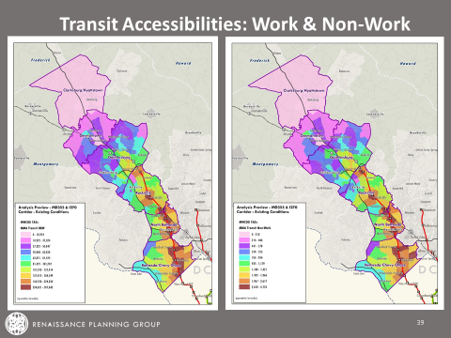
Analysis Approaches
EPA TEAM (Transportation Efficiency Analysis Method) Approach
  Utilizes TRIMMS tool to analyze TDM strategies, transit enhancements, pricing strategies (as well as limited potential for LU and bike/ped)
Tools developed for NCHRP 8-78, including use of GIS-overlay methods
  Analyzes shift in mode shares due to land use changes, bicycle/pedestrian accessibility
Argonne National Laboratory Greenhouse Gases, Regulated Emissions, and Energy Use in Transportation Modeling (GREET)
  A full life-cycle model to evaluate various vehicle and fuel combinations on a full fuel-cycle/vehicle-cycle basis
Simple spreadsheet tools
  Assess changes in vehicle operations, technologies, and fuels

Slide 22
Transportation and Land Use Scenarios
Strategy | Affected Mobile Source Emissions Parameter |  |  | Analytic Methodology | Scenarios/Level of Aggressiveness
 | VMT | Speed/ Idling | Vehicles / Fuels
TLU-1: Increase Urban Tree Canopy and Land Stewardship | X |  |  | Estimate carbon sequestration equivalent of 1 acre of tree cover. Develop acreage-saved conversion factor for relocating a household or employee from suburban/exurban greenfield development to urban/TOD/MXD location. Assess potential increase in tree coverage from other programs. | 2015: Establish base year tree canopy coverage by jurisdiction (also impervious surface, undeveloped land) 2020: Project effects of 2020 development increment on canopy coverage; possibly augment with tree preservation/planting programs in short term 2040: Link tree and undeveloped ground cover to base and stretch scenarios.
TLU-2: Sustainable Development Patterns & Urban Design (including Enhancements for Non-motorized Modes) | X |  |  | Calculate TAZ level modal accessibility scores for 2015, 2020 and 2040. Use these scores to project the effects of TR+LU on mode choice, leading to delta trips by mode and delta VMT. Create alternative land use allocations for the region & activity centers in 2040, and possibly key enhancements to the transportation network. Recalculate accessibilities and travel impacts | 2015: Base year accounting for accessibility effects on mode share (effects beyond COG model) 2020: Run base CLRP land use and transport networks (don’t expect major TR+LU changes between 2015 and 2020, but will still run accessibility procedure) 2040: Run base CLRP land use and networks 2040 Moderate: Reasonable adjustments in location of growth into and among centers, accounting for proximity to rail transit, jobs/housing ratios, holding capacity and other factors 2040 Stretch: Aggressive reallocation, possible TR network mods

Slide 23
Transportation and Land Use Scenarios Cont’d
Strategy | Affected Mobile Source Emissions Parameter |  |  | Analytic Methodology | Scenarios/Level of Aggressiveness
 | VMT | Speed/ Idling | Vehicles / Fuels
TLU-3: Improve Fuel Economy of Light-duty Vehicle Fleet |  |  | X | Use spreadsheet analysis to calculate emission reduction per ZEV | 2020: Increase % of light-duty zero emission vehicles (ZEVs) to 2% of total vehicle population in study region 2040: Increase % of light-duty ZEVs to 15% 2040 stretch: Increase % of light-duty ZEVs to 25%
TLU-4: Increase Alternative Fuels in Public Sector Fleets |  |  | X | Use spreadsheet analysis to calculate emission reductions per CNG vehicle, ZEV, and biodiesel consumption | 2020: Add X (TBD) CNG buses to public transit fleet 2040: Increase % of ZEVs in municipal light-duty fleets to 15% of total fleet population; require B5 in all municipal fleets and school buses; % (TBD) of public transit fleet to be converted to CNG 2040 stretch: Increase % of ZEVs in municipal light-duty fleets to 25% of total fleet population; require B20 in all municipal fleets and school buses; % (TBD) of public transit fleet to be converted to CNG

Slide 24
Transportation and Land Use Scenarios Cont’d
Strategy | Affected Mobile Source Emissions Parameter |  |  | Analytic Methodology | Scenarios/Level of Aggressiveness
 | VMT | Speed/ Idling | Vehicles / Fuels
TLU-5: Clean Freight Technologies |  |  | X | Spreadsheet analysis to estimate emission reductions per truck stop electrification (TSE) slot | 2020: Add one TSE location with 20 slots in study region 2040: Add five additional TSE locations with 20 slots/location 2040 stretch: Add eight additional TSE locations with 20 slots/location
TLU-6: Low Carbon Fuel Standard |  |  | X | Will use analysis already prepared by NESCAUM and apply portion of projected reductions specific to fuel use in region | 2020: N/A 2040: Reduce fuel emissions in region by 10% 2040 stretch: Reduce fuel emissions in region by 15%
TLU-7: Enhance System Operations |  | X |  | Utilize literature to estimate change in speed profile for vehicles from eco-driving; utilize TOPS-BC and literature to estimate potential reduction in delay or idling time. Apply speed-based emissions factors or idle emissions factors to estimate GHG reduction. Add V2I description as part of methodology | 2020: 20% of drivers adopt eco-driving practices; corridor operational improvements reduce travel time by 10% 2040: 80% of drivers adopt eco-driving practices; corridor operational improvements reduce travel time by 20% 2040 stretch: 100% of drivers utilize eco-driving practices; corridor operational improvements reduce travel time by 25%

Slide 25
Transportation and Land Use Scenarios Cont’d
Strategy | Affected Mobile Source Emissions Parameter |  |  | Analytic Methodology | Scenarios/Level of Aggressiveness
 | VMT | Speed/ Idling | Vehicles / Fuels
TLU-8: Reduce Speeding on Freeways |  | X |  | Spreadsheet analysis - Examine share of traffic on freeways at speeds above posted limits. For applicable VMT, apply emissions factors for corresponding speeds. | 2020: Average speeds on freeways (outside of congested periods) reduced to 57 mph. 2040: Average speeds on freeways (outside of congested periods) reduced to 57 mph. 2040 stretch: Average speeds on freeways (outside of congested periods) reduced to 55 mph. Incorporate into Operational Improvements Strategy Scenario. Note: This strategy overlaps with the ecodriving strategy, and potentially could be grouped.
TLU-9: Travel Demand Management | X |  |  | Use TRIMMS sketch planning tool - Extract mode shares (by region, sub-region, or by O-D pairs) and apply elasticities from TRIMMS to estimate change in mode split. | 2020: Expand employer-based incentives (subsidies of $50 per month for 40% of employers); 50% of parking in activity centers is priced at average of at least $8 per day ($1 per hour) 2040: Expand employer-based incentives (subsidies of $50 per month for 80% of employers); 90% of parking in activity centers is priced at average of at least $8 per day ($1 per hour) 2040 stretch: Expand employer-based incentives (subsidies of $80 per month for 100% of employers); 100% of parking in activity centers is priced at average of at least $8 per day ($1 per hour)

Slide 26
Transportation and Land Use Scenarios Cont’d
Strategy | Affected Mobile Source Emissions Parameter |  |  | Analytic Methodology | Scenarios/Level of Aggressiveness
 | VMT | Speed/ Idling | Vehicles / Fuels
TLU-10: Transit Enhancements | X | X |  | Use TRIMMS sketch planning tool - Extract mode shares (by region, sub-region, or by O-D pairs) and apply elasticities from TRIMMS to estimate change in mode split. | 2020: Reduce transit travel times by 5% and reduce headways (wait time) by 5% on 10 major commute corridors 2040: Reduce transit travel times by 20% and reduce headways (wait time) by 20% on 24 major commute corridors 2040 stretch: Reduce transit travel times by 30% and reduce headways (wait time) by 30% on 24 major commute corridors; reduce wait time by 10% on all other corridors (assumed due to improved traveler information)
TLU-11: Transit Incentives / Fare Reductions | X |  |  | Use TRIMMS sketch planning tool - Extract mode shares (by region, sub-region, or by O-D pairs) and apply elasticities from TRIMMS to estimate change in mode split. | 2020: Reduce transit fares during off-peak periods by 5% by offering monthly passes or providing free trips for students or free transfers 2040: Reduce transit fares regionally by 20% 2040 stretch: Reduce transit fares regionally by 40% partially funded through pricing strategies
TLU-12: Road Pricing | X |  |  | Use TRIMMS sketch planning tool - Extract mode shares (by region, sub-region, or by O-D pairs) and apply elasticities from TRIMMS to estimate change in mode split. | 2020: None – Long-term scenario only; but potentially assume 20 percent of drivers switch to Pay-As-You-Drive insurance 2040: Full VMT-based pricing at $0.25 per mile [May consider option for pricing only all freeways, but challenging without more detailed modeling 2040 stretch: Full VMT-based pricing on road network at $0.25 per mile peak. Cordon pricing into downtown DC at $5 [Need to determine if can forecast, and overlaps with transit service enhancements and fare reductions]

Slide 27
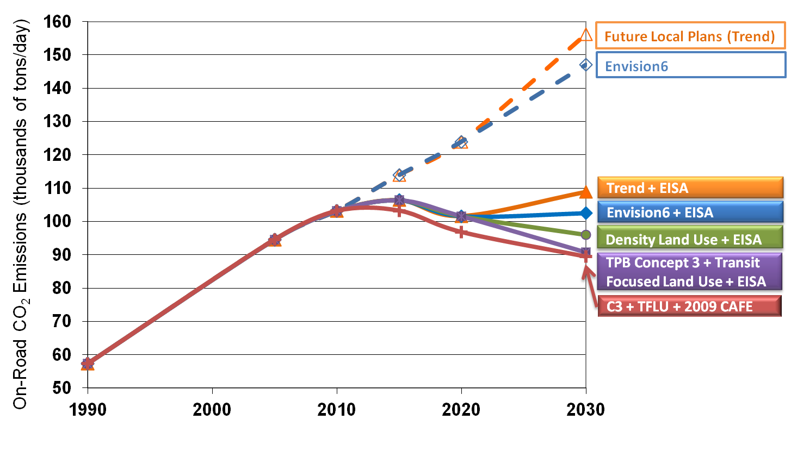
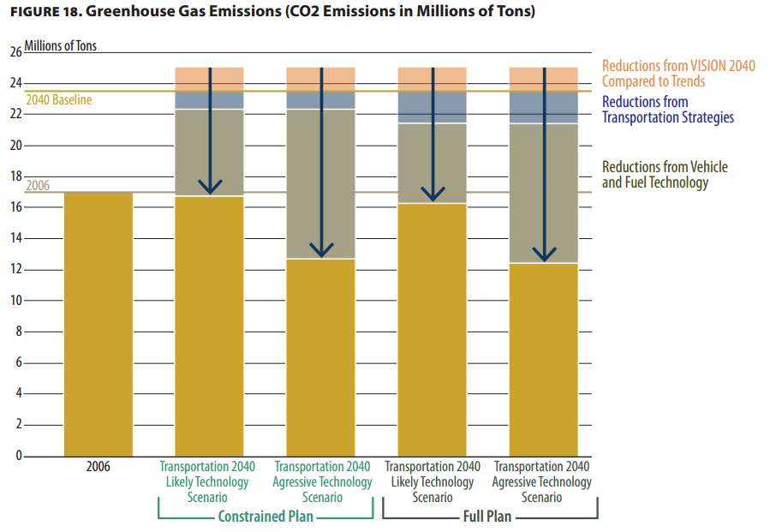
Different Analysis Approaches
Different sets of (combined) strategies
Different levels of aggressiveness
Source: Atlanta Regional Commission
Source: Puget Sound Regional Council, Transportation 2040, Chapter 3 and Appendix L, available at: http://www.psrc.org/transportation/t2040/t2040-pubs/final-draft-transportation-2040

