Slide 1
Potomac river water quality report
Christine Howard Environmental Analyst Water Resources Technical Committee September 14, 2018

Slide 2

Main Messages
Three Key Messages
  Our region has made a lot of progress but more needs to be done
  It isn’t a simple, linear story – estuaries are complex systems and it takes time to see a response
  Data indicates a mixed picture of progress- certain parameters showing signs of improvement while others have declined

Slide 3
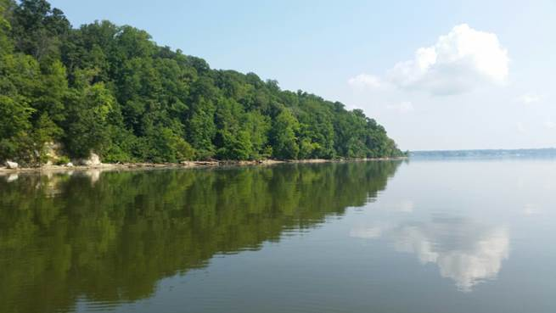
Report Format
Overview/Purpose
Technical sections - Inputs to the Estuary
  WWTP contributions
  Across the Fall Line – Chain Bridge Monitoring
  Below Fall Line – WQ Trends
SAV - regional success story
Conclusions/Next Steps

Slide 4
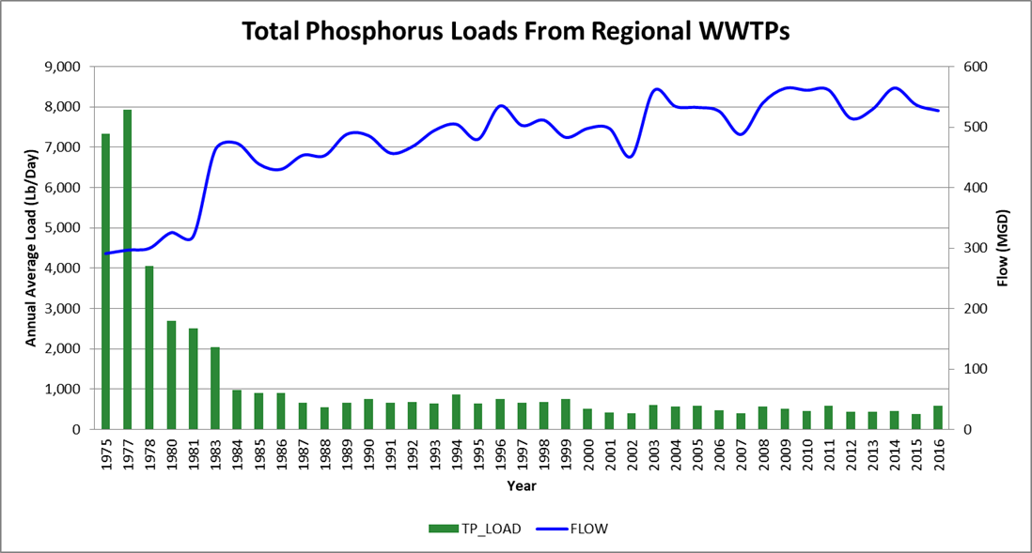
WWTPs
Emphasize the major contributions of nutrient reductions efforts / wwtp upgrades
Success is derived from a funding partnership among all levels of government
Will include graphs of TN and TP annual loads
  Reductions even more impressive given the increases in wwtp flow

Slide 5
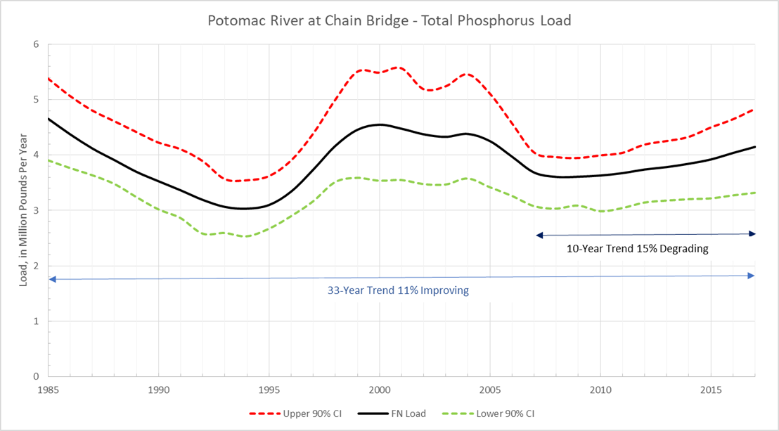
Across the Fall Line – Chain Bridge
Nutrient reduction efforts have led to decreasing trends since 1985 for all three of the major pollutants (TN, TP and TSS)
Yet phosphorus and sediment loads have increased in recent years (2007 – 2017)

Slide 6
Below the Fall Line – WQ Trends
Plan to use data from the CBP Tidal Monitoring Program
Main Message - data gathered in the Potomac estuary and the Bay since 1985 provides a mixed picture of progress
Certain parameters showing signs of improvement while others have declined
Focused on Bay Water Quality Attainment Parameters – dissolved oxygen, water clarity (secchi depth) and chlorophyll-a

Slide 7
Below the Fall Line – WQ Trends
Dissolved Oxygen – one of the key parameters for evaluating the success of the Bay TMDL
Bay Program developed the ‘attainment defecit’ metric to explain the extent of non-attainment for each parameter
  Uses the volume of water and amount of time the water segment is out of attainment (averages over a rolling 3 year period
  A “0” means that the segment is in attainment/ anything below the 0 line is in ‘non-attainment’

Slide 8
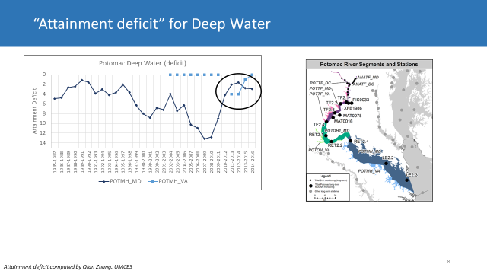
Below the Fall Line – WQ Trends
Source: Rebecca Murphy UMCES – COG’s Monitoring workshop

Slide 9
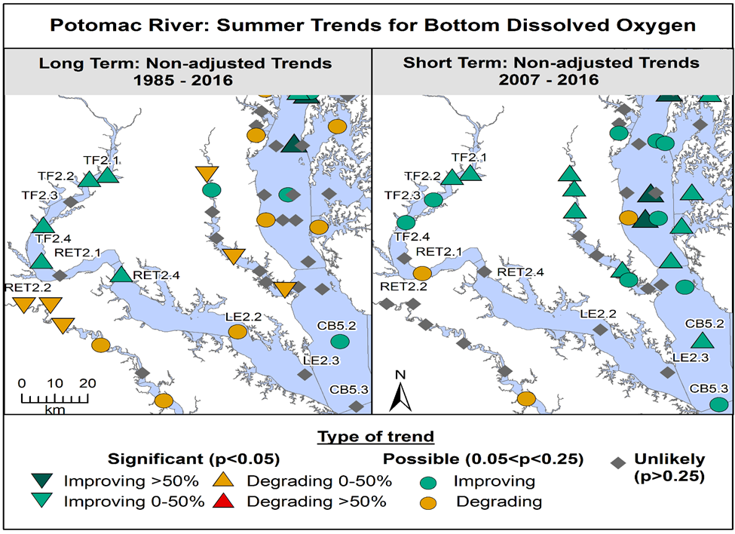
WQ Trends – Dissolved Oxygen
Bay Program and MDDNR – using a new statistical technique known as Generalized Additive Models (GAMs) to assess trends
Improving trends – green downward facing arrows or circles
Degrading – red or yellow
Neutral - grey
Long Term DO Trend – improving at almost all of the upstream stations
No trend or degrading at lowermost stations (LE2.2 and LE2.3)

Slide 10
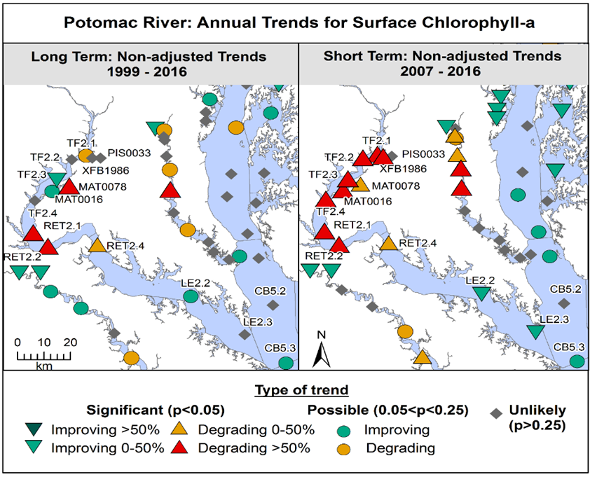
WQ Trends – Chlorophyll-a
A mixed picture but mostly negative/degrading
Why such a mixed picture/different from other trends?
  Some theories such as populations of freshwater clam species

Slide 11
Next Steps
Agree on the main messages and focus
Finalize draft and share with WRTC and CBPC
Reaching out/sharing the story
  Work with WRTC on a guest blog, news items?

Slide 12
Christine D. Howard Environmental Analyst (202) 962-3366 cdhoward@mwcog.org | mwcog.org
777 North Capitol Street NE, Suite 300 Washington, DC 20002

