Slide 1
Building Codes Training for the 2012 IECC
Final Action Hearings
October 25th-31st, 2010
Metropolitan Washington Council of Governments, Committee Meeting of the Intergovernmental Green Building Group
Dick Meyer
Program Director, Energy Codes
Institute for Market Transformation
Caroline Keicher
September 14, 2010
Program Associate, IMT
Notes:
Jessyca Henderson – AIA American Institute of Architects
Eric Lacey – RECA – Responsible Energy Codes Alliance

Slide 2
Building Energy Codes – the basics
Building codes are specific, detailed criteria that must be met and approved to receive building permits.
Professional associations and standards setting organizations create, discuss, debate, amend, and publish these model codes.
Two main organizations publish building energy codes:
  ICC – commercial & residential building energy codes
  ASHRAE – commercial building energy codes
  Energy Code Minimums = “The Least Energy-Efficient Building You Can Legally Build”
Notes:
American Society of Heating, Refrigeration and Air-Conditioning Engineers

Slide 3
Building Energy Codes – the basics
Model Energy Code amendment process occurs every three years
  State & Local Officials Vote for Final ICC Commercial & Residential Code
  50-Member Standing Standards Project Committee (SSPC) Sets ASHRAE 90.1 Commercial Code
Guided by Model Energy Codes, State and Local Codes are then amended, adopted, administered, and enforced by Local Officials

Slide 4
Why is the International Energy Conservation Code (IECC) so important?
National Model Energy Code of Choice
  40 States and D.C.
Cited throughout federal law for:
  National private and Federal housing initiatives
  Energy Independence & Security Act of 2007 (EISA)
  Energy Conservation & Production Act, as amended
    National benchmark for single family homes, townhomes, low-rise condominiums & apartments
  Manufactured Housing (HUD 24 CFR 3280)
  Energy Efficient Mortgage Programs (FHA, VA, Fannie & Freddie)

Slide 5
The State of Energy Codes in Virginia
  The Virginia Uniform Statewide Building Code (USBC)
  Mandatory, effective May 1st, 2008
  Based on 2006 IECC
  On July 26, 2010, the Virginia Board of Housing and
  Community Development approved a proposed rule
  to update the Uniform Statewide Building Code
  (USBC) to reference the 2009 IECC and 2009 IRC
Notes:
Intro/Brief:
The Virginia Uniform Statewide Building Code (USBC) is a state regulation promulgated by the Virginia Board of Housing and Community Development, a Governor-appointed board, for the purpose of establishing minimum regulations to govern the construction and maintenance of buildings and structures.
The provisions of the USBC are based on nationally recognized model building and fire codes published by the International Code Council, Inc.. The model codes are made part of the USBC through a regulatory process known as incorporation by reference. The USBC also contains administrative provisions governing the use of the model codes and establishing requirements for the enforcement of the code by the local building departments and other code enforcement agencies.
In keeping with the designations of the USBC used previously, since the 2006 editions of the International Codes are incorporated by reference into this version of the USBC, it is known as the 2006 edition of the USBC.

Slide 6
The State of Energy Codes in Maryland
The 2010 Maryland Building Performance Standards (MBPS – COMAR 05.02.07)
Mandatory, effective January 1, 2010
Incorporates by reference the 2009 editions of the International Building Code (IBC), the International Residential Code (IRC), and the International Energy Conservation Code (IECC) with modifications by the state .
The Maryland Department of Housing and Community Development (DHCD) must adopt subsequent versions of the MBPS within 12 months of publication of new code editions by the International Code Council (ICC).
Notes:
Maryland
The 2010 Maryland Building Performance Standards (MBPS – COMAR 05.02.07)
Mandatory, Effective January 1, 2010
incorporates by reference the 2009 editions of the International Building Code (IBC), the International Residential Code (IRC), and the International Energy Conservation Code (IECC) with modifications by the state . Each local jurisdiction in Maryland may modify these codes to suit local conditions with exception to the 2009 IECC and the energy efficiency chapter (Chapter 13) of the 2009 IBC, which can be made more stringent but not less by the local jurisdictions. The energy efficiency chapter (Chapter 11) of the 2009 IRC has been deleted and replaced with a reference to the 2009 IECC.
These regulations became effective January 1, 2010.
The Maryland Department of Housing and Community Development (DHCD) must adopt subsequent versions of the MBPS within 12 months of publication of new code editions by the International Code Council (ICC).
Enforcement of the MBPS shall be the responsibility of the local jurisdiction in which the building or structure is located. Local governments must implement and enforce the most current MBPS within six months of adoption by DHCD.

Slide 7
The State of Energy Codes in DC
The 2008 D.C. Construction Codes
Mandatory, effective December 26, 2009
  Residential Code: based on the "30% Solution" (developed to be 30% beyond the 2006 IECC), which is more stringent than the 2009 IECC.
  Commercial Code: based on ASHRAE 90.1-2007, with several greening amendments.
The D.C. Green Building Act of 2006 requires that updated building codes be submitted to the City Council by January 1, 2010 and again every three years thereafter. The Act requires that codes "shall incorporate as many green building practices as practicable."
Notes:
Intro/Brief:
Residential Code: 2008 D.C. Construction Codes, based on the "30% Solution" (developed to be 30% beyond the 2006 IECC), which is more stringent than the 2009 IECC.
Commercial Code: 2008 D.C. Construction Codes, based on ASHRAE 90.1-2007, with several greening amendments.
On December 5, 2006, the D.C. City Council unanimously passed the D.C. Green Building Act, according to which the Mayor was to submit a comprehensive set of green building standards by January 2008. These standards were not only expected to include the provisions of the 2006 IECC; starting in 2012, they were expected to require all commercial development of 50,000 square feet or more to qualify for LEED certification. Incentives for early adopters of green building practices were envisaged for the period before 2012.
On December 2, 2008, the D.C. City Council adopted new residential and commercial building codes that incorporate many energy efficiency and green building standards. Replacing the previous code based on the 2000 IECC that became effective in January 2004, the 2008 D.C. Construction Codes have been developed from ASHRAE 90.1-2007 for commercial buildings (about 7% more stringent than the standard in place for neighboring Virginia and Maryland) and the"30% Solution" for residential buildings (30% energy savings above the 2006 IECC, or about 30% more stringent than the standard in place for Virginia and Maryland), which was a comprehensive package of amendments offered at the 2009 International Code Council hearings in September.
The new codes also contain several greening amendments recommended by the D.C. Green Building Advisory Council(GBAC), including (among others) cool roofs, on-site stormwater retention, and low-flow residential and commercial plumbing fixtures. The GBAC had recommended adoption of the energy efficiency section of ASHRAE Standard 189.1, which would have yielded a 30% increase in commercial energy efficiency requirements, but due to delays in its publication, it could not be referenced in this D.C. code edition.
The new codes were effective immediately upon publication in the D.C. Register on December 26, 2008, but contain aone-year transition period during which building permit applications may use either the new code or the previous code adopted in 2003 (based on the 2000 IECC). The D.C. Green Building Act of 2006 requires that updated building codes be submitted to the City Council by January 1, 2010 and again every three years thereafter. The Act requires that codes "shall incorporate as many green building practices as practicable."

Slide 8
What can a 30% improvement in energy codes do?
“By 2030, DOE estimates that full adoption and implementation of 30% model codes in America's homes and buildings has the potential to save approximately 2.7 Quads of energy per year and to avoid nearly 160 million metric tons of C0₂ equivalents per year, which could potentially save consumers up to $20 billion in annual energy expenditures.” DOE Asst. Sec David Rodgers, testimony 7/08

Slide 9
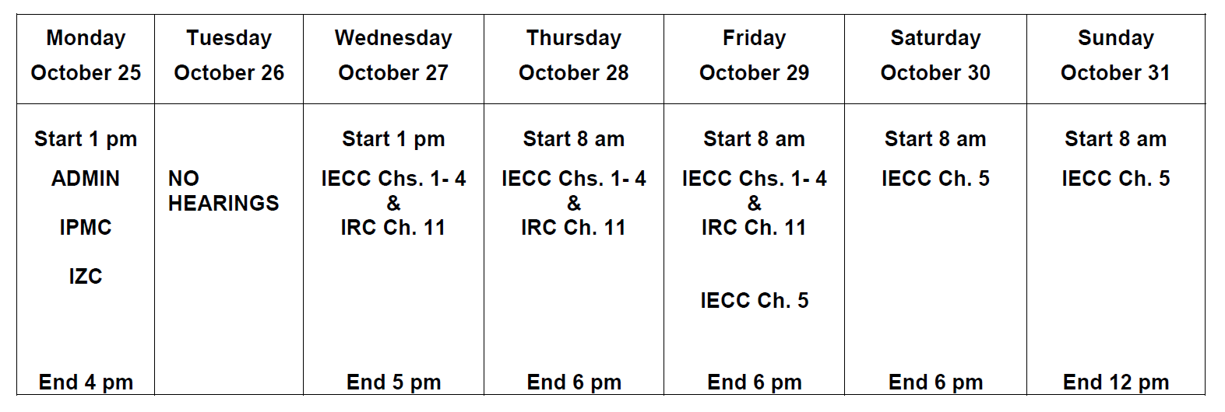
And now for logistics… and scheduling!
The Hearings on the IECC and IRC will not start until 1:00 pm on Wednesday. Actual start times for each code/chapter cannot be stipulated due to uncertainties in hearing progress. The hearing on each code/chapter will begin immediately upon the completion of the hearings for the prior code/chapter. This may require late nights and schedule adjustments.

Slide 10
ICC Policy on Financial Assistance for Governmental Member Voting Representatives
ICC Council Policy #CP-36 defines the circumstances under which it is permissible for Governmental Member Voting Representatives to accept funds to enable a Governmental Member Voting Representative to attend ICC code hearings.
Prior to receiving a voting device, each Governmental Member Voting Representative will have to sign a written certification that he/she has complied with ICC policy regarding the receipt of financial assistance in connection with attendance at the hearing.

Slide 11
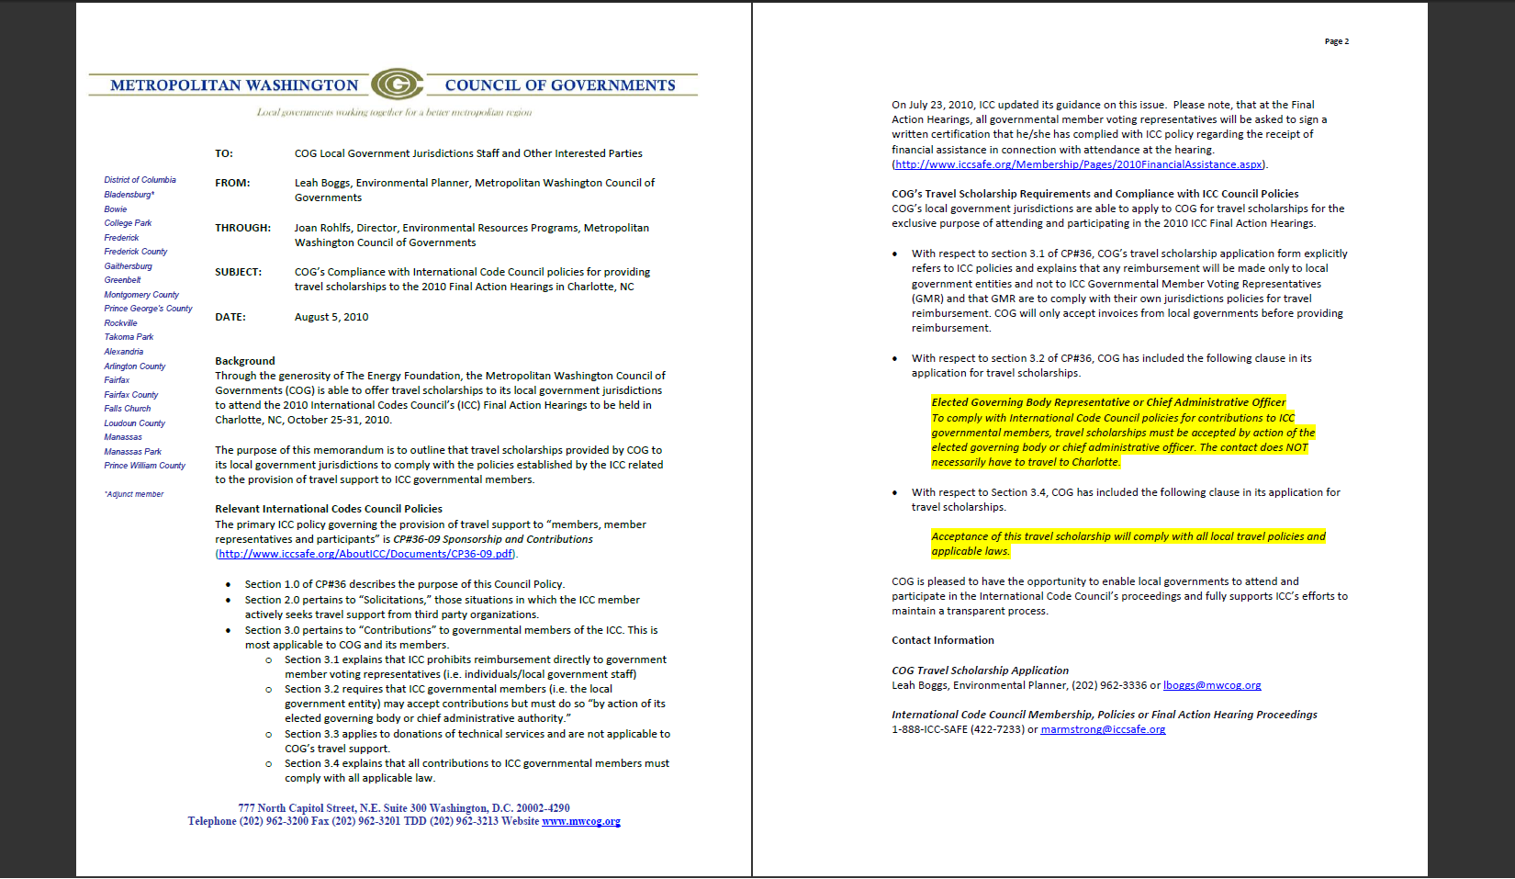
COG’s Compliance Memo on ICC Policies

Slide 12
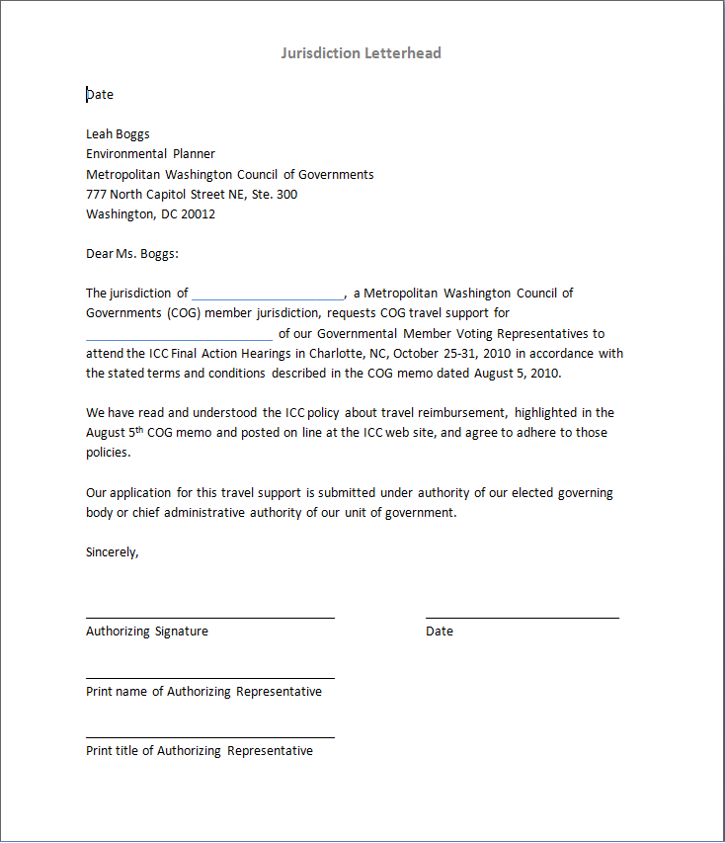
Your jurisdiction’s compliance with ICC’s Policies
The jurisdiction of ____________, a Metropolitan Washington Council of Governments (COG) member jurisdiction, requests COG travel support for ___ of our Governmental Member Voting Representatives to attend the ICC Final Action Hearings in Charlotte, NC, October 25-31, 2010 in accordance with the stated terms and conditions described in the COG memo dated August 5, 2010.
We have read and understood the ICC policy about travel reimbursement, highlighted in the August 5th COG memo and posted on line at the ICC web site, and agree to adhere to those policies.
Our application for this travel support is submitted under authority of our elected governing body or chief administrative authority of our unit of government.

Slide 13
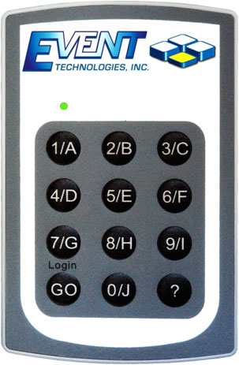
Your Voting Apparatus!
Picking up a keypad:
Key pads can be picked up at registration, or at the ICC table once voting has begun.
Keep your keypad with you at all times, but be sure to return it to ICC at the end of the hearings (otherwise you will be charged $250).
Voting instructions:
For Code Hearings, follow the instructions on the screen – press #1 for Yes and #2 for No
As long as the green light illuminates on the key pad your vote counted; you do not need to turn on the keypad or login. No other buttons are needed.
If you make a mistake, just revote. The system only accepts the last signal it received. If you press the button 20 times, just the last one counts.
There will always be instructions & a test at least once a day during voting.

Slide 14
Thanks! See you in Charlotte…
Please don’t hesitate to contact us with questions:
Caroline Keicher
caroline@imt.org
Dick Meyer
dick@imt.org
202-525-7005
Notes:
Jessyca Henderson – AIA American Institute of Architects
Eric Lacey – RECA – Responsible Energy Codes Alliance

