Slide 1

REACH a RIDE
THE ONE-STOP WEBSITE WITH INFORMATION ON SPECIALIZED TRANSPORTATION SERVICES IN THE REGION
Lynn Winchell-Mendy Transportation Planner III Access for All Advisory Committee August 25, 2016
Agenda Item #3
Notes:
How many of you are familiar with our have used Reach a Ride?
Reach A Ride is a searchable database and information hotline, furnished by the Metropolitan Washington Council of Governments, that provides information on transportation options for individuals with special transportation needs in the National Capital Region.
Improving information for customers, a priority of the TPB’s Coordinated Human Service Transportation Plan.

Slide 2
Purpose
To provide people with disabilities and older adults in the National Capital Region with improved access to information on transportation options.
Agenda Item #3: Reach a Ride
August 25, 2016

Slide 3
Implementation
Improving information for customers is a priority of the TPB’s Coordinated Human Service Transportation Plan.
WMATA asked COG to create and maintain the web site.
DRPT, DDOT, MTA provided initial funding to launch.
KFH provided assistance in communications with providersw and data collection
Funding has come from JARC grants and WMATA traditionally providing matching funds.
Currently funded through June 30, 2017
In order to leverage $210,000 in unused JARC funds, COG has asked WMATA to provide match for continued maintenance, operation and enhanced marketing of Reach a Ride through June 30, 2019.
Agenda Item #3: Reach a Ride
August 25, 2016

Slide 4
Features
Web site meets high standards of accessibility
Web site is available in Spanish
Dedicated toll free number, (855) 732-2427 or 855 REACH-A-RIDE, with access to a live person
Spanish speaking call center agents
TDD/TTY
Provider portal
Agenda Item #3: Reach a Ride
August 25, 2016

Slide 5
Timeline
November 2009 - functional requirements analysis to ensure the highest level of accessibility for people with visual impairments, database specification, and standards for maintaining the data
December 2010 – Began provider data collection efforts
Late December 2010 - Marketing campaign
December 5, 2011 – Launch and press event
May 2011 - Held focus groups with individual users from each of the project target markets. Incorporated feedback into web site.
2015– provider portal testing and launch
Ongoing – maintenance of website, including keeping provider information up to date, support from project and call center staff, continued advertising, funding
Agenda Item #3: Reach a Ride
August 25, 2016

Slide 6
Marketing
Media outlets include:
Beacon Newspaper
Retirement Living Sourcebook
El Tiempo Latino
Radio – WILC – AM, WETA-FM
Adverticket – Cash Jackets
Pharmacy Bags
On-line ads
Social Media
Agenda Item #3: Reach a Ride
August 25, 2016
Notes:
Circulate pharmacy bag and on-line ad examples
Over entire life of project

Slide 7
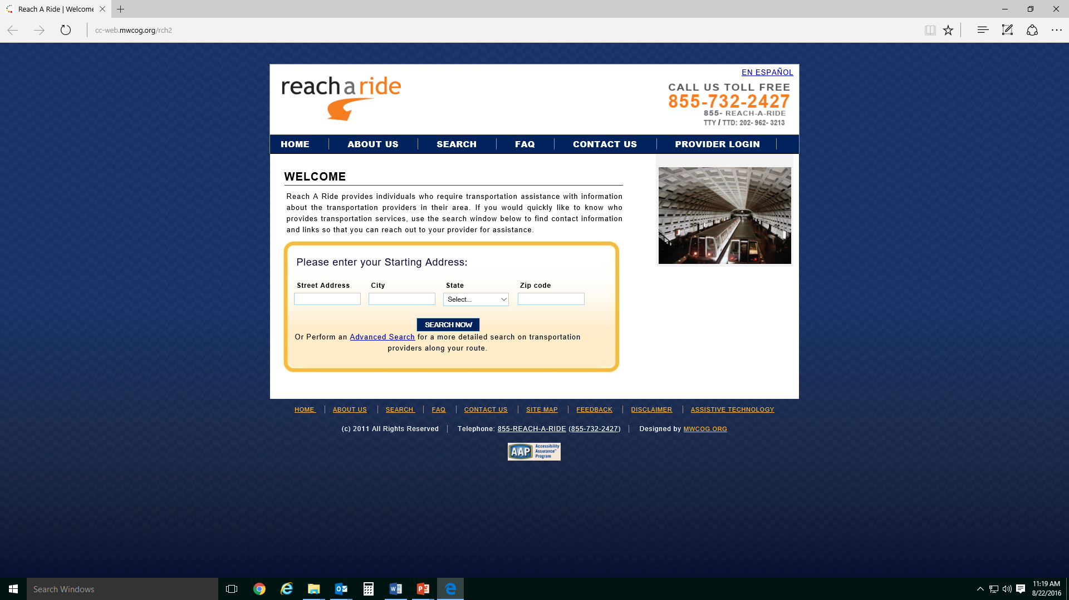
Web site
http://cc-web.mwcog.org/rch2/
Agenda Item #3: Reach a Ride
August 25, 2016

Slide 8
Web site Overview
Home - Quick Search on opening page
About Us
Search – advance feature allows for more filtering
FAQ page
Contact Us
Provider Login
Translate site into Spanish
Call Center number highly visible
Agenda Item #3: Reach a Ride
August 25, 2016

Slide 9
Demonstration
http//cc-web.mwcog.org/rch2/
http://cc-web.mwcog.org/rch2/
Agenda Item #3: Reach a Ride
August 25, 2016
Notes:
Advanced Search:
777 North Capitol Street, NE
Washington, DC 20002
Kensington Medical Center
10810 Connecticut Ave
Kensington, MD 20895
Only check Curb to Curb – show Seabury as provider

Slide 10
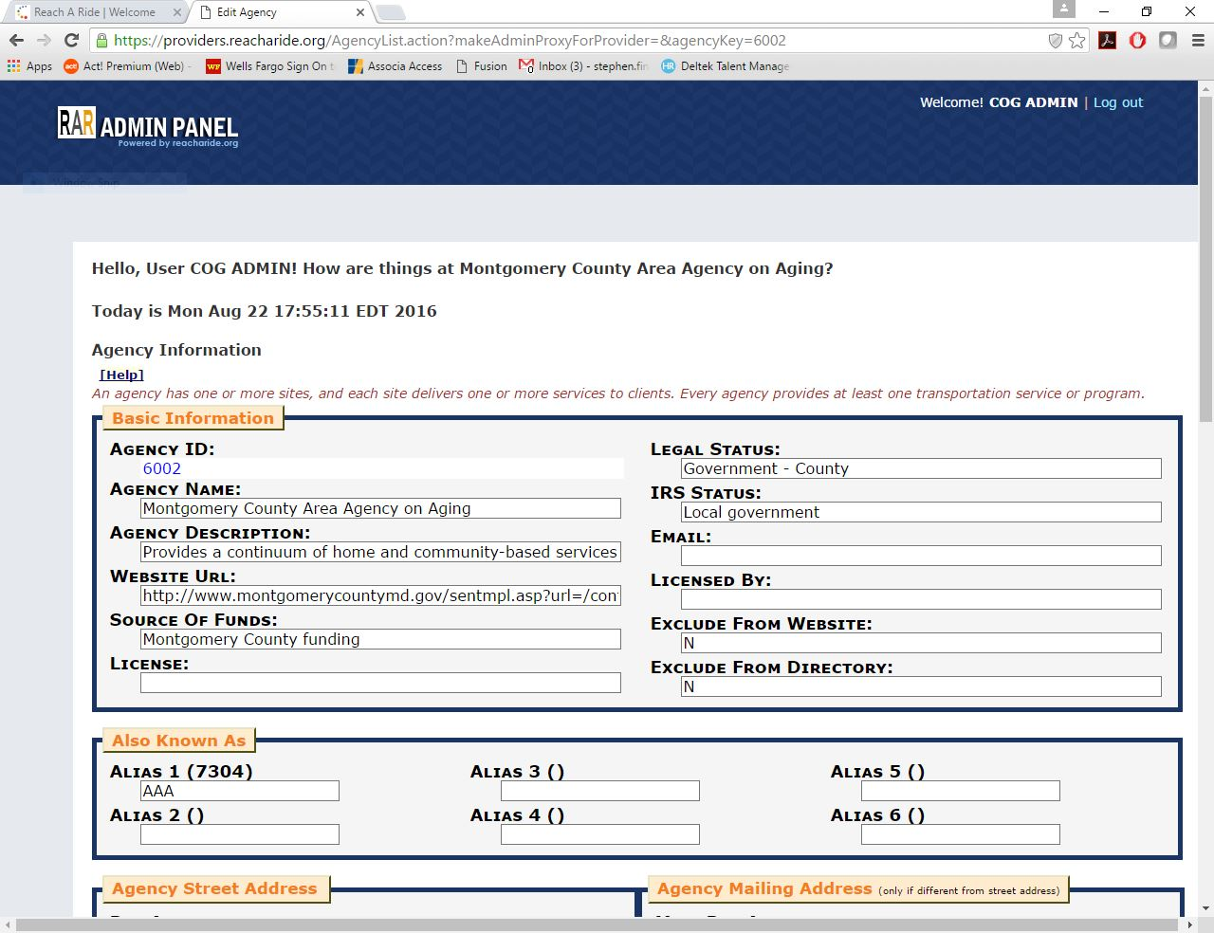
Provider Portal
Agenda Item #3: Reach a Ride
August 25, 2016
Notes:
Each provider receives an email from COG. The provider then sets up their own information for their account. COG then activates the provider account and they are good to go.
855-732-2427 can be used by the public or the providers.

Slide 11

Stats
December 2011 through June of 2016:
Due to marketing efforts this year, the home page views are already up 200% from 2014
Calls | VM | Home Page Views | Total Searches
793 | 112 | 13,009 | 6,672
Year | Month | Calls | VM | Home Page Views | Total Searches
2016 | Column1 | Column2 | Column3 | Column4 | Column5
 | January | 14 | 0 | 128 | 94
 | February | 9 | 0 | 136 | 101
 | March | 9 | 0 | 199 | 109
 | April | 12 | 3 | 729 | 224
 | May | 26 | 1 | 1,727 | 219
 | June | 22 | 3 | 2,288 | 186
 | Total | 92 | 7 | 5207 | 933
Agenda Item #3: Reach a Ride
August 25, 2016

Slide 12
Questions
http://www.reacharide.org/
855-732-2427 or 855 REACH-A-RIDE
TTY/TTD: /202-962-3213
Agenda Item #3: Reach A Ride
August 25, 2016

Slide 13
Lynn Winchell-Mendy Transportation Planner III (202) 962-3253 lmendy@mwcog.org | mwcog.org
777 North Capitol Street NE, Suite 300 Washington, DC 20002

