Slide 1
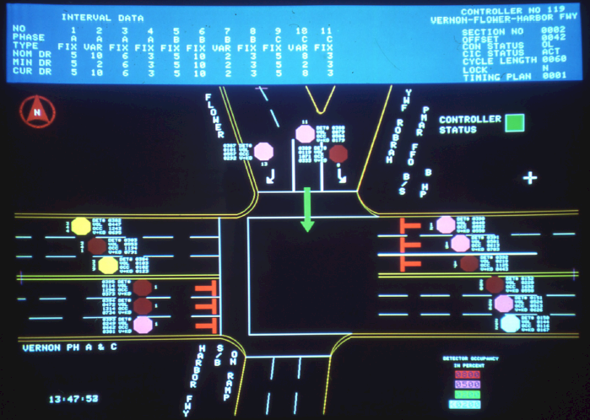
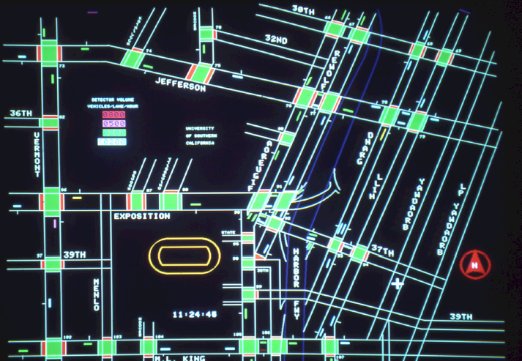
Traffic Signal Operations Practices in Metropolitan Washington and Other Cities
Item #5
Marco Trigueros, P.E.
COG/TPB Staff
Traffic Signals Subcommittee
November 12, 2013

Slide 2
Overview
Discussion at September TPB regarding the importance of traffic signal optimization and initiatives in other cities
  Los Angeles Automated Traffic Surveillance and Control
  New York’s Midtown in Motion
Need Input from partners to highlight planned and ongoing projects

Slide 3
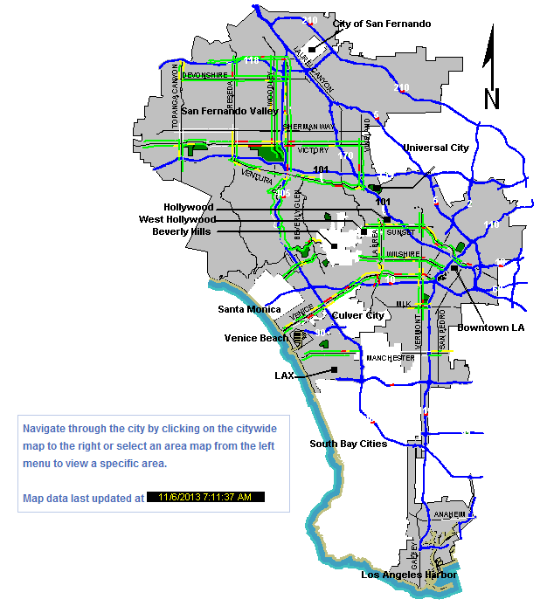
ATSAC
Automated Traffic Surveillance and Control
  Adaptive Traffic Control System software brought online in 2001 – available through McTrans
Equipment installed over 30 years
  4,400 Signals within the City of Los Angeles
  21,000 system detectors in place
Functionality
  ATCS
  TSP
  CCTV
  Traveler information
Results
  12% reduction in delay
  16% in average speeds

Slide 4
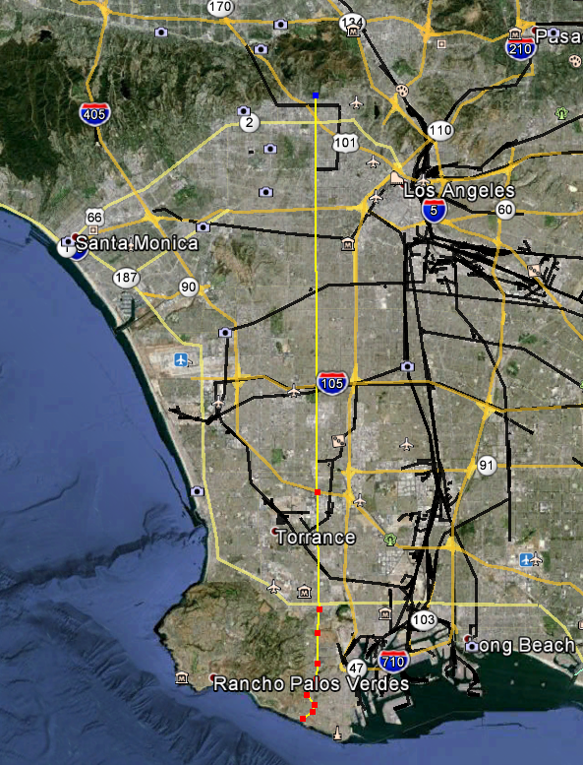
ATSAC Media Coverage
To Fight Gridlock, Los Angeles Synchronizes Every Red Light
“Los Angeles has synchronized every one of its 4,500 traffic signals across 469 square miles — the first major metropolis in the world to do so”¹
Claim
  “driving Western Avenue from the Hollywood Hills to the San Pedro waterfront without stopping once”¹
Reality
  27 mile corridor is not entirely within the City of Los Angeles
  LADOT recognizes that “models usually produce scenarios that result in the least total delay for all drivers, but may give less than perfect traffic progression.”

Slide 5
ATSAC Media Coverage
  “The computer system, which runs software the city itself developed, analyzes the data and automatically makes second-by-second adjustments, adapting to changing conditions and using a trove of past data to predict where traffic could snarl, all without human involvement.
  Long Beach and Gilroy, Calif., have already adopted the Los Angeles software, and Washington — the only city in the country that had worse traffic congestion than Los Angeles last year, according to the Texas A&M report — has considered buying it as well…”¹

Slide 6
Midtown In Motion
Covers Midtown Manhattan from 1st to 9th Avenues between 42nd and 57th Streets.
Equipment: 210 microwave sensors, 56 traffic cameras, 59 E-Zpass readers
Functionality: Identify congestion issues and remotely adjust traffic signals
Results: Preliminary results show 10% improvement in travel times.

Slide 7
DDOT Initiatives
“Another feature of DDOT’s program in the traffic controller computer software upgrade is Adaptive Traffic Signal Control Technology which will utilize real-time traffic information to adjust the timing of lights to accommodate changing traffic patterns and ease traffic congestion. In cooperation with the Federal Highway Administration, DDOT will begin testing this new technology on New York Avenue, Pennsylvania Avenue SE and Rhode Island Avenue corridors in 2014. This feature will work to improve overall traffic flow. ”²

Slide 8
VDOT Initiatives
SIGNAL OPERATIONS CENTER
Real-time traffic network management
Signal system health management
Communication and information pass-downs
Arterial Networks Monitoring
Real-Time Incident Management
Congestion Management
Work zone Management
Weather Events and Emergency Management
Special Event Management
Monitoring & Reporting of CCTVs Status
Monitoring Signals on Flash, Detector Status and Pedestrian Signal Status using MIST.
Dispatching of Signal Technicians as per the need of the issue.
Coordinating with Signal Contractors to Resolve Problems relating to Signals Under Construction.
Documentation of Incidents
Coordination with TOC Personnel, Traffic Engineers and Customer Service Center
Discussion with the Management on critical and major operational issues
Transferring of any on-going incidents to the oncoming shift personnel and TOC personnel.

Slide 9
MDOT
At the ITS Maryland Conference, the Deputy Secretary of Transportation noted that funding has been allocated to install LED signal heads at all SHA intersections.

Slide 10
Outlook
Important initiatives planned and ongoing throughout the region
Discussion
  Additional Information?
  Any results that should be highlighted?

