Slide 1

REGIONAL COMPREHENSIVE ECONOMIC DEVELOPMENT STRATEGY (CEDS) BUILT ENVIRONMENT & ENERGY ADVISORY COMMITTEE
Sakina Khan Director, Community and Economic Services Emilio Urteaga Senior Economic Planner September 17, 2026

Slide 2
A Regional Strategy for a Changing Economy
The region is facing new and unprecedented economic conditions.
These challenges cross jurisdictional boundaries – residents, workers, visitors and businesses experience the region as an interconnected place and economy.
We need coordinated solutions.
A shared economic framework can align jobs, businesses, infrastructure, energy and land use so that the region can respond collectively, grow inclusively, compete effectively and build long-term economic resilience.

Slide 3
Regional Economy: Competitive Advantages
COG region is one of the largest regional economies in America.
With a real GDP of roughly $583 billion (2024), the region is in 7th place amongst metropolitan areas in the US and 14th when compared to states.
Professional and business services employ more than three-quarters of a million workers. The metro area has roughly 781,300 professional and business service jobs, reflecting its concentration of consulting, law, lobbying, accounting, cybersecurity, AI, and government-adjacent industries.
Government remains a crucial anchor.
Despite downsizing, there are still 314,000 federal jobs, each supporting approximately 1.5 to 2.5 additional jobs through contracting and household spending. The entire government sector (including local and state) accounts for a fifth of the region's workforce.
The region is extraordinarily educated.
More than half of adults over 25 hold a bachelor's degree or higher, and about a quarter hold graduate or professional degrees—among the highest educational attainment rates in the nation.

Slide 4
Regional Economy: Competitive Advantages (cont’d)
Hub for innovation.
The region produces more than 2,300 patents annually, with federal laboratories, universities, biotechnology firms, and defense-related research contributing heavily to
innovation.
Hospitality, tourism and entertainment is one of the region's largest sectors
Tourism spending is estimated at more than $15 billion and supports 315,500 jobs. There were over 27 million visitors to DC in 2024, up 5% from 2023.
People connect to jobs via a strong transportation network.
The region is well connected by multiple transportation options including public transit. Commuting patterns have mostly returned to pre-pandemic levels with 28% of weekly commute trips made by public transportation, biking, walking or carpool. Between 2022 and 2025, commuter satisfaction increased by 16%.

Slide 5
Population and GDP Growth Rebounded Post-Pandemic,
Although Beginning to Flatten
Total Population and Real GDP (2015 - 2025)
5,900,000
$700,000,000
$582,881,136
Real GDP (Thousands of USD$)
5,800,000
$552,355,420
$600,000,000
5,846,081
Total Population
$478,954,625
$500,000,000
5,700,000
5,728,840
$400,000,000
5,600,000
$300,000,000
5,500,000
$200,000,000
5,493,213
5,400,000
$100,000,000
2015
2016
2017
2018
2019
2020
Population
2021
Real GDP
2022
2023
2024
2025
Source: Bureau of Economic Analysis, Gross Domestic Product (GDP) is in thousands of real dollars. Last Updated: February 5, 2026.

Slide 6
COG Region Total Jobs by Sector/Industry
 | Washington MSA At-Place Employment Number Percent |  | National At-Place Employment Number Percent |  | Location Quotient ( LQ)
Manufacturing | 56,200 | 1.7% | 12,694,000 | 7.9% | 0.21
Mining, Logging, & Construction | 172,700 | 5.2% | 9,151,000 | 5.6% | 0.93
Trade, Transportation, & Utilities | 401,700 | 12.1% | 28,652,000 | 18.0% | 0.67
[Retail] | 253,700 | 7.6% | 15,450,500 | 9.7% | 0.79
Information | 78,500 | 2.4% | 2,788,000 | 1.7% | 1.36
Financial Activites | 154,200 | 4.6% | 9,149,000 | 5.7% | 0.81
Professional & Business Services | 781,300 | 23.5% | 22,647,000 | 14.2% | 1.66
Educational & Health Services | 491,100 | 14.8% | 27,666,000 | 17.6% | 0.84
Leisure & Hospitality | 340,600 | 10.2% | 17,676,000 | 10.6% | 0.96
[Accommodation and Food Service | 280,900 | 8.4% | 14,686,600 | 9.0% | 0.94
Other Services | 179,200 | 5.4% | 6,113,000 | 3.8% | 1.42
[Local] | 261,500 | 7.9% | 14,686,600 | 9.7% | 0.82
[State] | 94,400 | 2.8% | 5,121,000 | 3.5% | 0.79
[Federal] | 314,000 | 9.4% | 2,687,000 | 1.7% | 5.58
Government | 669,900 | 20.1% | 22,113,000 | 14.9% | 1.35
Total | 3,325,400 | 100.0% | 158,695,000 | 100.0%
Sources: July 2026, Preliminary data from the Bureau of Labor Statistics, Not Seasonally Adjusted.

Slide 7
Higher Educational Attainment in 15 Largest Metro Areas
Washington
Boston San Francisco
Seattle New York Philadelphia
Chicago
Atlanta
Dallas Miami Detroit
Phoenix
Graduate or professional degree
Houston
Los Angeles
Bachelor's degree
Inland Empire*
0%
10% 20%
Source: U.S. Census, 2024 ACS 1-Year Estimates
Counties in CA
30%
40% 50%
*Inland Empire consists of Riverside and San Bernardino
60%

Slide 8
Regional Economy: Challenges
Economic growth is slowing and population growth is limited.
Over the last 5 years, economic growth (real GDP) for the COG region has been lagging at 7.13% compared to peer average growth of 13%. The region's population (Census Population Estimates Program) has only grown by about 160,000 people or 1 percent between July 2020 and July 2025.
Largest employment decline among major metros.
Between January 2025 and July 2026, the region lost more than 102,000 jobs, comprised on 61,800 federal government and 40,900 nonfarm job losses. Post-pandemic regional jobs recovery has been slow and has significantly trailed faster-growing metro areas such as Richmond.
Overreliance on federal government means impacts are rippling through regional
economy.
Reductions in the federal workforce and spending are having outsized effects on employment and business activity across many sectors, as well as on real estate and consumer spending.

Slide 9
Regional Economy: Challenges Cont'd
Commercial real estate adjustment.
Accelerated by the pandemic, recent federal downsizing and hybrid work trends, the region is experiencing elevated office vacancy rates currently at 18.1%. New commercial construction declined by 30% from 2024 to 2025.
Persistent economic disparities and uneven opportunity.
Economic growth has not been evenly distributed throughout the region with geographic concentrations of opportunity and racial wealth gaps. The top fifth of households earn roughly half of all income in the area. The bottom fifth earn 3.37%.
Housing costs are affecting the region's ability to retain and attract businesses and talent. Housing costs remain among the nation's highest. The Washington's MSA median home value is $604,800, compared to $360,600 nationally. For renters, the region’s average one bedroom apartment rents for $1,926 per month, compared to $1,584 per month nationally. These costs creates affordability challenges for workers and employers alike.

Slide 10
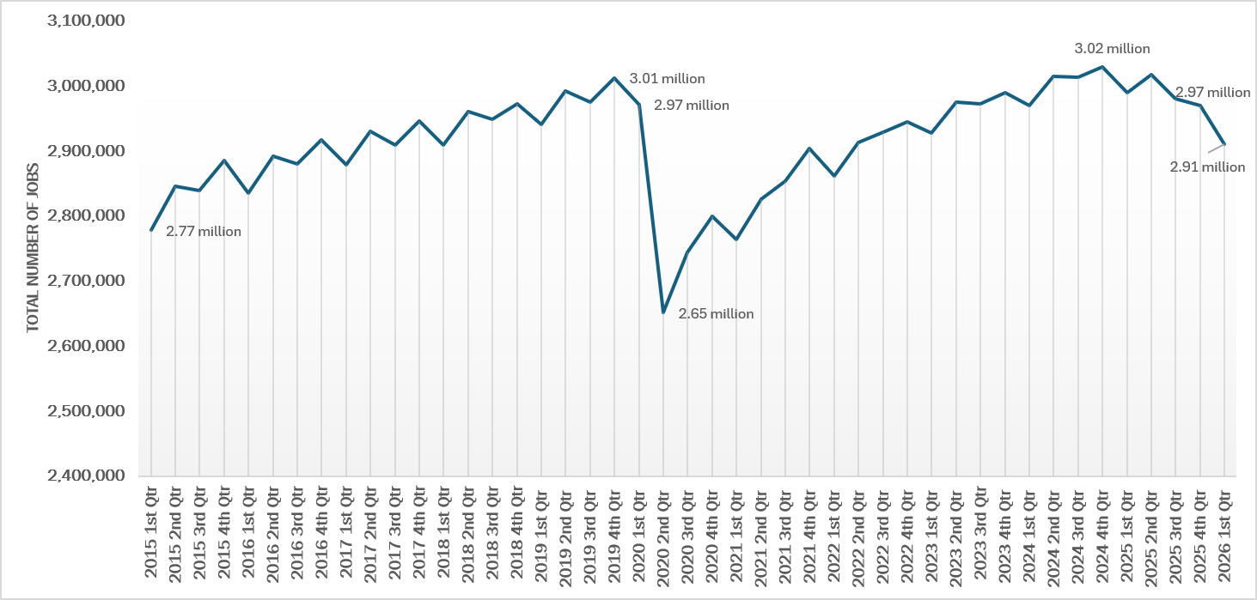
Total Number of Jobs in the COG Region (2015-2026)
The Quarterly Census of Employment and Wages (QCEW) program publishes a quarterly count of employment and wages reported by employers covering more
than 95 percent of U.S. jobs.
Source: U.S. Bureau of Labor Statistics

Slide 11

Number of Federal Government Jobs in the Washington MSA
July Data (2015 – 2026)
380,000
377,100
379,400
370,000
366,700
364,200
360,000
350,000
340,000
330,000
320,000
NUMBER OF FEDERAL GOVERNMENT JOBS
310,000
314,000
300,000
290,000
280,000
2015
2016
2017
2018
2019
2020
2021
2022
2023
2024
2025
2026
Source: Current Employment Survey, Not Seasonally Adjusted, U.S. Bureau of Labor Statistics

Slide 12
COG Region Change in Total Jobs by Sector/Industry
Washington MSA Over-the-Year Employment Change by Industry
Group* July 2026
(1,000s of Jobs)
Source: Bureau of Labor Statistics, CES, Not Seasonally Adjusted
National Over-the-Year Employment Change by Industry Group*
July 2026
(1,000s of Jobs)
Source: Bureau of Labor Statistics, CES, Not Seasonally Adjusted
Government
[Federal] [State] [Local]
Other Services [Accommodation and Food Services]
Leisure & Hospitality Educational & Health Services Professional & Business Services
Financial Activites
Information
[Retail] Trade, Transportation, & Utilities Mining, Logging, & Construction
Manufacturing
-59.5
Government
[Federal] [State] [Local]
Other Services
[Accommodation and Food Services]
Leisure & Hospitality Educ. & Health Services Prof. and Bus. Services
Financial Activites
Information
[Retail] Trade, Transportation, & Utilities Mining, Logging, & Construction
Manufacturing
-253.0
-253.0
-50.2
0.0
-40.0
8.4
40.0
46.0
122.9
77.0
-4.3
2.7
2.2
1.8
554.0
-20.5
136.0
-1.6
-4.6
-1.6
-1.5
-1.8
-1.1
-10 0
-129.0
-94.0
9.8
-14.0
58.0
1.0
0 200
-70 -60 -50 -40 -30 -20
10 20
-600 -400 -200
400
600
800
Sources: July 2026, Preliminary data from the Bureau of Labor Statistics, Not Seasonally Adjusted.

Slide 13
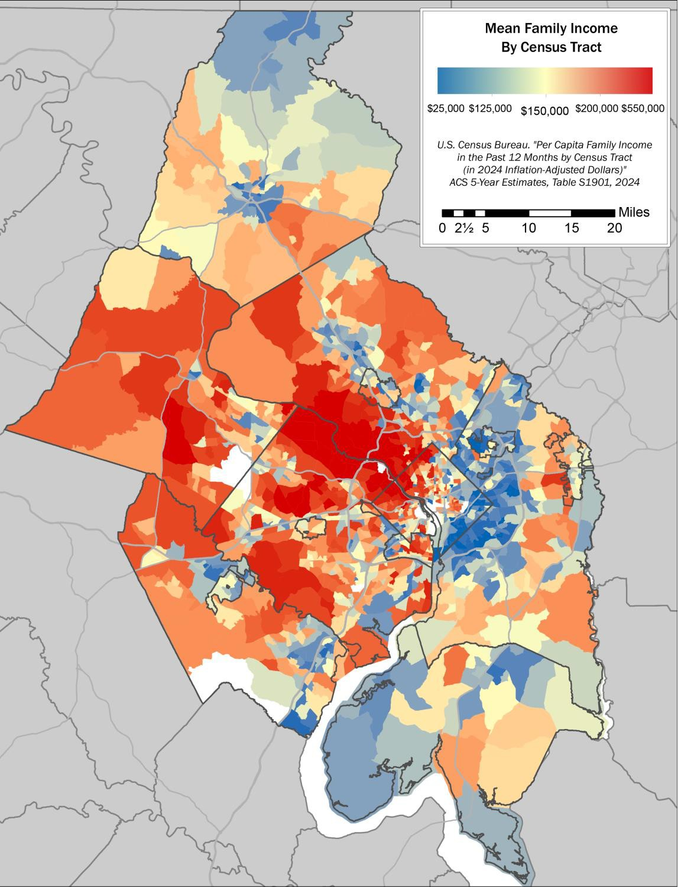
Income Inequality in COG Region
Mean household income in the COG region ranges from $27,000 to $550,000
Spatial distribution of income
differences
  The western half of the region has significantly higher incomes than the eastern side
Comprehensive Economic Development Strategy (CEDS)
September 2026
13

Slide 14
What is a Comprehensive Economic Development Strategy (CEDS)?
A CEDS is a shared, regional strategy for strengthening economic opportunity, competitiveness and resilience
Brings together leaders from local government, the private sector, non-profit organizations, foundations, and stakeholder groups to identify strategies and share ownership of actions
Provides the capacity-building foundation for cross-sector collaboration and creates the environment for regional economic prosperity
Approved by the U.S. Economic Development Administration (EDA), and a starting point for designation as an Economic Development District (EDD)
EDA identifies economic resilience and workforce development as essential to a CEDS

Slide 15
What will the region's first-ever regional CEDS achieve?
Identify strategies, accompanying implementable actions, and an evaluation framework to
measure the success over a five-year period
Prioritize workforce development, strengthen economic resiliency, improve economic
mobility, attract investment, and support business
Advance inclusive economic growth and improve quality of life
Create shared ownership across the region and sectors, focusing on a unified regional approach to economic development
Enhance the region's ability to compete for federal, state, private sector and philanthropic
funding

Slide 16
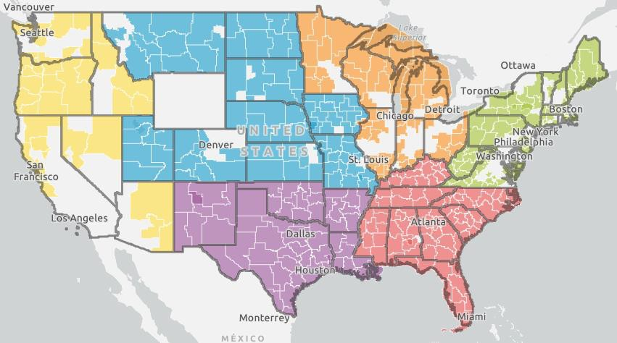
Economic Development Districts Across the US
85% of US counties are in an EDD
Of the ten largest metro areas in the country, only New York City, LA, and DC are without a designated EDD
More than 77% of EDA grants and 71% percent of total EDA project investment went to areas covered by an EDD
Per capita, the total project cost invested by EDA in EDD areas is more than three times the amount of investment outside of EDD areas
Designated EDDs shaded by EDA Regional Office
Sources: NADO Research Foundation (May 2026), Urban
Institute (October 2023)

Slide 17
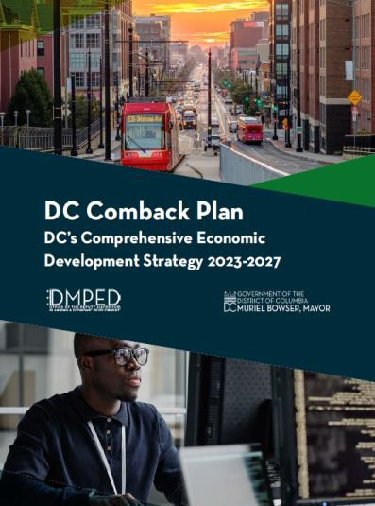
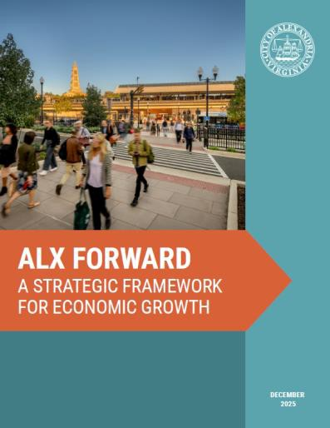
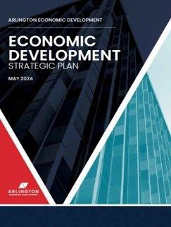

Economic Development Plans Around the Region
Jurisdiction | Year | Name
District of Columbia* | 2023 | DC's Comeback Plan
Town of Bladensburg | 2026 | Bladensburg C.A.R.E.S Closeout Report
City of Bowie | 2022 | Economic Development Strategy and Action Plan
City of College Park | 2023 | Five to Ten-Year Economic Development Strategy
Charles County | In progress | Shaping Tomorrow Together: Vision 2050
City of Frederick | 2021 | 2020 Comprehensive Plan
Frederick County | 2026 | Economic and Workforce Strategic Growth Plan
City of Gaithersburg | In progress | Build Gaithersburg 2040
City of Greenbelt | 2026 | Economic Development Strategic Plan
City of Hyattsville | 2026 | Stepping Forward: 2026-2031 Strategic Plan
City of Laurel | 2016 | Master Plan: Goals, Objectives, and Policies
Montgomery County** | 2022 | Moving Forward Together
Prince George's County | 2022 | Economic Development Strategic Action Plan
City of Rockville | 2021 | 2040 Comprehensive Plan
City of Takoma Park | 2019 | Housing and Economic Development Strategic Plan
City of Alexandria | 2025 | ALX Forward: A Strategic Framework for Economic Growth
Arlington County | 2024 | Economic Development Strategic Plan
City of Fairfax | 2025 | Economic Development Strategic Workplan
Fairfax County | 2025 | Countywide Strategic Plan
City of Falls Church | 2017 | Falls Church Vision 2040
Loudoun County | 2026 | Loudoun County 2019 General Plan
City of Manassas | 2025 | Historic Heart. Modern Beat.
City of Manassas Park | In Progress | Comprehensive Plan 2026
Prince William County | 2025 | 2025-2028 Strategic Plan *designated as a CE
DS
**developing a CEDS

Slide 18
The Environment and Energy are Critical to Economic Development
A sustainable and thriving environment is necessary for economic growth, it impacts
every aspect of the economy.
Stable and reliable energy is critical for the development of the economy. To improve economic competitiveness against peer metro areas, we need affordable energy that can keep up with increasing demand.
Sustainable, predictable, and stable energy distribution is critical to attracting and maintaining businesses, workers, and residents to the region.
A thriving environment is key to improving livability and maintaining a productive economy

Slide 19
Building the Region's First CEDS
What are you seeing? Are there existing and/or emerging policy and economic trends in your communities that the CEDS should consider?
What are our greatest opportunities and barriers? How can we better align energy policy, energy affordability, environmental protection, and economic development?
What are you working on? What initiatives are underway that we should be aware of and that would align with the CEDS (e.g. Envrionmental Plan, Energy Policies, etc.)?

Slide 20
Sakina Khan Director of Community and Economic Services skhan@mwcog.org Emilio Urteaga Senior Economic Planner eurteaga@mwcog.org | mwcog.org
777 North Capitol Street NE, Suite 300 Washington, DC 20002

