Slide 1
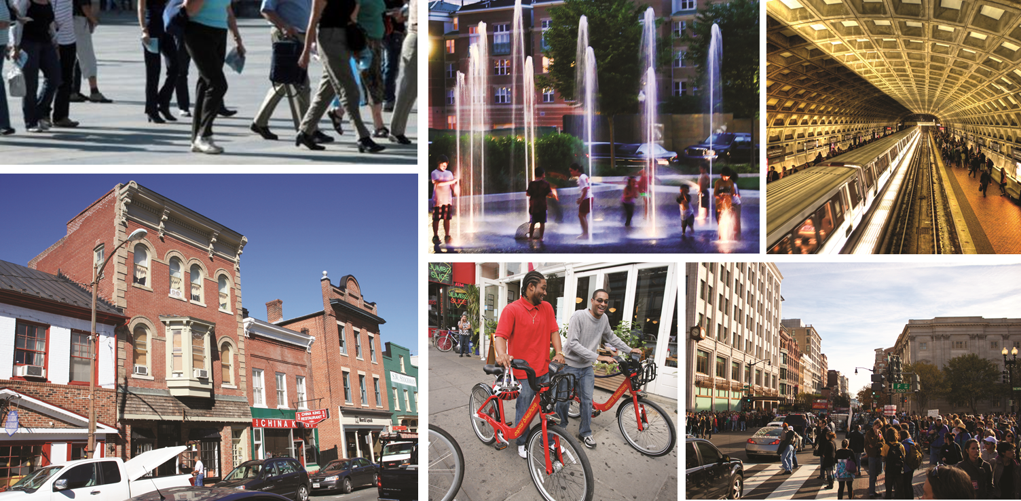
Region Forward Update
Human Services & Public Safety Policy Committee
June 20th 2014
Notes:
We’ve presented this project a couple of times – now that you have the full report in front of you, providing one more overview

Slide 2
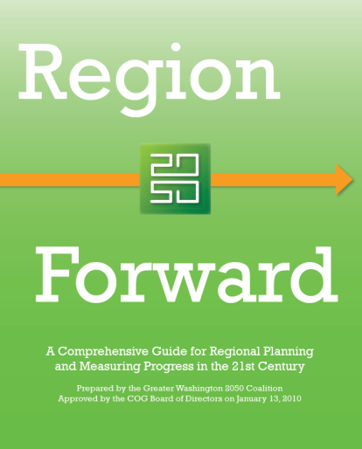
Region Forward
COG’s vision for a more Prosperous, Accessible, Livable, and Sustainable metropolitan Washington
Sustainability
Prosperity
Accessibility
Livability
Notes:
To provide some context –
Activity Centers are a main component of Region Forward – many of the targets in the Plan are focused on directing development/investment to Centers to:
accommodate growth
provide choices for residents
use natural resources & infrastructure more efficiently
Centers are also an important part of Economy Forward

Slide 3
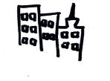








Region Forward: 9 Goal Areas
Land Use
Transportation
Environment
Climate & Energy
Economic
Housing
Health
Education
Public Safety
Notes:
The scenario workshop, the public attitudinal survey, and existing regional policy to date informed the Coalition’s work to draft a set of new Goals for the Region.
Setting goals allowed the Coalition to establish broad direction for our Region.
There 9 goal categories in areas of physical, social, and economic categories that communicate a path for Regional growth and development and set the stage for short and long term action in our Regional Targets. The goals are also the only element of this effort that are included in the Regional Compact. For the next few slide I will touch on a few of the goals to give you a sense of how these are worded.

Slide 4
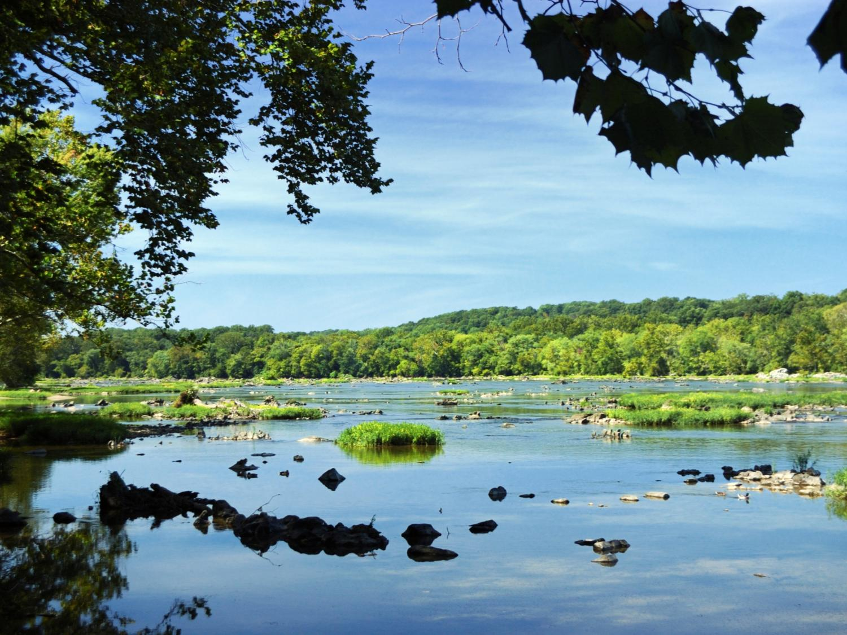
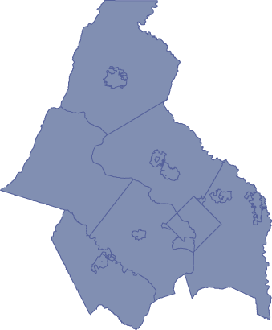

Compact: Voluntary local commitment
to regional action

Slide 5
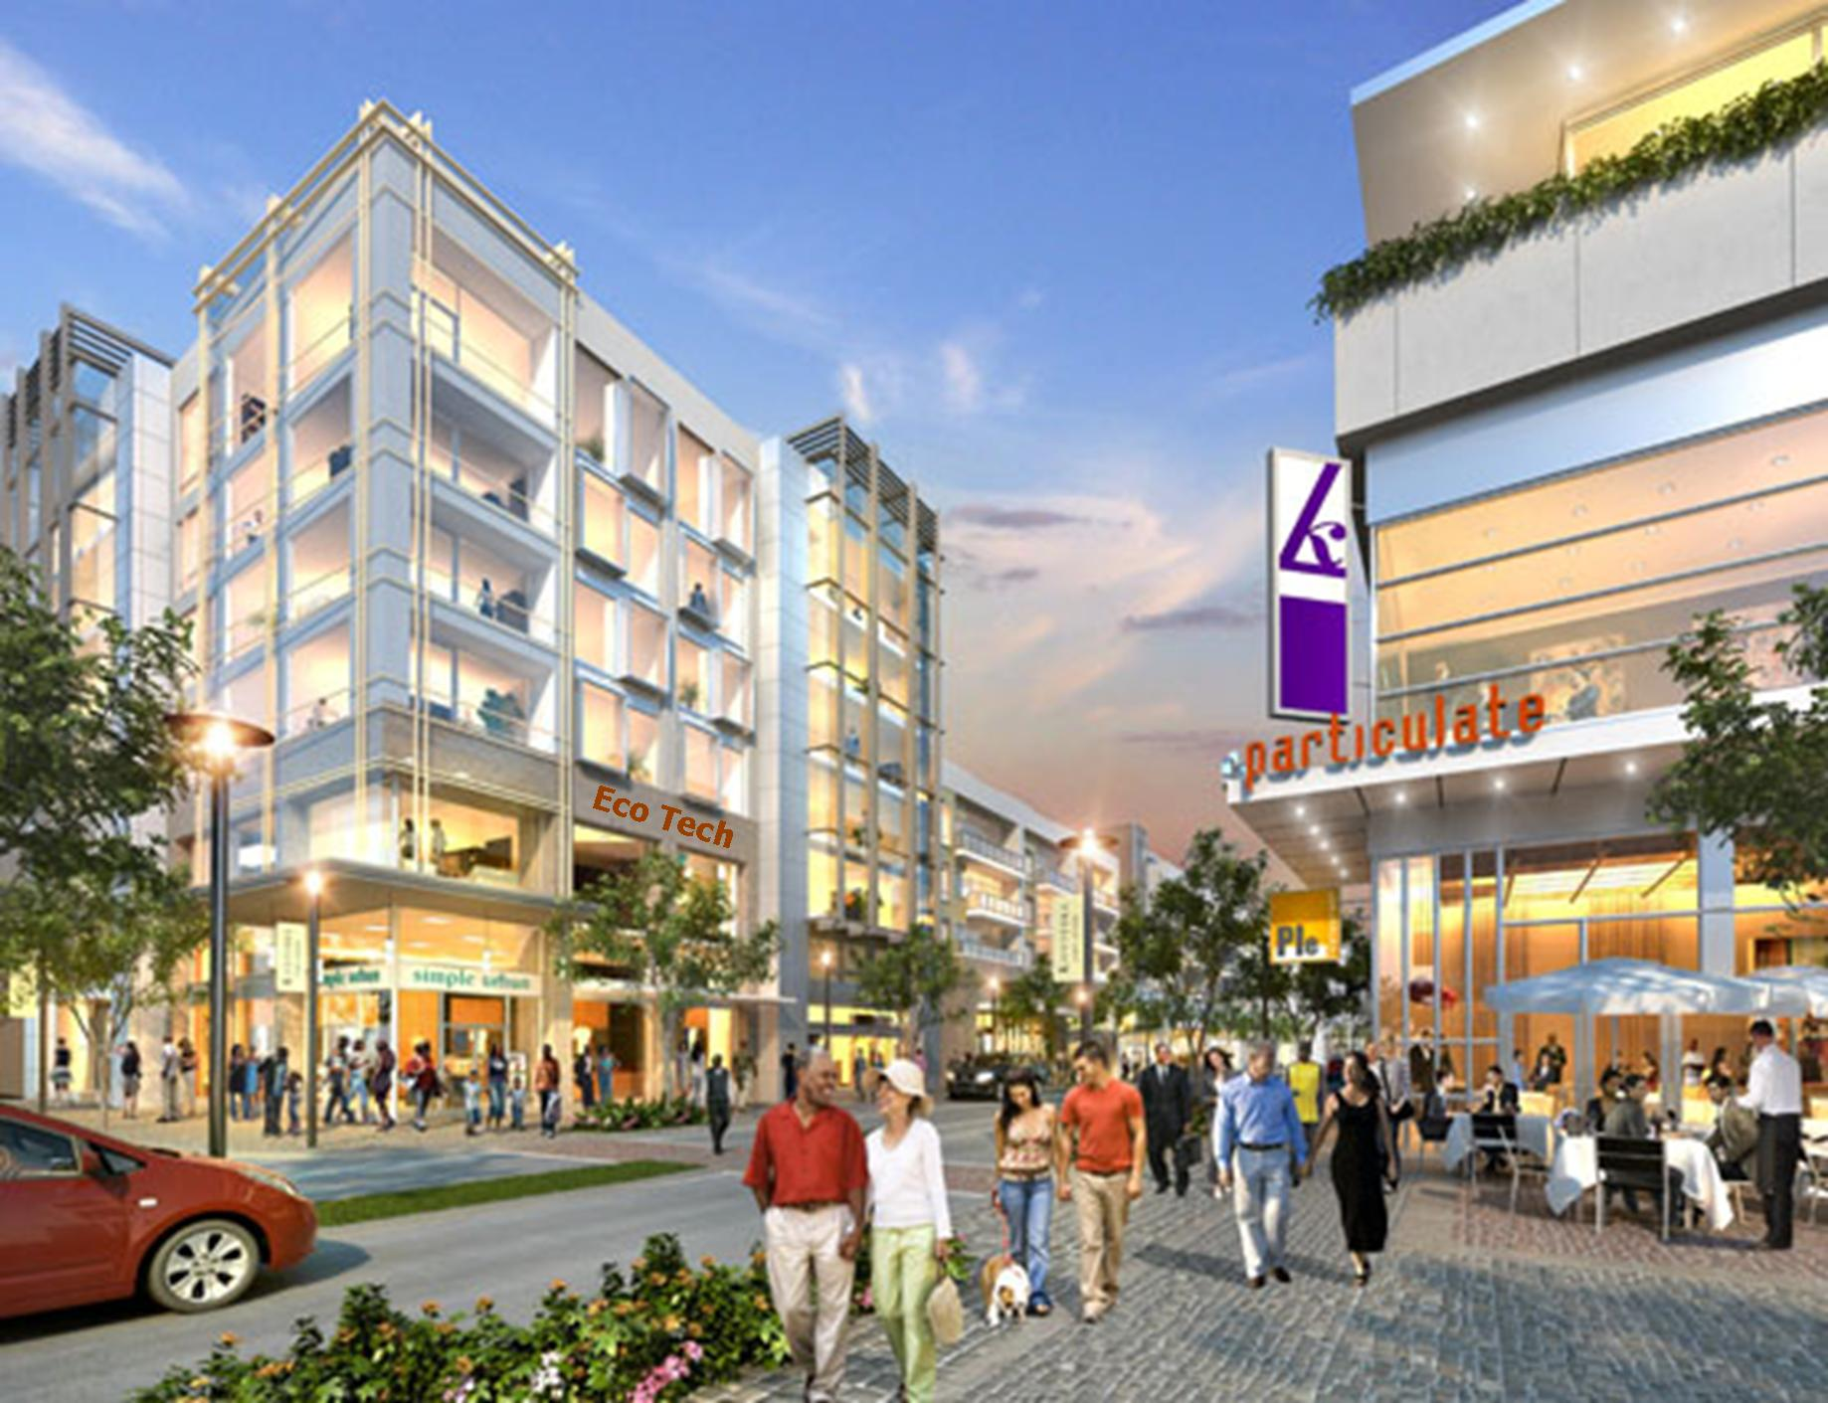
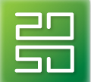
Prosperity
Improve access to vocational training
Median wage growth exceeds inflation

Slide 6
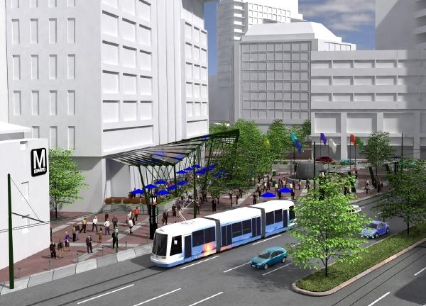
Accessibility
2020: Housing + Transportation Cost in Activity Centers will not exceed 45% of AMI
Capture 75% of commercial construction & 50% of households in Activity Centers
Tysons Corner
All Regional Activity Centers will have transit

Slide 7
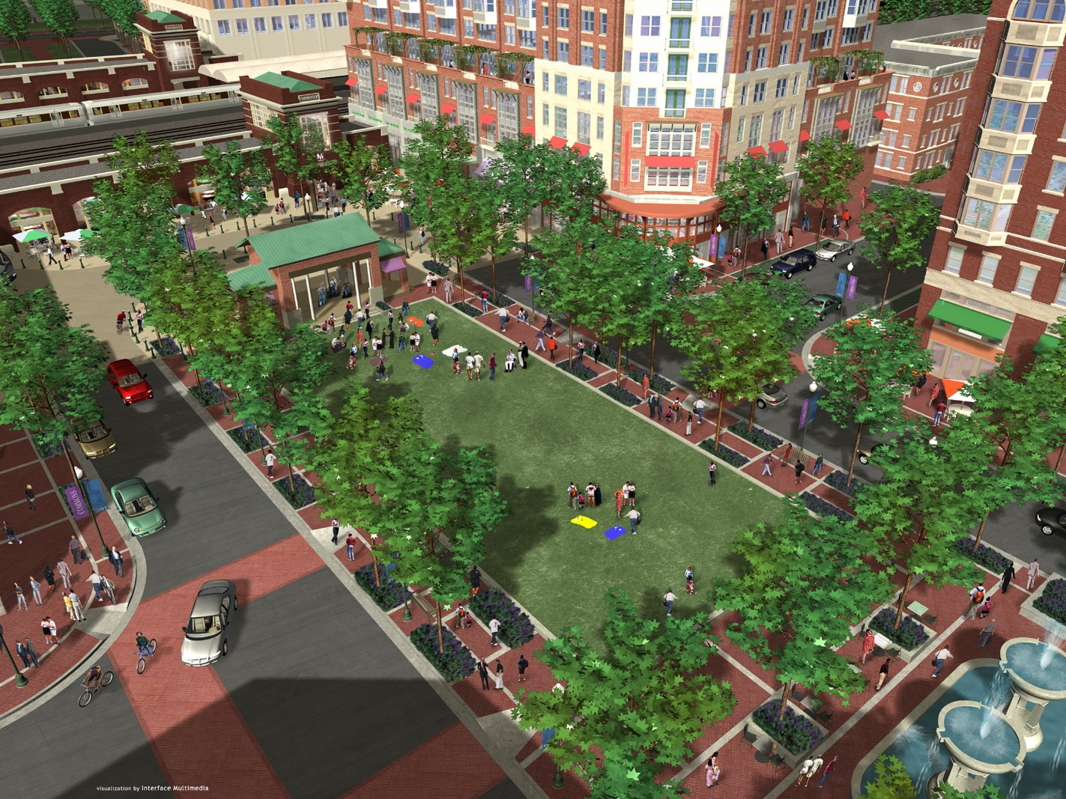
Livability
Beginning in 2012, 80% of new or preserved affordable housing units in activity centers
Reduce bike/ped fatalities

Slide 8
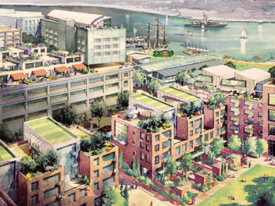
Sustainability
By 2025 achieve 100% of Chesapeake Bay Water Quality Goals
By 2020 All new residential & commercial buildings LEED Silver
2014 Regional air quality will improving beyond federal standards

Slide 9
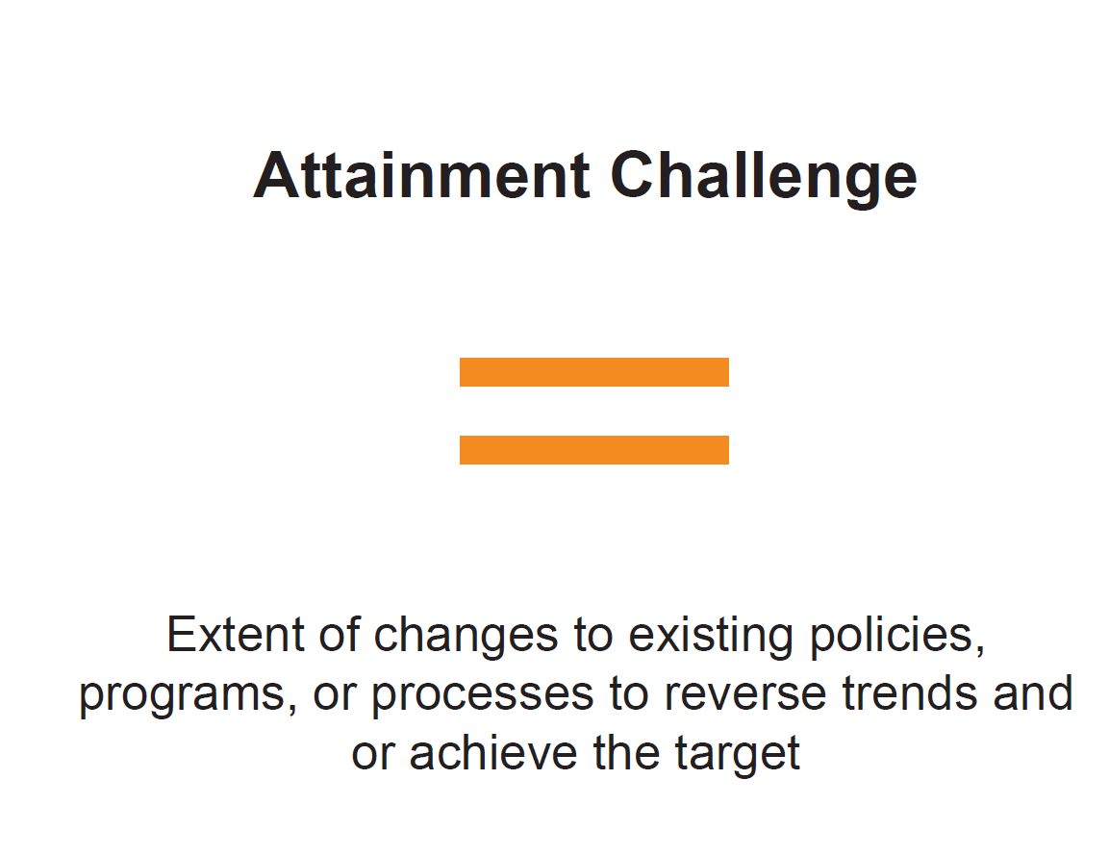

Slide 10
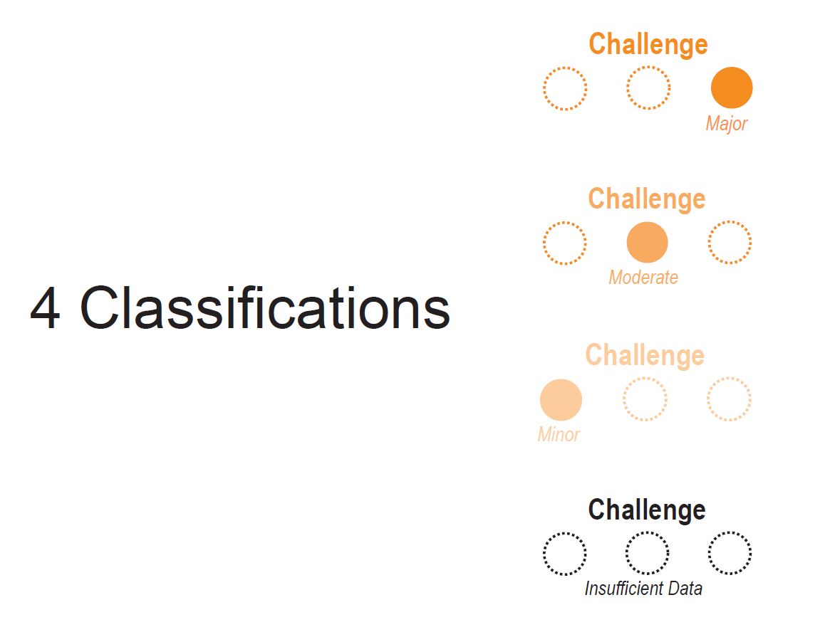

Slide 11
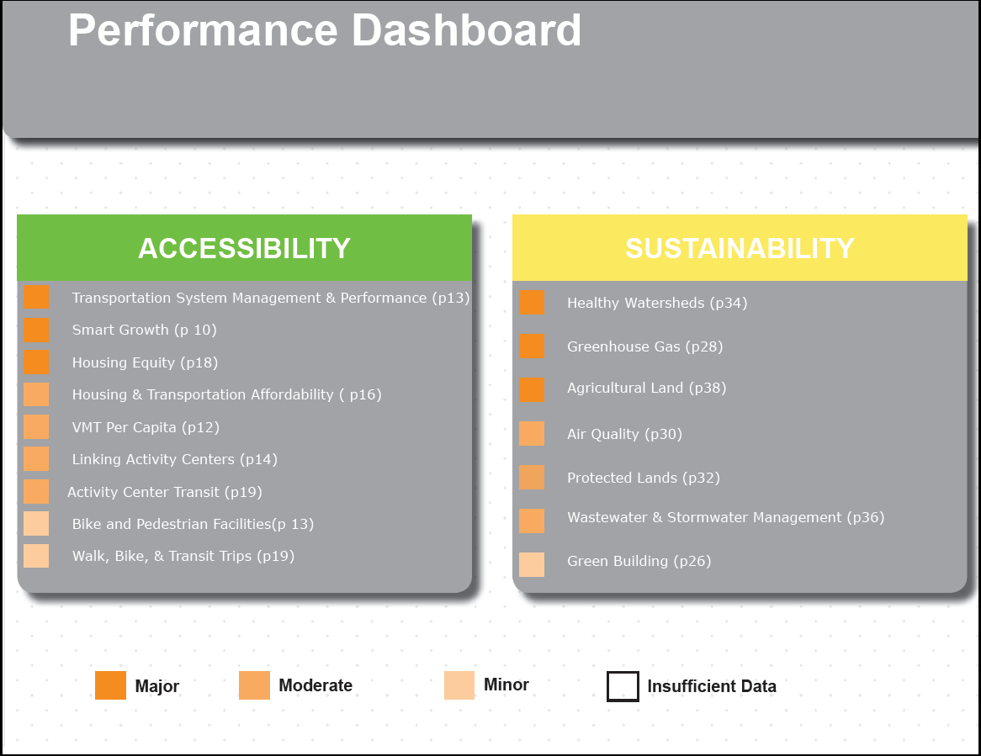

Slide 12
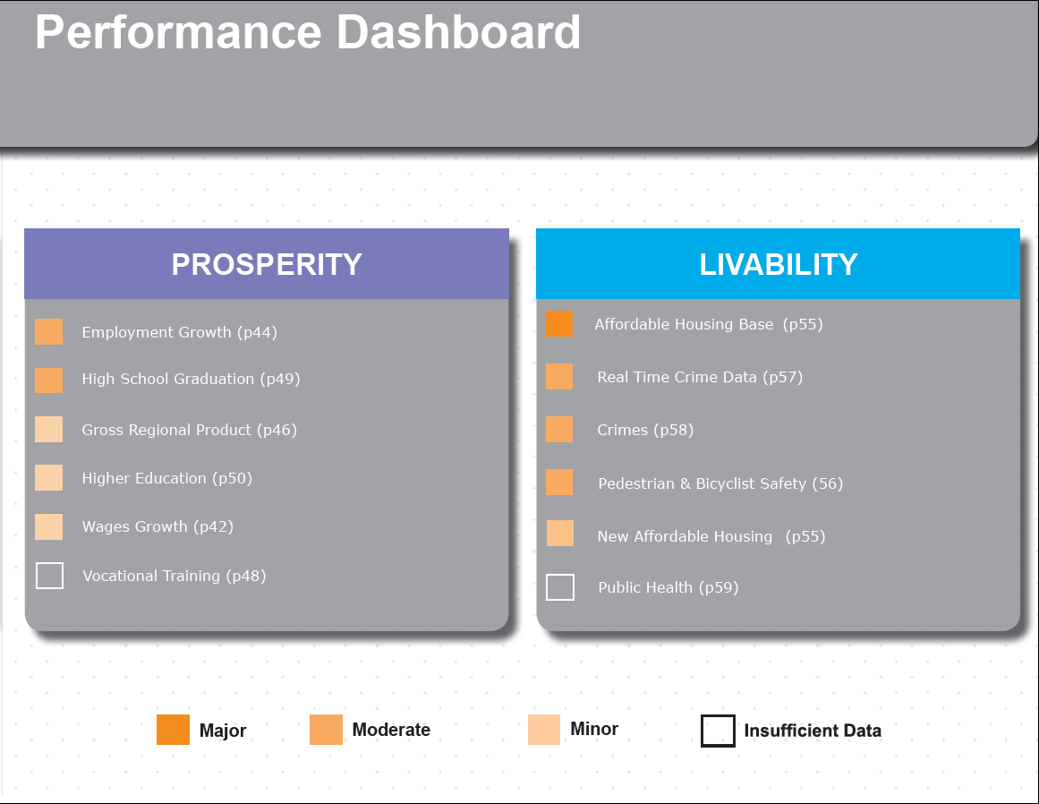

Slide 13
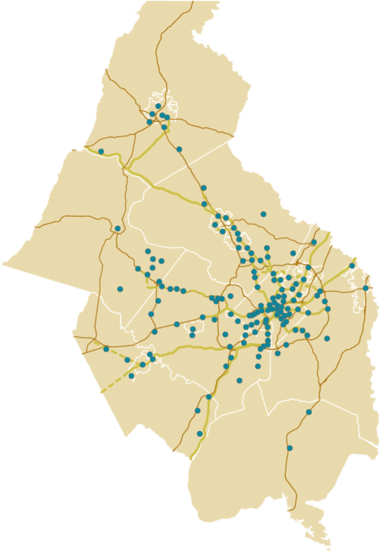
What Are Activity Centers?
Places targeted for regional growth
Urban & suburban centers, traditional towns, emerging communities
Consistent with local planning
Mixed-use
Aligned with existing &
planned transportation network
Notes:
Centers are places where much of region’s future growth will occur:
9% of region’s land area
1.6 Million additional residents anticipated by 2040
60% of additional HHs +
75% of additional jobs projected for Activity Centers
They are diverse places: urban centers, suburban town centers, traditional towns, emerging areas
They are consistent with where local planning & growth priorities
Have a mix of uses
Aligned with our transportation network – 70% are or will be served by high-capacity transit by 2040. this is particularly important -- The concept underlying all our work on Activity Centers is that we need Centers with the right mix of land uses to make the most of our transportation network, and need a range of transportation options within and between our Centers for them to be high-quality, successful places

Slide 14
Place + Opportunity
Resource to support local government investment in Activity Centers
Regional perspective:
- Identifies similar challenges & needs of Centers throughout the region
- Provides tailored tools and strategies to help communities meet their aspirations
Facilitates regional knowledge-sharing—local governments can learn from each other
Notes:
Purpose:
We created this report not only to provide analysis & resources to jurisdictions, but also to provide a regional framework for understanding Activity Centers in a broader context.
Centers are diverse, have their own aspirations, and there’s no one size fits all, but Centers with common characteristics can benefit from similar strategies
Studying at this level allows us to identify common challenges throughout the region, understand relationships between Centers, and most importantly share solutions

Slide 15

Report Overview
2/3 of Centers Analyzed
Place
Types
Opportunity
Types
Goals
Goals
Strategies
Strategies
Tools
Tools
Notes:
Studied 2/3 of Centers
Each Center has a place type + opportunity type
Created development goals to respond to the needs of each type
Identified detailed strategies and tools to support these goals
Important to note that goals, strategies, tools made for each Center type, not for individual Activity Centers

Slide 16
Methodology
Places Typology
Urban Form
Built environment characteristics,
Walkability (State of Place™)
Partner: Urban Imprint
Market Characteristics
Office rents (Costar)
Residential rents (REIS)
Market potential (Metrologic™ model)
Partner: RCLCO
Notes:
Created Place Typology & Opportunity Typology to be used side-by-side
Builds on:
1) typology work of Reconnecting America, -- they have done typology projects, including a lot of transit station typologies in lots of regions, including Portland, Denver, Twin Cities, Baltimore, etc.
2) Brookings Institution study: “Walk This Way: the economic promise of walkable places in metropolitan washington, dc” – Mariela Alfonzo, a co-author of that report, was one of our partners on this project. That report studied a large number of neighborhoods throughout the metro DC region and established a connection between walkable communities and higher economic performance.
Used that report & connection between urban form and market strength as a jumping off point. Mariela developed a diagnostic tool called Irvine Minnesota Inventory/State of Place that measures features of built environment & walkability. Were able to leverage data already collected for about 70 places in our region, and then used volunteers from our member agencies to collect that data on additional 25 places.
On the market side, we collected data on all of the 92 centers on office rents & residential rents (also considered retail and home sales) to get at current market performance, and then also used a tool called Metrologic developed by our partner RCLCO that forecast market potential by analyzing regional competitiveness. We used this measure of market potential because it takes into account role of location within a region, looking at regional access, amenities, supply factors.
This report is about place-making: factors that create distinct, thriving places.
So we studied physical attributes/ urban form/land use/market features,
Based on that analysis, we identified six place types. Transportation network not used to identify these types, but I’ll talk generally about the transportation aspects of each:
-Urban Centers, most dense & urban communities in region, all have high-volume Metro stations & strong street network and pedestrian infrastructure
-Dense MU, most have existing or planned Metro or streetcar, and are fairly walkable and pedestrian-oriented
-Suburban Multi-Use, mix of suburban Metro, commuter rail stations, or no transit. Pedestrian infrastructure in these Centers tends to be retail-oriented
-Close-in & Urbanizing, mix of Metro, streetcar, commuter rail – presence of transit, but may be safety or barriers to address in order to increase accessibility
-Revitalizing Urban, most Centers have transit stations and strong street network, but may be accessibility and safety issues. This category includes a number of Centers with underutilized Metro stations on eastern side of region (e.g. Branch, Naylor Rd, Landover)
-Satellite City, half commuter rail, half no transit, many have historic downtowns, which tend to have good, walkable street networks

Slide 17
State of Place™ – measures attributes along 10 urban design dimensions
Urban Design Dimensions | Description/Example Items
Density | Measure of enclosure based on building concentrations and height
Proximity | Presence of non-residential land uses
Connectivity | Measure of disconnectivty; Potential Barriers (e.g., six-lane roads)
Form | Measure of streetscape discontinuity (e.g. drive-thrus)
Parks and Public Space | Parks, Playgrounds, Plazas, Playing Fields
Pedestrian Infrastructure/Amenities | Curbcuts, Sidewalks, Street Furniture, Bike Racks
Personal Safety | Graffiti, Litter, Windows with Bars
Traffic Measures | Traffic Signals, Speed Limit, Traffic Calming
Aesthetics (Pleasurability & Maintenance) | Attractiveness, Open Views, Outdoor Dining, Maintenance
Recreational Facilities | Gym/Fitness Facilities, Other Recreational Uses
IMI/SoP placeholder slide

Slide 18
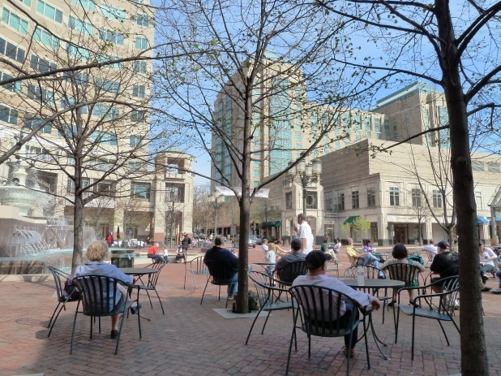
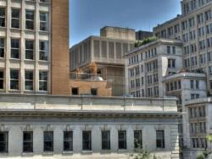
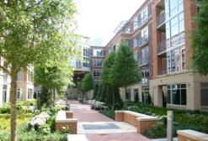
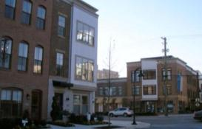
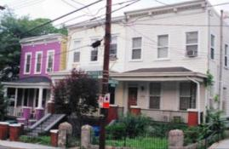
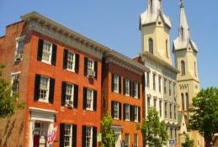
6 Place Types
Urban Center
Dense Mixed-Use
Suburban Multi-Use
Downtown DC
Reston Town Center
Falls Church
Close-in & Urbanizing
Revitalizing Urban
Satellite City
West Hyattsville
Minnesota Avenue
Downtown Frederick
Notes:
This report is about place-making: factors that create distinct, thriving places.
So we studied physical attributes/ urban form/land use/market features,
Based on that analysis, we identified six place types. Transportation network not used to identify these types, but I’ll talk generally about the transportation aspects of each:
-Urban Centers, most dense & urban communities in region, all have high-volume Metro stations & strong street network and pedestrian infrastructure
-Dense MU, most have existing or planned Metro or streetcar, and are fairly walkable and pedestrian-oriented
-Suburban Multi-Use, mix of suburban Metro, commuter rail stations, or no transit. Pedestrian infrastructure in these Centers tends to be retail-oriented
-Close-in & Urbanizing, mix of Metro, streetcar, commuter rail – presence of transit, but may be safety or barriers to address in order to increase accessibility
-Revitalizing Urban, most Centers have transit stations and strong street network, but may be accessibility and safety issues. This category includes a number of Centers with underutilized Metro stations on eastern side of region (e.g. Branch, Naylor Rd, Landover)
-Satellite City, half commuter rail, half no transit, many have historic downtowns, which tend to have good, walkable street networks

Slide 19
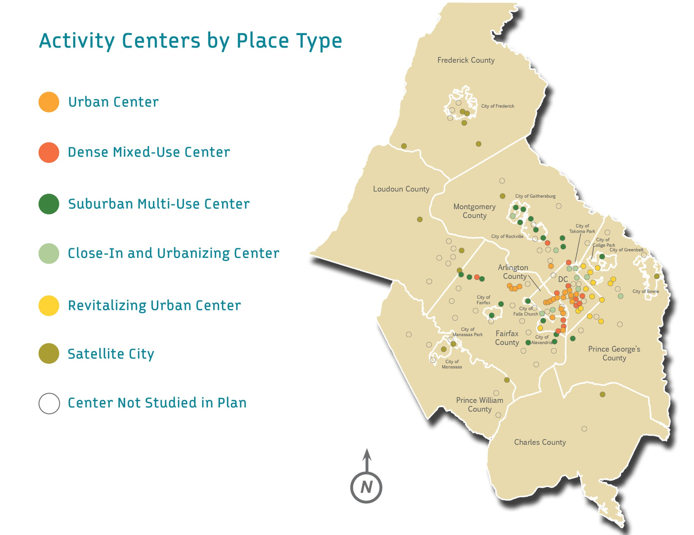

Slide 20
Opportunity Typology
Vulnerability
Concentration of households below 40% of area median income (American Community Survey)
Partner: Reconnecting America
Assets
Housing affordability (CNT Housing + Transportation Index)
Job access by transit (COG TPB Accessibility Model)
Income diversity (Esri Business Analyst from ACS data)
Partner: Reconnecting America
Notes:
Also considered whether there was high-capacity transit, existing or planned

Slide 21
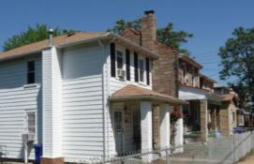
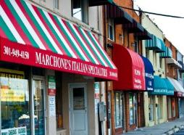
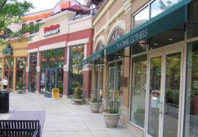
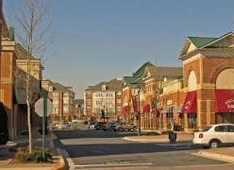
4 Opportunity Types
Transforming
Transitioning
Poplar Point
Wheaton
Connected Core
Stable
Clarendon
King Farm
Notes:
We also wanted to look at the human side of Activity Centers – the features that make a Center an inclusive, high opportunity place to live and work
So we studied socioeconomic & housing features and job access by transit of the Centers,
Based on that analysis, we identified 4 these opportunity types:
Again, I’ll talk about the transportation aspects of each type.
Transforming: places with relatively high affordability, high proportion of low income residents, high job access by transit, so likely to experience most immediate development pressures. These Centers have existing Metro or are located along Streetcar or Purple Line
Transitioning: share similar characteristics, but not facing as immediate development pressures. Nearly all of these Centers have Metro stations.
Connected Core: strong assets and amenities, & are major job centers – all of these Centers have high-volume Metro stations
Stable: broadest category so more variation. These Centers have lower concentration of low income HHs and lower hsg affordability, but a good number of Centers have suburban Metro stations, commuter rail stations, or planned stations along the Silver Line that could provide opps for TOD and enhancing accessibility

Slide 22
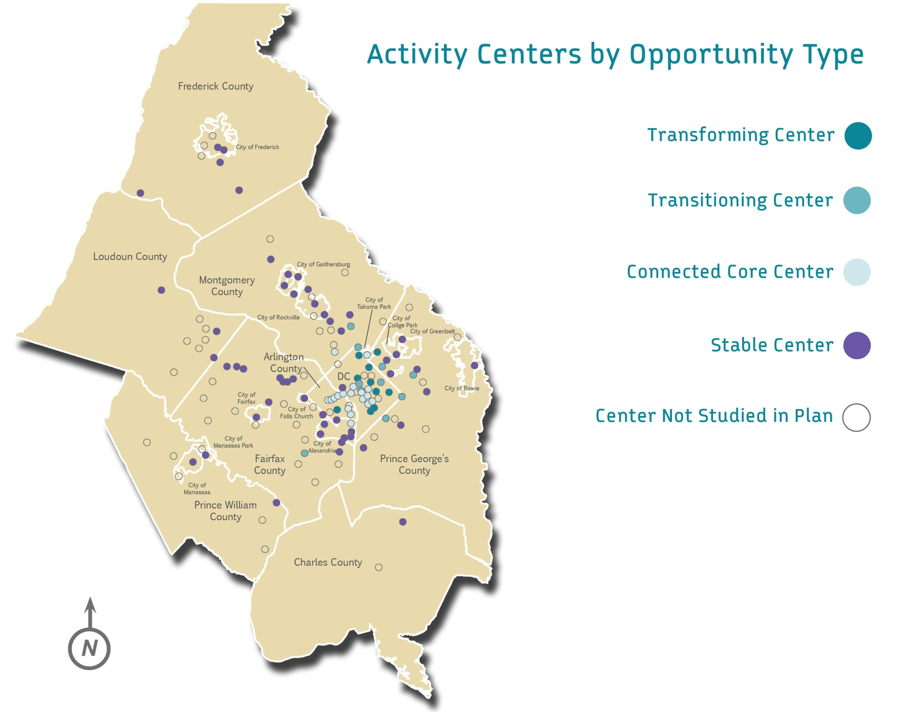

Slide 23
Project Considerations/Lessons Learned
Simplicity of typology
Determine main focus/need and build the typology around that (place-making v. equity v. TOD/transit-readiness v. health, etc.)
Who are the intended audiences? Does the project need to be approved/adopted by a Board?
  Will inform whether methodology & report are more technical/quantitative v. qualitative
  Consider focus groups with intended audiences/stakeholders
Notes:
Simplicity of typology – we intended to use a number of additional attributes for both typologies (e.g. home sales prices, retail rents, educational attainment, health indicators) but found that they didn’t buy us much in terms of understanding the centers differently, and they also made it harder to explain and harder for others to understand
Related, being very clear about what the main focus is for this typology? Is it to make investment decisions for transit station areas? Or to identify places at-risk of displacement/gentrification? Or some other purpose? We started with a focus on place-making, but also addressed economic development, equity, and transit considerations, which were less prominent at the beginning, so needed to continually tweak our methodology.
Clarity on who the primary audiences are, and whether this needs to be approved and adopted. We started with a larger number of audiences that included not just local government planners and transportation/transit agencies, but also community groups, developers, and philanthropists. We ultimately needed to have this approved by board of directors, so this meant that our methodology and report became somewhat less technical b/c not just for a technical planner audience. We held a couple focus groups – planners, transportation groups, developers. That helped clarify that this project wasn’t going to be as helpful to developers as we imagined, which was OK – it helped us focus more on planners & elected officials as our key audiences, although we have also done a fair amount of outreach to fed gov’t, philanthropic groups, and development audiences.

Slide 24
Next Steps for Region Forward Coalition
July 18th - “Prosperity / Livability”
  “Bursting the Bubble” - Commonwealth Institute
  “Housing Security Study” - Urban Institute / Community Foundation
Fall – “Livability”
  Mark Fenton - www.MarkFenton.com
  Health goals, targets and indicators
Notes:
Simplicity of typology – we intended to use a number of additional attributes for both typologies (e.g. home sales prices, retail rents, educational attainment, health indicators) but found that they didn’t buy us much in terms of understanding the centers differently, and they also made it harder to explain and harder for others to understand
Related, being very clear about what the main focus is for this typology? Is it to make investment decisions for transit station areas? Or to identify places at-risk of displacement/gentrification? Or some other purpose? We started with a focus on place-making, but also addressed economic development, equity, and transit considerations, which were less prominent at the beginning, so needed to continually tweak our methodology.
Clarity on who the primary audiences are, and whether this needs to be approved and adopted. We started with a larger number of audiences that included not just local government planners and transportation/transit agencies, but also community groups, developers, and philanthropists. We ultimately needed to have this approved by board of directors, so this meant that our methodology and report became somewhat less technical b/c not just for a technical planner audience. We held a couple focus groups – planners, transportation groups, developers. That helped clarify that this project wasn’t going to be as helpful to developers as we imagined, which was OK – it helped us focus more on planners & elected officials as our key audiences, although we have also done a fair amount of outreach to fed gov’t, philanthropic groups, and development audiences.

