Slide 1
The 2015 International Energy Conservation Code
Results of Atlantic City and the Impact on MWCOG Members
TODD SIMS
PROGRAM ASSOCIATE
INSTITUTE FOR MARKET TRANSFORMATION

Slide 2
AGENDA
Review of outreach efforts surrounding the Public Comment Hearing in Atlantic City
An overview of what the 2015 IECC is expected to look like
Looking ahead at the effects of cdpACCESS on the code development process

Slide 3
Outreach Efforts
Outcomes
Raise awareness on the importance of code development process and upcoming deadlines to MWCOG
Facilitate travel scholarships allowing voting members to attend the hearing
Educate voting members on specific code change proposals
Provide rapid-response assistance during the hearings
COG members played an integral part of shaping the 2015 IECC.
With 4 jurisdictions represented in Atlantic City, they played a key role in defending energy-efficiency.
You were the best represented region through the duration of the hearing.

Slide 4
Result
MWCOG voting members in Atlantic City:
4 jurisdictions represented, ≈15 voting members
Sat through ≈100 hours of testimony over 6 days
Collectively COG voting members cast over 8,970 votes
Successfully defended energy efficiency against significant rollbacks

Slide 5
Setting the Stage
Prior to Atlantic City, many experts expected significant rollbacks in EE to occur
Potential the 2015 IECC could have been less efficient than the 2012 IECC
  Would have been first time in history
  Could have failed DOE determination
“Holding the line” would have been considered a major victory

Slide 6
Results of Atlantic City
“When you leave Atlantic City with more than you came with, you count yourself lucky”
Major “rollback” proposals were defeated
(RE-166)
One major energy efficiency win
(RE-188)
All-in-all: not significantly different energy savings than the 2012 IECC
  However, the 2015 IECC will be clearer, more ‘user-friendly’, making it easier to realize those energy savings

Slide 7
2015 IECC – Residential
Overview
Not many significant changes
Many of the proposals were fights over preventing backsliding
  RE-166 would have re-instituted unrestricted equipment trade-offs
One major change: RE-188
  Institutes an Energy Rating Index compliance path
Overview

Slide 8
2015 IECC – Residential
Ch 1: Scope & Admin
‘Existing Buildings’, Historic Buildings’, and ‘additions, alterations, renovations, and repairs’ sections removed from Ch. 1
  Will be given a new section (likely a new Ch. 5)
Historic Buildings are no longer exempt from the IECC
  Alterations and repairs must comply with IECC to the extent that compliance does not compromise the historic nature
§ 104 has been revised to list and describe the required inspections
  Footing and foundation
  Framing and rough-in
  Plumbing rough-in
  Mechanical rough-in
Scope and
Administration

Slide 9
2015 IECC – Residential
Ch 2: Definitions
The following definitions have been added or revised for the 2015 IECC:
  Continuous Insulation (ci)
  ERI Reference Design
  Fenestration
  Historic Building
  Insulated Siding
  Skylight
  Vertical Fenestration
Definitions

Slide 10
2015 IECC – Residential
Ch 3: General Requirements
New climate zone added
  § 301.4 will define what regions would constitute a “Tropical Climate Zone”
New section added for “insulated siding”
  Lists ASTM C1363 as the test standard to determine R-Value of insulated siding
General
Requirements

Slide 11
2015 IECC – Residential
Ch 4: Energy Efficiency
New exemption to § R402.2.4
  Allows for vertical doors that provide access to conditioned space from unconditioned spaces to meet the fenestration requirements in Table R402.1.1
New exemption to § R402.2.7
  Allows for floor framing cavity insulation not to be in contact with the underside of the subfloor decking as long as it is in contact w/ the topside of sheathing or continuous insulation installed on the bottom side of floor framing
Building Envelope
Provisions
Notes:
R402.2.4 – This change means that these types of doors, such as attic kneewall doors, do not have to be insulated the same as the surrounding wall as long as they meet the U-value requirements in the table.

Slide 12
2015 IECC – Residential
Ch 4: Energy Efficiency (cont’d)
New section R402.2.13
  Addresses “walls with partial structural sheathing”
Section R402.3.2 ‘Glazed fenestration SHGC’
  Revised to recognize dynamic glazing
Significant revision to R402.4.1.1 ‘Air Barrier and Insulation Installation’
  Splits the ‘criteria’ column into separate ‘air barrier’ and ‘insulation installation’ criteria. Plus new criteria for ‘concealed sprinklers’, ‘walls’, ‘floors’, and ‘fireplaces’
Testing for building envelop air leakage under § 402.4.1.2 revised to require that all testing been done in accordance w/ ASTM E 779 or ASTM E 1827
Tight-fitting doors on factory-built fireplaces also be listed and labeled for the fireplace
Building Envelope
Provisions

Slide 13
2015 IECC – Residential
Ch 4: Energy Efficiency (cont’d)
Change re: new equipment and combustion closets
  Climate Zones 3-8 only: Atmospheric vented appliances inside the building envelope…must be in closet sealed and insulated according to Table R402.1.1
Duct insulation provisions:
  Clarifies both supply & return ducts in attics must be insulated to a min. R-8, where 3 in. or > in diameter and R-6 where < 3 in.
  Elsewhere must be insulated to a min. of R-6 where 3 in. or > and R-4.2 where < 3 in.
The testing option of ‘rough-in test’ is listed before ‘post-construction’ test
Change to § R403.6 ‘Equipment Sizing’
  “New or replacement heating and cooling equip. shall have an efficiency rating > or = the min. required by fed. law”
Mechanical Systems
Provisions
Notes:
New equipment and combustion closet applies to DC. (climate zone 4)

Slide 14
2015 IECC – Residential
Ch 4: Energy Efficiency (cont’d)
Change prohibits both gravity and thermo-syphon
circulation systems
Change requires recirculation systems to be demand-controlled
Hot water pipe insulation remains R-3 but the provisions have been simplified
  ‘Maximum run length’ table deleted
Hot Water
Provisions
Notes:
* Many of the Hot Water Provisions also apply to the Commercial Code

Slide 15
2015 IECC – Residential
Ch 4: Energy Efficiency (cont’d)
Performance Path
Provisions
RE-188
  Only significant change to the 2015 IECC
  A win for efficiency advocates
  A new performance path compliance option and will become Sec. R406, ‘Energy Rating Index’
  Will set ERI score between 51-55
  Sets building-envelope stringency levels at 2009 IECC levels
  Requires 3rd Party verification
** IMT has several educational resources on RE-188

Slide 16
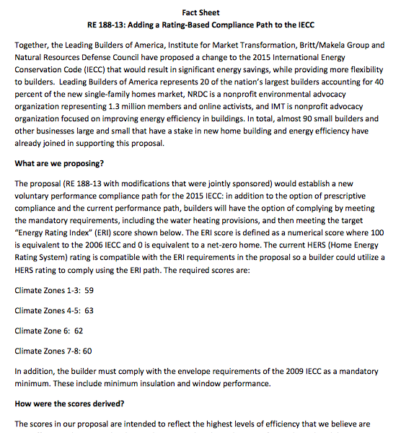
RE-188

Slide 17
2015 IECC – Commercial
Overview
Several changes to the Commercial Code
Many of these yield incremental efficiency gains
  The rest reorganize and clarify the code
Most changes concentrated in Lighting and HVAC
Overview
Source: NEEP Presentation on ICC PCH Reactions and Next Steps by Don Vigneau and Kevin Rose

Slide 18
2015 IECC – Commercial
Lighting
More requirements for daylighting controls and zones
Occupancy sensors in warehouses, lounges, etc.
Minimum skylighting area requirement extended
Commissioning of occupancy sensors and daylighting controls
Three new options to § C406:
  Enhanced lighting controls
  Dedicated outdoor air system
  High efficiency service water heating
Lighting
Source: NEEP Presentation on ICC PCH Reactions and Next Steps by Don Vigneau and Kevin Rose

Slide 19
2015 IECC – Commercial
HVAC, Water Heating, Lighting
Minimum HVAC, Water Heating, and Lighting Efficiency
  Min. performance criteria were improved for the following to match ASHRAE 90.1-2013:
HVAC, Water Heating,
and Lighting
AC/Heat pump | Multi-zone VAV systems
Energy recovery equip. | Hot water system controls
Kitchen exhaust flow | Exterior lighting controls
Refrigeration | Lighting power densities
Economizers and controls | Electric transformers
VAV fans | Electrical motors
Heat rejection equip. | People movers
1/12 – 1 HP fans | Lighting O&M manual
Source: NEEP Presentation on ICC PCH Reactions and Next Steps by Don Vigneau and Kevin Rose

Slide 20
What’s Next
Education and Training
  Review supporting documents and resources
  Train internal staff
  Stay engaged
Support adoption of the 2015 IECC
  No sweeping changes. BUT the changes that were made make the code clearer and easier to comply with.
Assess overlaps in policy
  Current sustainable building policies may have overlap with the Code
  Allows for more targeted policies
Get educated on cdpACCESS
Next Steps

Slide 21
cdpACCESS
What is it?
  cdp (code development process) ACCESS
  NEW online voting portal
  Administered by the International Code Council
What will it do?
  Allow you to vote on code changes remotely
  Removes cost and time burden of traveling to Public Comment Hearings
  Significantly increase participation in code development
Overview

Slide 23
cdpACCESS
What effect will it have?
  Make it easier for all code officials to participate in the process
  BUT – efficiency opponents will be significantly advantaged when it comes to ‘voter outreach’ thanks to existing infrastructures
What are the next step?
  Education
    ICC hosting several webinars
    IMT developing tools and guides
  Plan for the future
    First opportunity to use it: Group C Committee Action Hearing, April 27 – May 4, Memphis, TN
Next Steps

Slide 24
Thank You
TODD SIMS
Program Associate
Institute for Market Transformation
todd@imt.org
202.525.2883 x321

