Slide 1
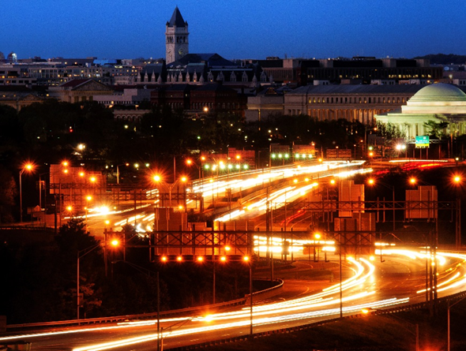
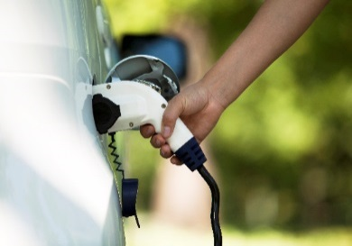
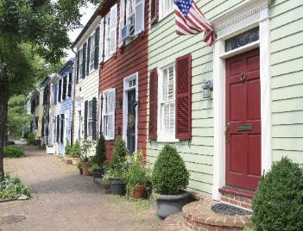

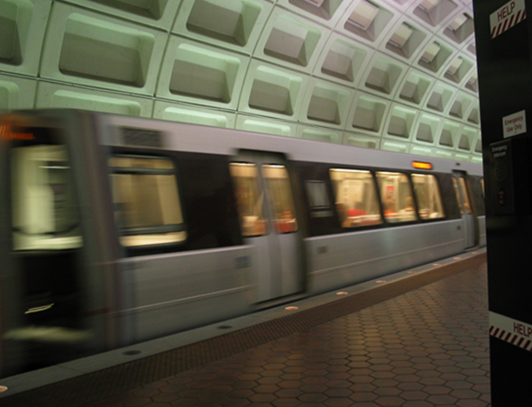
Multi-Sector Approach to Reducing Greenhouse Gas Emissions in the Metropolitan Washington Region
Land Use and Transportation Strategies
Prepared for:
Metropolitan Washington Council of Governments
Friday, April 17, 2015

Slide 2
Land Use and Transportation Strategies
Land Use Strategies
L-1: Maximize urban tree canopy
L-2: Increase proportion of new housing and jobs in activity centers
L-3: Improve regional jobs/housing balance
L-4: Maximize walkable design in activity centers
L-5: Establish adequate retail balance in activity centers
L-6: Focus Government employment near premium transit
Transportation Strategies Continued
T-6: Roadway bottleneck relief / targeted capacity enhancements
T-7: Corridor / regional operational improvements
T-8: Promote ecodriving
T-9: Off-peak freight deliveries
T-10: Lower speed limits
T-11: Advance adoption of connected vehicle technologies
T-12: Enhance the bicycle/pedestrian environment
T-13: Enhance transit services
T-14: Transit incentives
T-15: Park-and-ride and HOV investments
T-16: Parking management
T-17: Travel demand management
T-18: Road pricing / congestion pricing
T-19: Cordon pricing
T-20: Pay As You Drive insurance
T-21: Increasing fuel taxes / Carbon tax
Transportation Strategies
T-1: Improve fuel economy of light-duty vehicle fleet
T-2: Increase alternative fuels in public sector fleets
T-3: Clean freight technologies
T-4: Lower emissions off-road construction vehicles
T-5: Low carbon fuel standard

Slide 3
Notes for Analysis
State, Regional and Local Actions, not Federal
  National policies and regulations could have the most significant impacts, but these strategies may not be feasible or desirable to be applied at a regional level
Strategies not implementation Mechanisms or Processes
  A number of implementation mechanisms and ‘process’ requirement could play important roles in helping to advance implementation strategies
Grouping of Strategies
  For analysis, we plan to bundle several strategies

Slide 4
Initial Concepts for Prioritized Strategies
Most Promising | Increase proportion of new housing and jobs in activity centers (L-2) + Maximize walkable design in activity centers (L-4) + Establish adequate retail balance in activity centers (L-5) + Focus Government employment near premium transit (L-6) + Enhance the bicycle/pedestrian environment (T-12) Improve fuel economy of light-duty vehicle fleet (T-1) Low carbon fuel standard (LCFS) (T-5) Promote eco-driving (T-8) + Advance adoption of connected vehicle technologies (T-11) + Corridor operational improvements (T-7) + Roadway bottleneck relief/targeted capacity enhancements (T-6) Transit incentives (T-14) + Enhance transit services (T-13) Travel demand management (T-17) Road pricing/ congestion pricing (T-18) + Pay as You Drive insurance (T-20)
Somewhat Promising | Maximize urban tree canopy (L-1) Improve regional jobs/housing balance (L-3) Increase alternative fuels in public sector fleets (T-2) Clean freight technologies (T-3) Parking management (T-16)
Less Promising | Lower emissions of off-road construction vehicles (T-4) Off-peak freight deliveries (T-9) Lower speed limits (T-10) Park-and-ride and HOV investments (T-15) Cordon pricing (T-19) Increasing fuel taxes / carbon tax (T-21)

