Slide 1
District of Columbia tidal water quality monitoring stations trend
GAM Model Results
Mukhtar Ibrahim Environmental Engineer Water Resources Technical committee March 13, 2026

Slide 2
What is GAM?
Generalized Additive Model is a statistical model used to model nonlinear data. The response variable depends nonlinearly on unknown smooth function of predictor variables.
Chesapeake Bay (CBP) developed a GAM-based package R.
There are 4 models within GAM.
α = 0.05 or 95% confidence level is used in the model.
Metropolitan Washington Council of Governments (COG) agreed to work with the District of Columbia Department of Energy and Environment (DOEE) and Chesapeake Bay (CBP) to produce trends results for stations in tidal Potomac and Anacostia Rivers.

Slide 3
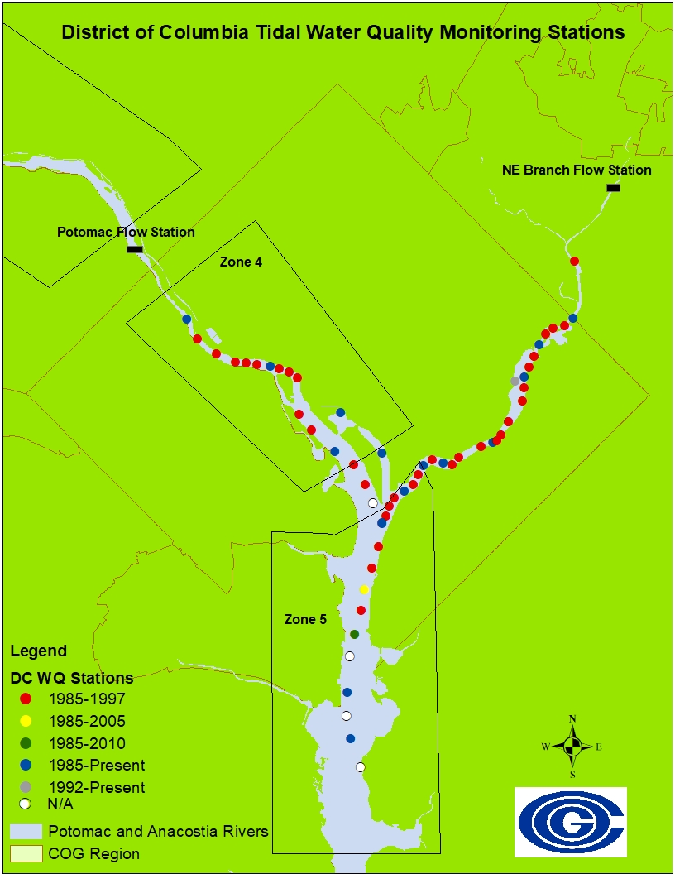
Water Quality Monitoring Stations
Most of the Potomac and Anacostia River Stations do not have continuous data records.
All of DC stations are within the tidal Potomac and Anacostia Rivers.
Potomac River stations are in zone 4 and 5, these zones are identified based on physiographic and hydrologic characteristics.
Flows from the Potomac and Northeast Branch Anacostia Rivers Pump stations are used in this model.

Slide 4
Parameters List for 2024 GAM Results
Based on what was decided and used last year, this is the list that we used to generate trends for DC stations.
The percent change computations should at least contain 1999-2000 to 2021-2023 for comparison between stats.
For this Trends we used the GAM models 2 and 4.
Parameter | Layer | Full years for GAM runs | Subsets for percent change^{b}
 |  |  | Seasons | years
Dissolved Oxygen | S | 1985-2024 | Annual, Summer1 (Jun-Sep) | 1985-1986 to 2022-2024; 2015-2016 to 2023-2024
Secchi Depth | S | 1985-2024 | Annual, SAV (Apr-Oct) | 1985-1986 to 2022-2024; 2015-2016 to 2023-2024
Chlorophyll-a | S | Any yearª - 2024 | Annual, Spring1 (Mar-May), Summer2 (Jun-Sep) | 2015-2016 to 2023-2024 (we just presented short-term for these stations based on data availably for chla)
TSS | S | Any yearª -2024 | Annual | 1999-2000 to 2023-2024; 2014-2015 to 2023-2024
Orthophosphate (PO4) - - Not reported in 2024 | S | Any yearª -2022 | Annual | 1999-2000 to 2021-2022; 2013-2014 to 2021-2022

Slide 5
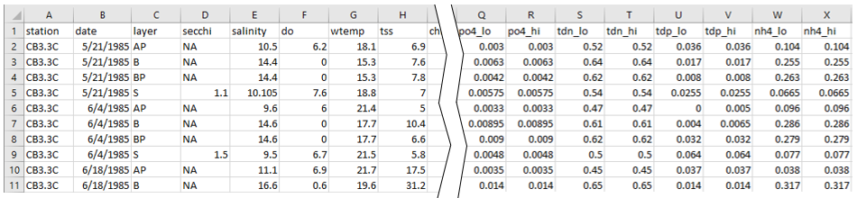
Input Water Quality Data File
Not enough TN data to run the model.
TP data up to 1992 and no sufficient data to run gam4.
There are gaps in data with other parameters.
There are gaps in data for Stations with continuous records.
DO, CHLA, SECCHI, and TSS.
NO PO4 Data for 2023 and 2024

Slide 6
Stations and Layers
Potomac River Tidal Stations: PMS01, PMS10, PMS21, PMS29, PMS44, PMS48, PTB01, PWC04.
Anacostia River Tidal Stations: ANA01, ANA05, ANA08, ANA11, ANA14,ANA19, ANA21, ANA24, ANA29, ANA30, KNG01, KNG02).
Layer filters:
S = surface, SAP = surface and above pycnocline, B = bottom, BBP = bottom and below pycnocline, AP = Above pycnocline, BP = Below Pycnocline.
analySpec$layerFilt <- c('S','M','B’),
analySpec$layerFilt <- c('S','AP','SAP')
analySpec$layerFilt <- c('B','BP','BBP')
analySpec$layerFilt <- c('S’)
analySpec$layerAggOption <- 4

Slide 7
Analysis Periods and Seasons
Long-Term Period from 1985 to 2024 (1985/1986 and 2022/2024)
Short-Term Period from 2014 to 2024 (2015/2016 and 2022/2024)
Season Name = All, season Months = c(1:12)
Season Name = Summer1, Season Months = c(6:9)
Season Name = Summer2, Season Months = c(7:9)
Season Name = Spring1, Season Months = c(3:5)
Season Name = SAV1, Season Months = c(4:10)
For DO we used All and summer1
For CHLA we used All season, summer2 and spring1

Slide 8
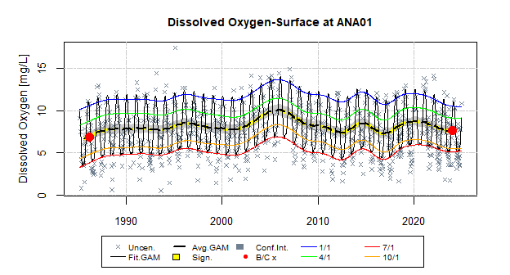
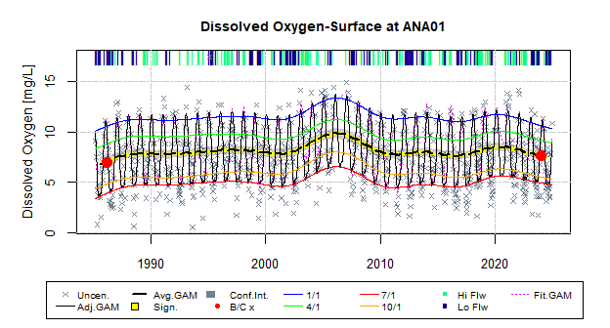
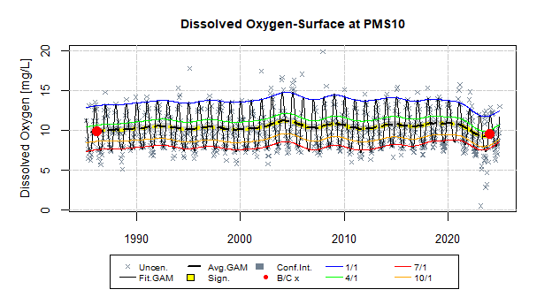
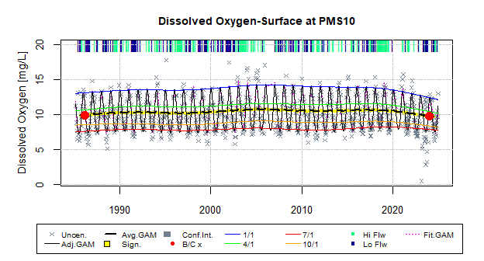
Dissolved Oxygen

Slide 9
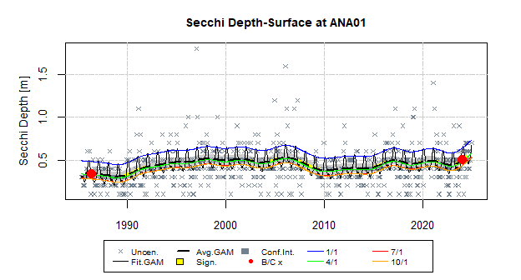
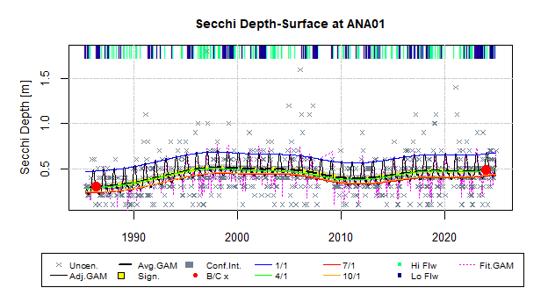
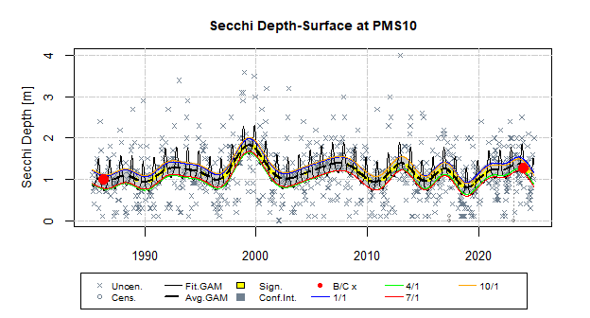
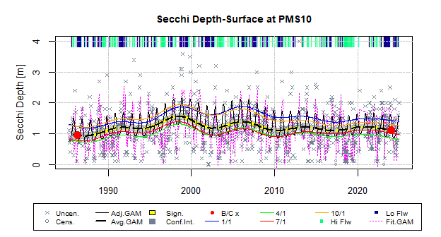
Secchi Depth

Slide 10
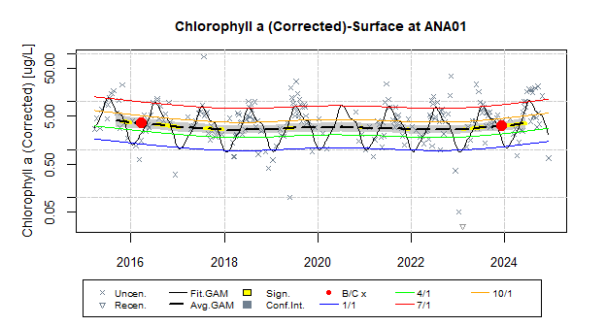
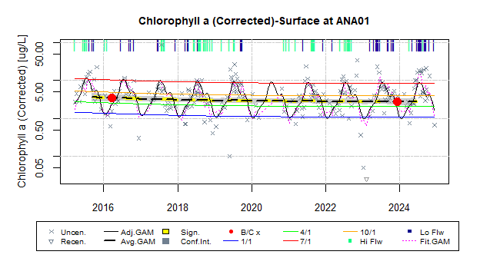
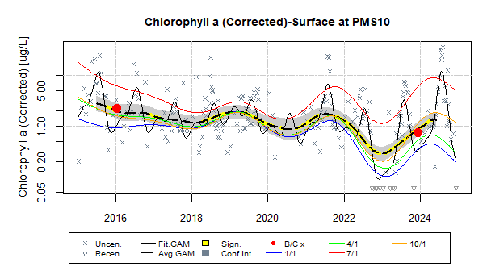
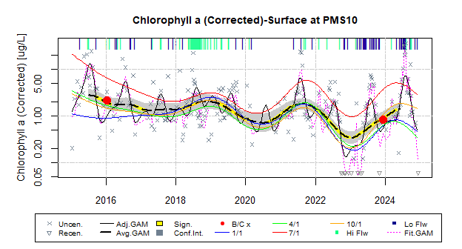
Chlorophyll-A

Slide 11
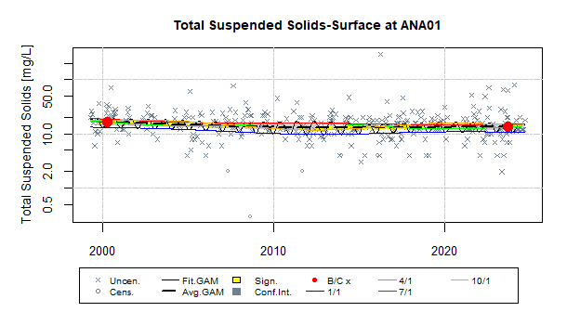
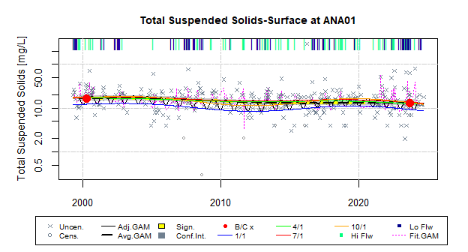
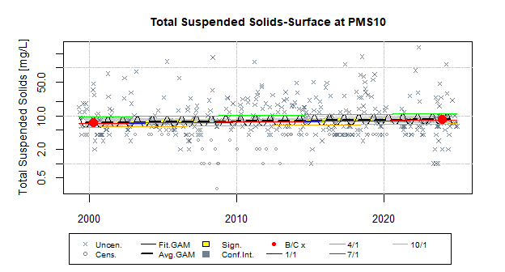
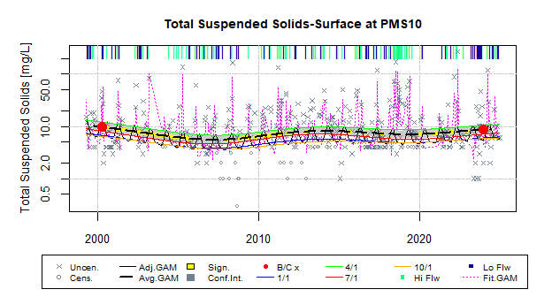
Total Suspended Sediment

Slide 12
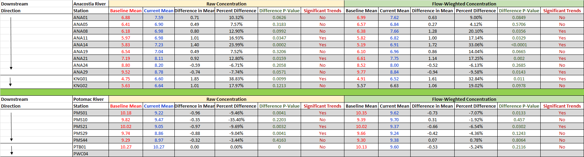
Dissolved Oxygen Annual Trends 1985-2024

Slide 13
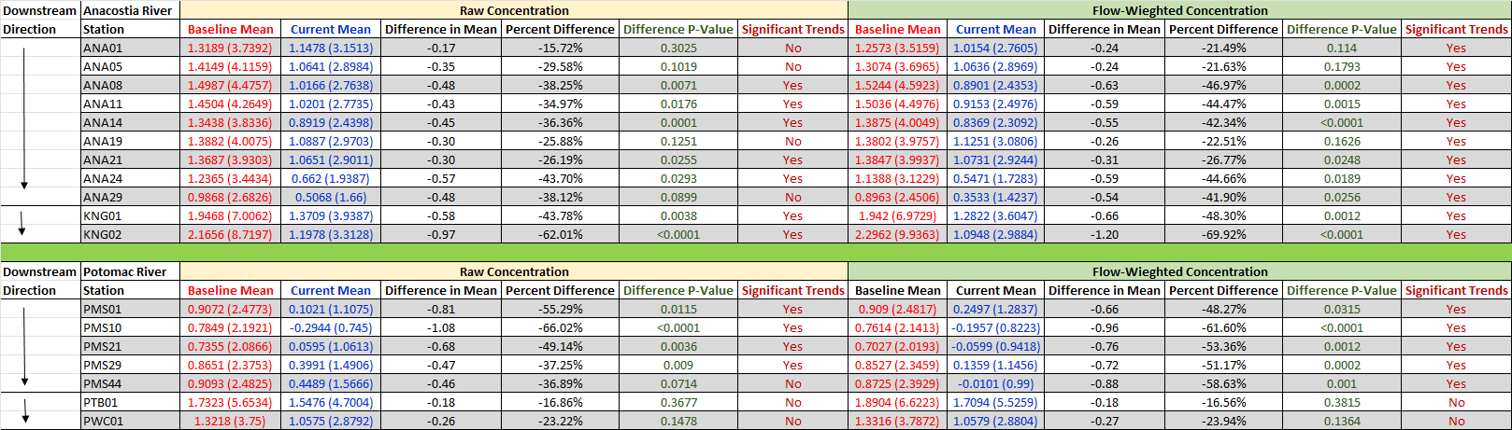
Chlorophyll-a Annual Trends 2014-2023

Slide 14
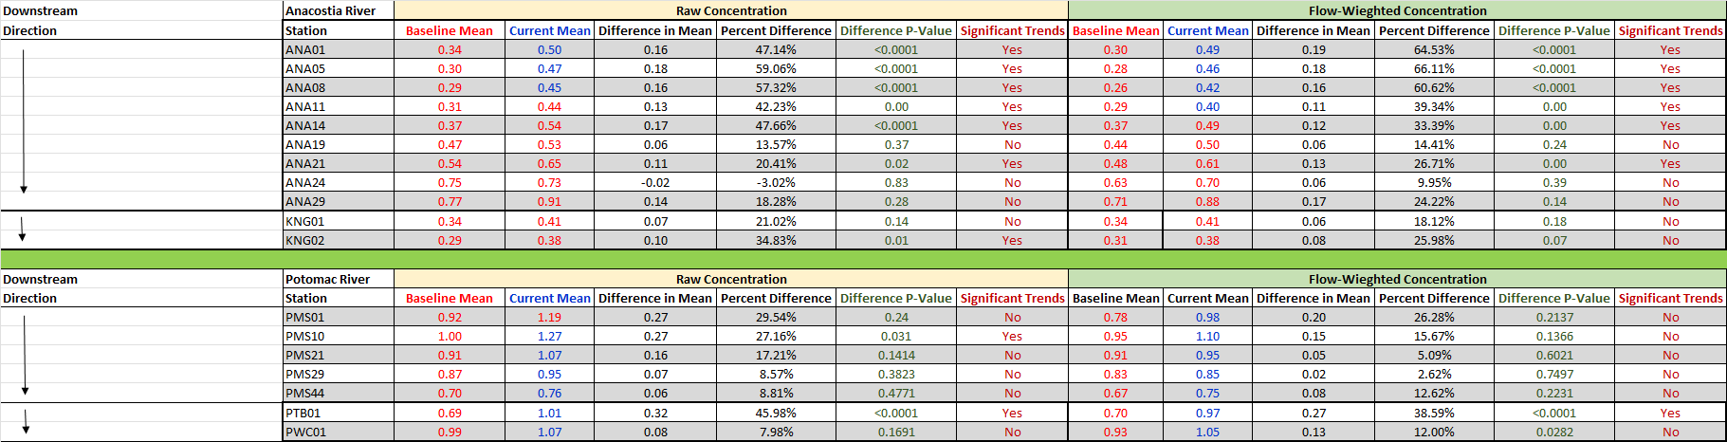
Secchi Depth Annual Trends 1985-2023

Slide 15
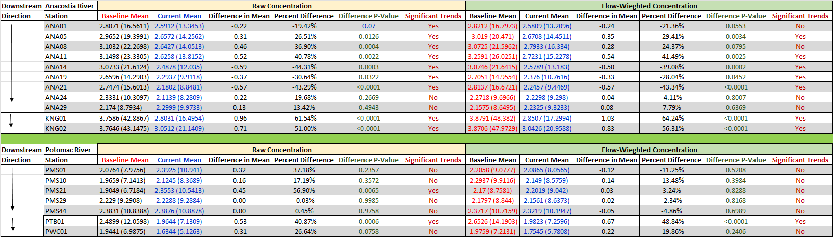
Total Suspended Solids Annual Trends 1985-2022

Slide 16
Summary
COG will continue to work with DCDOEE and CBP to produce tidal trends.
For flow weighted trends, we will continue using USGS flow gauge stations on Little Falls on the Potomac River and Northeast Branch Anacostia River.
We will continue to use surface layer data.
CBP reports summer DO trends because that is where most of the DO depletion occurs.
CBP reports CHLA from 2013 to present because the big gaps in data would not provide valid or accurate trends.

Slide 17
Mukhtar Ibrahim (202) 962-3364 mibrahim@mwcog.org | mwcog.org
777 North Capitol Street NE, Suite 300 Washington, DC 20002

