Slide 1
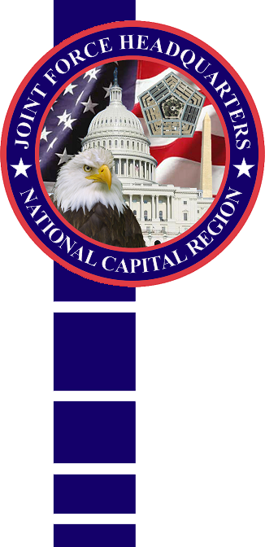

This Brief is Classified:
UNCLASSIFIED / FOUO
Joint Force Headquarters - National Capital Region
(JFHQ-NCR)
and
The United States Army
Military District of Washington (USAMDW)
57th Presidential Inauguration
Guardian
of the Nation’s Capital
MG Michael S. Linnington
Commanding General

Slide 2
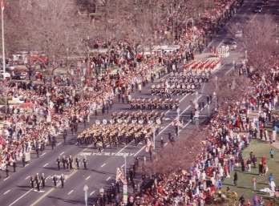
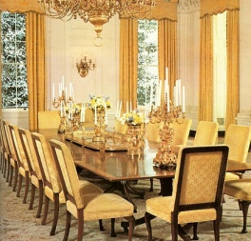
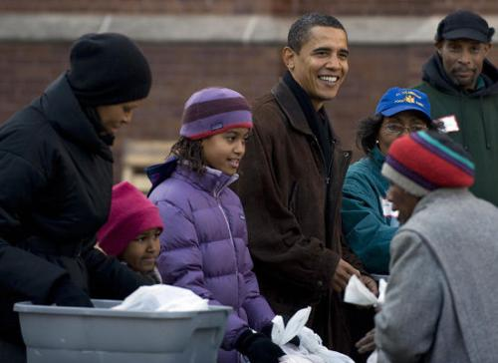
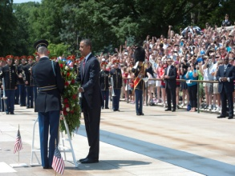
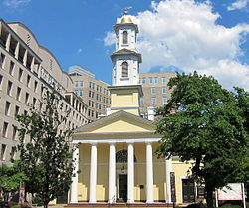
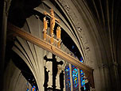


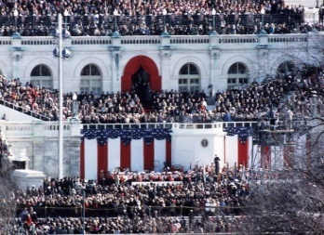
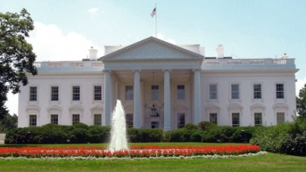
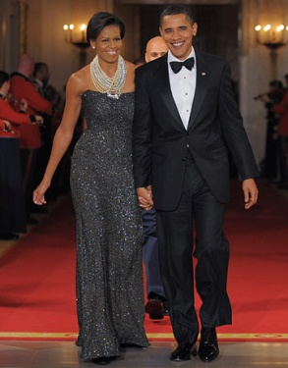
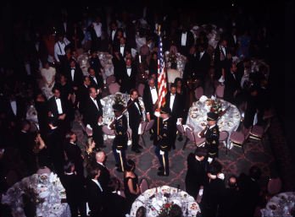
Major Event Schedule ~ 57th Inauguration
Sun, 13 JAN
Thurs, 17 JAN
Fri, 18 JAN
Sat, 19 JAN
Sun, 20 JAN
Mon, 21 JAN
Tues, 22 JAN
Dress Rehearsal
White House Brunch
and reception
White House Brunch
and reception
National Day of Service
Wreath Laying Tomb of Unknowns
Church Service
St John’s, Lafayette Park
National Prayer Service
What was Different in 2013:
- No Opening Ceremony
- Added White House brunch/reception
- No Presidential departure ceremony
- Two Oaths of Office Ceremonies (Sun/Mon)
- Smaller (size)… but not shorter (time) parade
- Only two official Inaugural Balls
- Smaller crowd
Children’s Concert
Convention Center
Church Service
Swearing in Ceremony
Open House
Oath of Office
Parade/St Cordon
Decisions made after Election (6 Nov) once
Presidential Inaugural Committee formed
Reception
National Bldg Museum
2 Inaugural Balls
Convention Center

Slide 3

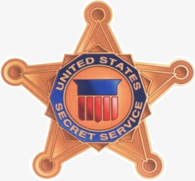
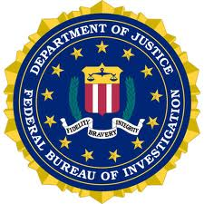
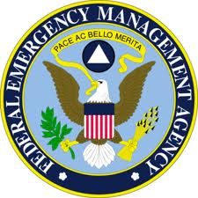
NSSE Primary Agencies
As directed by National Security Presidential Directive 46 (NSPD-46)
and Homeland Security Presidential Directive 15 (HSPD-15)
U.S. Department of Homeland Security (DHS): Federal department responsible for coordination of domestic incident management
U.S. Secret Service (USSS): is the lead agency for security design, planning and implementation
Federal Bureau of Investigation (FBI): is the lead agency for intelligence, counterterrorism and federal criminal violations
Federal Emergency Management Agency (FEMA): is the lead agency for Emergency Management (consequence management)
Notes:
Cover the Primary Agency responsibility which under the NRF…not sure if it goes back to “Lead Federal Agency”
Cover what USSS, FBI an FEMA are responsible for…not just for NSSEs

Slide 4
NCR NSSE Coordination
NSSE security is planned, exercised and
implemented through a unified command model
Executive Steering Committee:
  Chaired by U.S. Secret Service Event Coordinator (Special Agent from the Dignitary Protective Division)
  Agency-level representatives from USSS; FBI; FEMA; DOD (JFHQ-NCR); Federal, State and Local counterparts; DC Fire, Homeland Security and Emergency Management, and Metropolitan Police; others
  Oversees development and implementation of a comprehensive, integrated security plan
  Serves as final arbiter of disputes within or among subcommittees
Subcommittees (number and type vary by event):
  Staffed by interagency subject matter experts and stakeholders
  Develop and implement specific aspects of security plan
  Report regularly to Executive Steering Committee/Event Coordinator

Slide 5
2013 Inauguration Subcommittees
25 Total
Airspace Security
Civil Disturbance & Prisoner Processing
Consequence Management
Counter-Surveillance
Credentialing
Crisis Management
Critical Infrastructure
Crowd Management
Explosive Device Response
Fire/Life-Safety/HAZMAT
Health and Medical
Intelligence
Interagency Communications
Joint Base Andrews
Legal
Maritime Security
Parade Route
Public Affairs
Reviewing Stand
Tactical
Training
Transportation and Traffic
U.S. Capitol
VIP/Dignitary Protection
Venues

Slide 6
2013 Inauguration Observations
Executive Steering Committee (USSS Lead):
  Early designation of the NSSE (12 Sept 2012 vice 10 Dec 2009)
  Creation of a Critical Infrastructure Center @ USSS-WFO (private utilities)
  Creation of a Critical Events List
  Creation of a Facts and Assumption Tracker
  Established a Crowd Management Subcommittee (purple tunnel)
  Increased Social Media Engagement (USPP – emergency notifications/ event messages from the United States Park Police via text message [Nixle]; JFHQ-NCR Inaugural App)
  Increased signage
  Movement of MACC to the Rowley Training Center (Beltsville, MD)
  Addition of GSA & JCCIC as Executive Steering Committee members
  Multiple Rehearsal of Concept (ROC) Drills

Slide 7
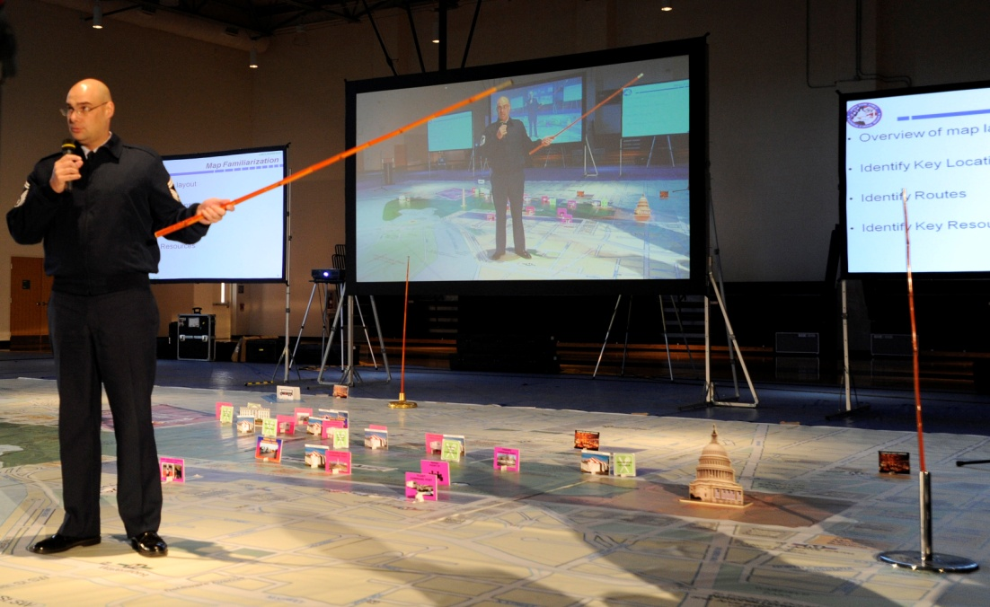
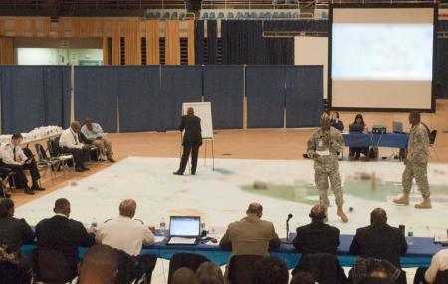
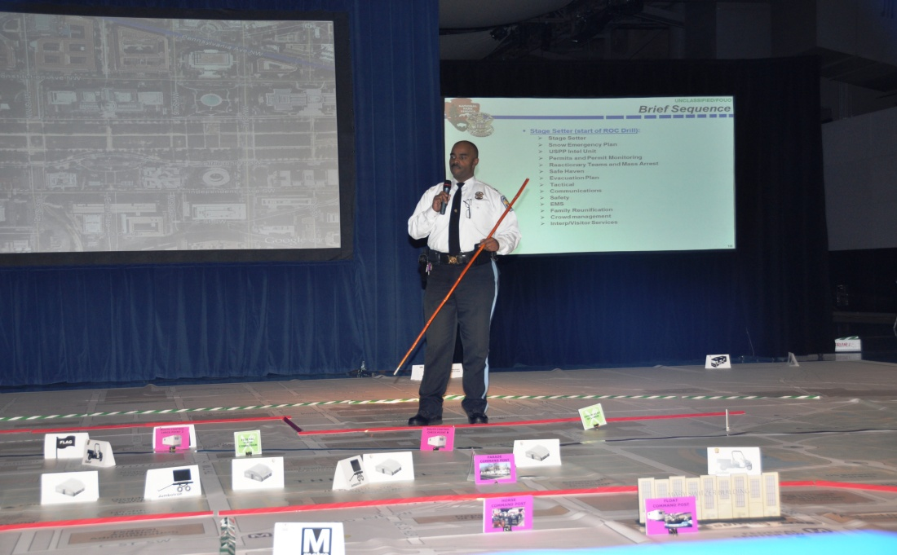
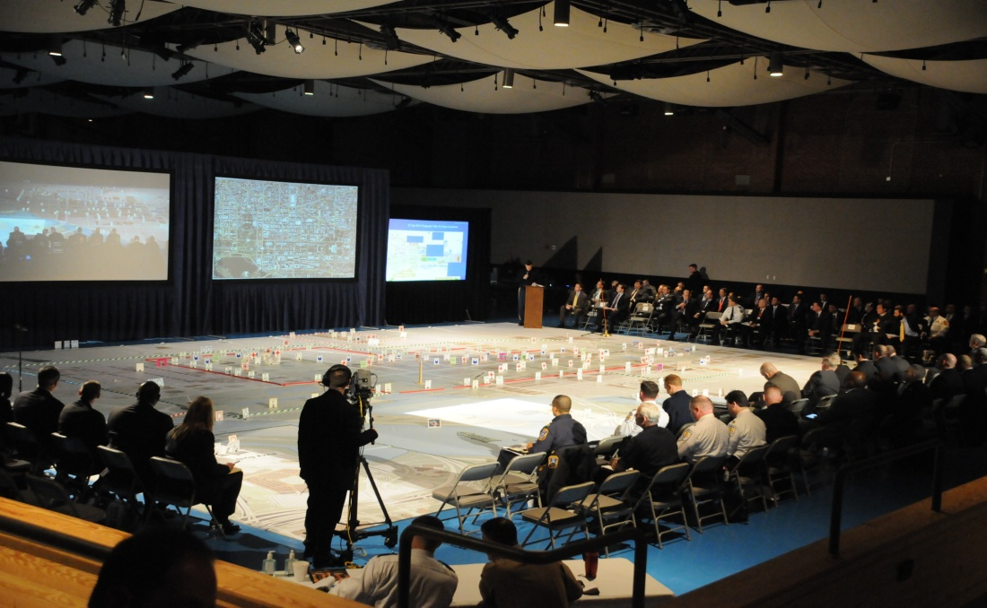
Rehearsal of Concept (ROC) Drill
JFHQ-NCR
DC HSEMA
USPP
USSS

Slide 8
2013 Inauguration Observations
Single, Integrated Joint Task Force (sustain):
  Eliminated previous stand-alone ceremonially focused Armed Forces Inaugural Committee (AFIC)
  Augmented JFHQ with additional staff (176) and unit capability (e.g., trans unit)
  Increased stress on workforce executing daily and inaugural issues (24 month planning process) as an “economy of force” organization
  Some risk – simultaneous national-level event
  Incorporate a 4-year planning cycle to sustain expertise (similar to State Funeral)
Early and Parallel Planning among Mission Partners (sustain):
  Planning initiated 24 months prior (submission of space requirements)
  Early briefings to familiarize on roles and responsibilities (AFIC construct)
  Executive Steering Committee activation (June 2012)
  Mission partners integrated into DOD Full Dress rehearsal
  “We don’t let disagreements become conflicts. We find solutions together” (USSS)
Credentialing (needs improvement):
  Everyone requires credentials – from bus driver to marching participant to CG
  Separate credentials/vehicle placards required for US Capitol Grounds
  Improved communications – identifying the problem set

Slide 9
2013 Inauguration Observations
Interagency Relationships (sustain):
  Longstanding mission partner relationships/processes facilitated successful planning and execution
  Recognition that no one entity could accomplish the mission alone
  Continue to leverage routine regional and interagency meetings
  Strength of relationships allowed valuable collaboration and quick resolution of challenges (e.g., credentialing)
Intelligence Oversight (needs improvement -- updated of pre 9/11 policy):
  Laws/Executive Orders govern DoD intelligence authorities
  Intelligence oversight concerns placed a constraint on shared situational awareness in the Joint Operation Center, e.g., not allowed to display open source internet traffic cameras / mission partner camera feeds
  Concern over potential “misperceptions” of DoD actions with regard to intelligence oversight

Slide 10
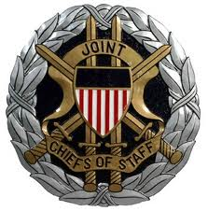
Joint Chiefs of Staff Quick Look
Joint and Coalition Operational Analysis Center
Suffolk, Virginia
- There is a common mission focus within the NCR
- There is a commitment to put the time and effort to
maintain relationships by JFHQ-NCR
- There are individuals with proper personalities and skill to develop and maintain relationships on JFHQ-NCR staff
- There is continuity among the players in the organizations within the NCR
- Interagency coordination begins long before any event

Slide 11
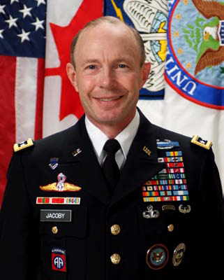
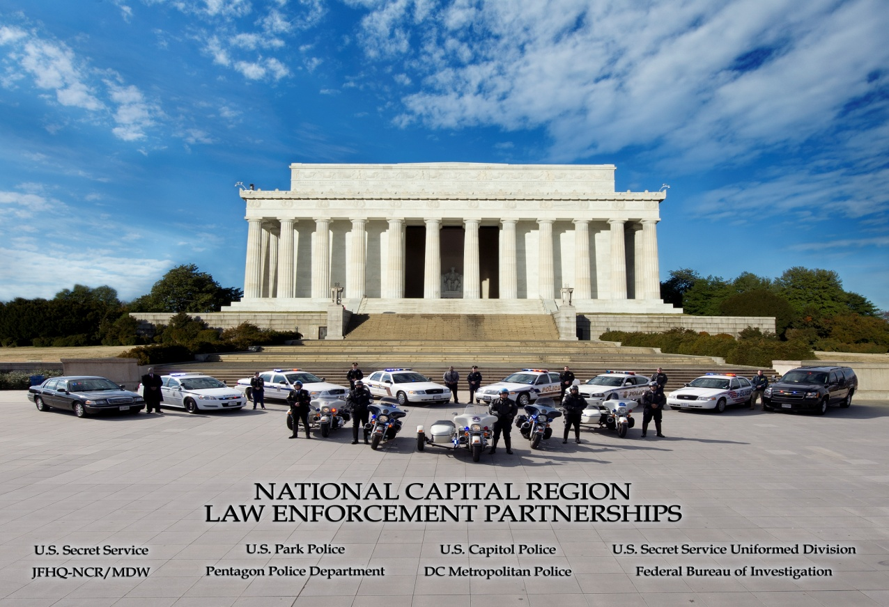
Partnerships
“The Power of Trust
Among Mission Partners...
is Our Center of Gravity”
General Charles H. Jacoby, Jr.
Commander, North American
Aerospace Defense Command and
United States Northern Command

Slide 12

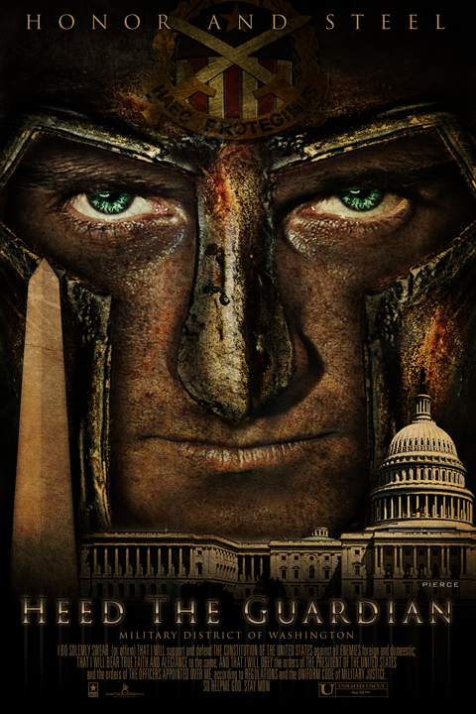
Questions and Discussion
Guardian
of the
Nation’s
Capital
Visit us at:
www.mdw.army.mil

Slide 13
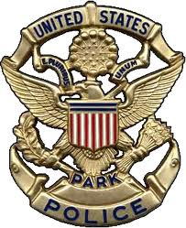
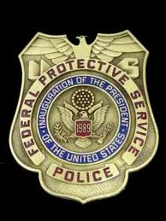
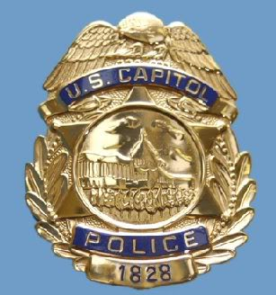
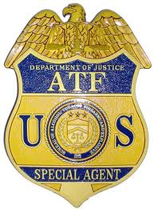
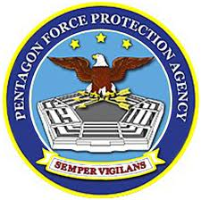


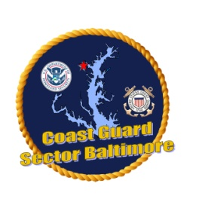

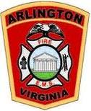
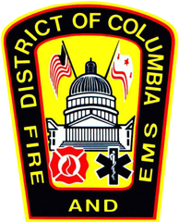
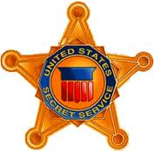
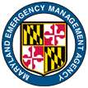
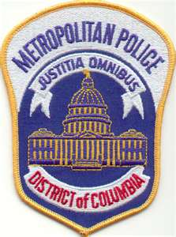
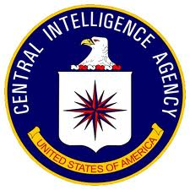
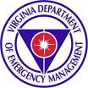





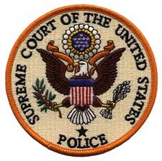

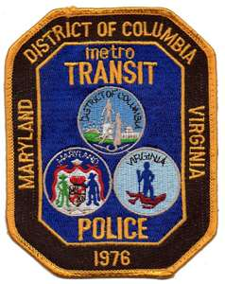









Partnerships
The Reason for Our Success…

Slide 14
BACK UP
SLIDES

Slide 15
Lines of Effort – 2013 Inauguration
President-Elect
U.S. Congress
Primary Federal Agency
District of Columbia
Presidential Inaugural
Committee
(PIC)
Joint Congressional Committee
on Inaugural Ceremonies
(JCCIC)
United States Secret Service,
United States Capitol Police
Federal Bureau of Investigation
Federal Emer Mgmt Agency
Mayor’s Office, DC-HSEMA,
DC MPD, DC-FEMS, DDOT,
DCDOH
Special Events including
  Opening Ceremonies
  Balls
  Galas
Inaugural Parade
White House Reviewing Stand
Swearing In Ceremony
Congressional Luncheon
Pass in Review
Secretary of Defense
Secretary
of the Army
Title 10
Title 32
Traffic Control
Crowd Control
CBRN
Transportation
U.S.
Northern Command
Ceremonial Support
IAW OSD Guidelines
DSCA RFA
Process
Joint Task Force-
National Capital
Region (JTF-NCR)
DC
National Guard
Service Bands
Marching Elements
Military Assistants
Military Cordon
CBRN
Medical
EOD
Comms
Lines of Support
Emergency Management
Assistance Compact
(EMAC)
DC MOUs
with
State Partners
Requests
Coordination
Notes:
The overall DoD concept of support for the Inauguration encompasses 4 major lines of effort. Working from left to right, they include:
Support to the President-Elect, as requested by the Presidential Inaugural Committee (PIC), including support from military bands and honor guards, the street honor cordon, and VIP escorts for opening ceremonies, galas, dinners, balls, the Inaugural Parade, and at the White House Reviewing Stand.
Support to the U.S. Congress, as requested by the Joint Congressional Committee on Inaugural Ceremonies (JCCIC), including military band, honor guard, escort and usher support for the Swearing-In Ceremony, Congressional Luncheon, and Pass in Review on the East Front of the U.S. Capitol.
Requests in these 2 lines of effort normally fall within the DoD Guidelines, and are approved by the JTF-NCR Commander.
The 3rd line of effort includes support to Secret Service and Capitol Police as Primary Federal Agencies. This support, typically DoD-unique communications, medical, EOD, and CBRN capabilities, is requested by the PFA through the DoD Executive Secretariat, and must be approved by the Secretary of Defense.
The 4th line of effort involves National Guard forces in Title 32 status. In this capacity, National Guard forces can perform domestic law enforcement and law enforcement support functions that Active Duty forces cannot. As such, they have historically been requested by DC HSEMA, Secret Service, Capitol Police and Park Police to assist with traffic and crowd control, and to provide CBRN capabilities able to respond quickly across jurisdictional lines. The Secretary of the Army is the approval authority for National Guard support, which is then provided by DC National Guard, supplemented by other Guard forces provided through a memorandum of agreement between DC and the states.

Slide 16
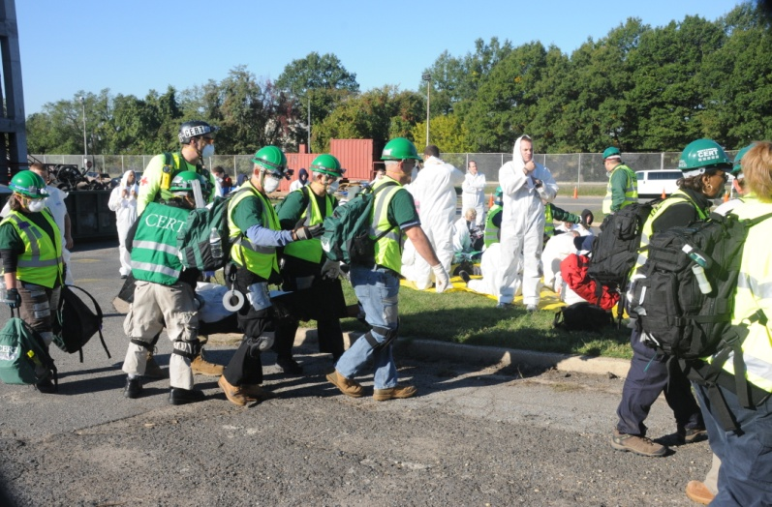
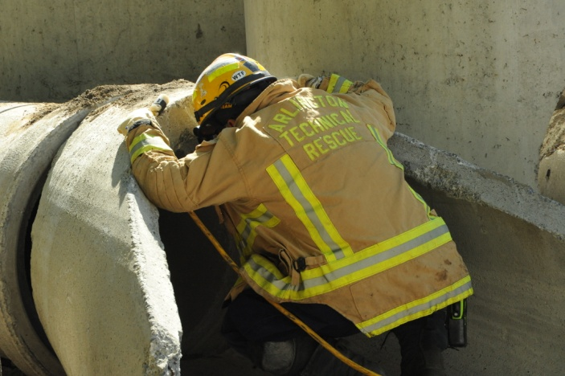
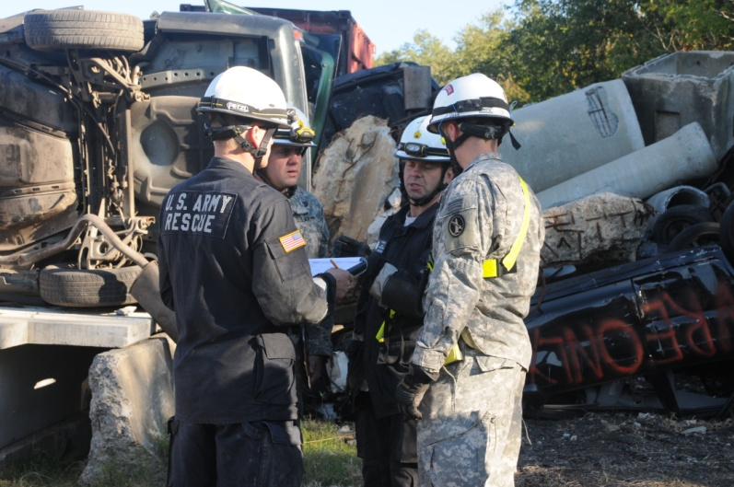
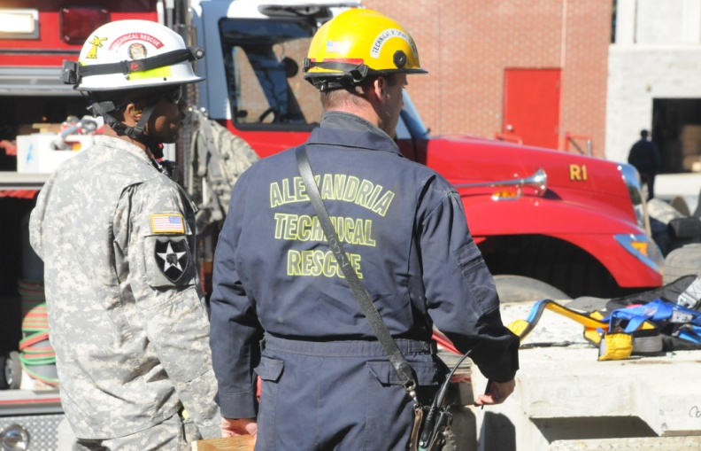
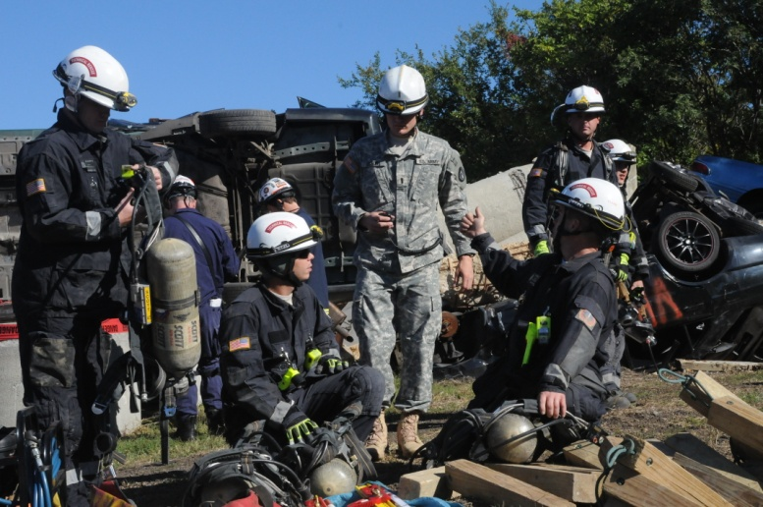
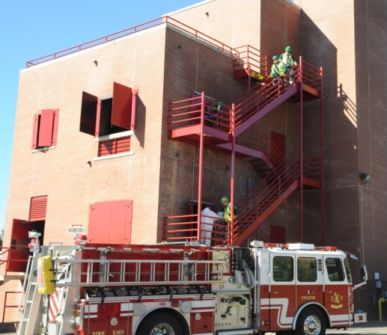
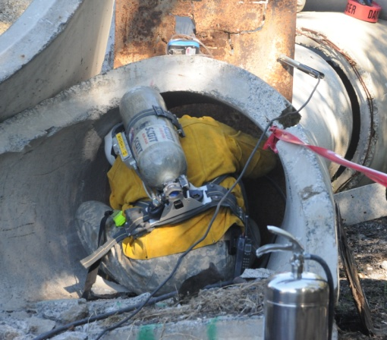
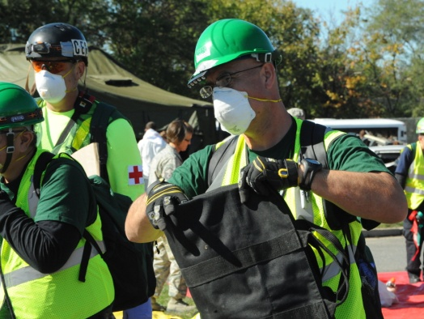
Exercise Capital Shield
Training = Preparedness/Readiness
WHO: DoD and Mission Partners
WHAT: Annual NCR Regional Command
Post and Field Training Exercise
WHEN: Annually in October (2012)

Slide 17
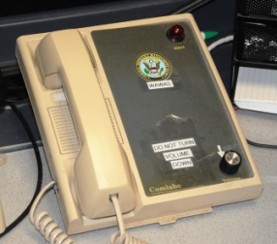
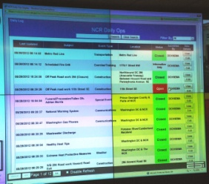
NCR Operations Center Communications
Shaping the NCR Common Operating Picture Through the
“NCR Operation Center Coordination Group”
EVENT
COMPLETE
EVENT
911
Law Enforcement Comms
Operations Center Report
Day-to-Day
Day-to-Day
WAWAS
(Non-secure, hard-wired telephonic notification system)
Web EOC/Regional Info Board
(Non-secure, web-based application)
Web EOC Event Log
RICCS
(Non-secure, text messaging via email, cell phone, pager, etc)
RICCS Event Conference Call
Phone (PSTN)
VTC
  WAWAS: Washington Area Warning System
  RICCS: Regional Incident Communications and Coordination System

