Slide 1
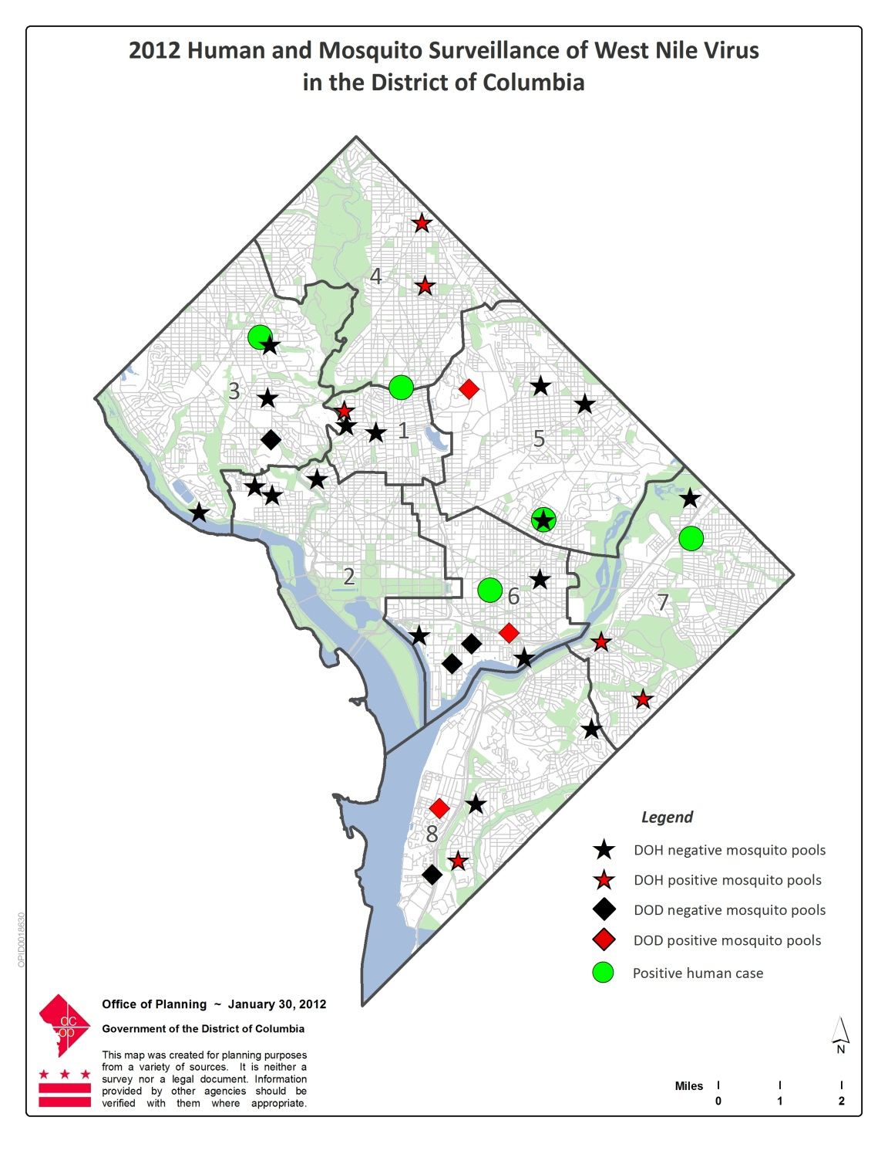
2012 DC West Nile Virus – Human and Mosquito Surveillance
Provided by Maria Hille,
Supervisory Biologist, M.S.
Animal Disease Control / HRLA
DC Department Of Health,
Washington, DC
4-3-13

