Slide 1
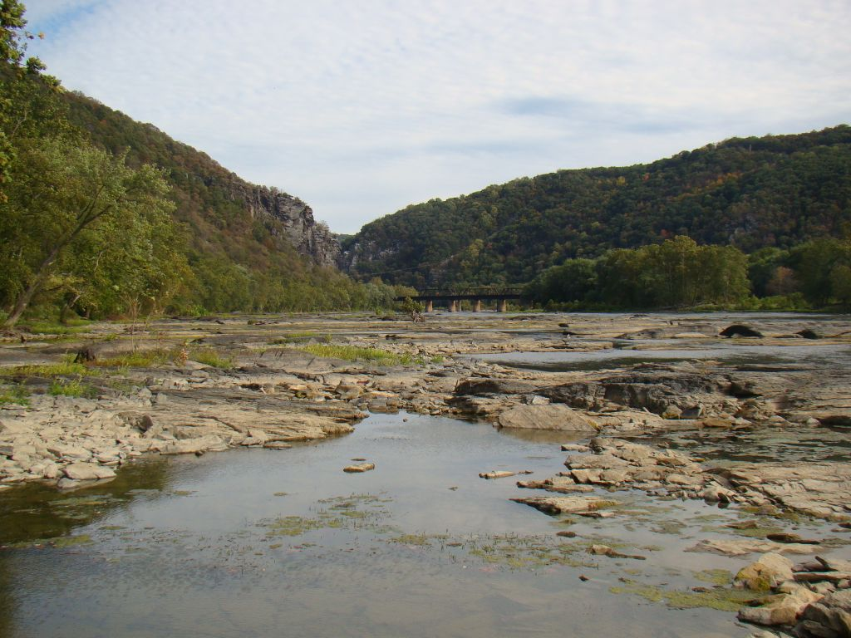
CO-OP Drought Management
Tools, Targets, and Triggers
MWCOG Drought Workshop
March 19, 2018
Cherie Schultz, Ph.D.
Section for Cooperative Water Supply Operations on the Potomac (CO-OP)
Interstate Commission on the Potomac River Basin (ICPRB)

Slide 2

Outline
Some current CO-OP tools
  CO-OP Data Portal
  Low Flow Forecast System
  Reservoir storage prediction tools
System targets and triggers
  For operations
  For water use restrictions
CO-OP current & upcoming
  Scoping for next generation tools
  Planning for 2018 Drought Exercise
Notes:
Next generation tools: improve forecast accuracy & support risk-based decisions

Slide 3
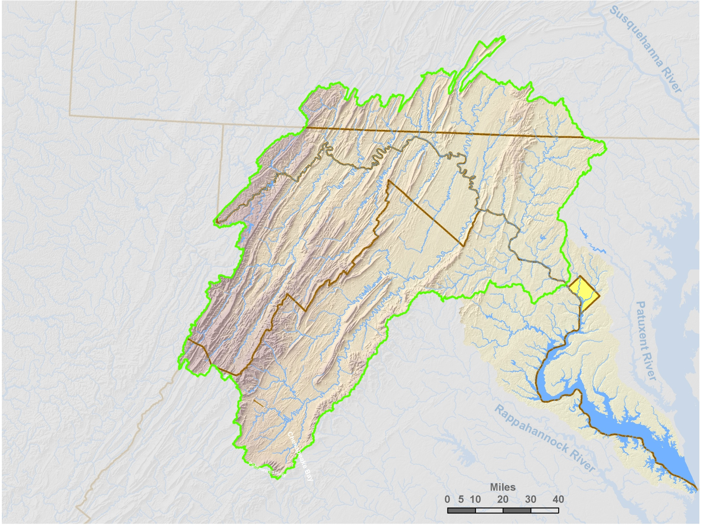
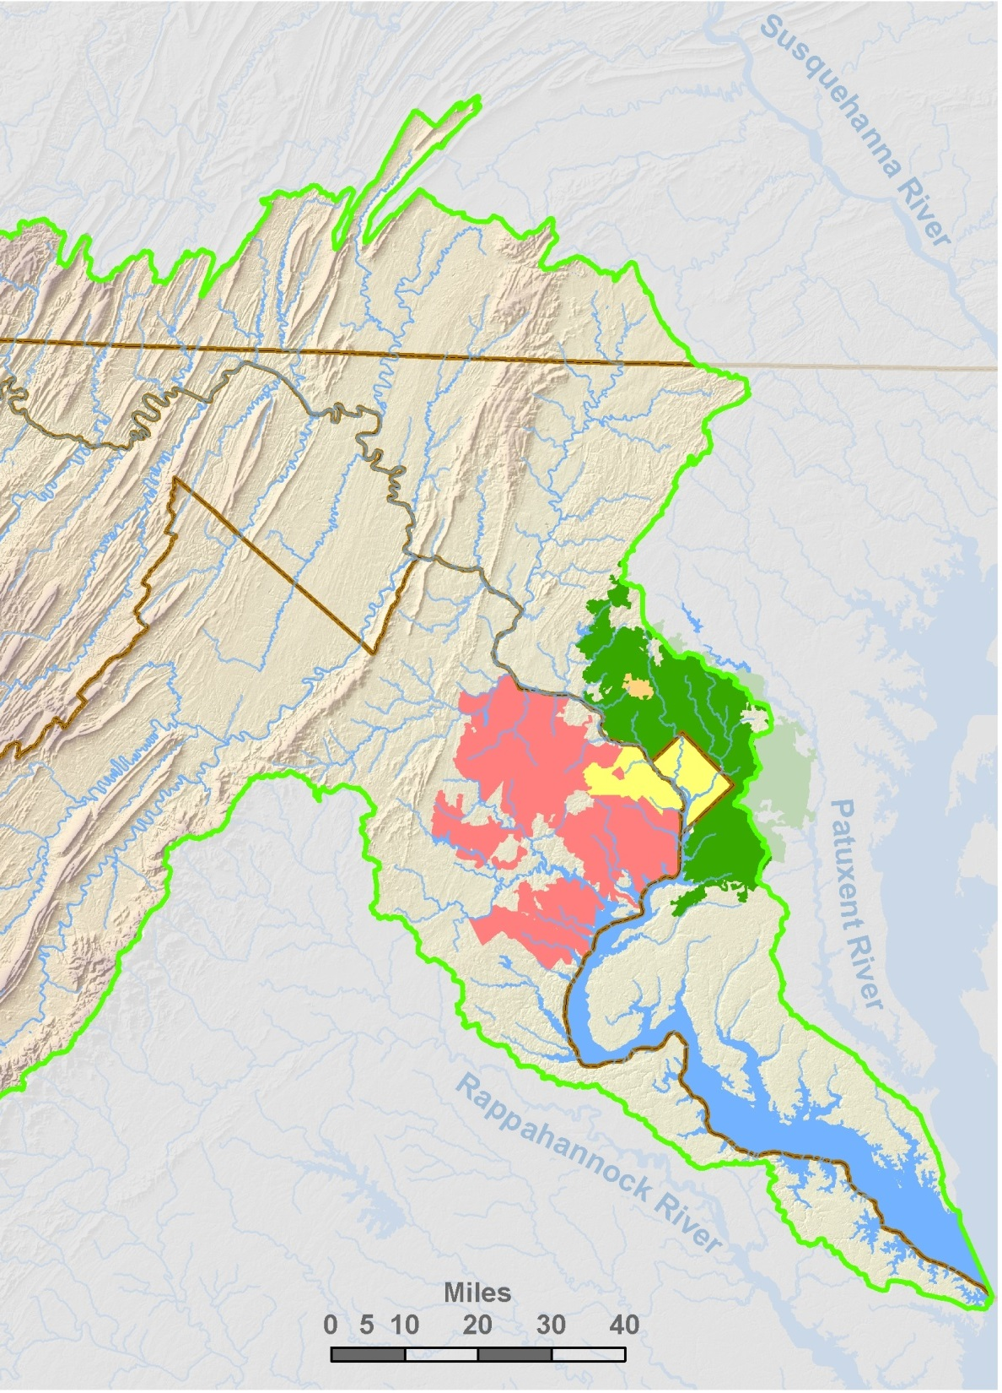
CO-OP drought operations
Goals
  Meet demands
  Maintain 100 MGD flowby at Little Falls dam
  Optimize use of resources
Key responsibilities
  Compile withdrawal data
  Forecast future river flows
  Determine reservoir release rates
  Keep stakeholders informed

Slide 4
Past droughts
Historic record (for streamflows): Oct-1929 – present day
Drought of record: 1930
CO-OP system
Potomac River at Point of Rocks, Maryland
Log flow in cfs
(1914)
1930
1966
1999, 2002
drought of record
deepest drought
Notes:
1966: POR at 547 cfs (354 MGD) on Sep 11; L Falls at 121 cfs (78 MGD) on Sep 9. POR actually a bit lower in 1914.
1930: MD, VA, WV, PA annual precip % - 56, 60, 59, 68; Jul-Aug precip % - 31, 39, 48, 43 (Tisdale, 1931)

Slide 5
Importance of flow forecasts
Short-term
  Meet Little Falls flowby target
  Use storage efficiently
Longer-term
  Meet June 1 refill target
Jennings Randolph
Little Seneca
1 day
L Falls flow-by
9 days
Notes:
Short term: reservoir releases and other operational changes to meet Little Falls flowby target. Longer term: management of reservoirs to meet June 1 refill target.

Slide 6
Potomac forecast challenges
Highly variable flow
  Natural hydrology
  Hydropower
Low flow considerations
  Proximity of intakes to Little Falls
  Water losses
  Travel times
Notes:
Our short-term forecast challenges are somewhat unusual. The Potomac is least regulated river in the eastern US, so there can be large short-term changes in flow just due to the natural hydrology. There are also significant flow variations from human causes. Withdrawals can vary up to 100 MGD in a 24-hour period, and last fall we observed a 200-300 MGD variation at the Shepherdstown gage due to an upstream hydropower facility. We hadn’t really been aware of this, since the gage at Shepherdstown was discontinued in 2004. Luckily, ICPRB and MWCOG have partnered to provide funding to reestablish this gage station, and data has again become available, beginning Sep 2016..

Slide 7
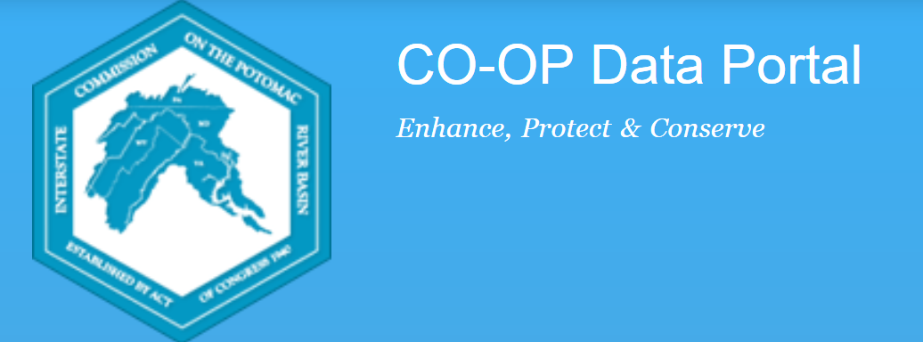
CO-OP Data Portal
Online hub for operational data
  Collects data from suppliers, USGS
  Generates CO-OP’s drought monitoring reports
  Upcoming: Potomac River withdrawal forecasts
(https://icprbcoop.org)
Notes:
Provides online database for CO-OP tools

Slide 8
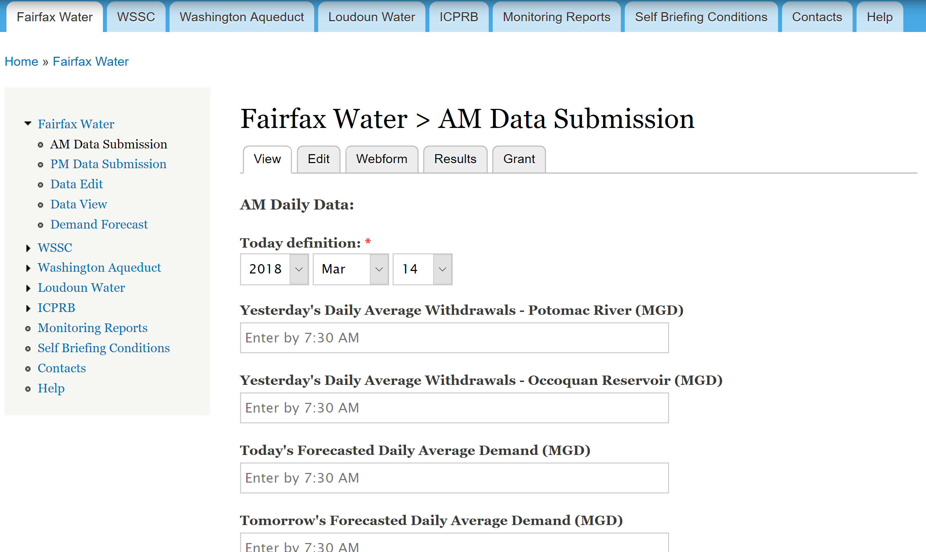
CO-OP Data Portal – data submission

Slide 9
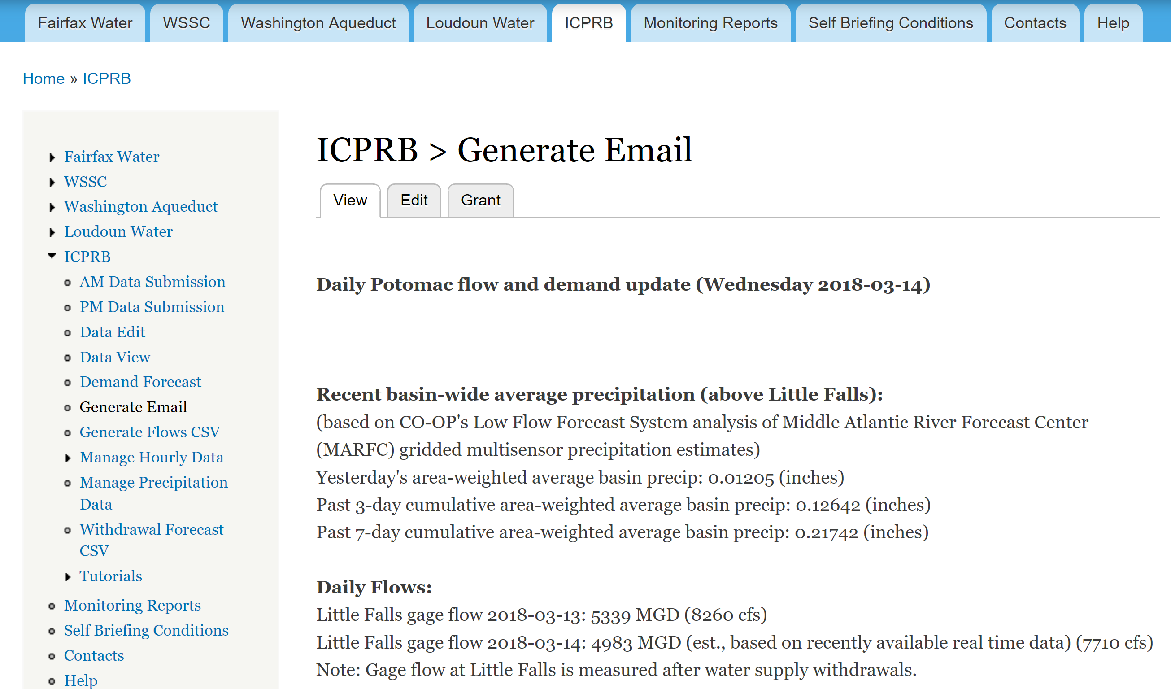
CO-OP Data Portal – drought reports

Slide 10
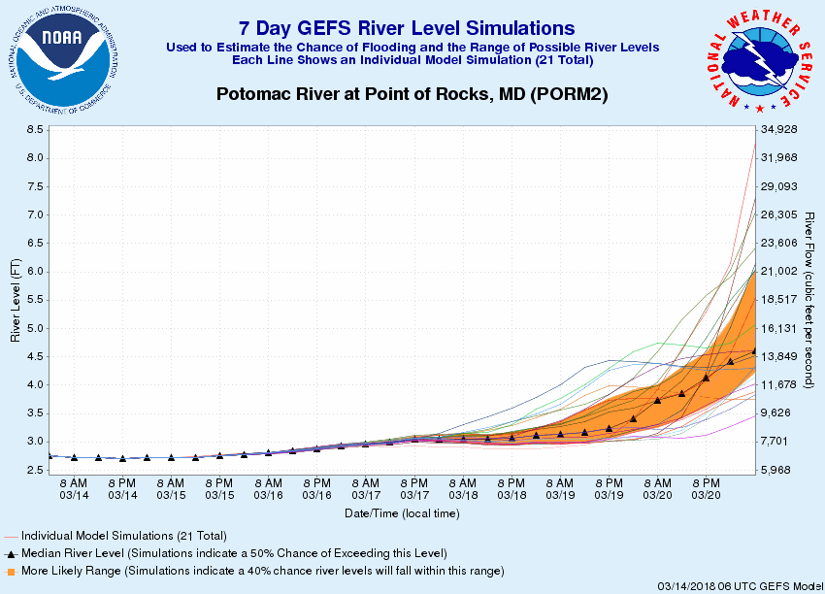
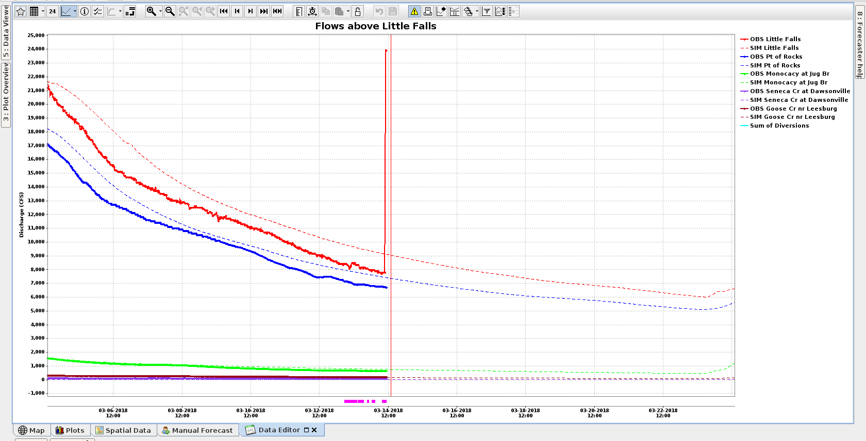
CO-OP Data Portal – withdrawal forecasts
Potomac withdrawals
Goal: improve Little Falls flow forecasts
Based on CO-OP daily demand model
14-day forecast
Coming soon!
2018-03-19 00:00, 78, 114. 138, 0, 0
2018-03-19 01:00, 72, 116. 140, 0, 0
2018-03-19 02:00, 87, 108. 142, 0, 0
2018-03-19 03:00, 74, 117. 131, 0, 0
2018-03-19 04:00, 85, 120. 138, 0, 0
2018-03-19 05:00, 82, 122. 138, 0, 0
2018-03-19 06:00, 86, 119. 129, 0, 0
MARFC¹ forecasts
CO-OP forecasts
¹ Middle Atlantic River Forecast Center

Slide 11
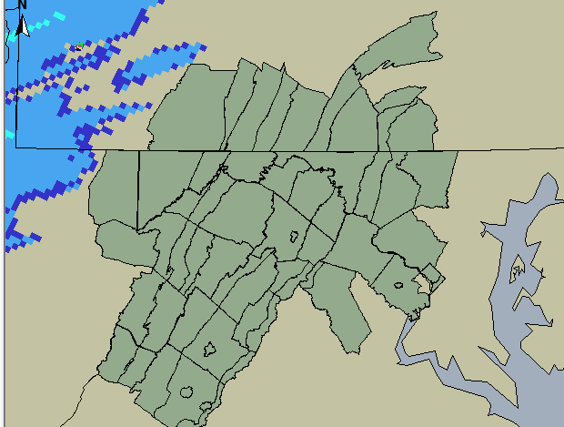
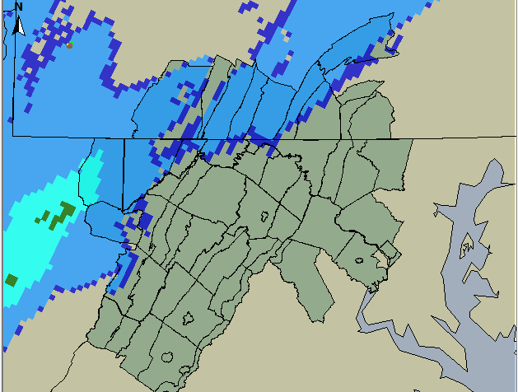
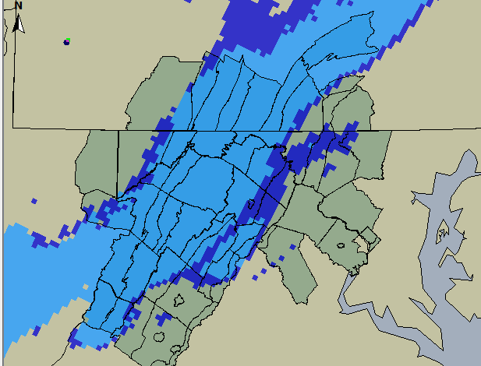
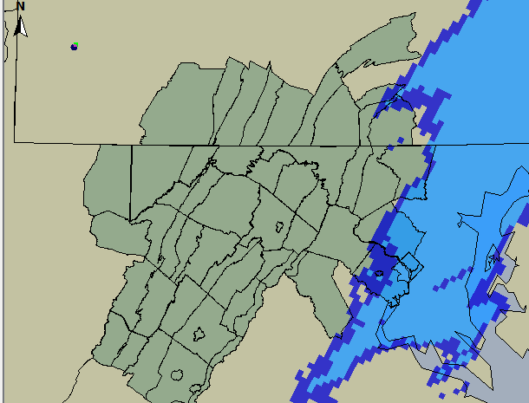
Low Flow Forecast System (LFFS)
In-house streamflow forecasting tool
  Provides real-time forecasts
  Focuses on low flow prediction
  Provides easy automated access to National Weather Service (NWS) and other data
Notes:
Potential advantages of “in-house” system
CBP watershed model simulates groundwater storage
Can incorporate more accurate data on withdrawals discharges

Slide 12
LFFS Inputs and Components
Reservoir releases
Actual/simulated
Future scenarios
NWS meteorological data
Actual
Forecasts
WMA withdrawals
Recent
Future scenarios
FEWS
Chesapeake Bay Program Watershed Model
Potomac basin stream flow forecasts

Slide 13
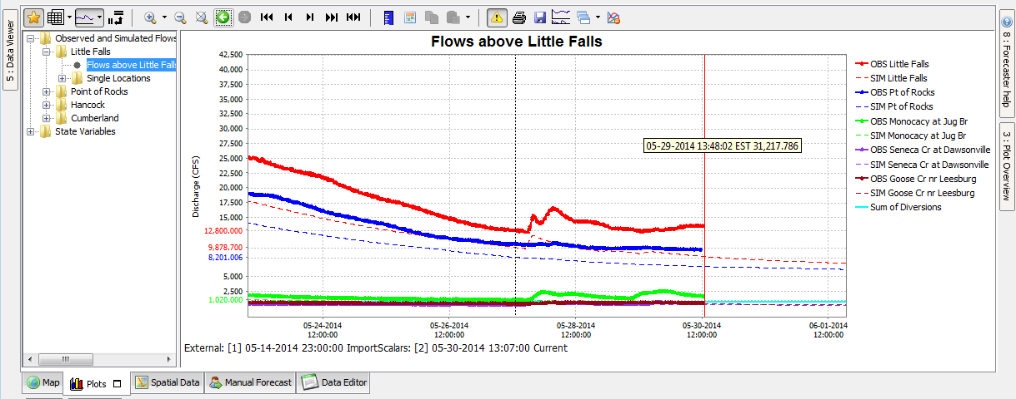
FEWS (Flood Early Warning System)
Open interface “task scheduler” by Deltares
Used at NWS River Forecast Centers (aka CHPS - Community Hydrologic Prediction System)
Facilitates real-time access to data
Notes:
Deltares is a water research institute in the Netherlands. CHPS is NOAA’s customized application of FEWS.

Slide 14
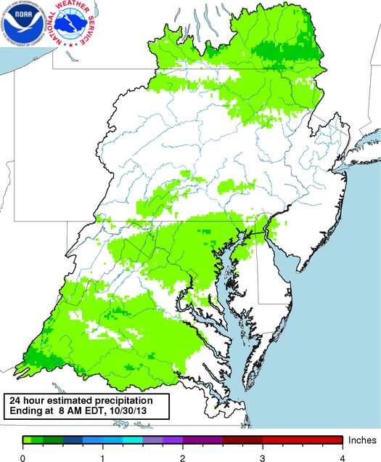
LFFS sources of observed data
NWS’s Hydrometeorological Automated Data System
MARFC’s mean precipitation estimates
NASA’s North American Land Data Assimilation System
National Severe Storm Laboratory

Slide 15
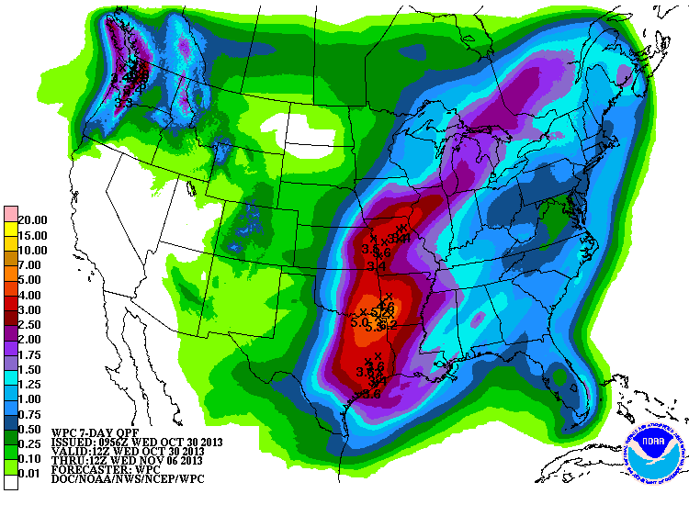
LFFS sources of forecasts
MARFC’s 3-day
Weather Prediction Center 7-day
National Digital Forecast Database 7-day
Global Ensemble Forecast System 15-day
Notes:
All of the QPF’s are provided at 6-hr intervals.

Slide 16
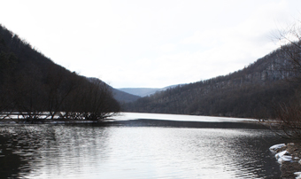
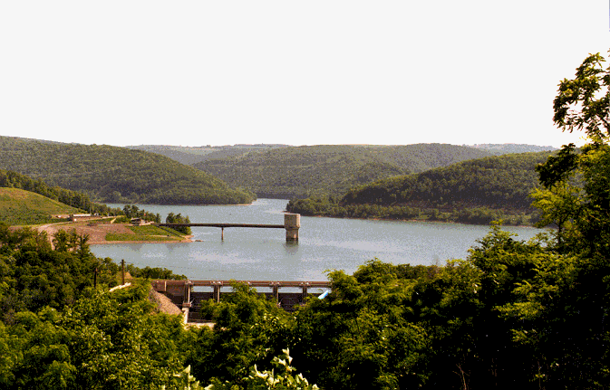
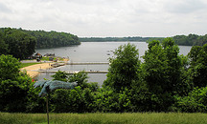
Reservoir storage prediction tools
Help manage reservoirs to
Maintain sufficient storage to meet demands
Ensure that all reservoirs 90% full on June 1

Slide 17
Individual refill prediction tools
  Originally paper and transparencies
  Currently in Excel
  Coming soon: online versions
Notes:
Inputs are current date, current storage, and future monthly withdrawals.
Online availability will make these tools more accessible to users, and allow us to maintain the tools more easily.

Slide 18
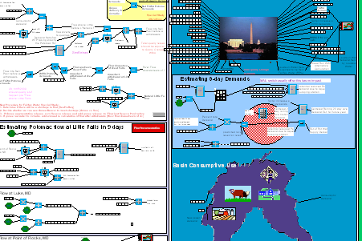
System refill prediction tool
For management during drought
PRRISM-based operational tool
Inputs
  Current date
  Current storage
  Current average annual demands
Current outputs
  Probability of shared storage reaching 5% of capacity
  Probability of Potomac River deficits
  Probability of refill next June 1

Slide 19
Targets & triggers - sources
For operations
  Low Flow Allocation Agreement, 1978 (LFAA)
  Water Supply Coordination Agreement, 1982 (WSCA)
Sources – for water use restrictions
  LFAA
  MWCOG drought plan¹
  Maryland drought plan² & consumptive use regs
  Virginia drought plan³ & consumptive use regs
1 Metropolitan Washington Water Supply and Drought Awareness Response Plan, 2001
2 Maryland Statewide Water Conservation Advisory Committee, Final Report, 2000
3 Virginia Drought Assessment and Response Plan, 2003

Slide 20
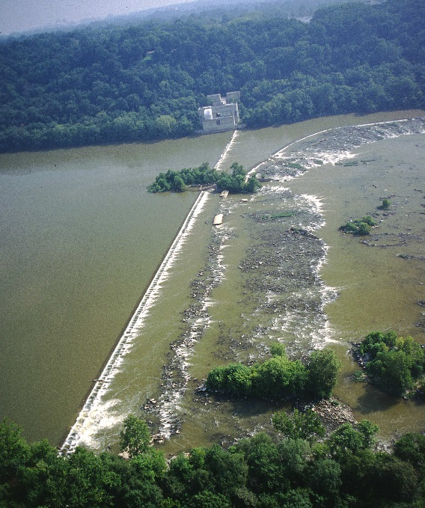
Operational target – flow-by
Daily average flow at Little Falls ≥ 100 MGD
Reflected in LFAA (as modified) & permits
Addressed by CO-OP’s “margin of safety” (MOS) in 1-day ops: ~100 MGD
CO-OP assumed probability of missing flowby*: < 0.12% in any given year
Little Falls dam
*Washington Metropolitan Area Water Supply Alternatives (2017)
Notes:
Assumed risk of < 0.12% in any given year translates to <10% in a reoccurrence of the drought of record. Even with the fairly large MOS, there is some risk of missing the flowby due to a forecast error. In our most recent planning study, the WMA WS alternatives study, ICPRB assumed that a risk of 0.12% in any given year, which translates to roughly 10% during a reoccurrence of the drought of record, was tolerable. This assumed risk value merits discussion.

Slide 21
Operational target – reservoir refill
Storage in all reservoirs on June 1 ≥ 90%
Requirement of WSCA
Must be met in 95% of years
90% full

Slide 22
Operational triggers
WSCA
  Daily monitoring & reporting:
  Q _{Point of Rocks} < 2000 (cfs)
  Drought operations:
  Q _{Little Falls} < W + 100 (MGD)
LFAA
  Alert Stage:
  Q _{Little Falls} < W (MGD)
W = total WMA Potomac River withdrawals
Q = flow observed at USGS gage station
Note: triggers as stated in LFAA are defined in terms of flow above intakes, ie, flow = (Q _{Little Falls} + W)
Notes:
Heads up triggers

Slide 23
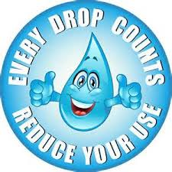
Restriction triggers – voluntary
MWCOG plan - Warning
  Jennings + L Seneca water supply storage < 60% for 5 consecutive days
  Or, 5% probability of not meeting unrestricted demands
CO-OP planning model
  Jennings + L Seneca water supply storage < 60%
  Assumed reductions of 5%/3% (summer/other)

Slide 24
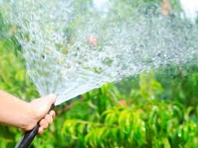
Restriction triggers
LFAA Restriction Stage
  Q _{Little Falls} < W/4 + 125 (MGD)
  May be declared by Aqueduct
  Mandatory restrictions probably envisioned
  Referenced in MD & VA upstream permits
?
Notes:
On the one hand, the LFAA Restriction Stage has been in many ways superceded by other plans; on the other hand, it is referenced in state withdrawal permits

Slide 25
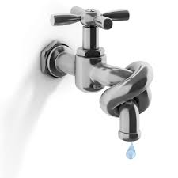
Restriction triggers – emergency
LFAA Emergency Stage
  Q _{Little Falls} < 100 (MGD) in next 5 days
MWCOG plan – Emergency (mandatory)
  50% probability of not meeting demands
CO-OP planning model
  Jennings + L Seneca water supply storage < 5%
  Probability in any given year < 0.06%
  Assumed reductions of 15%/5% (summer/other)
Notes:
CO-OP assumed water use reductions: 15%/5% (summer/other). CO-OP risked-based target for emergency restrictions*: Probability in repeat of drought of record < ~5%

Slide 26
Benefits of revisiting WMA restrictions?
Opportunity to resolve differences in LFAA & MWCOG plan restriction triggers?
Opportunity to increase coordination with Virginia DEQ?
Increased restrictions evaluated in 2 recent studies
Past input from CO-OP suppliers has been mixed
Notes:
Used in Hydrologics study to mitigate potential climate change. Found in CO-OP study to increase System Safe Summer Yield by 30 MGD
Supplier input:
Current demand likely less “elastic”
Mandatory restrictions should probably start before reservoir storage falls to 5%

Slide 27
CO-OP current & upcoming
Scoping phase for next generation tools
Planning for 2018 Annual WMA Drought Exercise

Slide 28
Scoping for next generation tools
Core goals
Potential enhancements
Integration of planning and operation models
Temporal refinement
  Hourly timestep
  Variable flow lags
More support for risk-based decisions
Incorporation of impact of upstream restrictions
Data assimilation/output post-processing
System optimization
Historical /synthetic data
Database
Real-time /forecast data
LFFS
System operations
User Interface

Slide 29
Potential support for risked-based decisions
NWS/NOAA ensemble forecasts
  Flow forecasts
  Meteorological forecasts
Sea surface temperature analyses to provide seasonal forecasts
Paleo studies to generate synthetic streamflows
LFFS

Slide 30
NWS/NOAA ensemble forecasts
MMEFS (Meteorological Model-based Ensemble Forecast System)
  7-day flow forecasts from MARFC
MEFP (Meteorological Ensemble Forecast Processor)
  > 120-day meteorological forecasts
  Bias corrected precipitation
HEFS (Hydrologic Ensemble Forecast System)
  >120-day flow forecasts from MARFC
  Based on MEFP outputs
  Bias corrected flows
National Water Model
  30-day flow forecast ensembles
  30-day land runoff/discharge ensembles
  Includes Patuxent & Occoquan
Notes:
Extreme events?: uses climatology from 1950-recent
“Memory” of MARFC continuous Antecedent Precipitation Index model is 1 month whereas memory of Potomac basin is 6-12 months
MARFC forecast area doesn’t include the Occoquan & Patuxent watersheds

Slide 31

Challenges of probabilistic forecasting for water supply
Representing extreme low flow events
  NWS historical record begins ~1950
Simulating low flows
  Calibration & bias correction: low vs. high flows
  Capturing processes that affect stream baseflow
  Representing effects of human activities
Taking into account climate change!
Notes:
We are mindful of the challenges and need to exercise care in selection of ensembles and modeling tools.
“Stationarity is dead” but everyone still makes use to some degree of historical data.

Slide 32
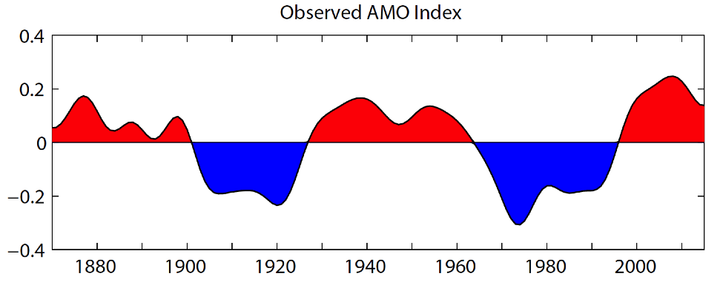
Sea surface temperatures (SST)
May be correlated with
  Decadal/multi-decadal streamflow variations
  Drought early warning indicators
Play a role in some NWS forecast products
  NCEP CFSv2 seasonal ensemble meteorological forecasts
  HEFS
Observed Atlantic Multi-decadal Oscillation
Notes:
Less reliance on historic data?
NCEP coupled forecast system model version 2 (CFSv2) (National Centers for Environmental Prediction)
Preliminary Potomac results: Jason Giavannettone, private communication

Slide 33
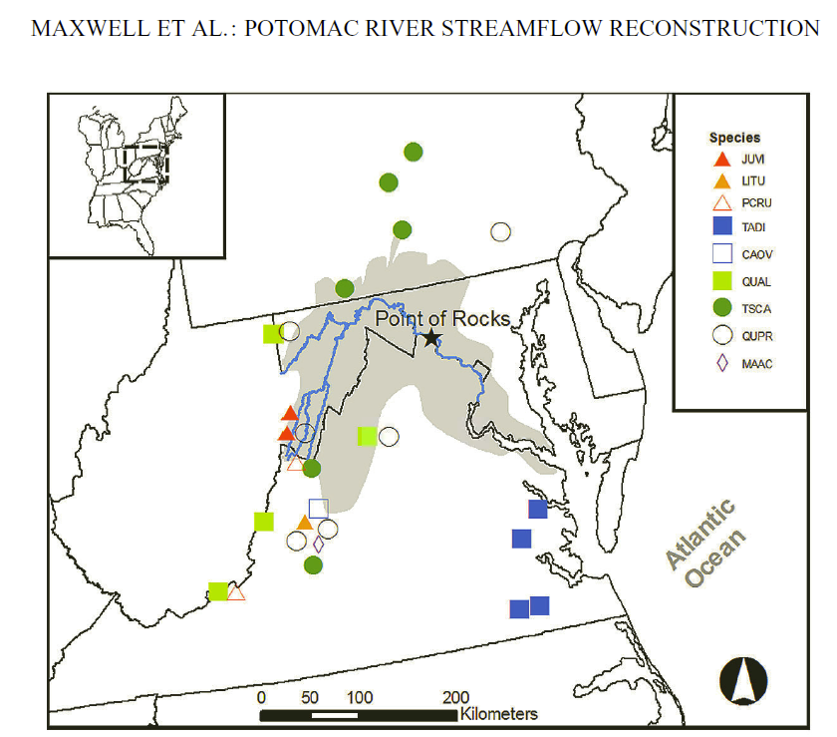
Use of paleo data to extend records
Tree rings provide record of past climate
Paleo reconstructions capture more extreme events
Two Potomac basin studies
  278 year reconstruction of PDSI¹
  >1500 year reconstruction of MJJAS flows²
¹ Cook, Meko, Stahle & Cleveland (1999)
² Maxwell, Hessl, Cook, and Pederson (2011)
Notes:
More reliance on historic data? But captures more potential variation.

Slide 34
From Maxwell, Hessl, Cook, and Pederson, 2011

Slide 35
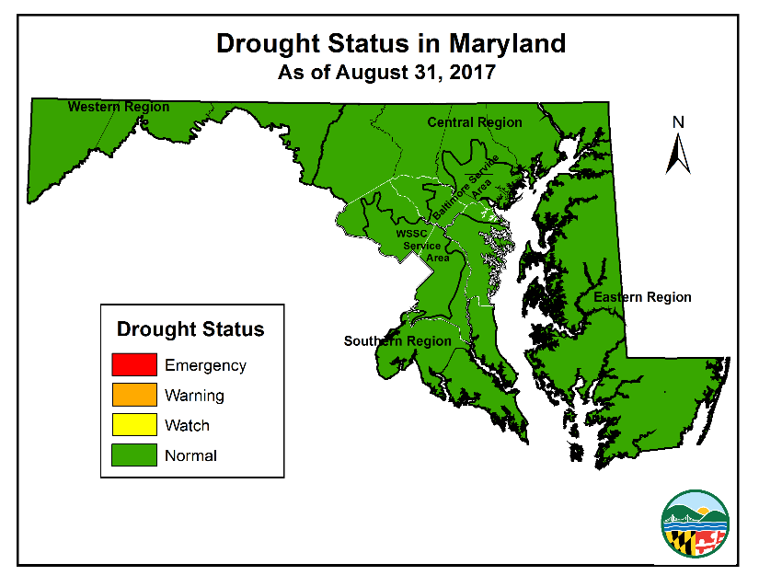
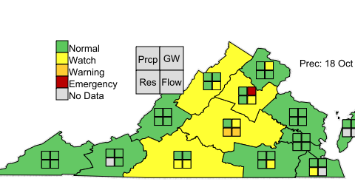
2018 WMA Drought Exercise
In-person table-top exercise
Simulate conditions more severe than drought of record
Will include suppliers, state agencies, and others
Will exercise LFAA, WSCA, MWCOG plan, and state triggers for restrictions
Will simulate use of LFAA emergency water allocation formula
Notes:
Will simulate drought whose severity exceeds the drought of record

