Slide 1

The Effect of the Changing Dynamics of the Conowingo Dam on the Chesapeake Bay
Mukhtar Ibrahim and Karl Berger, COG staff
Water Resources Technical Committee
March 6, 2015

Slide 2

Why This Presentation
CBPC presentation by Bruce Michael, Maryland DNR, at January 2015 CBPC meeting
  Based on LSRWA report/ request to relicense dam by Exelon
  http://bit.ly/LSRWA
Issue Has Policy Implications
  Clean Chesapeake Coalition
CBPC Action: direct WRTC to track issue; report back to CBPC on any policy recommendations
Today’s presentation: Provide technical details; outline potential policy recommendations

Slide 3
Outline
Slides 1 – 3 Intro
Slides 4 – 7 Background information on dam issue
Slides 8 -14 LSRWA technical findings
Slides 15 – 19 Policy implication; COG’s next steps

Slide 4
Draft Assessment Report Released in October
LSRWA Findings
Deposition and scouring rates are different than previously understood
Under TMDL attainment levels of load reduction, not addressing the changing dynamics of the dam would result in not meeting water quality standards in 3 of the Bay’s 92 tidal water segments
The non-attainment would result from the nutrients associated with the increase in sediment fluxes over the dam, not directly from the sediments themselves
The vast majority of the nutrients and sediment flowing over the dam come from upstream sources, not scouring
Dredging or other types of dam operational adjustments cannot offset the impact of increased scouring at realistic levels of investment
Upstream source control is more effective
(summarized from LSRWA FAQ document, pages 3-4)

Slide 5
Background Information
Flow in lower Susquehanna impacted by series of 3 dams
  Safe Harbor (PA)
  Holtwood (PA)
  Conowingo (MD) -- largest and last one to reach dynamic equilibrium.

Slide 6
Susquehanna’s Loads to the Bay – as Share of All Monitored Loads
From 1985 to 2013, as % of all monitored freshwater flows to the Bay, the Susquehanna River contributed:
60% of the fresh water
67% of the nitrogen
46% of the phosphorus
47% of the sediment
COG staff analysis: Data from USGS river input monitoring stations, accessed at: http://cbrim.er.usgs.gov
Others= Rappahannock, Appomattox, Pamunkey, Mattaponi, and Patuxant

Slide 7
Susquehanna’s Loads to the Bay – as Share of All Loads
As % of total loads to Bay
(CBP WSM results for 2012 scenario)
As % of total loads at RIM stations (1985-2013 average from monitoring data )
47% of freshwater flow
41% of TN
25 % of TP
27% of TSS
60% of freshwater flow
67% of TN
46% of TP
47% of TSS
Of these loads, USGS and USACE scientists estimate that, as a long-term average, 20 -30 % of the loads derive from scouring of the sediments in the dams; the rest derive directly from upstream sources.

Slide 8
Dam System Now in “Dynamic Equilibrium”
Dynamic equilibrium indicates a balance between sediment inflow and outflow over a long period of time. During high flow or storm events, the sediment and associated nutrients behind the dam are scoured and deposited downstream. That leaves storage capacity behind the dam, into which new sediment and nutrients can accumulate until the next scouring event.
Slide courtesy of Bruce Michael, MD DNR

Slide 9
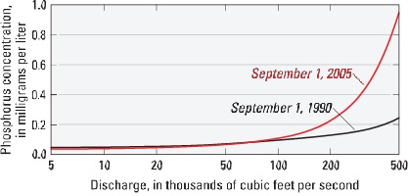
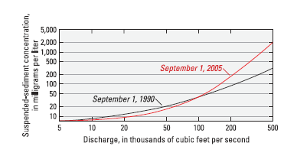
Changing Nutrient, Sediment Dynamics at Higher Flows
Data from Hirsch, R.M., 2012, “Flux of Nitrogen, Phosphorus, and Suspended Sediment from the Susquehanna River Basin to the Chesapeake Bay during Tropical Storm Lee, September 2011, as an Indicator of the Effects of Reservoir Sedimentation on Water Quality,” U.S. Geological Survey Scientific Investigations Report 2012–5185

Slide 10
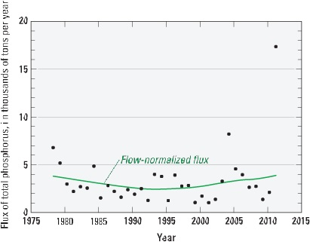
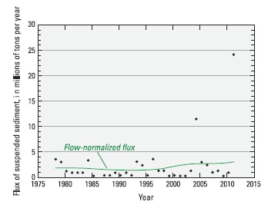
Impact on Load Trends
WRTDS estimated annual flux of total phosphorus and suspended sediment by water year for the Susquehanna River at Conowingo, MD
Total P trend:
up 55% from 1996-2011
Suspended sediment trend:
up 97 percent from 1996-2011
Data from Hirsch, R.M., 2012, “Flux of Nitrogen, Phosphorus, and Suspended Sediment from the Susquehanna River Basin to the Chesapeake Bay during Tropical Storm Lee, September 2011, as an Indicator of the Effects of Reservoir Sedimentation on Water Quality,” U.S. Geological Survey Scientific Investigations Report 2012–5185

Slide 11
Impact on Bottom DO Levels
(based on modeling data)
Computed changes in summer average bottom DO concentrations throughout Bay as a result of modeling January 96 hydrology with scour bathymetry compared to baseline scenario
Uses TMDL Attainment Scenario for watershed loadings
Data from LSRWA Report Appendix C

Slide 12
Impact on Water Quality Standards Attainment
(based on modeling data)
CBP Model results indicate that impact of changing dynamics – left uncorrected – would increase nonattainment of the deep channel DO WQ standard by about one percent
Source: LSRWA Report Appendix D (LWRSA scenario 21 – LSRWA scenario 3 computed change in deep channel DO for 1996-1998 hydrology period)

Slide 13
Effectiveness of Dredging
(based on modeling data)
Dredge to achieve 1996 bathymetry
Estimated Cost = $0.496 - $2.8 billion
Source: LSRWA Report Appendix C

Slide 14
Effectiveness of Dredging
(based on modeling data)
Dredge to remove average annual load (3 million cubic yards/year)
Estimated cost =
$15-270 million/year
Source: LSRWA Report Appendix C

Slide 15
Next Steps in Dam Relicensing
Late 2014 Exelon relicensing decision put off for now
  Exelon withdrew application; agreed to help fund more studies
MD and partners sponsoring more studies (increased monitoring, sediment particle analysis, fate and effect of particular nutrients)
Likely outcome: Exelon gets new license; agrees to provide funds for Susquehanna watershed BMPs; no dredging or other dam system management changes

Slide 16
Impact on Bay TMDL – if no dredging or dam management changes
Bay Program Faces Policy Decision
CBP will change nutrient, sediment dynamics of dam system in the watershed model to account for new understanding – THIS WILL AFFECT WATER QUALITY MODEL OUTPUT
Under TMDL accounting, the impact on non-attainment of WQ standards must be addressed somehow
Preliminary estimate:
  4.4 million pounds of total nitrogen/ 0.41 million lbs of total phosphorus needed from Bay watershed as a whole
  or
  2.4 million pounds of nitrogen / 0.27 million pounds of phosphorus from Susquehanna watershed

Slide 17
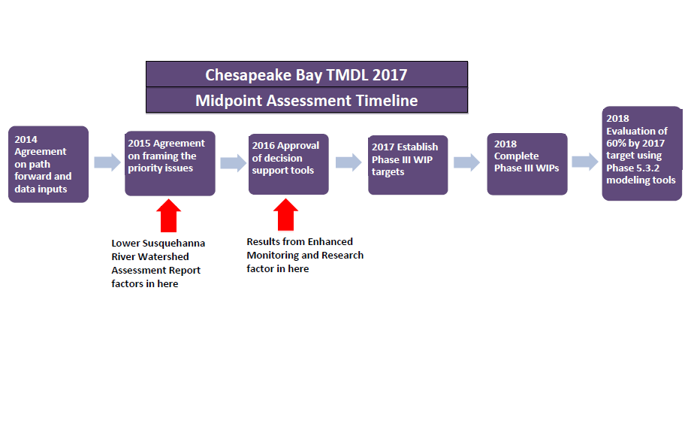
    Integrating LSRWA Findings into Bay TMDL Midpoint Assessment
CBPC follow-up to CBP partners
CBPC input to CBP partners
Slide courtesy of Bruce Michael, MD DNR
WRTC tracking, recommendation
Notes:
**Consideration of these new findings about Conowingo Dam are an integral component of the Chesapeake Bay TMDL midpoint assessment, a process driven by the partners with shared decisions by the partners;
Results indicate that additional nutrient loadings associated with changed conditions in the lower Susquehanna River system may result in nonattainment of jurisdictions’ water quality standards associated with the Chesapeake Bay TMDL, even with full implementation of the jurisdictions’ WIPs. This information, along with additional knowledge gained from Recommendation 1 (short-term enhanced monitoring and modeling) above, should be incorporated into ongoing analyses integrated into the Chesapeake Bay TMDL to reflect new loadings, and allocate the additional offset reductions needed to fully attain the jurisdictions’ water quality standards.

Slide 18
Recommended WRTC Action
Federal, state relicensing decision (2015 or later): no COG involvement
Bay Program TMDL load allocation decision (during 2017 mid-point assessment) – COG comment
  WRTC to track revisions to model output, non-attainment estimates, load allocation options
  Recommend COG support for most equitable allocation option
Notes:
It would be helpful to make the point that we would welcome GIS help from
other states in developing Phase 6 land use datasets for their jurisdictions.
Only Maryland has attempted this. Delaware originally expressed some interest in
developing the Phase 6 land uses but has not done anything to date other than
deliver data to us.
The CBP Land Data Team will produce the Phase 6 land use dataset and overlays
if states don’t want to do so themselves.
However we could still use help developing the base layers like tree canopy,
impervious surfaces, parcel coverages, and an urban mask.

Slide 19
For More Information
    Draft LWRSA Report Available
      http://bit.ly/LSRWA
    USGS Conowingo report
      http://pubs.usgs.gov/sir/2012/5185/
    Bruce Michael COG presentation
        http://www.mwcog.org/uploads/committee-documents/ZF1XW1Zc20150114085202.pdf
    COG staff contacts: Karl Berger, kberger@mwcog.org
                Mukhtar Ibrahim, mibrahim@mwcog.org

