Slide 1
“A Climate Conversation”
Introduction to Climate Science Webinar
Part of the “Building a Climate Resilient National Capital Region” series of webinars and workshops
http://www.mwcog.org/environment/climate/resilience.asp
Notes:
Please acknowledge the use of any of these slides as coming from:
“A Climate Conversation” Introduction to Climate Science Webinar (18 Feb 2014), Part of the “Building a Climate Resilient National Capital Region” series of webinars and workshops organized by the National Capital Planning Commission, General Services Administration, National Aeronautics and Space Administration, Metropolitan Washington Council of Governments, Smithsonian Institution, and the United States Global Change Research Program.

Slide 2
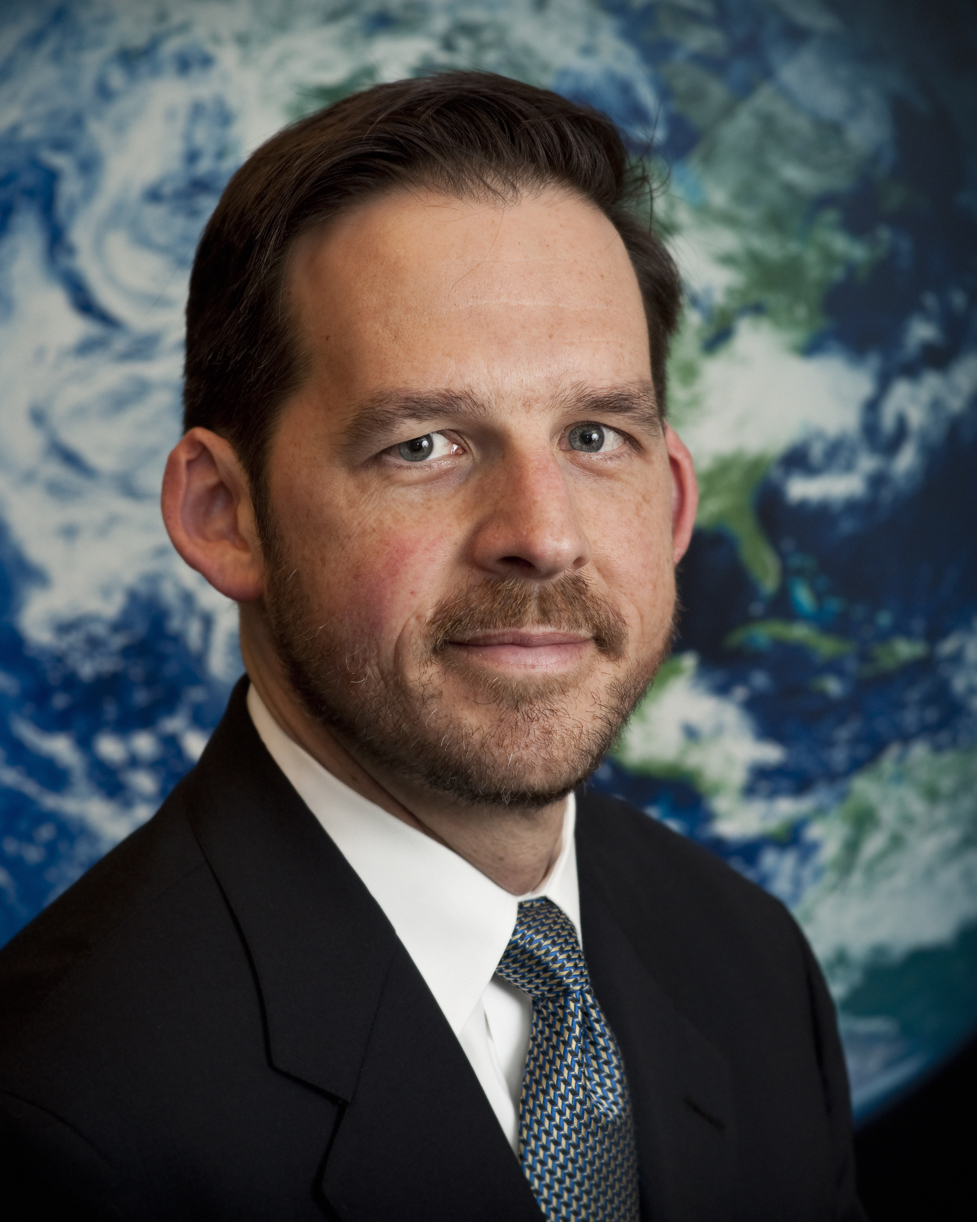


Opening Remarks
Lawrence Friedl
Director, Applied Sciences Program, Earth Science Division
National Aeronautics and Space Administration (NASA)
Notes:
Brief opening remarks from Lawrence Friedl.
NASA is committed to harnessing the power of good science in service to the Nation and the world. Called upon by many governments to help prepare for climate change, in addition to providing key scientific advancements in the field of climate science, NASA has also been working with institutional stewards at its own field installations across the Nation over the past five years to advance climate adaptation planning. The resulting scientist-steward partnership has been a laboratory in which we’ve honed the way stakeholders can work most productively together to prepare.
What we’ve learned can be of use to many beyond NASA, and our very mission includes disseminating useful information and expertise. NASA recognized a particular opportunity to help stakeholders in its hometown of Washington DC (with its irreplaceable “Monumental Core”) adapt to climate risks. Working closely with the National Capital Planning Commission, the Metro Washington Council of Governments, The Smithsonian, GSA, and the US Global Change Research Program, this webinar begins an adaptation process for DC, and we welcome your involvement…
The following science presentation is presented as a conversation between a NASA decision-maker and a NASA scientist.
---
Lawrence Friedl serves as the Director of the Applied Sciences Program within the Earth Science Division at NASA Headquarters. The Program supports efforts to discover and demonstrate innovative and practical applications of Earth science by government, business, and other organizations.
Among his responsibilities, Lawrence is a Vice-Chair of the interagency U.S. Group on Earth Observations and represents the United States on the international Group on Earth Observations. He is the NASA Principal for the interagency Civil Applications Committee. He serves on the Award Committee for the National Space Club’s Award for Innovative Uses of Earth Observation Satellite Data, the Program Organizing Committee for the American Meteorological Society 2014 meeting, and the International Committee for Remote Sensing of Environment.
Lawrence received a Masters degree in Public Policy from Harvard University’s Kennedy School of Government, specializing in Science and Technology Policy. He received a Bachelors degree in Mechanical & Aerospace Engineering from Princeton University. He also received a certificate in Space Policy and Law from the International Space University.

Slide 3
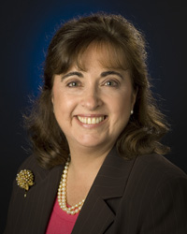

A Climate Conversation:
The Decision-Maker
Olga Dominguez
Associate Administrator for Strategic Infrastructure
NASA’s Strategic Sustainability Officer
Notes:
The Decisionmaker:
Ms. Olga M. Dominguez is the Assistant Administrator for NASA’s Office of Strategic Infrastructure. She leads the agency infrastructure policy efforts and the integration of infrastructure issues and risks in support of accomplishing NASA’s Science, Aeronautics, Space Operations and Exploration Missions.
As the AA for Strategic Infrastructure Ms. Dominguez has many leadership roles including the Agency Senior Sustainability Officer, the Agency Real Property Officer, the Agency Historic Preservation Officer, the Agency Aircraft Acquisition and Disposition Officer, the Agency Property Disposition Officer, and the Agency Climate Adaptation Officer.
Ms. Dominguez's educational background includes a Bachelor of Science degree in Fish and Wildlife Management, with emphasis in Zoology. She brings over thirty years of experience in leadership and management spanning local, state and federal governments. She and her family reside in Annapolis, MD.

Slide 4

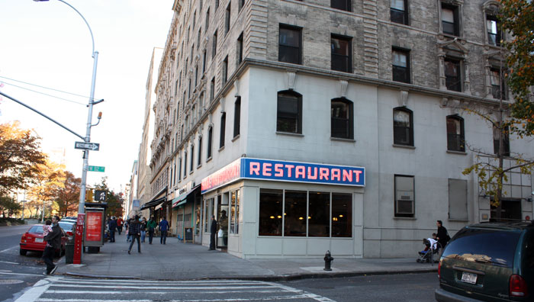

A Climate Conversation:
The Scientist
Goddard Institute for Space Studies
Dan Bader
Research Analyst
NASA Goddard Institute for Space Studies
Notes:
The Scientist:
Dan Bader is a Research Analyst at Columbia University’s Center for Climate Systems Research and NASA Goddard Institute for Space Studies. One of his primary responsibilities is developing climate scenarios to be used for adaptation planning. Through his work at Columbia, Mr. Bader has extensive experience with preparing and communicating climate science information to policy makers, specifically in New York City and New York State. He is also the project manager for NASA's Climate Adaptation Science Investigator (CASI) Workgroup (EXPLA.
Mr. Bader's educational background includes a Bachelor of Science in Atmospheric Sciences from Cornell and Master of Arts in Climate and Society from Columbia.
As a partnership between NASA and Columbia University, GISS combines the strengths of two research organizations.

Slide 5
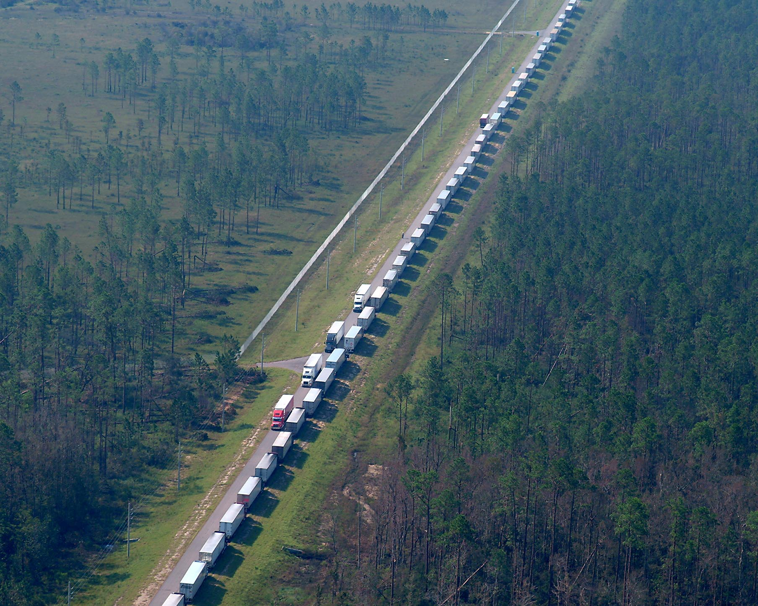
Trucks Carrying Hurricane Relief Supplies Await Distribution Instructions at NASA’s
Stennis Space Center
Notes:
Olga: A NASA illustration of how much climate and extreme weather can affect a landowner. Three lessons:
Even when we share climate risks, the impacts and prudent adaptations vary a lot by location.
Everything happens within communities. Even if a landowner isn’t hit as hard as the surrounding community, there will be ripple effects.
In a crisis, we Feds aren’t usually top priority. We return to normal once our neighbors get back to normal, perhaps even later.
[Olga might cite other impactful events (other coastal storms, electrical grid failure in Huntsville, Station Fire in Pasadena…) that augment the importance of getting climate risks on installation radars…]

Slide 6
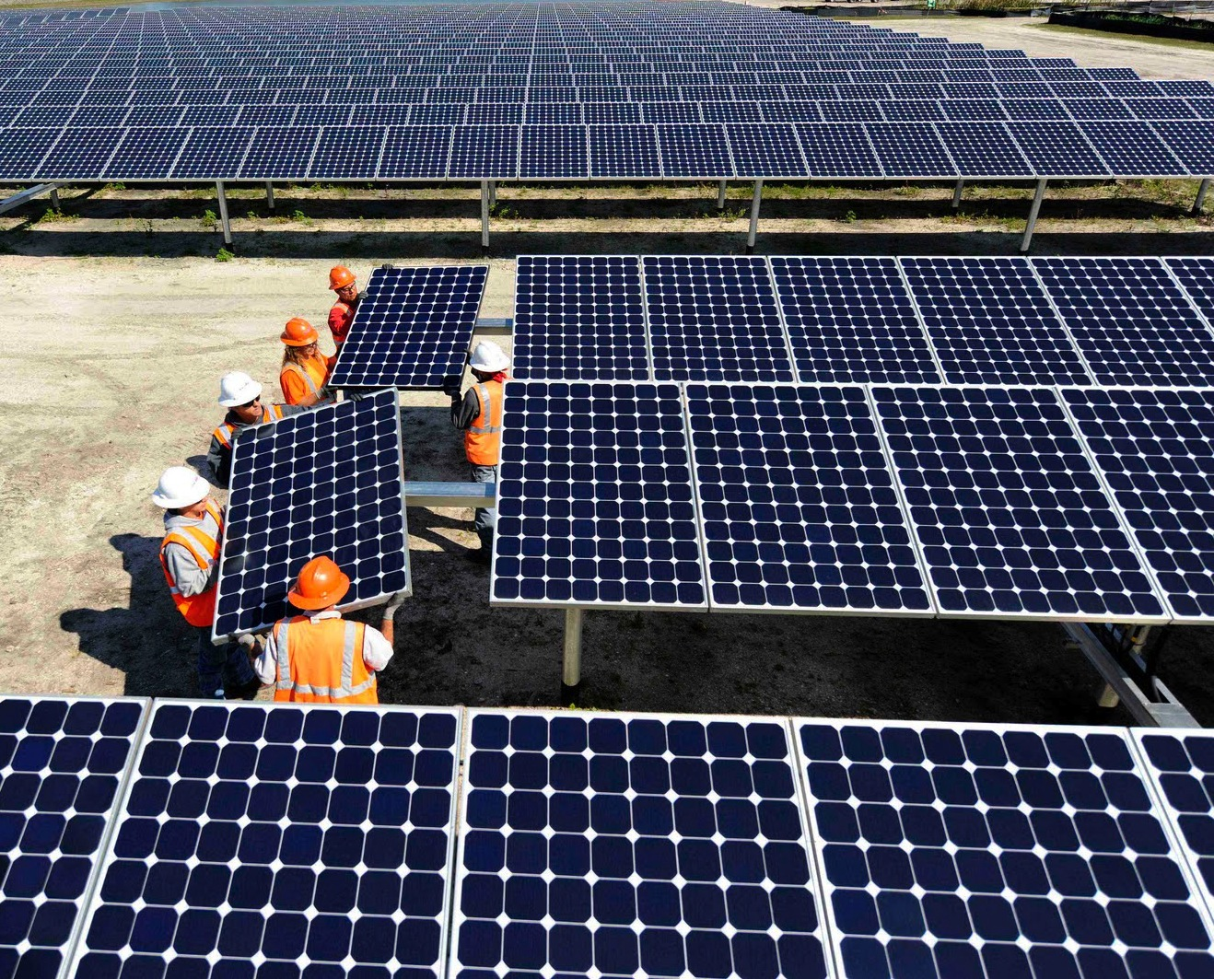
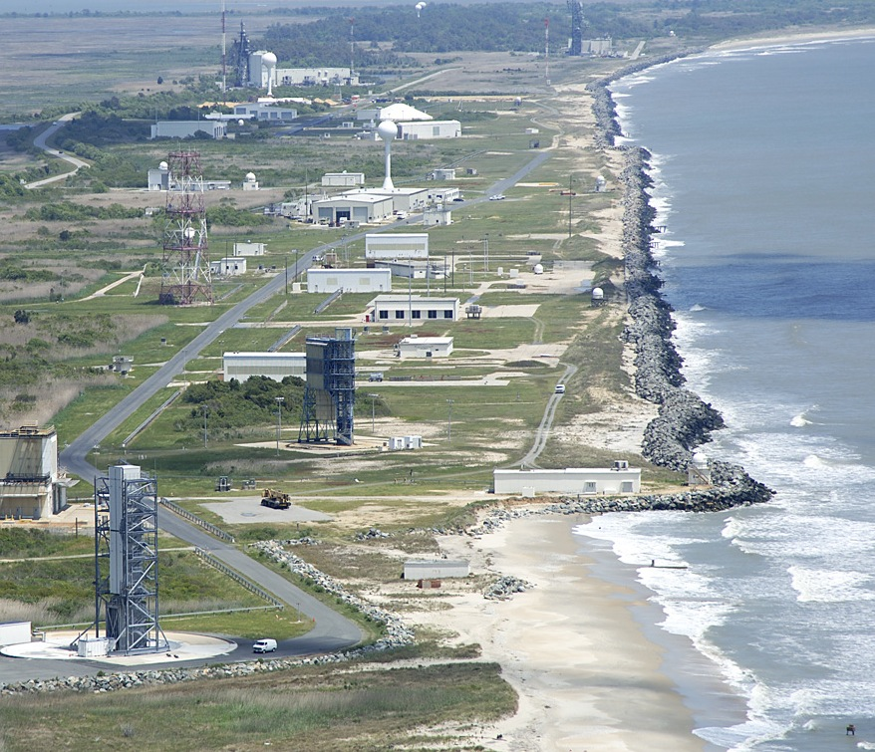
Responding to Climate Risks
Mitigate to reduce our impact on natural systems…
…and adapt where we nevertheless expect impacts.
Notes:
Olga:
As we begin this conversation we’ll define a couple of key terms.
Mitigation is… (NASA’s examples include partnering with a utility to add renewable power for our Kennedy Space Center and for the surrounding community)
Adaptation is… (NASA’s examples include needing to protect a coastline that might otherwise retreat at the peril of its operations on Virginia’s Eastern Shore)
Dan:
Some adaptations can also mitigate (green roof example); we always seek such opportunities.
Olga:
Institutions always look to leverage investments across multiple goals; we must think broadly even as we act locally.

Slide 7
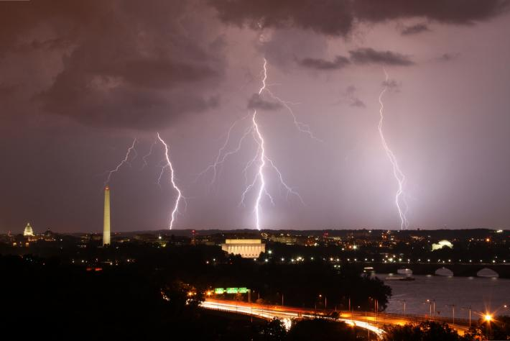
Question
Distinction between weather and climate?
Notes:
Olga:
Acknowledge the expertise among participants (we expect thoughtful, proactive participants…)
Nevertheless, climate risks are new to many institutional stewards, so a fundamental question to begin…

Slide 8

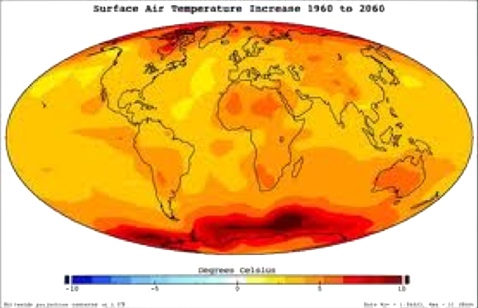
Comparing Weather and Climate
Weather describes current and near-term conditions
Climate describes weather patterns over a longer term
“Weather is what you get; climate is what you expect.”
Notes:
Dan: This slide seeks to ensure is the audience understands the distinction between weather and climate.
Weather and climate quotation from Robert A. Heinlein.

Slide 9
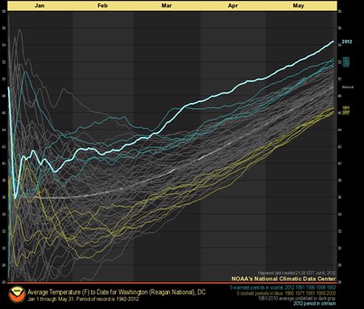

Question
January
February
March
April
May
2012
What does the climate record tell us?
Notes:
Olga:
So weather impacts disaster preparations, response, and recovery management; Climate is really the driver for long-term strategy, plans, and investments.
Illustration: A NOAA chart of average temperature over 71 years for the months of January to May, with 2012 highlighted.
Source: Washington Post, 7 June 2012. Image colors inverted for visual consistency with other graphics.

Slide 10
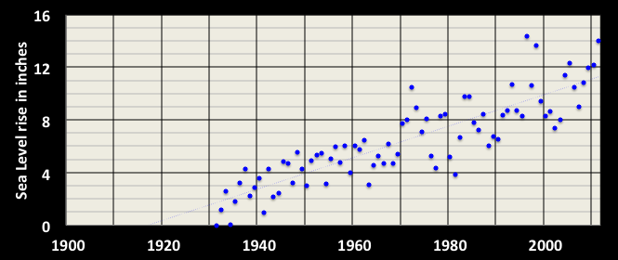
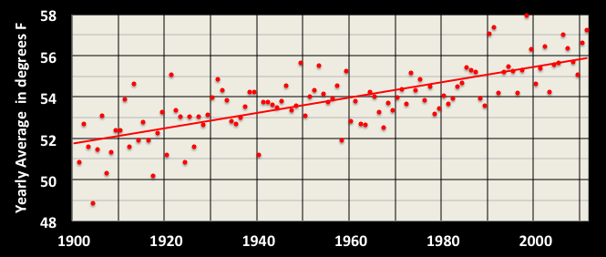
What’s already happened locally?
Sea Level
has risen over decades, though individual years vary somewhat
Trend: +10 in since 1930
Temperature has risen too, but the trend varies more year-to-year
Trend: +4.2ºF since 1900
A century of local data tells us the climate is changing
NOAA 2013
Notes:
Dan:
Extending back about a century, the local climate record shows that the climate is certainly changing, with a degree of annual variability.
All data are from NOAA.. Observed temperature data from Beltsville, MD. And sea level data based on the Washington Ship Channel.

Slide 11
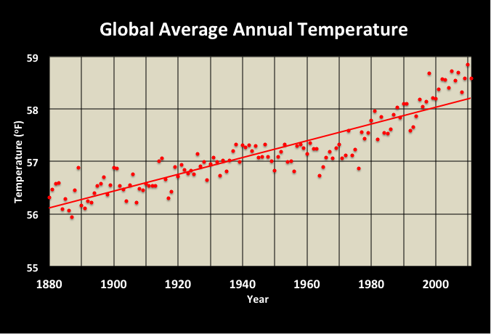
Part of a larger pattern?
Trend: +2º F since 1880
Observed local patterns reflect world-wide trends
NASA GISS
Notes:
Dan:
The DC area is consistent with broader trends.
Source: http://data.giss.nasa.gov/gistemp/graphs_v3/

Slide 12
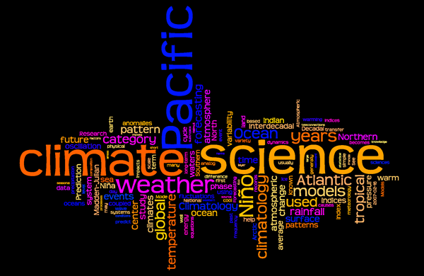
Question
What is the basis for climate projections?
Notes:
Olga
Image source: http://www.globaled.uconn.edu/student_climate/images/climate_science_wordle.png

Slide 13
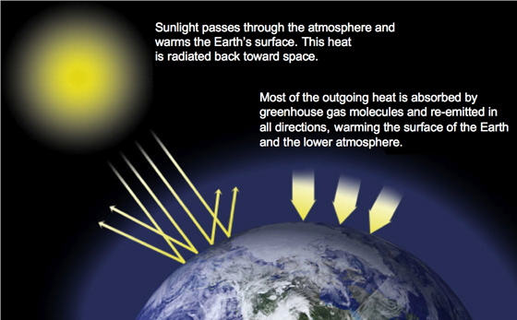
First principles
Scientists have understood this pattern for over a century
NASA
Notes:
Dan: A slide to introduce the concepts behind global warming.
Source: http://climate.nasa.gov/causes/

Slide 14
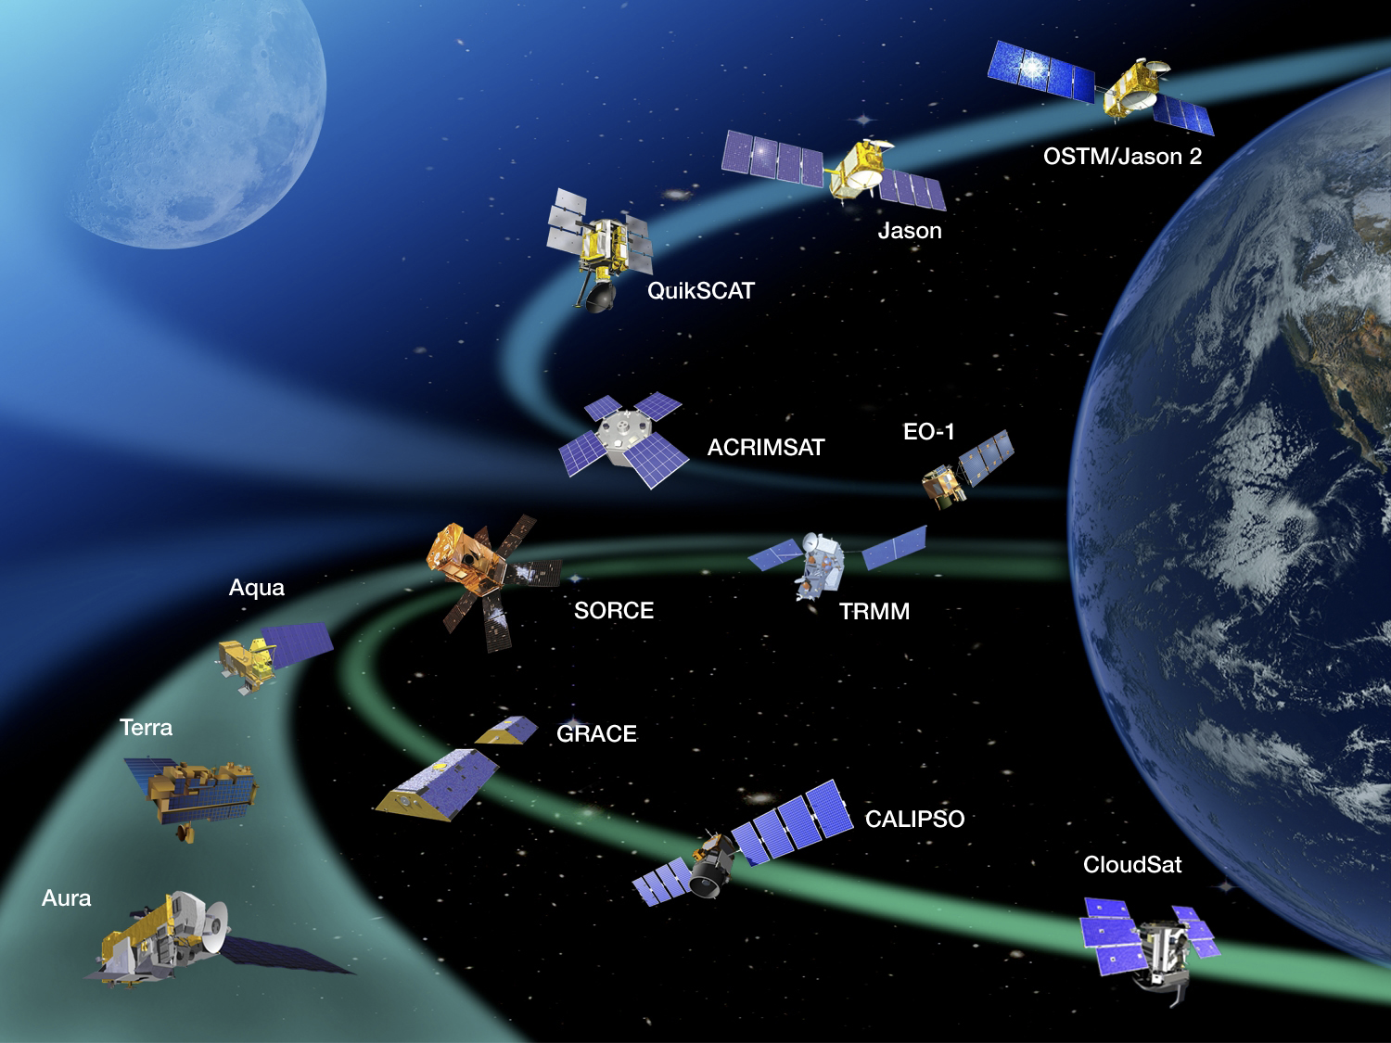
Gathering better data
NASA’s orbital perspective is a critical vantage-point
NASA
Notes:
Dan:
NASA’s Earth-observing satellites make critical contributions to gathering climate data.
Source: http://earthobservatory.nasa.gov/Features/WhyItMatters09/images/eos_constellation.jpg

Slide 15
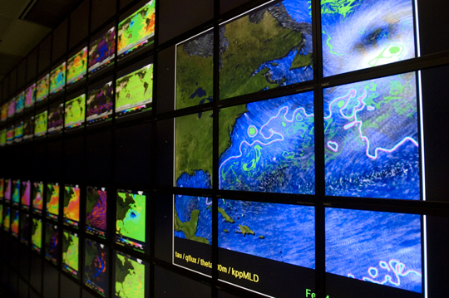
Building on a strong foundation
Powerful computer models let us test and refine hypotheses
Notes:
Dan:
Sophisticated computer models let us crunch enormous quantities of data to understand the patterns and project where they lead us.
Source: http://vector1media.com/spatialsustain/wp-content/uploads/2010/04/hyperwall2_2.jpg

Slide 16
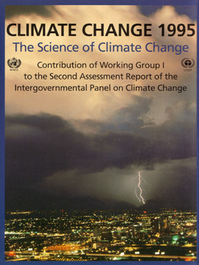
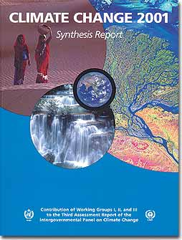
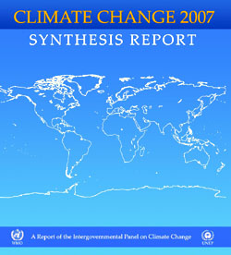
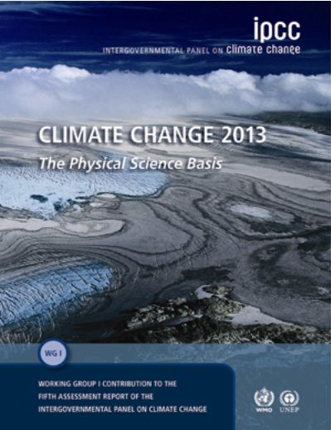
Intergovernmental Panel on Climate Change
Consensus-based projections using
Several models
Several future greenhouse gas emission scenarios
Updated as the science advances
Notes:
Dan:
NASA’s projections are a part of an international consensus among climate experts.

Slide 17
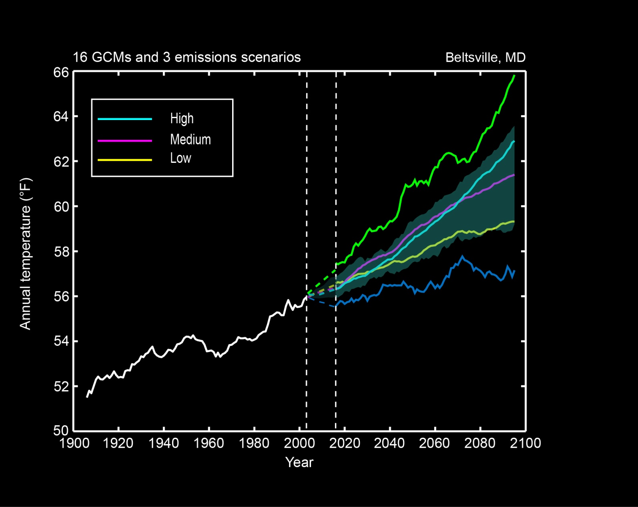
IPCC Models
Middle 67%
Range of Projections
Central range of models is basis for NASA’s projections
NASA GISS 2013
Notes:
Dan:
NASA GISS considers a full range of IPCC models and varying assumptions about greenhouse gas emissions in the future, but bases its projections on the central range.
Based on 16GCMs and 3 emissions scenarios. Data is from BCSD dataset. Central range is the middle 67% of values from model-based probabilities.
Source: NASA GISS

Slide 18
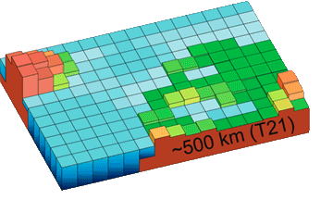
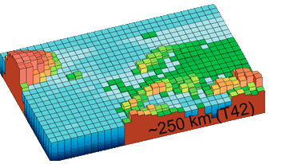
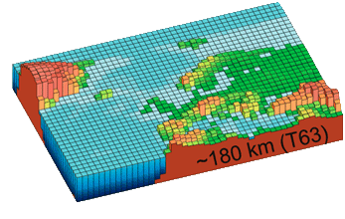

Rising precision/resolution over time
1990
1996
2001
2007
New models + better data = more specific projections
Notes:
Dan:
Over time, computer power and available data have let scientists make more precise projections.
Source: http://www.windows2universe.org/earth/climate/climate_models_CDcourses.html

Slide 19
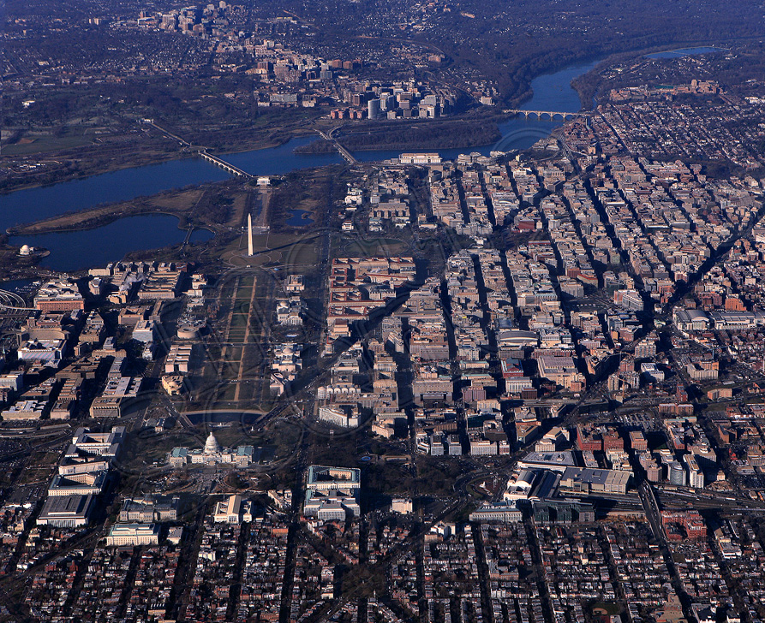
Question
What is projected for Washington DC?
Notes:
Olga
Image source: http://www.city-data.com/forum/city-vs-city/1197397-washington-d-c-vs-san-jose-10.html

Slide 20
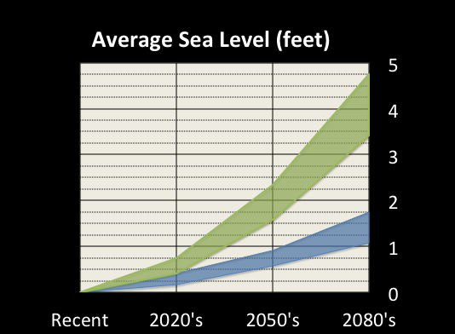
What is projected locally?
Adjusted for observed
rapid ice melting
Not adjusted for
rapid ice melting
Sea level rise is projected to accelerate this century
NASA GISS 2013
Notes:
Dan:
Sea level rise is expected to continue. Observations of polar ice melting indicate a faster rate of sea level rise, so it’s wise to consider this possibility when evaluating impacts.
Based on 7 GCMs and 3 emissions scenarios. Baseline (recent) is 2000 to 2004. Rapid ice-melt scenario is based on acceleration of recent rates of ice melt in the Greenland and West Antarctic ice sheets and paleoclimate studies. Projections based on the Washington Ship Channel tide gage.
Source: NASA projections for the Washington DC area projected sea levels using a format inspired by a 10 September 2012 NYTimes article.

Slide 21
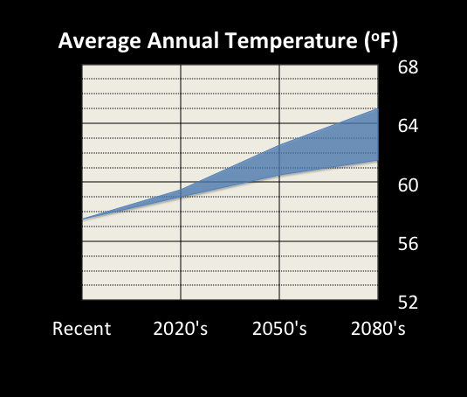
What is projected locally?
Average temperatures are projected to rise
NASA GISS 2013
Notes:
Dan:
Average annual temperature projections indicate a faster rise than in the twentieth century.
Based on 16GCMs and 3 emissions scenarios. Data is from BCSD for the Reagan National Airport, Washington DC. Based on the middle 67% of values from model-based probabilities.
Source: NASA projections for the Washington DC area projected sea levels using a format inspired by a 10 September 2012 NYTimes article.

Slide 22
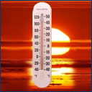
What can a few degrees warmer do?
New
Average
Very Likely Increase:
Extremely warm days
Average Action
Point
A small average change can mean a big effect on extremes
Notes:
Dan:
A modest change in average temperature might not seem very important, but the change may result in a big change on the number of days above or below extreme temperatures.
The term “action point” ties to how an organization operates. One action point is the temperature at which outdoor work is curtailed; another is the point at which air conditioning or heating is needed.

Slide 23
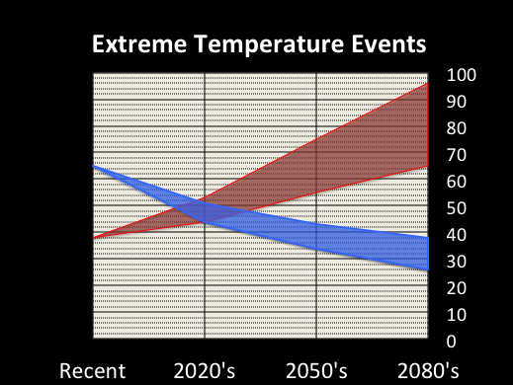
What can a few degrees warmer do?
Days/year above 90ºF
Days/year
Days/year below 32ºF
Extremes can change much faster than averages.
NASA GISS 2013
Notes:
Dan:
Compared with recent averages, the number of days over 90 degrees for the DC region is projected to roughly double by the 2080’s.
On the other hand, the number of days it freezes is projected to be reduced by half in that same timeframe.
Based on 16GCMs and 3 emissions scenarios. Data is from BCSD dataset.
Source: NASA projections for the Washington DC area projections using a format inspired by a 10 September 2012 NYTimes article.

Slide 24
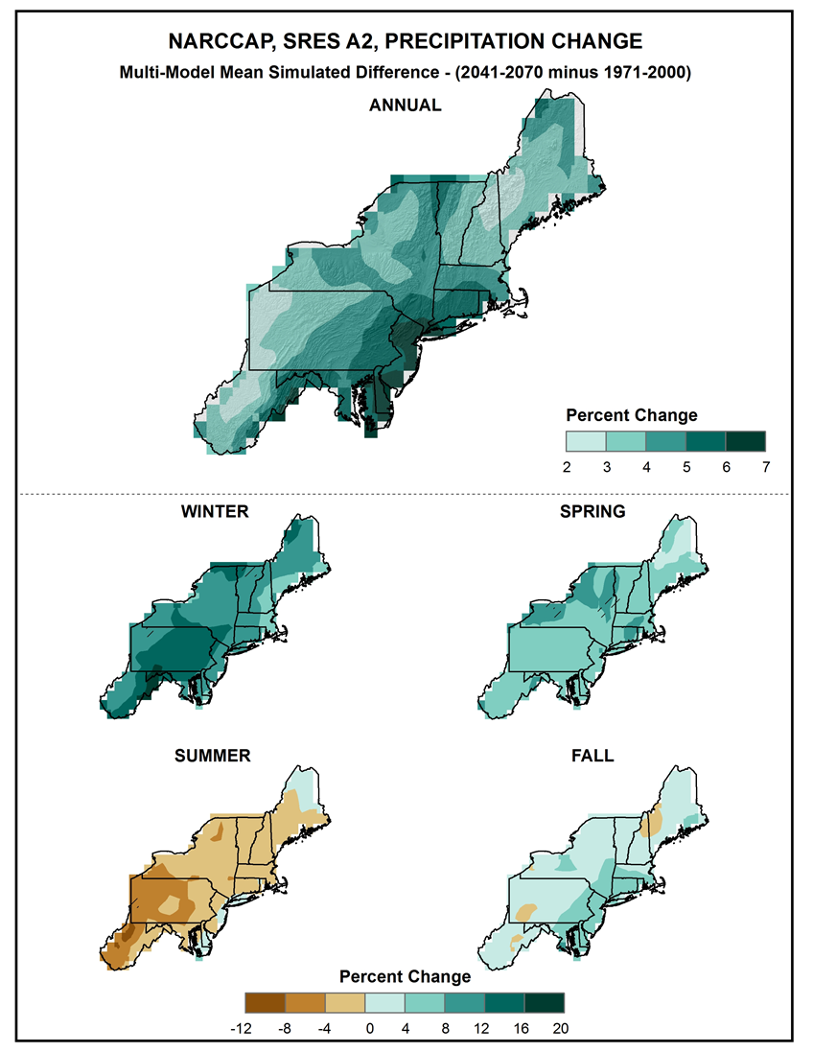
NCA Regional Climate Scenarios
Information on precipitation are illustrated here for the Northeast Region. Other regions available at: http://scenarios.globalchange.gov/node/1155
Seasonal changes simulated by NARCCAP* indicate an increase in precipitation for winter, spring, and fall, but a decrease for summer
National Climate Assessment 2013
*North American Regional Climate Change Assessment Program (NARCCAP)
Notes:
Dan:
Additional relevant information is available from the National Climate Assessment, which part of the interagency US Global Change Research Program. The National Climate Assessment uses two of the IPCC global climate models to provide information on observed climate trends and future climate scenarios in broad regions across the United States.
Here, for example, you can see information on the projected seasonal changes in temperature predicted for the 2040 to 2070 timeframe, from what it was for 1971-2000 average for each season.
Source:
NCA’s summary 2-pager Regional Climate Trends and Scenarios: http://scenarios.globalchange.gov/node/1155

Slide 25
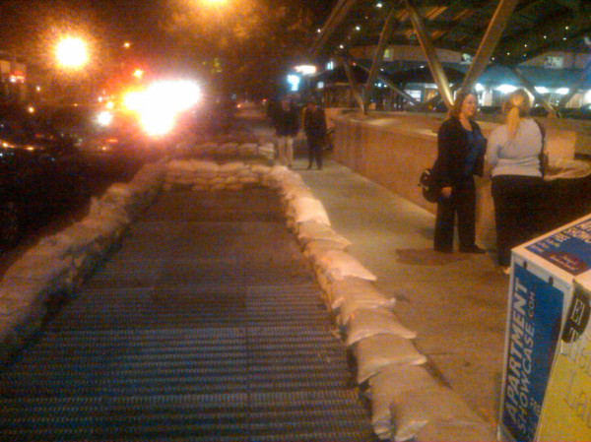
Question
What other changes are projected?
Notes:
Olga: You’ve covered temperature and sea levels.
This image of sandbags around a Metrorail air intake reminds me that we’re dealing with other climate risks…
What other types of events does the science suggest we should plan for?
Image: http://www.breakingnews.com/item/ahZzfmJyZWFraW5nbmV3cy13d3ctaHJkcg0LEgRTZWVkGO61owsM/2012/10/27/photo-sandbags-outside-the-cleveland-park-station-in-washington-dc-as

Slide 26
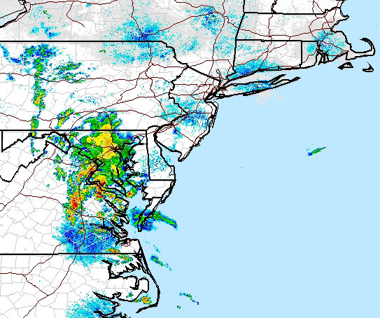
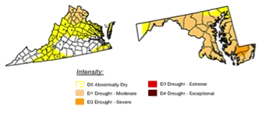
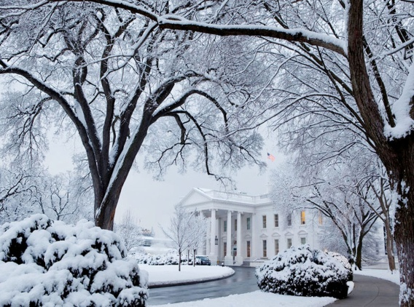
What other changes are projected?
Likely Increase
More likely than not
Intense rainfall
events
Increases in drought events
Normal Conditions
Abnormally Dry
Likely Decrease
Moderate Drought
Severe Drought
Snowfall frequency & amount
There’s more to consider than averages
NASA GISS 2013
Notes:
Dan:
This slide rounds out the qualitative projections in order of likelihood.
Sources: Rainfall image is NOAA radar image, drought is from National Drought Monitor.

Slide 27
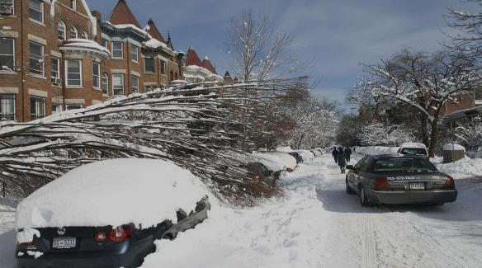
Question
What types of impacts might these
projected changes have on us in terms of
workforce, communities, and natural systems?
Photo by dbking (Wikimedia Commons)
Notes:
Olga

Slide 28
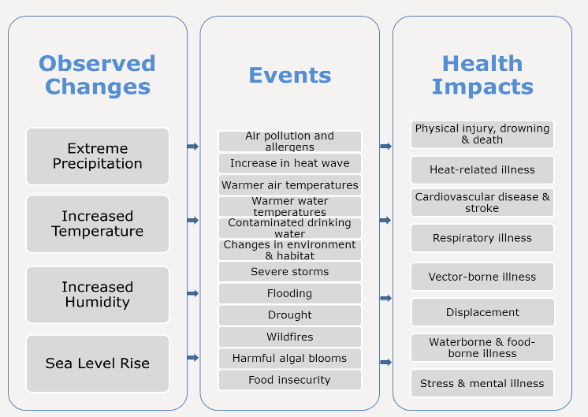
Public Health Impacts
Maryland Department of Health and Mental Hygiene
Notes:
Dan:
Climate change will directly and indirectly impact human health.
Direct health impacts include injuries and deaths from floods, as well as illnesses and deaths from heat waves. Some infectious diseases are more common in certain areas.
Indirect health impacts include the occurrence of more food- or water-related infections and respiratory diseases because of the anticipated changes in pollen amounts, air pollution concentrations, and environmental damage due to climate change.
Source:
Maryland Department of Health and Mental Hygiene
http://phpa.dhmh.maryland.gov/OEHFP/EH/SitePages/health_impacts.aspx

Slide 29
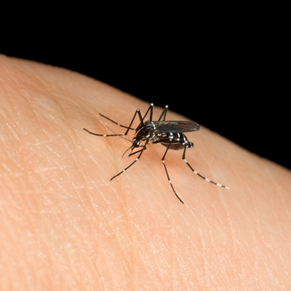
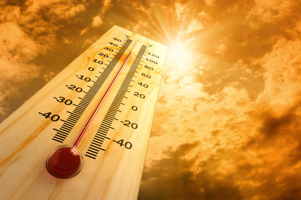

The Most Immediate Climate-Related Threats to Public Health in this Region
Air quality
Extreme heat
Floods, droughts, and extreme weather events
Vector borne diseases
Food borne illness
Sea level rise
Contaminated drinking water
Malnourishment & food insecurity
Maryland Department of Health and Mental Hygiene
Notes:
Dan:
According to the Maryland Department of Health and Mental Hygiene’s climate program, which is funded in part by the Centers for Disease Control…
Source:
Maryland Department of Health and Mental Hygiene
http://phpa.dhmh.maryland.gov/OEHFP/EH/SitePages/health_impacts.aspx

Slide 30
The Most At-Risk Populations
Young children
Elderly 65 years old and older
Elderly people that live alone
Communities already stressed by environmental justice and health factors
Socially isolated persons
Chronically ill people or people with respiratory diseases
Persons living in low-lying land areas
Persons that have a low socioeconomic status
Maryland Department of Health and Mental Hygiene (2014)
Notes:
Dan
According to the Maryland Department of Health and Mental Hygiene…
Source:
Maryland Department of Health and Mental Hygiene
http://phpa.dhmh.maryland.gov/OEHFP/EH/SitePages/health_impacts.aspx

Slide 31
Natural Systems Impacts
EXAMPLES:
Inundation of wetlands and low-lying areas.
Native species may be forced out of the area.
Dead zones in the Chesapeake Bay will likely increase.
Establishment of invasive populations of species.
Degraded water quality in coastal bays due to increases in winter-spring runoff.
Increased length of the growing season early in century.
Milk and poultry production negatively impacted by heat stress later in the century.
Increased forest vulnerability to drought, insect pests, and forest fires.
University of Maryland Center for Environmental Science (2014)
Notes:
Dan:
Examples of natural systems impacts from the University of Maryland Center for Environmental Science include…
Source:
http://www.umces.edu/applying-science/global-warming-free-state-highlights

Slide 32
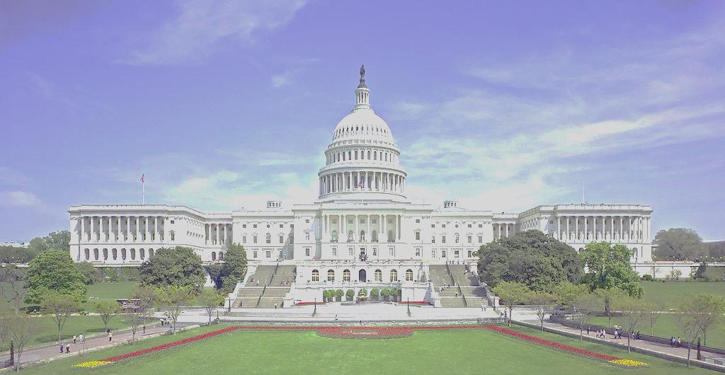
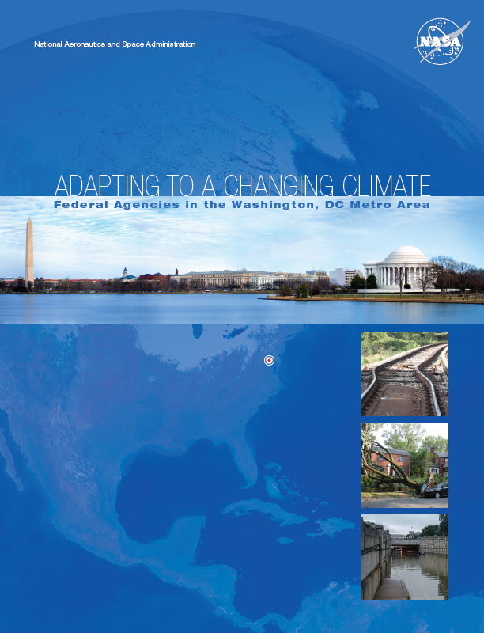
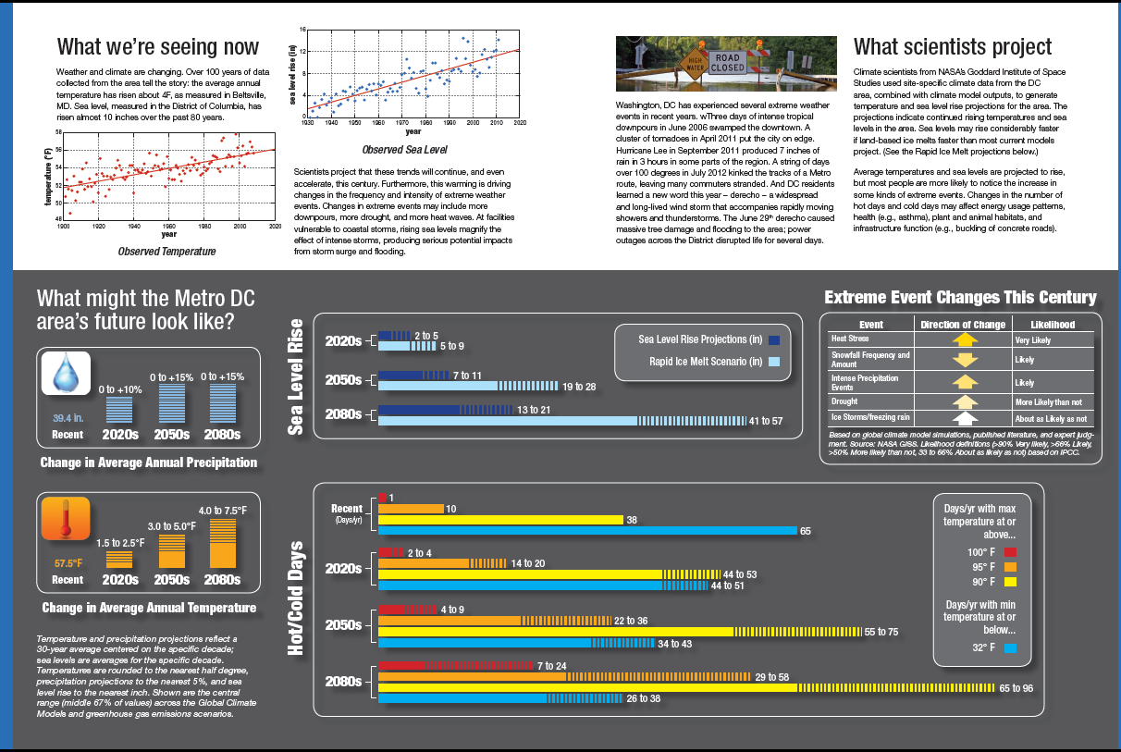
For more information…
http://www.mwcog.org/environment/climate/resilience.asp
NASA
Notes:
This first shows the cover of our handout, then focuses folks on the core science info (as seemed appropriate to sum up a climate scientist’s talk).
Source: NASA’s Climate Risks handout for the 31 January 2013 Federal Facilities Council workshop at the National Academy of Sciences.

Slide 33
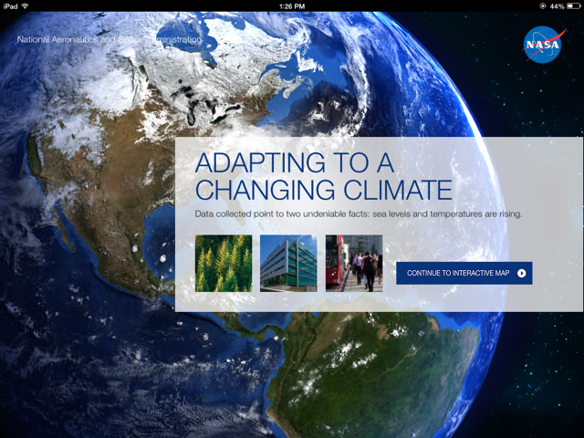

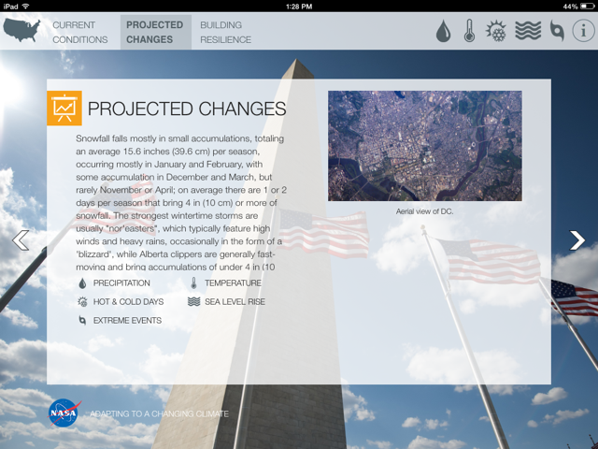
For more information…
COMING SOON, mobile app with basic location-specific info:
NASA
Notes:
In addition, the same info will be viewable in a mobile app (NASA Climate Science for Adaptation; ADAPT for short) that is to be released soon. This info will be updated periodically as new information becomes available.
Source: NASA HQ Earth Science Division & GISS projections

Slide 34
QUESTIONS*?
*You may also pose questions to NASA climate scientists at any time during the course of this series of webinars and workshops using the link under the Questions & Feedback section on:
http://www.mwcog.org/environment/climate/resilience.asp

