Slide 1

Sustainable Development
November 20, 2013

Slide 2
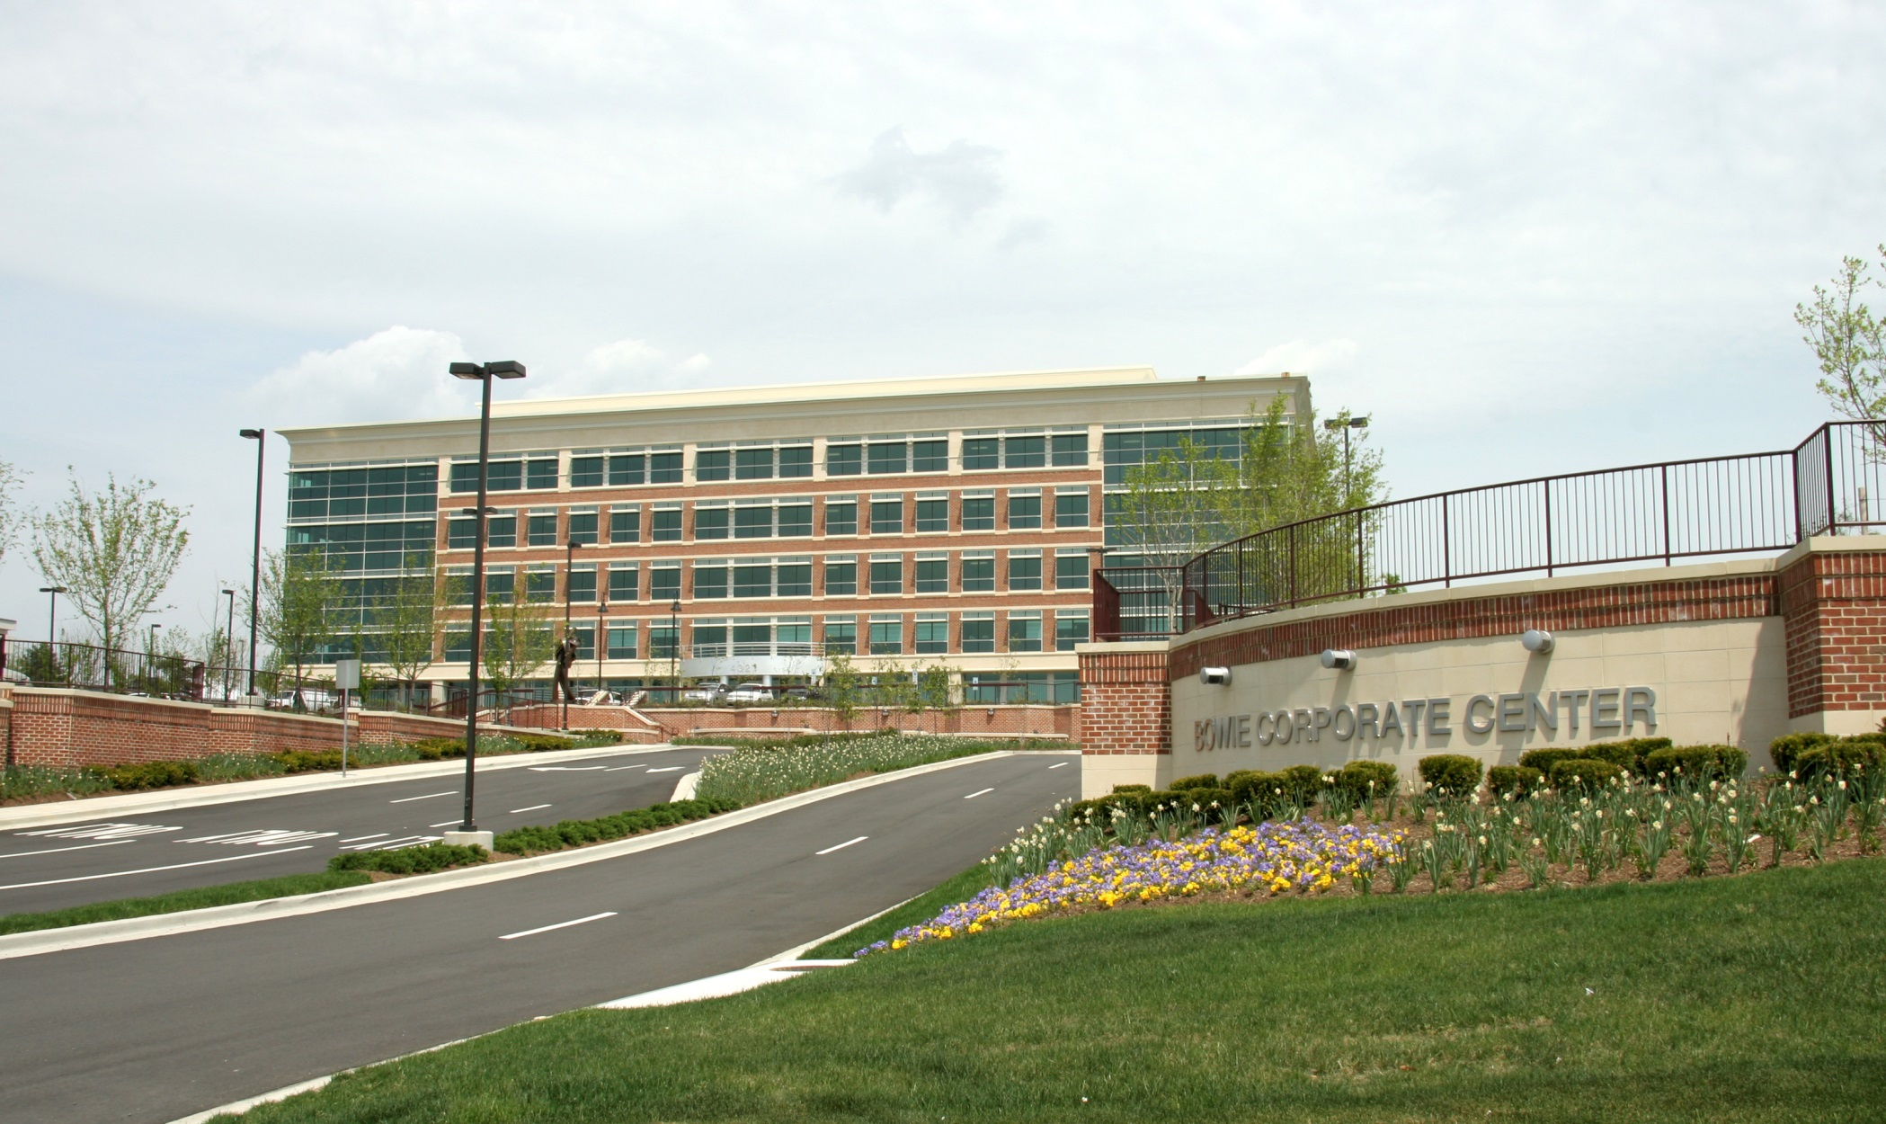
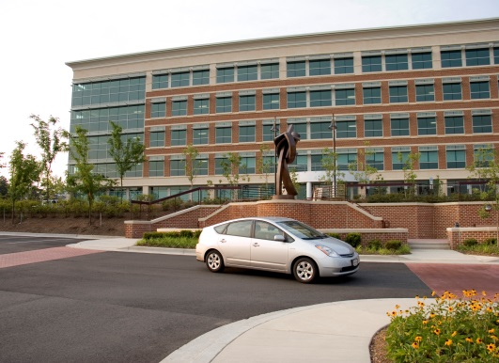
Bowie Corporate Center – Bowie, MD

Slide 3
Bowie Corporate Center – Bowie, MD
Sustainable Features:
Named Best Suburban Office Building and Best Environmentally Friendly Building in 2007 by the Maryland/DC Chapter of NAIOP.
Located across the street from Bowie Town Center offering quick and easy access to Route 50 via MD 197 and MD 3.
Bus service in front of the building to the New Carrollton Metrorail station.
High performance features such as enhanced indoor air quality, day lighting, low emitting materials, and water-conserving plumbing fixtures.
Bike racks, preferred parking for hybrid vehicles and an exercise room with showers.

Slide 4
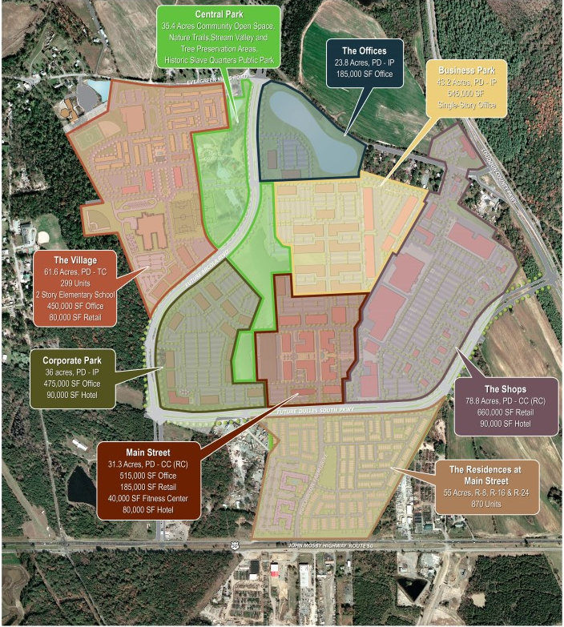
Suburban Development – A Mix of Uses vs. Mixed-Use – Arcola Center

Slide 5
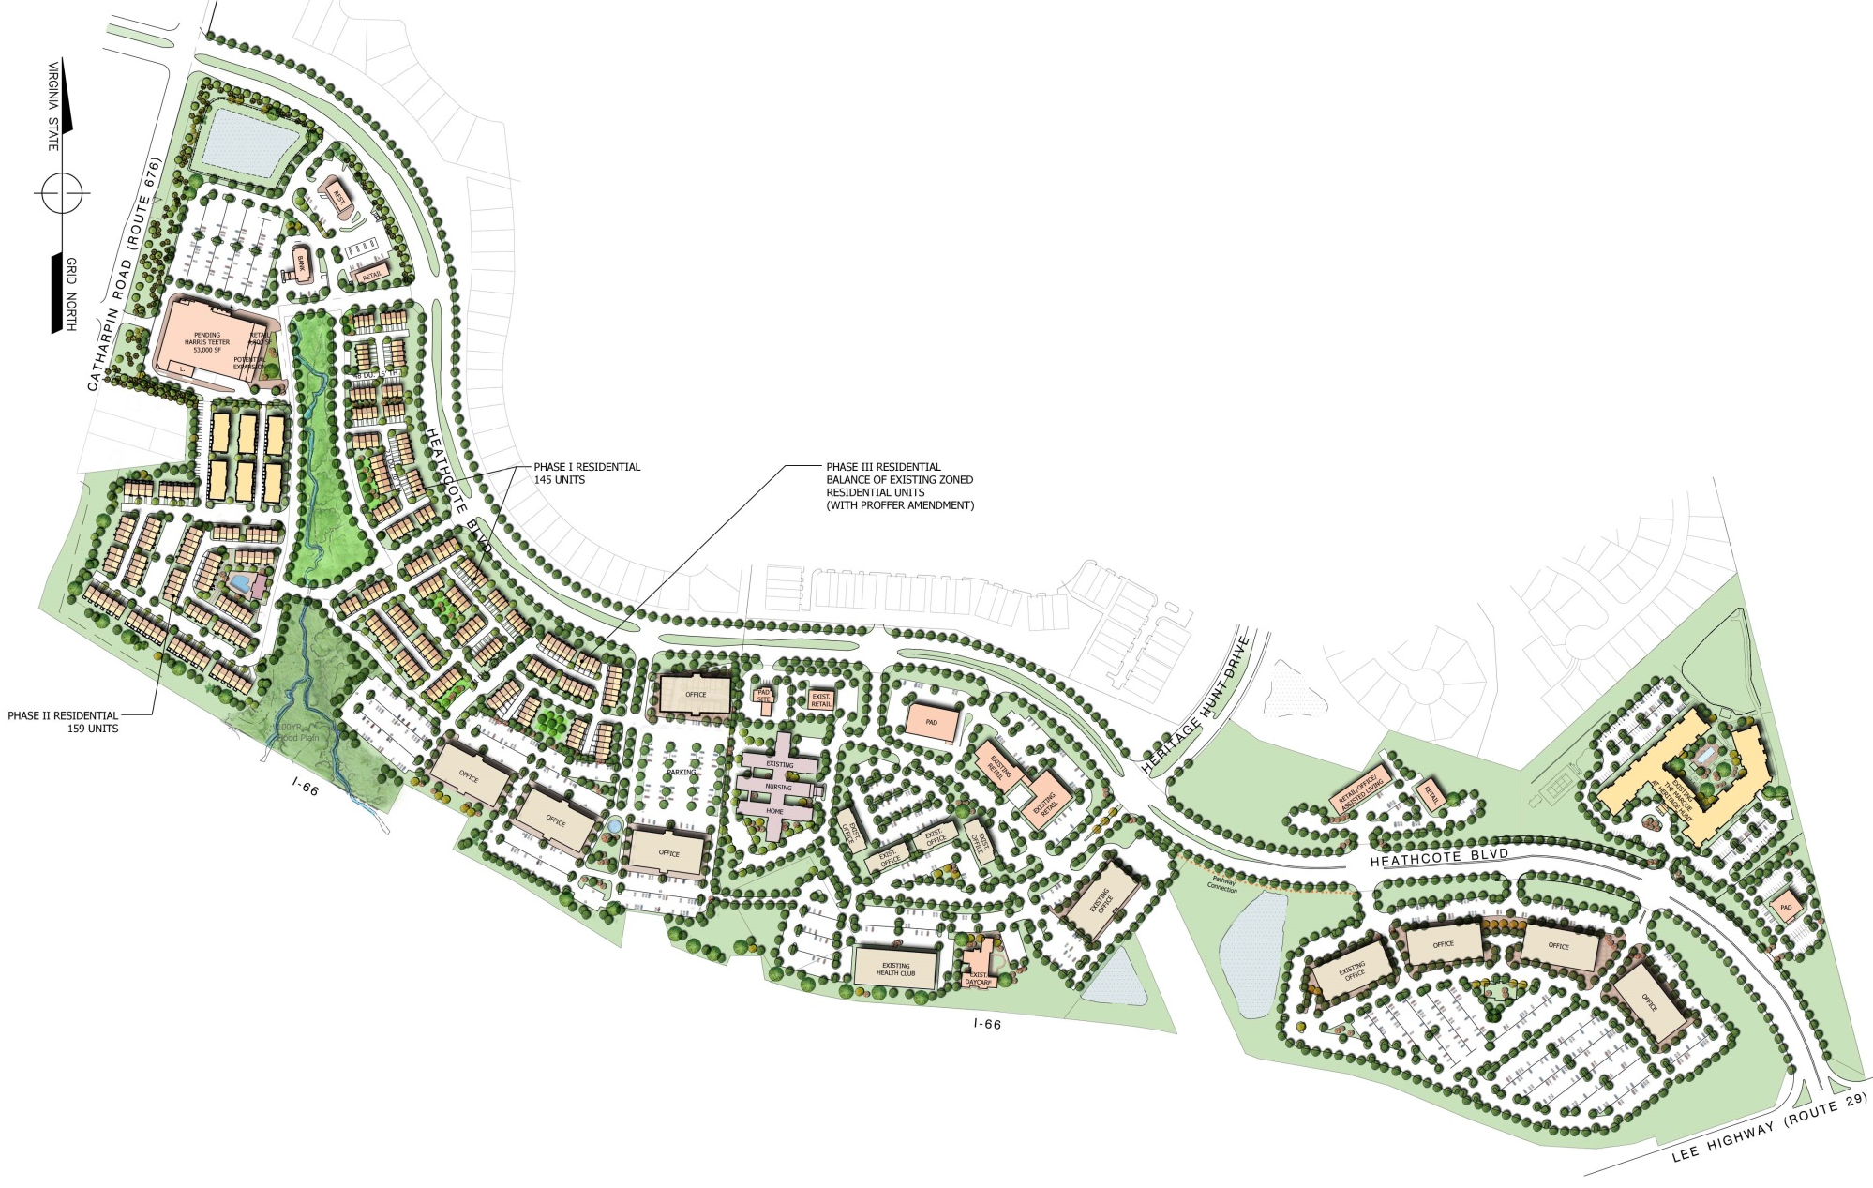
Suburban Development – A Mix of Uses vs. Mixed-Use – Heritage Hunt

Slide 6
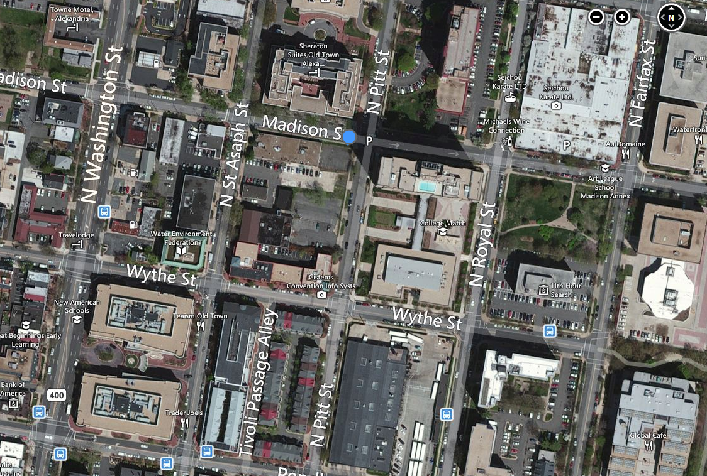
The Kingsley @ 500 Madison – Old Town Alexandria, VA

Slide 7
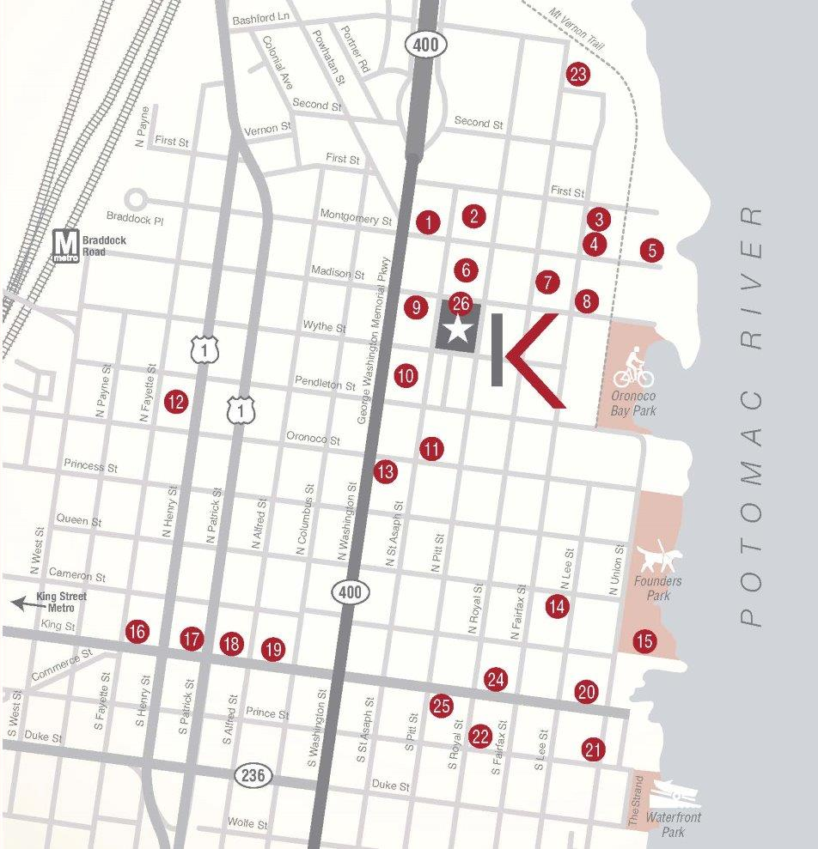
The Kingsley @ 500 Madison – Old Town Alexandria, VA

Slide 8
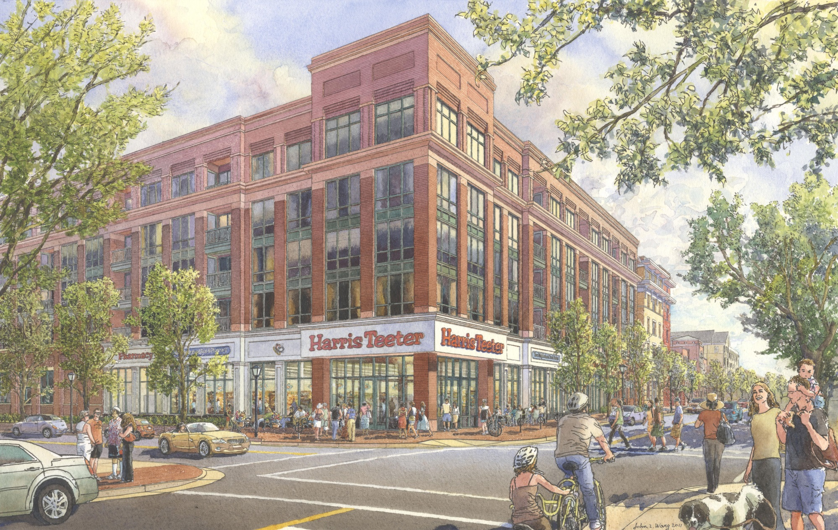
The Kingsley @ 500 Madison – Old Town Alexandria, VA

Slide 9
The Kingsley @ 500 Madison – Old Town Alexandria, VA
Sustainable Features:
Redevelopment of existing dilapidated buildings & contaminated site, asbestos remediation in existing buildings.
Both multifamily & Harris Teeter seeking LEED Silver Certification.
Building not designed with a continuous dewatering system.
Repurposing storm water and condensate from rooftop units for landscape irrigation and hose bibs for cleaning sidewalks.
Energy Star appliances and WaterSense plumbing fixtures.
6 blocks from Metro.
3 blocks from Mount Vernon bike trail, onsite Capital BikeShare, onsite bike storage lockers and repair shop.
Building will contain preferred parking for hybrid and electric vehicles as well as vehicle charging stations.

Slide 10
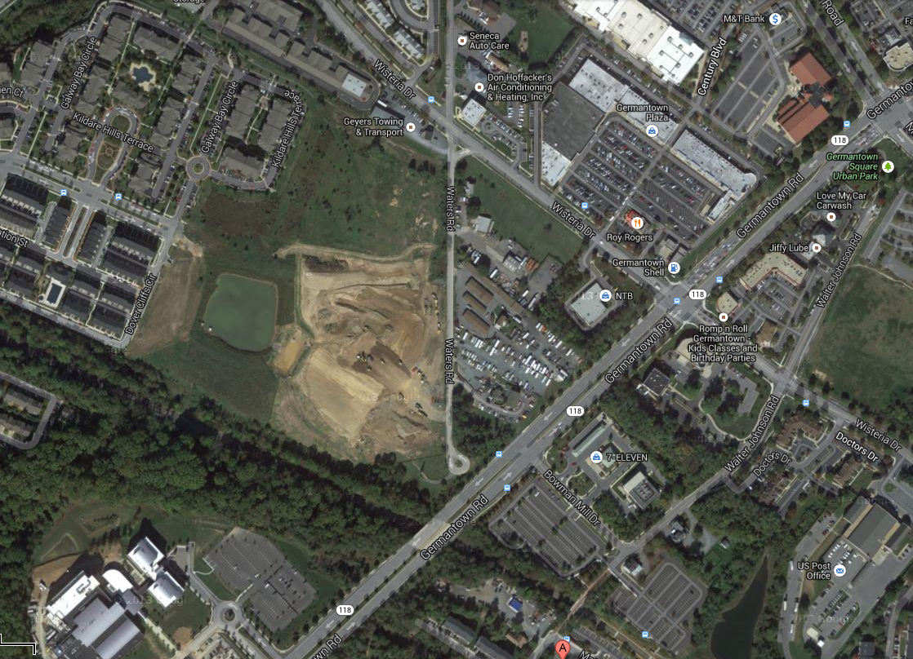
Waterford Hills– Germantown, MD

Slide 11
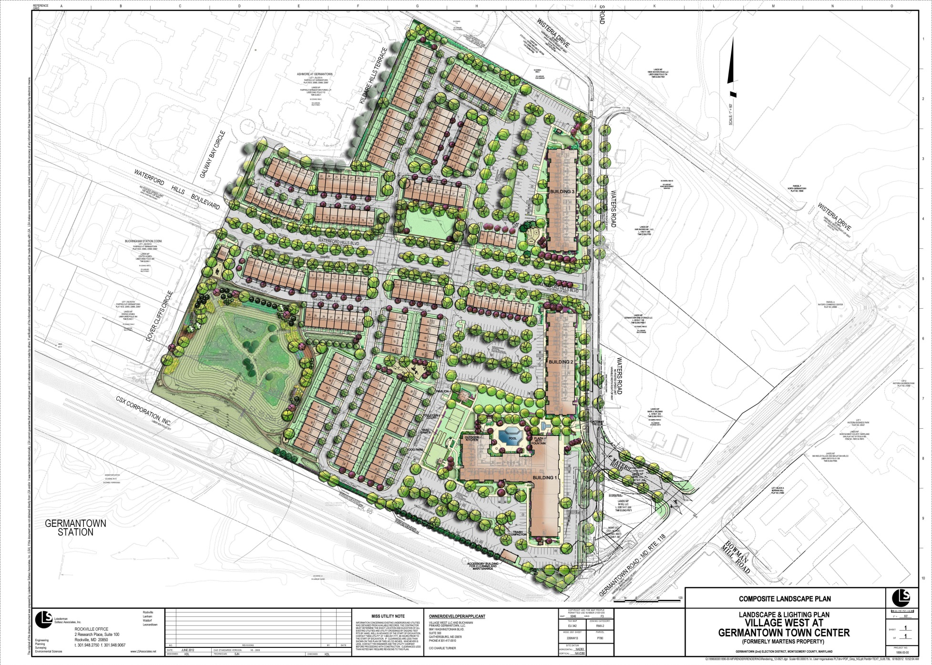
Waterford Hills– Germantown, MD – Townhouses, Multifamily & Retail

Slide 12
Waterford Hills– Germantown, MD
Sustainable Features:
Adjacent to MARC station and existing retail and commercial services.
Remediation of a very contaminated site that was used for construction dumping.
Revised site plan with contract purchaser for multifamily units to build 5 story LEED instead of 4 story, non-certified buildings.

Slide 13
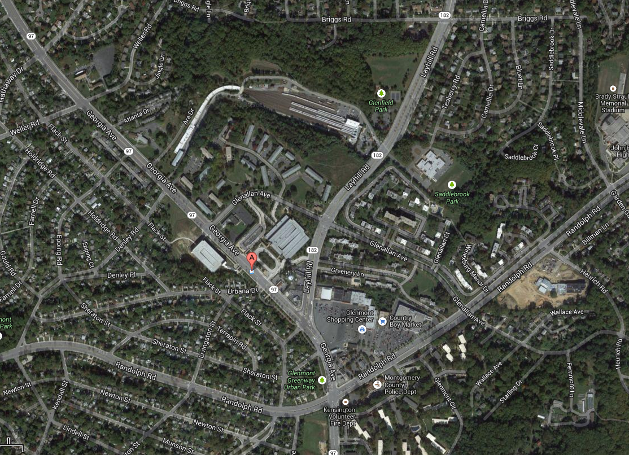
Glenmont Metro Site – Glenmont, MD

Slide 14
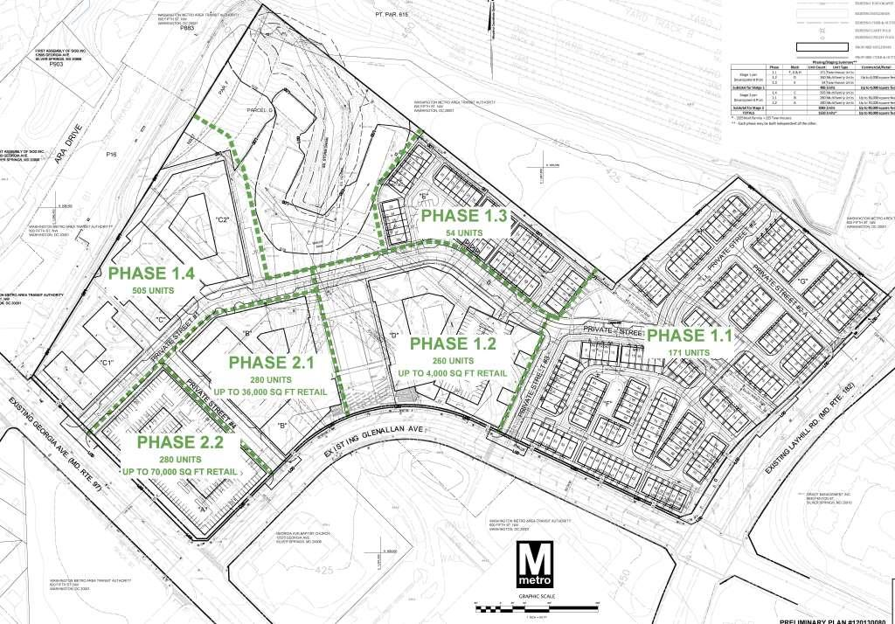
Glenmont Metro Site – Glenmont, MD

