Slide 1
Commuter connections Advanced Transportation and Congestion Management Technologies Deployment Program (ATCMTD)project update
Recent Accomplishments and Upcoming Activities
Nicholas Ramfos Transportation Program Operations Director Systems Performance, Operations and Technology Subcommittee January 6, 2022

Slide 2
ATCMTD Overview
Advanced Transportation and Congestion Mitigation Technologies Deployment (ATCMTD)
  FHWA Funds authorized through FAST Act
$5.95 million grant application awarded November 2020
  3-year project scheduled to conclude in November 2023
Year 1 Focus: Model Enhancements & Program Expansion (Tasks A - C)
Year 2 Focus: Specialized TDM Programs (Tasks D - F)
Year 3 Focus: Improved Accommodations (Tasks G)

Slide 3
Project Goals
Leverage the best available technology to maximize the cost effectiveness of a megaregion TDM program
Integrate and expand existing dynamic TDM programs with a shared technology platform for coordination among public and private-sector partners
Provide personalized, timely and accurate traveler information and incentives to minimize congestion, energy use, and emissions
Enhance multimodal transportation access and system performance for all user groups with rewards and gamification
Notes:
Goals for the project largely revolve around program expansion, integration of more programs (supplemental to the Commuter Connections incentive program, for instance, employer commuter challenges), and dynamic/personalized incentives
Allow for improvements or enhancements to the points award model
Incentive fulfillment – we’d like to get away from paper checks and offer some type of virtual payment (more on this later in presentation…)

Slide 4
Task A - Accomplishments
Task A: Develop Personalized and Dynamic TDM in Existing Service Areas
  Areas of focus: TPB non-attainment area and Maryland
  WMATA & MTA real-time GTFS feeds integrated
  All fixed-route local transit services integrated
  TDM System adapted to administer multiple incenTrip programs
  MDOT incenTrip Incentive Program
    Operations/rewards are similar to Commuter Connections
      Eligibility is based upon work location
    Launched in early November 2021

Slide 5
Task B - Accomplishments
Task B: Technology Deployment in the Entire DMV Megaregion and Adjacent Rural Counties
  Areas of focus: Central Virginia, Delaware, and select counties in West Virginia and Pennsylvania
  Created network model
    Data elements include megaregion street network, real-time traffic data, and fixed-route transit
    Users are now able to plan a trip within expanded region, all the way down to Richmond
    Released in early November 2021

Slide 6
Task C - Accomplishments
Task C: Expand multimodal reward and payment options within the incenTrip community
  Identified incentives to pursue for inclusion
    PayPal/Venmo digital payments
    eGift Cards (Giftcards.com / OmniCard) and Nift Gift
    WMATA SmarTrip, MTA CharmPass, E-ZPass
  Created new “Payment Module” in TDM System
  Created 5 new APIs that permit communication between incenTrip, the TDM System, and PayPal
    Enable users to link PayPal accounts to incenTrip accounts so that digital payments can be received

Slide 7
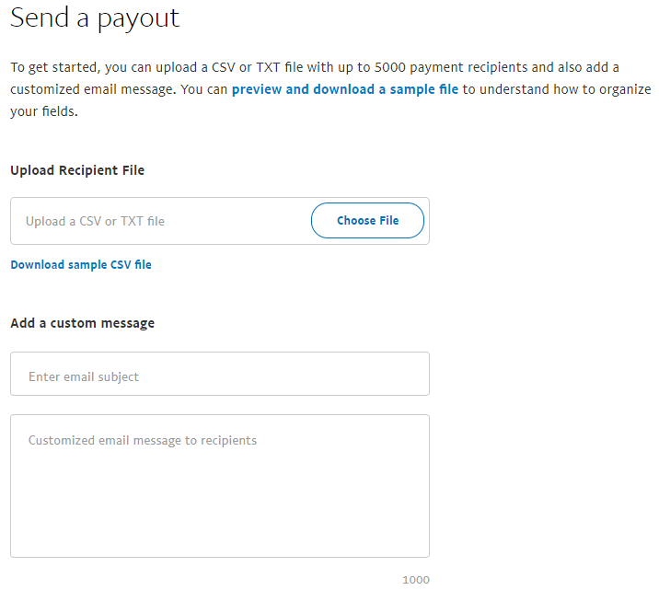
Task C - PayPal Payouts
CSV includes:
  PayPal ID
  Amount
  Currency
  Reference ID
    (Email)
  Note
  Wallet
    (PayPal or Venmo)

Slide 8
Task C - Updated Deployment Timeline
Incentive | Expected Deployment
PayPal Digital Payment | Q4 2021
Gift Cards | Q4 2021
Nift Gifts | Q1 2022
WMATA SmarTrip | Q1 2022
MTA CharmPass | TBD
VA & MD EZ-Pass | TBD

Slide 9
Task D - Overview
Task D: TDM Deployment for Non-Recurrent Congestion Mitigation
  Develop and deploy (a) personalized and dynamic incentives and (b) traveler info to mitigate non-recurrent congestion in the region
  Examples of non-recurrent congestion: major accidents, dangerous weather, work zones, holidays, and special events
    Focus will remain focused on peak-commute timeframes, unless otherwise suggested
  Encourage shifts in (a) mode, (b) departure time, and (c) route
  Stakeholder input requested from ATCMTD Stakeholder Group

Slide 10
Task E - Overview
Task E: Corridor-Level TDM Deployment for Multimodal Integrated Corridor Management (ICM) and Transportation Systems Management & Operations (TSM&O)
  Monetary and non-monetary incentives
  Encourage shifts in (a) mode, (b) departure time, and (c) route
  Focus on improving commuters’ awareness of multimodal choices and park-and-ride options along selected corridors
  Ability to react to projected congestion levels along corridor and allocate incentives accordingly
  Stakeholder input requested from ATCMTD Stakeholder Group

Slide 11
Task D & E - Methods
Potential methods for personalized & dynamic incentivization:
  Flextime Rewards / awarding points for route change or delayed departure
    $8 per flexed trip – scale appropriately for points allocation
  Increased rideshare vehicle occupancy
  Customized corridor challenges
  Boost points for all non-SOV trips within certain distance of eligible corridors
Potential methods for disseminating real-time traveler information:
  Flextime Rewards / alerting of delays along route
    In-app push notifications, email alerts

Slide 12
Task D & E - Scenarios and Corridors
Transform 66 Major Construction Project
  Convert HOV2 carpools to HOV3
I-270 Corridor Project
  Leverage MDOT’s $100 million investment in ramp meters, variable speed limits, and auxiliary lane extensions
Bay Bridge holiday travel
  Reduce number of commute trips along bay bridge so more capacity is available for non-commute trips
Heavy traffic days
  Tuesday following Labor Day
  Day before Thanksgiving

Slide 13
Task F - Overview
Task F: Integration of Employer-Funded TDM for Shared-Platform Development
  Develop an Employer Module that allows employers to create and deploy customized TDM programs
    Access a webpage to input information and create challenges
    New “Employer Dashboard” to permit ETC administration privileges within incenTrip
  Reward employees for choosing non-SOV modes and/or flexible work schedules
    Overlayed on top of existing public incentive programs
  Employers may be asked to offer cash match or fully fund customized rewards

Slide 14
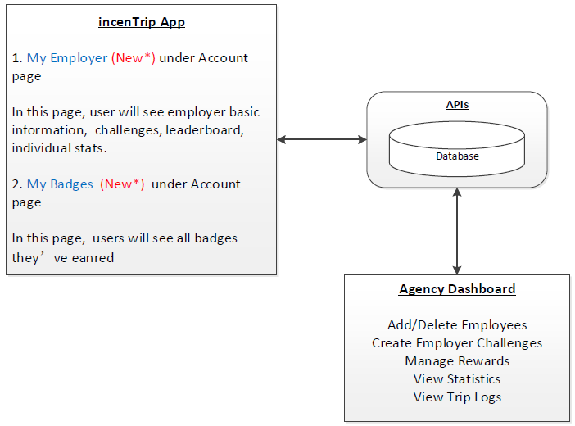
Task F – Employer Program Design
Graphic courtesy UMD MTI

Slide 15
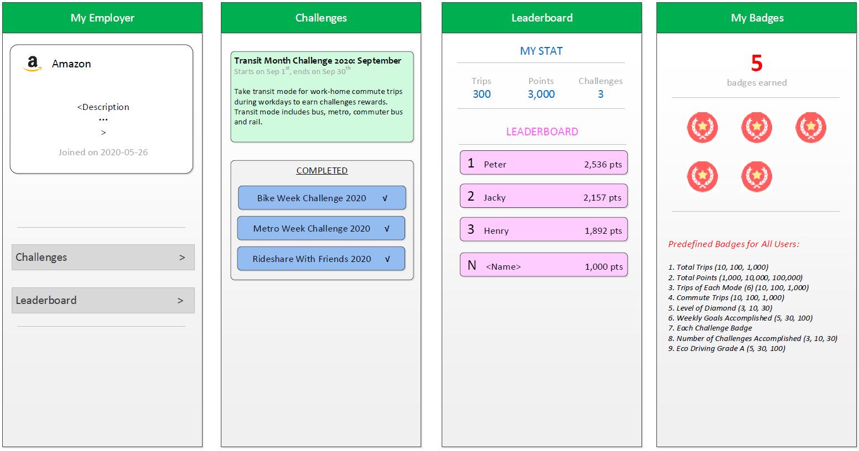
Task F – App UI Design
Mockups courtesy UMD MTI

Slide 16
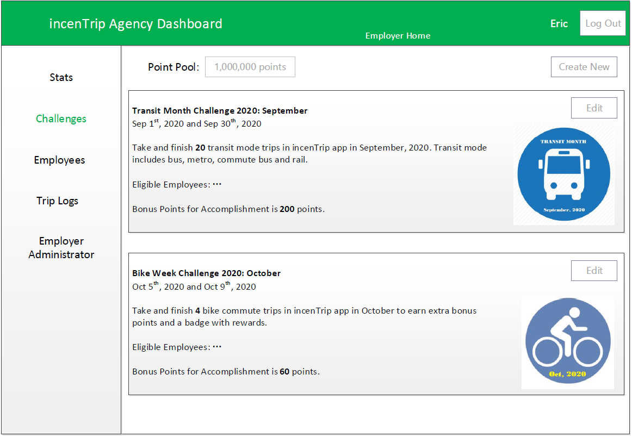
Task F – Dashboard UI Design
Mockups courtesy UMD MTI
Notes:
Predefined Challenges:1. ? trips during <start date?> and <end date?>2. ? commute trips during <start date?> and <end date?>3. ? trips of <mode?> during <start date?> and <end date?>4. ? work commute trips during <start date?> and <end date?>5. ? non-commute trips during <start date?> and <end date?>6. car free during<start date?> and <end date?>7. ? points earned during <start date?> and <end date?>
Customizable Items:1. Name of a Challenge2. Challenge Start Time3. Challenge End Time4. Number of Total Trips/Commute or Non-Commute Trips/Trips of Mode5. Point Pool of a Challenge6. Trip Points Range7. Eligible Employees

Slide 17
Year 2 Schedule - Tasks D, E, F
Phase 1: Stakeholder engagement to determine plans
  November 2021 – December 2021
Phase 2: Design plan development and stakeholder group approval
  January 2022 – April 2022
Phase 3: Programming and deployment
  May 2022 – October 2022

Slide 18
Nicholas Ramfos DTP Program Operations Director (202) 962-3313 nramfos@mwcog.org | commuterconnections.org
Metropolitan Washington Council of Governments 777 North Capitol Street NE, Suite 300 Washington, DC 20002

