Slide 1
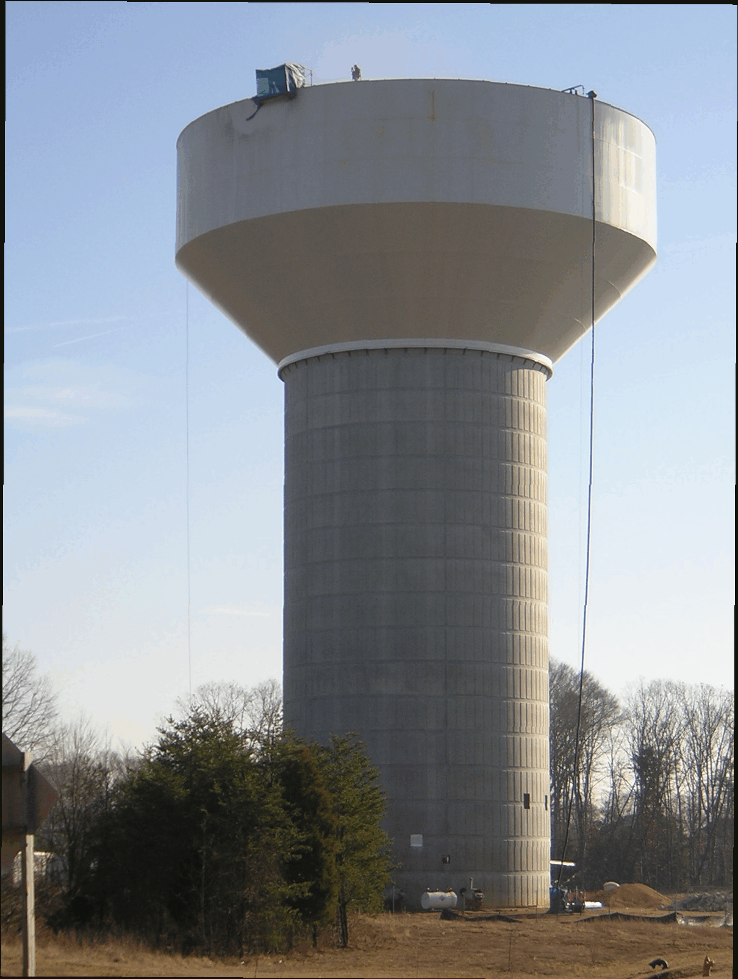
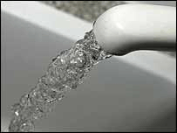
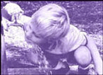

Water Resources Overview
Charles County, Maryland
2018

Slide 2
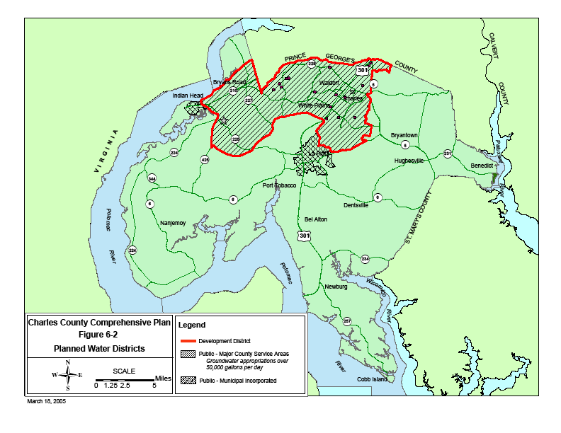
Overview
Water Service Area Map

Slide 3
Overview
Potable Water Resources
Surficial Aquifer
Aquia Aquifer
Magothy Aquifer
Upper Patapsco Aquifer
Lower Patapsco Aquifer
Patuxent Aquifer
Washington Suburban Sanitary Commission (WSSC)

Slide 4
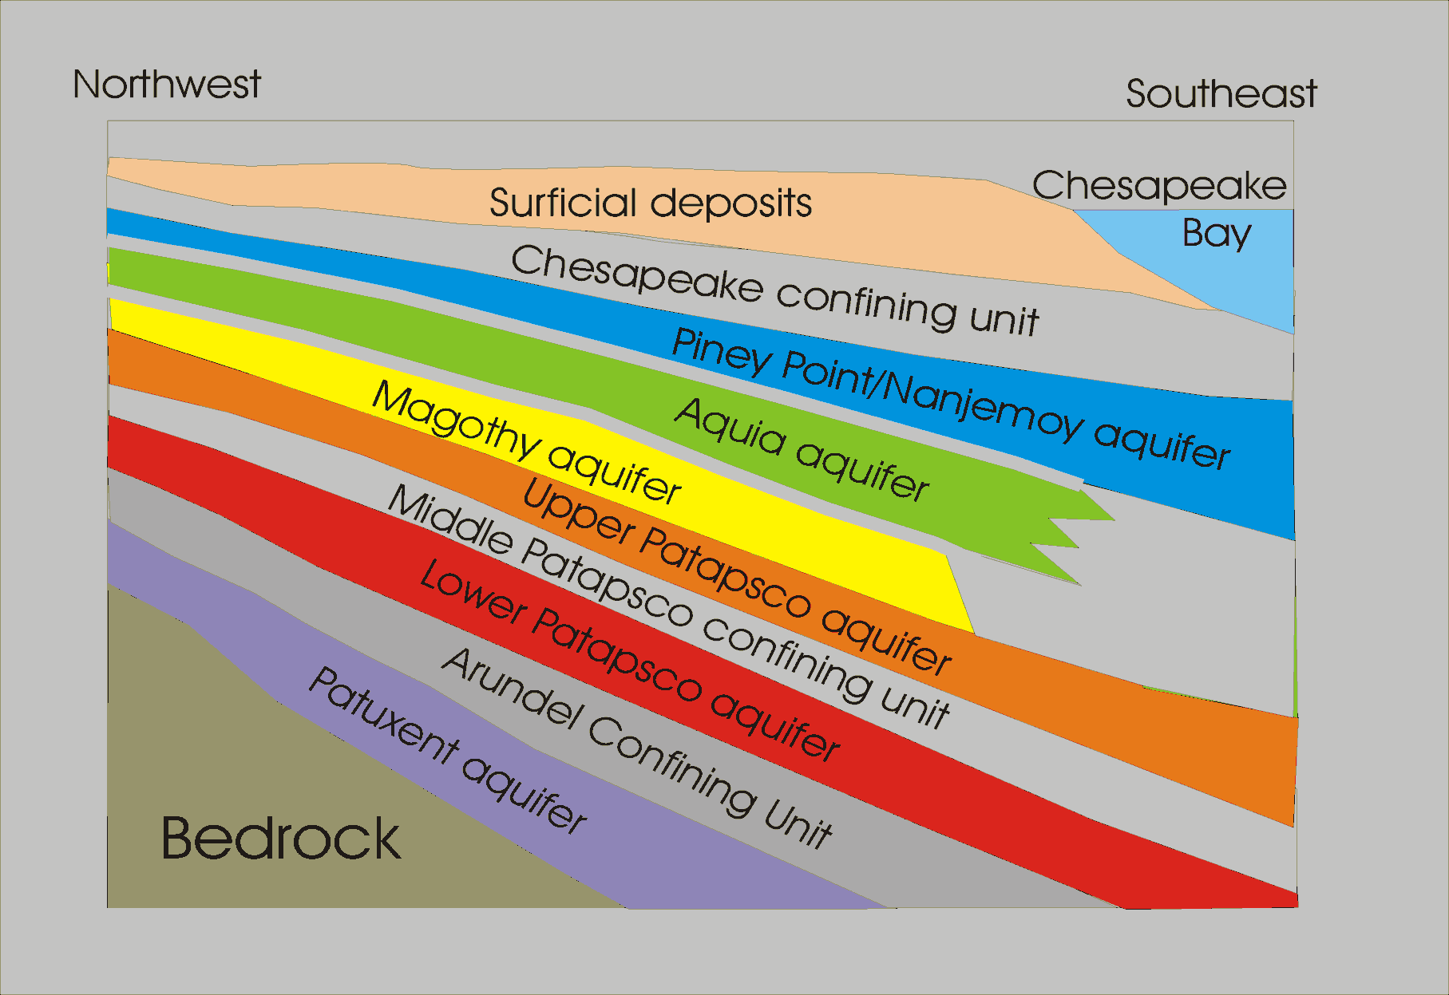
Overview
Southern Maryland Aquifers

Slide 5
Overview
Water Resources have been studied in Charles County for over 25 years:
Magothy Aquifer Management Strategy - Early 1980's
Charles Co. Water Supply Resources Development & Mgt Plan - 1984
Ground-water use in the Coastal Plain of MD, Charles County, MGS - 1989
Bryans Road Water System Study - 1989
Waldorf Aquifer Study, MGS - 1990
Bryans Road Regional Water Supply Study - U.S. Army Corps - 1993
Bryans Road Water Study - 1996
Charles County Water Supply & Availability Study, 1997
Bryans Road/Indian Head Patapsco/Patuxent Aquifer Study, MGS - 1999
Waldorf Groundwater Optimization Study, MGS - 2003
Bryans Road Groundwater Optimization Study, MGS - 2004
Southern Maryland Regional Aquifer Study, MGS Admin. Rpt. - 2005
Central Development Area W/S Feasibility Study – 2006
Southern Maryland Regional Aquifer Study, MGS Admin. Rpt. - 2005
Waldorf Water System Distribution Study - 2008

Slide 6
Strategies
Water Resources Advisory Committee - WRAC
Formed in late 2005
Members/Participants included:
  County Staff
  Concerned citizens
  Health Department
  MD Dept. of the Environment
  Town of La Plata
  Town of Indian Head
  Well driller/Water Professional
Committee made Recommendations to the County Commissioners in 2006 and updated those recommendations in a Strategic Plan in 2011.

Slide 7
Water Resources Strategies
Groundwater Monitoring
Minimize drawdown in Magothy & Patapsco aquifers
Utilize down-dip area
Well Field Management
Water Re-Use/Closed Loop
Supplement our water system with alternatives to groundwater
Water conservation program

Slide 8
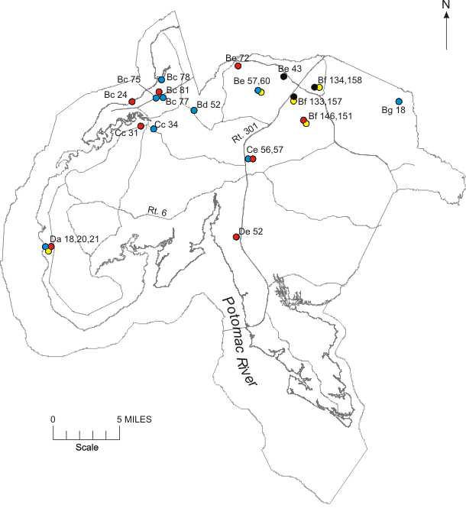
Strategies
Groundwater Monitoring
Regular measurements to observe water levels
Gather Data
Establish trends
Adjust pumping as needed
Plan for future needs

Slide 9
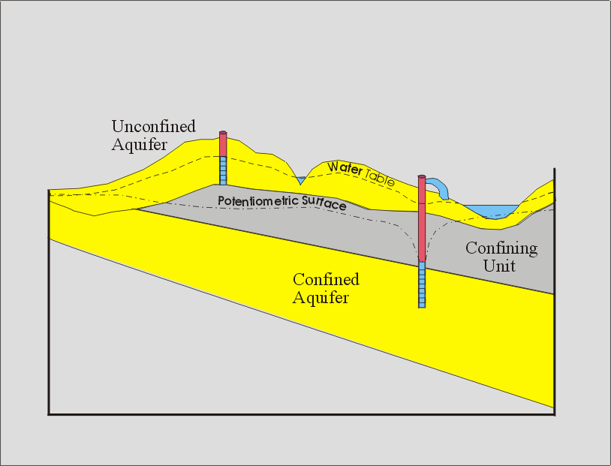
Minimize drawdown
What is drawdown?
“Change in water level caused by pumping”
-www.groundwater.org

Slide 10
Minimize Drawdown
How do we do that?
WSSC Connections (Existing 1.4 MGD & Potentially an Additional 5.0 MGD)
Effluent Re-Use - Power Plants/Industrial Users
Well Field Optimization & Automation
Bryans Road shift to the Patuxent aquifer
    Reduce Lower Patapsco Withdrawals
    Shift to Patuxent Wells

Slide 11
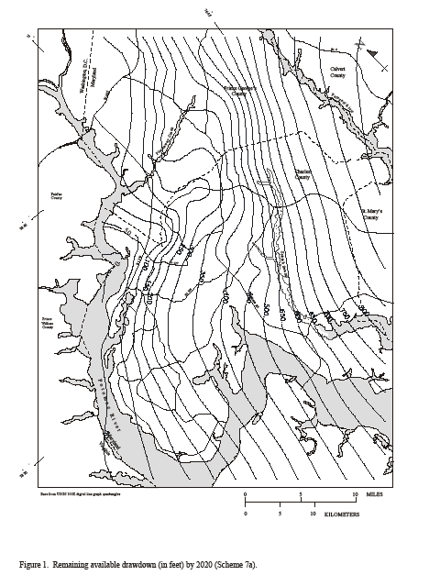
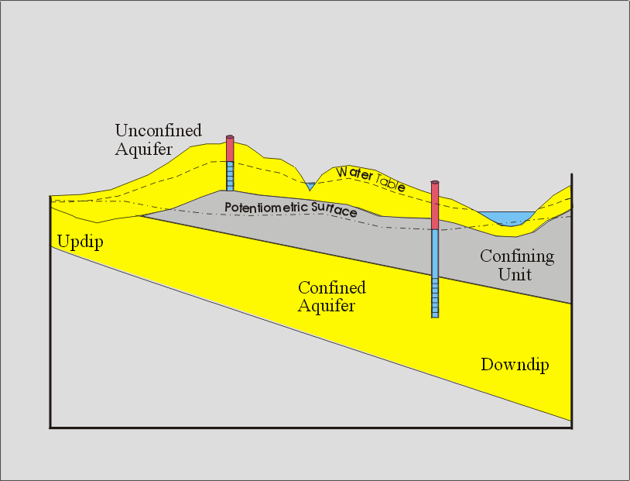
Utilize Down-dip Area
What is the down-dip area?

Slide 12
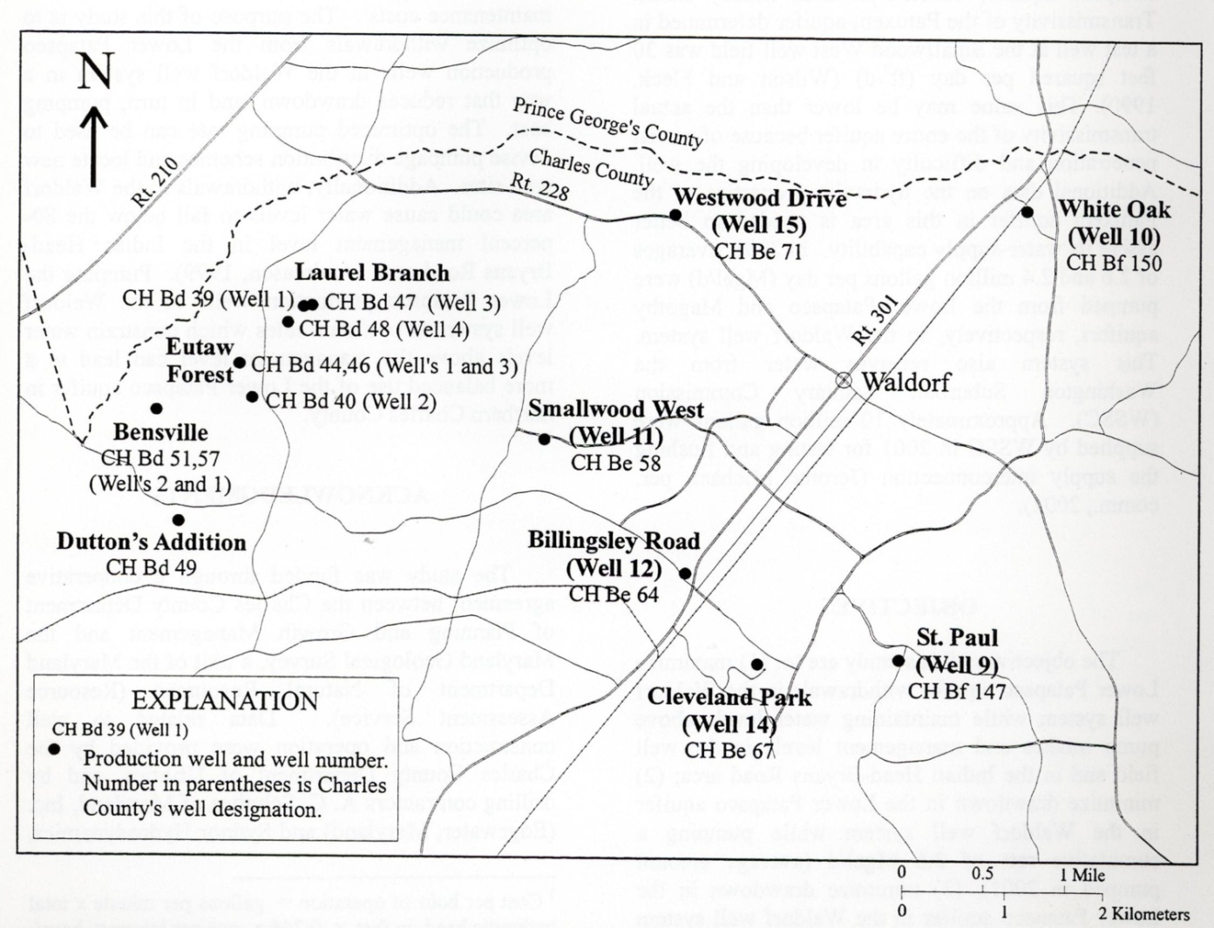
Well Field Management
Optimize Withdraws based on MGS Studies
Automate Operations
Plan new wells based on this strategy
Increase storage
Optimize distribution

Slide 13
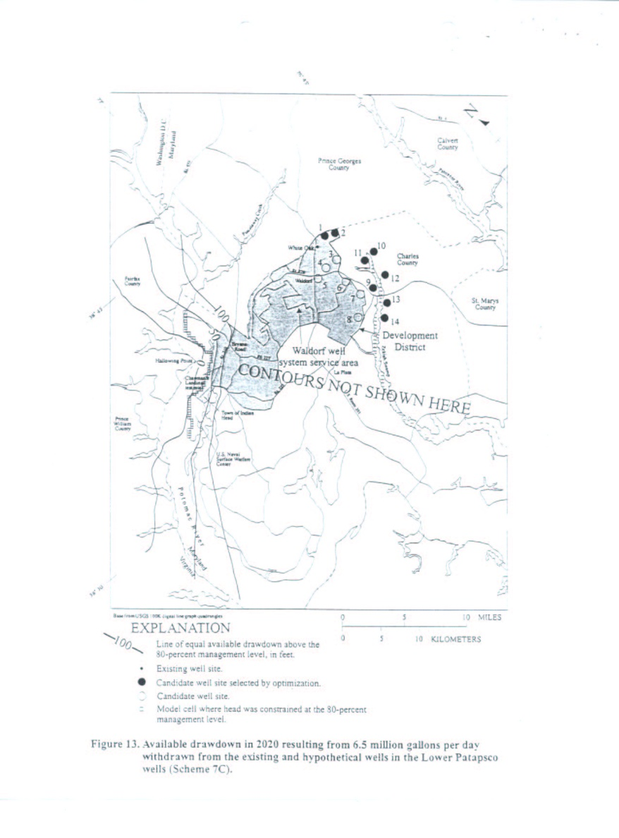
Well Field Management
MGS Optimization Studies
    Waldorf
    Bryans Road
Optimized Withdrawals & Pumping
Modeled Future Pumping Scenarios
Determined Optimal Future Well Locations

Slide 14
Water Re-Use/Closed Loop
Re-use water from WWTPs for:
  Industrial Uses
  Power Generation Facilities
  Irrigation
  Non-consumable crops
Reduces dependence on Potable Water
Preserves potable water sources
Reduces open water discharges of WWTPs

Slide 15
Water Re-Use/Closed Loop

Slide 16
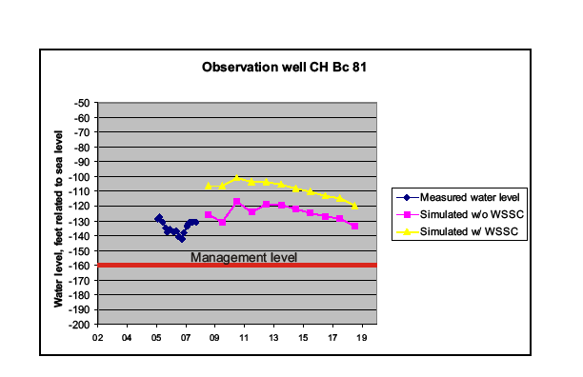
Supplement our water system with alternatives to groundwater
Why is this important?

Slide 17
Supplement our water system with alternatives to groundwater
Implementation Measures & Strategies
Existing 1.4 MGD from WSSC
Potential for 5.0 MGD from WSSC
Alternative Source Study to include:
    Surface Water Treatment Plant (possible desalinization.)
    Water Re-use
    Aquifer Storage and Recharge

Slide 18
Water Conservation Program
Water Billing - Tiered Rate Structure:
County has put in place a graduated rate structure
  Encourages conservation
  Higher rates for heavy users
  Eliminate requests for sub-meters
  Will continue operational & capital costs
  Must achieve financial balance

Slide 19
Summary
Charles County has a good foundation and plan for the future of water resources.
Strategies
Continue to Monitor Groundwater Levels
Minimize drawdown in Magothy & Patapsco aquifers
Utilize Down-dip Area
Manage groundwater pumping
Expand Water Re-Use/Build Closed Loop System
Supplement water systems with alternatives to groundwater
Water Conservation Program

Slide 20
Thank You
Send Questions/Comments to:
Jason Groth
Charles County Planning & Growth Management
301-396-5814
grothj@charlescounty.org

Slide 21
Water Conservation
If one person shortens their shower by 2 minutes, up to 430 gallons per month can be saved.
If you stop running water while brushing your teeth, you can save about 90 gallons per month.
If everyone in the County did these two things, we’d save 77 Mil. Gallons/Month or 2.56 MGD

Slide 22
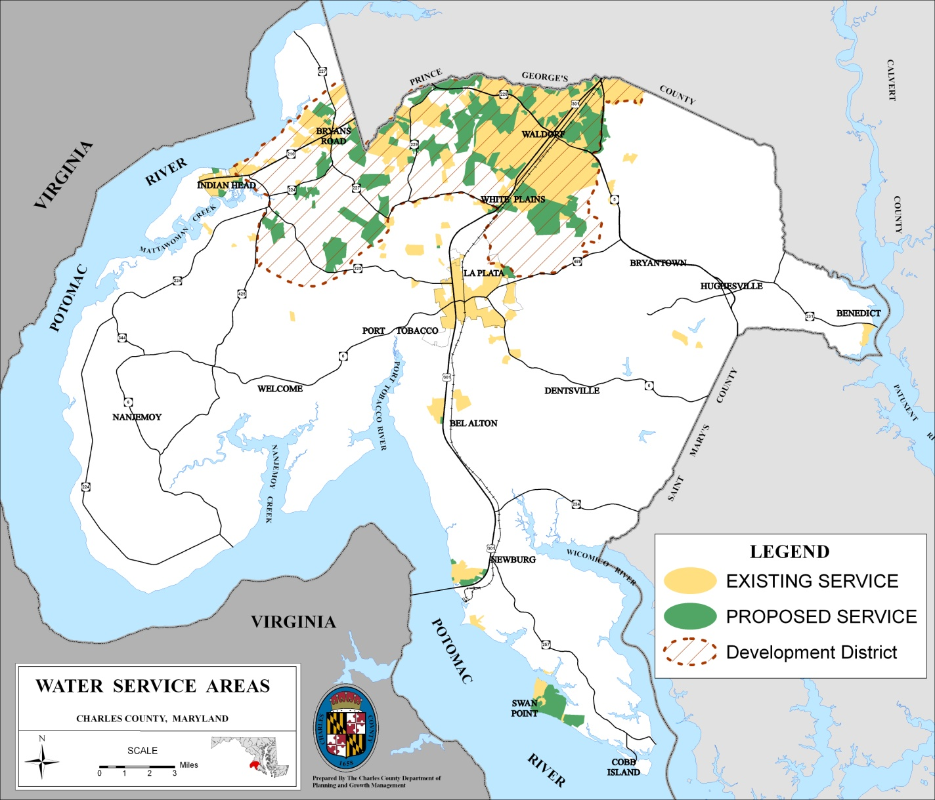
Overview
Water Service Area Map

