Slide 1
RHCC Overview
Collaboration
Updated 02.09.2026

Slide 2
Objectives
  Understand the mission and responsibilities of the Northern Virginia Regional Healthcare Coordination Center (RHCC)
  Review Partner Organization
  Understand RHCC Activation Triggers

Slide 3
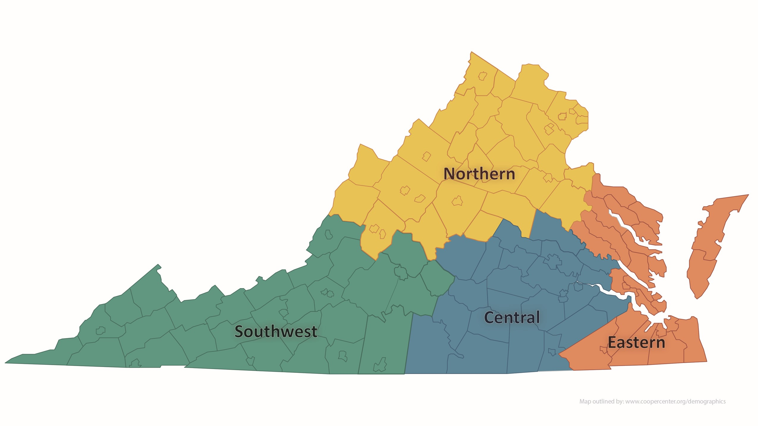
Healthcare Regions

Slide 4
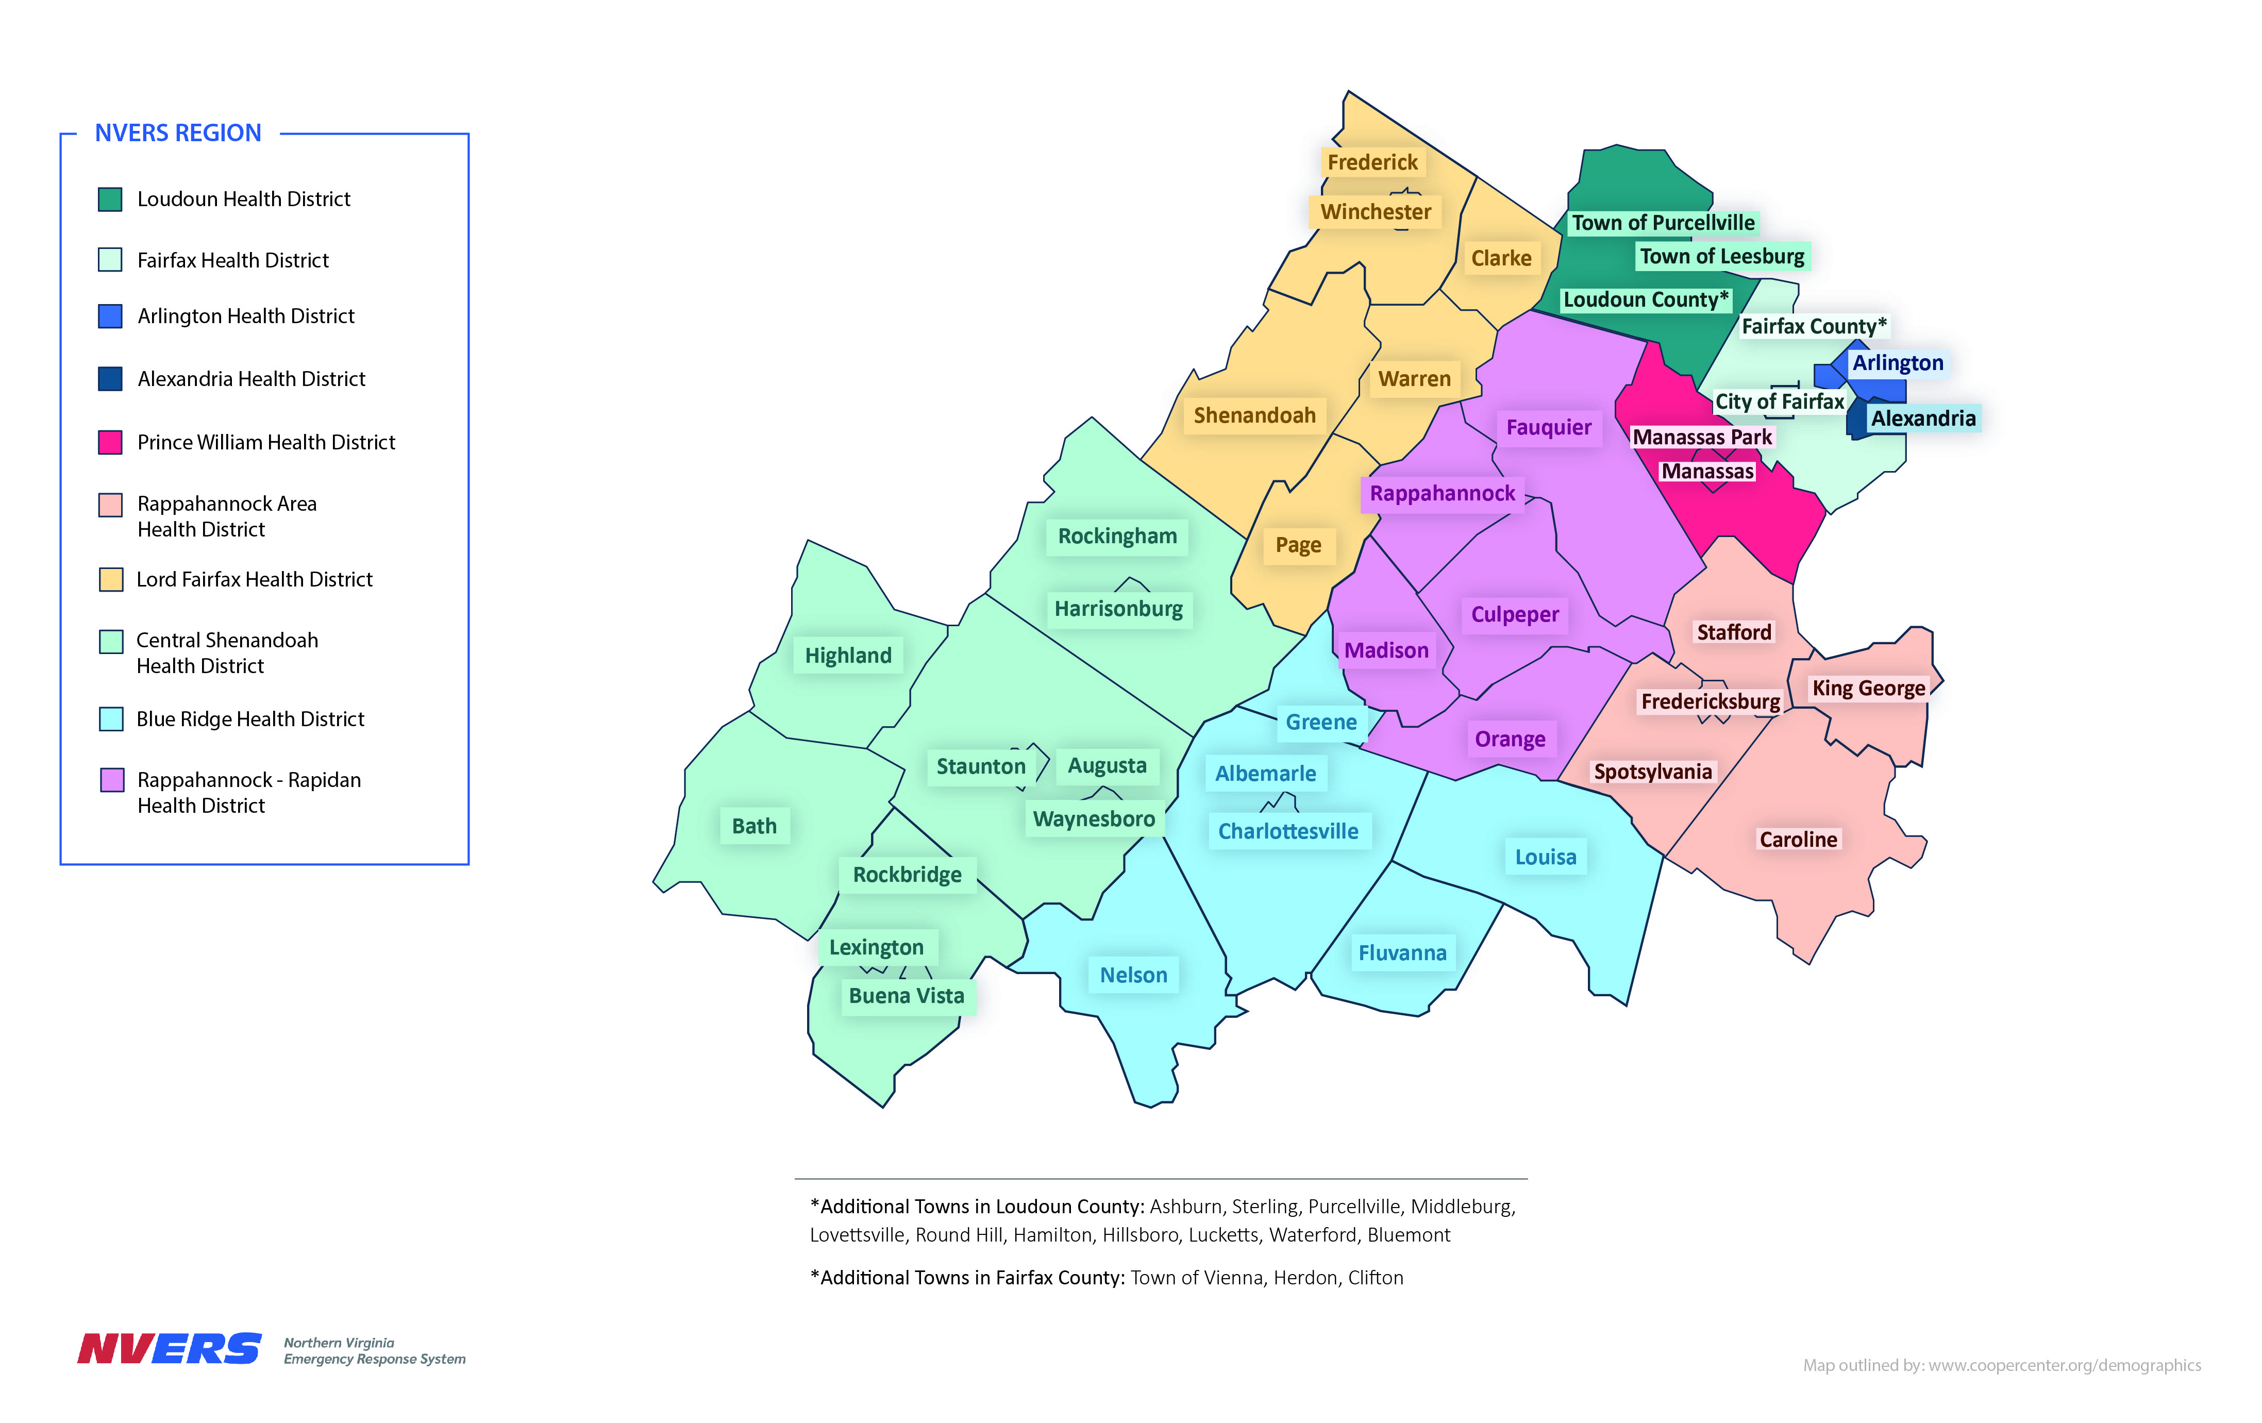
Expanded Region

Slide 5
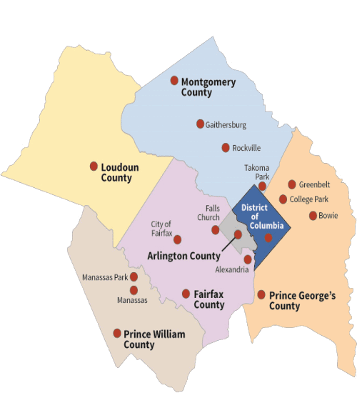
National Capital Region
Maryland
  Maryland Institute for Emergency Medical Services Systems (MIEMSS) / Emergency Medical Resource Center (EMRC)
DC
  District of Columbia Department of Health (DC DOH) / Homeland Security and Emergency Management Agency (HSEMA) / Coalition Notification Center (CNC)

Slide 6
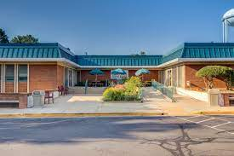
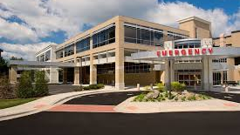
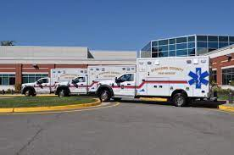
Member and Partner Overview
Coalition Forum
  Hospitals (32)
  Free-Standing Emergency Departments (10)
  Public Health (10 Local Districts, 2 State Regions)
  Emergency Management (40 Local, 2 Regional Offices)
  EMS (5 EMS Council Regions)
  Skilled Nursing Facilities (86)
  Dialysis Providers (72)
  Home Health Agencies (~100)
  Intermediate Care Facilities (ICF/ID) (16)
  Inpatient Mental Health Providers (12)
The Steering Committee is a multi-disciplinary body of emergency response leaders in Northern Virginia tasked with advising the NVERS Board of Directors on regional priorities and capability gaps.
5
Notes:
These numbers reflect the expansion of NVERS effective July 1, 2023.
NVERS encompasses not only the traditional core coalition disciplines, but additional

Slide 7
Regional Healthcare Coordination Center
(RHCC)
Each of the four regions has an RHCC
The RHCC is a function, not just a place. It is a Multi-Agency Coordinating Center responsible for ensuring the response activities of healthcare facilities in Northern Virginia in a uniform and Coordinated manner through the activation of the Northern Virginia Regional Healthcare Emergency Operations Plan (RHEOP)
  Implementing strategies for managing patient surge
  Coordinating with other NCR and Statewide response agencies and healthcare facilities
  Managing and Coordination of Resources
  Information Sharing

Slide 8
Northern RHCC
Unlike other regions, Northern RHCC works directly with EMS on scene for:
  Early Hospital Notification
  Distribution of Patients
    Based on hospital capability
  Resources
  Patient Tracking
  Family Reunification
  Healthcare System Awareness

Slide 9
RHCC Activation Triggers
Facility Initiated:
Activation of Facility Emergency Operations Plan
Expected volume of patients to exceed capabilities
Mutual Aid request (equipment, supplies, or staff)
Facility Evacuation
EMS/PH/EM Initiated:
10+ patients requiring transporting
3+ Hospitals to receive patients
HAZMAT event with 3+ patients decontaminated in the field by EMS
Category A biological event
Mass Casualty Unit activated for an NCR event
EOC activated Public Health & Medical Services (ESF 8) function

Slide 10
Activation
Notification to the RHCC should include the most basic information on the incident that is known at the time:
  Location
  Type of event (vehicle crash; explosion; major fire; shooting; etc)
  Numbers and types patients (even if just estimates)
  Phone # or radio channel to be used for ongoing communications
For EMS related calls ; The RHCC will provide;
  The five (5) closest hospital/FSED’s, to include two (2) Trauma Centers immediately;
  then all NVERS hospitals within 10 minutes.

Slide 11
Information Sharing / Coordinating with NCR and Statewide Partners
Notify Hospitals for EMS Events
Notify Local Public Health On-Call Duty Officer
  Create “RHCC Incident Notification Form”
    Alerts statewide partners, Virginia Hospital & Healthcare Association (VHHA), State Hospital Coordinator (VDH), Regional Emergency Coordinator (VDH), NCR Partners
      Provides detailed incident information and is updated throughout event
Create Virginia Healthcare Alerting and Status System (VHASS) Event
  Allows for simultaneous statewide updates and communication hub
Send VHASS Alert to all partners
  ALL registered users in VHASS with alerting privileges

Slide 12
Managing Patient Surge
VHASS Facility Status Boards and Event Log
  Update available beds
    Allows EMS to transport to “appropriate” facility
    Inpatient data reflects surge availability
  Communicate facility impacts
    Event logs allow transparency on needs or solutions to events
  Track healthcare system impacts
    At a glance visualization of impacts across the state
  Track patients
    Starts in the field, continues through hospitals and partnership with public health 211

Slide 13
RHCC Resources
Medical Supply Caches
Ventilators
Access to other hospitals outside of NoVA
Access to clinical support
Portable Morgue, Decedent care
Body Bags (including biologically sealed)
NVERS PPE, Rx caches and EMS/Hospital decontamination systems
Many, many other types of resources

Slide 14
RHCC Contact Information
888-987-7422 (24/7)
    (Backup iPhone, 571-567-6774
rhcc@nvers.org
RHCC Manager
  chris.cook@nvers.org
  703-798-2625
800 MHz NCR

Slide 15
Questions?
chris.cook@nvers.org

