Slide 1
A brief introduction to the
TPB
Regional Transportation Data Clearinghouse
Charlene Howard, GISP
COG GIS Committee
8 July 2014

Slide 2
Presentation outline
What is the Clearinghouse (RTDC)?
Main components of the Clearinghouse
Recent functional enhancements
Highlights: selected data layers (new and updated)
  Annualized/Hourly Traffic Volumes
  Vehicle Classification
  INRIX data
  Average Weekday Transit Ridership
  Central Employment Core Cordon Count
  WMATA: Metrorail Passenger Survey & other data
Demonstration of the RTDC
Looking ahead

Slide 3
What is the RTDC?
Overall, it is a collection of transportation-related data
  Includes our own datasets & data collected from member agencies & assembled by us
  Additional Esri base maps for reference
RTDC first released over a decade ago as an ArcView 3.2 project
  Over the years, focus has shifted toward building a comprehensive regional database of traffic counts tied to the TPB master network
  Expanded to include transit-related count data & other datasets
Currently available as a desktop web map application using the ArcGIS Viewer for Flex (version 3.6)
  Member jurisdiction and agency staff needed an easier way to access our datasets than what has traditionally been delivered to them
  Provides users with a more interactive experience

Slide 4

What is the RTDC? continued
A web-based transportation data viewer
Regional Transportation Data Clearinghouse
Planning-related data (Cooperative Forecast, Activity Centers)
Robust database of regional traffic counts & volumes
Additional transportation datasets (transit, aviation)
Data from partners & jurisdictions
Tools for data display, query & analysis
Data Download

Slide 5
Main components of the RTDC
Widgets- the tools that provide application functionality
The RTDC includes both OOTB and custom 3rd party widgets
Emphasis on trying to be as OOTB as possible
  Advanced Query- show related data tables *
  Query (‘select by attribute’) *
  Download Data
  Documents (User’s Guide)
  Cordon Count resources
  WMATA datasets
  Bike Data
  General application & navigation
Available data layers
  Highway network (traffic related)
    Annualized Annual Volumes
    Hourly Traffic Counts
    Classification Counts
  Transit Routes- Average Ridership
  Central Employment Core Cordon Count
  2011 Regional Air Passenger Survey
  2012 Metrorail Passenger Survey
  Metrorail Stations & Lines
  Cooperative Forecast by TAZ
  Version 2.3 Screenlines, Regional Core
  2013 Regional Activity Centers
  Regional Boundaries
  Bike: jurisdictional & Capital Bikeshare

Slide 6
Data enhancements to the RTDC
Updates to current data layers
  Hourly Traffic Counts
  Annualized Traffic Volumes
  Average Weekday Transit Ridership
  Regional Activity Centers
  Cooperative Forecast
  Metrorail: stations & lines
New data layers added to the RTDC
  External Station Traffic Volumes
  2012 Vehicle Classification Counts
  Central Employment Core Cordon Count
    Vehicle Counts by Mode
    HOV/SOV Counts
    Passenger Counts by Mode
  2011 Regional Air Passenger Survey
  Regional Core area polygon
** Coming soon **
Aggregated INRIX speed data
** Data obtained from partners**
- WMATA datasets
- Bicycle-related data

Slide 7
Recent functional enhancements
Related records
  Ability to view related records in the popup menus & attribute table window
  3rd party widgets allow export of related tables (OOTB does not)
  Hourly & Classification Counts, Cooperative Forecast, Metrorail Passenger Survey
Using GDB attachments
  PDF reports highlighting selected data for select RTDC data layers
  Reports created in Excel; converted to PDF
  2012 Metrorail Passenger Survey; Central Employment Core Cordon Count
Data Layer tools- a different way to view data
  Specialized ‘tools’ for interacting with certain RTDC data layers
  Query & Layer List widgets used as menu items
  A simple way to highlight data without creating custom tools

Slide 8
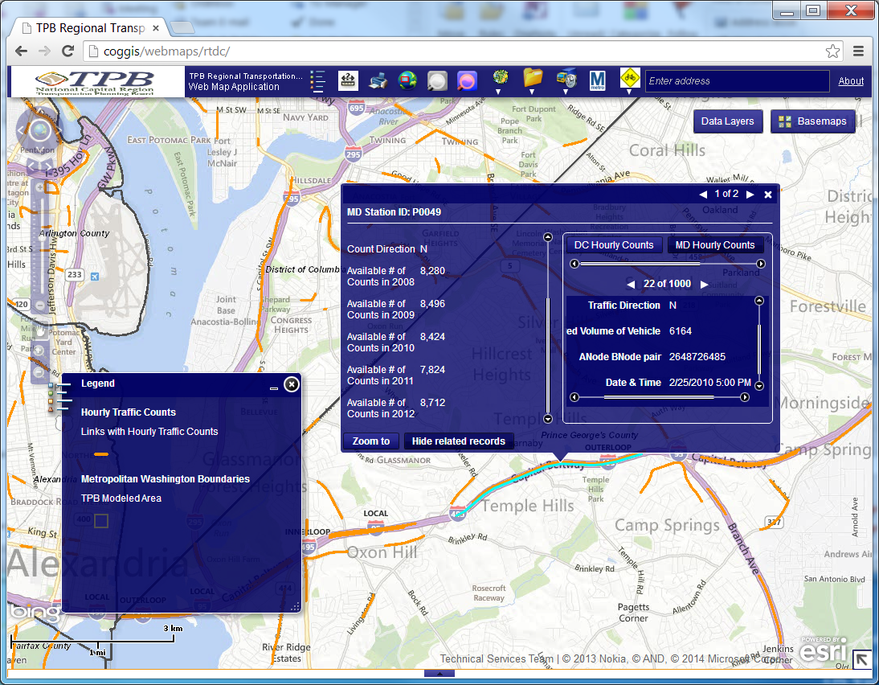
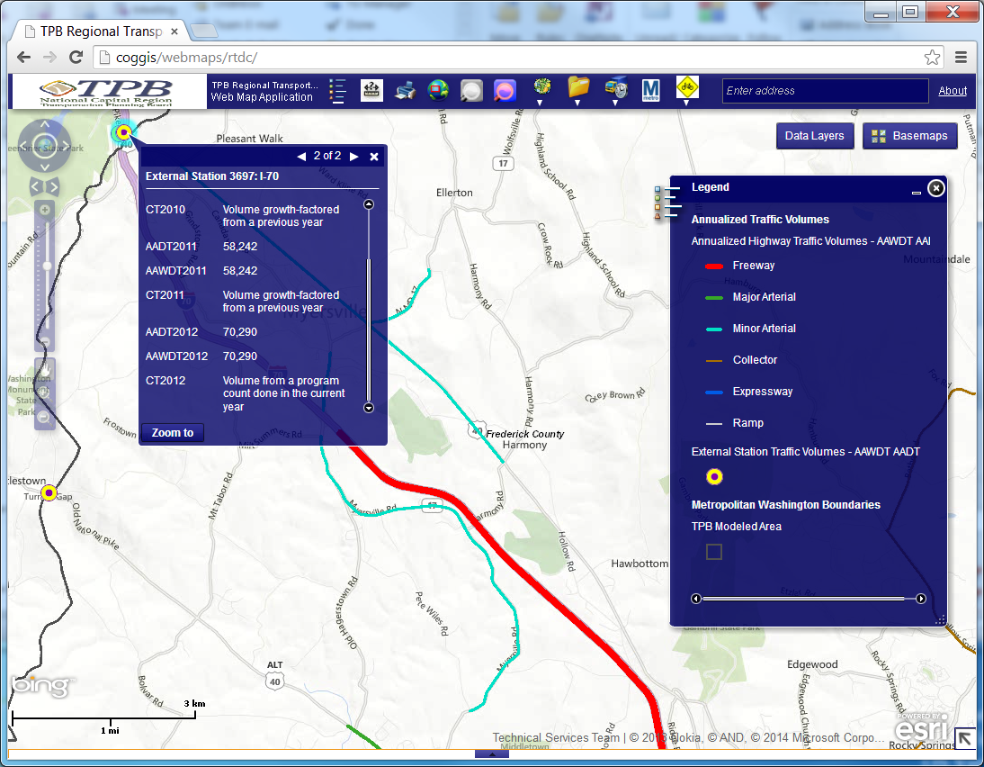
Annualized & Hourly Traffic Volumes
updated & new to the RTDC
Annual Volumes for links and External Stations
  Updated station to link matching for split links
  Updated Annualized Traffic Volumes layer to include 2006-2012 data
  Updated Hourly Traffic Counts layer to include 2008-2012 data
  Added AADT and AAWDT for 2010-2012 at External Stations

Slide 9
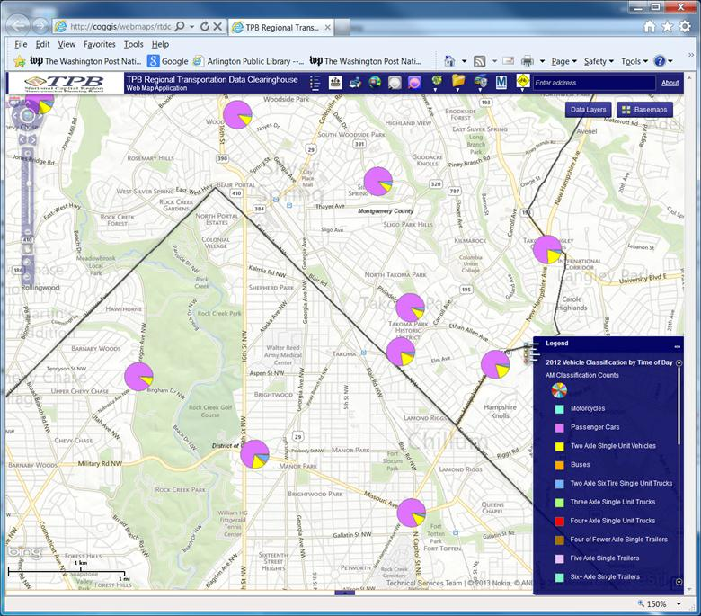
2012 Vehicle Classification Counts
New to the RTDC
2012 Vehicle Classification related to network links
  Pie charts showing time-of day vehicle classification
  Pop-up hourly vehicle classification values
  Query of vehicle classification data
  (coming soon)
  File download of hourly 2012 state vehicle classification data with related network link (coming soon)

Slide 10
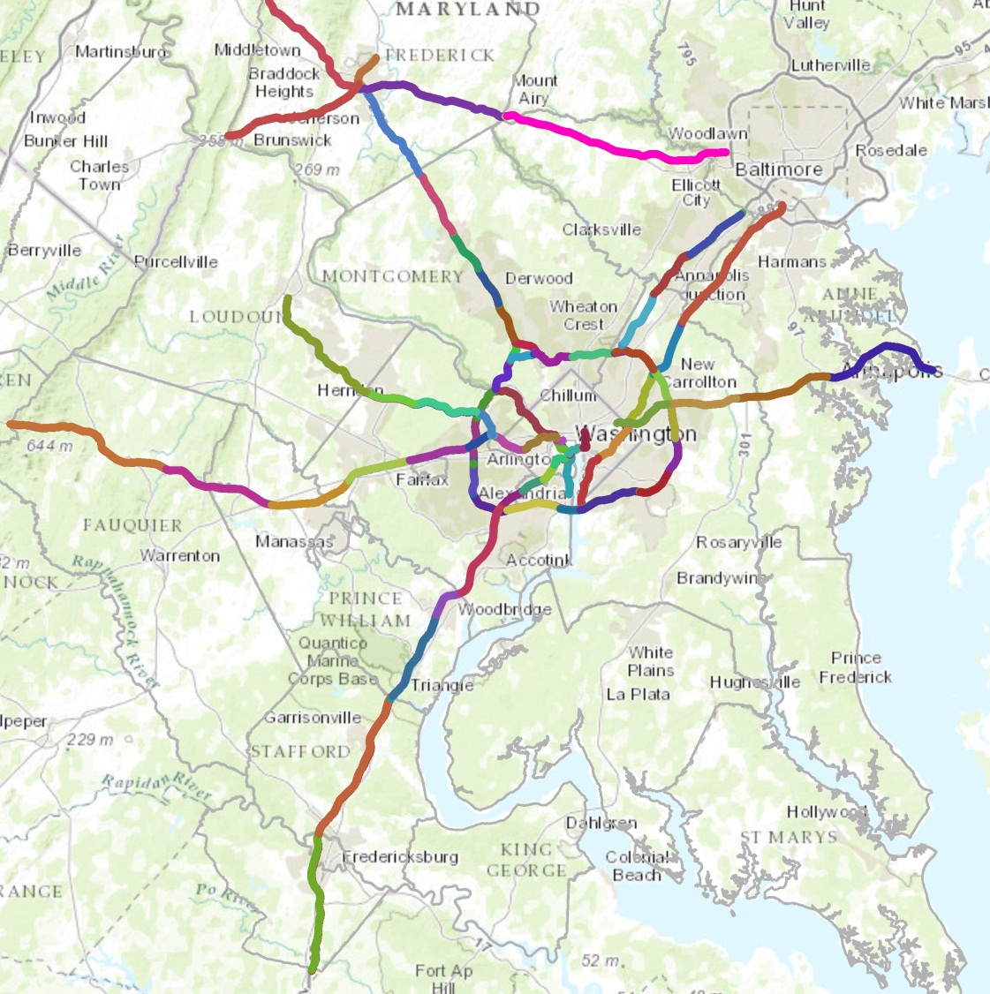
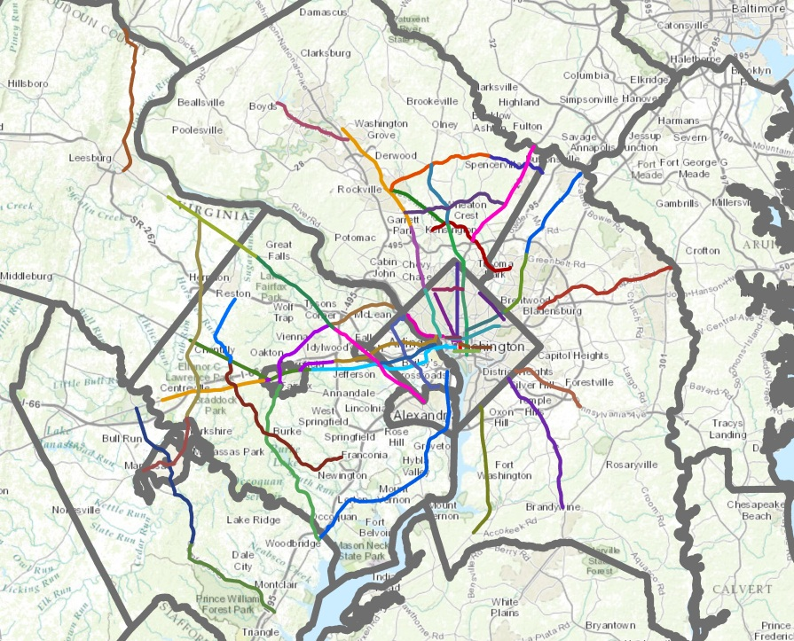
Coming Soon – INRIX Data
New to the RTDC
INRIX Speed Data – Aggregated temporally and spatially
  Aggregated Freeway and Arterial corridors
  Speed Data aggregation
  30 minute intervals non-holiday Tu/We/Th
  60 minute intervals weekends
            By month
    2010 -2012

Slide 11
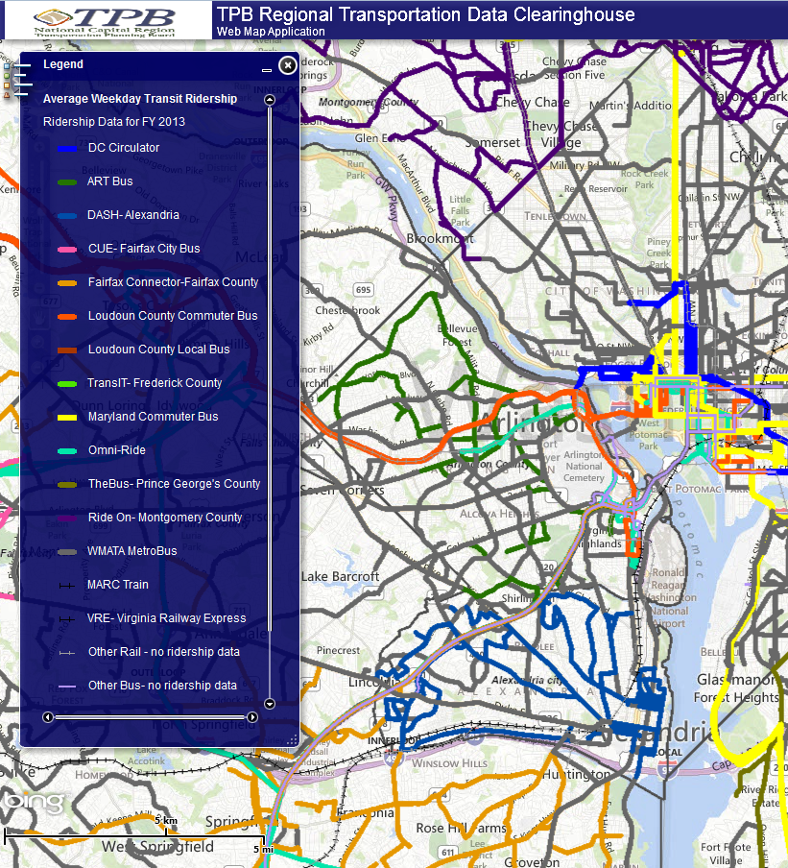
Average Weekday Transit Ridership
Updated
New & existing transit ridership data joined to the 2013 year TPB regional transit network.
  Average weekday ridership by month for FY13
  New data fields for provider route name & notes
  Continuing to expand data collection, added Loudoun County Local Bus

Slide 12
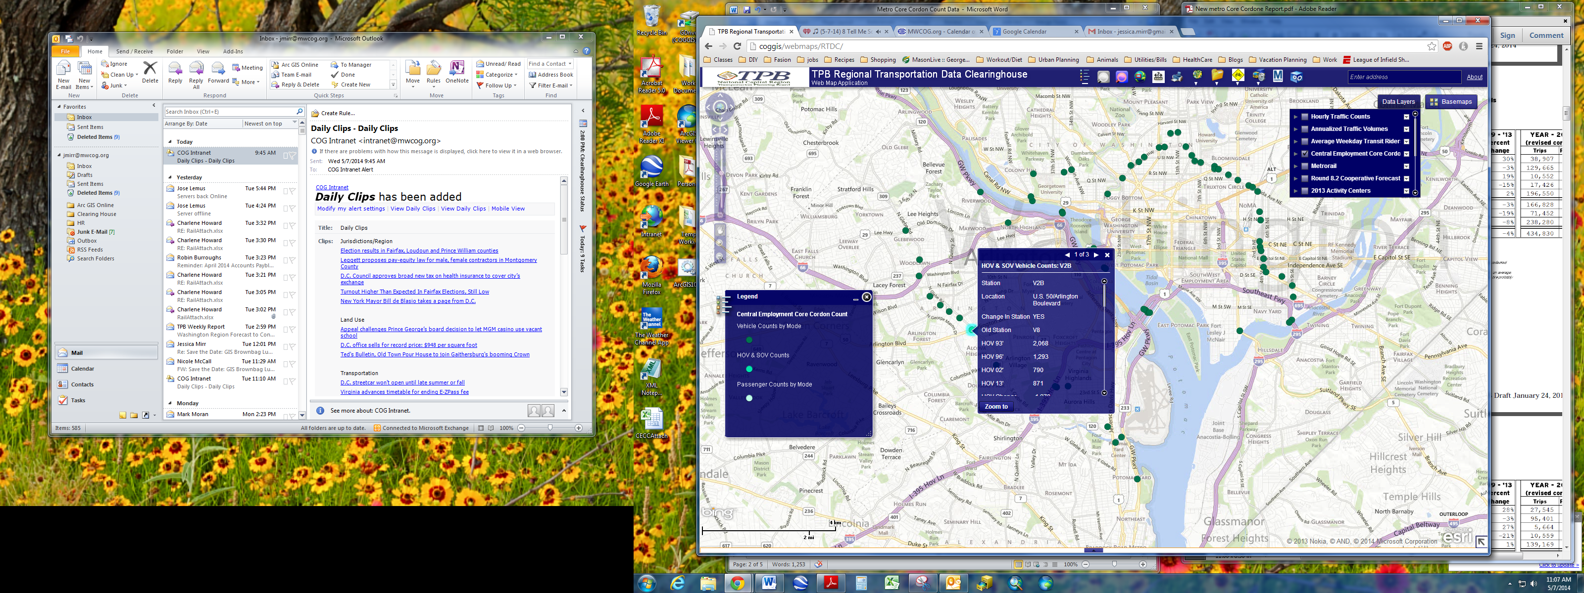
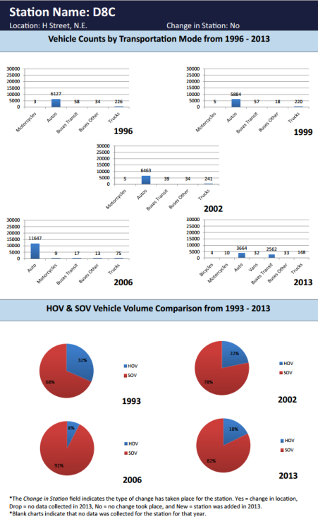
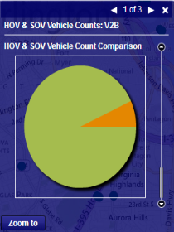
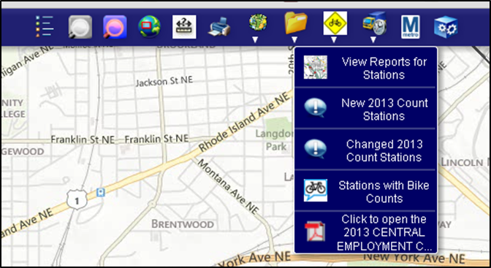
Central Employment Core Cordon Count
New to the RTDC
  CECC Station locations containing AM peak period data for years ‘93,’96, ‘99, ‘02, ‘06, and ‘13
Layers displayed by data type
  Vehicle Counts by Transportation Mode
  HOV/SOV Counts
  Passenger Counts by Transportation Mode
The CECC Data Layer tool displays stations with bike counts, new and changed count stations, and Station Count reports.
HOV & SOV Comparison Chart
Station Count Report
Data Layer Tool

Slide 13
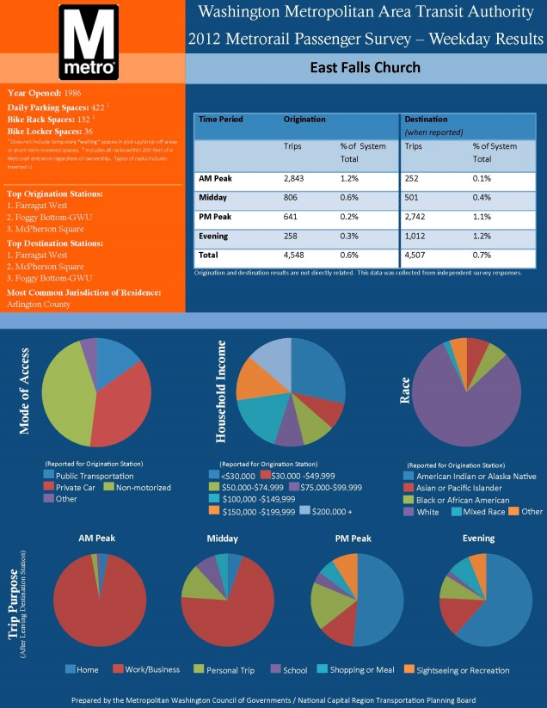
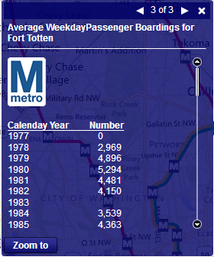
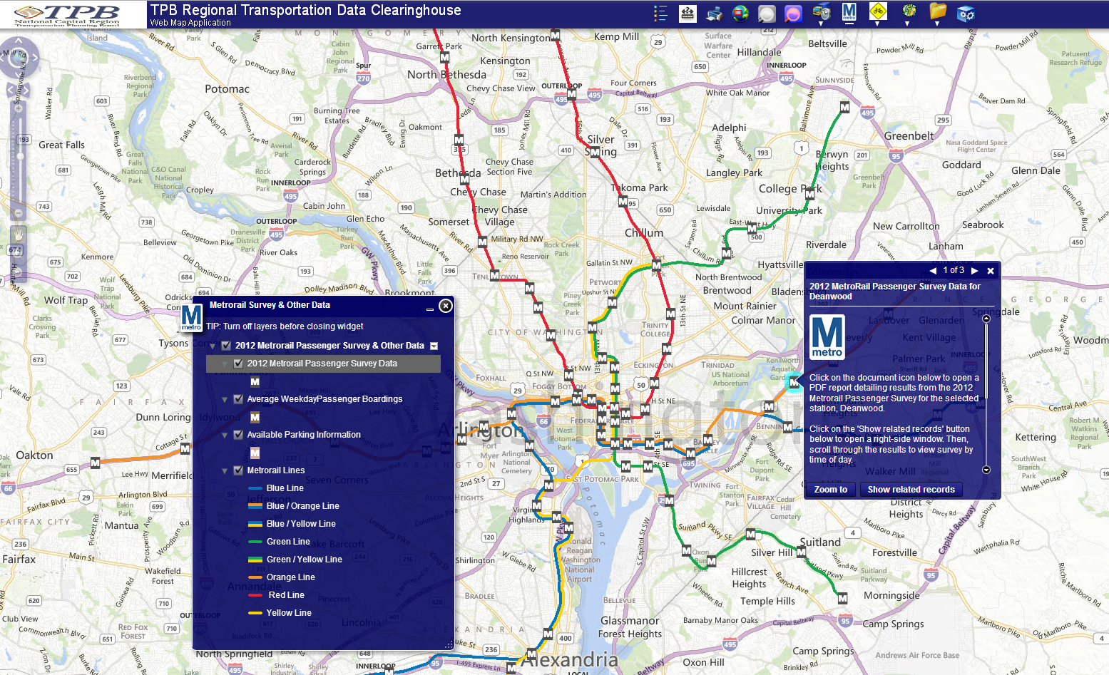
Metrorail Survey & Other Data
New to the RTDC
Datasets were obtained from WMATA to be used in the RTDC and are accessible through a custom Data Layer tool
Average weekday passenger boardings by year
Station Amenities- Parking spaces, bike rack spaces, and bike locker spaces
2012 Metrorail Passenger
Survey Weekday Results
  Household income, race,
  mode of access, trip
  purpose, origination and
  destination stations
  Summary report
  for each station (PDF)

Slide 14
Demonstration
https://gis.mwcog.org/webmaps/RTDC

Slide 15
Looking ahead
Shorter term
  Inclusion of ‘coming soon’ data layers
    Aggregated INRIX speed data
    Classification counts – Query & data download
  RTDC efforts will go into ‘maintenance mode’ to address any data inconsistencies, application bugs, etc.
  Acquire additional bicycle data layers
  Integrate user suggestions
Longer term
  Data: additional datasets- what can we add to the RTDC?
  Data: update RTDC layers on an ‘as-available’ basis
  Application: additional ways to access / view data
  Application: ArcGIS Online maps of RTDC datasets
Your suggestions for data & application enhancements are appreciated & encouraged!

Slide 16
The RTDC team
John Kent
Martha Kile
Nicole McCall
Jessica Mirr
Charlene Howard

Slide 17
For more questions, please contact
Charlene Howard
Principal GIS Analyst
202/ 962.3384
charlene@mwcog.org
https://gis.mwcog.org/webmaps/rtdc

