Slide 1
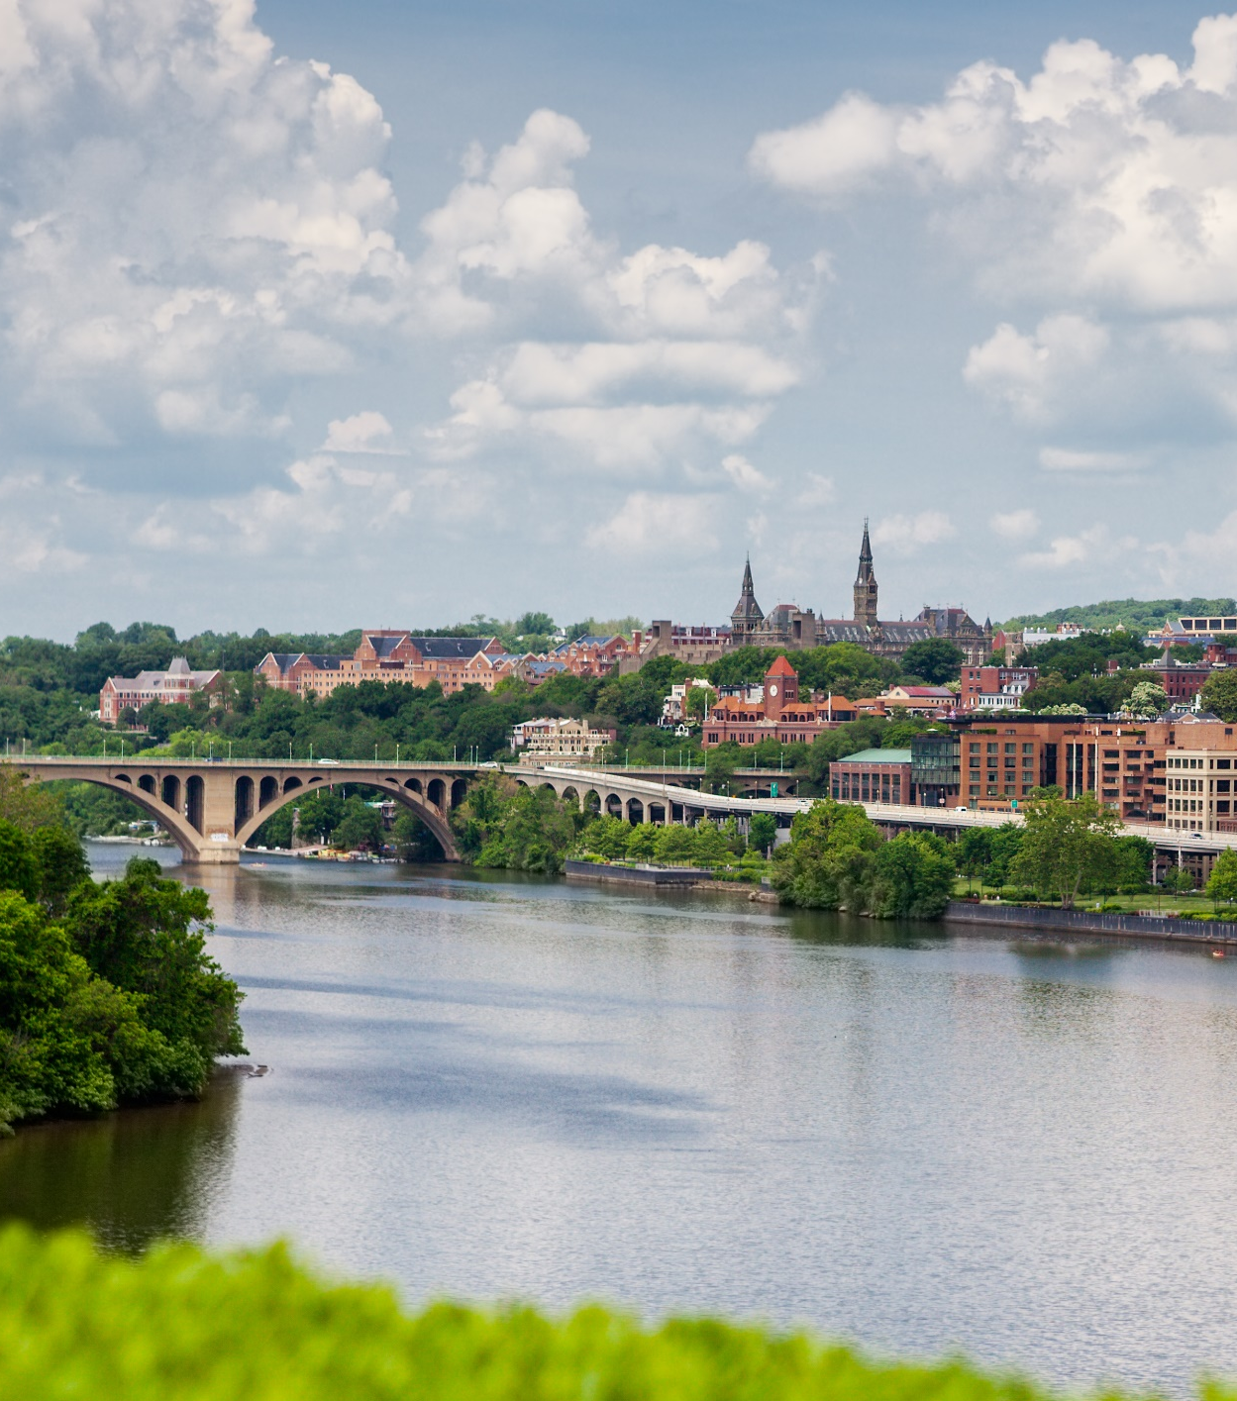
FY’26 Regional Water quality management work program and budget
Caitlin Bolton Environmental Planner Chesapeake Bay Policy Committee 3/21/25
Notes:
Good morning, everyone. I have a brief presentation with about six slides to cover our Regional Water Quality Management Work Program and Budget. This should go quickly, as you’ve already received the full document by email, along with a one-page summary.

Slide 2
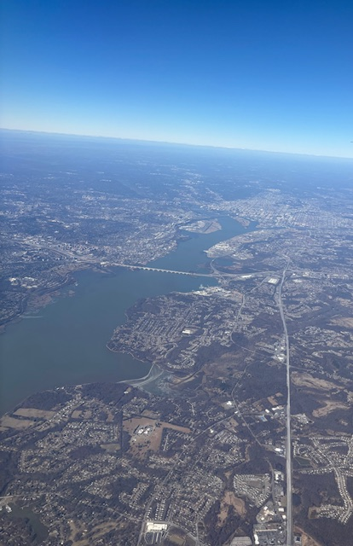
Program Overview
This program addresses regional water resources:
  Supporting wastewater treatment and improving surface and groundwater quality.
  Ensuring an adequate supply and protection of drinking water sources.
  Coordinating regional efforts to protect local water quality, including the Potomac and Anacostia Rivers and the Chesapeake Bay.
  Advocating for water infrastructure support.
  Promoting preservation of and improvements to stormwater management and green infrastructure.
Notes:
This program focuses on regional water quality, stormwater management, watershed restoration, water security, and supply issues that impact COG member jurisdictions, as well as local drinking water and wastewater utilities. Our goals include:
Improving surface water and groundwater quality
Protecting drinking water sources
Coordinating regional efforts to safeguard the Potomac, Chesapeake Bay, and Anacostia rivers
Advocating for infrastructure support and policy improvements
The program is supported by the Regional Water Fund and is overseen by both the Chesapeake Bay and Water Resources Policy Committee (CBPC) and the Blue Plains IMA Leadership Committee.

Slide 3
Key Initiatives
Dialogue and Policy: Engage with the EPA, states, and stakeholders on the Chesapeake Bay Program to support local issues.
Partnerships: Foster partnerships to leverage resources and address technical, policy, workforce development, and economic issues.
Emerging Issues: Address emerging issues like PFAS regulation, freshwater salinization, regional water supply redundancy, and variability in weather patterns.
Chesapeake Bay Program Advocacy: Advocate for COG’s members and provide local perspectives on issues such as Phase III WIP Implementation, the Bay Program Model, and relevant workgroups.
Communications: Represent the COG region and support COG Board initiatives by addressing pollution control efforts, challenges in wastewater and stormwater management, water infrastructure and workforce development, as well as the impacts of extreme weather.
Notes:
Through the Water quality and Management Work program:
We collaborate with key stakeholders such as the EPA, Chesapeake Bay Program, local elected officials, and utility partners to shape regional water policy.
We monitor issues like PFAS contamination and drought and advocate for COG’s members within the Chesapeake Bay Program (CBP).
We represent local perspectives on major initiatives such as the Bay TMDL, Phase III WIP implementation, and workgroups within the CBP.
And we support COG Board initiatives through Communications on by addressing pollution control efforts, challenges in wastewater and stormwater management, water infrastructure and workforce development, and resilience planning for extreme weather events.

Slide 4
FY’25 Accomplishments
Represented the region’s technical and policy interests to the Chesapeake Bay Program and advocated for regional water priorities and provided a voice for local perspectives on important issues.
Received funding for a NOAA Marine Debris Removal Program project. Implementation is beginning to remove abandoned derelict vessels and large debris from the Anacostia River and the Lower Beaverdam Creek Tributary.
Worked with a coalition of water utilities and other partners in the region to begin implementing a U.S. Army Corps of Engineers feasibility study of the region’s water supply.
Supported the Blue Plains IMA Parties by facilitating the revisions of the operations and maintenance cost allocation processes and the corresponding documentation for the 2012 IMA.
Notes:
Just a couple of things to point out for FY25 in terms of accomplishments. You should all be familiar with the first bullet. As always, we continue to advocate for local priorities within the Chesapeake Bay Program, ensuring that our member jurisdictions have a strong voice.
Last year, we secured about $1 million in NOAA funding for a four-year project to remove large debris and abandoned boats from the Anacostia River and Lower Beaverdam Creek. We are now about halfway through year one. This is a very exciting project and we’ve gotten a lot of good press so far.
Next, we have a three-year water supply study that is officially underway now. The committee heard about this topic in a presentation last month. We have already put in a lot of effort to secure the funding and have gone through a lot of pre-planning for the study. A lot of coordination with partners such as the Army Corps of Engineers, DC Water, WSSC Water, and Fairfax Water has already taken place.
Finally, we also supported the Blue Plains Intermunicipal Agreement (IMA) which is a s a collaborative initiative focused on managing wastewater treatment services provided by the Blue Plains facility.

Slide 5
FY’26 Focus Areas
Serve as the local voice in the Chesapeake Bay Program “Beyond 2025” process, advocating for regional priorities and the use of sound science in the development of policy recommendations and restoration priorities for meeting the goals and outcomes of the Chesapeake Bay Watershed Agreement beyond 2025.
Continue working with a coalition of water utilities and other partners in the region to implement a U.S. Army Corps of Engineers feasibility study of the region’s water supply, including the identification of a secondary water source and additional water storage capability for the metropolitan Washington region.
Continuation of PFAS monitoring in the Potomac River watershed, building on Water Research Foundation Project 5269, as well as other PFAS related research.
Continue to provide technical and administrative support to the Blue Plains users. This will include updating elements of the 2012 IMA Operating Agreements.
Notes:
Looking forward to 2026, We are actively engaging in the Bay Program’s Beyond 2025 process to ensure regional priorities are reflected in the next phase of the Chesapeake Bay Watershed Agreement. You’ll hear more about this in a later presentation today.
We’re going to continue with our regional water supply study. We recently selected a contractor through an RFP process to help identify alternative water sources in case of severe drought or contamination of the Potomac River.
We will continue to track PFAS contamination in the Potomac River through ongoing Water Research Foundation projects.
We will maintain our technical and administrative support for Blue Plains users.

Slide 6
FY’26 Regional Water Fund
Regional Water Fund (RWF) - The COG Board of Directors adopted the FY 2026 Member Dues and Regional Fees on October 9, 2024, which included $1,882,625 for the RWF. When combined with an increase in regional population, COG member dues increased by 5.0% compared with FY 2025. The RWF primarily supports work performed under the Regional Water Quality Management Program (RWQM).
Local Government Contributions to COG’s Regional Water Fund FY 2025 and FY 2026
Jurisdiction | Regional Water Fund Allocation FY2025 | Regional Water Fund Allocation FY2026
Alexandria, City of | 36,940 | 40,634
Arlington County | 51,271 | 54,186
Bowie, City of | 12,724 | 12,484
College Park, City of (WSSC Water) | 6,717 | 7,389
District of Columbia (DC Water) | 358,731 | 375,819
Fairfax County | 358,731 | 375,819
Fairfax, City of | 5,799 | 6,275
Falls Church, City of | 3,233 | 3,486
Gaithersburg, City of (WSSC Water) | 15,123 | 15,927
Greenbelt, City of (WSSC Water) | 4,985 | 5,316
Loudoun County | 95,158 | 101,052
Montgomery County (WSSC Water) | 358,731 | 375,819
Prince George’s County (WSSC Water) | 358,731 | 375,819
Prince William County | 107,465 | 113,188
Rockville, City of | 14,789 | 15,600
Takoma Park, City of (WSSC Water) | 3,817 | 3,813
TOTALS | 1,792,946 | 1,882,625
Notes:
The final slide provides a breakout of the Regional Water Fund, which you’ve likely seen before. Each October, the COG Board votes on the overall budget, including regional funds like this one.
Contributions and fees are population-based, and this year, the overall fee increased by 5% compared to FY25. The FY26 totals are actually a little lower than the estimated level that we sent around last year.
You can see the breakout here and you've got it in the document that you were provided as well.

Slide 7
Caitlin Bolton Environmental Planner cbolton@mwcog.org | mwcog.org
777 North Capitol Street NE, Suite 300 Washington, DC 20002
Notes:
So with that, I’m happy to answer questions before I ask Kenny to look for a motion to pass the Work Program and Budget.

