Slide 1
PANDEMIC TRANSPORTATION ANALYSIS
Emphasis on Labor Day 2021 and Previous Year 2019
C. Patrick Zilliacus Transportation Engineer Systems Performance, Operations and Technology Subcommittee (SPOTS) September 9, 2021
Agenda Item # 4

Slide 2
Background and introduction
This continues what staff shared with the committee in July.
Emphasis on Labor Day weekend 2021 and comparison with Labor Day weekend 2019
Probe data only – the some of the data in this presentation are from yesterday, Wednesday, September 8, 2021
Staff will be obtaining ATR count data in the coming days
Data used were derived from Inrix vehicle probe data, obtained from the Center for Advanced Transportation Technology Laboratory at the University of Maryland
Agenda Item # 4: Pandemic Transportation Analysis
September 9, 2021

Slide 3
What did staff examine?
Just one network analyzed:
  Interstates, other freeways, expressways, toll roads and federal parkways
All data are in aggregate for this network
Estimated costs of user delay computed using the CATT Lab’s User Delay Cost Analysis tool
Agenda Item # 4: Pandemic Transportation Analysis
September 9, 2021

Slide 4
Schematic view of Network
See high-level view of networks used for analysis.
In this presentation we used the Interstates, other freeways, expressways, toll roads and limited-access National Park Service Parkways
Managed reversible lanes on I-95/I-395 were excluded
Agenda Item # 4: Pandemic Transportation Analysis
September 9, 2021

Slide 5
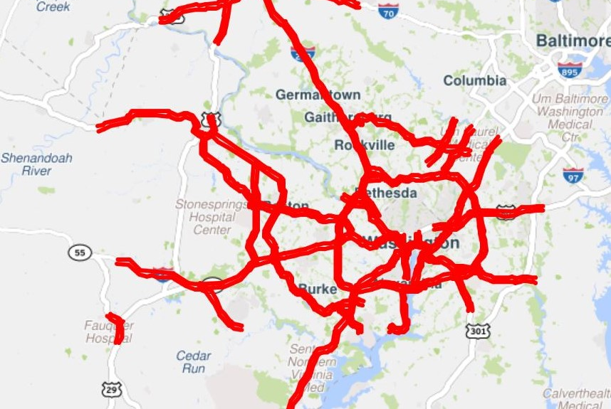

Slide 6
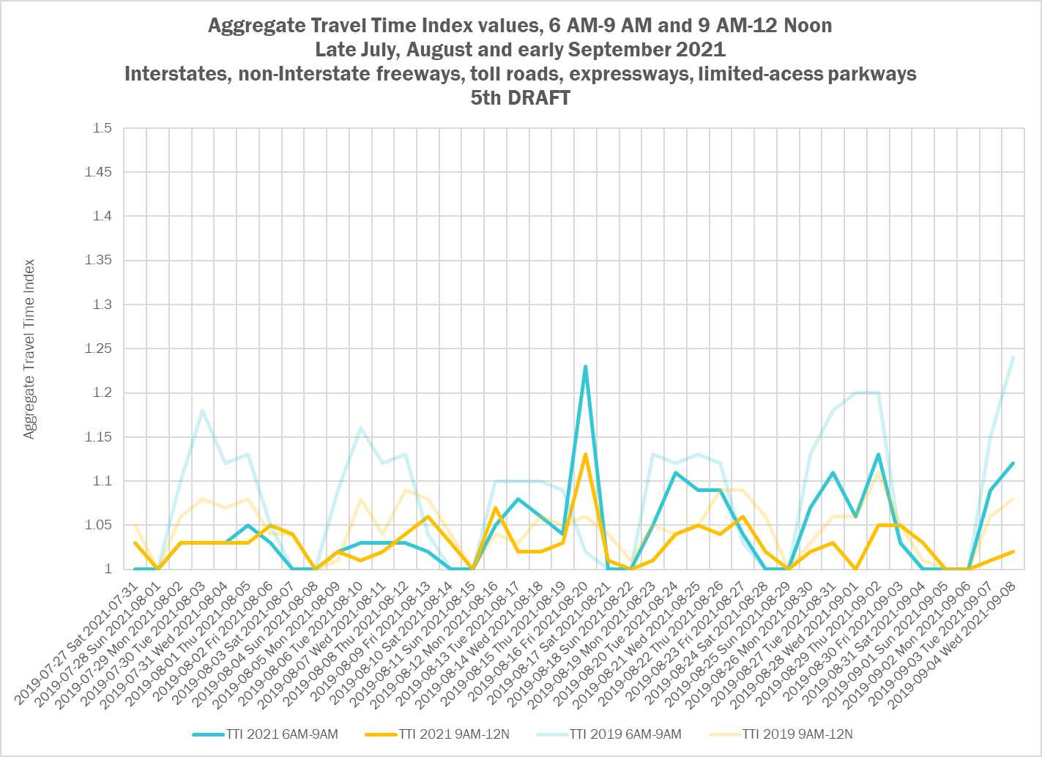

Slide 7
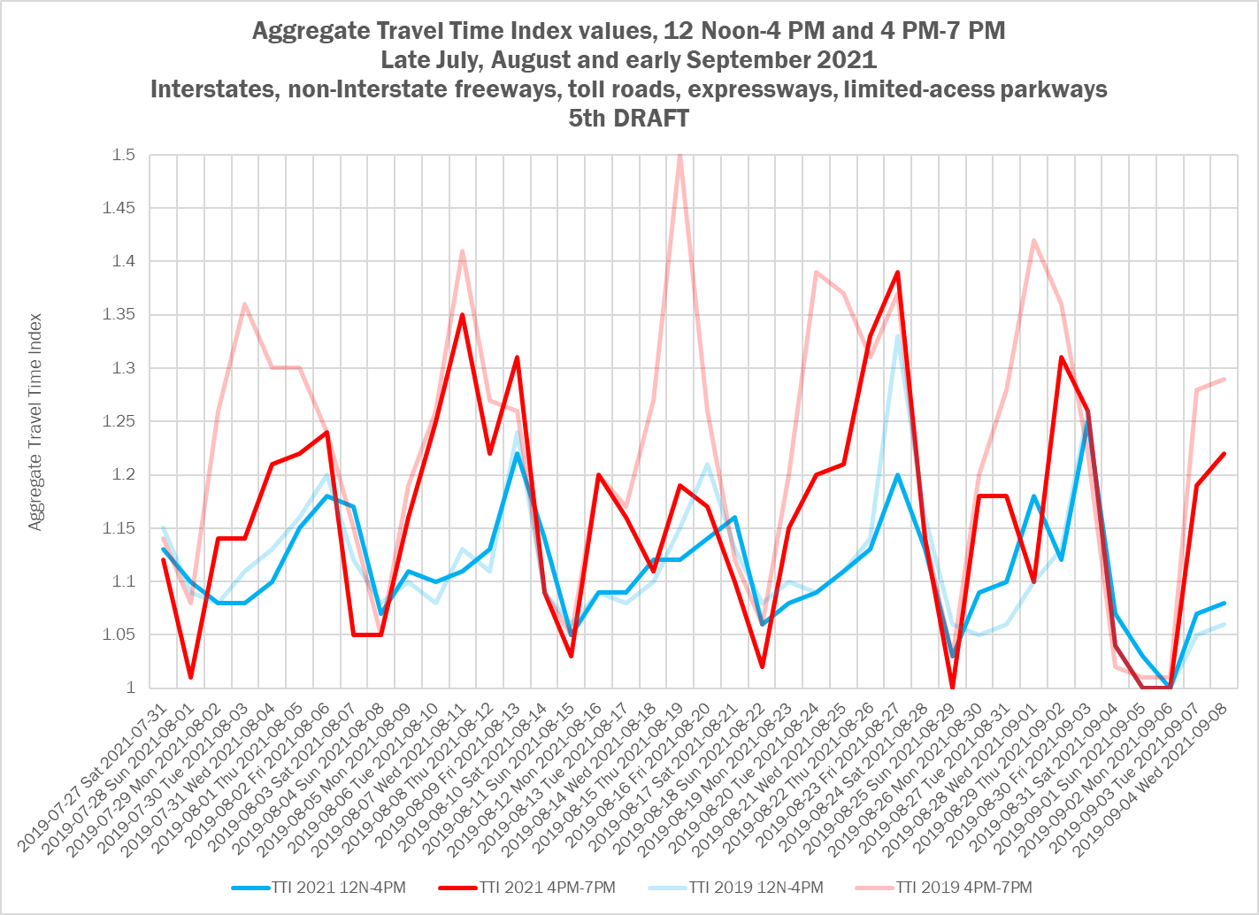

Slide 8
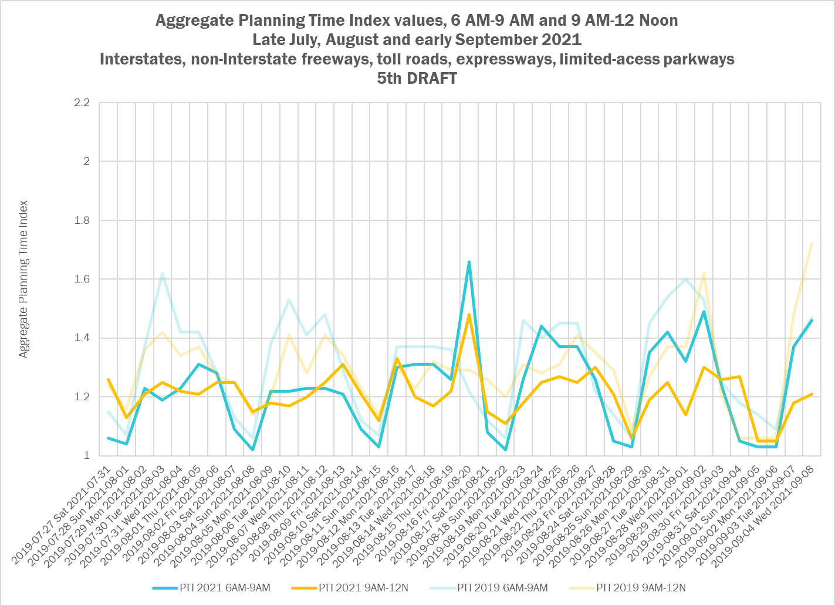

Slide 9
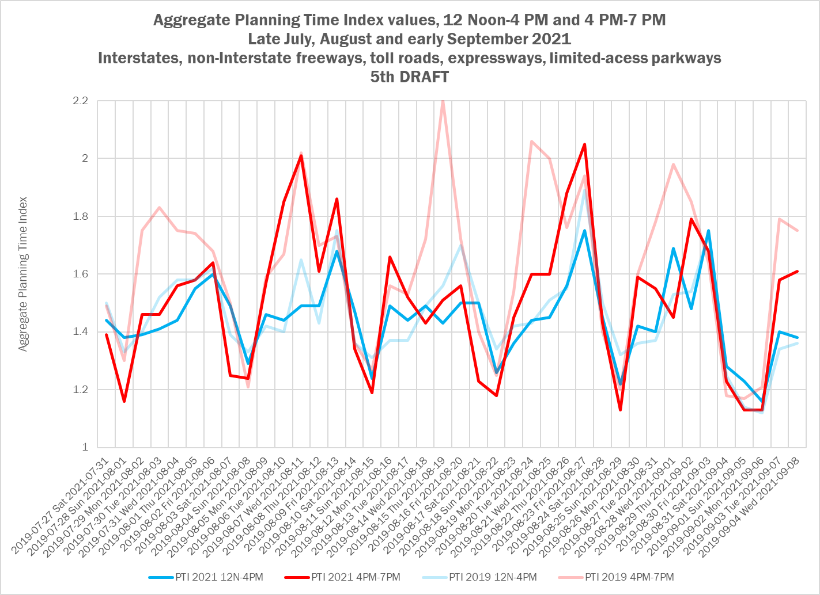

Slide 10
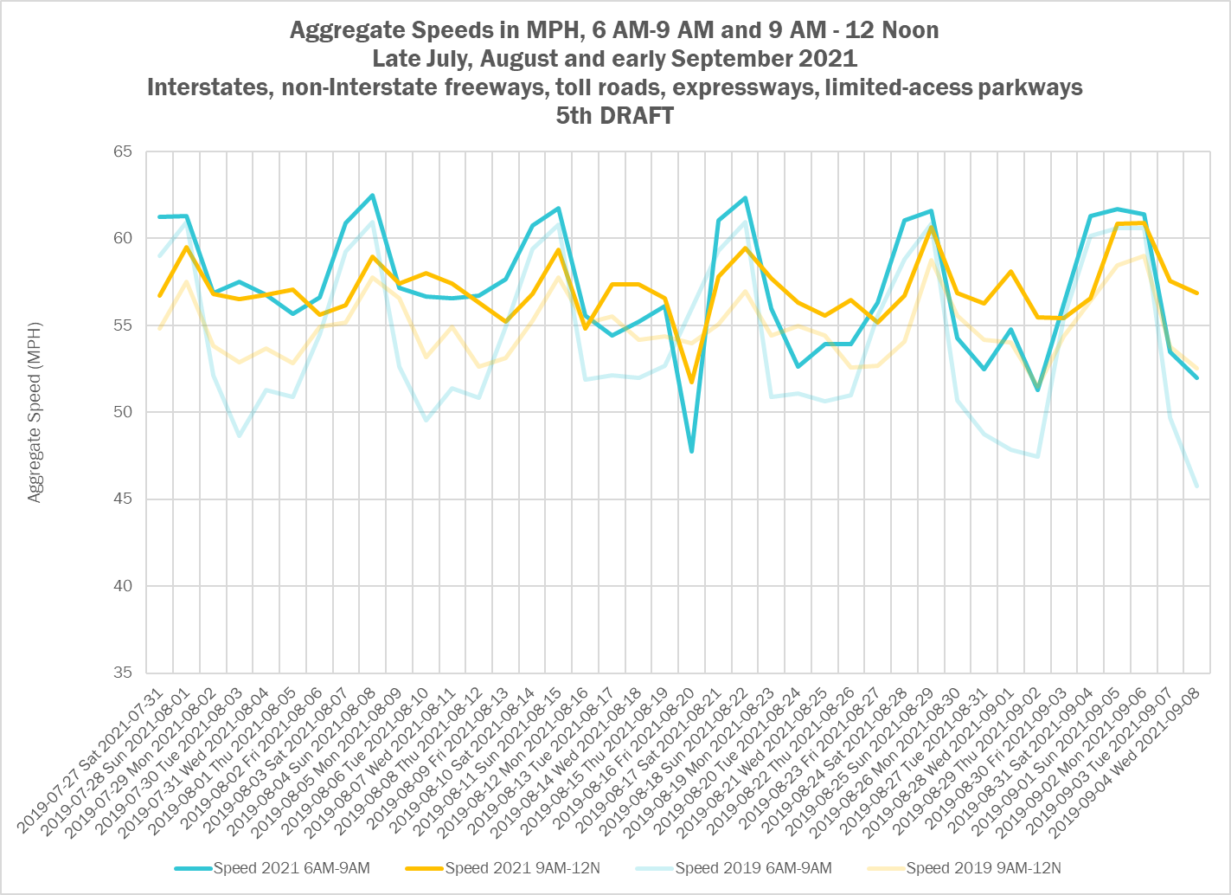

Slide 11
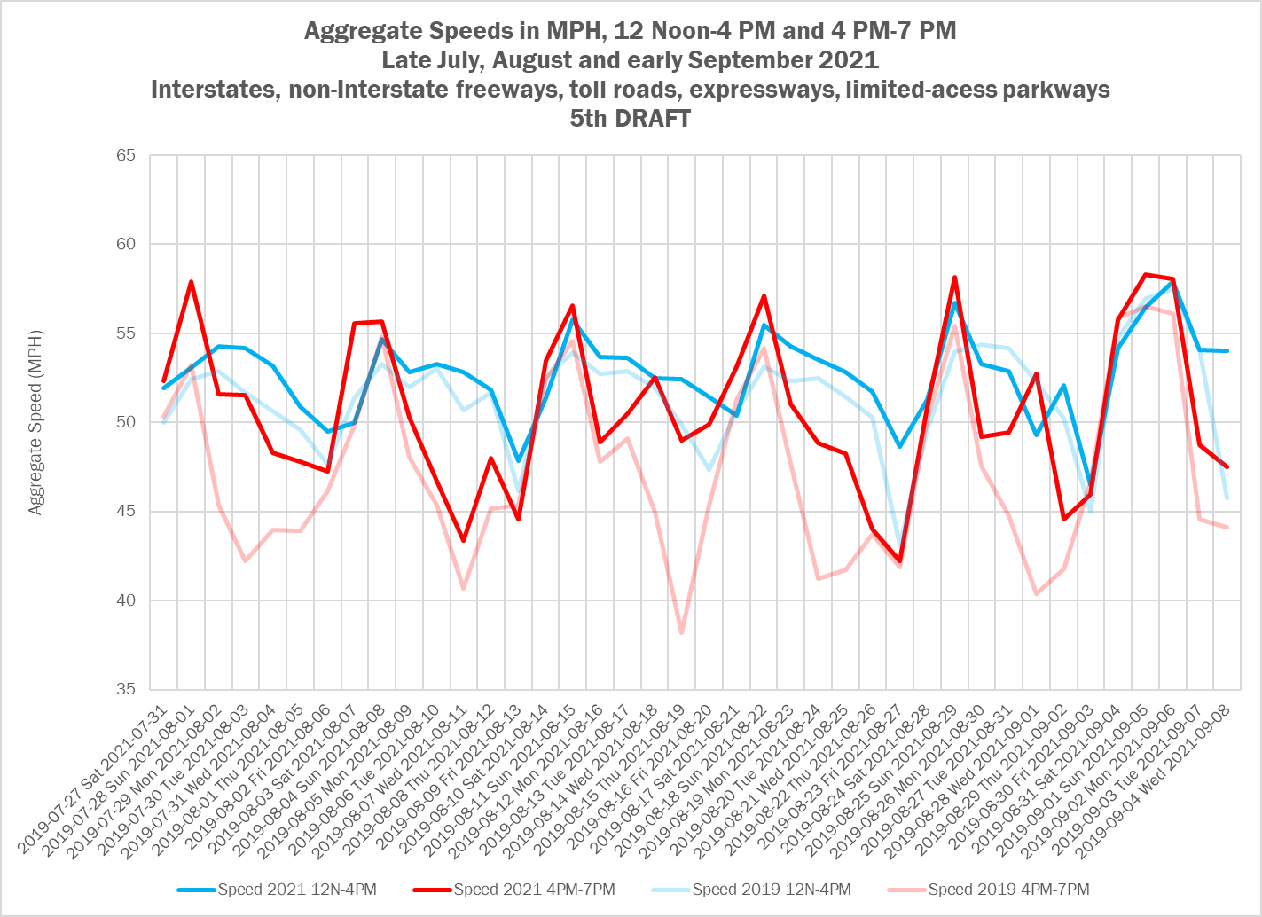

Slide 12
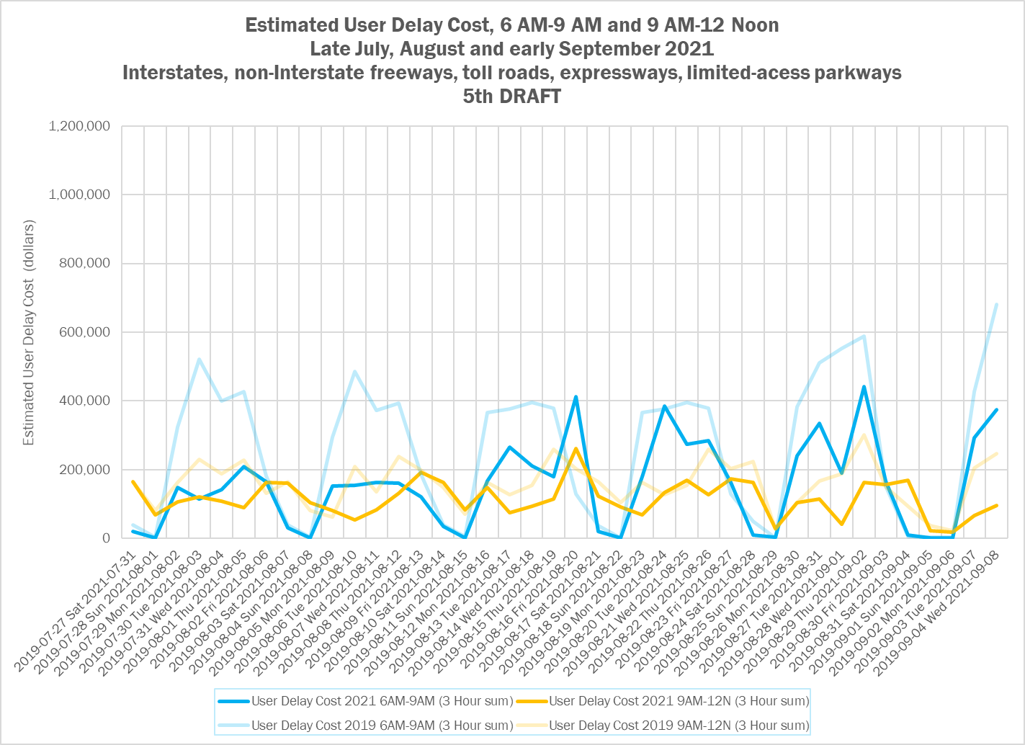

Slide 13
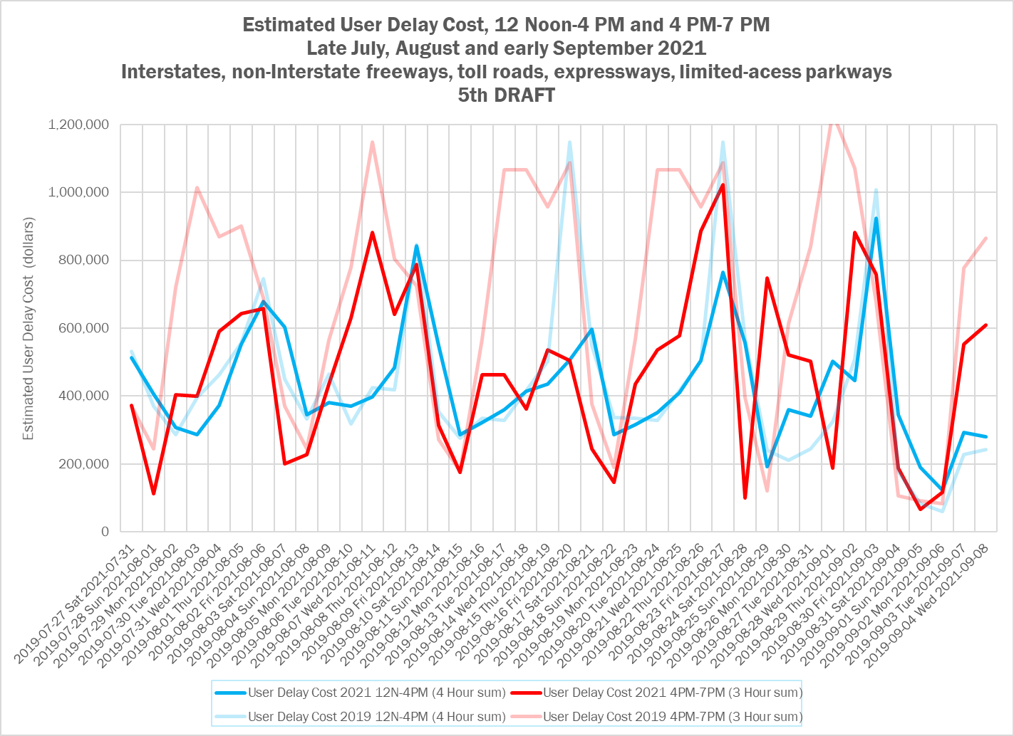

Slide 14
Conclusions from Labor Day 2021
Congestion on the limited access system for Labor Day 2021 is back, but mornings are not as bad as afternoons, and the afternoons in 2021 are generally not as bad as 2019.
This is similar to what was observed for Memorial Day 2021.
The system is generally not as congested on weekdays around Labor Day in 2021 as it was in 2019 – especially in the mornings
Agenda Item # 4: Pandemic Transportation Analysis
September 9, 2021

Slide 15
Planned work - near future
1. Continue to capture and monitor probe data to see if new trends develop post-Labor Day 2021.
2. Compare probe data with traffic counts from ATRs around the region to see if trends are similar
3. “Zoom in” on a few known congestion-prone areas on this network and do a similar analysis.
4. Write a technical memorandum describing the three holiday weekends in 2021 and how they compare to 2019.
5. Share with this group at a future meeting.
Agenda Item # 4: Pandemic Transportation Analysis
September 9, 2021

Slide 16
What to watch for
Will congestion return in the morning peak commute periods?
Will weekend and holiday congestion return to levels seen in 2019?
Will ATR counts continue to show increases in traffic volumes?
Agenda Item # 4: Pandemic Transportation Analysis
September 9, 2021

Slide 17
Potential Scenarios for Operations
Return to Pre-Pandemic Conditions
Some Pandemic Traffic Conditions Persist
Increased traffic and congestion
Everything goes back to the way it was
Morning peaks and downtown traffic are lighter
Similar to pre-pandemic elsewhere in the region, and for mid-day and PM peaks
Increased freight movement
Driving could increase due to desire for social distancing, avoidance of transit
Agenda Item # 4: Pandemic Transportation Analysis
September 9, 2021
Notes:
Scenario 1
Following recovery period, the region reverts to “old” normal
Regional growth projections are unaffected
Telework pattens return to pre-pandemic levels
Regional travel, including commuting, return to pre-pandemic levels
Essential front-line workers still needed to support the regional economy
Scenario 2
Following period of transition, increased teleworking takes hold
Demand for and use of office/commercial space may be influenced
Housing location choices may not be tied as strongly to proximity to worksite (i.e., commute length/time less of a consideration)
Regional composition of industry sectors and supporting workforce does not change
Essential front-line workers still needed to support the regional economy
Scenario 3
Teleworking takes a significant regional and societal hold resulting in many workers, who can telework, not feeling tied to live in the same region where their jobs are “located.”
Outmigration of components of the workforce may influence composition of employment sectors in the region
Changing economy may influence demand for talent
Essential front-line workers still needed to support the regional economy

Slide 18
Presenter Name C. Patrick Zilliacus (202) 962-3292 zill@mwcog.org | mwcog.org
777 North Capitol Street NE, Suite 300 Washington, DC 20002

