Slide 1
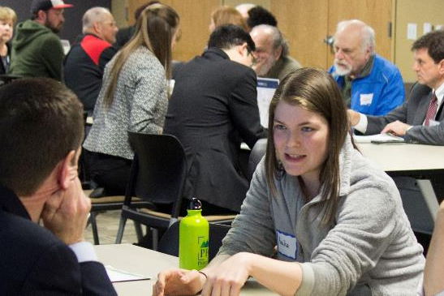
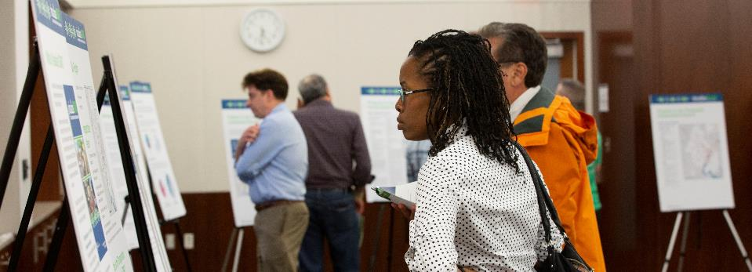
Evaluation of TPB Public Participation Activities
Briefing on a Consultant Study
John Swanson TPB Transportation Planner Access for All Advisory Committee March 7, 2019

Slide 2
Background and Purpose
What:
Rhodeside & Harwell, Inc. was contracted to conduct an evaluation of the TPB’s public participation activities
Why:
Help us refine our activities and develop new ones
The time was right: We just finished Visualize 2045 outreach
Federal Certification: This evaluation provides helpful documentation
When:
September 2018 – February 2019
How:
Review of past activities & practices
Focus groups
Assessment of data on participation
Evaluation of TPB Public Participation Activities
March 7, 2019

Slide 3
Key Recommendations
REGARDING THE PURPOSE AND GOALS OF PUBLIC PARTICIPATION
1. Update the Participation Plan to streamline content, clarify roles and purposes, and evolve strategies to reach different constituencies.
2. Undertake a campaign to clarify the TPB’s role for the general public.
3. Revisit the Participation Plan on a regular basis, through tools such as an annual survey.
Evaluation of TPB Public Participation Activities
March 7, 2019

Slide 4
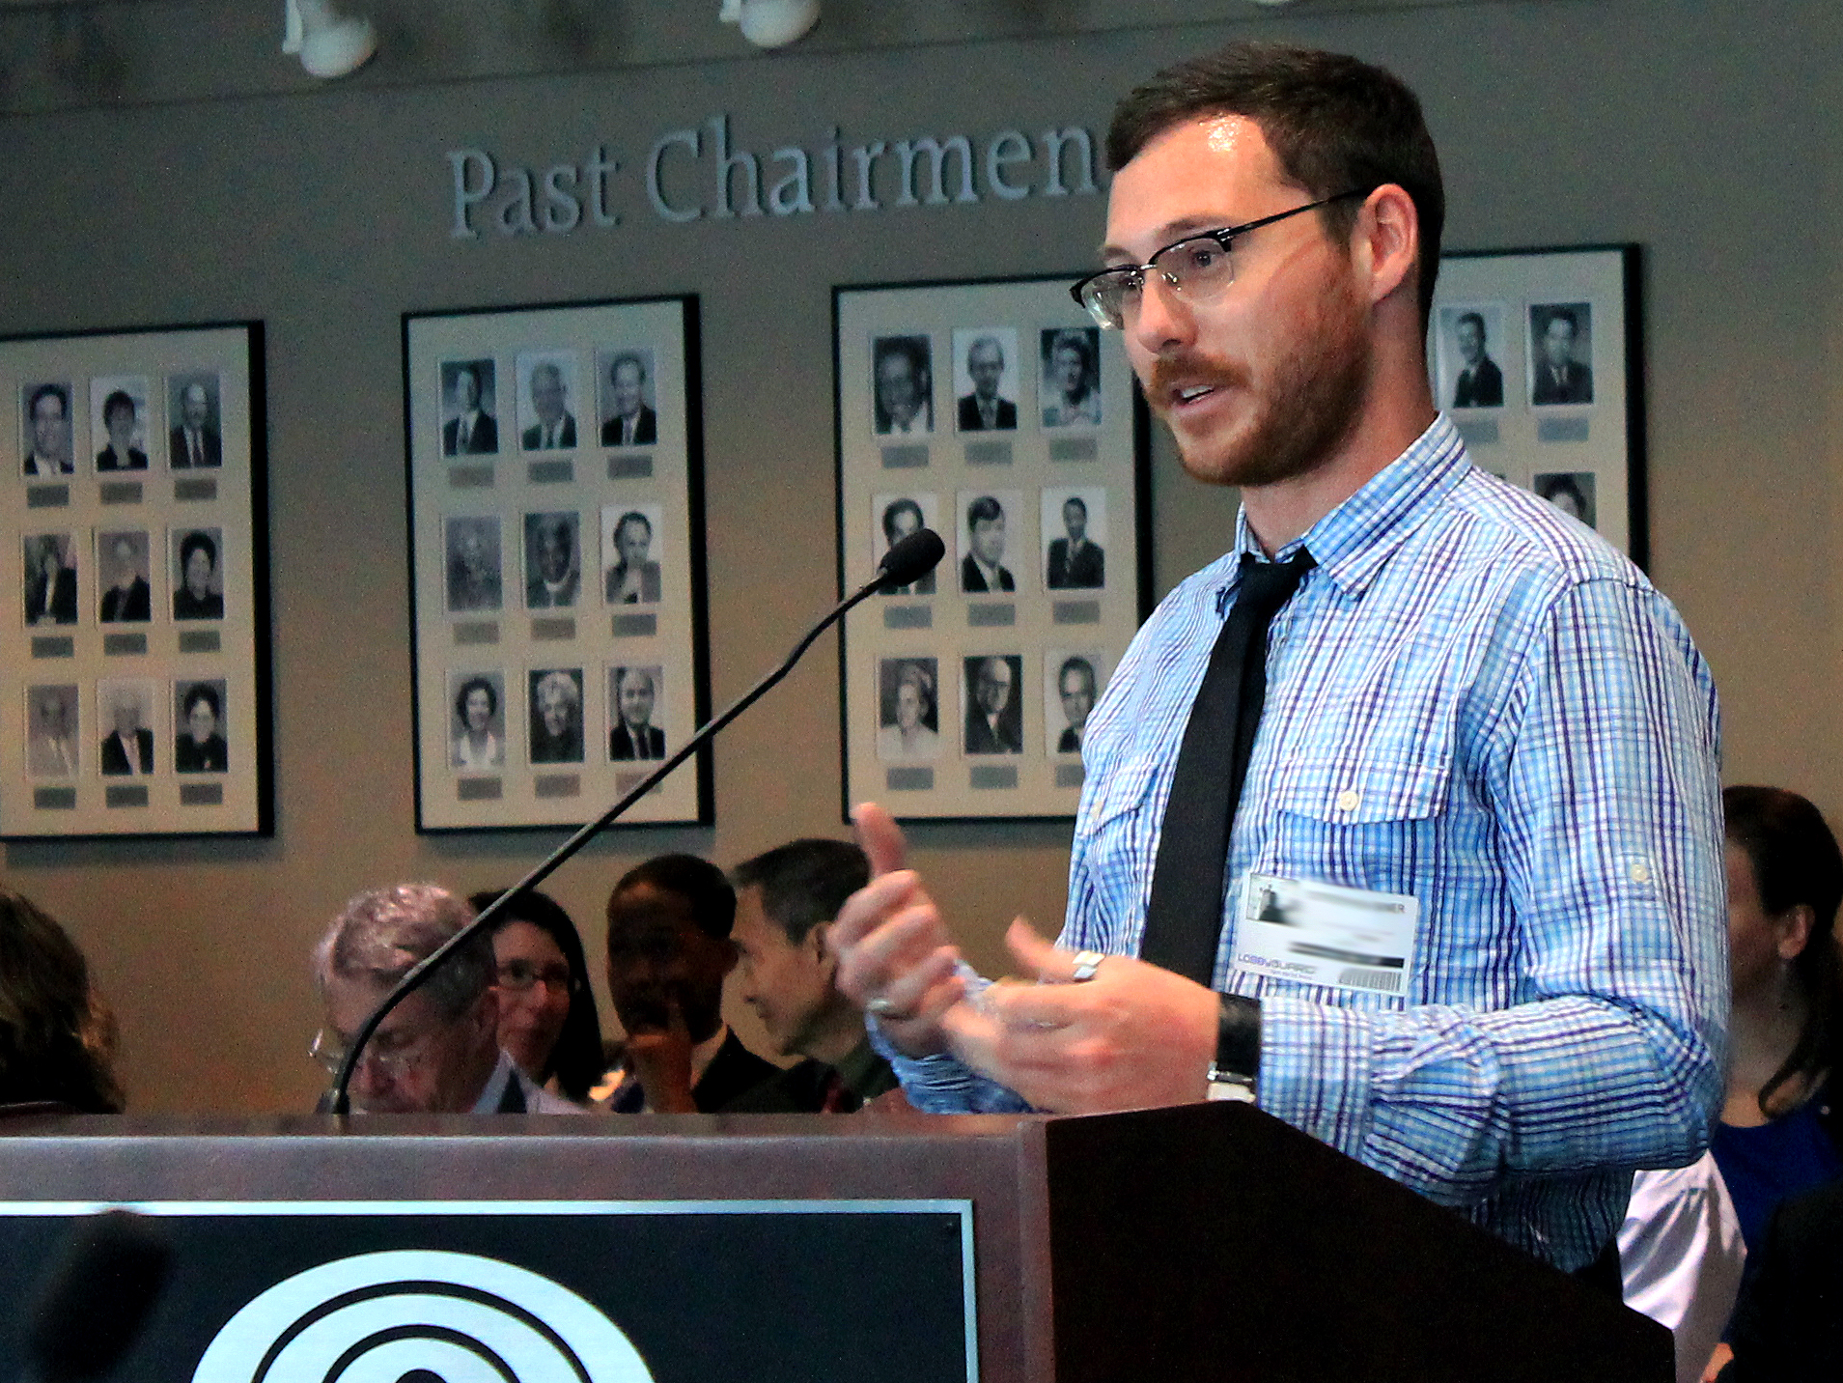
Key Recommendations
REGARDING CURRENT PRACTICES AND TOOLS
4. Hire at least one additional staff member to expand TPB’s communications and outreach capabilities.
5. Consider whether an expanded regional coordination role may be appropriate.
6. Improve public participation related to Board meetings and the TIP Forum.
Evaluation of TPB Public Participation Activities
March 7, 2019

Slide 5
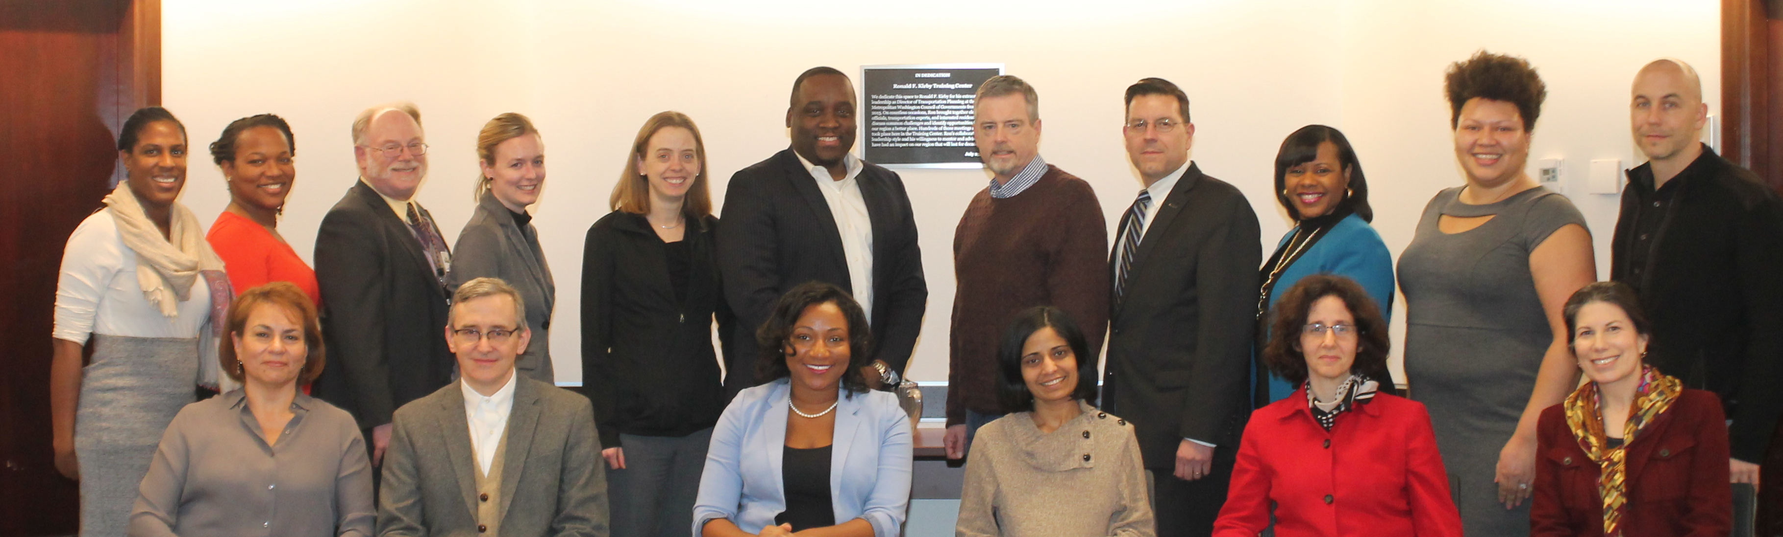
Key Recommendations
REGARDING CURRENT PRACTICES AND TOOLS (Cont’d)
7. Clarify the expectations and role of each Committee, particularly regarding public input and communications.
8. Evolve Committee processes and structures, including Board engagement, educational activities, and provision of outreach materials.
9. Advance social media practices to reach a broader spectrum.
Evaluation of TPB Public Participation Activities
March 7, 2019

Slide 6

Key Recommendations
REGARDING CURRENT PRACTICES AND TOOLS (Cont’d)
10. Keep all levels of constituencies updated on long-range plan implementation progress, using successful strategies from Visualize 2045 as a guide.
11. Take a leadership role in providing regional transportation education.
12. To prepare for the next long-range plan update, conduct a survey to assess how the public felt about the Visualize 2045 branding and outreach efforts.
Evaluation of TPB Public Participation Activities
March 7, 2019

Slide 7
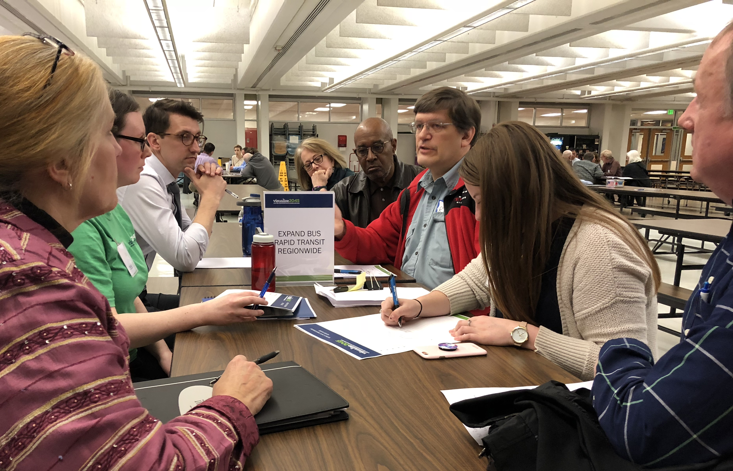
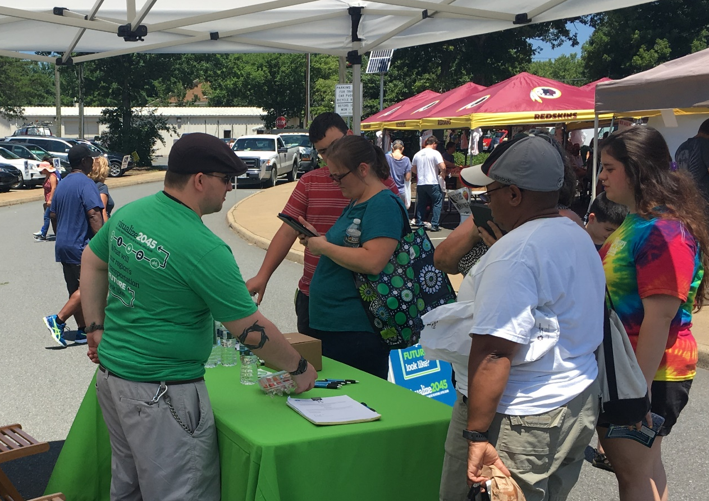
Key Recommendations
REGARDING CURRENT PRACTICES AND TOOLS (Cont’d)
13. Expand the TPB’s leadership role in regional transportation research.
14. Plan for ways to improve overall participation based on lessons learned, including an evaluation of what was successful in the Visualize 2045 process.
Evaluation of TPB Public Participation Activities
March 7, 2019

Slide 8
Key Recommendations
REGARDING NEW STRATEGIES, APPROACHES, AND TOOLS (Cont’d)
15. Consider development of a series of videos to educate about the TPB in general, as well as about its ongoing and one-off activities.
16. Meet with member jurisdictions and other related groups to coordinate efforts and “grow” a group of messaging ambassadors.
17. Foster discussions about regional and local efforts to define effective transportation narratives and build an understanding of issues.
18. Make efforts to educate people about transportation issues and potential solutions from a younger age than is typical for the TPB “public.”
Evaluation of TPB Public Participation Activities
March 7, 2019

Slide 9
What’s next?
The consultant report was released on February 22.
TPB staff will discuss the report with the TPB Technical Committee, the Access for All Advisory Committee, and the Citizens Advisory Committee.
TPB staff will use the report to enhance our ongoing public involvement processes and inform new activities.
Evaluation of TPB Public Participation Activities
March 7, 2019

Slide 10
John Swanson TPB Transportation Planner (202) 962-3295 jswanson@mwcog.org | mwcog.org/TPB
Metropolitan Washington Council of Governments 777 North Capitol Street NE, Suite 300 Washington, DC 20002

