Slide 1

Total Maximum Daily Load Implementation Plans
Baltimore County Department of Environmental Protection and Sustainability

Slide 2
Presentation Outline
Approach by pollutant type
3. Approach and Monitoring
Timeline for meeting TMDL targets
2. Timeline
Future TMDLs
Completed TMDL Implementation Plans by watershed
1. TMDLs of Baltimore County
Milestones
Reporting
Monitoring by pollutant type
Uncertainties

Slide 3
TMDL Implementation Plans in Baltimore County
22 TMDL Implementation Plans (In review by MDE and EPA Region 3)
3 Plans In Development
  Liberty Reservoir Phosphorus and Sediment
  Trash TMDL Implementation Plan in Development (Gwynns Falls and Jones Falls)
Prettyboy Reservoir | Loch Raven Reservoir | Liberty Reservoir (Phosphorus and Sediment in development) | Lower North Branch Patapsco | Gwynns Falls | Jones Falls | Back River | Baltimore Harbor
Phosphorus | Phosphorus | Phosphorus | Bacteria | Bacteria | Bacteria | Nutrients | Nutrients
Bacteria | Sediment | Sediment | Sediment | Sediment | Sediment | Bacteria | PCBs
Mercury | Bacteria | Bacteria |  |  | PCBs | PCBs | Chlordane
 | Mercury |  |  |  |  | Chlordane

Slide 4
Timeline
All Sediment and Nutrient TMDL Implementation Plans are consistent with Bay TMDL timeline
TMDL Implementation Plan Development
Sediments and Nutrients by
Bacteria and Toxics by
December 2014
2025
2035

Slide 5
Timeline
Will prepare 2 year Milestones for each TMDL in accordance with Chesapeake Bay TMDL 2 year milestones
Must account for lag times when measuring progress
Sediment Interim Milestones
Measure | Year
 | 2017 | 2020 | 2023 | 2025 | 2026 | 2029
Implementation of Reduction Actions |  | 50% |  | 100%
Mean BIBI Score | 2.23 | 2.46 | 2.70 |  | 2.97 | 3.27

Slide 6
Timeline
Bacteria Interim Milestones
Single Sample Target (MPN/100 ml)
Weather Condition | 2020 | 2025 | 2030 | 2035
Dry | 576 | 410 | 298 | 235
Wet | NA | NA | NA | NA
Geometric Mean Target (MPN/100 ml)
Dry | 477 | 360 | 243 | 126
Wet | 6,880 | 4,630 | 2,380 | 126

Slide 7
Reporting
Progress reporting will be through the Annual NPDES-MS4 Permit Report
http://www.baltimorecountymd.gov/Agencies/environment

Slide 8
Adaptive Management
Note:
All of the County’s TMDL Implementation Plans follow an adaptive approach to meeting reductions.
An adaptive management assessment will be developed for the plans to enhance actions as needed.
Loading rates and reduction credits have been calibrated to the current Chesapeake Bay Model
Implement and Monitor
Evaluate progress
Plan and Adapt

Slide 9
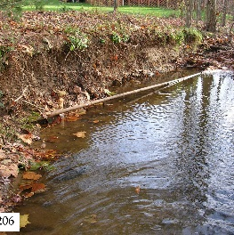
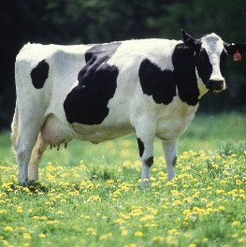
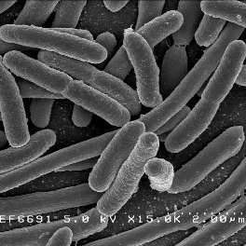
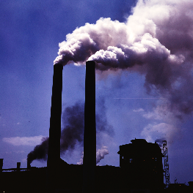
Approach by Pollutant Type
Sediment
Nutrients (Phosphorus and Nitrogen)
Bacteria
Toxics (PCBs, Mercury and Chlordane)

Slide 10
Sediment Reductions Approach
The County developed a potential implementation scenario,
The TMDL Targets were adjusted for change in load since the baseline year of the TMDL
The County’s Small Watershed Action Plans (SWAPs) were used to inform the potential for actions in each watershed
The total actions in the scenario were not to exceed actions identified for achieving the Bay TMDL

Slide 11
Sample Reduction Scenario
Watershed | TMDL Reduction Required | Baltimore County Scenario Reductions
Jones Falls | 4,378,000 lbs/yr | 4,410,972 lbs/yr

Slide 12
Nutrient Reduction Approach
Nutrient Reduction Approach was similar to Sediment
Also developed a potential reduction scenario
These actions combined with sediment actions were also not to exceed actions designated to meet the Bay TMDL
Sediment reducing actions also reduce nutrients
Potential reduction scenarios were adjusted, as needed, to meet both sediment and nutrient TMDLs

Slide 13
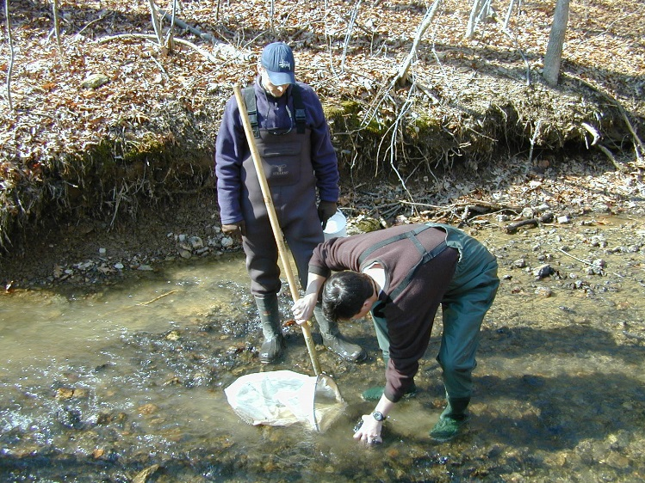
Sediment and Nutrient Monitoring
Continue Random Point Biological Monitoring
Currently collecting data for Subwatershed Biological Condition Monitoring- determine progress on watershed basis
Continue Chemical Monitoring – Tests for Chlorides, Sulfates, and TSS
Explore the utility of deploying Continuously Recording Turbidity Meters – Currently in pilot
Continue SAV monitoring
Notes:
Turbidity Meters – Pilot is through a cost share with USGS
Turbidity Meters- may provide more consistent data collection than taking samples

Slide 14
Bacteria Reduction Approach
Unknown:
There is no established loading rate for bacteria by land use for Baltimore County
Available literature supports that actions included in the implementation approach will lead to reductions, but exact numbers are still unknown
Approach:
Achieve water quality standards and percent reductions for each monitoring station
Implement actions that are known to have reduction effect
Human inputs are prioritized, but actions are included to target each source

Slide 15
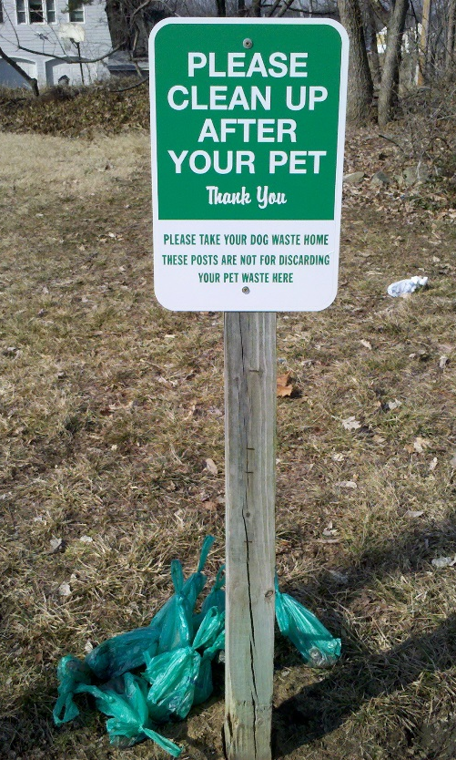
How the Reductions Will Be Achieved
The following are just some of the actions that will be utilized to achieve reduction requirements:
Design and implement stormwater retrofits
Continue stream restoration projects
Street sweeping
Storm drain inlet cleaning
Continue to meet requirements of the consent decree
Continue to assist land owners in addressing failing septic systems
Investigate and convert existing dry detention ponds
Implement an awareness campaign to spread information about pet waste

Slide 16
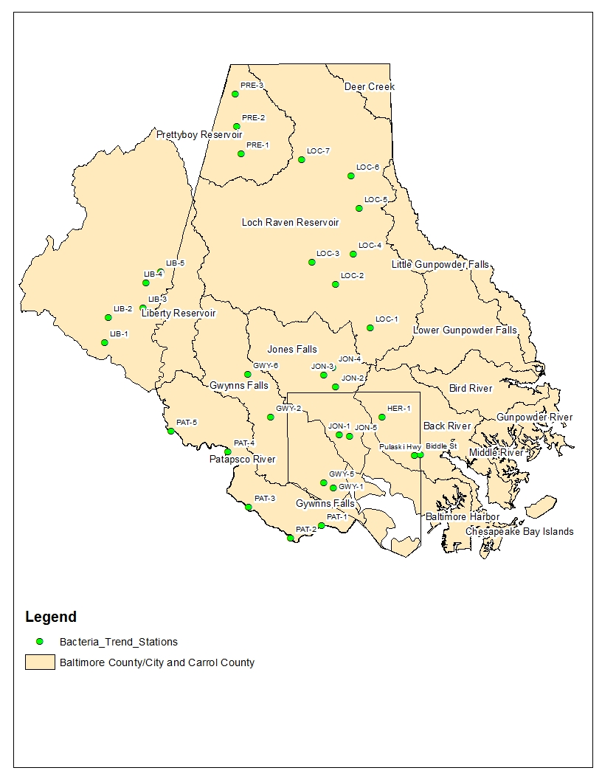
Reductions Required by Trend Monitoring Station
MDE Station Code | County Code |  | E. coli Baseline Load (BillionMPN/year) | Target Load Reduction (BillionMPN/year) | Long-Term Average E. coli TMDL Load (BillionMPN/year) | % Required Reduction
JON0184 | JON-3 | County | 1,206,325 | 1,115,075 | 91,250 | 92.4%
UQQ0005 | JON-4 | County | 133,955 | 123,370 | 10,585 | 92.1%
JON0082sub | JON-2 | County | 887,315 | 845,340 | 41,975 | 95.3%
JON0039sub | JON-1 | City | 3,340,480 | 1,184,260 | 156,220 | 95.3%
SRU0005 | JON-5 | City | 636,560 | 622,960 | 13,870 | 97.8%
Total |  |  | 6,204,270 | 5,890,735 | 313,900 | 94.4%
The County will measure success by following the reductions achieved at bacteria monitoring stations within the watershed

Slide 17
Bacteria Monitoring
Initially Trend Monitoring done in conjunction with Carroll County and Baltimore City
Future Monitoring Plans:
Sub-watershed Prioritization Monitoring
Bacteria Source Location Tracking implemented based on these results
Bacteria Source Relative Contribution Tracking (species tracking): Human, Pet Waste, Wildlife, Livestock
Notes:
Relative Contribution Tracking- Will work with MDE to develop this. Possibly at the beginning of each five year permit cycle.

Slide 18
Bacteria Monitoring
E. coli Geometric Mean Concentrations at Site JON-3 for both Annual and Seasonal Flow Periods Stratified by Flow Condition, MDE Results Added for Comparison

Slide 19
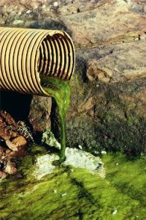
Toxics Reduction Approach
Unknown:
Awaiting data from MDE on the results of 2014 fish tissue studies
Sources of PCBs and Mercury need to be identified
Will require additional monitoring
Unknown relationship between toxics and sediment transport
Lag times

Slide 20
Toxics Reduction Approach
Approach:
Education of proper disposal methods of hazardous materials is an action proposed for all three toxic pollutants
As a practice, adding sand organic filters to all SWM pond conversions
PCBs
PCBs adsorb to sediments, so initial actions include those that reduce sediment
  Baltimore County will work with MDE to develop a load reduction calculation for PCBs that will link sediment reductions to PCB reductions
Monitoring results will allow more targeted actions

Slide 21
Toxics Reduction Approach
Approach:
Mercury
The County is not proposing any additional restoration actions for mercury reduction other than what is being proposed to reduce nitrogen and phosphorus
The Maryland Healthy Air Act required a 90% reduction of mercury emissions from 2002 levels by 2013, this may have a major impact on mercury levels in reservoirs
Chlordane
Management and restoration actions of chlordane will be determined based on the findings of the fish tissue monitoring results

Slide 22
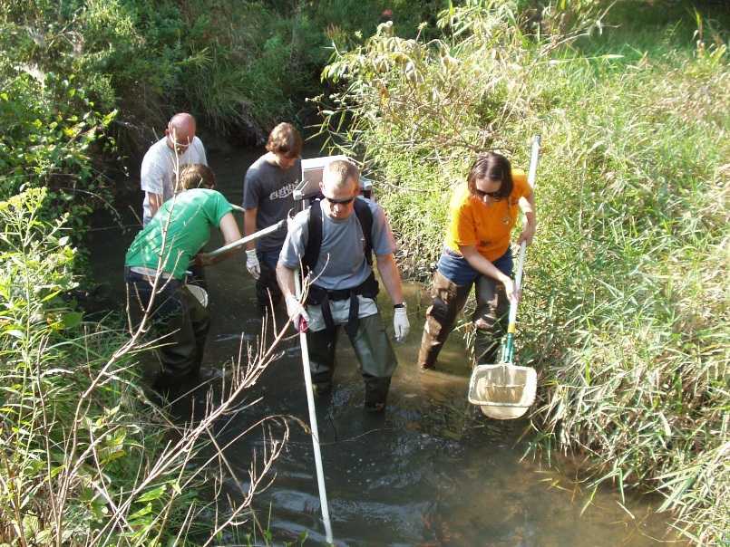
Toxics Monitoring and Reporting
Awaiting results of 2014 fish tissue monitoring from MDE
Baltimore County plans to develop a program to monitor fish tissue on a three year cycle
The County expects to develop a program to monitor the bioavailability of toxics using caged bivalves
  Could help focus future efforts in identifying toxics sources

