Slide 1
NCHRP 03-133:
Non-Motorized Users at Traffic Signals
Burak Cesme, PhD
Joint SPOTS & Traffic Signals Subcommittee Meeting
Washington, D.C.
December 5, 2019

Slide 2



NCHRP 03-133: Traffic Signal Design and Operations Strategies for Non-Motorized Users
Develop toolbox of strategies and treatments to make traffic signals work better for peds/bikes
April 2018 – March 2020

Slide 3
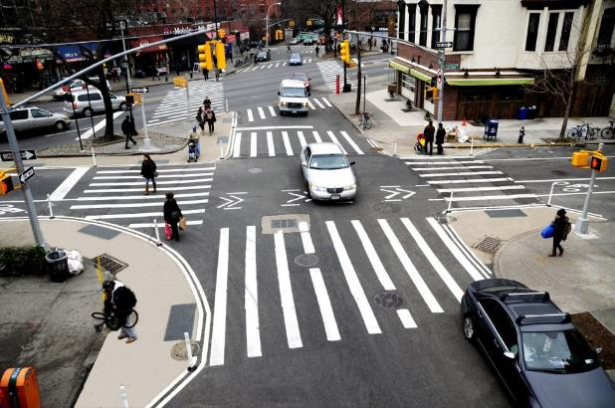
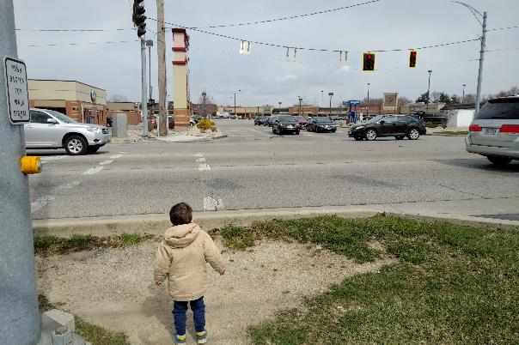
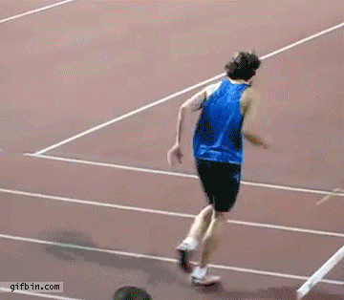
3 “Raises/Razes”
Raise the roof
  Research and innovation – advance practice
Raise the floor
  Improve practice – adjust the status quo
Raze the barriers
  Improve processes for implementation

Slide 4
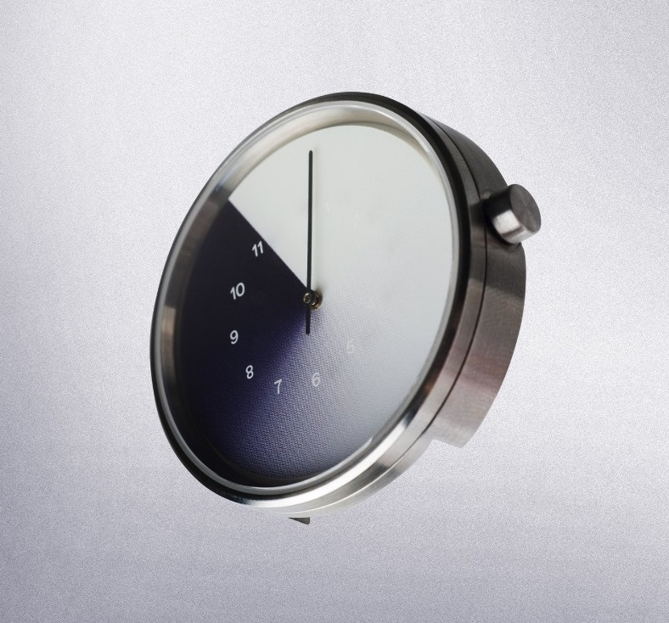
SET 1: Basic Treatments to Reduce Pedestrian Delay
Evaluating Pedestrian and Bicycle Crossing Delay
Short Cycle Length
Maximizing Walk Interval Length
  General (Pre-timed Phases)
  Rest in WALK
  Adapting Minimum Green to Demand
  Adaptive Walk Intervals
  Changing from actuated to pre-timed
Recall versus Actuation for Pedestrians

Slide 5

Basic Treatments to Reduce Pedestrian Delay
“Evaluating Pedestrian and Bicycle Crossing Delay”
Boston Example
Timing Plan 1: 123 s average ped delay
Timing Plan 2: 45 s average ped delay (with 0.5 s increase in vehicular delay)
Policy: Whenever vehicular delay is reported, ped delay must be reported, too.
“Only what’s measured counts”

Slide 6

Basic Treatments to Reduce Pedestrian Delay
“Short Cycle Length”
Amsterdam Policy:
Make cycles as short as possible
Maximum Cycle = 100 s
Less Pedestrian Delay, Less Transit Delay
Better Ped/Bike Compliance
Fewer Speeding Opportunities

Slide 7
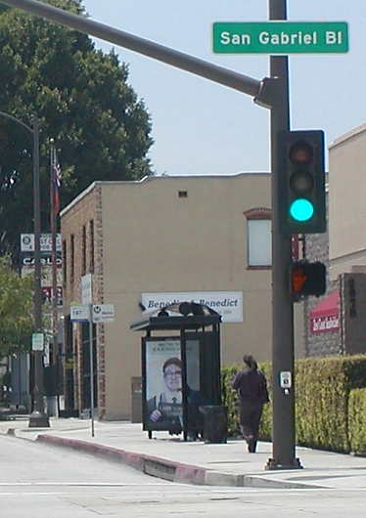

“Maximizing WALK Interval Length”
Basic Treatments to Reduce Pedestrian Delay
Not this:
but this:
[Make the WALK interval as long as will fit within the parallel vehicular phase]
For coordinated phases, use the setting “Rest in WALK”

Slide 8
SET 2: Eliminating Conflicts with Parallel Traffic Turns
Exclusive Pedestrian Phases
Protected Left Turns on Multilane Roads
Concurrent-Protected Pedestrian Crossings
Delta Islands (Channelized Right Turns) for Ped and Bike Crossings

Slide 9
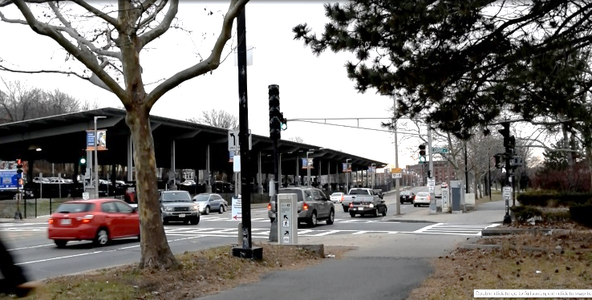
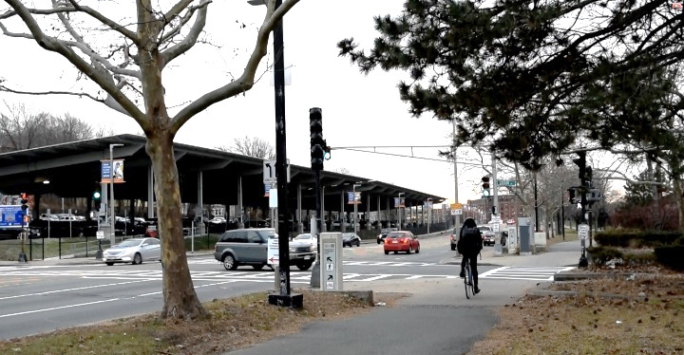
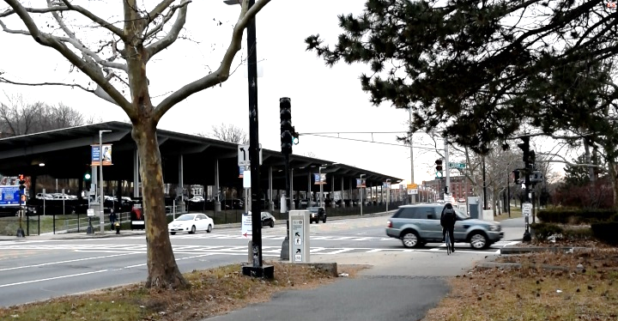
Eliminating Conflicts with Parallel Traffic Turns
“Protected Left Turns on Multilane Roads”
Amsterdam Policy: On multilane roads, left turns are protected only, never “permitted”.
1
2
US Guidelines: Permitted lefts are OK unless:
50+ mph speed limit
Crossing 4+ lanes
Crash experience
  Contrary to Vision Zero principles
3

Slide 10
Eliminating Conflicts with Parallel Traffic Turns
“Concurrent-Protected Pedestrian Crossings”
a.k.a. Protected Right Turns, Right-Turn Overlap
Using right turn AND left turn signals to protect crossings from all turn conflicts

Slide 11
SET 3: Mitigating Conflicts with Parallel Traffic Turns
Leading Pedestrian Intervals
Delayed Turn
Flashing Ped/Bike Crossing Warning

Slide 12
Mitigating Conflicts with Parallel Traffic Turns
“Leading Pedestrian Intervals”
a.k.a. Pedestrian Head Start
Relative Stopline Setback
Leading interval (3-7 s): Peds only
Concurrent traffic with turn conflicts
Audible signal needed
May bikes use it, too?
Can make cycle longer – and so in Netherlands:
  NOT used where “protected intersection” layout gives peds/bikes a head start in space.
  Only used where bike & car have the same stopline

Slide 13
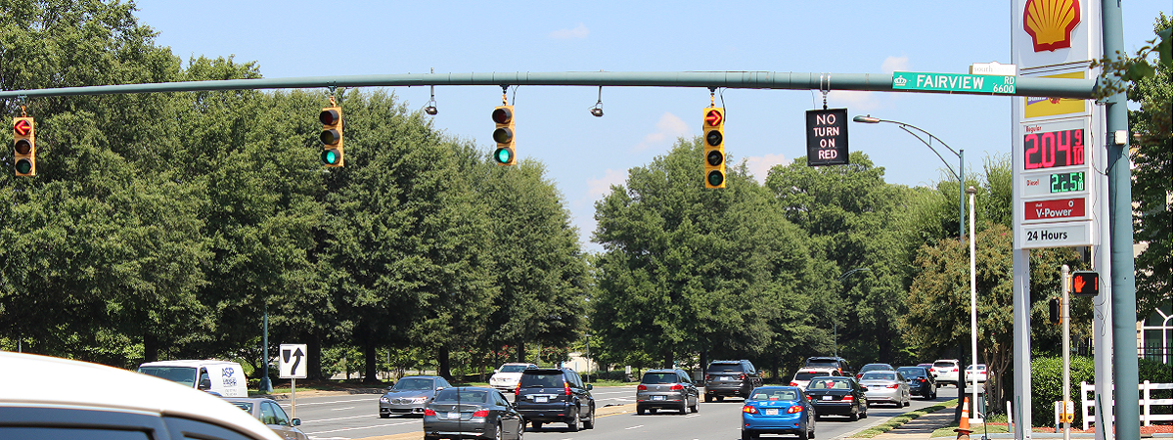
Mitigating Conflicts with Parallel Traffic Turns
“Delayed Turn”
a.k.a. Leading Bike Interval, Leading Thru Interval, LPI+
Leading interval (10 s or more)
Charlotte (“LPI-Plus”)
New York, Charlotte: Only with a right turn lane
Montreal: Without a right turn lane

Slide 14
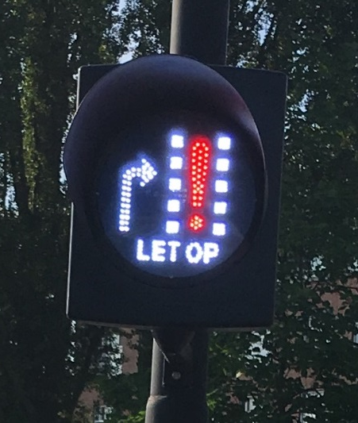
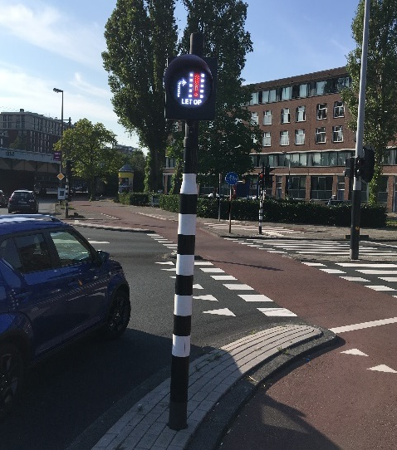
Mitigating Conflicts with Parallel Traffic Turns
“Flashing Ped/Bike Crossing Warning”
Flashing Yellow Arrow
“LET OP” = WATCH OUT
Flashing Bike Crossing Warning, Amsterdam

Slide 15

SET 4: Improving Ped/Bike Information and Ease
Pedestrian Countdown
Red Period Countdown
No Turn on Red
Independently Mounted Pushbuttons
Accessible Signals without Pushbuttons
Call Indicators
Serving Slower Pedestrians

Slide 16
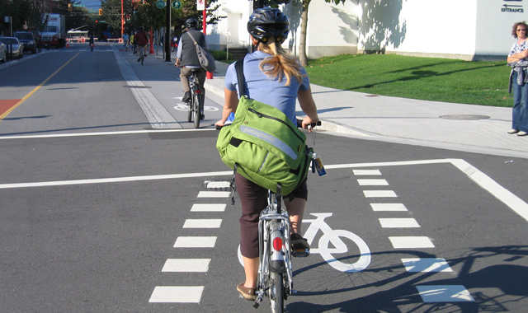
SET 5: Bicycle Phases and Special Bike Needs
Indicating Bike Phases
Detection for Bicycles
Minimum Green and Change Interval Settings for Bikes with Shared Traffic Signals

Slide 17

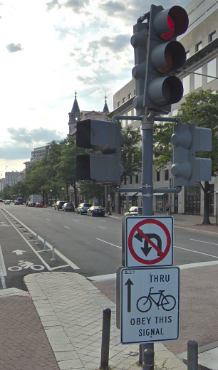
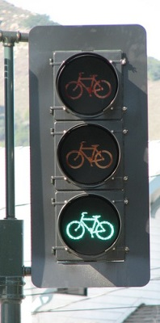
Bicycle Phases and Special Bike Needs
“Indicating Bike Phases”
Peds
Bikes
Vehicles
FHWA won’t allow bike green if there are permitted turn conflicts

Slide 18
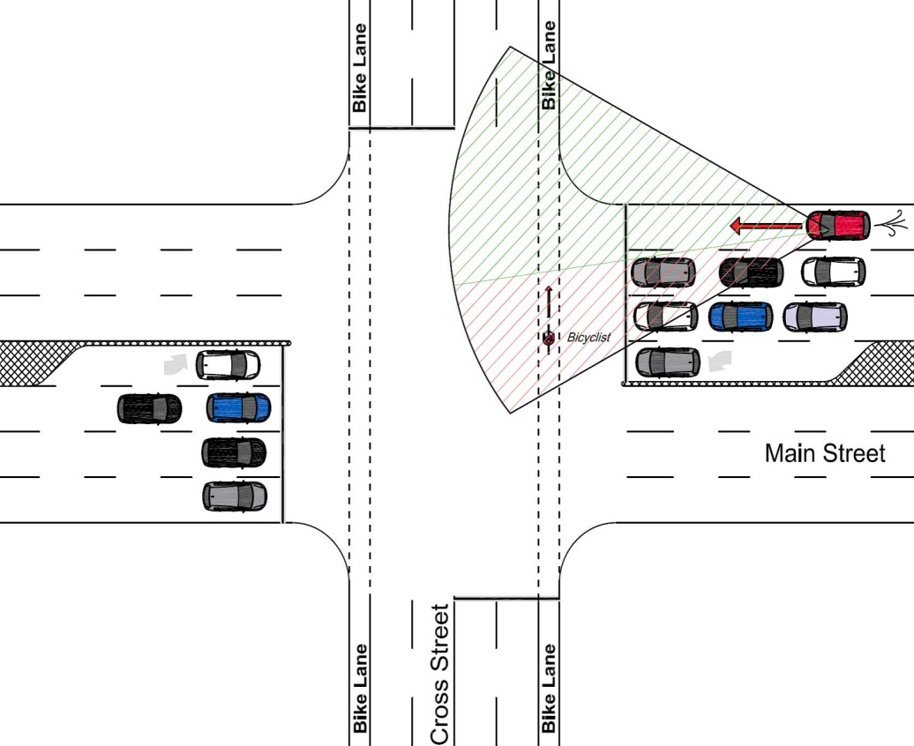
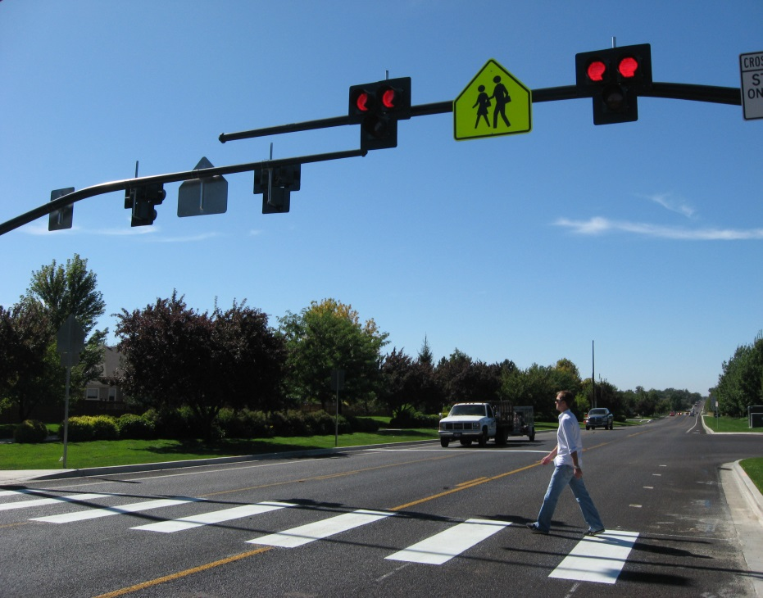
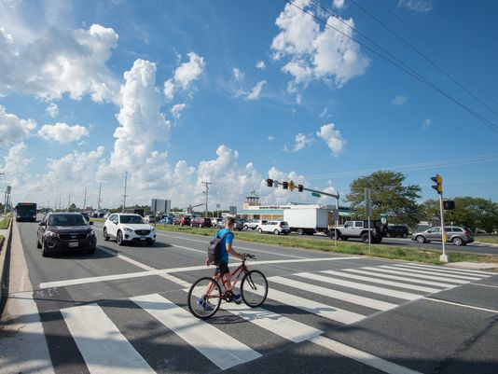
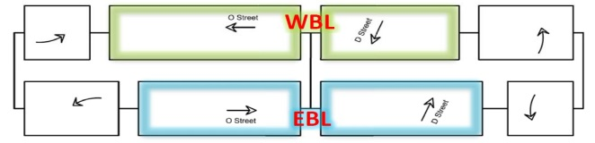
SET 6: Special Phasing Techniques Favoring Peds and Bikes
Multi-Stage Crossings
  Progression through ped crossings
  Pedestrian Overlaps with Left Turn Phases and Different Lead-Lag Phasing Sequences
Pedestrian Phase Overlaps with Each Other, with Bike Phases, and with Vehicular Holds
Re-service for the Ped/Bike Phase
Two-Stage Left Turn Progression for Bikes
HAWK Signals at Intersections with Minor Streets

Slide 19
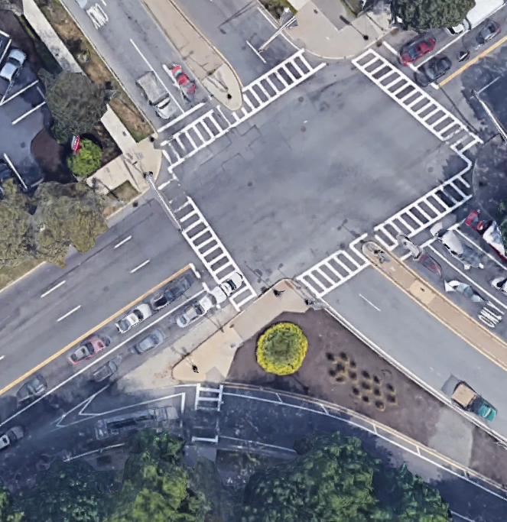
Special Phasing Techniques Favoring Peds and Bikes
“Re-service for the Ped/Bike Phase”
Reservice: twice per cycle
Run free: on demand, allowing cars 10 s green between ped phases

Slide 20
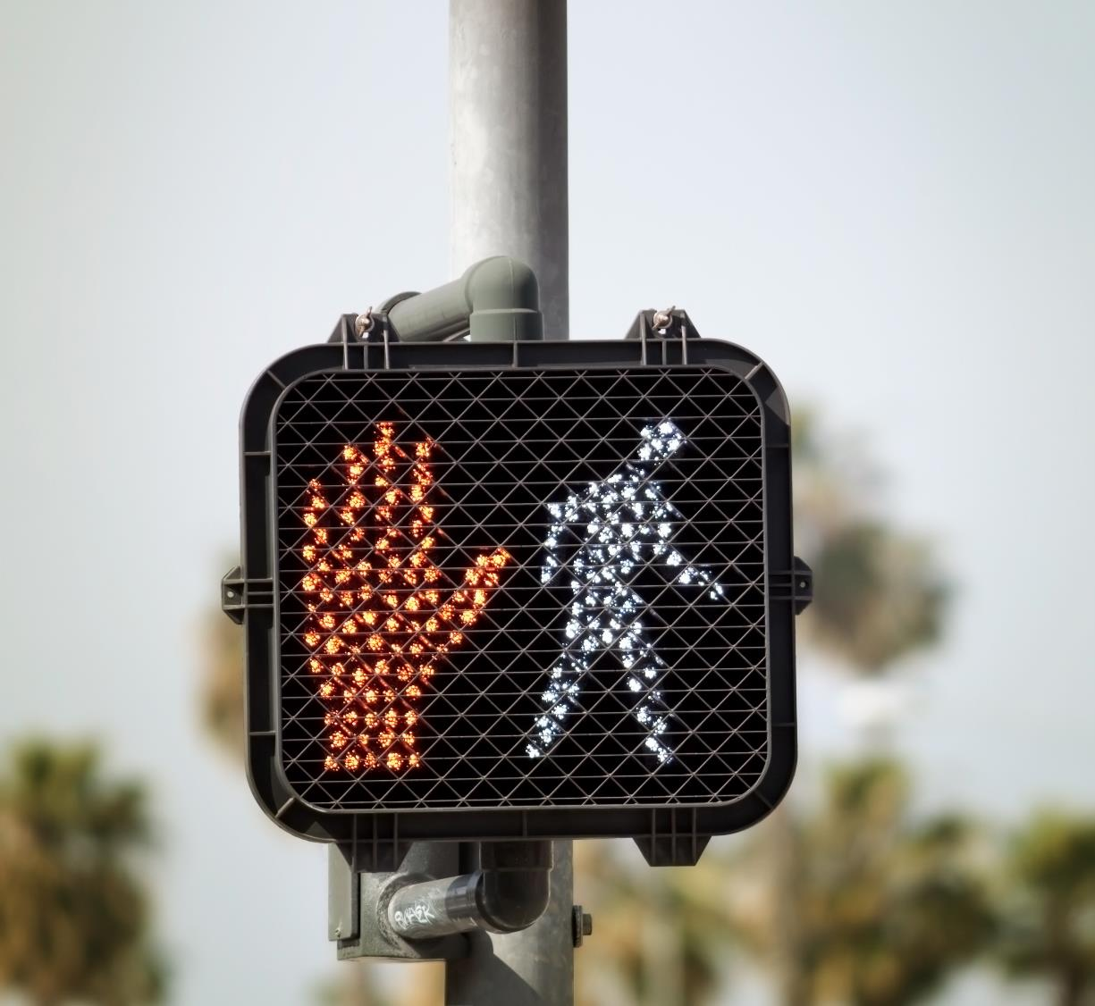
Questions?
Burak Cesme, PhD
bcesme@kittelson.com

