Slide 1
A Dice Bag Full of Sixes
A GIS-Based Tool for POD Allocation Decisions
in Resource-Limited Scenarios

Slide 2
POD Basics
Points of Dispensing (PODs) provide Medical Countermeasures (MCM) during a public health emergency.
PODs may need to start operating very quickly.
Notes:
Ask for a show of hands-who is part of their MCM program, who has helped set up a POD?
POD basics, discuss that ours are still designed for anthrax response due to the short time requirements there
48 hours

Slide 3
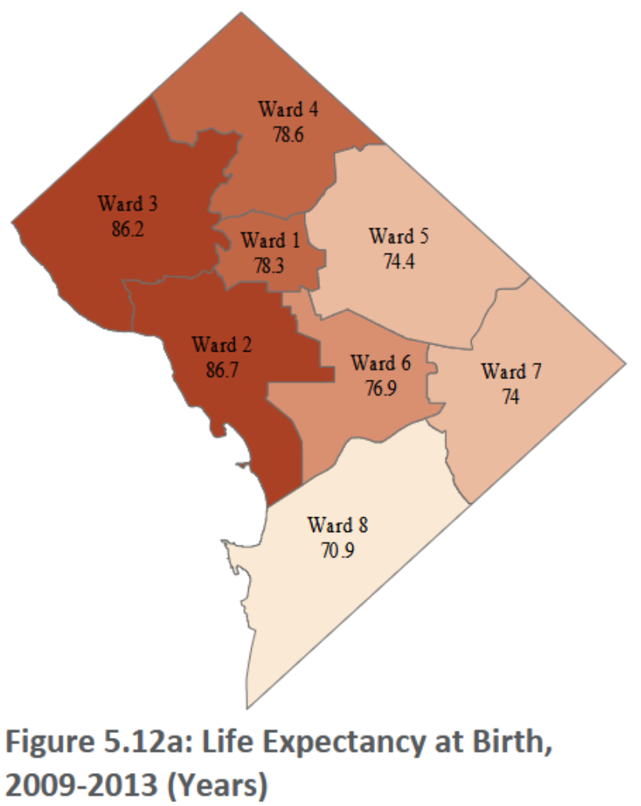
POD Basics
The availability of PODs matters!
During the COVID-19 pandemic, the locations of vaccine sites was a key factor for health outcomes.
Notes:
During COVID, areas without easily available PODs had lower vaccination rates
If you build it, they will come…but only so far.
This repeats other long-term health outcomes across the District

Slide 4
POD Response in the DC Area
No time for complex decision-making in a POD response
POD resources can be prepared in advance.
Buildings
Supplies
Staff
If any of these are limited, the number of PODs will also be limited.
Notes:
12 hours from activation to POD opening
We can have resources available in advance with things like MOAs
Limiting factors (like in chemistry)

Slide 5

POD Staffing Sources
Mutual aid for staffing is unlikely to be available in a POD scenario for DC Health.
Other traditional sources of surge staffing (e.g. contractors) may not be available in time.
Where does that leave DC Health?
Agency personnel, Medical Reserve Corps (MRC), and other volunteer organizations-roughly 800 people in total.
At current staffing levels, DC Health can operate 8 POD sites.
Notes:
Mutual aid is the first thing most places will turn to
Our Maryland and Virginia partners will be activating their plans IN COORDINATION with us
Staffing from DC Health and MRC-800 people, 8 PODs
With these limitations, we can’t afford to roll the dice TRANSITION

Slide 6

Taking No Chances
With a limited number of PODs able to be opened, we can’t afford to “roll the dice”.
Before we need to activate our POD plan, we need to know which sites will provide the best value over other POD candidates.
So how do we know where those best sites are before we need them?
Notes:
We need to make sure we get that “six” every time

Slide 7
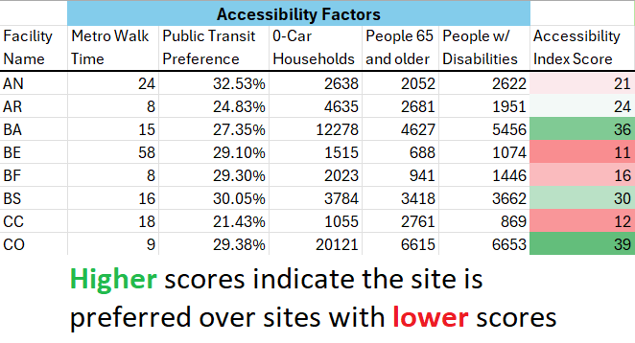
What Makes a “Six”?
How can a site improve access to MCM?
Access to critical transit methods
Availability to people with limited mobility
To get the most people to PODs, this focuses on total #s
Notes:
“So what is a six?”
Stats here depend on census tract data-larger jurisdictions may want to use other units
Areas around each POD
Few of DC’s POD sites have good parking, so public transportation is important
But also including the total proximity of populations which may have difficulty traveling long distances
For more spread-out jurisdictions, they may want to invert and make things like parking capacity a factor

Slide 8
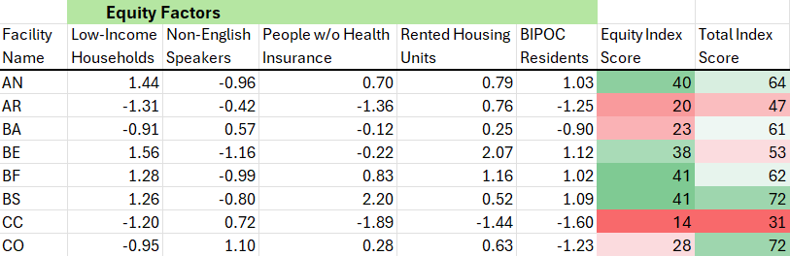
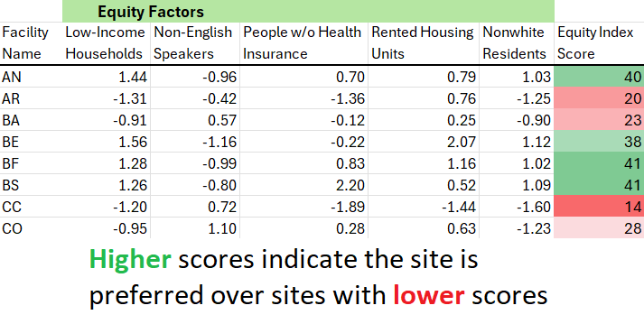
What Makes a “Six”?
How can a site improve overall health outcomes?
If they don’t get MCM, who will have trouble getting healthcare?
After regression analysis of 12 socio-economic factors, these were the chosen indicators for each facility’s surrounding area
Notes:
What happens if people don’t get MCMs?
Covering factors that may make it harder for people to access and afford healthcare
Regression analysis of 11 factors (single-parent households, no smartphones, etc)
Comparative factors for the different PODs

Slide 9
Location-Allocation
What is location-allocation analysis?
An optimization method for placing service locations
Finds the best selection to limit travel time to a service site within a set area
Within ArcGIS Pro, this function is available under “Network Analysis”
Notes:
Talk about uses for Location-Allocation analysis
Calculates the BEST PLACES to LIMIT TRAVEL TIME across the whole area
Using the index value in place of “customer demand”

Slide 10
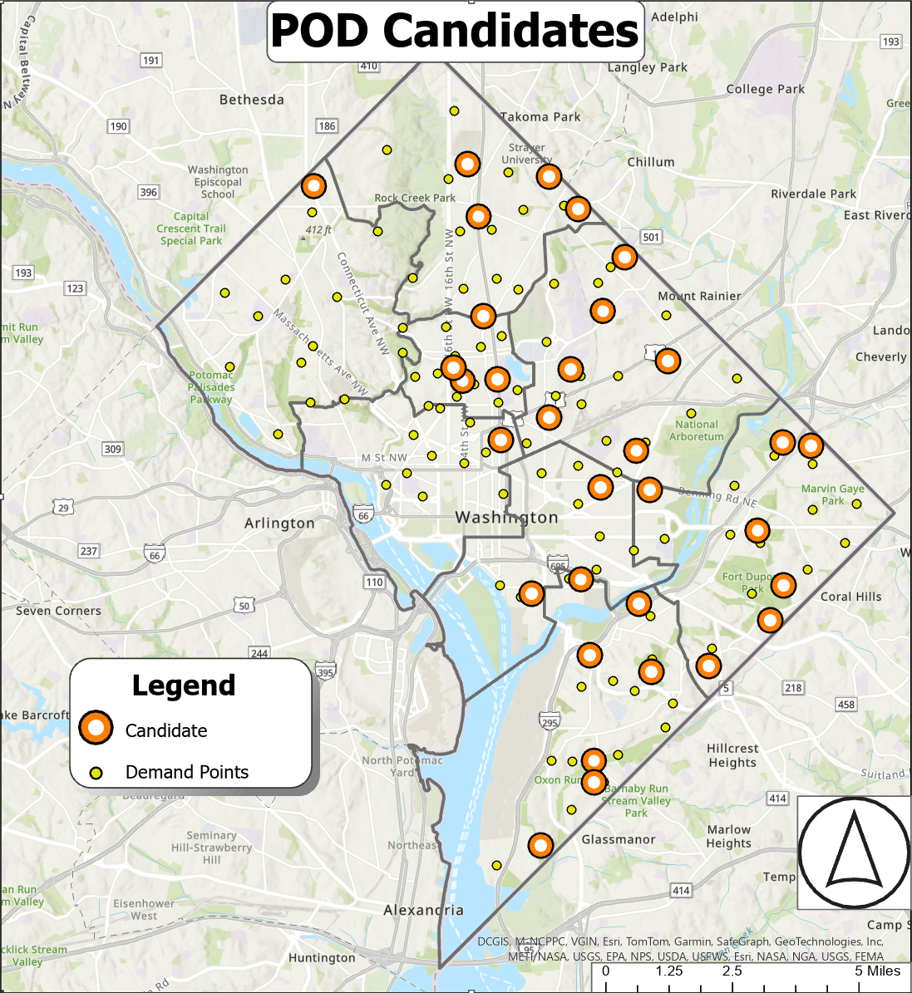

Location-Allocation
This analysis needs 2 datasets:
Demand points, showing where people are, and;
Candidate facilities, all possible locations being considered.
Notes:
Two sets of points:
Demand points, 100 points mimicking the population distribution
Candidate facilities, all our potential POD sites (Department of Parks and Rec facilities)

Slide 11
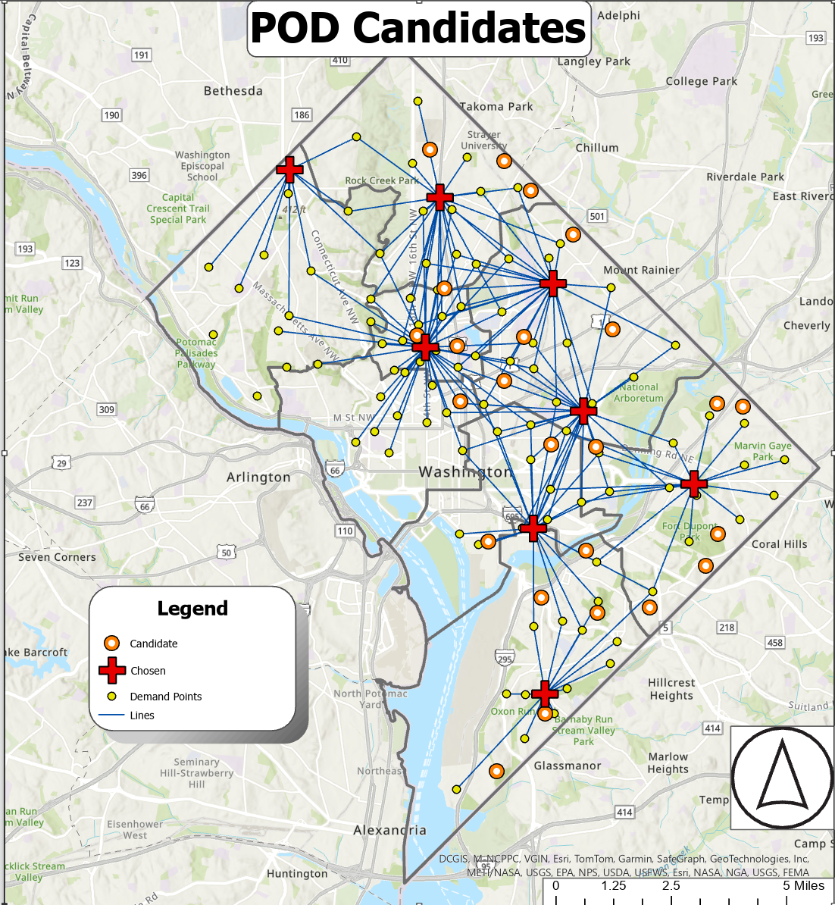
Location-Allocation
This map shows which sites have been chosen. We can see the travel lines from demand points to those chosen facilities.
Notes:
8 PODs are selected here by the algorithm
You can see the blue lines from most demand points to the chosen facilities, these represent travel time to the PODs
Some demand points are outside of the “cutoff” time and aren’t connected to a site
A point for us to plan around later, but these are some of the most mobile areas

Slide 12
Location-Allocation
Some notes on this analysis:
DC Health used walking speeds for this analysis; other jurisdictions may want to use driving.
Some demand points are outside the travel time cut-off.
Selected PODs may not have the highest scores!
Notes:
Walking speeds used here, ArcGIS does not have the ability to use multi-modal travel for this analysis
Also we may lose the Metro if that is where the incident takes place
Those jurisdictions mentioned earlier (more suburban/rural) may want to use driving to PODs as the travel method
The PODs chosen by the analysis may not be your highest-scoring

Slide 13
Making the Ideal Real
What do we get from doing this analysis?
          Optimized distribution of POD sites across your jurisdiction
          Less travel time to PODs
          Ensure availability of dispensing to all communities
          In a response with limited resources, find which sites should be your priority

Slide 14
Making Use of Location-Allocation
Visit selected primary sites-confirm that these are the facilities you want to use
Compare against:
          Index factors
          Transportation plans and capabilities
          Partner agencies’ recommendations
          Establish next-best sites
          Don’t be afraid to adjust!
          Drill your primaries as much as possible
Notes:
Talk site visit checklist
Transportation (including logistics)
Discuss PACE for POD candidate facilities
Elaborate on how to implement this in plans and how this gets included in plans

