Slide 1
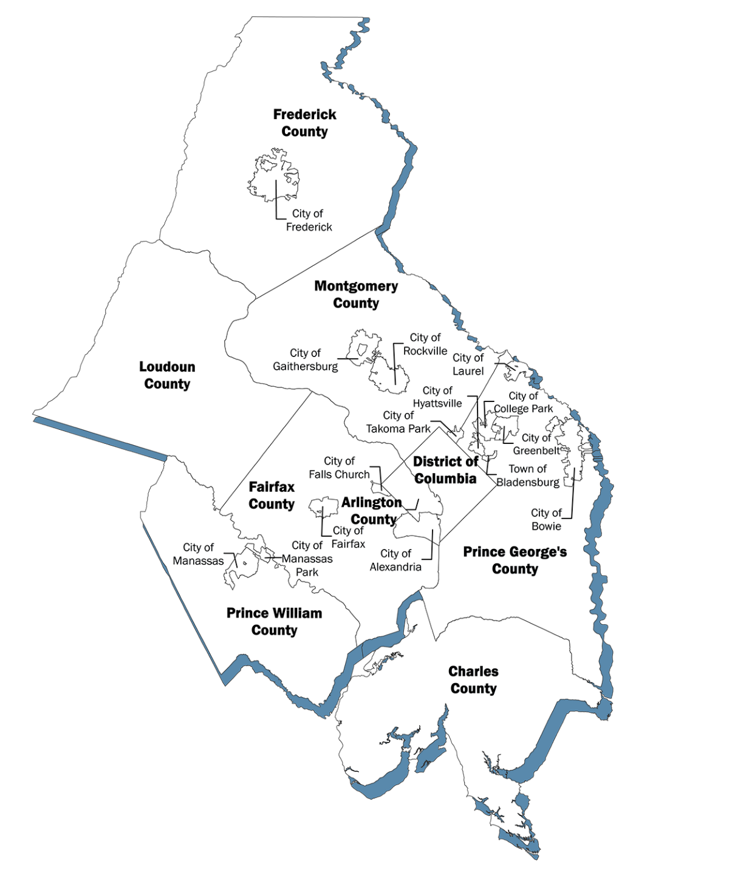
Stars, stripes and stomach aches
NCR Water Contamination TTX
Council of Governments Public Health Emergency Planners Subcommittee February 19, 2026

Slide 2
Acknowledgements
Thank you COG for hosting and organizing the event. Thank you to the PHEP Subcommittee Members for organizing and planning this event. Special recognition to the NVERS Water & Wastewater Emergency Preparedness Work Group for their Water & Wastewater TTX on October 15, 2026, which this exercise was inspired by.

Slide 3
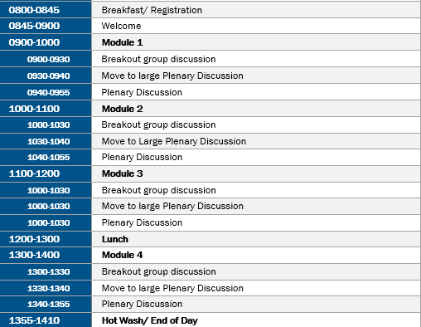
Exercise Schedule

Slide 4
Objectives
Assess ability to identify and validate early ESSENCE GI-syndrome signals.
Evaluate leadership and cross-jurisdictional decision-making regarding protective actions
Assess environmental health response to water system failure
Evaluate healthcare coordination regarding surge, dialysis impact, and alternate water needs
Examine feasibility and process for antibiotic prophylaxis and POD activation.
Assess regional capacity for unified risk communication across jurisdictions.

Slide 5
Scenario
A cyber intrusion resulting in distribution of unfiltered, contaminated water across sections of the NCR. Illness increases over the July 4th holiday period, prompting escalation, advisories, and eventual need for prophylaxis and POD operations.

Slide 6
Modules
Module 1: Pre-Incident Context
Module 2: Detection
Module 3: Confirmation of Contamination
Module 4: Prophylaxis and POD Planning
Exercise Structure:
For each module players will participate in:
Jurisdictional Conversation (30 mins)
Large Group Plenary Discussion (15 mins)
Jurisdictional Groupings:
Maryland
District of Columbia
Virginia

Slide 7
Reminders
This is a NO FAULT environment.
This is meant to be used for us to learn and understand capabilities and gaps.
Do not fight the scenario.
We will operate only with the information we have. We might not have complete representation present, so we will have the discussion based off of the expertise we have in the room today.

Slide 8
 | MODULE 1
PRE-INCIDENT CONTEXT

Slide 9
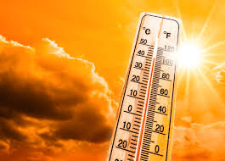

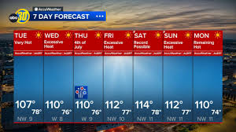
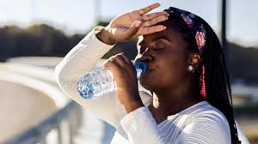
July 2, 2026 - 17:00
As Americans prepare for July 4th and the 250th birthday of the nation, a period of extreme heat drives unusually high residential and commercial water usage across the NCR. Water utilities operate near peak capacity, with several treatment plants running continuous filtration cycles.

Slide 10

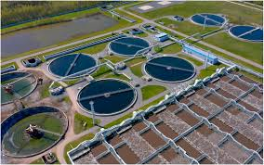
July 2, 2026 – 19:30
Unbeknownst to the utility, a cyber intrusion impacts automated filtration controls at major treatment plants. The plant continues distributing unfiltered water, and automated monitoring systems do not immediately flag the anomaly due to control system compromise.

Slide 11
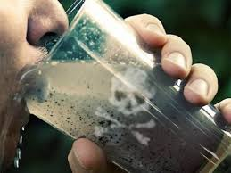
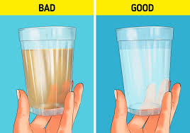
July 2, 2026 – 22:00
Customers in several service zones report “cloudy” or “chemical‑tasting” water through informal channels, though no significant spike in official complaints is yet recorded. No illnesses have been reported at this time.

Slide 12
Jurisdictional Discussion Questions
Epidemiology
What surveillance capabilities (ESSENCE, hot weather–related monitoring, syndromic partnerships) are active heading into the holiday weekend?
Are there any thresholds, alerts, or unusual findings/reports that would trigger enhanced monitoring or further investigation?
Environmental Health/ Drinking Water
What communication pathways exist between public health and water utilities for reporting early operational anomalies?
How would your jurisdiction learn about sudden operational changes or spikes in community water complaints?
Leadership/ ESF-8
What preparatory considerations should leadership take going into a high‑risk weekend (heat, mass gatherings, high water usage)?

Slide 13
Jurisdictional Discussion Questions
Healthcare Partners
Are hospitals and urgent cares anticipating experiencing surge due to the heat? Are they sharing that information with ESF‑8 partners? If so, how?
  Are there pre-determined surge thresholds, or other triggers, that might result in reaching out to ESF-8 partners?
What routine situational awareness practices, or emergency plans, are in place heading into large regional events?
Risk Communications
Are any precautionary or readiness messages issued prior to the July 4th holiday?
How is community‑reported information (taste, odor, color complaints) monitored and validated?

Slide 14
Plenary Discussion

Slide 15
 | MODULE 2
DETECTION

Slide 16


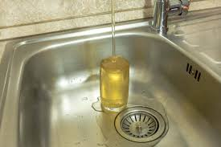
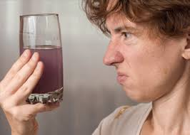
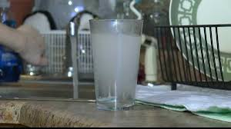
July 3, 2026 – 08:00
ESSENCE* triggers a statistically significant increase in GI symptom activity across multiple NCR jurisdictions. Several Emergency Departments report clusters of acute GI illness with dehydration; cases note drinking tap water in the previous 24 hours. 311 call logs indicate sporadic reports of cloudy or odd-tasting water. Public speculation and media reports begin circulating on social media.
*Electronic Surveillance System for the Early Notification of Community-Based Epidemics (ESSENCE)

Slide 17

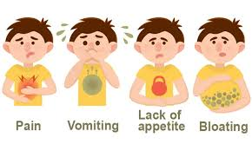
July 3, 2026 – 10:00
Healthcare partners report additional GI case clusters presenting in emergency rooms and urgent care centers. No confirmatory lab testing has been conducted by the Department of Health or healthcare partners. The timing of the GI symptom onset appears consistent with exposure on July 2, 2026.

Slide 18
Jurisdictional Discussion Questions
Epidemiology
What steps will your jurisdiction take to verify the ESSENCE GI signal? What symptoms, surge volume, or other triggers would initiate case investigations?
What staffing or analytical support do you require to investigate the trend?
What additional data is needed to confirm or refute a waterborne hypothesis?
Environmental Health/ Drinking Water
What immediate steps will you take to contact the utility to request information related to operational anomalies?
What information do you require from public health leadership, the jurisdictional health department, or the utility, to initiate response actions?
How will you prioritize field sampling or site assessments?

Slide 19
Jurisdictional Discussion Questions
Leadership/ ESF-8
What, if any, of the concerns included in the scenario would result in issuing precautionary messaging to the public or leadership?
How will you coordinate situational awareness across NCR partners?
How are you supporting/ communicating with healthcare partners?
Healthcare Partners
What trends or clinical markers would you communicate to public health partners at this stage?
What additional information, and/or resources, do you need to maintain continuity of operations?
Risk Communications
What holding statements or early messaging considerations are appropriate given holiday weekend sensitivities?
How will jurisdictions coordinate communication regionally? How do we stay regionally aligned if our decisions are different?

Slide 20
Plenary Discussion

Slide 21
 | MODULE 3
CONFIRMATION OF CONTAMINATION

Slide 22
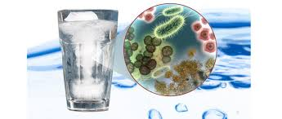
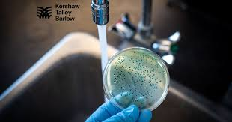
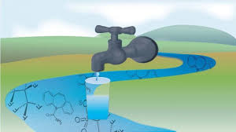


July 3, 2026 – 14:00
The regional water utility reports a confirmed treatment failure resulting in the distribution of unfiltered water contaminated with a fictional pathogen (“Bacteria X”), which is known to cause GI illness with severe nausea, diarrhea, and vomiting. Extent of exposure remains unknown. Estimated system flush out time is 72 hours. GI cases continue to rise, 250th Celebration event organizers request guidance.

Slide 23
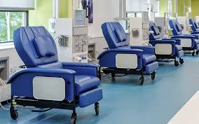

July 3, 2026 – 16:00
Dialysis centers raise urgent concerns about water treatment operations. Media reports speculate about a cyberattack connection.

Slide 24
Jurisdictional Discussion Questions
Epidemiology
How will you adjust case investigation protocols now that water contamination is confirmed?
How will you share data consistently across NCR jurisdictions?
Environmental Health/ Drinking Water
What sampling plan, system mapping, and facility risk assessments will you implement?
How will results inform decision-making on advisories?
Leadership/ ESF-8
What protective actions (Boil Water Advisory, resource requests) will you initiate, and what triggers guide these decisions?
How will you coordinate response posture (ICS/EOC activation) with regional partners?

Slide 25
Jurisdictional Discussion Questions
Healthcare Partners
How will your facilities modify water-dependent services, including dialysis?
What resources, or guidance, are needed for safe operations?
Risk Communications
How will jurisdictions coordinate message alignment, message release timing, and spokesperson consistency across the region for the next 72 hours?

Slide 26
Plenary Discussion

Slide 27
 | MODULE 4
PROPHYLAXIS AND POD PLANNING

Slide 28
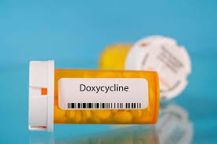
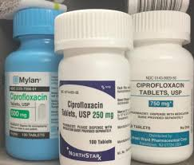
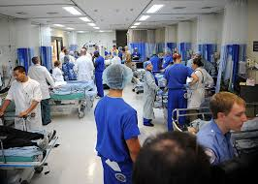
July 4, 2026 – 08:00
Utility confirms 25% of customers have received contaminated water. Laboratory partners verify doxycycline and ciprofloxacin as effective prophylaxis and treatment for Bacteria X ingestion. Hospitals note continued GI illness surge and dehydration cases.

Slide 29

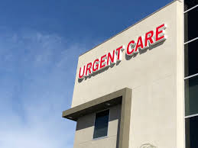
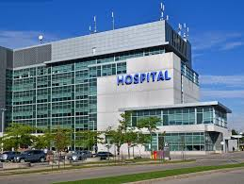
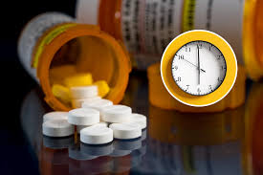
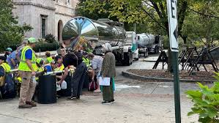
July 4, 2026 – 10:00
Pharmacies and healthcare partners request prophylaxis and treatment dosing guidance. Residents inquire whether they should seek prophylaxis if they consumed water within the past 24 hours. Water distribution issues emerge at cooling centers.

Slide 30
Jurisdictional Discussion Questions
Epidemiology
What surveillance indicators will guide prophylaxis scaling and POD monitoring?
How will you track adverse events or dosing errors?
Environmental Health/ Drinking Water
What criteria must be met to rescind advisories, and how will you validate system clearance?
How will you coordinate with food service and healthcare facilities as operations are restored to normal operations?
Leadership/ ESF-8
What authorizations and resource requests are needed to activate PODs or hybrid dispensing models?
How will you coordinate staffing, logistics, and mutual aid?
How will you support healthcare partners, if at all, in their efforts to treat existing cases?

Slide 31
Jurisdictional Discussion Questions
Healthcare Partners
How will you integrate clinic-based prophylaxis and treatment with regional POD operations?
What populations require targeted outreach or alternate distribution pathways?
Risk Communications
How will you communicate clear, multilingual eligibility criteria for prophylaxis and treatment?
What strategies ensure access for vulnerable or transient populations (hotels, travelers, homebound people)?

Slide 32
Plenary Discussion

Slide 33
Thank You!

