Slide 1

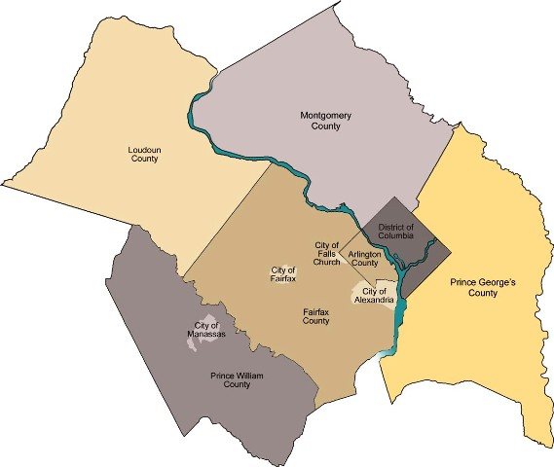
NCR Behavioral Survey 2011
Work, School or Home?:
Sheltering in Place During an Emergency
November 9, 2011
Summary of Final Results
1

Slide 2
UVa Project Team
Senior staff:
Robin A. Bebel
James M. Ellis, Jr.
John Lee Holmes
Co-investigators:
Thomas M. Guterbock, CSR
James H. Lambert, Systems Engineering
Analysts:
Young-Il Kim
David Morris
Mark W. Parker
Project Assistants:
Matthew Braswell
Kathy Coker
Khatantuul Z. Filer
Elizabeth Kaknes
2

Slide 3
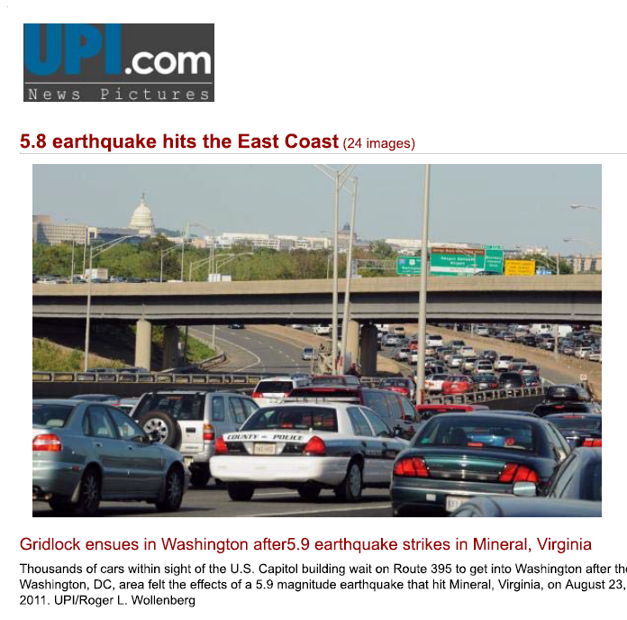
When everyone leaves work at once …

Slide 4
Presentation Summary
Preview of recommendations
Survey design: 2009 and 2011
Communication techniques
Workplace preparedness
School preparedness and trust in schools
How the scenarios were varied
Factors affecting behavioral response
      Will they stay or will they go?
Implications for emergency planners and managers

Slide 5
Survey Builds on 2009 Results
Key 2009 results:
One ‘dirty bomb’ far away while at work:
  Less than half of respondents would stay at their workplace
One bomb a mile away while at work:
  Majority would shelter in place at work, though the percentage doing so was less than for those at home
Main reasons for leaving earlier:
  To be with children or adult members of household
  Most of these people say they would remain at their original location if they were assured that their loved ones were safe
A dirty bomb incident would trigger evacuation that will cause widespread gridlock
5

Slide 6
Features of the 2011 Survey
Telephone interviews conducted by CSR, May-June 2011
  Adults working outside the home 10 hrs per week or more
Phone sample design includes cell phones
Fully supported Spanish language interviews
816 interviews
Margin of error: +/- 4.4 percentage points
6

Slide 7
Geography
Survey targeted National Capital Region
  ARLINGTON COUNTY, VA
  ALEXANDRIA CITY, VA
  DISTRICT OF COLUMBIA
  FAIRFAX COUNTY, VA
    FAIRFAX CITY, VA
    FALLS CHURCH, VA
  LOUDOUN COUNTY, VA
  PRINCE WILLIAM COUNTY, VA
    MANASSAS CITY, VA
    MANASSAS PARK CITY, VA
  MONTGOMERY COUNTY, MD
  PRINCE GEORGE'S COUNTY, MD

Slide 8
How People Communicate

Slide 9
Main Form of Communication
What forms of communication do you typically use? (under normal circumstances)
Percentages add up to more than 100% because
respondents could choose more than one response

Slide 10
Preferred Form of Communication
During an Emergency
What technology would you rely on the most to contact your loved one in an emergency?

Slide 11


Slide 12
Which Puts a Higher Burden on the Cell
Phone System?

Slide 13
Current Levels of Emergency Preparedness at Work

Slide 14
Emergency Plan at Work
Does your workplace have an emergency plan prepared?

Slide 15
Ability to Shelter at Work
How confident are you in your ability to shelter at work?

Slide 16
Workplace Characteristics and Perceptions
Higher awareness of emergency plans in their workplace:
  People working for local, state, or federal government
  The closer people work to the District of Columbia
  People working in high rise buildings (4+ stories)
  People in larger workplaces
More confident in their ability to shelter-in-place at work:
  People in workplaces with more than 50 employees

Slide 17
School Preparedness and Trust in Schools

Slide 18
Emergency Communications
How do you receive information about emergencies at your child's school?
*Survey question does not differentiate between individually dialed calls and automated phone call systems.
Percentages add up to more than 100% because
respondents could choose more than one response

Slide 19
Awareness of School Preparedness
Does your child’s school have a plan in place for emergencies?
Of Definitely and Probably Responses:
61.5% reported that they were
Somewhat or Very familiar with the plan

Slide 20
Emergency Plan at School by Age of Youngest Child
Percentages shown are for “Definitely” responses only

Slide 21
Confidence in School Care
Overall about 65% of respondents are very confident that the school could care for their children for up to 24 hours
No significant difference among counties
70% of Whites and Hispanics are very confident whereas about 50% of Blacks and Asians express confidence
Blacks are the only group in which some indicated complete lack of confidence (7%)

Slide 22
Factors Affecting Behavioral Response
Will They Stay or Will They Go?

Slide 23
Event Scenarios
Focus: dirty bomb(s) in the NCR
Will residents decide to stay or to go?
3 scenarios at increasing hazard levels: Minimum, moderate, maximum
    All scenarios were “No Notice” before the event
Respondent is presented with two versions of the scenario at the same randomly assigned hazard level
Total scenarios evaluated: 1,625
23

Slide 24
Stay/Go Response by:
Phone Service Working
Minimum Hazard: “Please imagine that today while you're at work, you hear that a bomb has just exploded in Tyson Corner, VA (or College Park, MD, for VA workers)…
no special instructions have been issued for your area.”
Minimum Hazard Level | Phone | No Phone
Stay or Continue with Activities | 58.7 | 41.3
Call, Seek Info, Depends on Situation | 8.7 | 2.9
Leave immediately | 32.6 | 55.8
Respondents are asked about their behavior twice, varying whether the phone system (landline and cell) is working

Slide 25
Stay/Go Response by:
Phone Service Working
Maximum Hazard: “Please imagine that it is a weekday afternoon and you are at work when you hear that multiple bombs have exploded in the NCR. And just now, another bomb has exploded one mile away… Both you and your loved one are within the cloud’s path and have been asked to shelter in place.”
Maximum Hazard Level | Phone | No Phone
Stay or Continue with Activities | 76.5 | 64.3
Call, Seek Info, Depends on Situation | 3.2 | 4.9
Leave immediately | 20.4 | 30.8
Respondents are asked about their behavior twice, varying whether the phone system (landline and cell) is working

Slide 26
Stay/Go Response by:
Who is Sheltering in Place?
Respondents are asked about their behavior twice, varying whether self or loved one is in path of cloud and, thus, sheltering in place.
Moderate Hazard Level | Respondent SIP | Loved One SIP
Stay or Continue with Activities | 79.9 | 44.6
Call, Seek Info, Depends on Situation | 4.4 | 11.5
Leave immediately | 15.7 | 43.9

Slide 27
Stay/Go Response by:
Awareness of Work Emergency Plan
All Hazard Levels | Definitely | Probably | Don’t Know | Probably Not | Definitely Not
Stay or Continue with Activities | 69.8 | 58.2 | 55.2 | 54.3 | 48.8
Call, Seek Info, Depends on Situation | 6.3 | 7.6 | 10.3 | 6.9 | 4.1
Leave immediately | 24.0 | 34.2 | 34.5 | 38.9 | 47.1

Slide 28
Summary Findings From Scenarios:
As in the 2009 survey, many will leave work if an incident occurs and they are not asked to shelter
  About 44% would leave work immediately if the incident is near their loved one and they are not told to shelter
Majority of workers will comply with SIP
  About 80% will stay at work if told to shelter and loved one is not in danger from the incident
If telephone service is not available, the number leaving work increases substantially
  Minimum scenario: 33%→56%
  Maximum scenario: 20%→31%

Slide 29
Summary Findings From Scenarios:
Workers are more likely to leave immediately if:
  They don’t think their workplace has an emergency plan in place
  Their workplace does not have a critical function in an emergency
  Their loved one is a child
Parents more likely to leave if:
  They are not sure about the school’s emergency plan
  They are not “very confident” that school can care for the child
  They think the school’s primary goal should be reuniting children with their parents

Slide 30
Practical Implications

Slide 31



Slide 32
Communications
Workers are much more likely to leave the workplace if telephone networks are not functional
Educate the public that text messages place less of a burden on networks than voice calls
Consider providing temporary capabilities that could boost the capacity of the cell phone network during emergencies

Slide 33
Emergency Plans
Workers are more likely to leave when their workplace does not have an emergency plan or if they are unaware of it
Help enterprises create emergency plans and publicize plans that already exist
Parents are more likely to leave work if they aren’t certain that schools and daycare centers have emergency plans and can take care of their children
Make parents aware of school emergency plans
Help daycare centers create such plans

Slide 34
School Procedures
Immediately reuniting children with parents may not be possible in a scenario that requires sheltering in place
Help schools drive home message that their primary responsibility in an emergency is to keep kids safe
Make plans to better inform parents that their children are safe at school and that they can stay at work without undue fear for their children’s safety

Slide 35
NCR Behavioral Survey 2011
Work, School or Home?:
Sheltering in Place During an Emergency
November 9, 2011
Questions and follow-up:
Janet Clements
janet.clements@ahcusa.org
804-332-2467
Full report available on COG portal
35

