Slide 1
PANDEMIC TRANSPORTATION ANALYSIS
Emphasis on Memorial Day 2021 and Previous Years - and DC-295 Bridge Collapse
C. Patrick Zilliacus Transportation Engineer Systems Performance, Operations and Technology Subcommittee (SPOTS) July 8, 2021
Agenda Item # 3

Slide 2
Background and introduction
Traffic volumes and traffic congestion in and around major holidays and from major incidents are of interest to the public
Staff has examined the impacts of the Memorial Day 2021 holiday and comparing it with previous Memorial Day weekends back to 2017, including 2020
A similar analysis what is shown here is in process for Independence Day weekend 2021 and will be prepared for Labor Day 2021
An examination of the impact of the DC-295 bridge collapse in June 2021 was also conducted
Agenda Item # 3: Pandemic Transportation Analysis
July 8, 2021

Slide 3
Background and introduction (cont’d)
Data used were derived from Inrix vehicle probe data, obtained from the Center for Advanced Transportation Technology Laboratory at the University of Maryland
Staff also obtained recent automatic traffic recorder count data from:
  Data Services Division, Office of Planning & Preliminary Engineering, MDOT/SHA; and
  Traffic Engineering Division, VDOT
Agenda Item # 3: Pandemic Transportation Analysis
July 8, 2021

Slide 4
What did staff examine?
Three networks were analyzed:
  Capital Beltway (not 495Express lanes)
  Interstates in the region (not managed lanes) and
  Interstates, other freeways, expressways, toll roads and federal parkways
Percentage of network by directional miles that was not congested (TTI 1.3 or less); moderately congested (TTI greater than 1.3 and less than or equal to 2.0) and severely congested (TTI greater than 2.0)
Cost of delay computed using the CATT Lab’s User Delay Cost Analysis tool
Agenda Item # 3: Pandemic Transportation Analysis
July 8, 2021

Slide 5
Schematic view of Networks
See high-level view of networks used for analysis.
In this presentation we used toe Capital Beltway (excluding Transurban lanes) and the network of Interstates, other freeways, expressways, toll roads and limited-access National Park Service Parkways
Agenda Item # 3: Pandemic Transportation Analysis
July 8, 2021

Slide 6
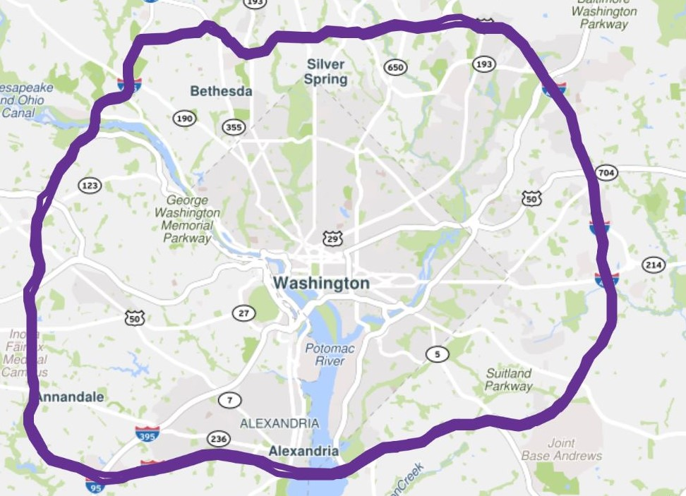
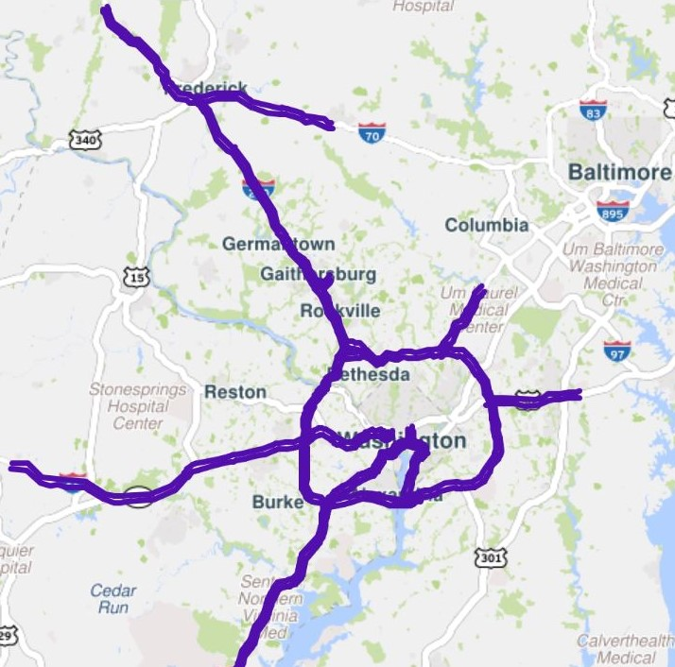
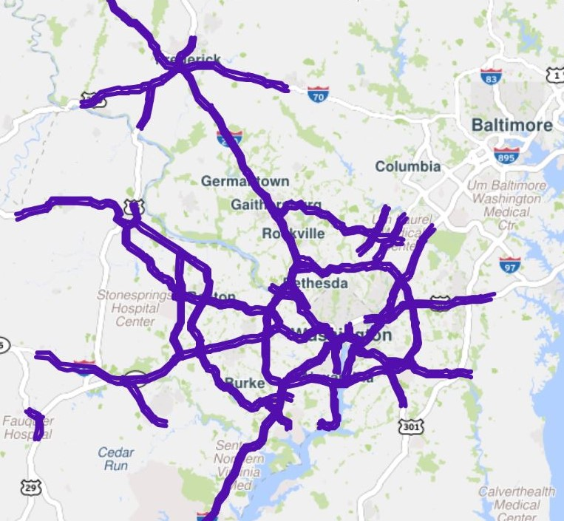

Slide 7
Extent of congestion
What follows are four graphs showing extent of congestion since 2017 for Interstates, other freeways, expressways, toll roads and parkways; and followed by the non-toll sections of Capital Beltway
First is weekdays (when most businesses and government are open)
Second is weekends (when most businesses and government agencies are closed)
Then a similar plot for the Capital Beltway only, weekdays
Then Capital Beltway only, weekends
Sections of the system with little or no congestion are not graphed
Agenda Item # 3: Pandemic Transportation Analysis
July 8, 2021

Slide 8
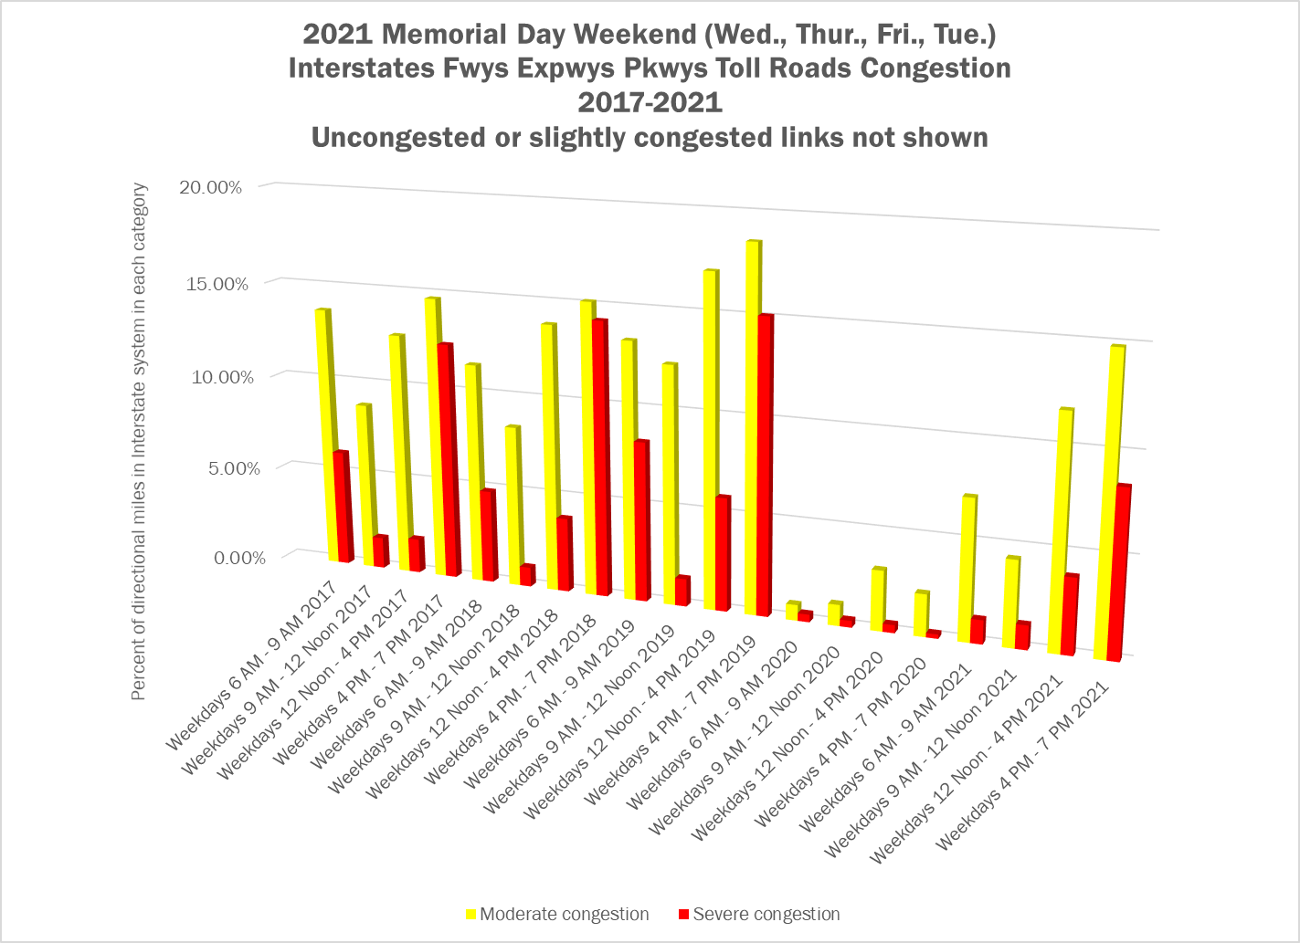
Interstates, freeways, expressways, parkways and toll roads (weekdays)
Agenda Item # 3: Pandemic Transportation Analysis
July 8, 2021

Slide 9
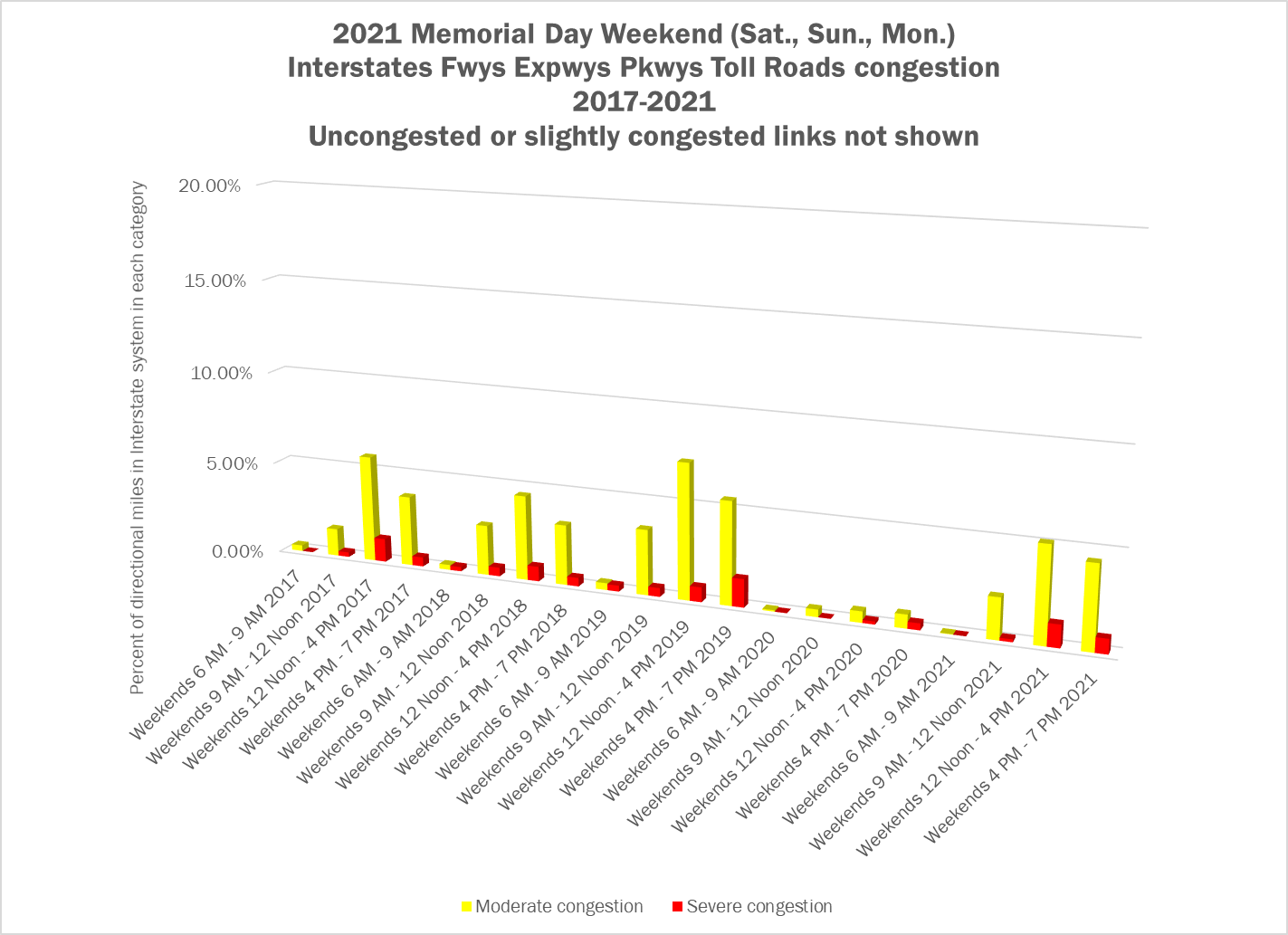
Interstates, freeways, expressways, parkways and toll roads (weekends)
Agenda Item # 3: Pandemic Transportation Analysis
July 8, 2021

Slide 10
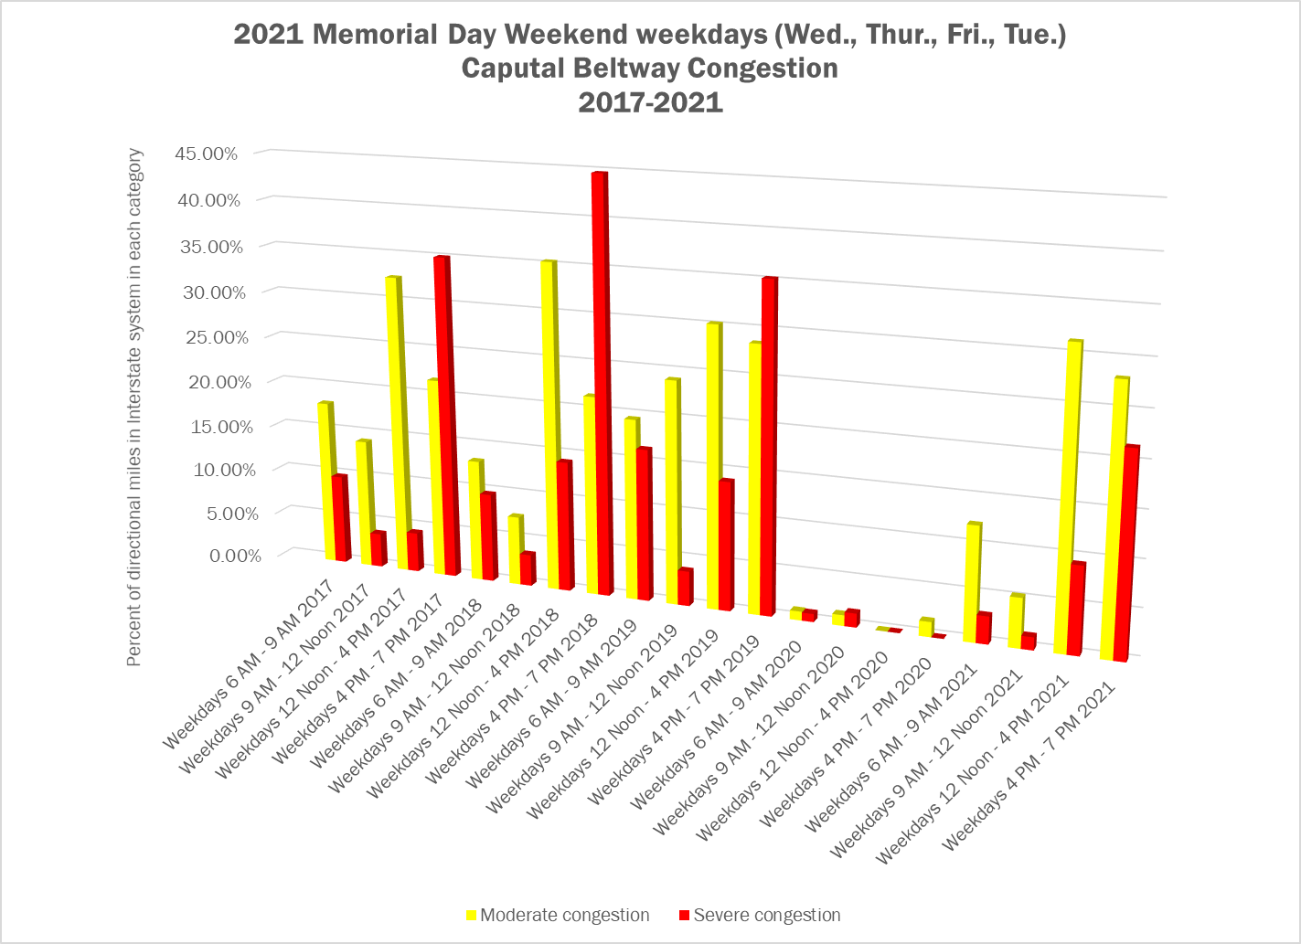
Capital Beltway (weekdays)
Agenda Item # 3: Pandemic Transportation Analysis
July 8, 2021

Slide 11
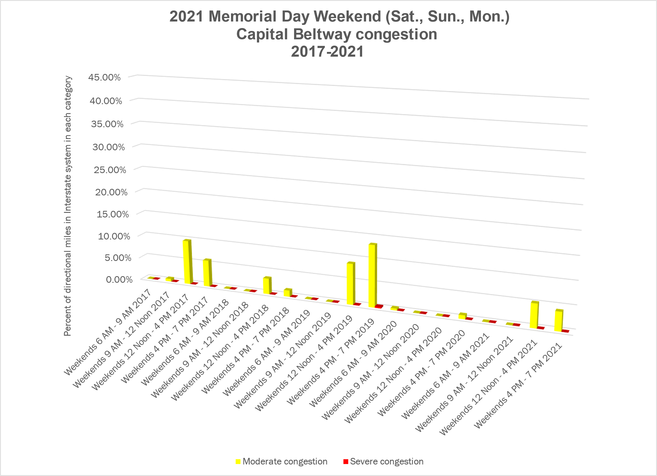
Capital Beltway (weekends)
Agenda Item # 3: Pandemic Transportation Analysis
July 8, 2021

Slide 12
User Delay Costs
User delay costs for Interstates, other freeways, expressways, toll roads and parkways; and followed by the non-toll sections of Capital Beltway
Agenda Item # 3: Pandemic Transportation Analysis
July 8, 2021

Slide 13
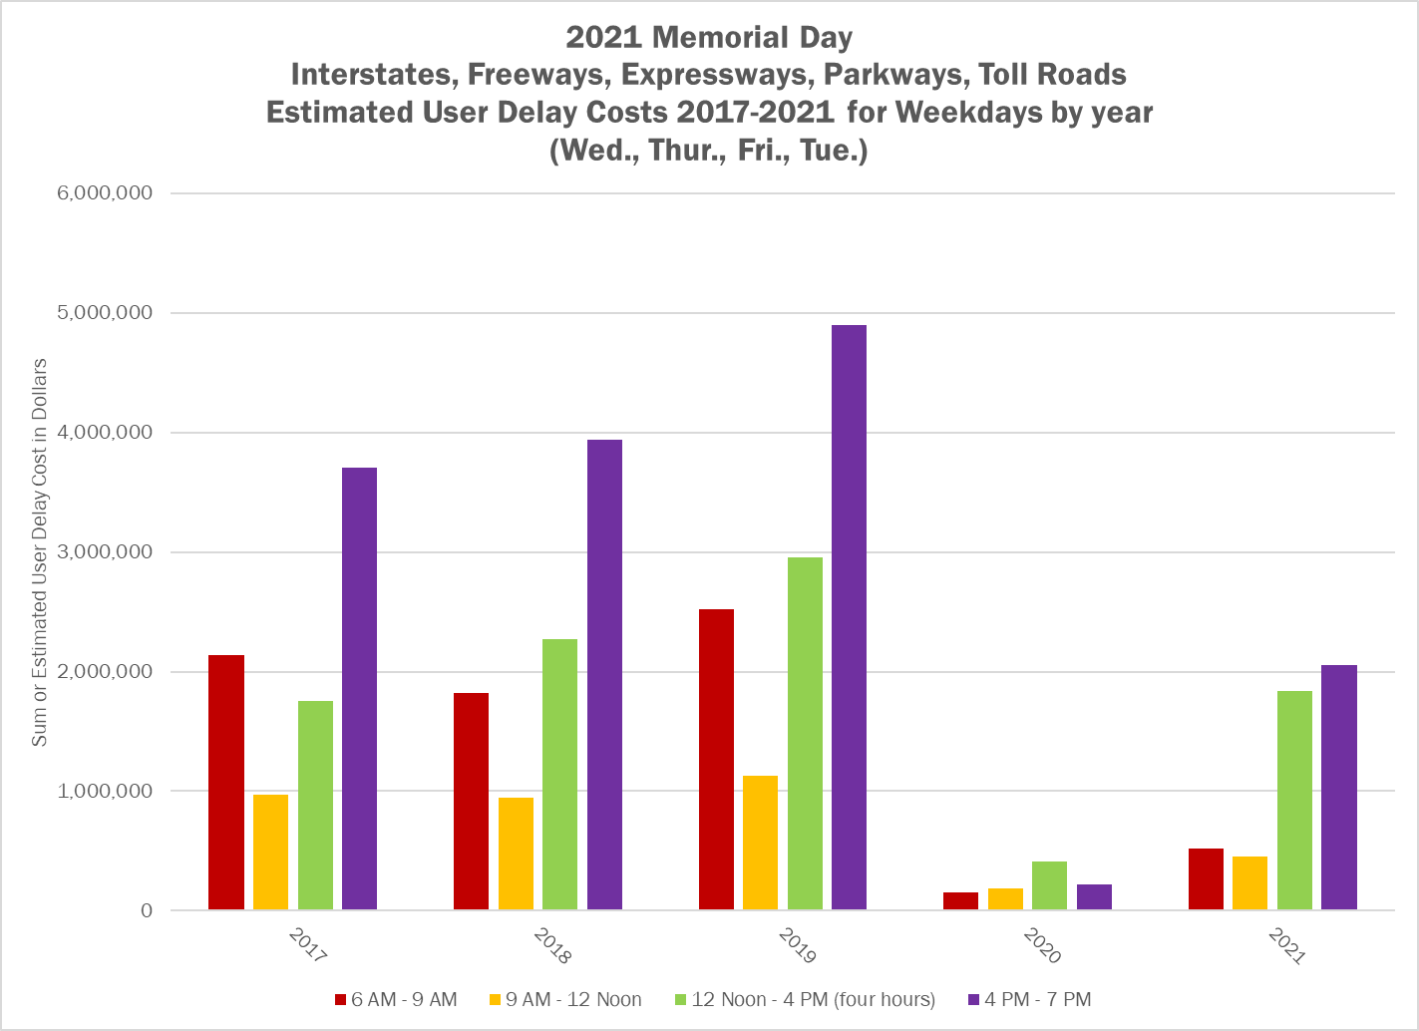
Interstates, freeways, expressways, parkways and toll roads (weekdays)
Agenda Item # 3: Pandemic Transportation Analysis
July 8, 2021

Slide 14
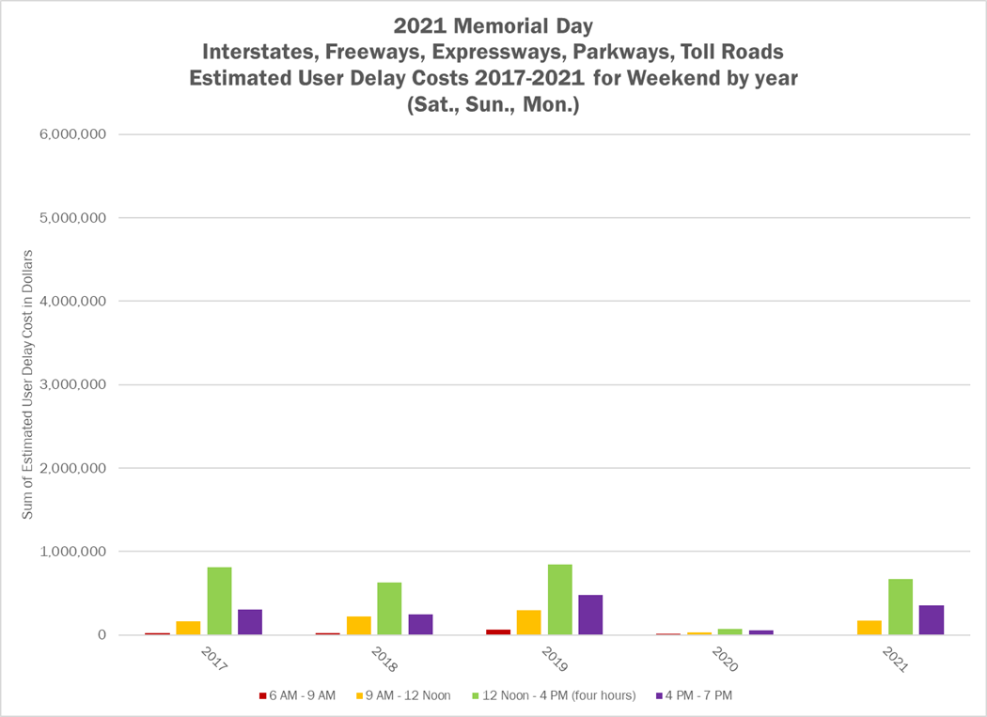
Interstates, freeways, expressways, parkways and toll roads (weekends)
Agenda Item # 3: Pandemic Transportation Analysis
July 8, 2021

Slide 15
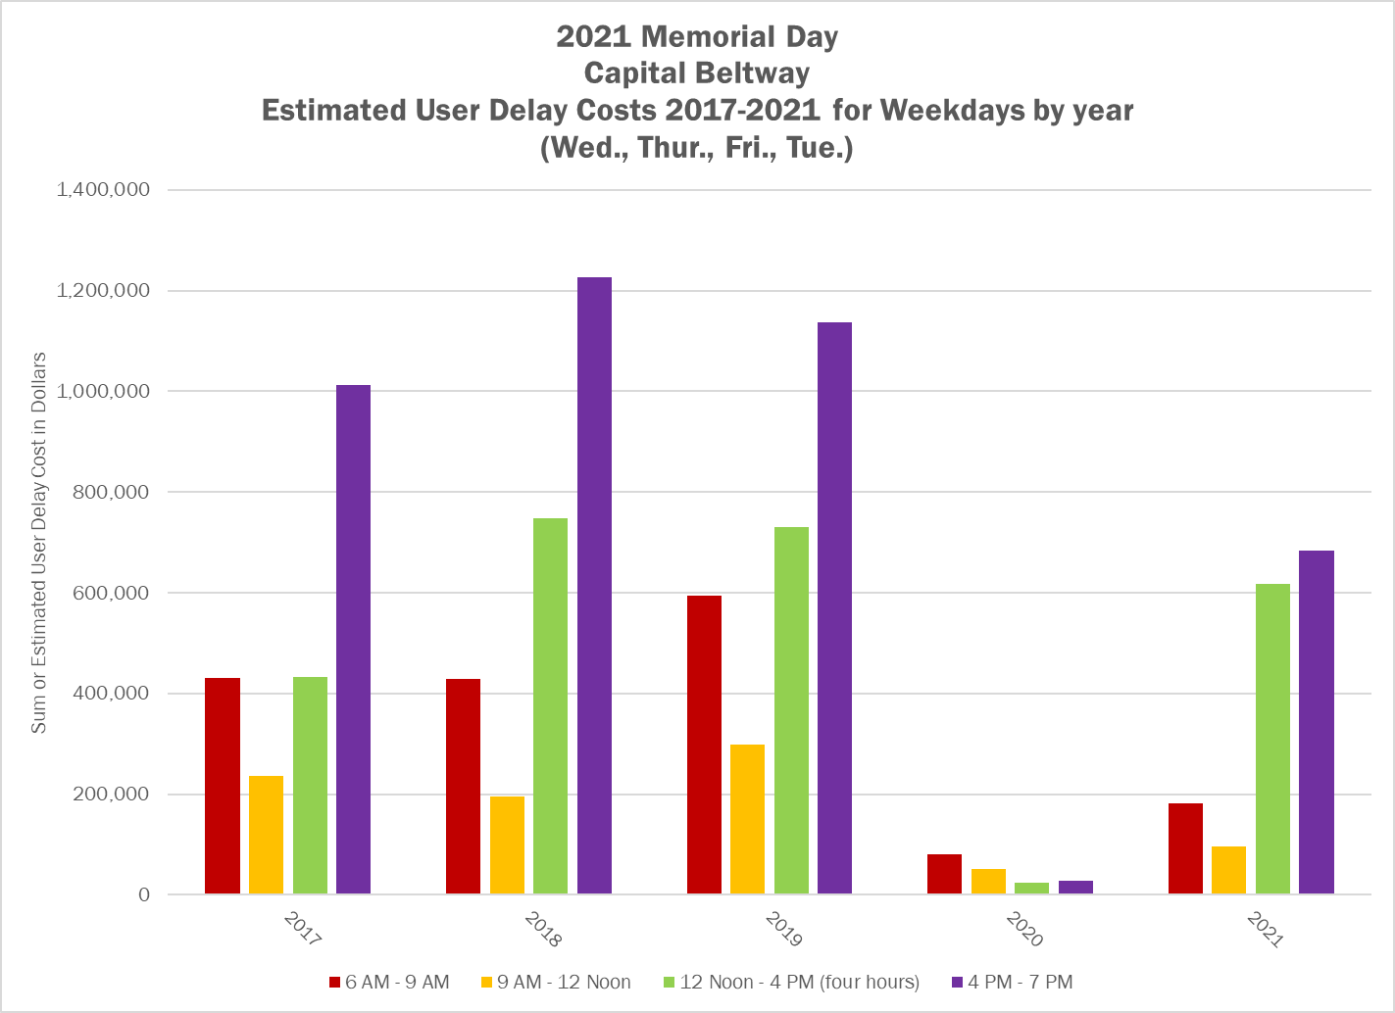
Capital Beltway (weekdays)
Agenda Item # 3: Pandemic Transportation Analysis
July 8, 2021

Slide 16
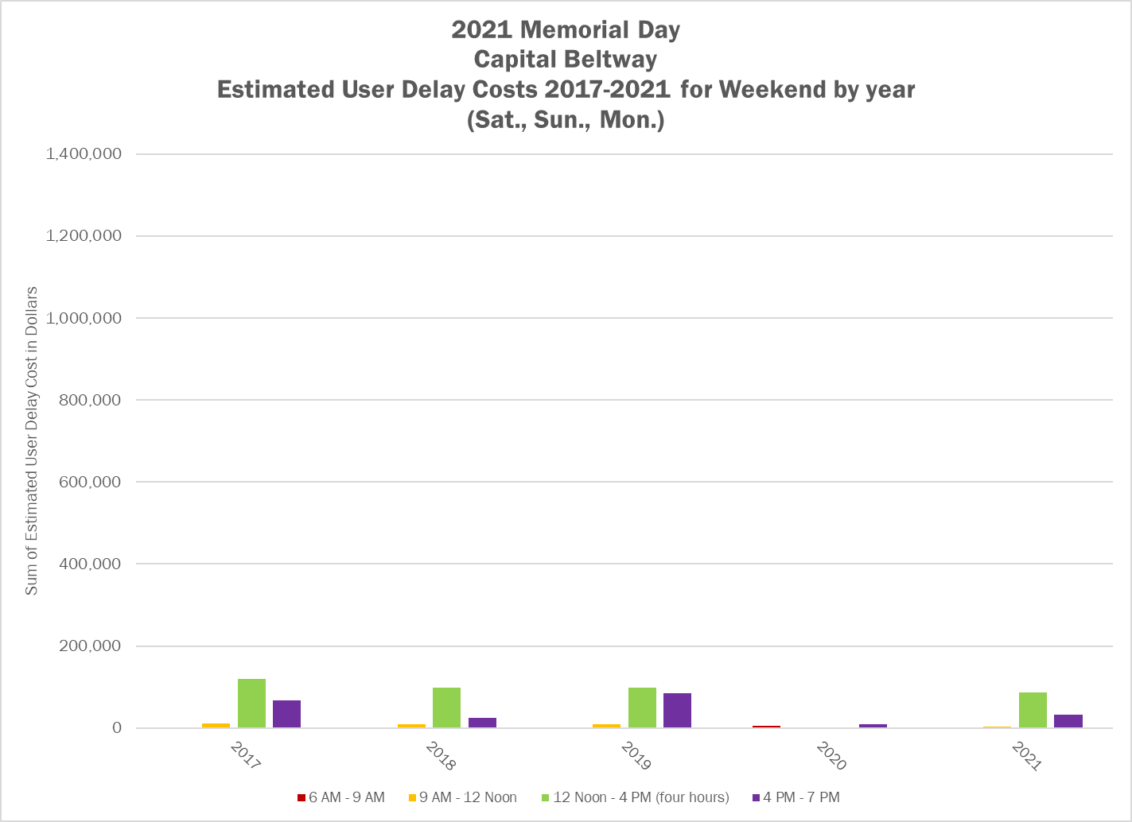
Capital Beltway (weekends)
Agenda Item # 3: Pandemic Transportation Analysis
July 8, 2021

Slide 17
Automatic Traffic Recorder Counts
Counts were provided by MDOT/SHA and VDOT
Interstates shown here
Data do not go back to 2017
Maryland ATR counts are provided by week, and last two weeks of May are used for Memorial Day
Virginia ATR locations not shown but can be provided
Agenda Item # 3: Pandemic Transportation Analysis
July 8, 2021

Slide 18
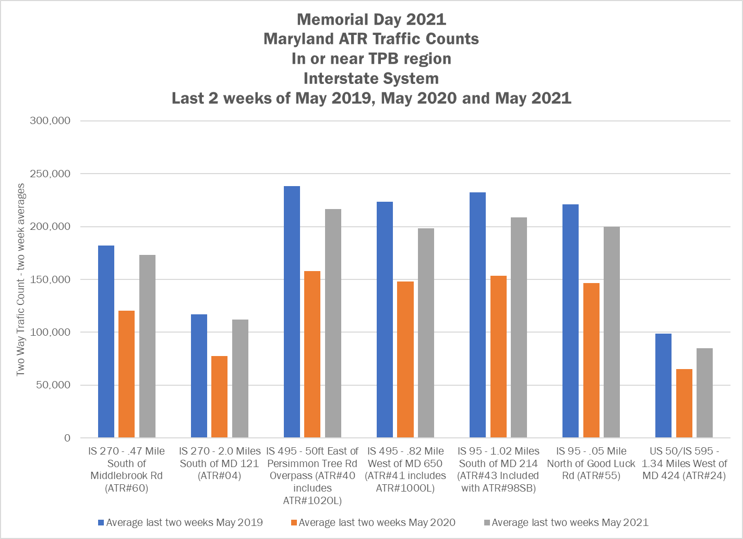
ATR counts Maryland - Bidirectional
Agenda Item # 3: Pandemic Transportation Analysis
July 8, 2021

Slide 19
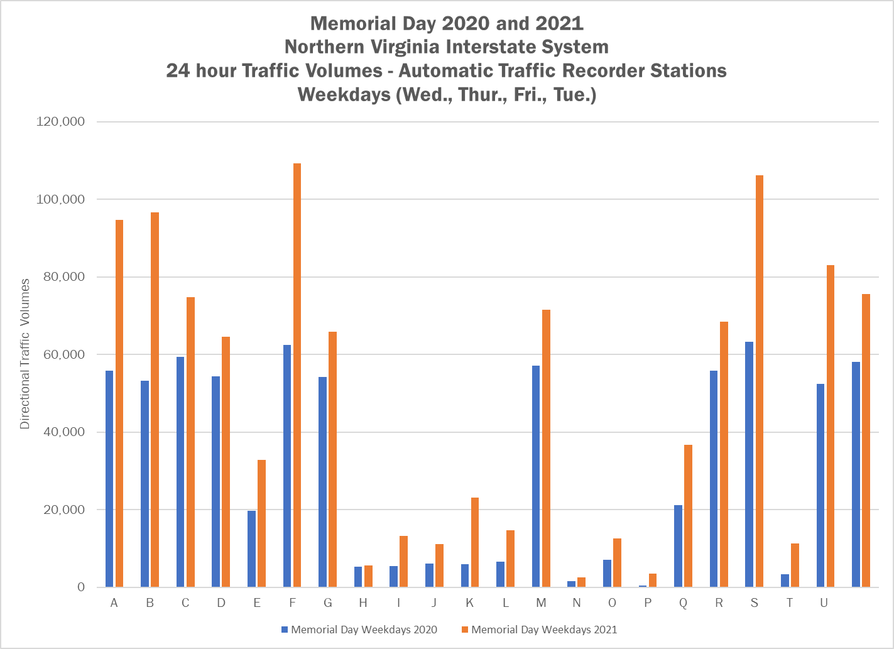
ATR counts Va.– Directional – Weekdays
Agenda Item # 3: Pandemic Transportation Analysis
July 8, 2021

Slide 20
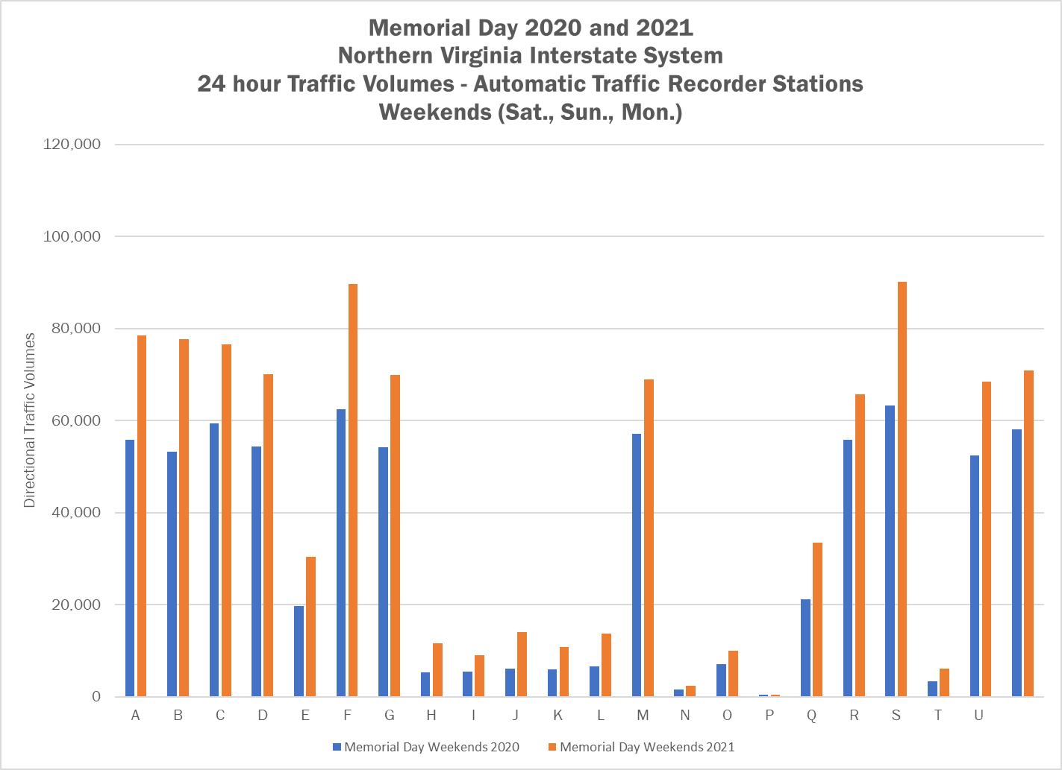
ATR counts Va.– Directional –Weekends
Agenda Item # 3: Pandemic Transportation Analysis
July 8, 2021

Slide 21
Conclusions from Memorial Day 2021
Congestion on the limited access system for Memorial Day 2020 nearly disappeared
Congestion has returned in 2021, though not generally as severe regionwide as it was in 2019
The system is generally not as congested on weekdays around Memorial Day in 2021 as it was in 2019 in the mornings
Traffic at locations monitored by ATR have increased from 2020 to 2021
Staff will complete similar analysis for Independence Day 2021 and Labor Day 2021
Agenda Item # 3: Pandemic Transportation Analysis
July 8, 2021

Slide 22
What to watch for
Will congestion return in the morning peak commute periods?
Will weekend and holiday congestion return to levels seen in 2019?
Will ATR counts continue to show increases in traffic volumes?
Agenda Item # 3: Pandemic Transportation Analysis
July 8, 2021

Slide 23
Potential Scenarios for Operations
Return to Pre-Pandemic Conditions
Some Pandemic Traffic Conditions Persist
Increased traffic and congestion
Everything goes back to the way it was
Morning peaks and downtown traffic are lighter
Similar to pre-pandemic elsewhere in the region, and for mid-day and PM peaks
Increased freight movement
Driving could increase due to desire for social distancing, avoidance of transit
Agenda Item # 3: Pandemic Transportation Analysis
July 8, 2021
Notes:
Scenario 1
Following recovery period, the region reverts to “old” normal
Regional growth projections are unaffected
Telework pattens return to pre-pandemic levels
Regional travel, including commuting, return to pre-pandemic levels
Essential front-line workers still needed to support the regional economy
Scenario 2
Following period of transition, increased teleworking takes hold
Demand for and use of office/commercial space may be influenced
Housing location choices may not be tied as strongly to proximity to worksite (i.e., commute length/time less of a consideration)
Regional composition of industry sectors and supporting workforce does not change
Essential front-line workers still needed to support the regional economy
Scenario 3
Teleworking takes a significant regional and societal hold resulting in many workers, who can telework, not feeling tied to live in the same region where their jobs are “located.”
Outmigration of components of the workforce may influence composition of employment sectors in the region
Changing economy may influence demand for talent
Essential front-line workers still needed to support the regional economy

Slide 24
DC-295 Bridge Collapse
Incident closed DC-295 (Kenilworth Avenue, N.E.) in both directions between Eastern Avenue and Nannie Helen Burroughs Avenue, N.E. on Wednesday, June 23, 2021 from about 12 Noon until early the next morning (the incident was clear by 5 AM on June 24)
Staff developed a network to use based on initial observations of where congestion had formed after the incident was reported
User delay costs for the entire network were computed
Agenda Item # 3: Pandemic Transportation Analysis
July 8, 2021

Slide 25
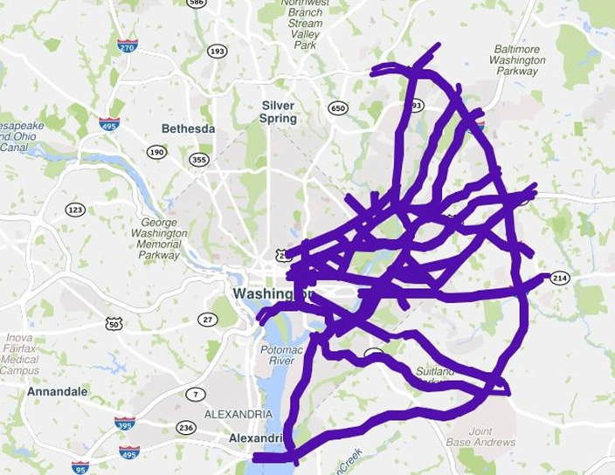
DC-295 Bridge Collapse – Analysis network
Agenda Item # 3: Pandemic Transportation Analysis
July 8, 2021

Slide 26
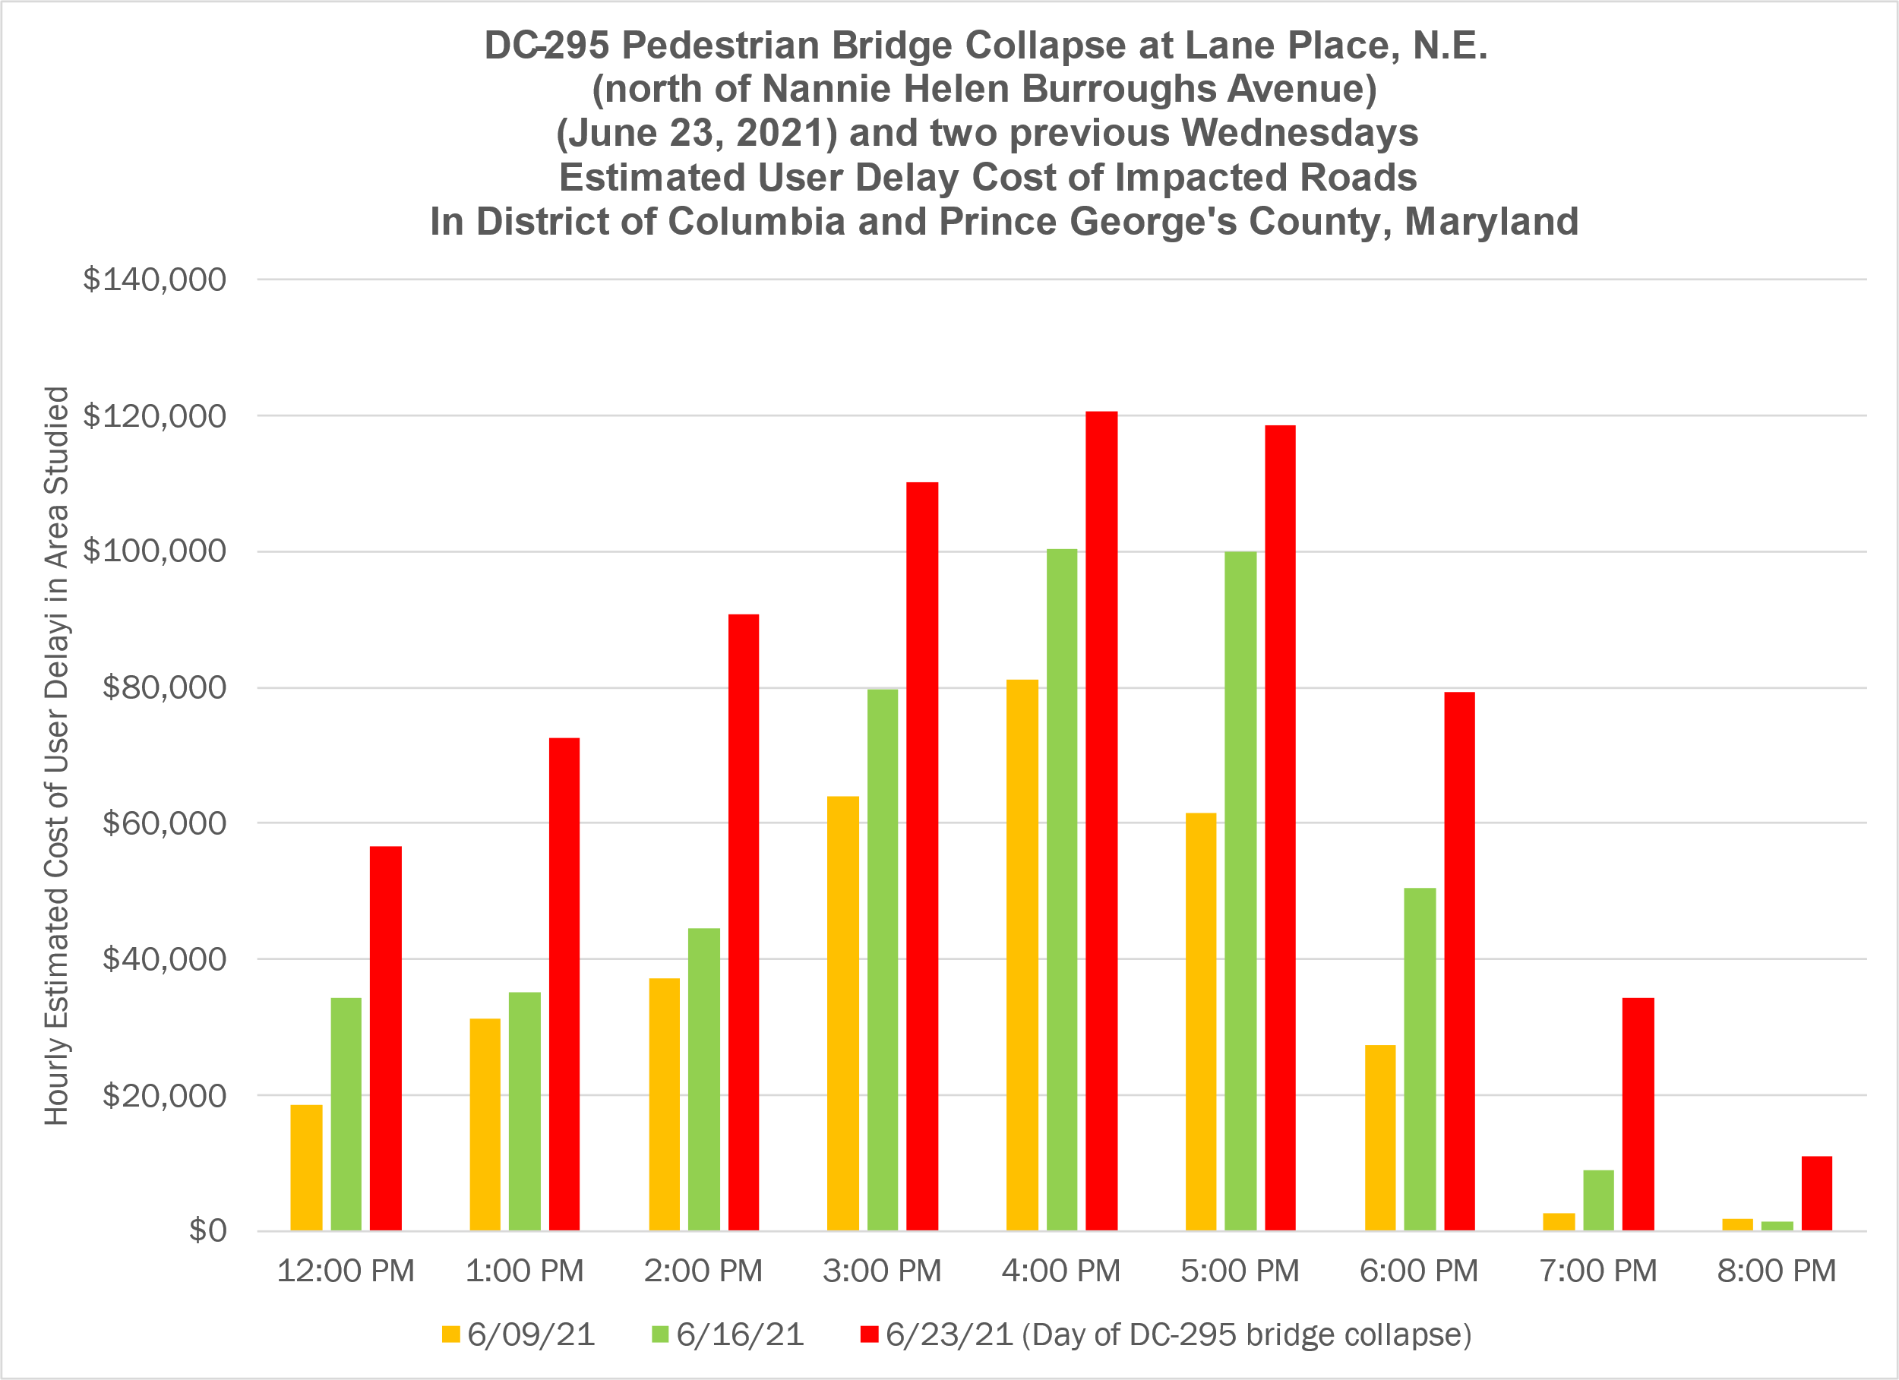
DC295 Bridge Collapse User Delay Costs
Agenda Item # 3: Pandemic Transportation Analysis
July 8, 2021

Slide 27
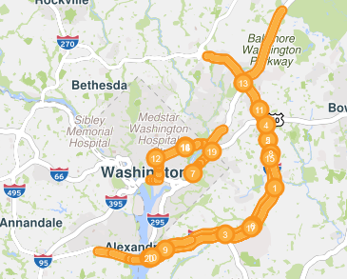
DC295 Bridge Collapse top 20 Bottlenecks
Agenda Item # 3: Pandemic Transportation Analysis
July 8, 2021

Slide 28
DC-295 Bridge Collapse - Conclusions
A hard closure of this duration impacted a large area in the District of Columbia and nearby Prince George’s County, Maryland
It increased user delay costs for every hour from 12 Noon to 8 PM on monitored roads
The most severe impacts of the incident were on the Capital Beltway (I-95/I-495 section), according to the Bottleneck Ranking tool
Other roads impacted included I-395 (Third Street Tunnel) northbound approaching New York Avenue; U.S. 50 (New York Avenue, N.E.) and Baltimore-Washington Parkway
Agenda Item # 3: Pandemic Transportation Analysis
July 8, 2021

Slide 29
Questions and Comments
Questions and comments from the group are welcome
Or contact me by e-mail
Thank you
Agenda Item # 3: Pandemic Transportation Analysis
July 8, 2021

Slide 30
Presenter Name C. Patrick Zilliacus (202) 962-3292 zill@mwcog.org | mwcog.org
777 North Capitol Street NE, Suite 300 Washington, DC 20002

